Slide 1
Helping Small Business
Go Global
Office of International Trade
A Webinar for Businesses
January 23, 2020

Slide 2
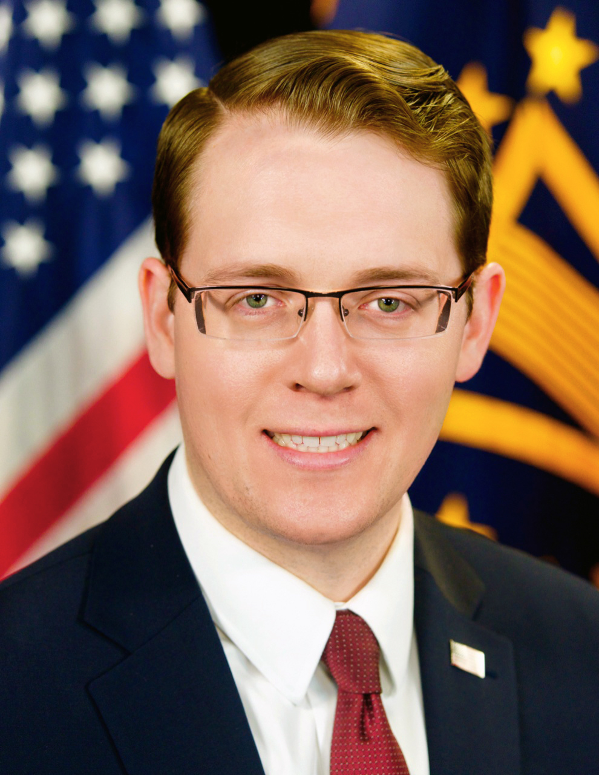
Agenda
Introduction – David Glaccum, SBA’s Office of International Trade
Company Success – Natalie Kaddas, President/CEO, Kaddas Enterprises Inc.
Get Help from SBA
  Advice and counseling to get started
    Sarah Bonner, SBA’s Office of International Trade
  Grants to find international buyers
    Miles Hansen, President/CEO, World Trade Center Utah
  Financing for your international sales
    Bryson Patterson, SBA’s Office of International Trade
Q&A
David Glaccum
Associate Administrator
SBA

Slide 3
The Global Sales Opportunity

Slide 4
The Case for Small Businesses
95%
of Consumers live Outside the United States
98%
of Exporters are Small Businesses
33.3%
of U.S. Export Value is from Small Businesses
Business Growth
10 year longer
3X employees
2X sales

Slide 5
Obstacles to Overcome
Top reasons small businesses don’t export
          Don’t know where to start
          Believe regulatory environment is too complex
          Cite difficulty getting financing for international operations
* National Small Business Association’s 2016 Exporting Survey
37%
24%
35%

Slide 6


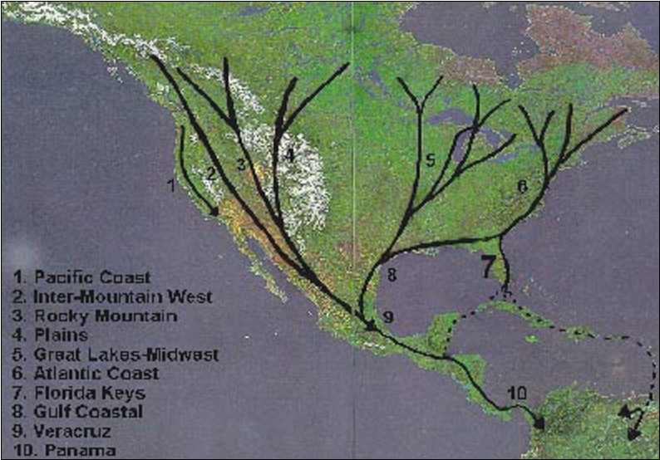
BirdguarD Products in action
Original Global Market Strategy:
Follow the Migratory Patterns of Birds of Prey

Slide 7
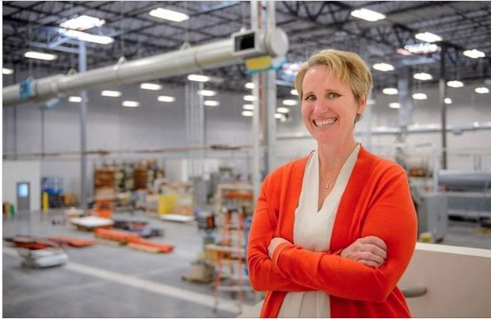
Company Success
Natalie Kaddas
President and CEO
Kaddas Enterprises Inc.
Salt Lake City, UT
Kaddas Enterprises is a Woman owned, second-generation family owned business, that manufactures Thermoform Plastic products.
Contract Manufacturing for Aerospace/Transportation companies
Developed our own products for Energy Sector called BirdugarD
CHALLENGE: Domestically steep competition
SOLUTIONS: Explore Global Markets- Help from the STEP Grant and Governor Lead Trade Mission
RESULTS: - Ship into 12 countries
- Kaddas Representatives in 3 countries;
- Increased confidence, revenues, jobs, and capacity to take the company to another level

Slide 8
The SBA Can Help You Go Global
Advice to Get You Started
Grants to Find International Buyers
Financing for Your International Sales
Find a Local Advisor at sba.gov/local
See if your state/territory offers grants at sba.gov/international
Contact your local export finance manager at sba.gov/international

Slide 9
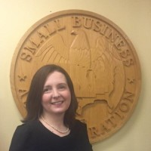
Advice to Get You Started
Search sba.gov/local to find:
  A local mentor with SCORE
  Advice and counseling from your local Small Business Development Center
  Support for women entrepreneurs at your local Women’s Business Center
  Support for veteran entrepreneurs at your local Veteran’s Business Outreach Center
Call or email SBA’s Office of International Trade
Sarah Bonner
Export Policy Advisor, SBA

Slide 10



Grants to Find International Buyers
The State Trade Expansion Program or STEP provides grants to U.S. states/territories to help small businesses to go international.
Last year alone, $18 million in STEP grants:
  Helped over 6,000 small businesses
  Enabled small businesses to earn over $500,000,000 in export sales.
Visit sba.gov/international to find out if your state/territory is participating in SBA’s State Trade Expansion Program.

Slide 11
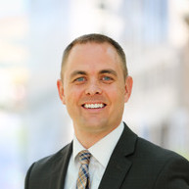
Grants to Find International Buyers
Your small businesses may qualify for a grant and/or training to:
Learn how to export
Cover expenses to:
  Participate in foreign trade missions
  Exhibit at international trade shows
Obtain services to support foreign market entry
Translate websites to attract foreign buyers
Design marketing media and more!!
Miles Hansen
President & CEO
World Trade Center
Utah

Slide 12
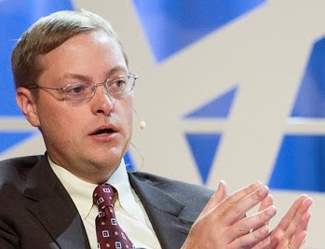
Financing Your International Sales
Loan options:
Export Express for export development
  $500,000 limit
Export Working Capital to fulfill your export orders
  $5 million limit
International Trade Loan for expanding your overseas sales capacity
  $5 million limit
Bryson Patterson
Export Finance Manager
SBA

Slide 13

Financing Your International Sales
Examples of uses:
Offer payment terms to customers to make your bid more competitive
Proactive marketing
Purchase machinery or equipment to meet international demand for your product
Finance foreign accounts receivables
Contact your local export finance manager at sba.gov/international

Slide 14
Get Help From SBA
Search for local help
  For advice, find your local advisor at sba.gov/local
  For grants, find your State Trade Expansion Program (STEP) at sba.gov/international
  For export finance, find your nearest Export Finance Manager at sba.gov/international
Call SBA toll free (855) 722-4877
Email international@sba.gov
  with your contact information, trade questions
Stay Informed with SBA’s OIT’s Newsletter and Webinars

Slide 15
Q&A
For more information, please visit sba.gov/international
Sign up for our export newsletter: sba.gov/newsroom
To watch this webinar again, please visit
YouTube.com/sba

Slide 16
Additional Federal Resources
Export.gov (https://www.export.gov)
  Market research and trade leads
  Tariff information
  Trade events
www.STOPfakes.gov
Ex-Im Bank (https://www.exim.gov)
  Export credit insurance
Census (https://www.usatradeonline.gov)
  Trade statistics
  Documentation and shipping
State Department (https://www.pmddtc.state.gov)
  Export licensing

