Slide 1

Money Makes the World Go Round
Learn How Exporters
Can Access Funds
A Webinar Hosted by Census
Thursday, February 20
2:00 p.m. EST

Slide 2
Introduction
Summary of Export Financing
Export Credit Insurance
The Need for a Lender!
Q&A Session
Agenda

Slide 3
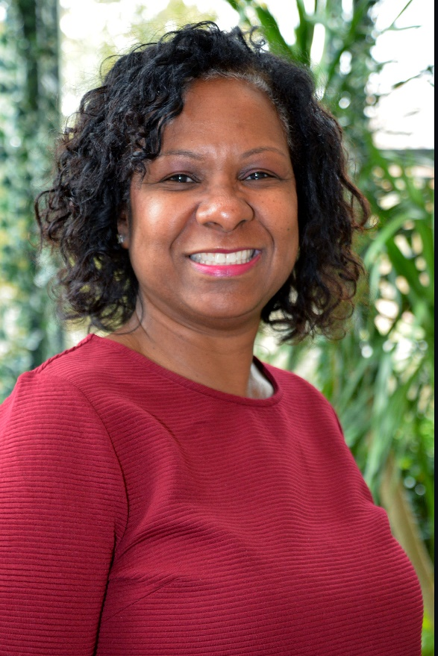
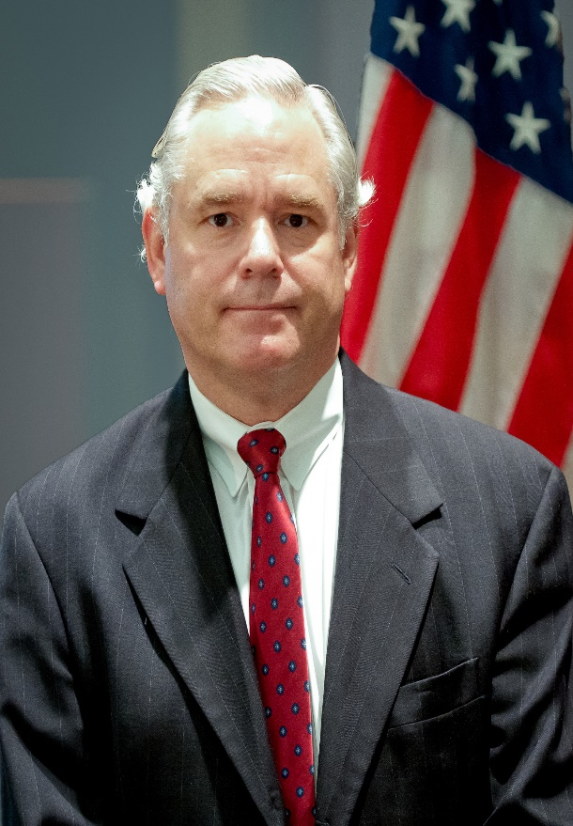
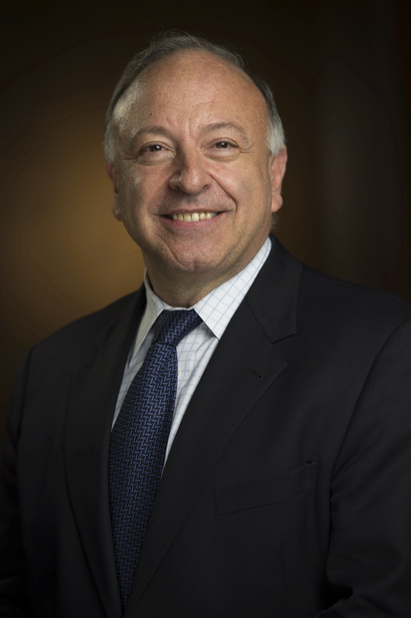
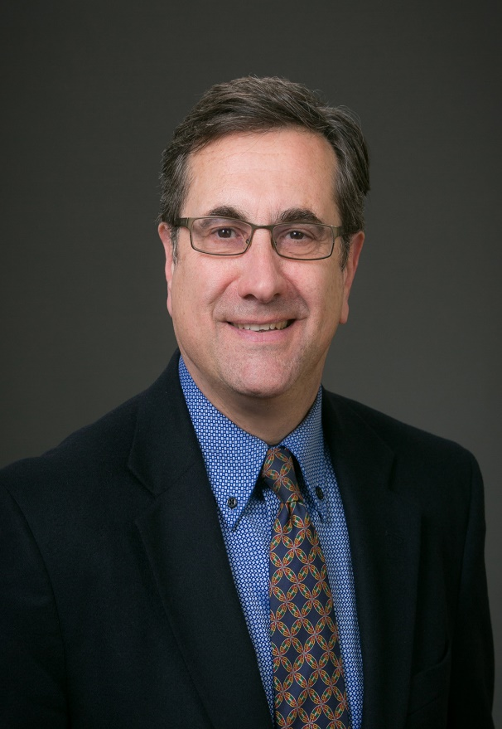


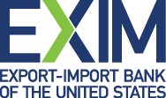
Today’s Speakers
Host: Wendy Peebles
Lead Outreach Coordinator, Census Bureau
SBA: Bill Houck
Export Finance Manager
EXIM: Stephen Maroon
Director of Marketing
Special Guest: Federico Manno
Vice President, Fulton Bank
Notes:
The Census Bureau Statistics are how America knows what America needs. As we continue to measure the nation’s People, Places and Economy—we are very excited to share where US businesses can get started to expand into the global marketplace.
Our presenters today are from the US Department of Commerce’s International Trade Administration. They are XXXXXXX, with <<<TITLE>>>> with <<<OFFICE>>>

Slide 4
US Export Assistance Center (USEAC)
SBA
EXIM
USCS & State EDO
- Market analysis
Match making
Buyer due diligence
SBA
Export activity working capital
Transaction working capital
Fixed asset and real estate term loans
EXIM
Export Credit insurance
U.S.
Commercial
Service
(USCS)

Slide 5
SBA Export Financing Programs
Export Express
  90% guarantee for amounts up to $350,000 (for up to 7 years)
  75% guarantee for amounts between $350,000 and $500,000 (for up to 7 years)
  Lender uses its own loan approval process and documents
  For financing of inventory, accounts receivable and export development activities
  Fixed assets, permanent working capital and real estate
Export Working Capital Program
  90% guarantee for amounts up to $5,000,000
  Use of funds for purchase order financing, accounts receivable and inventory financing, advance rates ranging from 75% (inventory) to 90% (AR)
International Trade Loan Program
  90% guarantee for amounts up to $5,000,000
  For working capital term loans for financing and refinancing of fixed assets
  used for exporting (loan tenures up to 10 years for plant and equipment and 25 years for real estate)
  Developing an Export Business Plan - www.sba.gov/exportbusinessplanner

Slide 6
Benefits of EXIM’s Export Credit Insurance
Limits Nonpayment Risk
  Insures a U.S. exporter against nonpayment by foreign buyers due to commercial and political reasons
Extends Credit to Buyers
Increases sales to existing customers and new buyers by offering open account terms. This improves the buyers’ cash flow and they tend to buy more on credit rather than cash-in-advance.
Provides Access to Funds
  Enlarges an exporter’s borrowing base by assigning the
  EXIM-insured receivables to the exporter’s lender as collateral

Slide 7
The Lender is the Key Gate Holder!
Working with the lender to access funds
  The process
  Documentation
Examples of accessing funds
  SBA working capital
    Useful for purchase order financing
  EXIM export credit insurance
    Additional collateral by pledging the policy coverage
  Federico Manno is Vice President of the International Banking Group at Fulton Bank, a SBA and EXIM approved lender. If you have questions, email FManno@fultonbank.com or call 703.946.0659.

Slide 8
Questions and Answers Session

Slide 9

Federal Government Trade Resources
Identify Global Markets with New Interactive Tool:
https://www.census.gov/library/visualizations/interactive/export-markets.html
Learn More: International Trade Helpline 800.549.0595, Option 4 or
eid.international.trade.data@census.gov
Find Buyers and Distributors:
https://www.export.gov/Gold-Key-Service
Learn More: https://www.export.gov/services
Financing to Fulfill Sales Orders and Improve Cash Flow:
www.sba.gov/international
Learn More: Contact Bill.Houck@sba.gov or call 202.557.4063
Minimizing Nonpayment Risk and Offering Open Account Credit Terms:
https://www.exim.gov/what-we-do/export-credit-insurance
Learn More: Contact Stephen.Maroon@EXIM.gov or call 202.565.3901
Notes:
CENSUS OVERVIEW
The U.S. Commercial Service’s global network of trade professionals is in more than 100 U.S. cities and in U.S. embassies and consulates in more than 70 countries. Its services help U.S. small and medium-sized companies select the best markets and sales channels, understand the rules and regulations, find qualified partners, connect with buyers around the world, and recommend ways to finance exports. Staff of the U.S. Commercial Service are dedicated to working with businesses every step of the way, including advocating on their behalf for easier market entry
EXIM
The Export-Import Bank of the Unites States, also known as EXIM, empowers exporters of U.S. goods and services to win sales that otherwise would go to foreign competitors. Whether a small business needs protection against buyer nonpayment, or the ability to extend open account credit terms to buyers, EXIM has a solution. The agency covers up to 95 percent of the sales invoice. No company or deal is too small, and EXIM provides support in more than 180 countries.

