Slide 1





Celebrating Manufacturers and the Resources They Use for Growing Global Sales

Slide 2
Celebrating Manufacturing Day
Celebrating Manufacturers Day with accomplished small business manufacturers. Learn successful business strategies and utilize government resources to help grow your company’s international sales.
Brought to you by your federal government trade partners:
U.S. Small Business Administration, Export-Import Bank of the United States, U.S. Census Bureau, and U.S. Commercial Service
Access more international trade resources on www.export.gov
Webinar
Government Resources to Increase Your Export Sales
October 3, 2019

Slide 3
Celebrating Manufacturing Day
Webinar
Government Resources to Increase Your Export Sales
Discover online tools to access data and help find new markets
Assist in finding new buyers
Support with finance deals
Minimize nonpayment risks
October 3, 2019

Slide 4
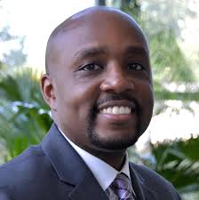
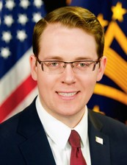
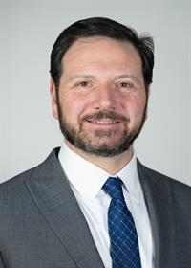
Today’s Speakers
Host: Omari Wooden, Assistant Division Chief
U.S. Census Bureau
Remarks: David Glaccum. Associate Administrator
U.S. Small Business Administration
Kevin Scott
National Association of Manufacturers
Notes:
The Census Bureau Statistics are how America knows what America needs. As we continue to measure the nation’s People, Places and Economy—we are very excited to share where US businesses can get started to expand into the global marketplace.
Our presenters today are from the US Department of Commerce’s International Trade Administration. They are XXXXXXX, with <<<TITLE>>>> with <<<OFFICE>>>

Slide 5
Why Manufacturing Day?
MFG Day showcases the diverse career opportunities available in the manufacturing industry and connect with America’s current workforce.
The manufacturing industry is not our grandparents’ workplace
Creators Wanted - we want to inspire the next generation of manufacturers
Manufacturing career opportunities include high pay and exposure to cutting edge technology and innovations
Open house and learning opportunities for a diverse audience: students, parents, educators, employees, community

Slide 6
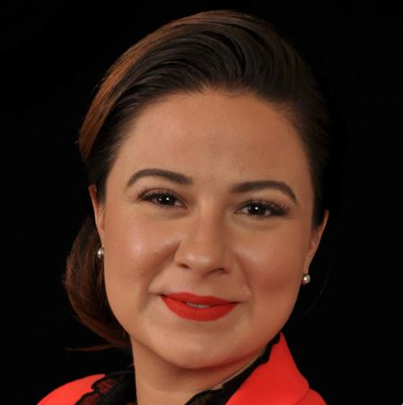
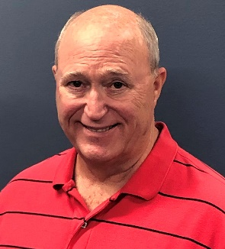
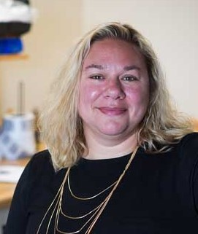
Featured Manufacturers
Tasha Jamaluddin, Managing Director
Epcon Industrial Systems
William Scott, Vice President of Finance
AirFixture
Julie Detmering, Export Manager
Equilibar
Notes:
The Census Bureau Statistics are how America knows what America needs. As we continue to measure the nation’s People, Places and Economy—we are very excited to share where US businesses can get started to expand into the global marketplace.
Our presenters today are from the US Department of Commerce’s International Trade Administration. They are XXXXXXX, with <<<TITLE>>>> with <<<OFFICE>>>

Slide 7
Presenters:
Notes:
The Census Bureau Statistics are how America knows what America needs. As we continue to measure the nation’s People, Places and Economy—we are very excited to share where US businesses can get started to expand into the global marketplace.
Our presenters today are from the US Department of Commerce’s International Trade Administration. They are XXXXXXX, with <<<TITLE>>>> with <<<OFFICE>>>

Slide 8
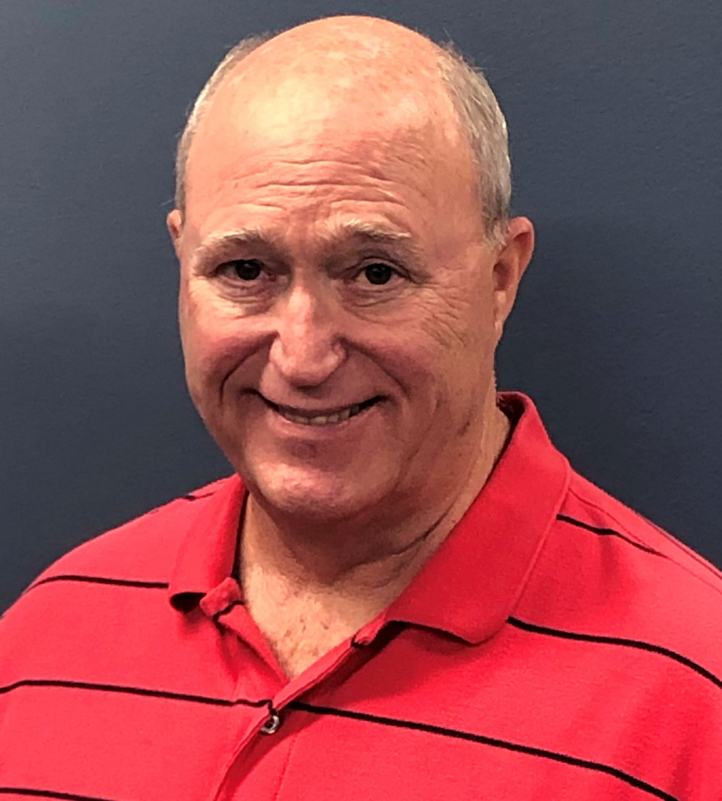
AirFixture, LLC
Kansas City, Kansas
The company designs and develops Under Floor Air Distribution equipment for commercial buildings.
AirFixture uses the SBA for working capital financing, and EXIM for export credit insurance to protect against nonpayment and offer open account credit terms to its customers.
William Scott | Vice President of Finance
wscott@airfixture.com |www.airfixture.com

Slide 10
Featured Manufacturers
Tasha Jamaluddin, Managing Director
Epcon Industrial Systems
William Scott, Vice President of Finance
AirFixture
Julie Detmering, Export Manager
Equilibar
Notes:
The Census Bureau Statistics are how America knows what America needs. As we continue to measure the nation’s People, Places and Economy—we are very excited to share where US businesses can get started to expand into the global marketplace.
Our presenters today are from the US Department of Commerce’s International Trade Administration. They are XXXXXXX, with <<<TITLE>>>> with <<<OFFICE>>>

Slide 11


Celebrating Manufacturing Day
Webinar
Government Resources to Increase Your Export Sales
October 3, 2019

Slide 12
Government Resources
Identify Global Markets with New Interactive Tool:
https://www.census.gov/library/visualizations/interactive/export-markets.html
Learn More: International Trade Helpline 800-549-0595, Option 4 or
Email: eid.international.trade.data@census.gov
Find Buyers and Distributors:
https://www.export.gov/Gold-Key-Service
Learn More: https://www.export.gov/services
Financing to Fulfill Sales Orders and Improve Cash Flow:
www.sba.gov/international
Learn More: Contact your SBA Regional Export Finance Manager: https://www.sba.gov/article/2017/nov/01/list-useacs-sba-staff
Minimizing Nonpayment Risk and Offering Open Account Credit Terms:
https://www.exim.gov/what-we-do/export-credit-insurance
Learn More: Contact Stephen.Maroon@EXIM.gov or call 202.565.3901
Webinar
Government Resources to Increase Your Export Sales
October 3, 2019
Notes:
CENSUS OVERVIEW
COMMERCE
The U.S. Commercial Service’s global network of trade professionals is in more than 100 U.S. cities and in U.S. embassies and consulates in more than 70 countries. Its services help U.S. small and medium-sized companies select the best markets and sales channels, understand the rules and regulations, find qualified partners, connect with buyers around the world, and recommend ways to finance exports. Staff of the U.S. Commercial Service are dedicated to working with businesses every step of the way, including advocating on their behalf for easier market entry
SBA
You can use the U.S. Small Business Administration’s international trade finance programs to cover short-term or long-term costs associated with selling products abroad. SBA also administers the State Trade Expansion Program (STEP) which provides grant funding through state governments to support small business participation in trade missions and other global sales promotion strategies. SBA’s Regional Export Finance Managers housed with Department of Commerce Trade Specialists in 21 U.S. Export Assistance Centers around the country can help you meet your global sales financing needs.
EXIM
The Export-Import Bank of the Unites States, also known as EXIM, empowers exporters of U.S. goods and services to win sales that otherwise would go to foreign competitors. Whether a small business needs protection against buyer nonpayment, or the ability to extend open account credit terms to buyers, EXIM has a solution. The agency covers up to 95 percent of the sales invoice. No company or deal is too small, and EXIM provides support in more than 180 countries.

