Slide 1


Trade Trends, Policy Actions and Resources for Metals and
Critical Minerals
For Audio please dial:
1-888-323-9729
Passcode: 8745780#
January 16, 2020

Slide 2
Trade Trends,
Policy Actions and Resources
for Metals and Critical Minerals
January 16, 2020

Slide 3

Today’s Speakers
Host: Wendy Peebles, Lead Outreach Coordinator
Data User and Respondent Outreach
U.S. Census Bureau
Presenters: Ashley Albritton, Statistician
International Trade Indicator Micro Analysis Branch
U.S. Census Bureau
Henock Kebede, Section Chief
International Trade Indicator Macro Analysis Branch U.S. Census Bureau

Slide 4


Today’s Speakers (continued)
Gary Stanley, Director
Office of Materials Industries
International Trade Administration
Salim Bhabhrawala, Senior International Trade Specialist
Office of Materials Industries
International Trade Administration

Slide 5
Today’s Agenda
Introduction to Online Databases and Data Analyses Tools
Examples of Tools in Action
Products and Services ITA Offers to Promote Exports and Facilitate Trade
Questions and Answers
Webinar
Government Resources to Increase Your Export Sales
October 3, 2019

Slide 6
Schedule B Classification Search Tool
Ashley Albritton, Statistician
International Trade Indicator Micro Analysis Branch
Economic Indicators Division
Email: ashley.f.albritton@census.gov
Phone: 301-763-1158
Branch line: 1-800-549-0595; Option #2
Branch email: eid.scheduleb@census.gov

Slide 7
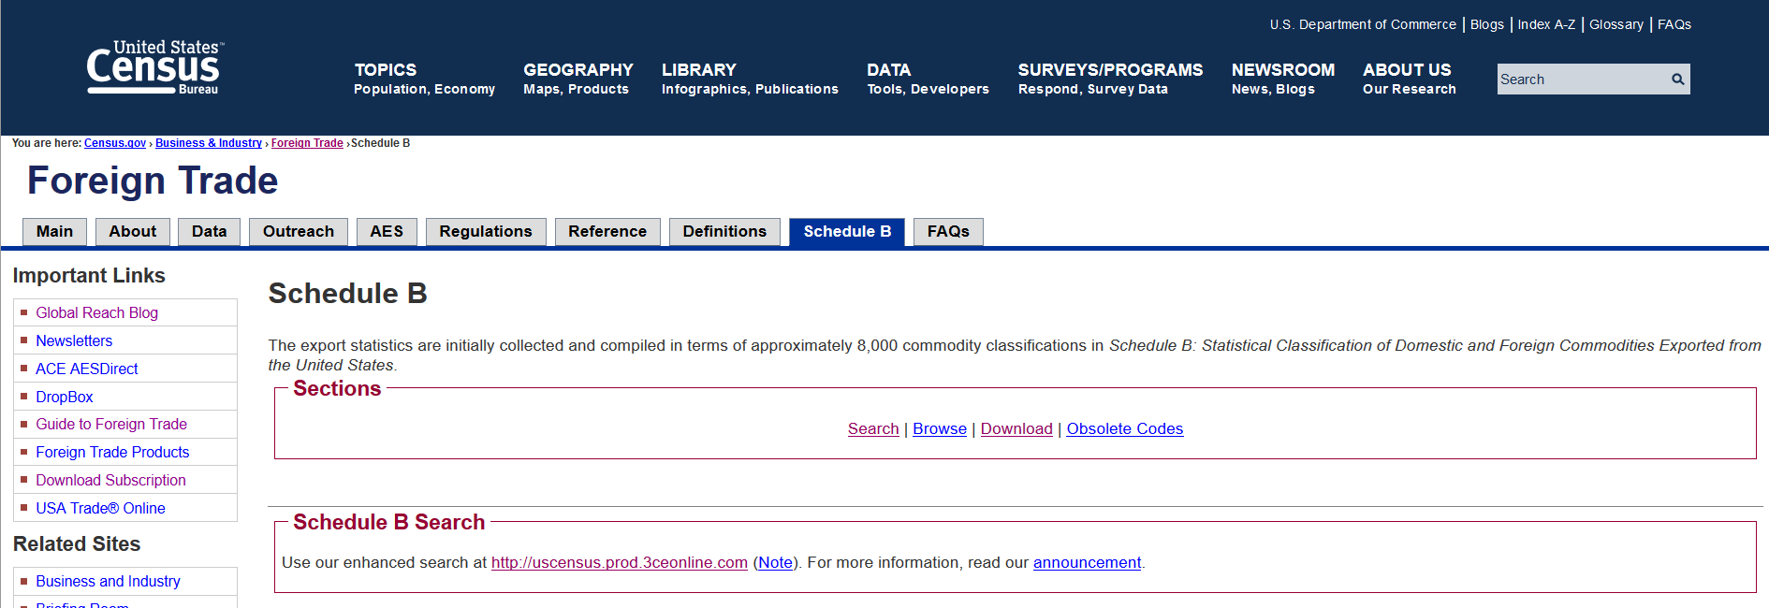
Schedule B Search Demonstration
www.census.gov/scheduleb

Slide 8
Schedule B Classification Training
Global Reach Blog Posts
  "Finding Your Schedule B Number"
  "Exporting with Import Classification Numbers“
Export Training Webinars
  "Classifying Your Product" under Basics of Export Compliance
  "Export Classification (Spanish)" under International Trade Webinars

Slide 9
Online Data Analysis Tools
Henock Kebede, Section Chief
International Trade Indicator Macro Analysis Branch
Economic Indicators Division
Email: henock.kebede@census.gov
Phone: 301-763-1880
Branch line: 1-800-549-0595; Option #4
Branch email: eid.international.trade.data@census.gov

Slide 10

Official Source
The U.S. Census Bureau is the official source for U.S. export and import goods statistics and is responsible for issuing regulations governing the reporting of all export shipments from the United States.

Slide 11
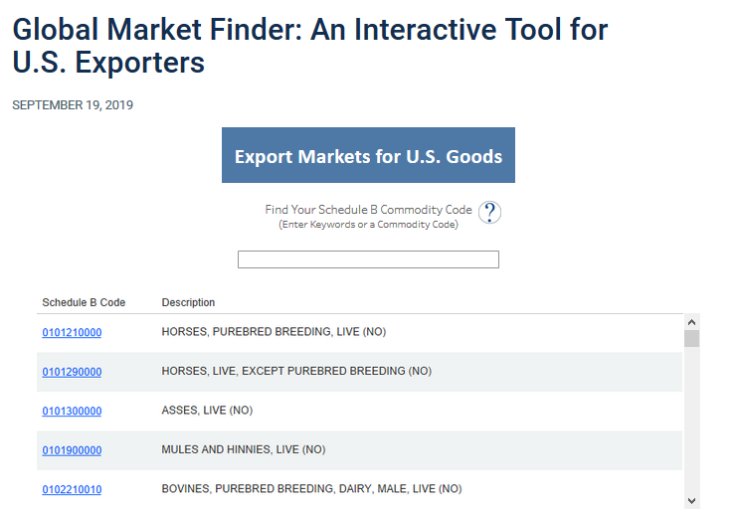
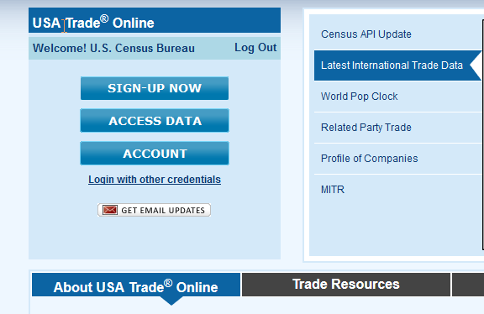
Data Tools Demonstration
Global Market Finder
https://www.census.gov/library/visualizations/interactive/export-markets.html
USA Trade® Online
usatrade.census.gov

Slide 12
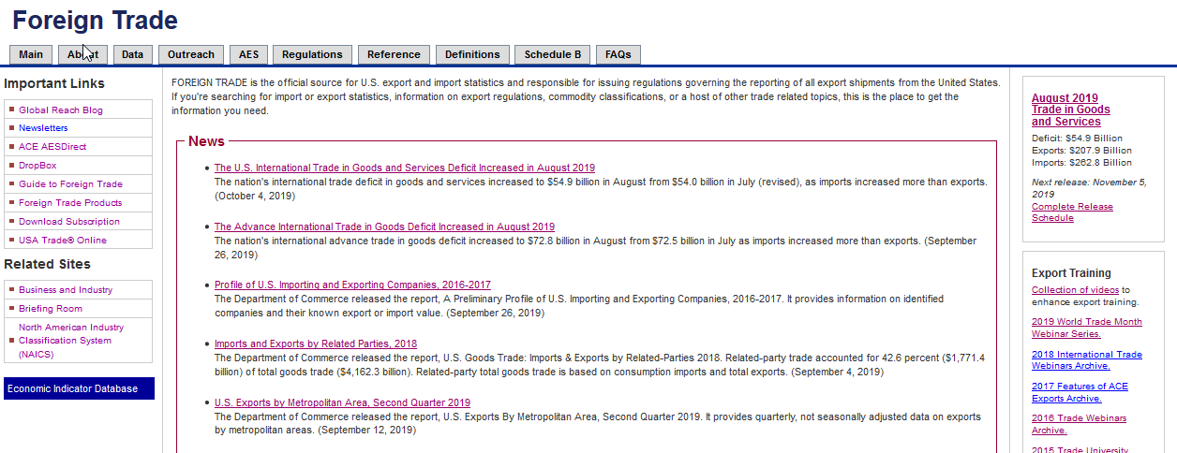
International Trade Website
www.census.gov/trade

Slide 13

Office of Materials Industries
Overview and Discussion of The Executive Order on Critical Minerals
Gary Stanley & Salim Bhabhrawala

Slide 14
ITA specialized teams and in-house experts aim to strengthen U.S. industry competitiveness via multiple programs and activities
Not for copy without permission

Slide 15
How ITA is Organized to Help You
Industry & Analysis/Industry Offices
Leads within ITA for an assigned industry sector, monitor US exports and competitiveness, producing market research and supporting trade policies in support of industry
Enforcement & Compliance
Monitors our trading partners compliance with trade agreements and support US firms engaged in disputes for unfair trading practices
U.S. Commercial Service
Often first, local point of inquiry, within ITA, Business Advisor and Coordinator for USG assistance
Not for copy without permission

Slide 16
ITA’s U.S. COMMERCIAL SERVICE (GLOBAL MARKETS)
Teach exporting basics
Assist in developing a company’s export strategy
Assist in selecting best markets
Assist in evaluating overseas partners
Promote trade events to bolster brand awareness and market exposure
ITA Trade Specialists in 109 U.S. Export Assistance Centers

Slide 17
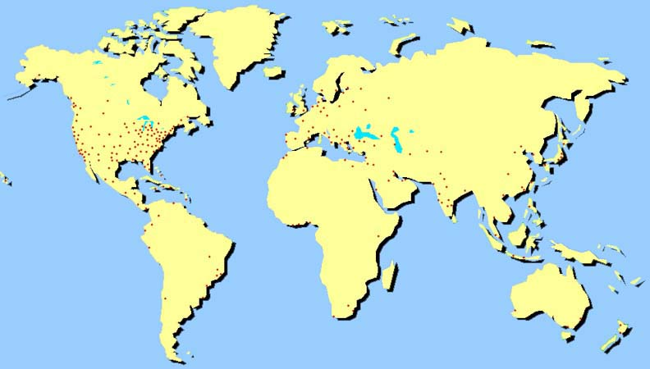
ITA’S Global Footprint
Market intelligence
Country Commercial Guides
Affordable consulting services:
  Customized business matchmaking
  International Partner Search
  Gold Key Service
119 overseas posts in 77 markets

Slide 18
How OMI participates in the Trade Policy Agenda
Bringing core sectoral expertise to USG preparatory work for Free Trade Agreement (FTA) negotiations
Reaching out, and beyond ITA, to advocate for a level playing field for U.S. business, while ensuring compliance with FTA provisions.
Identifying and addressing increased market access in connection with USEACs, GM, foreign officials contacts, and in compliance with FTA provisions
Not for copy without permission

Slide 19







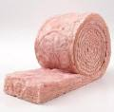


U.S. Building Products Total Annual U.S. Exports 2019 Projected: $81.4 Billion* (*based on annualized Jan-Aug data)
Wood Products 2017: $8.1 billion 2018: $7.3 billion 2019: $4.1 B projected | Plumbing Products 2017: $1.09 billion 2018: $1.2 billion 2019: $1.2 B projected | Asphalt 2017: $610 million 2018: $673 million 2019: $641 M projected
HVAC Equipment 2017: $18.5 billion 2018: $18.8 billion 2019: $18.6 B projected | Plaster & Gypsum Board 2017: $207 million 2018: $212 million 2019: $201 M projected | Cement & Concrete 2017: $466 million 2018: $458 million 2019: $419 M projected
Metal Products 2017: $22.9 billion 2018: $24.1 billion 2019: $22.9 B projected | Insulation 2017: $1.04 billion 2018: $1.10 billion 2019: $1.01 B projected | Masonry & Stone 2017: $224 million 2018: $232 million 2019: $220 M projected
Electrical Systems & Lighting 2017: $21.3 billion 2018: $22.5 billion 2019: $21.8 B projected | Appliances 2017: $3.11 billion 2018: $3.11 billion 2019: $2.99 B projected | Glass 2017: $857 million 2018: $769 million 2019: $791 M projected
Paints, Adhesives & Plastics 2017: $4.3 billion 2018: $4.5 billion 2019: $4.6 B projected | Doors & Windows 2017: $751 million 2018: $720 million 2019: $690 M projected | Miscellaneous Other 2017: $1.16 billion 2018: $1.18 billion 2019: $1.15 B projected

Slide 20
Trade Policy: Industry Trade Advisory Committees
A Unique Public-Private Partnership – Industry’s Voice in U.S. Trade Policy
Since 1974, the U.S. Department of Commerce and the U.S. Trade Representative (USTR) have worked side-by-side with business leaders who serve as industry trade advisors to the U.S. Government.
USTR/Commerce jointly administer the Industry Trade Advisory Committee (ITAC) program to reflect today’s U.S. economy & vision for the future (www.trade.gov/itac).
Currently, approximately 370 industry representatives serve as advisors to Commerce and USTR with a diverse representation of private industries ranging from small to large companies and from all U.S. geographic regions.
Commerce and USTR consider the ITACs to be an integral part of the U.S. trade policy-making process. Advisors have direct access to policymakers and negotiators to offer industry positions on U.S. trade policy and negotiating objectives.
ITAC 5 – Forest Products, Building Materials, Construction, and Nonferrous Metals
Notes:
John

Slide 21
















A Federal Strategy to Ensure Secure and Reliable Supplies of Critical Minerals
Response to Executive Order 13817

Slide 22
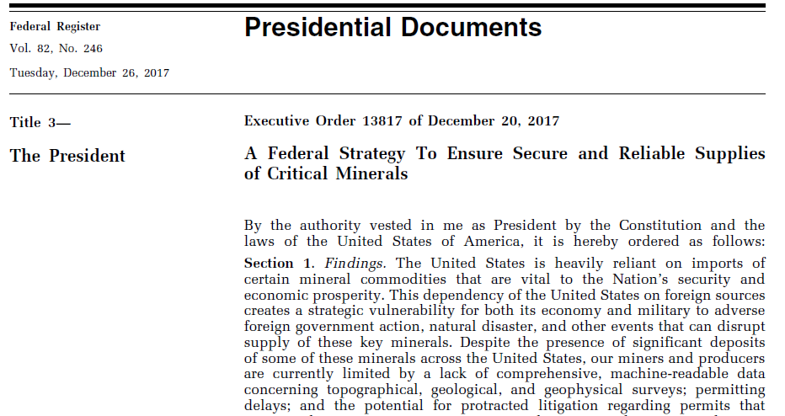

Slide 23
Executive Order 13817
The President issued Executive Order (EO) 13817, A Federal Strategy to Ensure Secure and Reliable Supplies of Critical Minerals, which seeks to address strategic vulnerabilities in critical minerals supply chains
EO 13817 directs:
  The Secretary of Interior, in coordination with executive branch agencies and offices, to publish a list of critical minerals
  The Secretary of Commerce, in coordination with executive branch agencies and offices, to submit a report to the President that includes:
    a strategy to reduce the Nation’s reliance on critical minerals
    assessment of progress toward developing recycling and reprocessing technologies, and technological alternatives
    options for investment and trade with our allies and partners
    improved topographic, geological, and geophysical mapping data and metadata, made electronically accessible to support private sector mineral exploration
    recommendations to streamline permitting and review processes related to developing leases; enhancing access to critical mineral resources; and increasing discovery, production, and domestic refining of critical minerals

Slide 24
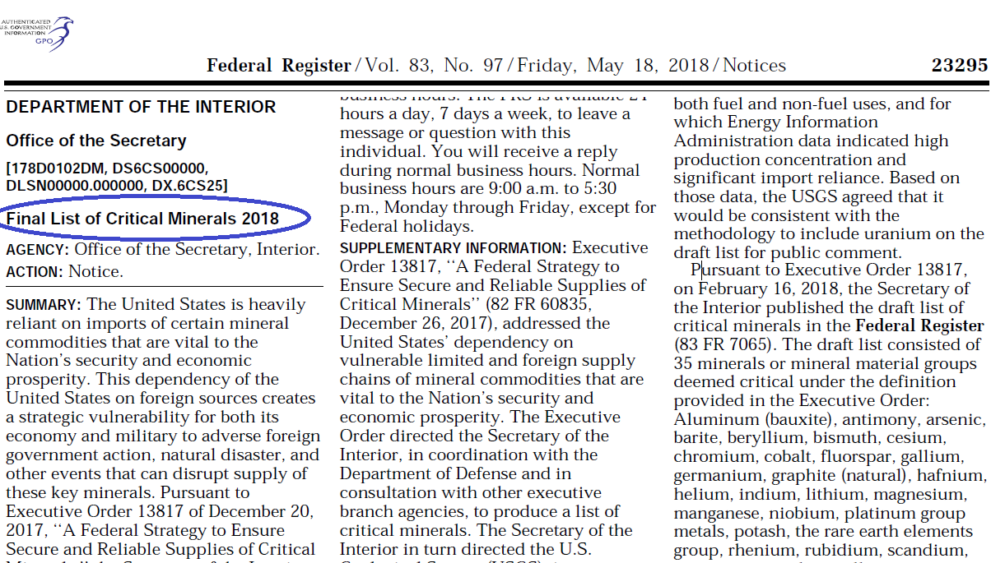

Slide 25
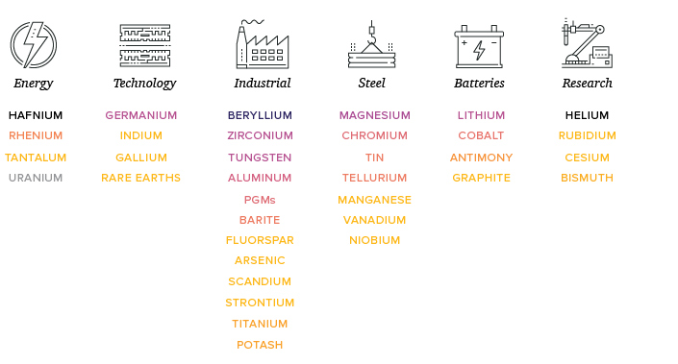

Slide 26

https://www.commerce.gov/news/reports/2019/06/federal-strategy-ensure-secure-and-reliable-supplies-critical-minerals

Slide 27
Executive Order Calls to Action (CTA)
Advance Transformational Research, Development, and Deployment Across Critical Mineral Supply Chains
Strengthen America’s Critical Mineral Supply Chains and Defense Industrial Base
Enhance International Trade and Cooperation Related to Critical Minerals
Improve Understanding of Domestic Critical Mineral Resources
Improve Access to Domestic Critical Mineral Resources on Federal Lands and Reduce Federal Permitting Timeframes
Grow the American Critical Minerals Workforce

Slide 28
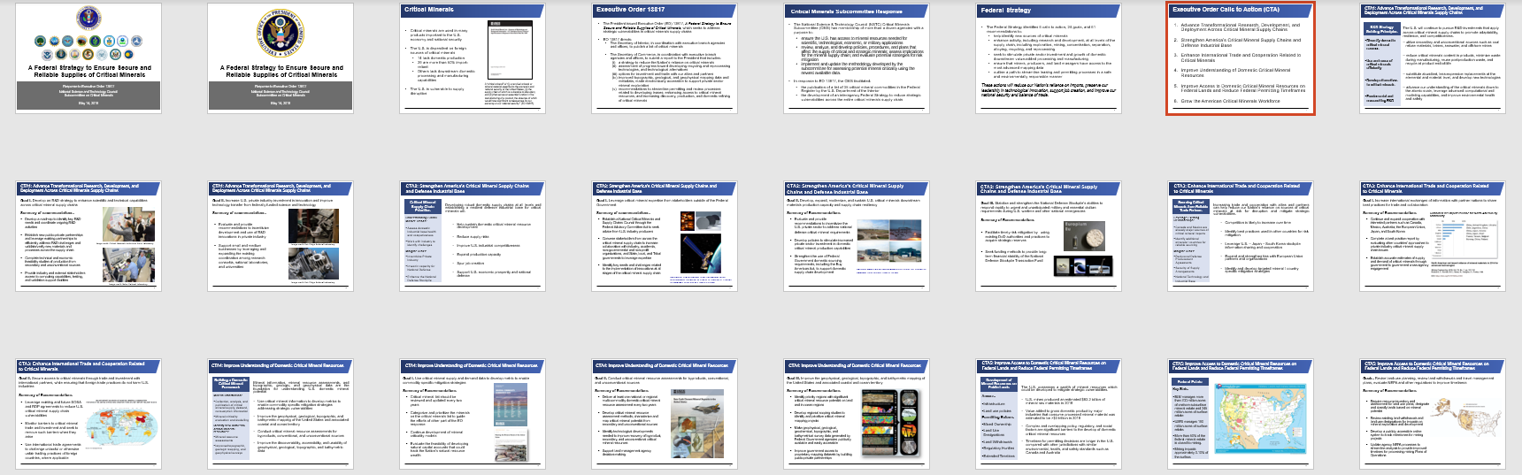
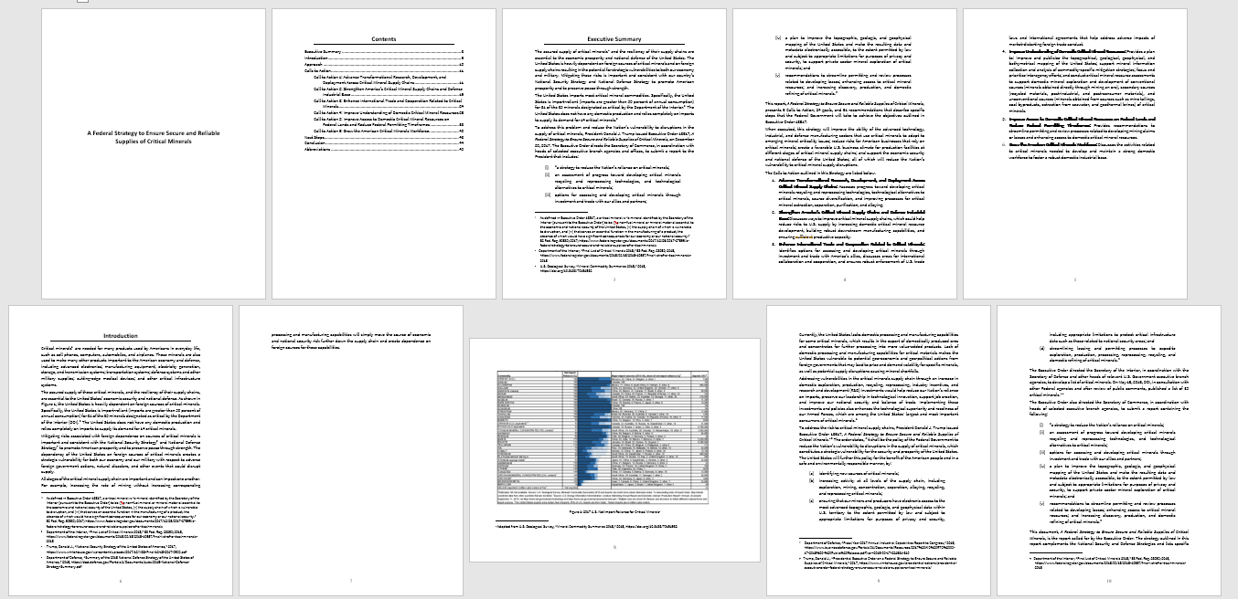
A Detailed Report…

Slide 29
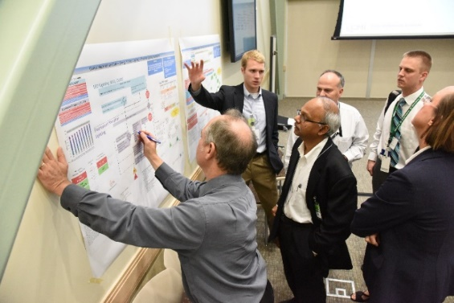
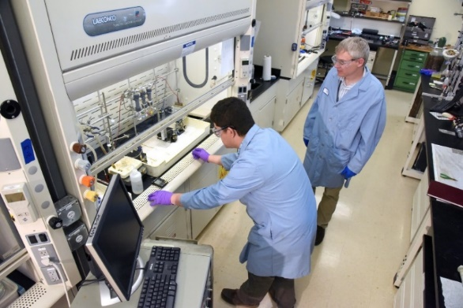
CTA1: Advance Transformational Research, Development, and Deployment Across Critical Minerals Supply Chains
Goal I: Develop an R&D strategy to enhance scientific and technical capabilities across critical mineral supply chains
Goal II: Increase U.S. private industry investment in innovation and improve technology transfer from federally funded science and technology
Summary of Goals:
Develop a roadmap to identify key R&D needs and coordinate ongoing R&D activities
Establish new public-private partnerships and leverage existing partnerships to efficiently address R&D challenges and validate/verify new materials and processes across the supply chain
Complete technical and economic feasibility studies of production from secondary and unconventional sources
Provide industry and external stakeholders access to computing capabilities, testing, and validation support facilities
Evaluate and provide recommendations to incentivize development and use of R&D innovations in private industry
Support small and medium businesses by leveraging and expanding the existing coordination among research consortia, national laboratories, and universities
Image credit: Critical Materials Institute at Ames Laboratory.
Image credit: Idaho National Laboratory.

Slide 30
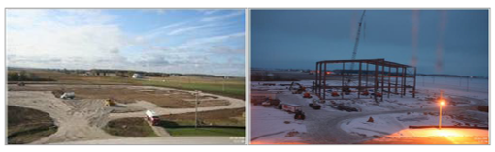

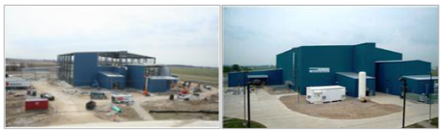
CTA2: Strengthen America’s Critical Mineral Supply Chains and Defense Industrial Base
Goal I: Leverage critical mineral expertise from stakeholders outside of the Federal Government
Goal II: Develop, expand, modernize, and sustain U.S. critical minerals downstream materials production capacity and supply chain resiliency
Goal III: Stabilize and strengthen the National Defense Stockpile’s abilities to respond rapidly to urgent and unanticipated military and essential civilian requirements during U.S. wartime and other national emergencies
Beryllium Metal Pebble Plant at Materion in Elmore, OH. Funded by Defense Production Act Title III Program.
Germanium Space Qualified Solar Cell Manufacturing Improvement Program at 5N Plus in St. George UT. Funded by Defense Production Act Title III Program.

Slide 31
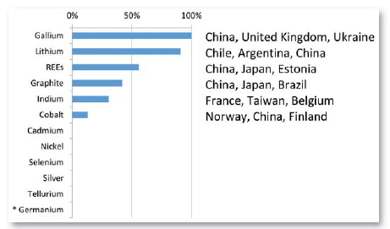
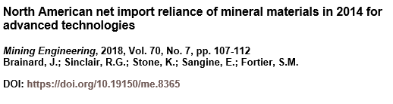
CTA3: Enhance International Trade and Cooperation Related to Critical Minerals
Goal I: Increase international exchanges of information with partner nations to share best practices for trade and collaboration
Summary of Recommendations
Combined net import reliance for North America by commodity.
Continue and expand cooperation with interested partners such as Canada, Mexico, Australia, the European Union, Japan, and South Korea
Complete a best practice report by evaluating other countries’ approaches to private industry critical mineral supply chain issues
Establish accurate estimates of supply and demand of critical minerals through government to government cross-agency engagement

Slide 32
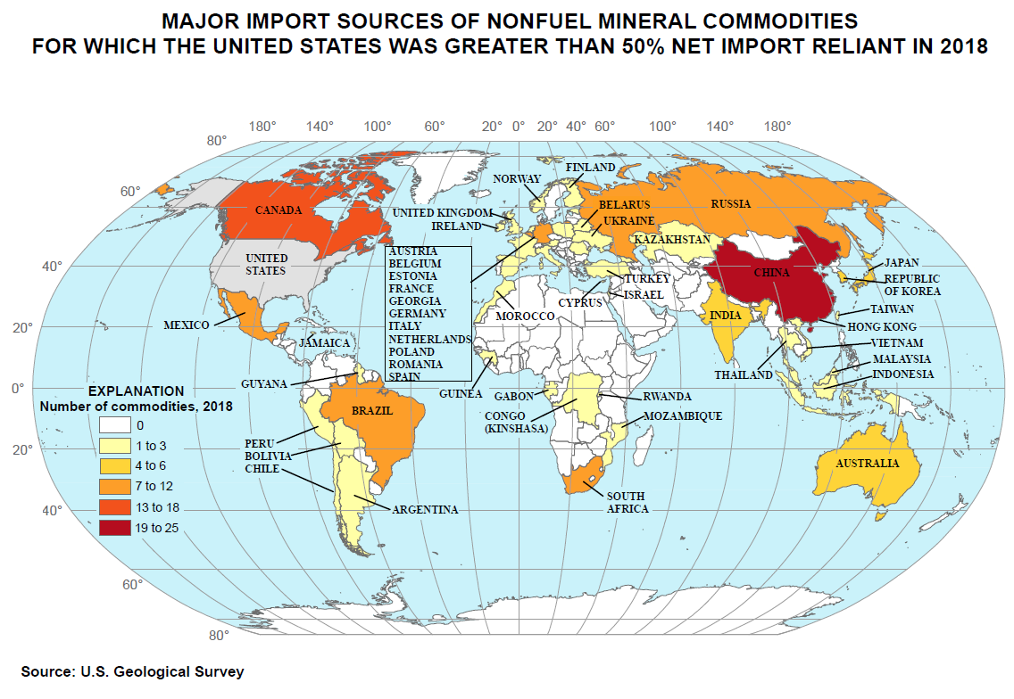
CTA3: Enhance International Trade and Cooperation Related to Critical Minerals
Goal II: Secure access to critical minerals through trade and investment with international partners, while ensuring that foreign trade practices do not harm U.S. industries
Summary of Recommendations
Leverage existing and future acquisition and procurement agreements to reduce U.S. critical mineral supply chain vulnerabilities
Monitor barriers to critical mineral trade and investment and seek to remove such barriers when they arise
Use international trade agreements to challenge unlawful or otherwise unfair trading practices of foreign countries, where applicable

Slide 33
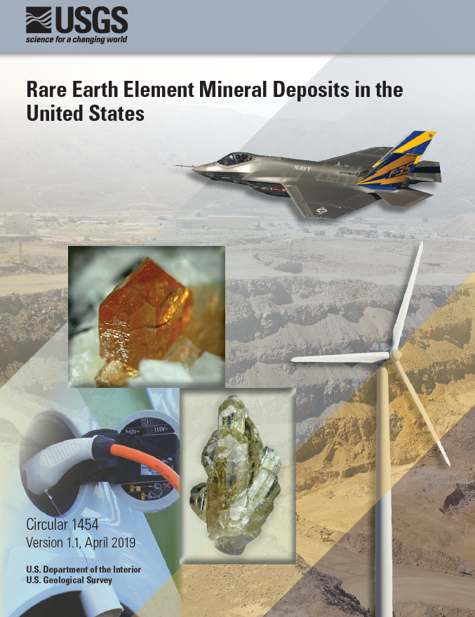
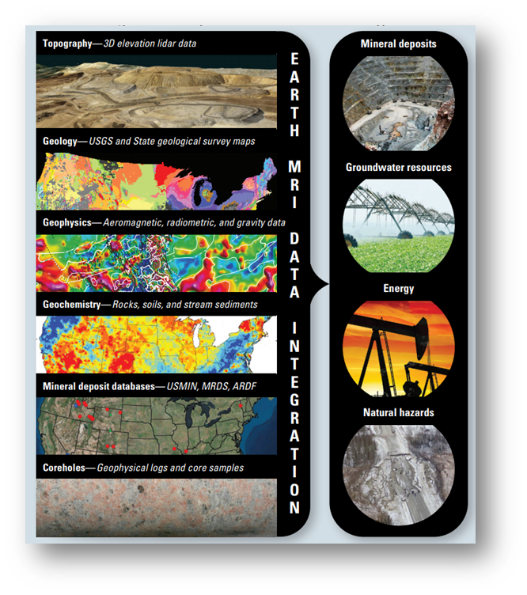
CTA4: Improve Understanding of Domestic Critical Mineral Resources
Goal I: Use critical mineral supply and demand data to develop metric to enable commodity specific mitigation strategies
Goal II: Conduct critical mineral resource assessments for byproducts, conventional, and unconventional sources
Goal III: Improve the geophysical, geological, topographic, and bathymetric mapping of the United States and associated coastal and ocean territory

Slide 34
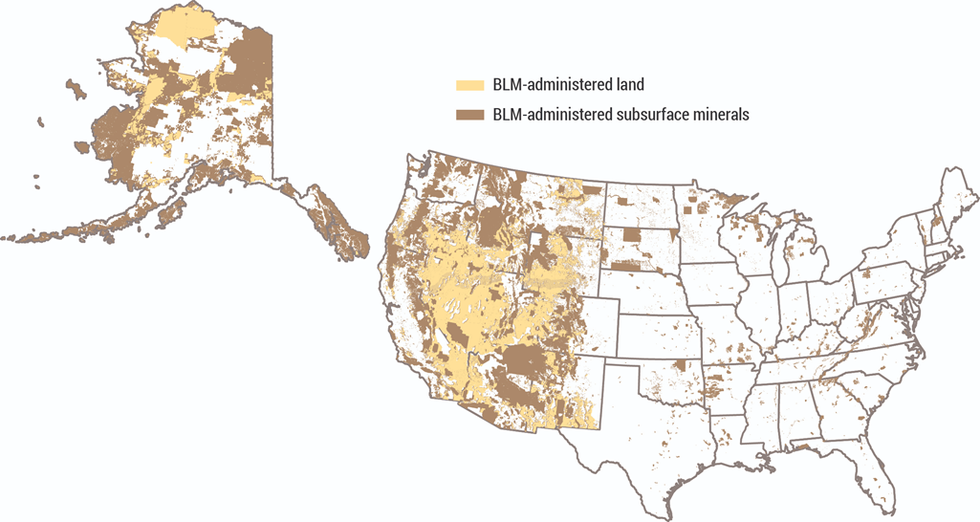
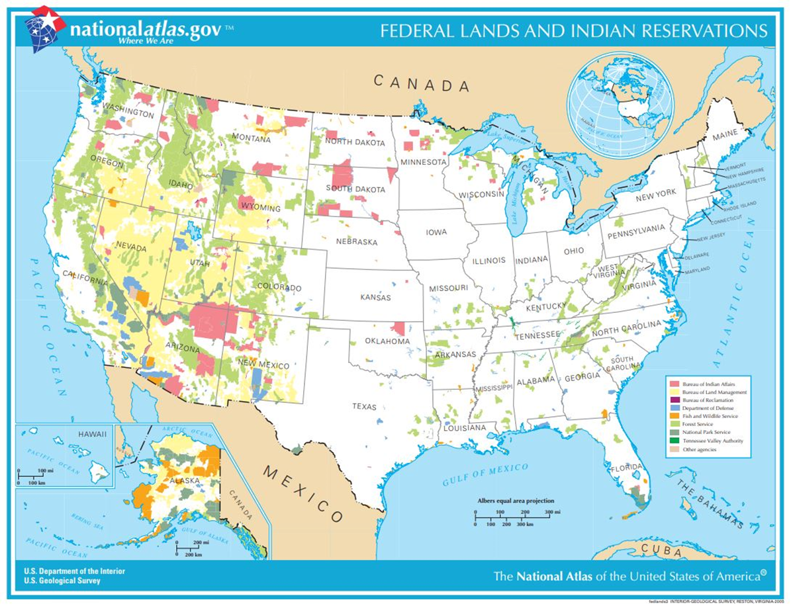
CTA5: Improve Access to Domestic Critical Mineral Resources on Federal Lands and Reduce Federal Permitting Timeframes
Goal: Revise land-use planning, review land withdrawals and travel management plans, evaluate NEPA and other regulations to improve timeliness
Federal Estate
Key Stats:
BLM manages more than 700 million acres of onshore subsurface mineral estate and 245 million acres of surface estate
USFS manages 190 million acres of surface estate.
More than 50% of the federal mineral estate is closed to mining.
Mining impacts approximately 0.10% of the surface.

Slide 35

CTA6: Grow the American Critical Minerals Workforce
Education Priorities
Goal I: Bolster education in mining engineering, geology, and other fields related to critical materials manufacturing
Goal II: Cross-fertilize material science, computer science, and related disciplines to modernize the minerals supply sector industry and make the field more attractive to new talent
Summary of Recommendations
Comprehensive Local Needs Assessment:
Perkins V contains a new requirement within the local recipient application for funds, must be included in each local application and updated at least every two years. The law requires an analysis of how CTE programs are meeting workforce needs, and provides eligible recipients with multiple ways to demonstrate labor market demand.
Innovation & Modernization Grants:
Under this new discretionary grant program, the Department will award competitive grants to eligible entities, institutions, or recipients to identify, support and rigorously evaluate evidence-based and innovative strategies and activities to improve and modernize CTE and align workforce skills with labor market needs.
High School Pathways to STEM Apprenticeships:
This demonstration program is designed to support state efforts to expand and improve the transition of high school CTE Students to postsecondary education and employment through apprenticeships in science, technology, engineering, and mathematics (STEM) fields that begin during high school. $3,000,000 in Perkins funds were awarded to six states for a three-year project period.
Develop partnerships with academia and private sector to support universities involved with mineral related education and research
Develop opportunities to facilitate partnerships between industry and technical colleges to coordinate credentialing / skillset alignment
Bolster the mineral supply chain sector workforce by leveraging provisions in the Strengthening Career and Technical Education for the 21st Century Act

Slide 36

Webinar
Government Resources to Increase Your Export Sales
October 3, 2019

Slide 37
U.S. Government Trade Data Resources
Identify New Markets with the Global Market Finder
https://www.census.gov/library/visualizations/interactive/export-markets.html
Discover Trends and Analyze Markets with USA Trade Online
usatrade.census.gov
Find the Right Harmonized System Code with the Schedule B Search Engine
www.census.gov/scheduleb
October 3, 2019

Slide 38
U.S. Government Trade Data Resources (continued)
Access Economic and Trade Data for Top Markets
http://tpis.trade.gov
Identify Reduced Tariff Rates with our Free Trade Agreement (FTA) Partners
http://export.gov/fta/ftatarifftool/
How to Navigate the Section 301 Tariff Process
https://ustr.gov/issue-areas/enforcement/section-301-investigations/search
October 3, 2019

