Slide 1

Helping Federal Clients Move from Table-based Reporting to Dynamic Dashboards
A case study with the National Crime Victimization Survey (NCVS)
Presenter: Marcia Underwood: (RTI Center for Data Science)
Alex Giarrocco, Anna Godwin, Alex Harding, Chris Krebs, Lynn Langton, Michael Long, Roman Ruiz-Esparza, Ian Thomas, Chris Townsend, Lewis Smith, Michael Wenger, Stephanie Zimmer
FedCASIC Workshop
April 5-6, 2022
The opinions, findings, and conclusions or recommendations expressed in this presentation are those of the authors and do not necessarily reflect those of the Department of Justice.
Notes:
Put URL into zoom chat: ncvs.bjs.ojp.gov
Self- RTI –CDS, thx for attn and thank you to FedCASIC’s organizers for giving all of us this space to share our work
I’ll be Speaking today about: title
THEN: in relation to our work w BJS

Slide 2
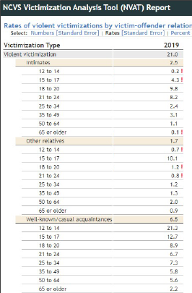
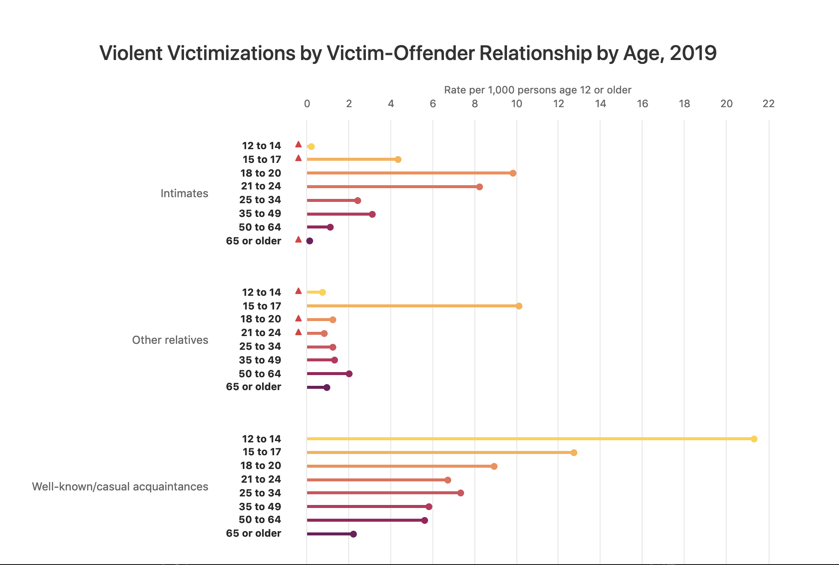
Helping Federal Clients Move from Table-based Reporting to Dynamic Dashboards
Notes:
…is the primary source of information on criminal victimization in the United States.
As it is a survey of individuals about their experience of crime, these estimates created from this survey are for nonfatal crime.
The survey has been ongoing since 1973
You’ve had some context on the project already from the BJS team (name) While NCVS data had been accessible to the public, expectations evolve.. Our goal was to go beyond sharing data only to be used by subject-matter experts and those interested in downloading and analyzing complex datasets. Well considered charts, and other types of data visualizations, can make data more quickly interpretable, and more accessible to a wider range of audiences.
BJS has been especially motivated recently,
moving towards:
Dynamic tools, presenting data in ways more accessible and digestible for the public, and incorporating exploratory tools allowing users to seek answers to their own questions

Slide 3
What were our goals for a new tool?
Visualization- more quickly interpretable results, and engaging presentation
Wider range of user customization in queries
Great user experience
Accessible to public
Easy to update
Notes:
BJS has been especially motivated recently,
moving towards:
Dynamic tools, presenting data in ways more accessible and digestible for the public, and incorporating exploratory tools allowing users to seek answers to their own questions
RTI is involved in this work through several efforts with BJS
Including the tool I’m speaking to today, NCVS dashboard or N-DASH

Slide 4
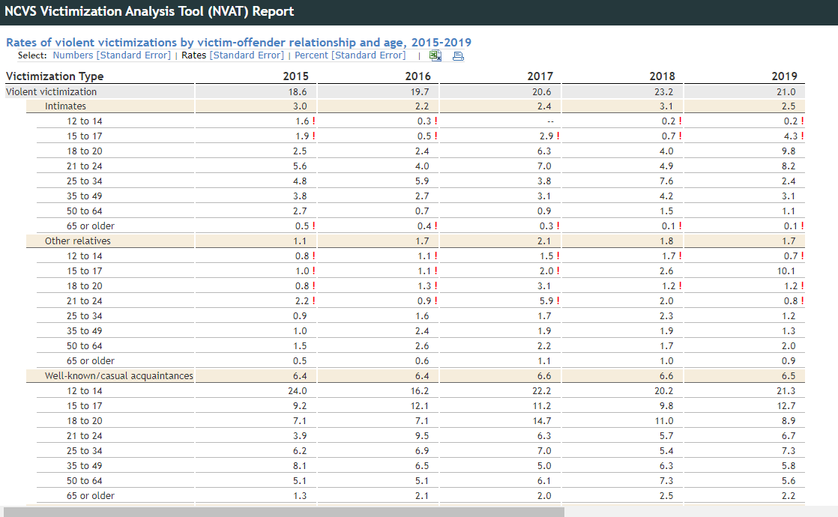
What were our goals for a new tool? A transformation from this:
Notes:
Example of result of a custom query using the NVAT. A table -based result.
This was where we saw an opportunity
We proposed visualizing NCVS data, and BJS was interested
Work was Initially conceived as a prototype, which then evolved into the final live application
Our aim here was to transform table view such as this

Slide 5
What were our goals for a new tool? Into this:
Notes:
Into something much more quicky interpretable- interactive DV such as you see here

Slide 6
Dashboard Overview
Notes:
Like to take a few minutes to introduce you to what we’ve created

Slide 7
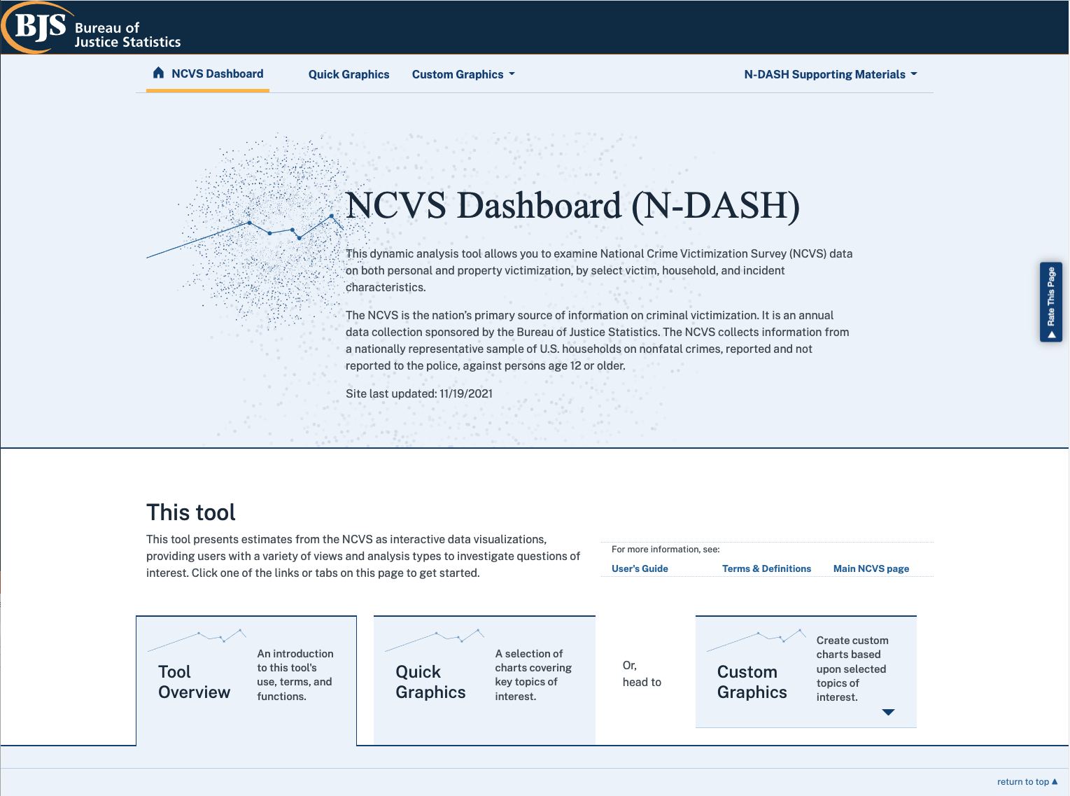
NCVS Dashboard (N-DASH): Home page
https://ncvs.bjs.ojp.gov/
Notes:
N-DASH inspired by NVAT because NVAT did some things quite well
Page Structure
Quick Graphics – Pre-selected analysis of certain topics. E.g: Trend of Violent Victimization 2015-2019.
Custom-Graphics – User selected analysis. E.g: User picks person or household victimization, then selects various filters
Retains feature of queries Exported to CSV so they can be used outside of the context of the tool
What is the “Research Question”: example: Gender - Reporting to the Police

Slide 8
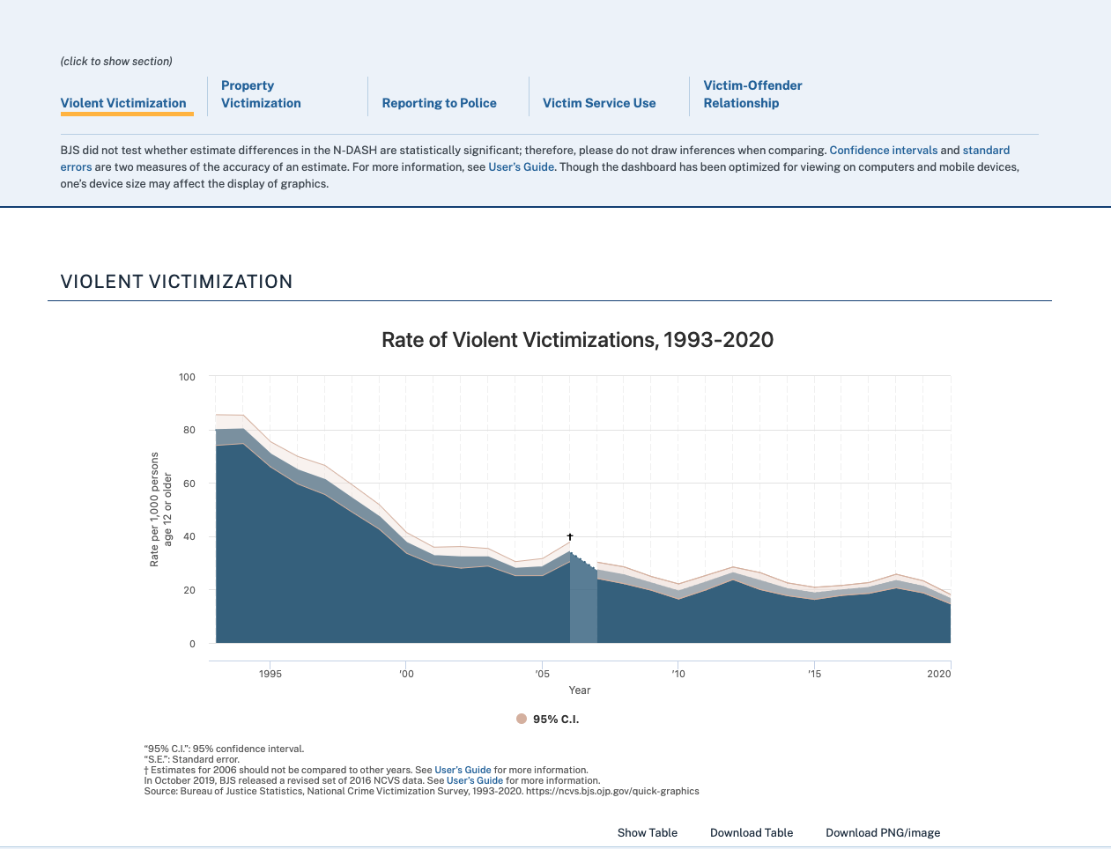
NCVS Dashboard (N-DASH): Quick Graphics page
https://ncvs.bjs.ojp.gov/
Notes:
Example of quick-graphics ‘curated’ chart selection
Can see the tabs here for other pre-selected topics
Area for users who are looking for quick familiarity rather than a ‘deep dive’

Slide 9
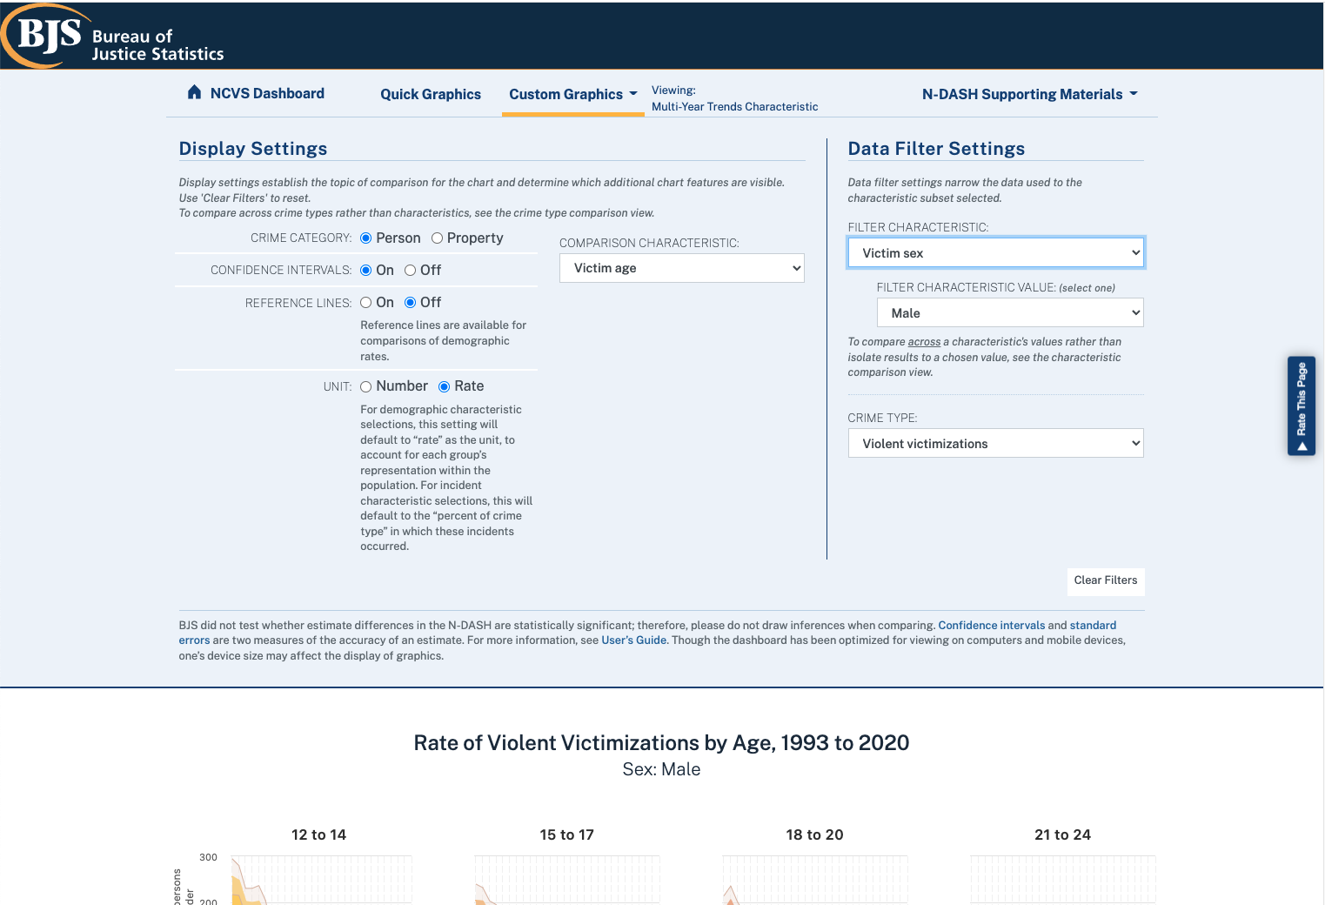
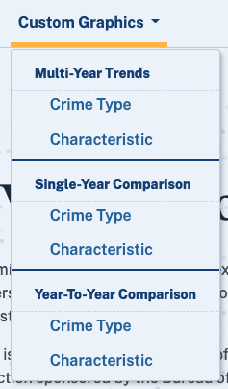
NCVS Dashboard (N-DASH): A Custom Graphics page
https://ncvs.bjs.ojp.gov/
Notes:
Example of one of the several CG pages:
Filter and Display Selections
(options vary by view)
Comparing either characteristic or crime types for each chart/analysis type
Victimization: Person or Household
Years: 1993 – 2019
Go over available pages: For analysis types, for crime type vs characteristic, (of either victim or of the victimization)
Other available unit dynamically updated
So, once a user has gone through and determined their question…

Slide 10
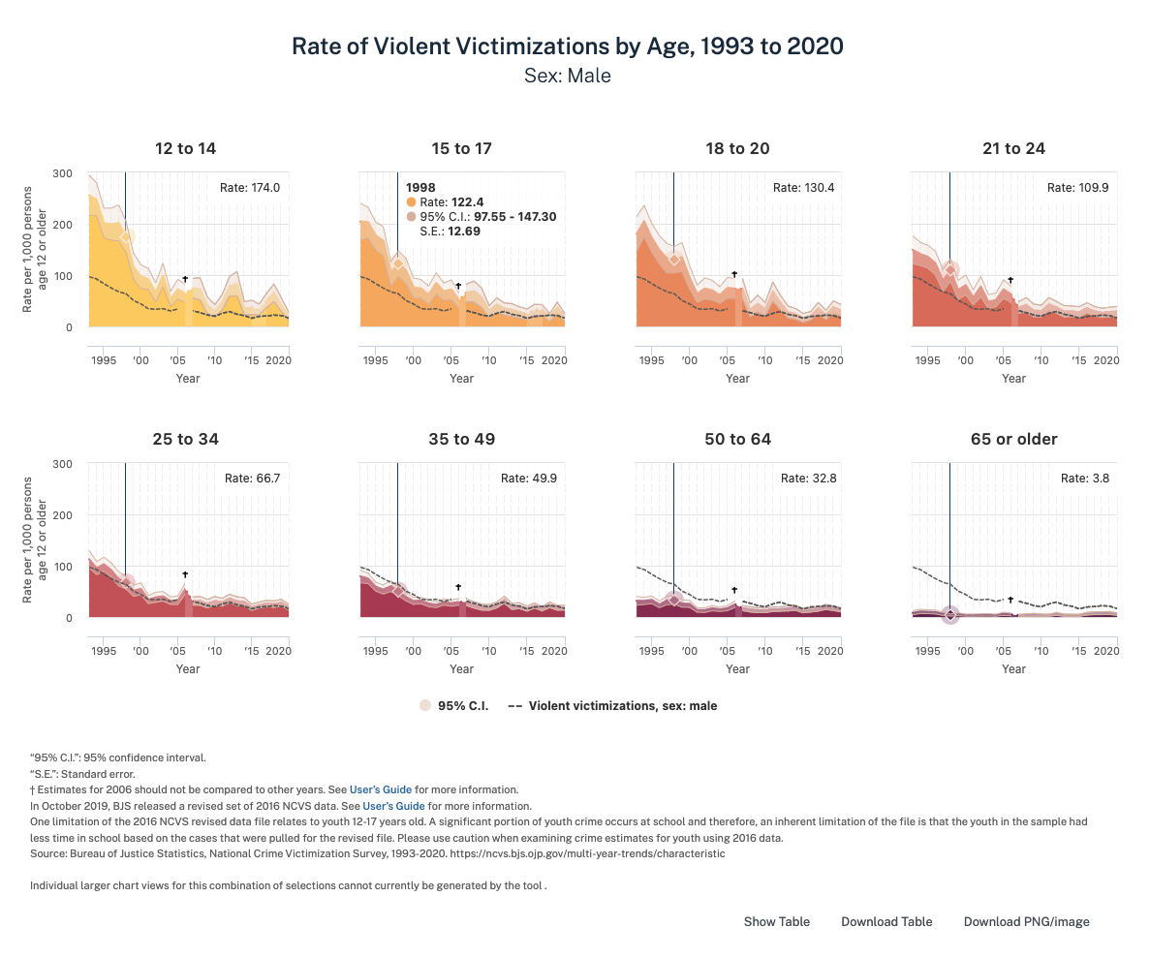
NCVS Dashboard (N-DASH): A Custom Graphics page
https://ncvs.bjs.ojp.gov/
Notes:
Example of a custom graphics view created by using view and filter selections to examine rate of violent victimization by age group, filtered to only males
‘Small multiples’ charts give a quick overview to compare the volume and ‘shape’ of change, reference lines, CI give context and linked cursor lines give context, and
Though the charts are small to allow cross-comparison, tooltips retain fine detail for every data point plotted here

Slide 11
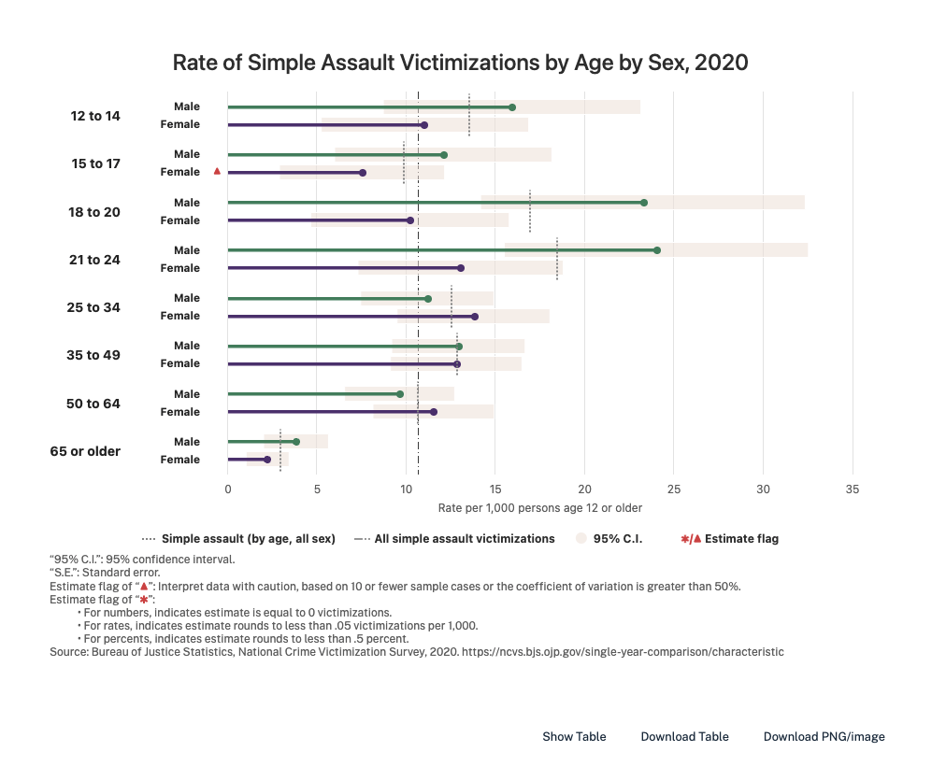
NCVS Dashboard (N-DASH): A Custom Graphics page
https://ncvs.bjs.ojp.gov/
Notes:
Here is an example of the second of our 3 chart/ analysis types single year comparison- also comparing characteristics
Toggleable settings for these visualizations can show ci, and reference lines both for the overall (cuts across all rows), and for each age group to see where rate for that sex diverges from for the age group overall

Slide 12
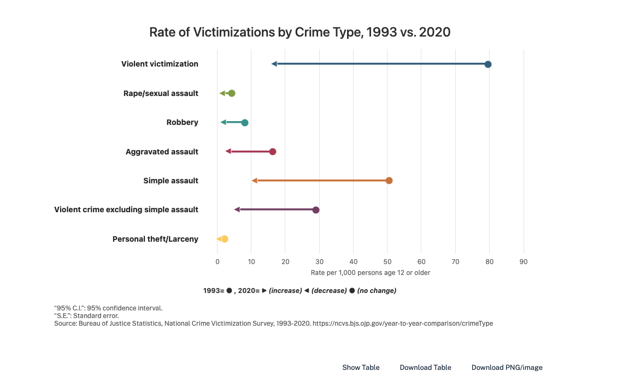
NCVS Dashboard (N-DASH): A Custom Graphics page
https://ncvs.bjs.ojp.gov/
Notes:
Graphic here is an example of the year-to-year comparison, this time showing a comparison across crime types
We can see both the direction of change (down for all crime types), and easily compare the magnitude of that change between different crime types

Slide 13
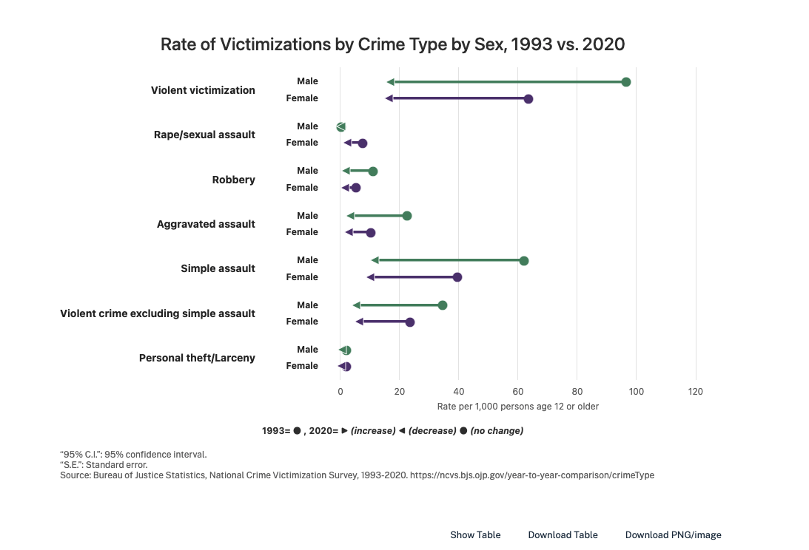
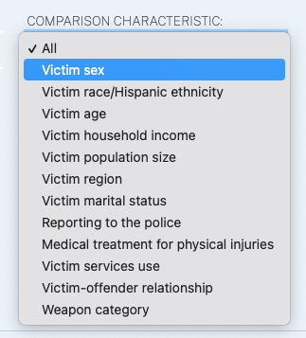
NCVS Dashboard (N-DASH): A Custom Graphics page
https://ncvs.bjs.ojp.gov/
Notes:
With a click of the comparison characteristic drop-menu, we can now see that same comparison broken down by a new minor-group, victim sex

Slide 14
The Project Work
Notes:
Now that I’ve given you a look into what we’ve created, how did this tool come together?
I’ll go over a few of the considerations it presented, and our choices for solutions

Slide 15
How did we go about this transformation? The Project Team
AJR: Applied Justice Research
DSDS: Division for Statistical and Data Sciences
CDS: Center for Data Science
Client Relationship & Client Management
RCD: Research Computing Division
Domain Expertise
Social Statistics Expertise
Computing Estimates
Data Visualization Expertise
Prototyping, Web Application & Dashboard Development
Web & Application Development Expertise
Product Packaging, Validation & Deployment Documentation
Notes:
Cross-disciplinary Team
Very fortunate to have people across the org with diverse relevant experience and skills to draw from,…
Subject matter expertise in Criminology
Colleagues with Relationship with BJS
Statistics and data science
Data visualization
Web Application development
UI/ UX
Expertise in optimizing, packaging up, and deploying our application final deliverable

Slide 16
NCVS Data:– Content and Complexity
Individuals are interviewed about the frequency, characteristics, and consequences of their criminal victimization experiences
Produces information on:
Violent and property crime victimizations
Characteristics of victims and perpetrators
Characteristics and consequences of incidents
Due to the complex sampling/survey design, the NCVS data files include:
Person, household, victimization, and incident weights
Statistical adjustments that compensate for things like telescoping and repeat victimization experiences
Reality: Downloading, analyzing, and understanding the data and results is not easy
Notes:
As far as the underlying data…There is complex statistical work to be done in getting from raw survey results to creation of national and regional estimates…
RTI had already been involved in statistical work w NCVS
First step for our team in CDS- get to know the data to display.
Number of reasons:
In part BC of complex weights, better speed on user end (?), and ability to make a more lightweight application,
Rather than calculating estimates on the fly, tool uses numerous small pre-computed csv files

Slide 17
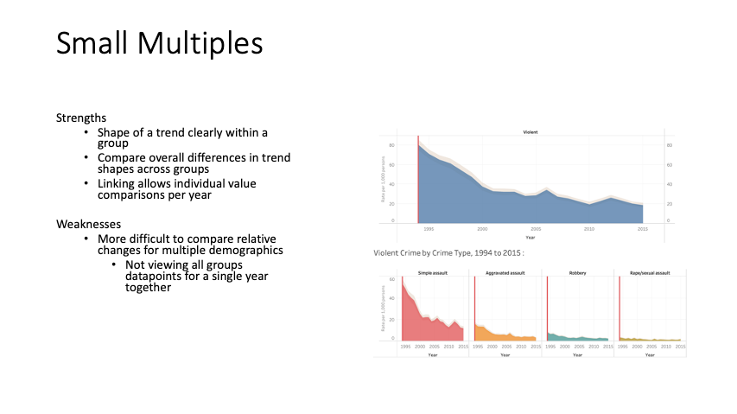
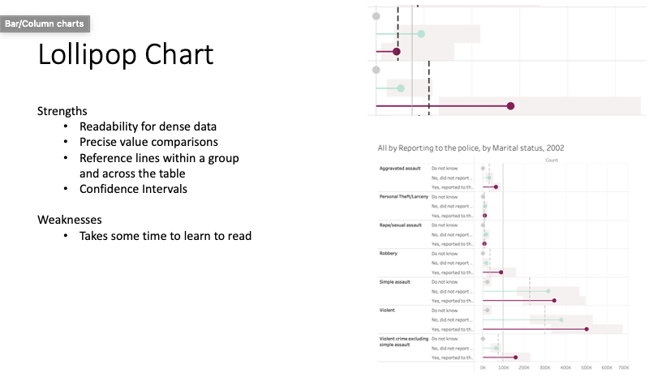
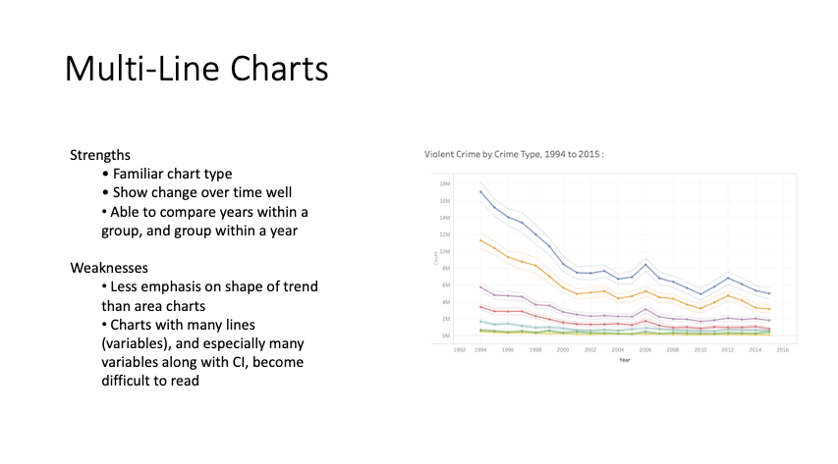
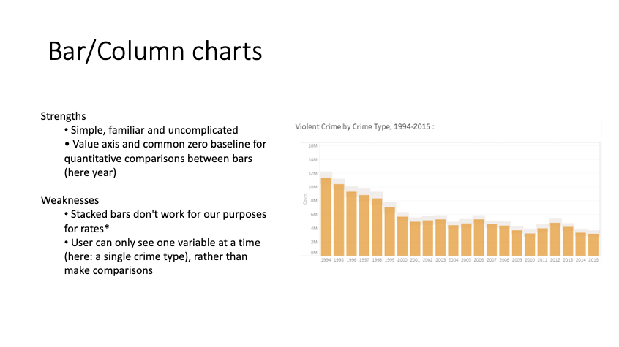
Scoping Dashboard Work / Decision Making
Notes:
Once we were familiar w the data, work on how to convey it
An approach to working through decisions that I think helped facilitate this process, and keep this work moving at a good pace going on this was:
I presented the client with pre-considered and named options (often as A,B ,or ABC )
So on our end, we could do the work of investigating solutions, and advocating for recommendations, but involve the client in the process to ensure what we were making was built to their vision
For final solution in charting>>
Details of customization desires led us to decide on a JS based solution- using a charting library, but able to be modified in JS,
This was a good balance between making use of ‘already solved problems’ but allowing ourselves the flexibility via coded solution beyond what a purely software-based solution allows
Some of those details include:
Showing several layers of information on top of the main chart type-
CI, major and minor reference lines, flagging of less reliable estimates
Small multiples, year indicator and vals lined across charts
Styles to show year in trends that doesn't align with others for comparison

Slide 18

Web Application
A state management plugin for dashboards
https://harnessjs.org
Notes:
Harness -Vue plugin Developed at RTI in CDS, including several members of the team making the Ndash tool
that provides architecture for building dashboards on the web, reducing the amount of scripting work needed around charting and filtering for building web dashboards.
Open Source .
https://github.com/RTIInternational/harness

Slide 19
Development Challenges
Prototype v Production
Rapid prototyping aids UCD because it lets users test the dashboard
Time Consuming
Disposable
How can we quickly prototype applications AND reuse that work?
Notes:
MentionTime frame
Rewrite to match the language of the story
By the time you decide what you want, you want to publish
This puts us in a better place to build upon, rather than build again

Slide 20
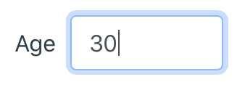

What is Harness-Vue?
Harness is an opinionated plugin that abstracts state management (Vuex) for our use case of charts and filters.
Data surveydata.csv [ { age: 20, sex: male, ... }
{ age: 36, sex: male, ... }
{ age: 55, sex: female, ... } ]
Filters Filter by max age <Input name=“ageFilter” />
Charts Display data <h1>Count: {{ count }}</h1>
[
{ age: 20, sex: male, ... } ]
Notes:
Let’s run through a simple example. I have some data, where each row is a person, and I want to filter that data by a maximum age, and then display how many people are matched

Slide 21
Harness-vue: Use example
Chart.vue
<template>
<div>
<h1>Count: {{ count }}</h1>
</div>
</template>
<script>
export default {
name: 'Chart',
computed: {
count () {
return this.getChartData('count')
}
}
}
</script>
const PageComponent = {
render() {
return (
<div>
<HarnessUiInput filter={{key: 'maxAge'}} />
<Chart />
</div>
)
}
}
HarnessUiInput is an Input that calls this.setFilter(value)
this.getChartData() is a function made available by Harness
Notes:
Harness-vue manages these functions we refer to as ‘getters’ and ‘setters’
Benefits::
By sharing libraries between your projects, features created for project A are available to project B
This has been a huge boon as we start new projects up – each new project has had more tools available from the beginning
Similarly, new projects give places to test new features or identify pain points/new features worth adding
If your projects use similar syntax and do things the same way, your developers can go project to project more easily
Easy to train new developers and drop them into legacy projects – if you know Harness-Vue, you can work on Harness-Vue projects

Slide 22
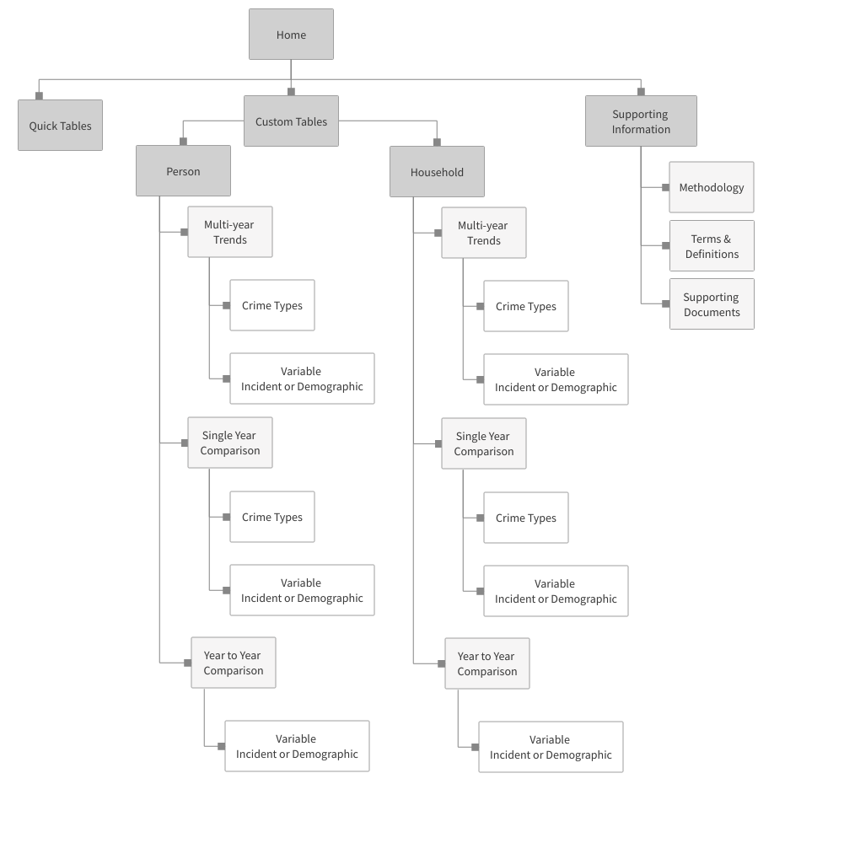
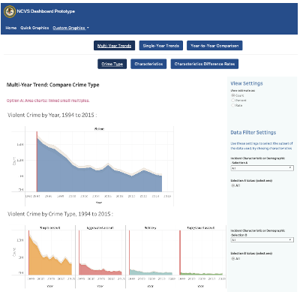
UI/UX problem solving
Wireframing
Iterative mock-ups
Notes:
Early: Wireframing to resolve structure for views- in this case largely steered by the data
Next: Static, interactive mock-ups both charts and page views
Then: User Testing- Helper text
Finally: Review Evaluation for 508 accessibility

Slide 23
Final Product Framework
SAS
Windows Server
Script computes estimates and returns CSVs
Deployment Environment
Dashboard Application
RTI Harness
Notes:
Easily re-run for future years to keep tool current, CDS worked along with RTI’s research computing division worked to ensure smooth deployment, ease of update, building in safeguards against versioning errors

Slide 24
Conclusion

Slide 25
What made this work?
Education on dashboards development & iterative feedback drove key and timely decisions
Bringing in the right team members at the right time allowed us to be agile and meet the needs of our client
User testing allowed us to see the application for the first time again and make improvements
Notes:
All of this was done in an enviro of close collaboration with a client rep who was curious, engaged, and in a position to make decisions
frequent client meetings with developers present, to show progress, weigh options and make incremental decisions along the way. For a creation of a tool like this, screensharing is near-essential.
Bringing in the Right Team Members at the Right Time
Agility to evaluate project needs and add team members as needed
User Testing
Allowed us to see the application through the eyes of a first-time user and make improvements to the overall user experience as a result

Slide 26
The result: A Digital Transformation for the NCVS
Dashboard live in Nov 2021
Data visualization supports communication goals of BJS, modernizing their offerings, and making findings more accessible to a wider audience
The tool is an opportunity for BJS to showcase its transparency, products, and innovation
Notes:
We do believe this is a digital transformation for the NCVS
Live
Supporting their communication goals making their data more accessible to the public

Slide 27
Special Thanks!
Project Team
Chris Krebs
Lynn Langton
Stephanie Zimmer
Ian Thomas
Marcia Underwood
Alex Harding
Alex Giarrocco
Heather Meier
Michael Long
Anna Godwin
Roman Ruiz-Esparza
Chris Townsend
David Henderson
Carl Fisher
Jennifer Wellard
Dean Jackman
JD Bunker
User Testing
Nicole Horstmann
Karen Lissy
Wayne Pitts
508 Testing
Anwar Mohammed
Notes:
Like to give recognition to all in the RTI team members involved
Like to thank the Bureau of Justice Statistics, for engaging us in this work, and Grace Kena for her continuous engagement

Slide 28
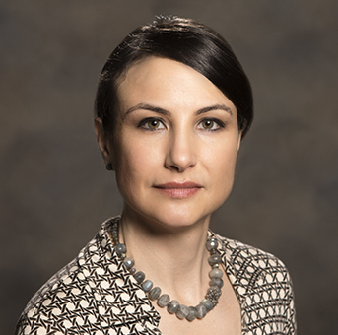
https://ncvs.bjs.ojp.gov/
Thank you!
Additional questions?
Contact:
Marcia Underwood
Senior Web Specialist
RTI International
Center for Data Science
munderwood@rti.org
Notes:
And all in attendance for your interest and time..
Contact info here if you have questions

