Slide 1
Implementing Efficient Data Quality Follow-Up (DQFU) Procedures in Establishment Surveys
FedCASIC Workshop
April 5, 2022
Steve Gomori, Hope Smiley-McDonald, Mai Nguyen
RTI International

Slide 2
Abstract
RTI has developed surveys for many federal studies and very often analyzes the collected data to ensure high data quality. Although web surveys can facilitate high quality data through logic checks, some clients are reluctant to use hard checks or allow for extensive error messaging during the survey. Thus, to improve the quality of collected data while honoring client preferences, RTI has, for multiple studies, implemented a Data Quality Follow-Up (DQFU) process. This process entails an interviewer calling or emailing the respondent with the intent to collect missing or inconsistent responses for the variables in questions. In our presentation, we will describe the technical components that RTI developed to facilitate this follow-up. These tools and processes are critical to ensure high quality data when clients are reluctant or prohibit the use of hard checks within a web survey environment.

Slide 3
Hard Check v Soft Check
Both hard and soft checks are messages presented to the respondent when they try to move on to the next question while the response values on the current question fail some sort of validation.
Both provide a description of the issue with the responses.
A hard check will not allow the respondent to continue until the issue is resolved.
A soft check will give the respondent the option to resolve the issue, or to keep the current response and proceed to the next question.

Slide 4
Why Soft-Checks with DQFU Call instead of Hard-Checks?
It’s a question of potentially irritating a respondent now with hard-checks in the instrument, or potentially irritating a respondent later with a follow-up call. I had asked the reasoning behind this decision. Was it evidence-based?
Research Paper? Dee, P. H. “Title of paper.” 1 April 2020.
Journal Article? Doe, J. (2020). Title of article. Publication, 12(3), 17-21.
“Do what the client wants.” Every project director. Ever.
Notes:
When validation issues are found on a form they are reported to the participant. A soft-check will allow the participant to continue without changing the response. A hard-check will not allow the participant to continue without resolving the issues. We work carefully with the client on the wording of the soft-check messages.

Slide 5
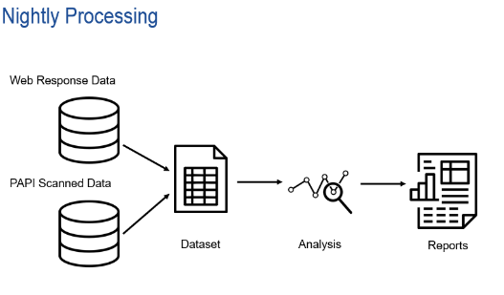
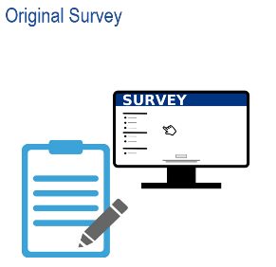
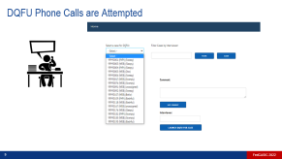
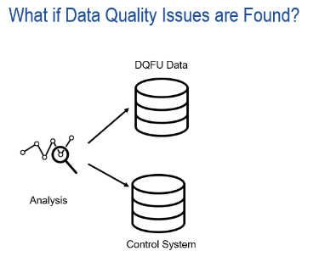

DQFU Process

Slide 6


Original Survey
Survey is self-administered on web with or paper (PAPI).
All validation messages are soft checks.
Intro
A1
…
…
…
…
A21
B1
…
…
…
…
…
B17
C1
…
…
…
…
…
C35
D1
…
…
…
…
…
D33
E1
…
…
…
…
…
E29
F1
…
…
…
…
…
F15
Notes:
PAPI: Pen-and-Paper Personal Interview
Showing a large survey for the purposes of this presentation. Diagram does not account for any skip patterns in the instrument.

Slide 7




Nightly Processing
Nightly job extracts response data and survey metadata into a dataset.
Analysis routines are performed on the data.
Reports are generated.
Web Response Data
PAPI Scanned Data
Dataset
Analysis
Reports

Slide 8
What if Data Quality Issues are Found?
If analysis detects a data quality issue it will prepare the DQFU process for that case.
Variable | Reason
A8 | Missing
A9 | NonRange
C2 | NonRange
C4 | Inconsistent (C2)
C6 | Inconsistent (C2)
C9 | Inconsistent (C6)
C11 | Missing
E1 | Missing
CaseID
99990118
DQFU Data
Information is loaded into the DQFU tables in the survey database.
Information is also loaded into the project’s control system so that DQFU progress and call history can be tracked.
Analysis
Control System

Slide 9
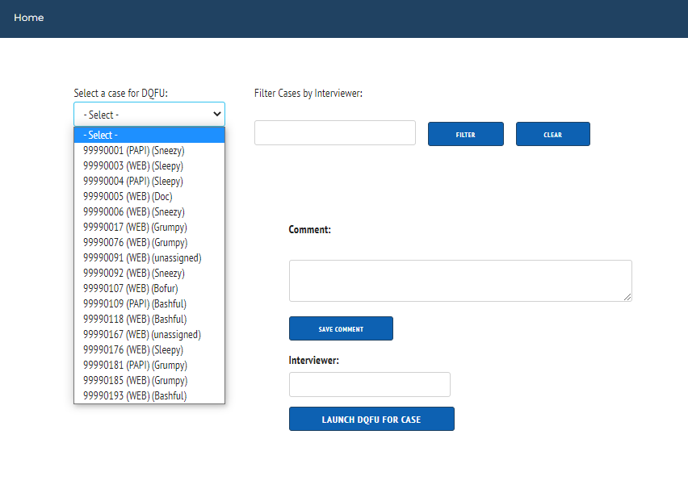

DQFU Phone Calls are Attempted
Notes:
When there was a small number of questions needing DQFU we used email for outreach instead of phone. More cost-effective.

Slide 10
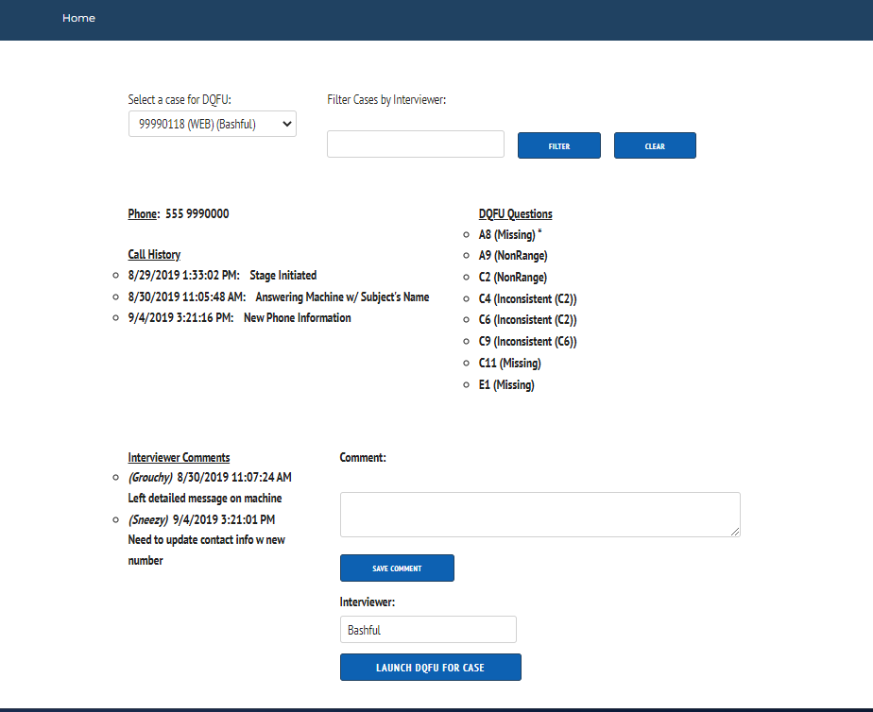

Slide 15

DQFU is Launched for a Case
The DQFU survey is a separate instrument.
Identical variables, options, question text, and validation.
When the “launch DQFU” button is clicked:
Response Data (Original)
Response Data (DQFU)
copy
All response data from the original instrument is copied to the corresponding variables in the DQFU instrument for that case.
There is a check to make sure this does not happen a second time if DQFU is launched again for a case, to resume a break-off for example.

Slide 16
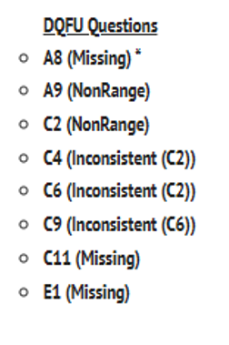
The DQFU Survey
The instrument will start with the next question in the DQFU list for the case (marked with * on the DQFU launch page).
Navigation (the Next button) will take the participant to the next question in the DQFU list.
Intro
…
A7
A8
A9
…
A21
B1
…
B17
C1
C2
C3
C4
C5
C6
C7
C8
C9
C10
C11
C12
…
C35
D1
…
D33
E1
E2
…
E11
…
E29
F1
…
Notes:
It is possible to still have data quality problems after the DQFU

Slide 17
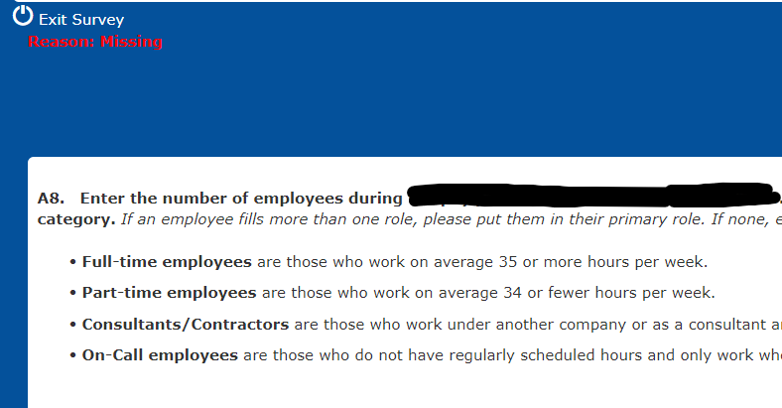
The DQFU Survey
The DQFU reason for each question is displayed on the survey question page.

Slide 18

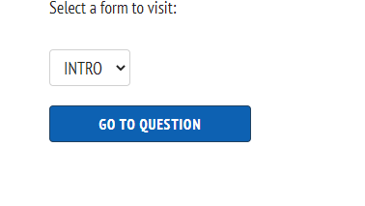
What if the Interviewer Needs to Look at Another Question?
Each form in the DQFU survey has a “Question Index” button.
This button takes you to a web page that lists every question in the instrument.
Can use this page to jump to any question in the instrument where that response to the original survey can be viewed or altered.
Clicking “Next” on that form will navigate to that case’s next question in the DQFU list.

Slide 19
Data Retrieval
We have also applied this process to perform what clients have called “data retrieval of critical items.”
This is a follow-up to respondents who have returned PAPI forms but have provided no responses for items that the client has deemed to be critical. Without these values the survey would not be analyzed.

Slide 20

Thank you
Contact: Steve Gomori | email: sgomori@rti.org Hope Smiley-McDonald | email: smiley@rti.org
Mai Nguyen | email: mnguyen@rti.org

