Slide 1
Adding jQuery, CSS, And HTML Programming To Voxco For Better User Experience
Presenters and Authors: Matthew Bensen, Rebecca Watkins, Melissa Page

Slide 2
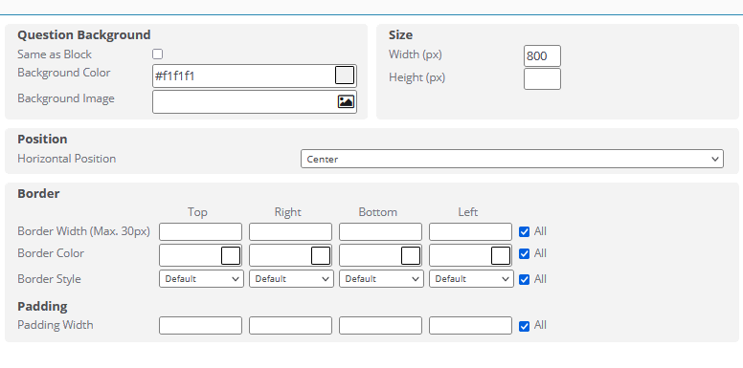
Voxco Provides Look and Feel Options

Slide 3
Enhance Voxco with custom HTML, CSS, and jQuery
Voxco generates its own HTML, CSS, and jQuery
But allows for custom HTML in various places
And custom CSS and JS/jQuery in Look and Feel → Advanced Settings
Notes:
We used custom HTML, CSS, and jQuery to accomplish certain goals that are not possible out-of-the-box in Voxco.

Slide 4



Voxco Allows You to Insert Your Own HTML, CSS, and JavaScript (or jQuery)
HTML
CSS
JS/jQuery
structure
style
dynamic/interactivity
Notes:
Simply: HTML provides the structure of a webpage, like the framing of a house. CSS allows for styling, like painting the walls or hanging curtains. JavaScript is like your dog who notices when someone is at the door and barks or runs around.
jQuery is a JavaScript library that makes coding with JavaScript a bit faster and easier. It is included by Voxco, so we have use of it.

Slide 5
Create Clean Page Presentation
Need: Make it so text doesn’t wrap around the question identifier
Solution:
CSS styling: Use Flexbox

Slide 6
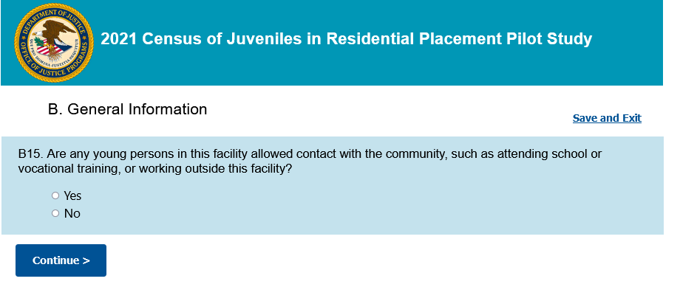

Slide 7
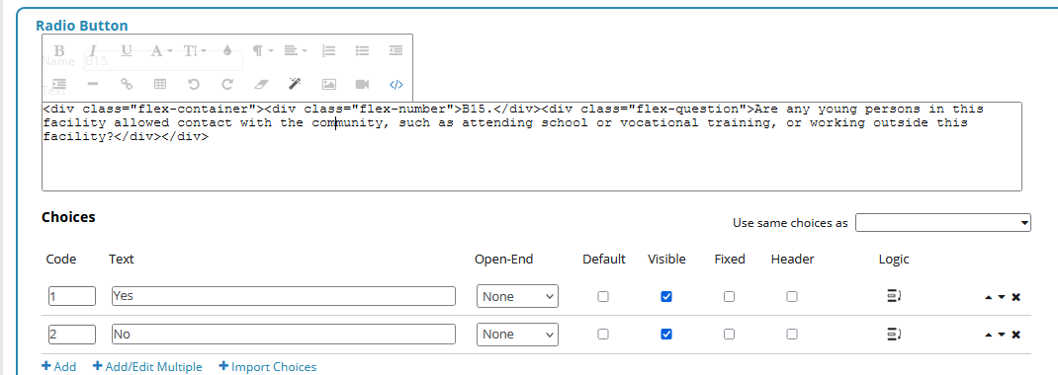

Slide 8
.flex-container {display: flex;}
.flex-number {
flex-grow: 0;
padding-right: 8px;
}
.flex-question {flex-grow: 1;}

Slide 9
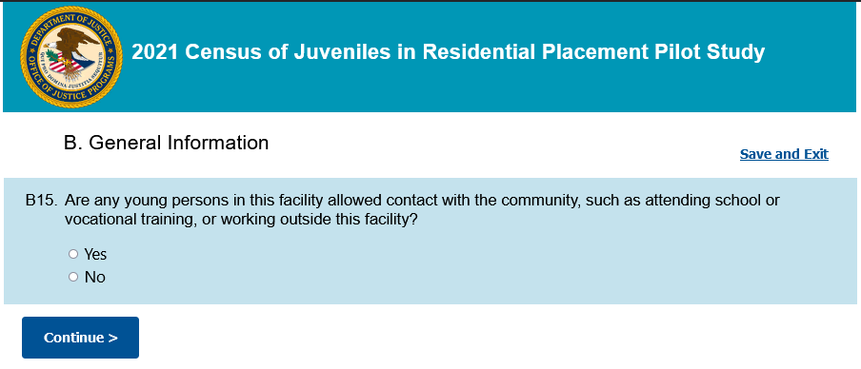

Slide 12
Create Clean Page Presentation
Need: Make it so two questions on a page have a cohesive appearance
Solution: CSS styling

Slide 13
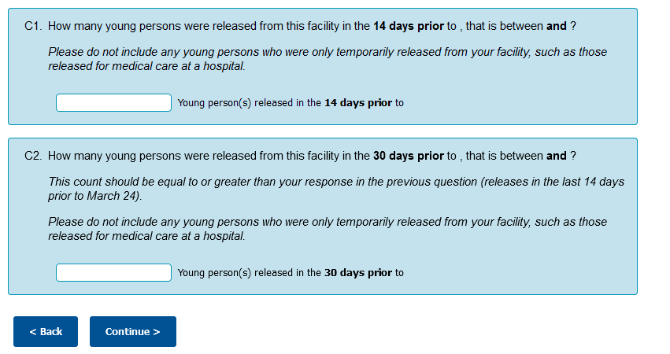

Slide 14
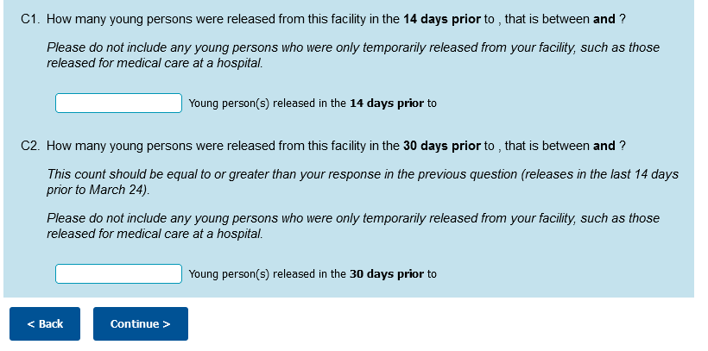

Slide 15
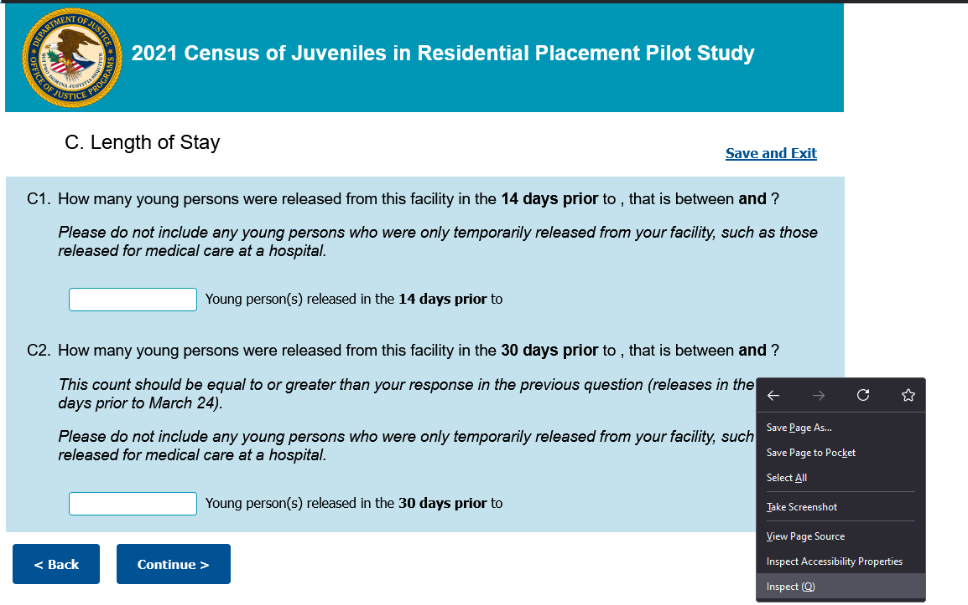

Slide 16
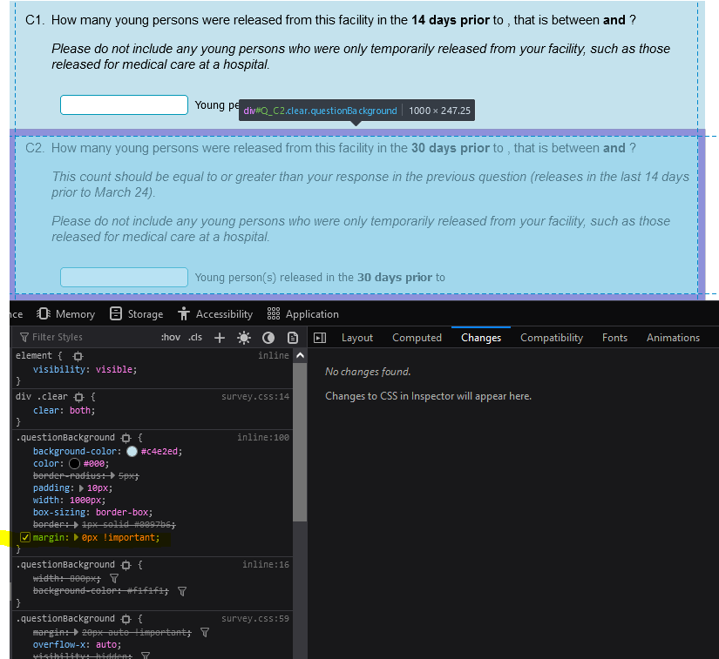

Slide 18
Create Clean Page Presentation
Survey need: Modify position and styling of multiple elements of a complex question
Solution: CSS styling

Slide 19
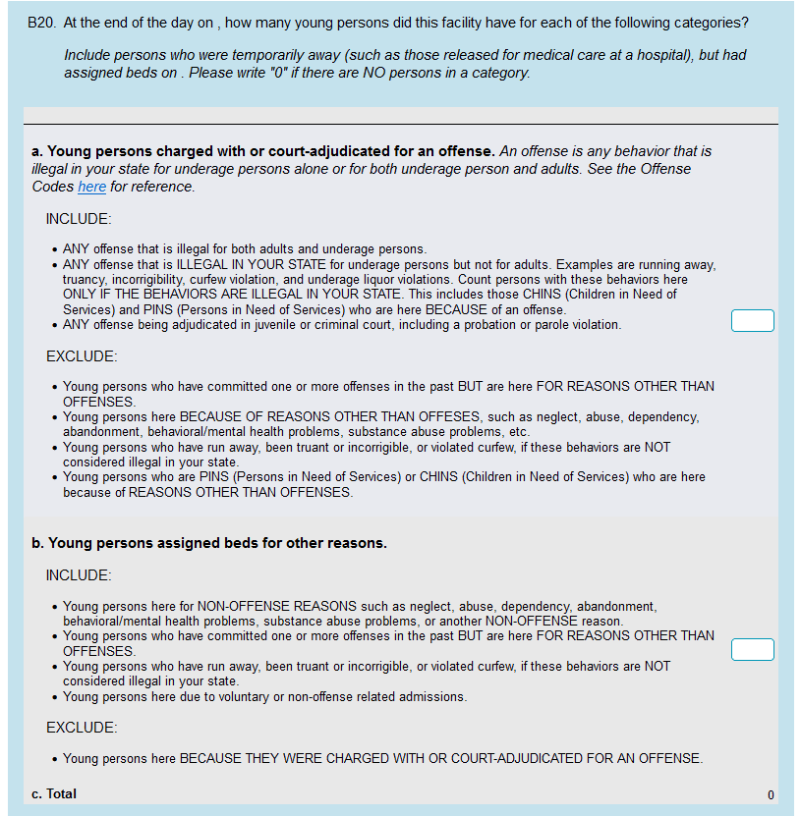

Slide 20







Slide 21
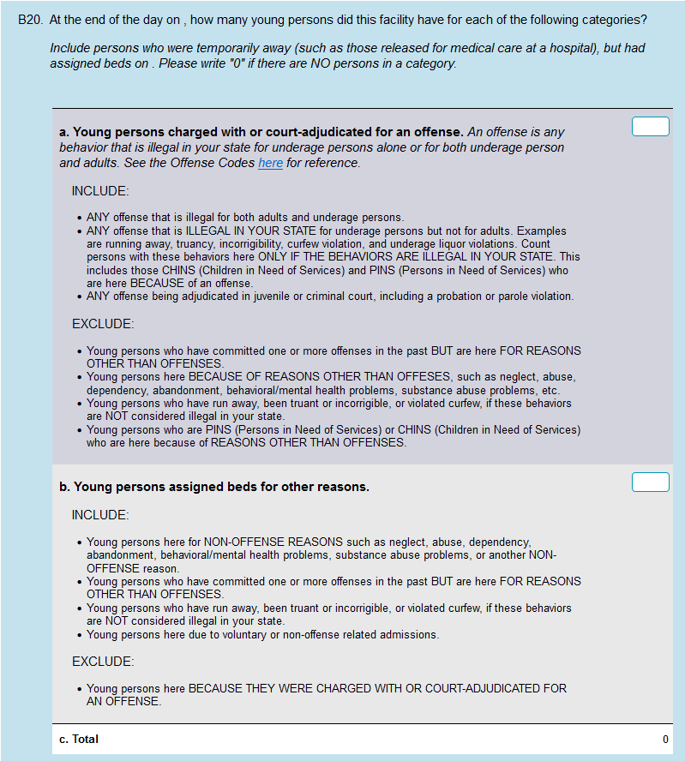

Slide 22
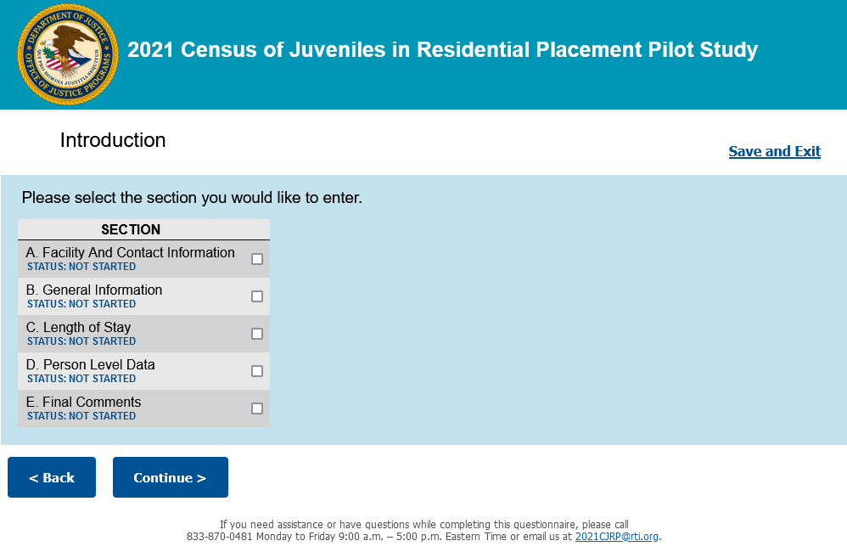
Create a Survey Dashboard
Survey need:
A “dashboard” showing the user:
Survey Sections
Completion status of each section
Buttons to enter the survey at a particular section
Problem:
Voxco provides ways to do two of the three bullets above. It does not allow for button-based navigation; only checkbox selection and use of the Next button.
Solution:
Use Voxco’s scaffolding and modify it with jQuery
Notes:
The client needed a different type of display for one of Voxco’s functionalities.

Slide 23
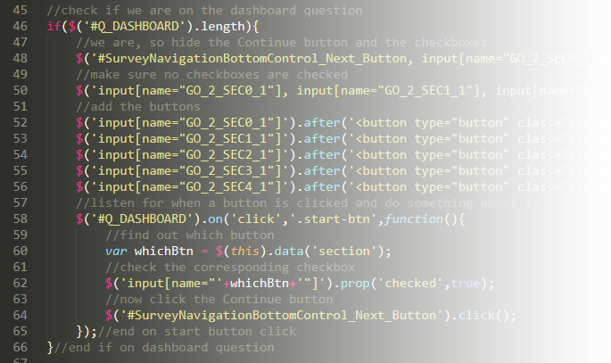
Create a Survey Dashboard
jQuery solution:
Check if it is the dashboard page
Hide the Next button and Section checkboxes
Deselect any selected checkboxes
Create buttons and insert them into the existing
HTML at the right place
When a button is clicked
Check which button it was
Select the corresponding Section checkbox
“Click” the hidden Next button

Slide 24
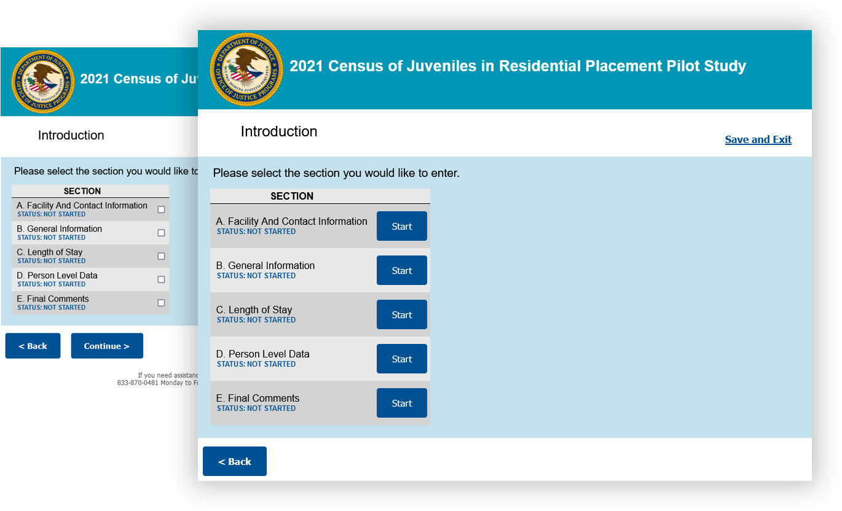

Slide 25
Fix Issue with Dynamic Subtitle
Survey need:
Provide a custom section subtitle
Problem:
When using the back button to enter a previous section, Voxco did not update its subtitle until the second "back" click. Users would see an inappropriate subtitle in some circumstances.
Solution:
Use jQuery to find and fill in the correct section subtitle
Notes:
This was due to the processing code not executing on “back” clicks.

Slide 26
Fix Issue with Dynamic Subtitle
jQuery solution:
Find which question page we are on
Find the subtitle HTML element
Replace its contents with the appropriate subtitle for the page

Slide 27
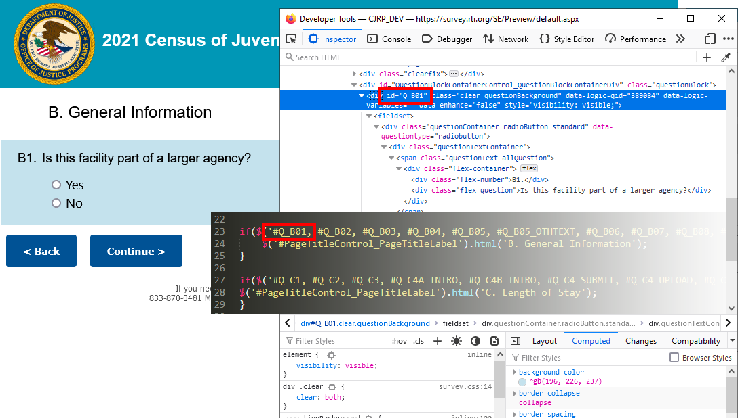

Slide 28
Creating custom tables for displaying key entries from each path through a loop
Survey need:
User-friendly way to review the data entered within each loop
Problem:
Potential for dozens of loops
Solution:
Dynamic tables

Slide 29
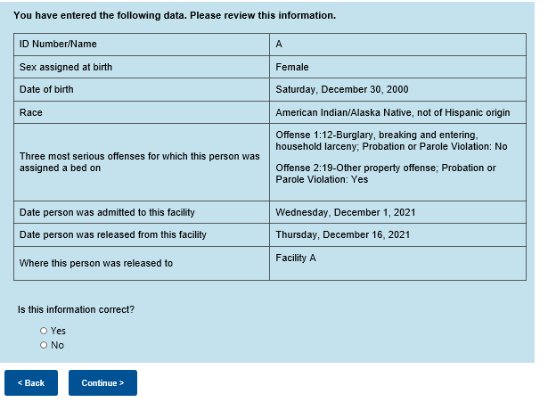
Creating custom tables for displaying key entries from each path through a loop

Slide 30
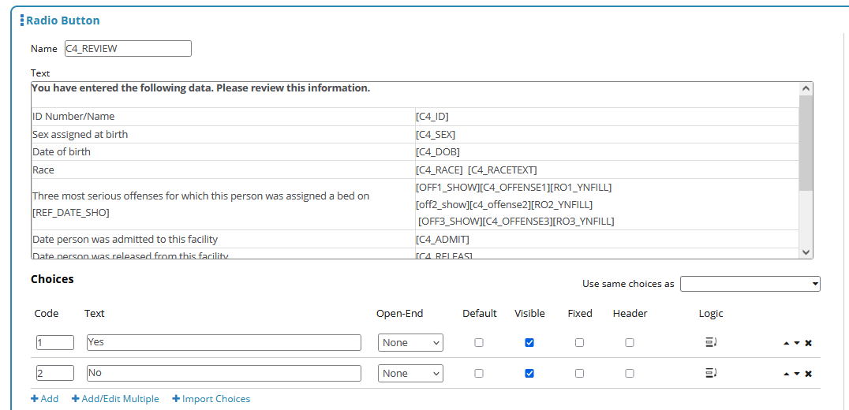
Creating custom tables for displaying key entries from each path through a loop

Slide 31
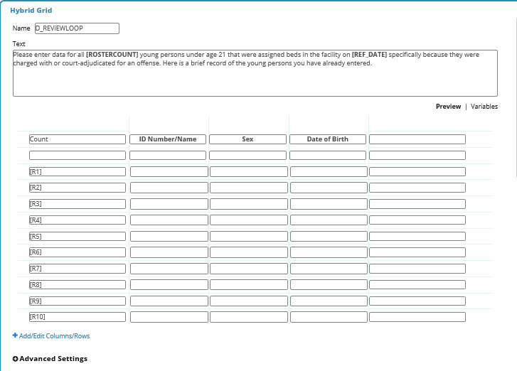

Dynamic Data Display

Slide 32
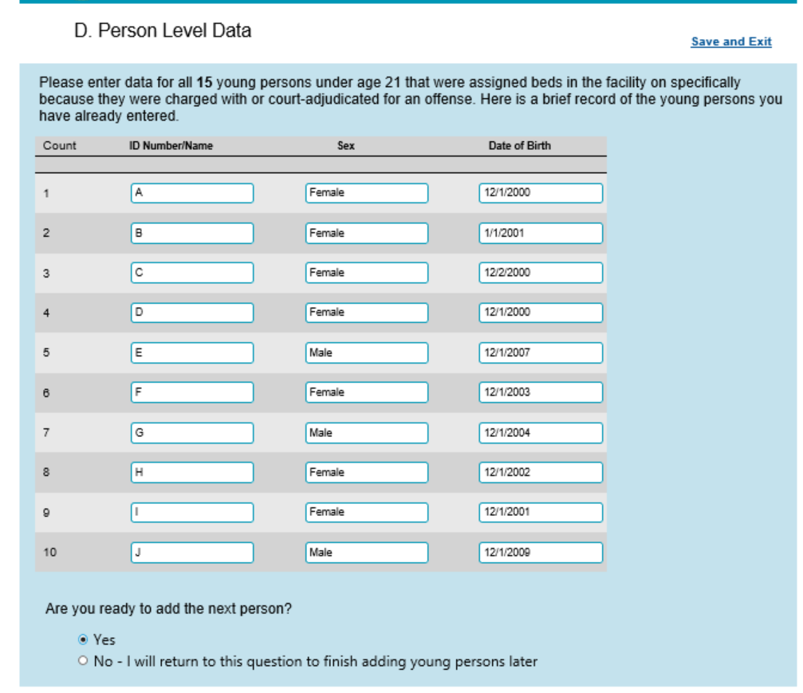
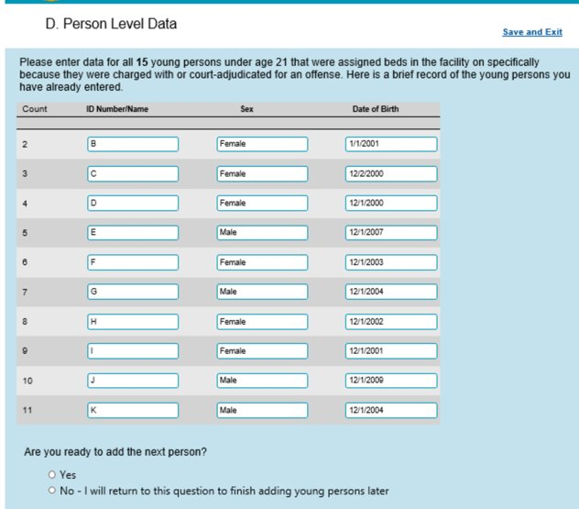
Dynamic Data Display

Slide 33
Summary
You can build upon or modify what Voxco provides through inserting custom HTML, CSS, and JavaScript.
Some simple modifications can greatly improve the experience for respondents.

Slide 34

Thank you
Contact: Matt Bensen| mbensen@rti.org Rebecca Watkins| rwatkins@rti.org Melissa Page| email: mpage@rti.org

