Slide 1

QUE Index: Measuring User Experience of Software Products
Abe George
Program Manager, Customer Experience and Data Science, Office of Information and Technology
U.S. Department of Veterans Affairs
Michael Maas
Senior Research Analyst, Customer Experience and Data Science, Office of Information and Technology
CFI Group

Slide 2
Objective
Measure user experience of software products and websites on factors that are most important for a product’s success.
Product Success Factors
Quality: Functioning of the product
Usability: Easiness of learning and using it
Efficiency: How the product impacts the efficiency of the user’s work

Slide 3
Common Methodologies: Net Promoter Score
ADVANTAGES
DISADVANTAGES
Use of a single question: “How likely is it that you would recommend Product X to a friend or colleague?”
Follow-up open-ended question for detailed feedback
Most popular methodology
Not applicable within government and other places where product choices are restricted
Score calculation considers only “promoters” and “detractors” and ignores the “passives”
Overall score cannot be split into attribute scores

Slide 4
Common Methodologies: Customer Effort Score
ADVANTAGES
DISADVANTAGES
Use of a single question on customer effort
Measures the effort customer had to exert to use a product or get a service
May follow-up with open-ended question for detailed feedback
Measures only the effort customer had to exert to use a product or get a service
Overall score cannot be split into attribute scores

Slide 5
Common Methodologies: System Usability Scale
ADVANTAGES
DISADVANTAGES
Has been in use for several years
Used in government and industries
Ten questions
Multiple questions “appear” similar
Cannot get scores for individual product attributes

Slide 6
QUE Index: A New Measure
Quality: Functioning of the product
“Product X functions in a high-quality and responsive manner.”
Usability: Easiness of learning and using it
“Product X is easy for me to learn and use.”
Efficiency: How the product impacts the efficiency of the user’s work
“Product X helps me to work more efficiently to achieve my goals.”
Open-Ended Question (optional)
“Please explain the reasons for the ratings you have given above”
Five-point Likert Scale Questions
1 (Strongly disagree) to 5 (Strongly agree)

Slide 7
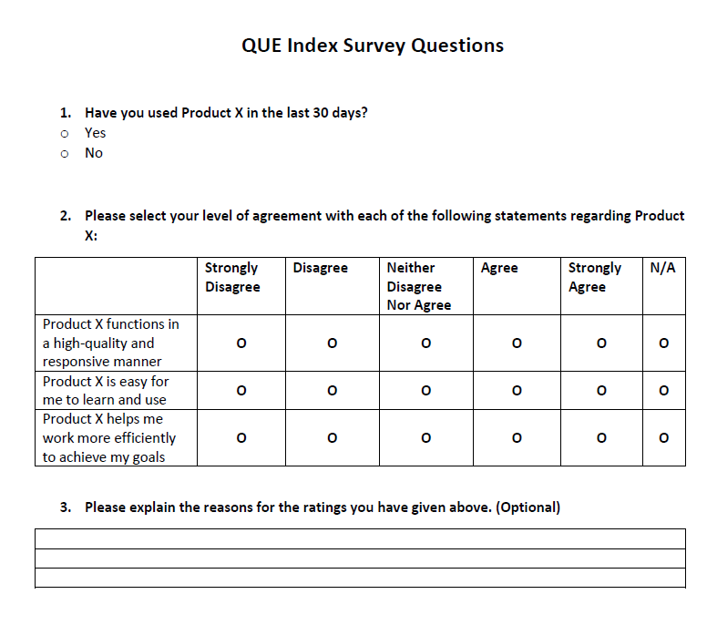
Survey Form

Slide 8
Calculations
Item Scores and QUE Index will range from 20 to 100
QUE Index = Weighted average (Quality Score, Usability Score, Efficiency Score)
Item Score = ((% Strongly Disagree x 1) + (% Disagree x 2) + (% Neither disagree nor agree x 3) + (% Agree x 4) + (% strongly agree x 5)) /5
QUE Index Value | Product Assessment
80 to 100 | Excellent
70 to < 80 | Very Good
60 to < 70 | Acceptable, Need Improvement
50 to < 60 | Poor, Need Improvement
Below 50 | Unacceptable

Slide 9




Applications and Uses
Baseline Measurement and Trend Analysis
Product Maturity Analysis
Requirements Gathering for Product Improvement
Return on Investment Analysis

Slide 10
Appendix-1
System Usability Scale (SUS) Questions:
I think that I would like to use this Product X frequently.
I found the Product X unnecessarily complex.
I thought the Product X was easy to use.
I think that I would need the support of a technical person to be able to use this Product X.
I found the various functions in this Product X were well integrated.
I thought there was too much inconsistency in this Product X.
I would imagine that most people would learn to use this Product X very quickly.
I found the Product X very cumbersome to use.
I felt very confident using the Product X.
I needed to learn a lot of things before I could get going with this Product X.

