Slide 1
Use Machine Learning Approach to Evaluate Interviewer Performance
Hanyu Sun, Ting Yan, Westat
Notes:
Good morning. I’m going to present how to use a machine learning pipeline that we developed at Westat to detect interviewer falsification and monitor interviewer behaviors. First, I’d like to thank Dr. Ting Yan for her contribution to the project.

Slide 2
Background
Computer-Assisted Recorded Interviewing (CARI) has long been used by survey organizations to monitor interviewer performance (e.g. Hicks et al. 2010, Thissen 2014)
  Interviewer performance
  Question evaluation
Previous research has found that providing feedback to interviewers based on CARI was effective at improving interviewer performance (Edwards, Sun, and Hubbard 2020)
Notes:
Computer-Assisted Recorded Interviewing (CARI) has long been used by survey organizations to monitor interviewer performance.
CARI produces question-level audio recordings that capture the interactions between the interviewer and the respondent. It can be used to monitor interviewer performance as well as question assessment.
Previous research has found that providing feedback to interviewers based on CARI was effective at improving interviewer performance (Edwards, Sun, and Hubbard 2020).

Slide 3
Conventional CARI Coding (1)
A coder first listens to the audio recording of the interactions between the interviewer and the respondent, and then evaluates and codes features of the question-and-answer sequence using a pre-specified coding scheme
  Interviewer falsification: how likely the interviewer fabricated the whole or part of the interview
  Interviewer performance: how closely the interviewer followed the standardized interviewing protocol
Coding of question-level recordings are aggregated to provide respondent-level or interviewer-level evaluations
Interviewers who are identified to have deviated substantially from the standardized interviewing protocol are called out for intervention
Notes:
Conventionally, a coder needs to first listen to the audio recording of the interactions between the interviewer and the respondent, and then evaluate and code features of the question-and-answer sequence using a pre-specified coding scheme.
The coding scheme is often designed to identify interviewer falsification by asking coders to indicate how likely the interviewer fabricated the whole or part of the interview.
Also, coders are asked to assess how closely the interviewer followed the standardized interviewing protocol, such as whether or not the interviewer read the question verbatim and whether or not the interviewer probed in a non-leading way.
Coding of question-level recordings are aggregated to provide respondent-level or interviewer-level evaluations. Interviewers who are identified to have deviated substantially from the standardized interviewing protocol are called out for intervention.

Slide 4
Conventional CARI Coding (2)
Time consuming and labor intensive
  High cost for behavioral coding
  Often a sample of cases are selected for coding per interviewer
  Often only a small number of questionnaire items are selected for coding across interviewers
Preliminary findings:
  Sun, Yan and Rivero (2021)
  Sun, Rivero and Yan (2019)
Notes:
Although it is an effective tool, the conventional CARI coding tends to be labor intensive and time consuming.
In practice, often a small proportion of completed interviews or a selected group of questionnaire items are coded and evaluated in a timely manner due to resource constraints.
We presented preliminary findings about the CARI ML pipeline at previous AAPOR. This time we present findings from a complete analysis.

Slide 5
CARI Machine Learning Pipeline
Dual goals:
  Processing 100% of the recorded interviews in real time with low cost
  Prioritizing coding of cases at a high risk of being falsified and interviewers with undesirable behaviors
Question-level Recording
Diarization
Speech-to-text
Number of speakers
Notes:
To achieve the goals of processing 100% of the recorded interviews in real time with low cost as well as prioritizing coding of cases at a high risk of being falsified and interviewers with undesirable behaviors, we developed a CARI machine learning (ML) pipeline to efficiently process audio recordings, facilitating interviewer monitoring in field data collection. There are existing APIs on speech recognition in the market. However, as we know audio recordings of field interviews often contain PIIs. For data security purposes, we keep the audio recordings in house and developed the pipeline in house.
As shown in the figure, the CARI ML pipeline includes two component processes: speaker diarization and speech-to-text. The speaker diarization process determine who spoke at which turn in a question-level audio recording. At the end of the diarization process, the number of different speakers is output for each question-level audio-recording.The speech-to-text process transcribes conversations at turn-level. The turn-level transcript is subsequently compared to the exact question wording from the survey instrument, producing several distance measures on lexical and semantic similarities.

Slide 6
CARI Machine Learning Pipeline
Interviewer falsification:
  Outcome measure: Number of speakers detected
  Recordings with 0 or 1 speaker detected are flagged as falsified interviews whereas recordings with 2 or more speakers detected are considered not falsified
Interviewer question reading behavior:
  Outcome measures: lexical distance, semantic distance
  All range from 0 to 1 with 0 meaning the transcript and the survey question wording are exactly the same and 1 indicating they are completely different
Notes:
We measured the interviewer falsification by the number of speakers detected during diarization. Recordings that are detected to have 0 or only 1 speaker are considered to be at a risk of interviewer falsification.
Regarding the interviewer question reading behavior, the distance measures produced from the speech-to-text component are used to evaluate interviewer question reading behaviors. These distance measures all range from 0 to 1 with 0 meaning the transcript and the survey question wording are exactly the same and 1 indicating they are completely different. The larger distance measure suggesting that interviewers are more likely to not read questions exactly as worded.

Slide 7
CARI ML Pipeline Performance Evaluation
Mock interview recordings
Field interview recordings
Notes:
We evaluated the performance of the CARI ML pipeline on recordings from both mock interviews conducted in a laboratory settings and actual in-person interviews from a national study.
We used mock interviews to test how feasible it is to process recordings using the pipeline.
After that, we used actual interviews to explore how the pipeline performs in a real world setting in which the recording quality varies substantively by case.

Slide 8
Mock Interview Recordings: Data and Methods
The true status of falsification and interviewer question reading behaviors are known
Script | Interviewers instructed to falsify | Number of Speakers Involved | Interviewers instructed to read questions | Number of question-level recordings
1 | No | 2 | Exactly as worded | 6
2 | No | 2 | Exactly as worded | 6
3 | No | 2 | Exactly as worded | 6
4 | No | 2 | Minor wording change | 6
5 | Yes | 1 | -- | 2
6 | No | 2 | Major wording change | 6
7 | Yes | 1 | -- | 2
Total | -- | -- | -- | 34
Notes:
As a feasibility testing, we applied the CARI ML pipeline to 34 mock interview recordings that were produced in a laboratory setting. For these recordings, interviewers and respondents were instructed to follow seven scripted question-and-answer interaction. In two scripts (scripts 5 and 7), interviewers were instructed to ask a survey question and answer that question themselves. In other words, interviewers truly fabricated the answers. Also, interviewers were instructed to read questions exactly as worded in 3 scripts, made minor wording change in one script, and made major wording changes when reading the survey question in script 6. The deviations were scripted so that they were the same across interviewers.
Two female interviewers were recruited to conduct the mock interviews. One of them is a native speaker of American English; she conducted interviews with three respondents (one native speaker and two non-native speakers), producing a total of 29 question-level recordings. The second interviewer is a non-native speaker and interviewed a respondent who is also non-native speaker, producing 5 question-level recordings.
Across these recordings, we manipulated features that are known to affect the quality of speech recognition, such as, the presence of background noise and the respondent’s distance to the digital voice recorder. In addition, this design allows us to explore how native vs. non-native speakers affect the performance of the speech-to-text component of the pipeline. All recordings were produced using the same digital voice recorder in a conference room on the same day.

Slide 9
Mock Interview Recordings: Findings (1)
4 recordings were truly interviewer falsification and all four are flagged as falsified interviews
30 recordings truly had two speakers:
  18 detected as of 2 or 3 speakers
  12 detected as of 1 speaker
    10 with non-native speakers
    1 with background noise
    1 with the respondent sat further away from the microphone
 | True number of speakers involved in recording
Number of speakers detected by pipeline | 1 | 2
1 | 4 | 12
2 + | 0 | 18
Total | 4 | 30
Notes:
We first examined how the CARI ML pipeline works in detecting interviewer falsification. This table displays the number of speakers detected by the pipeline in comparison to the true number of speakers actually involved in each recording. For the purpose of interviewer falsification, recordings with 0 or 1 speaker detected are flagged as falsified interviews whereas recordings with 2 or more speakers detected are considered not falsified.
As descripted earlier, four recordings were truly interviewer falsification and all four recordings are flagged as falsified interviews. Furthermore, 30 recordings truly had two speakers. However, the pipeline detected 2 or 3 speakers for 18 of them and one speaker for 12 recordings.
We further examined these 12 recordings to better understand why the pipeline only detected one speaker. In 9 recordings, the interviewer was a native speaker but the respondent was a non-native speaker. In 1 recording, both the interviewer and the respondent were non-native speakers. The pre-trained models used by the pipeline were developed and trained on a corpus of audio recordings in English. It is not surprising that the diarization process of the pipeline did not seem to work well for recordings involving non-native speakers.
For the remaining 2 recordings where the pipeline failed to detect two speakers, both the interviewer and the respondent were native speakers but there was either background noise in the recording or the respondent sat further away from the digital recorder microphone (i.e. far-field microphone). It is well documented that background noise and far-field microphones affect the performance of diarization.
Even though the CARI ML pipeline did not detect the correct number of speakers for all 34 recordings, it did correctly identify 4 falsified recordings as falsified and 18 non-falsified recordings as non-falsified.

Slide 10
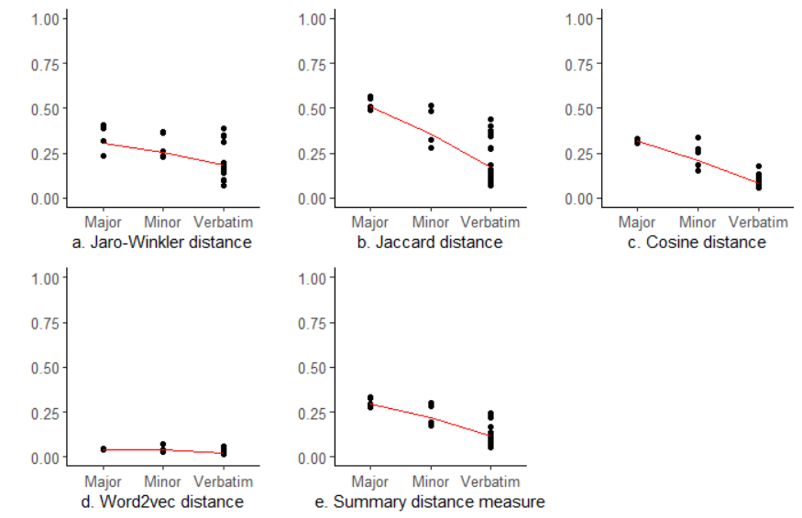
Mock Interview Recordings: Findings (1)
Plotted distance measures for all recordings by how interviewers actually read the survey questions:
  0 = Verbatim
Consistent pattern in the expected direction for all 3 lexical distance measures:
  Verbatim < Minor wording changes < Major wording changes
No differences between the actual question reading behaviors for the semantic distance
Summary distance measure (average of the four measures) is in the expected direction
Notes:
Next, we examined the performance of the CARI ML pipeline in assessing whether the interviewer read the question exactly as worded. This figure plots the four distance measures for all 34 recordings by how interviewers actually read the survey questions in the recordings. The red line shows the means of distance measures for recordings in each group. As stated earlier, the closer the distance measures are to 0, the more likely the interviewer read the question verbatim.
As shown in the figure, the mean of distance scores is closer to 0 for recordings in which the interviewer read the question verbatim and is smaller than that for recordings in which interviewers made minor wording changes, which is smaller than that for recordings in which interviewers made major wording changes. The pattern is consistent across the three distance measures that only compared on words used. The distance score that compares meanings didn’t seem to differentiate by actual question reading behavior (panel d of this figure).
We then created a summary distance measure by taking an average of the four distance scores for each recording and plotted the summary distance measure in panel e of the figure. We see the same downward line, indicating that the summary distance measure is able to differentiate interviewer question-answer behaviors.
Overall, the findings suggest that the CARI ML pipeline is a feasible approach to process question-level recordings.

Slide 11
Field Interview Recordings: Data and Methods (1)
1182 recordings of question-answer sequences from a large-scale cross-sectional study of a nationally representative sample
  All recordings were from 53 in-person interviews conducted by four field interviewers (three females and one male)
All recordings went through conventional CARI coding by having coders listen to the actual recordings using a behavior coding scheme
Notes:
To examine how the CARI ML pipeline works for recordings of interviews in actual data collection, we selected 1182 recordings of question-answer sequences from a large-scale cross-sectional study of a nationally representative sample. These recordings were from 53 in-person interviews conducted by four field interviewers (three females and one male). All recordings went through conventional CARI coding by having coders listen to the actual recordings using a behavior coding scheme.

Slide 12
Field Interview Recordings: Data and Methods (2)
Used the coder judgment to determine the number of speakers in the question-level recording
  How clearly can you hear the interviewer/respondent in the recording? (Very clearly, somewhat clearly, not very clearly, and cannot hear the interviewer/respondent)
    0 if neither the interviewer nor the respondent can be heard
    1 if either the interviewer or the respondent can be heard very clearly, somewhat clearly, or not very clearly
    2 if both the interviewer and the respondent can be heard very clearly, somewhat clearly, or not very clearly
Used the coders’ judgement to determine whether the interviewer maintained question meaning in the recording
  Did the interviewer maintained the question meaning? (Yes, No, Unclear)
Notes:
Coders were asked to indicate how clearly they can hear the interviewer and the respondent in the question-level recording by selecting one of the four options: very clearly, somewhat clearly, not very clearly, and cannot hear the interviewer/respondent. We used the coder judgment to determine the number of speakers in the question-level recording. The number of speakers is 0 if neither the interviewer nor the respondent can be heard. The number of speakers is 1 if either the interviewer or the respondent can be heard very clearly, somewhat clearly, or not very clearly. And the number of speakers is 2 if both the interviewer and the respondent can be heard very clearly, somewhat clearly, or not very clearly.
Coders were also asked to evaluate whether or not the interviewer maintained the question meaning by selecting yes, no, or unclear. We used the coders’ judgement to determine whether the interviewer maintained question meaning in the recording. If the coder selected yes, the interviewer maintained the meaning; whereas, if the coder selected no, the interviewer did not maintain the meaning.

Slide 13
Field Interview Recordings: Data and Methods (3)
Interviewer | Number of interviews | Number of question-level recordings | Number of recordings with 2 speakers (coder) | Number of recordings with question meaning maintained (coder)
1 | 3 | 60 | 30 | 54
2 | 26 | 615 | 559 | 552
3 | 9 | 172 | 152 | 130
4 | 15 | 335 | 299 | 282
Total | 53 | 1182 | 1040 | 1018
Recordings in which the coder could not hear the interviewer, the interviewer did not read the question, or coder selected unclear whether the interviewer maintained the question meaning were not included in the analysis
Notes:
This table presents the information about the 1182 recordings. As noted earlier, recordings in which the coder could not hear the interviewer, the interviewer did not read the question, or coder selected unclear whether the interviewer maintained the question meaning were not included in the analysis.

Slide 14
Field Interview Recordings: Findings (1)
142 recordings have either 0 or 1 speaker according to coders:
  111 detected as of either 0 or 1 speaker
  31 failed to be detected:
    Background noise such as music played in the background, loud static noise, and loud keyboard typing sound
Falsely flagged as falsified 323 (out of the 1040) recordings where coders indicated that there were 2 speakers:
  known features to affect diarization, such as overlapping speech and the respondent having a softer voice than the interviewer
 | Number of speakers by coder coding
Number of speakers detected by pipeline | 0 or 1 | 2
0 or 1 | 111 | 323
2 + | 31 | 717
Total | 142 | 1040
Notes:
We first examined how the CARI ML pipeline works in detecting falsification for question-level field interview recordings. This table presents the true and detected number of speakers in the question-level recordings. As shown in the table, 142 recordings have either 0 or 1 speaker according to CARI coding and the CARI ML pipeline successfully detected 111 of them as having either 0 or 1 speaker. In other words, the pipeline correctly flagged 78% of falsified recordings as falsified. As to the 31 recordings that the pipeline failed to flag as falsified, most of them had background noise such as music played in the background, loud static noise, and loud keyboard typing sound.
The CARI ML pipeline falsely flagged as falsified 323 (out of the 1040) recordings where CARI coding indicated that there were 2 speakers. We reviewed these recordings and noticed that most of the recordings include features that are known to affect diarization, such as overlapping speech and the respondent having a softer voice than the interviewer.

Slide 15
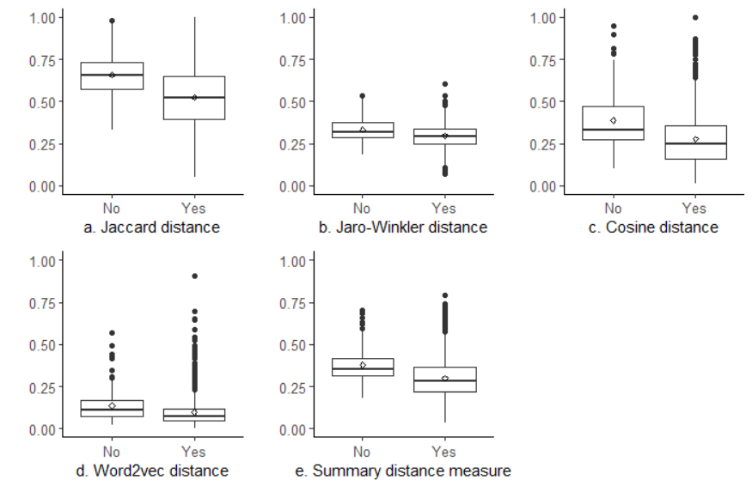
Field Interview Recordings: Findings (2)
All distance measures in the expected direction:
  Maintained < Did not maintain the question meaning
Notes:
Next, we examined the performance of the CARI ML pipeline in assessing whether the interviewer read the question exactly as worded. As shown in the figure, recordings in which the interviewer maintained the question meaning tend to have lower distance measures as compared to recordings in which the interviewer did not maintain the question meaning. As stated earlier, the closer the distance measures are to 0, the more likely the interviewer read the question verbatim. The effects are in the expected direction.

Slide 16
Field Interview Recordings: Findings (3)
Projects often monitor interviewer performance at case level or interviewer level
Interviewer falsification:
  Percent of either 0 or 1 speaker detected at the case level
Performance issues:
  Examine the distributions of the distance measures at the case level or interviewer level
Empirical question as what threshold to use:
  Lower threshold -> more cases to code by coders
Threshold (% 0 or 1 speaker detected) | Interviewer | Number of cases to review
50% | 1 | 1
 | 2 | 4
 | 3 | 2
 | 4 | 1
90% | 1 | 0
 | 2 | 1
 | 3 | 0
 | 4 | 0
Notes:
The purpose of using the CARI ML pipeline is to screen for cases or interviewers that require further investigation, such as, conducting the conventional CARI coding and contacting the interviewer for one-on-one follow-up. We aggregated the recording-level data to case-level and then interviewer-level to demonstrate how such information can be used to monitor interviewer performance.
Regarding suspected falsification, the project team can use the percent of either 0 or 1 speaker detected at the case level to select cases for conventional CARI coding. However, it is an empirical question as what threshold to use. The lower the threshold is, the more cases will be selected for the conventional CARI coding. As shown in Table , if we use 90% as the threshold, only 1 out of the 53 cases would be selected for review. But if we use 50% as the threshold, 8 out of 53 cases would be selected for review.
Similarly, regarding undesirable behaviors, the project team can examine the distributions of the distance measures to determine which case or which interviewer for further investigation.
Depends on the project budget and timeline, customized thresholds can be used to select cases or interviewers for further investigation.

Slide 17
Summary and Discussion
Robust performance at detecting the number of speakers to identify suspected falsifications
Robust performance at producing distance measures to assess how likely the interviewer read verbatim
More efficient and effective interviewer monitoring
  Step 1: 100% of the recorded interviews are processed
  Step 2: The conventional CARI coding is performed on the most problematic interviewers or cases to increase the likelihood of capturing undesirable behaviors to a great extent
Notes:
As a summary, we observed robust performance of the CARI ML pipeline at detecting the number of speakers to identify suspected falsifications as well as producing distance measures to assess how likely the interviewer read the question exactly as worded.
The goals of interviewer monitoring is to identify falsifications or undesirable interviewer behaviors as early as possible to either remove the falsifiers from data collection immediately or correct the undesirable behaviors in time. In reality, due to high cost, the project team often selects a random sample of completed cases for conventional CARI coding. Because it is a random sample, both good and bad cases are equally likely to be selected for coding. The real benefit of using the CARI ML pipeline is to process recorded interviews in real time to screen for interviewers or cases that are most likely to be problematic for the conventional CARI coding. This translates to more efficient and effective interviewer monitoring – 100% of the recorded interviews are processed and the conventional CARI coding is performed on the most problematic interviewers or cases to increase the likelihood of capturing undesirable behaviors to a great extent.

Slide 18
Future Research
Use the CARI ML pipeline to evaluate question performance, such as,
  Question-level transcript that deviates from the “paradigmatic” question-answer sequence may indicate respondent confusions
  How question characteristics affect the pipeline performance
Exploring which distance measure is more sensitive under certain circumstances

Slide 19
Thank You
Hanyu Sun
hanyusun@westat.com
Photos are for illustrative purposes only. All persons depicted, unless otherwise stated, are models.

