Slide 1
Analyzing 2020 Census Audio Recordings: A machine learning approach
Joanna Fane Lineback and Elizabeth Nichols
U.S. Census Bureau
Brian F. Sadacca
Accenture Federal Services
Federal Computer Assisted Survey Information Collection (FedCASIC) Workshop
April 5-6, 2022
The views expressed are those of the authors and not necessarily those of the U.S. Census Bureau.
CBDRB-FY22-CBSM002-020
Notes:
Hello. My name if Fane Lineback and I work at the U.S. Census Bureau. Today I’m going to talk about using a machine learning approach to analyze 2020 Census audio recordings. I would like to acknowledge my coauthors – Beth Nichols, also from the Census Bureau, and Brian Sadacca, the lead data scientist on this project, who works for Accenture Federal Services.

Slide 2
Outline
Background
Objectives
Approach
Findings
Next steps
Notes:
I’ll start with some background information on the 2020 Census and the related Census Questionnaire Assistance operation. Then I’ll talk about project objectives and the methodological approach. Following this, I will share some preliminary findings and conclude with some next steps.

Slide 3
2020 Census
Short questionnaire
Primarily online using internet self-response instrument (ISR)
-> available in 13 languages
Other modes of data collection:
Mail
In-person
Phone
Census Questionnaire Assistance (CQA):
For questions
Respond over the phone
Notes:
Starting in March 2020, households across the country were invited to participate in the 2020 Census. The Census consisted of a short questionnaire asking household size and a handful of demographic questions about household members. It was conducted primarily online using an internet self-response instrument, or ISR, which was available in 13 languages. Other modes of data collection included mail, in-person, and phone. For help with the Census or to report over the phone, respondents interfaced with the Census Questionnaire Assistance, or CQA, operation, which is the focus of this talk.

Slide 4
2020 CQA Operation
Number of recordings | Language
5,156,000 | English
412,000 | Spanish
54,500 | Puerto Rican Spanish
11,500 | Mandarin
8,600 | Cantonese
8,000 | Vietnamese
7,500 | Korean
7,200 | Russian
5,700 | Puerto Rican English
4,300 | Arabic
3,200 | Haitian Creole
2,600 | Portuguese
2,500 | Tagalog
2,100 | Japanese
2,000 | Polish
1,500 | French
Interactive Voice Response (IVR)
Customer Service Representatives (CSRs)
11 call centers, 7,300 CSRs
With permission, calls were recorded
-> about 5.7 million audio recordings
Notes:
A little more about the CQA process. The majority of CQA calls were handled by an Interactive Voice Response (IVR) system that provided broadcast messaging with time-relevant information aligned with 2020 Census milestones. The IVR also included a self-service portion where answers to frequently asked questions (FAQs) could be found by navigating menus. If callers had additional questions not addressed within the IVR, they could request to speak to a customer service representative, or CSR, to get further information or, as mentioned, to complete the census questionnaire over the phone. These callers whose questions were not resolved in the IVR were routed to one of 11 call centers and one of roughly 7,300 CSRs. With callers’ permission, the calls were recorded, which resulted in about 5.7 million audio recordings of interactions between callers and CSRs. As seen in the table, the vast majority, about 5.5 million, or 98%, of these calls were in English and Spanish. The remaining 61,000 calls were conducted in a language other than English or Spanish.

Slide 5
Objectives
Project long-term objective: Using CQA audio, develop machine learning models that can be used to enhance overall call experience for callers and CSRs.
Today’s objective: Share progress to date
Notes:
For well over a year now, we have been prepping and analyzing the CQA audio recordings with the long-term objective of using the CQA data to develop models for enhancing the overall call experience for callers and CSRs. Specifically, we want to add more automation and real-time decision making. Today’s objective in these 15 minutes is to summarize our progress to date.

Slide 6
Operational goals
Flag difficult calls
Identify features of negative calls
Track sentiment dynamics
Label call dispositions
Search FAQs
Identify new FAQs
Call sentiment
Call topic
Notes:
How will we tie the larger objective of enhancing the overall call experience back to the CQA operation? Well, we’ve identified the following goals which can further be subdivided into two areas - those having to do with call sentiment and those having to do with call topic, with some overlap.
Notice that the first three bullets here have a lot to do with tone of the call. We’d like to be able to flag difficult calls, identify features of negative calls, and track sentiment dynamics. One can imagine that this information could be used, for instance, to alert a supervisor to an escalating situation. It also could be used, for instance, to reward CSRs for successfully handling negative calls.
On the other hand, these next three bullets have more to do with the call topic. We’d like to automatically label call dispositions, increase automation of the FAQ search, and identify in near real time new FAQs. These serve several purposes such as speeding up calls and more quickly identifying emerging issues with the Census or the CQA operation itself.

Slide 7
Approach
Pre-process audio
Use natural language processing (NLP) and other machine learning models:
Transcribe audio to text
Emotion recognition
Topic modeling
Notes:
At a high level how are we approaching this? Before we could do anything else, we had to format the audio, which I’ll briefly talk about. Once we did this, we used natural language processing and other machine learning models to transcribe the data. So far, this has been the most difficult aspect of this project. But we needed good transcripts, because this makes the data easier to analyze and our results more trustworthy. With reasonable transcripts, we started working on the other components: emotion recognition modelling and topic modelling. Emotion recognition is as it sounds, identifying callers’ sentiment, and topic modelling, as you might think, is the process of identifying common structures or themes among calls. With reasonable emotion and topic models, we’re able to uncover patterns and outliers, and summarize content and sentiment.

Slide 8
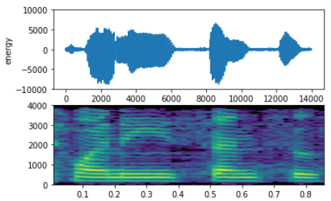
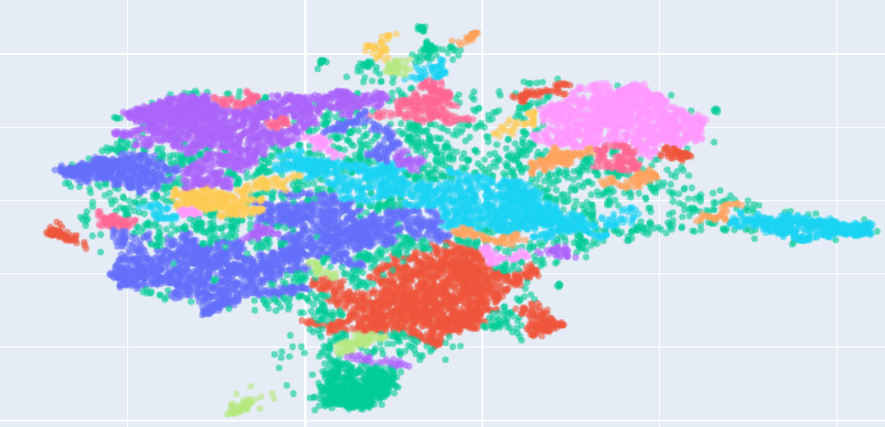

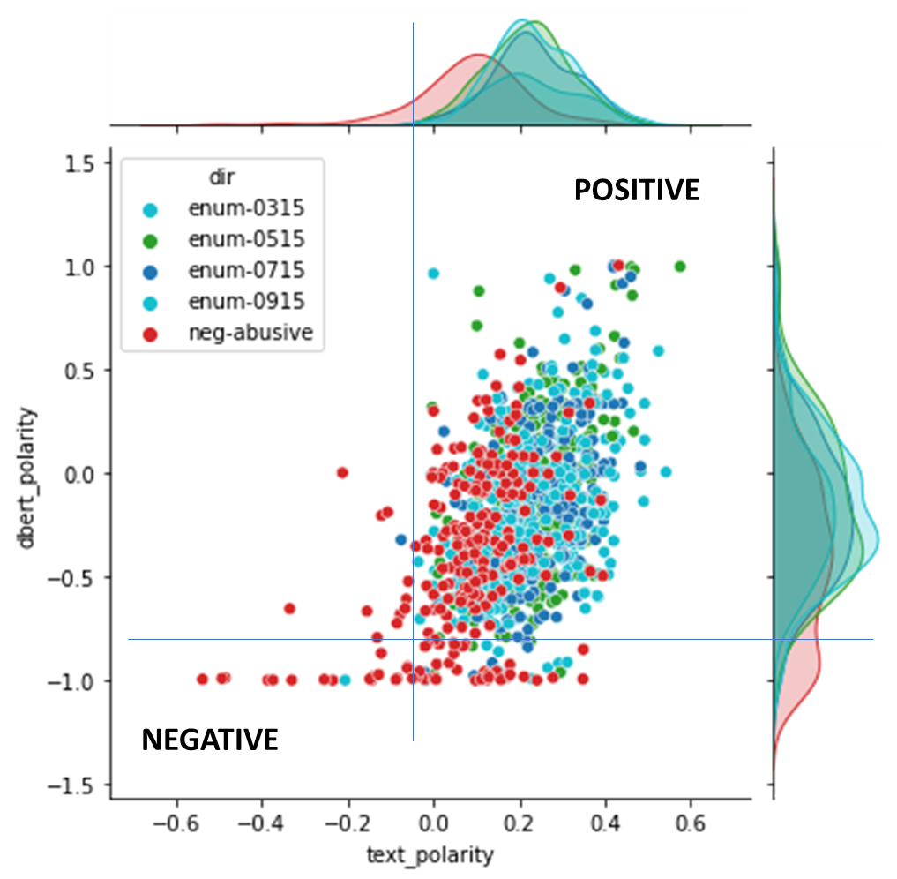
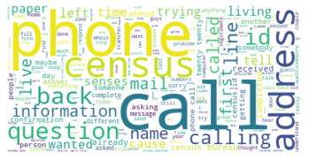
Pipeline
1
2
“may I record this call for quality assurance purposes?”
5
Raw audio
Pre-processed audio
Transcript
Call similarity, clusters
6
Approaches currently used in pipeline:
Normalize volume
Transcribe audio
Identify emotion in audio
Identify emotion in text
Identify and group similar calls
Identify topics discussed in groups of similar calls
3
4
Call topics,
nearest FAQ
Emotion scoring
Notes:
This display may do a better job of showing how this all fits together. We refer to this as our pipeline. So first we’ve got the raw audio which goes through some pre-processing such as normalizing volume. Then there’s the transcription of the audio to text. Then using both the pre-processed audio and the transcripts we identify the sentiment of the call, and using just the transcripts, we identify and group similar calls. Finally, we identify topics among the groups of similar calls. And I will briefly go through each step of this pipeline.

Slide 9
Pre-process audio
1
Raw audio
Pre-processed audio
Approaches currently used in pipeline:
Normalize volume
Notes:
First, pre-processing. Before we could apply any machine learning methods, there were some pre-processing steps required of the raw audio.

Slide 10
Preparing audio
Improve the sound quality
Adjust the volume
Split left (CSR) and right (caller) channels
Notes:
Before we could do any real analysis, we had to format the audio recordings, which is what you do with most any dataset, audio or otherwise. If we didn’t do this, we got unusable results when we moved to transcription, emotion recognition and topic modeling. In the end, we got the best results by making adjustments to the sound quality, increasing the volume, and splitting the calls by channel, left for the CSR, and right for the caller. Most of the analysis that follows has been done using 30 second snippets of these pre-processed calls.

Slide 11
Transcribe audio
1
2
“may I record this call for quality assurance purposes?”
Raw audio
Pre-processed audio
Transcript
Approaches currently used in pipeline:
Normalize volume
Transcribe audio
Notes:
With the data formatted, the next step was to transcribe the audio to text.

Slide 12
Sample transcripts*
Manual Transcript:
“Hello you have reached the twenty-twenty Census questionnaire assistance line, my name is John do I have your permission to continue recording this call for quality assurance purposes? Thank you, how may I help you?”
Automated Example 1:
“Hello you've reached the twenty-twenty Census question in your assistance line my name is John do I have your permission to continue recording this call for quality assurance purposes? Thank you and how may I help you?”
Automated Example 2:
“Hello you have reached the twenty-twenty sent this question the assistants I, my name is John do I have your permission to continue recording this call for quality assurance purposes? Thank you, how may I help you?”
*Made up transcripts
Notes:
We tested a number of machine learning models for transcribing audio to text. I think it’s helpful to see an example of what one of the transcripts might look like. This is just a snippet from the CSR’s script and the “hard words and phrases” from this snippet are in blue and red. By hard words and phrases, we mean that for most software they are uncommon in the data the software was trained on, making them less likely to be transcribed correctly.
So we started by manually transcribing the file. (Note that the manual transcriptions were the gold standard to which the model output was compared.) As we would expect, the manual transcript is very clean:
“Hello you have reached the twenty-twenty Census questionnaire assistance line, may name is John do I have your permission to continue recording this call for quality assurance purposes? Thank you, how may I help you?”
Then we have output from one of the models we tested. In this case, Census questionnaire assistance line was transcribed incorrectly as “Census question in your assistance line.”
Then we have output from another model. In this example, Census questionnaire assistance line was transcribed as “sent this question the assistants I.” Based on this this, we might say that the last model is less promising.

Slide 13
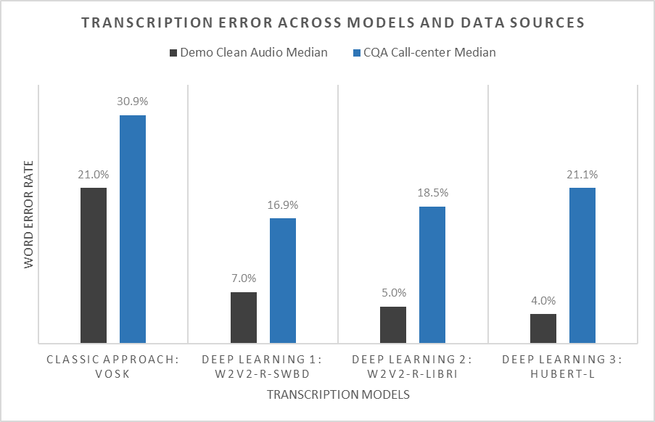
Preliminary findings - transcription
Newer models are better
Best model in one setting not best model in all settings
Notes:
Ultimately, the model with the lowest error rate across hundreds of calls is the one we will want to use in production. Here are the results comparing the median error rate for 4 potential models on both “clean” audio and CQA audio. The clean audio here came from pre-recorded books-on-tape. It’s important to compare the CQA audio with clean audio to get a sense of the “best” error rate by model. Note that call-center audio is more difficult to transcribe than many other types of audio: error rates on CQA audio are anywhere from 2-5 times higher than on ‘clean’ audio. You can imagine you have people talking over one another, accents, differences in volume, so on and so forth. Looking at the graph, the clean audio transcription error rates by model are in black, and the CQA error rates are in blue.
There’s not really time to go into detail about each of the models tested, but basically the takeaway here is that newer “deep learning” models are more accurate than classic automated speech recognition models (and show less or no male/female bias). In addition, models trained on phone call data show better performance on CQA audio over the best models for ‘clean’ data.

Slide 14
Summary of transcription rate to date by call type
Total machine transcribed (%) | Total machine transcribed | Total recorded | Type
2 | 31,000 | 1,570,000 | General assistance
.5 | 10,500 | 2,241,000 | Enumerate
74 | 8,100 | 11,000 | Complaint
15 | 5,200 | 34,500 | Technical issue
91 | 5,200 | 5,700 | Abusive caller
91 | 1,000 | 1,100 | Threat
0 | 0 | 219,000 | None selected
0 | 0 | 1,000 | Media call
0 | 0 | 1,800 | Robo call
0 | 0 | 258,000 | Other
Notes:
So after choosing the “best” model, we transcribed hundred of thousands of calls, and continue transcribing calls to build our project library. This is the distribution of the transcribed calls by type. We’ve transcribed almost all calls labeled as “threatening,” “abusive caller,” or “complaint.” We’ve also transcribed samples of technical, general assistance, and enumeration calls. Note that only English calls are reflected here.

Slide 15
Sentiment recognition
1
2
“may I record this call for quality assurance purposes?”
Raw audio
Pre-processed audio
Transcript
Approaches currently used in pipeline:
Normalize volume
Transcribe audio
Identify emotion in audio
Identify emotion in text
3
4
Emotion scoring
Notes:
So now I’ll talk briefly about how we’re using machine learning for emotion recognition and what we’ve found so far. If you’ll recall our operational goals, emotion analysis models will be useful for flagging difficult calls, identifying features of negative calls and tracking sentiment dynamics for things like automatically alerting supervisors to threatening calls. Note that for emotion recognition, we used both the audio and the call transcripts.

Slide 16
Sentiment examples
For fictional text put into production model and model generated score
Text: I think your survey was fantastic
Score: 0.987
Text: I’d like to receive a paper form
Score: 0.018
Text: My browser froze when entering my data
Score: -0.907
Notes:
So how are we determining sentiment? Well, what we do is put text into a model and it generates scores between -1 and 1, telling us something about the potential sentiment of the call. The higher the score, the more positive the call, in theory. So, for example, when we entered “I think your survey was fantastic,” we got a very high score of almost 1. In fact, assuming the caller wasn’t being sarcastic, this makes perfect sense. And when we entered the text “I’d like to receive a paper form,” we get a combined score closer to 0, suggesting a more neutral statement, which also makes sense. And, lastly, for “My browser froze when entering my data,” the score was close to negative 1, which likely reflects the sentiment of such a statement.

Slide 17
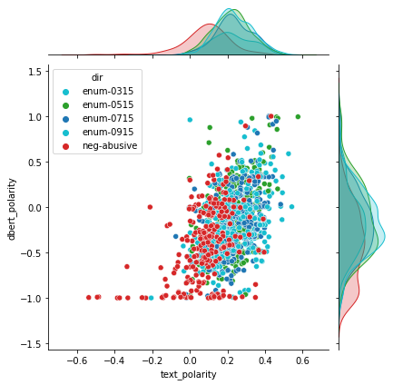
Preliminary finding – emotion recognition
Tested across 3,000 transcripts
Combining output of multiple models yielded most accurate predictions
‘Mislabeled’ calls based on score appear to often be human mis-labeling
POSITIVE
NEGATIVE
Notes:
Here’s what happened when we plotted a subset of model-generated scores from 3,000 transcripts from two sentiment models to distinguish CSR-labeled abusive calls from CSR-labeled enumeration calls. (Note that CSRs recorded a call disposition after every call.) Here each transcript is represented by a dot, with the color identifying if it was labeled by the CSR as an enumeration (blue or green) or an abusive call (red). The x and y axes represent the model generated scores, with right and up being higher numbers and more positive, and down and left being lower numbers and more negative. The histograms over the x and y axis show the distribution of scores for each of the models across transcripts. It looks like – while there is some overlap - abusive calls, again the red dots, seem to be identified as more negative (left/down) by both models. Ultimately, we found that combining the output of multiple models yielded the most accurate predictions at 82%.
Interestingly, we found that these models are also quite useful for identifying mislabeled calls. Many of the blue/green dots in the lower right are quite negative (and actually are not enumerations!), and many of the calls in the upper right labeled as abusive are actually neutral (and often technical support/tech issues). So the accuracy of the models is likely higher than 82%.

Slide 18
Call topic modeling
1
2
“may I record this call for quality assurance purposes?”
5
Raw audio
Pre-processed audio
Transcript
Call similarity, clusters
6
Approaches currently used in pipeline:
Normalize volume
Transcribe audio
Identify emotion in audio
Identify emotion in text
Identify and group similar calls
Identify topics discussed in groups of similar calls
3
4
Call topics,
nearest FAQ
Emotion scoring
Notes:
So finally I’ll talk about how we used machine learning methods to group and label calls. If you’ll recall our operational goals, topic analysis models will be useful as we explore labeling call dispositions, searching frequently asked questions, and identifying new frequently asked questions for operational goals such as reducing the manual effort of labeling calls.

Slide 19
Topic examples
Fictional text-
Text: What will happen if I refuse to complete the Census
Text: I’d like to receive a paper form
Text: My browser froze when entering my data
Notes:
Here are three examples of possible call topics.
Example 1 is “What will happen if I refuse to complete the Census?”
Example 2 is “I’d like to receive a paper form.”
Example 3 is “My browser froze when entering my data.”
In fact, as you might expect all of these – concerns with responding to the Census, requests for a paper form, and technical issues – were relatively common among real calls. With enough transcripts, we’ve been able to run topic models for identifying the similarity among transcripts/call topics.

Slide 20
Preliminary findings – topic modelling
Newer ‘deep learning’ language models better group similar calls together for both large topics (e.g. technical assistance vs residency questions) and more specific sub-topics
Example 1: Residence
Example 2: Race and Hispanic origin
'white', 'box', 'race', 'hispanic', 'origin', 'filling'
'canadian', 'citizen', 'canada', 'months', 'citizens
'white', 'race', 'german', 'origin', 'american', 'irish'
'residence’, 'live', 'state', 'address', 'winter', 'new’
'florida', 'months', 'residence', 'home', 'winter', 'resident'
Notes:
So here’s what we’re actually seeing from our topic modeling. This is output from one model tested on approximately 13,000 general and technical assistance transcripts on the caller channel (35,000 in total). First, we grouped similar calls, then we looked for similar topics. For example, towards the bottom of the plot, we saw groupings of topics around residency and then some subgroupings: Canadian, citizen in one box; Florida, winter in another box, and address, residence in another. And to the right, there are topics that appear associated with the race and Hispanic origin questions: white, race, origin, German, American, and Irish. We’ve found that newer ‘deep learning’ language models better group similar calls together for both large topics (e.g., technical assistance and residency questions) and more specific sub-topics.

Slide 21
Next steps – Improve existing functionality
Improve call labels
Implement speed improvements to pre-processing and transcription
Evaluate pipeline for non-English languages
Test transcription, emotion recognition on non-English languages
Test methods for multi-language topic modeling
Notes:
So I’ll conclude with some next steps.
We’d like to improve call labels, which will require additional manual labeling of calls
We’d like to speed things up – specifically, we’d like to speed up pre-processing and transcription. This will be important down the road if we plan to implement this in production.
Finally, we’d like to evaluate the pipeline for non-English languages. This includes testing transcription and emotion recognition on non-English languages. It also includes testing methods for multi-language topic modeling.
That’s all I have. For more on machine learning in general, please consider attending Session 7B, where Brian Sadacca our co-author will be giving an overview of Machine Learning for Survey Analysis.

