Slide 1
Physical measure and Biomarker Data collection: Lessons from the Health and Retirement Study
Jessica Faul, PhD, MPH, University of Michigan
Experiences with Home-Based Interviewer Mediated and Respondent Self-Collected Physical Measures and Specimen Collection, FedCASIC
April 6, 2022
The Health and Retirement Study is a cooperative agreement sponsored by the National Institute on Aging (NIA U01AG009740) with additional support from the Social Security Administration

Slide 2
Building a biosocial survey: rationale
Obtain data from nonclinical samples, population-representative sample
Validate self-reports of health status
Identify health status information unknown to survey participants
Enable richer modeling of pathways between socioeconomic determinants and outcomes – health, behavioral…
The growing interest in using biomarkers and genetic data in health surveys graphically illustrated by a 2007 PubMed search for articles which indicated the use of both bio-measures and survey data.

Slide 3
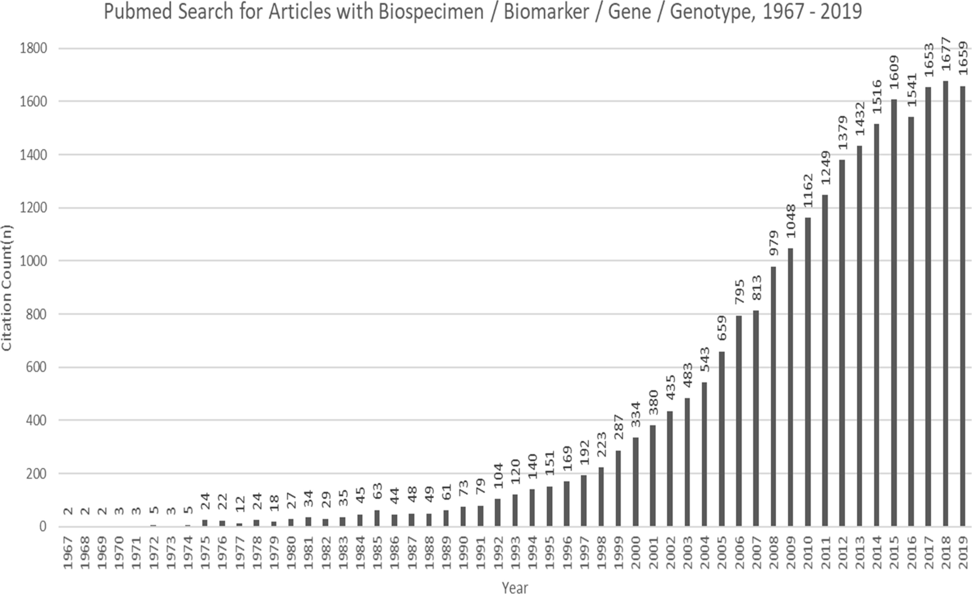
Boyle J, Berman L, Dayton J, Iachan R, Jans M, ZuWallack R. Physical measures and biomarker collection in health surveys: Propensity to participate. Research in Social and Administrative Pharmacy. Volume 17, Issue 5,. 2021

Slide 4
Adding Biological Data: Considerations
Can mean a change in mode (face-to-face?)
Increased respondent burden
Possible increased attrition, change in initial participation
Increased cost
Require significantly more work to calibrate and standardize measures across equipment, technicians, laboratories etc.
Preserving confidentiality of respondents
Ethical issues – what to report to participants
Preserve the integrity of a longitudinal observational study
  Do not want it to be transformed into an intervention study

Slide 5
SELECTION OF MEASURES
Balance scientific value vs. (cost + burden)
In field-collected studies, feasibility is also an issue:
  Mode – In person? Mail?
  Collection - can participants collect themselves? Can interviewers be trained? Are specially-trained persons (e.g. phlebotomists) required?
  Delay in processing – is my sample stable for shipping? Exposure to factors - time, heat, humidity – that aren’t issues in clinical samples

Slide 6
HEALTH AND RETIREMENT STUDY
Longitudinal panel study that surveys a representative sample of ~20,000+ adults over age 50 in the United States
Multimode survey – FTF, Tel, Web, Mail
Core collection every 2 years
Collected biological data first in 2001 (buccal swabs), but started collecting physical measure and biomarker data on a large scale in 2006
Mostly done with a trained interviewer in the participant’s home but we’ve also done actigraphy, mail-in collections, collections by contractors at a separate visit

Slide 7
COMMON Biological measures in surveys
Physical Measures and Anthropometrics:
  Blood pressure
  Breathing / lung function tests
  Grip strength
  Balance tests
  Height and weight
  Body circumferences (waist, hip, and limbs)
  Gait speed
  Hearing tests
  Smelling tests
Universally high consent for these items - ~95%
Issues:
Eligibility (nursing home residents, proxy)
Safety
Space
Equipment

Slide 8
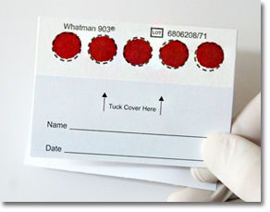
Biomarker: Dried blood spots
Can obtain some high-value biomarkers, including DNA
Relatively easy and inexpensive
Can be administered by trained interviewers without a separate visit
  Some studies have done self-collection
Assays more limited than what can be done with venous blood
HRS DBS Assays:
HbA1c
Total and HDL cholesterol
C-reactive protein (CRP)
Cystatin C
IL-6

Slide 9
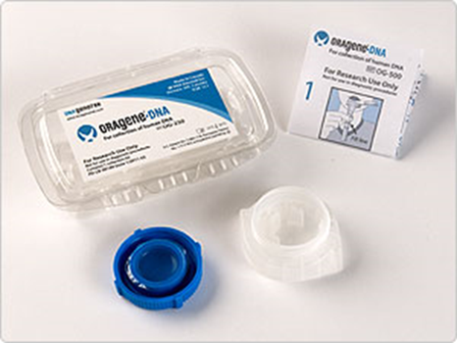
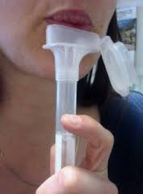
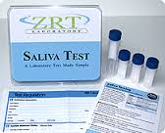
BIOMARKER: SALIVA
DNA
RNA
DNA Methylation
Telomeres
Cortisol
Hormones
Inflammation
Oral Microbiome
Antibodies
Cotinine (nicotine)…
But…different collection containers usually required (different preservatives)

Slide 10
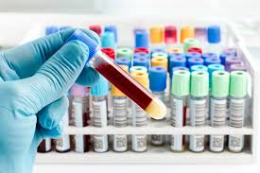
BIOMARKER: VENOUS BLOOD
More analytes available than with DBS
Often can be analyzed by a clinically-certified lab and valid enough to be reported to participants
Requires special skills to collect
Lower consent rates than with less invasive methods

Slide 11
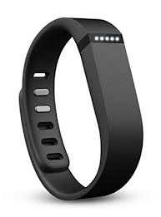
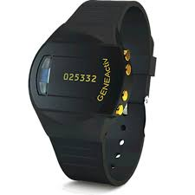
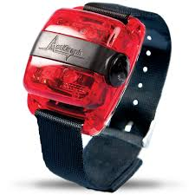
Actigraphy DEVICES
Actigraphy – non-invasive collection of physical movement and sleep data to supplement self-reports
Fitbit Flex | GENEActiv Original | Actigraph wgt3x

Slide 12
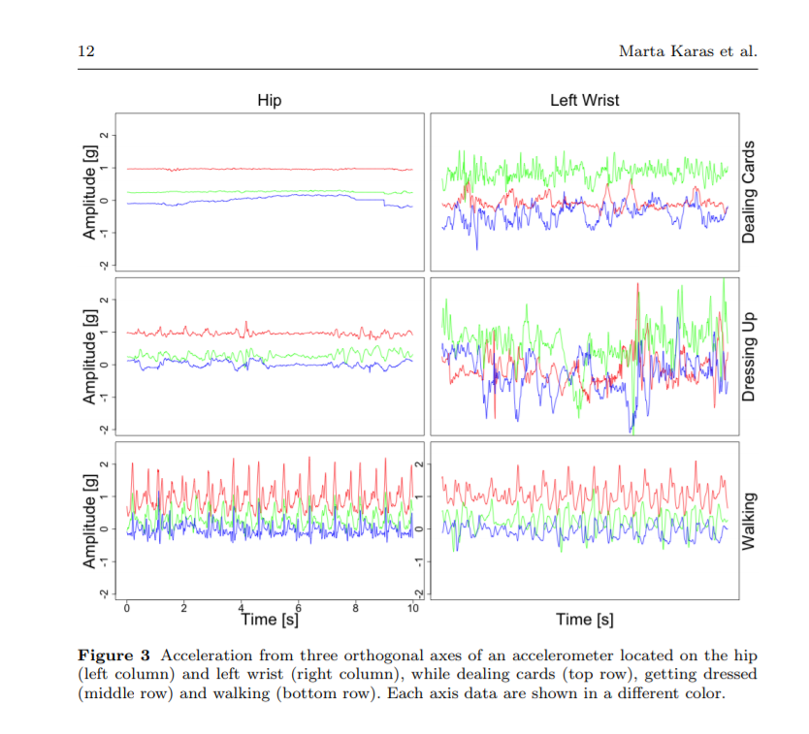
  As battery and memory have increased, it is possible to collect and store high-throughput, three-axial, sub-second level acceleration data (between 10-200 obs per second)
  Supplementary sensors including gyroscopes, thermometers, inclinometers, pulsometers, light intensity and skin conductance sensors
  Data of this type requires a lot of data processing and storage – do not underestimate this!
  Different devices measure and are calibrated differently (apple watch ≠ fit bit etc.)
Karas et al. (2018) Accelerometry data in health research: challenges and opportunities. BioRx
Notes:
when using actigraphy, including techniques such as event markers or sleep diaries, and other methods in the study of populations where these techniques may not be valid.

Slide 13
CONSENT AND PARTICIPATION
Declining overall response rates in population surveys is a well-known problem
Unfortunately, relatively limited research on barriers and motivators for surveys with biological measures
Is consent associated with a person's health status and/or other factors often associated with nonresponse in surveys?
Important both because we would like to know how to get high participation and because it would suggest that survey non-response could be related to potential bias in health measures
Notes:
How we got into this DNA-thing

Slide 14
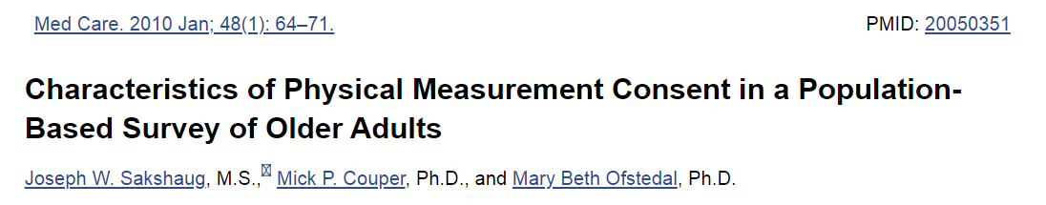
CONSENT AND PARTICIPATION
Health and Retirement Study 2006, N=7457
Propensity to consent was significantly greater among Hispanic respondents matched with bilingual Hispanic interviewers, and those who visited a doctor in the past 2 years
Lower among younger respondents, respondents with functional limitations, less physical activity, and those interviewed by black interviewers
Survey resistance indicators, such as number of contact attempts and interviewer observations of resistant behavior in prior wave of HRS were also negatively associated with physical measurement consent

Slide 15
HRS PHYSICAL MEASURE AND BIOMARKER DATA
Collected during in-person interview
Separate consents for physical measure, dried blood spot and salivary DNA collection
Exclusion criteria:
  Nursing home residents
  Proxy respondents
HRS does not offer a separate incentive for these components individually but does offer a larger token of appreciation for face-to-face interviews than phone interviews (paid in advance, not dependent on consent)

Slide 16
Salivary dna completion rates for first-time requests, 2006-2018
DNA consent and collection has been part of the “enhanced” face-to-face survey since 2006. As collection directly follows consent there is very little difference between consent and completion rates. Rates are high and stable
~5% difference in consent between first asks among new respondents and first asks at the first follow-up wave

Slide 17
Salivary dna completion rates by Race/ethnicity and education, first and second requests
The ability to ask multiple times for consent improves overall completion rates. For DNA, this has been especially helpful with Black participants.

Slide 18
Dried blood spot completion rates, 2006-2018
Like DNA, DBS consent and collection has been part of the enhanced face-to-face survey since 2006. Completion rates improved over time. We stopped DBS in favor of whole blood after 2016.

Slide 19
VENOUS blood completion rates by race/ethnicity and education, 2016
Whole blood is a 2-stage process with consent provided in the main interview (tel or FTF), followed by scheduling and completing a home phlebotomy visit. In 2016, 78% consented, and 85% of those completed, for 66% overall.

Slide 20
HRS VENOUS BLOOD CONSENT AND COMPLETION
Consent
(% consented, sub - overall (among eligible))
Complete
(% completed, sub - overall (among consenters))
n
(eligible)
Overall
0.0%
0.0%
11,417
Female
-
0.8%
-
0.1%
6,704
Male
0.9%
0.3%
4,628
<65 years
2.5%
*
-
2.9%
*
4,525
65 – 79 years
-
1.1%
2.1%
*
4,810
80+ years
-
3.2%
*
1.8%
2,004
Non-Hispanic Black
-
1.9%
*
-
6.3%
*
2,170
Hispanic
5.3%
*
-
5.5%
*
1,745
Non-Hispanic white
-
0.6%
3.0%
*
7,502
< 12 yrs
4.2%
*
-
5.1%
*
2,317
HS / Some College
-
0.9%
1.0%
6,181
College
-
1.6%
*
2.3%
*
2,841
-8.0%
0.0%
8.0%
-8.0%
0.0%
8.0%
* Statistically significant at 95% confidence level.

Slide 21
HRS VENOUS BLOOD CONSENT AND COMPLETION
Consent
(% consented, sub - overall (among eligible))
Complete
(% completed, sub - overall (among consenters))
n
(eligible)
Overall
0.0%
0.0%
11,417
VBS Cons: Phone
-
2.7%
*
0.0%
4,605
VBS Cons: FTF
1.9%
*
0.0%
6,812
IW attempts: < 7
1.7%
*
4.4%
*
7,472
IW attempts: 7 +
-
3.0%
*
9.3%
*
-
3,945
Metro 1M+
-
2.4%
*
-
1.2%
4,323
Metro 250K - 1M
2.3%
*
0.5%
2,195
Metro <250K
0.3%
1.2%
692
Non-Metro
0.4%
-
0.1%
1,718
Midwest
0.2%
*
3.3%
2,493
Northeast
-
4.8%
*
-
2.5%
*
1,589
South
0.4%
-
1.7%
*
4,836
West
*
2.3%
1.5%
2,479
-8.0%
0.0%
8.0%
-8.0%
0.0%
8.0%
* Statistically significant at 95% confidence level.

Slide 22
VENOUS BLOOD FIELD EFFORT 2016
While we were able to collect a lot more data, this came with considerable cost…
Cost of collection and higher incentive
Blood shipped to the lab overnight
Respondents mailed a report with results from 27 assays – results mailed within 2 weeks
Rs with extreme values notified within 48 hrs by telephone (N=144)
> 1,600 call-ins to the study 1-800 line related to VBS
  More info requested on assays, genetics
Test | Alert Value
Potassium | <2.7 or >6.0 mmol/L
Sodium | <120 or >160 mmol/L
WBCs | <1.0 or>50 x 10⁹/L
Serum Creatinine | >= 2.4 mg/dL

Slide 23
SARS-CoV-2 AnTIBODY TESTING - Following the pandemic in real time
The pandemic coincided almost exactly with our 2020 wave of core data collection
Forced a number of modifications to what we do, and some deferrals
Created opportunities
Timing shaped both the opportunities and our strategies for response

Slide 24
Difficult logistical challenge
Wanted to assay SARS-CoV-2 antibodies before vaccination
Dispersed national sample of ~15,000 people
How to collect samples without direct personal contact?
How to transport samples to lab?

Slide 25
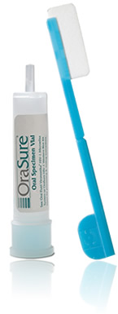

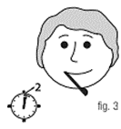
SOLUTION PART 1 - ORASURE
Self-collection of oral fluid using OraSure Oral Antibody Collection device ($4)
Contains a viral inactivation agent – safe to ship and handle
Requires only 3-5 mins
FDA approved
Can only be used for
antibody testing, not for
DNA or active virus testing
BUT: Lab tests indicated samples
needed to be kept at 4⁰C for
stability of assay

Slide 26
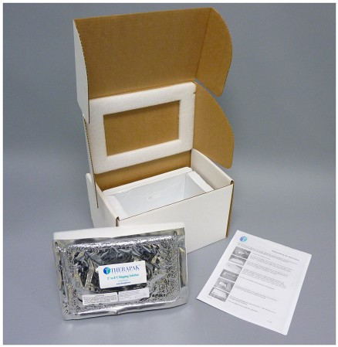
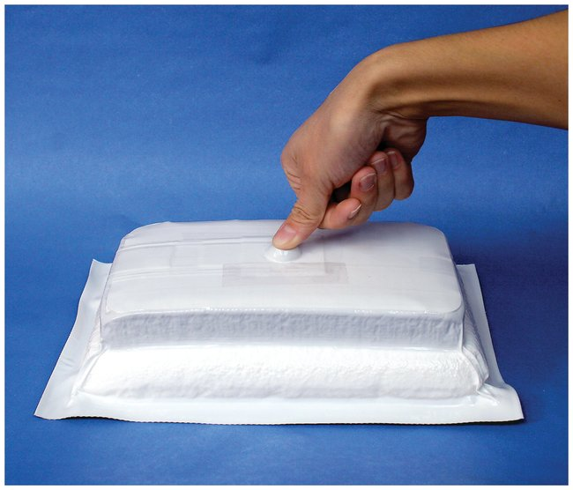
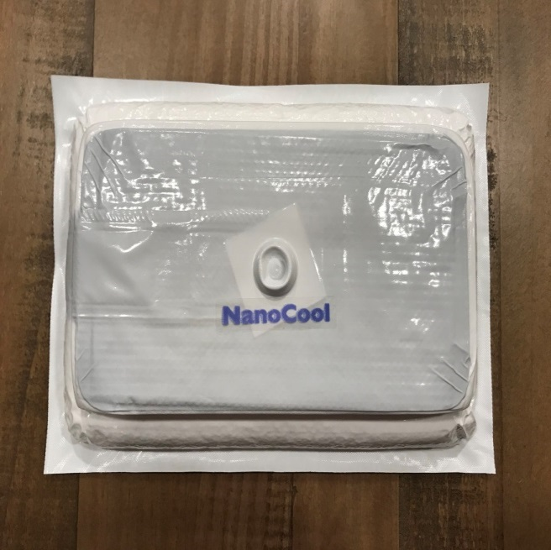
SOLUTION PART 2: NANOCOOL TECHNOLOGY
Refrigerated shipping system keeps samples cool (2-8°C) for 48 hrs – no need to freeze in advance
(Relatively) easy to activate

Slide 27
HRS SARS-CoV-2 ANTIBODY TESTING
Massive undertaking during partial lockdown
8 semi trucks to deliver us the NanoCool boxes
3,000 hours to assemble and QC the kits for mailing
Kits mailed to respondents via UPS
Participants could schedule pick up at home for return Sept-Nov 2020
  All no-contact
Telephone follow-ups in February-March to assist/encourage participation
  Vaccinated were told they were no longer eligible

Slide 28
SARS-CoV-2 Antibody completion rates - Mail
Overall, the participation was 44% with larger than normal differentials by race/ethnicity and marital status

Slide 29
FIELD AND COLLECTION ISSUES
Must calibrate and standardize measures across equipment – all devices are not created or measure equally well
For biological assays quality control is needed – standardize across technicians, laboratories, and QC steps for data to be reliable
  Use blinded duplicates throughout your field period when you can
Field collection ≠ lab collection – need to pilot your protocol
  Exposure to factors - time, heat, humidity – can affect the validity of your outcome measures (DBS in particular)
As assays become more experimental and innovative, increasingly difficult to harmonize and benchmark to other nationally-representative surveys – fewer studies to compare to and less-standardized QC

Slide 30
IMPROVING CONSENT and collection
Use separate consents - don’t make a request conditional on participation in other parts of your study
In person collections almost always have higher consent and completion than web / mail / self-collection requests
Continue to ask for biomarker collection from new respondents and prior refusals every wave, if possible
  Approx. 50% of respondents who refused in a prior wave consent when re-asked in the next wave (2 years later)
  25% of respondents who initially refused venous blood collection in HRS converted to consent after participating in a substudy conducted only 2-4 months after the core interview and asked to consent a 2nd time
  This helps increase representativeness and generalizability!
Incentives – fit within your overall study design
  Pre-paying works well unless return of equipment is required
Carefully consider how returning results to participants fits within your collection plan – could be an incentive to participate, also ethics and safety concerns

Slide 31
THANK YOU

Slide 32
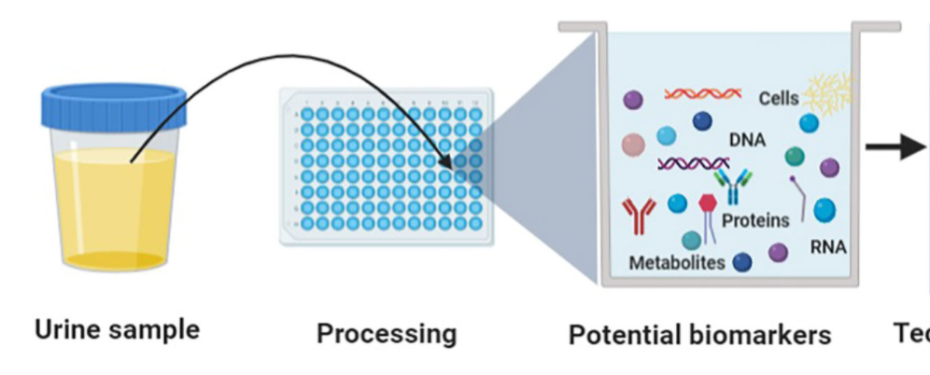
Biomarker: URINE
Easy to collect
Sensitivity issues for some people
Metabolomics
Proteomics
Genomics
Transcriptomics
Inflammation
Medications/drugs
Front. Oncol., 03 November 2020 | https://doi.org/10.3389/fonc.2020.559016

Slide 33
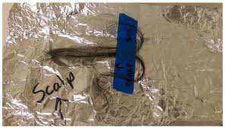
Biomarker: HAIR
Cut a small bit of hair from the back of the head, clipping close to the scalp
We take about 50-100 hairs - about the same amount we lose every day in the normal course of life
Important to label which end was closest to the scalp
Challenges with short or braided hair, because of religious or spiritual beliefs including exposing hair (e.g., Muslim women), hair as sacred (American Indian groups), or cultural norms that connect hair to standards of beauty and self-image
Collected for: cortisol, environmental pollutants, medications/drugs

