Slide 1

Supporting National Enrollment:
Expansion of Remote Biosample Collection Protocols in the All of Us Research Program
April 6, 2022
James McClain, PhD, MPH
Chief, Participant Technology Branch
Division of Technology & Platform Development
All of Us Research Program
National Institutes of Health

Slide 2
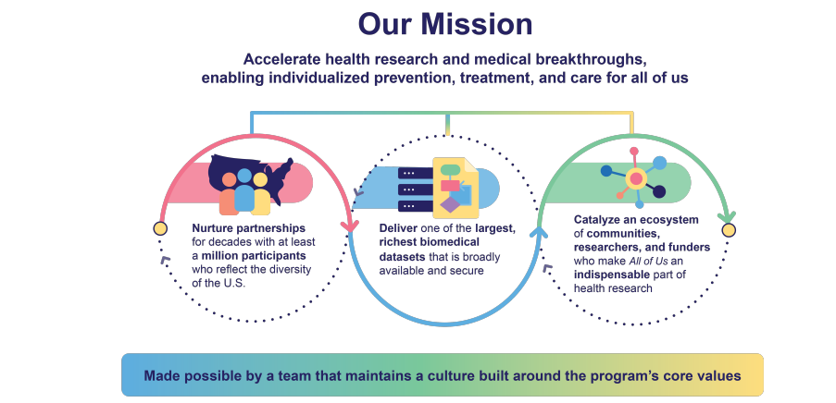
All of Us Research Program Mission

Slide 3
Major Components of the All of Us Research Program Consortium
DATA AND RESEARCH CENTER
Big data capture, cleaning, curation, and sharing in secure environment
Vanderbilt, Verily, Broad Institute
BIOBANK
Repository for processing, storing, and sharing biosamples (35+M vials)
Mayo Clinic
PARTICIPANT TECHNOLOGY SYSTEMS CENTER
Web and phone-based platforms for participants
Vibrent Health
GENOMICS PARTNERS Genotyping and whole genome sequencing of biosamples; counseling and educational resources for participants
Baylor College of Medicine, Broad Institute, University of Washington, Color, HudsonAlpha, and partners
PARTICIPANT CENTER/
DV NETWORK
Direct volunteer participant enrollment, digital engagement innovation, and consumer health technologies
Scripps Research Institute (with multiple partners)
HEALTH CARE PROVIDER ORGS NETWORK
HPOs with clinical & scientific expertise, enrollment & retention of participants
30+ regional medical centers, FQHCs, and VA
COMMUNICATIONS & ENGAGEMENT NETWORK Communications, marketing, and design expertise; engagement coordination and community partners network
Wondros, Pyxis Partners, University of Utah, and many community engagement partner organizations

Slide 4

Two Methods of Enrollment
HEALTH CARE PROVIDER ORGANIZATIONS
DIRECT VOLUNTEERS

Slide 5





Current Protocol
Enroll, Consent, and Authorize EHR
Answering Surveys
Physical Measurements*
Provide Biosamples*
Wearables and Digital Apps
Recruiting 18+ years old initially; plan to include children in future
Online, interactive consent
Includes authorization to share EHR data
Current Surveys:
The Basics
Overall Health
Lifestyle
Health Care Access & Utilization
Personal & Family Health History
Social Determinants of Health
Blood pressure
Heart rate
Height
Weight
BMI
Hip circumference
Waist circumference
Blood (or saliva)
Urine specimen
Biosamples will be stored at the program’s biobank
Share data from wearable fitness devices, starting with Fitbit
Coming soon:
Integrated apps to track mood & cardio-respiratory fitness
Additional surveys will be released on an ongoing basis
*Based on diverse sampling and capacity
*Based on diverse sampling and capacity

Slide 6
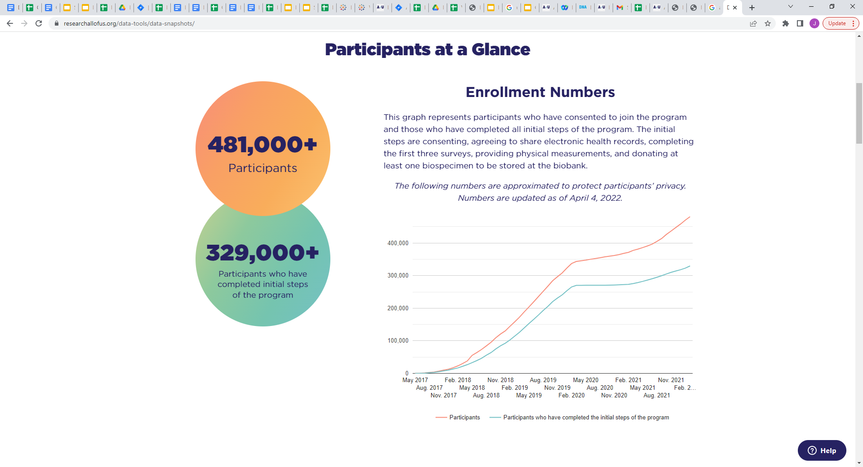
All of Us Enrollment
(Updated 4/1/2022)
Enrollment Numbers
The following numbers are approximated to protect participants’ privacy.
Participants
Participants who have completed the initial steps of the program

Slide 7
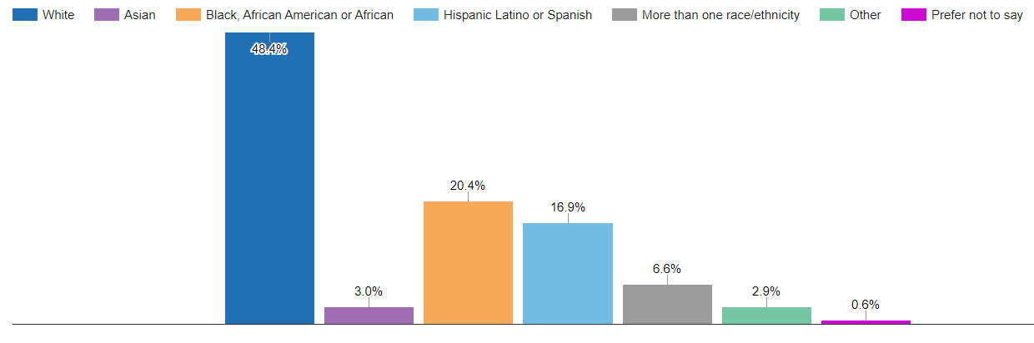
All of Us Demographics
(Updated 4/1/2022)
Race & Ethnicity

Slide 8
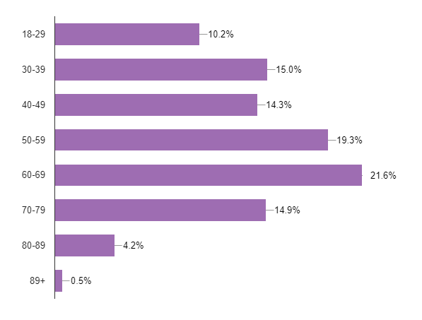
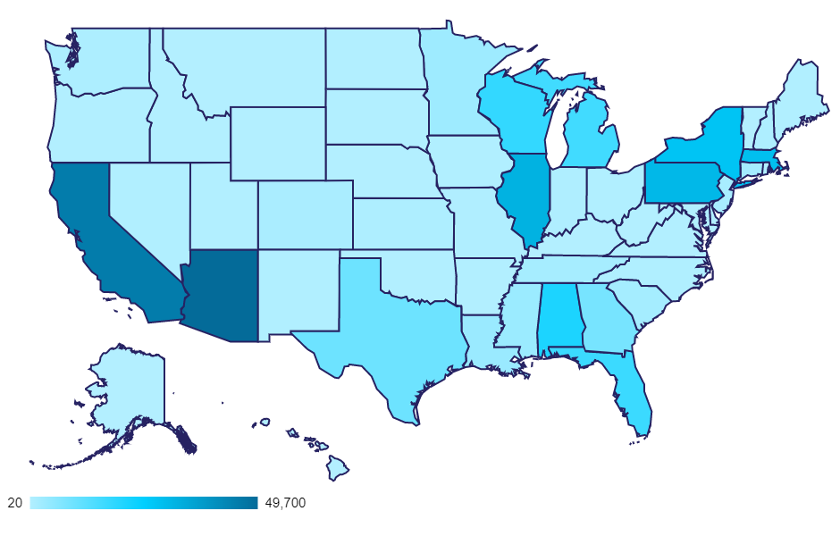
All of Us Demographics & Geographic Distribution
(Updated 4/1/2022)
Age
Geography
All 50 states
Bilingual enrollment
Interactive mobile exhibits

Slide 9
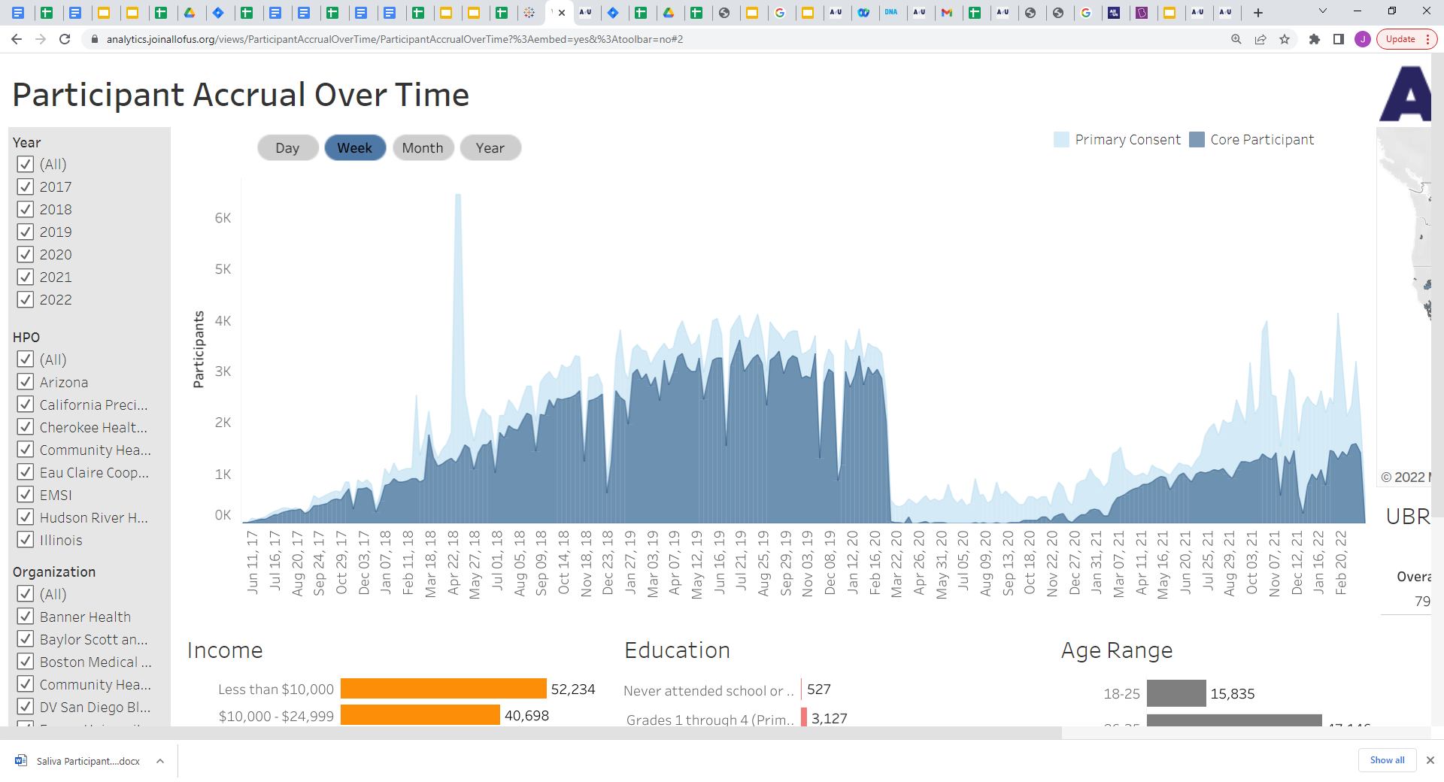
National Enrollment Challenge: Geographic Support for Biosample Collection
All of Us opened nationwide digital enrollment in May 2017
Expanded enrollment to over 3k participants/wk prior to pandemic
Supported and driven primarily by over 50 enrollment org. & 300+ sites nationally
Pandemic shut down clinical sites for 6-12 months or more
Reactivation slowed down due to required safety precautions & local research policies
All of Us needed to expand remote enrollment protocols
Support participants nationally and expand local capacity during pandemic

Slide 10
National Enrollment: Pilot Testing Remote Biosample Collection Protocol
As a program, All of Us has prioritized our standard biosample collection protocol including blood & urine capture
Establishing a robust biobank of samples for future analysis
All of Us began piloting use of in-home saliva collection kits in Q3/Q4 2019
To expand participant access to biosample collection nationally
Invited 6100 existing participants living in states without All of Us enrollment sites to provide saliva samples
38% order rate & 88% return rate
Sustained pandemic restrictions on research operations by late 2020 increased the program’s interest in remote sample collections

Slide 11
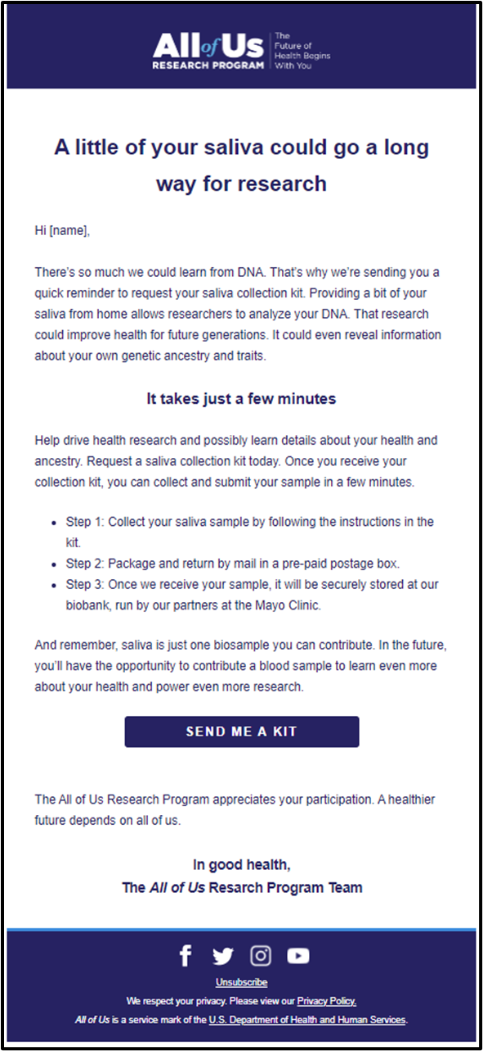
National Enrollment: Expansion of Remote Collection Protocols
All of Us expanded access to the in-home saliva collection protocol progressively to participants beginning in Dec 2020
Initially through batch invitations based on
State of residence (access to enrollment locations)
Elapsed time since biosample eligibility
Progressively automated protocol workflows
Real-time invite / portal ordering for 28 states / US territories
Remaining 22 states received invites 6 months after biosample eligibility w/ no on-site sample collections
Protocol communications via email / SMS (based on user preference)
Invitation + 2 ordering reminder messages
Notifications including kit shipped & received by biobank
Five return reminder notifications from 3 to 45 days post delivery

Slide 12
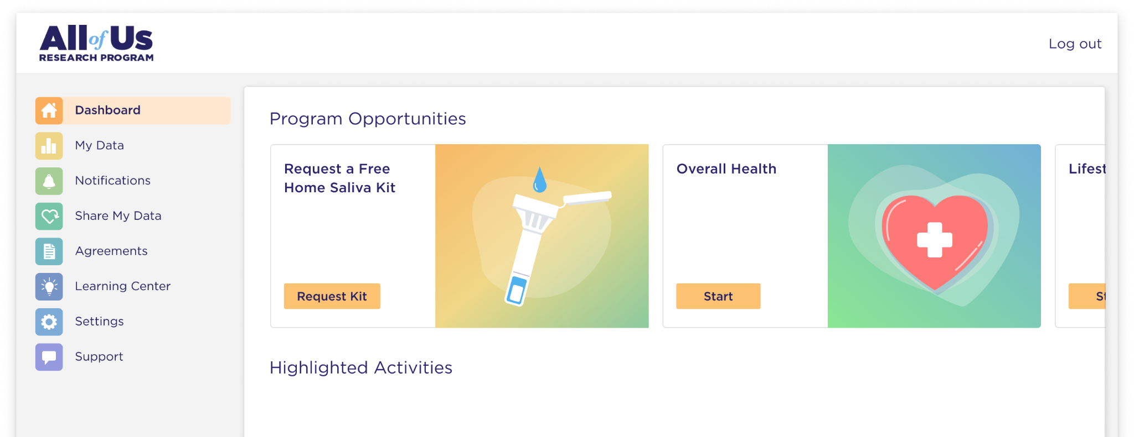
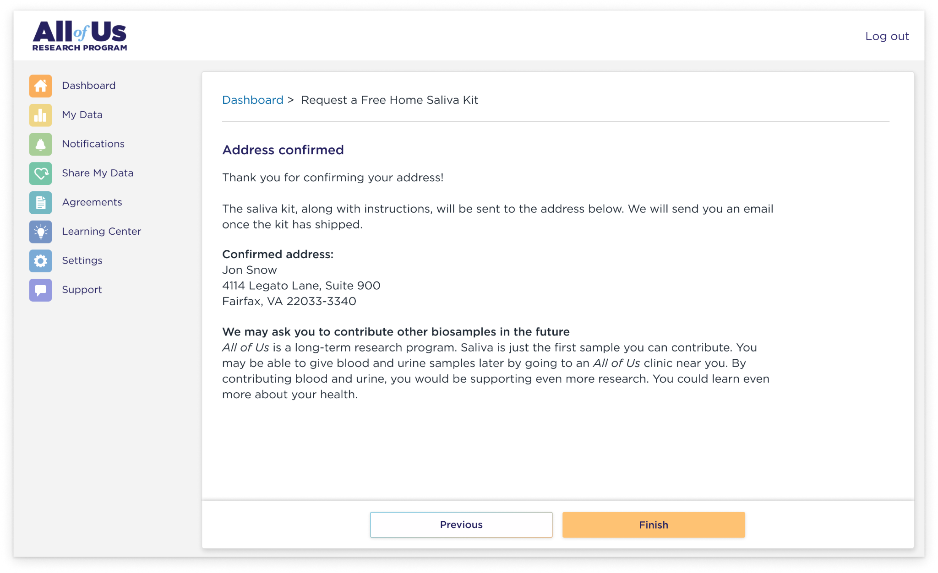
Kit Ordering: Informational Content & Shipping Address Confirmation

Slide 13
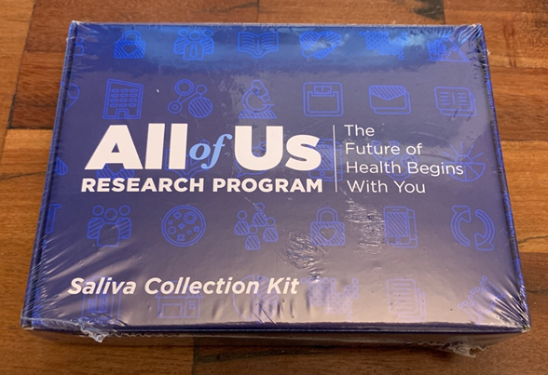
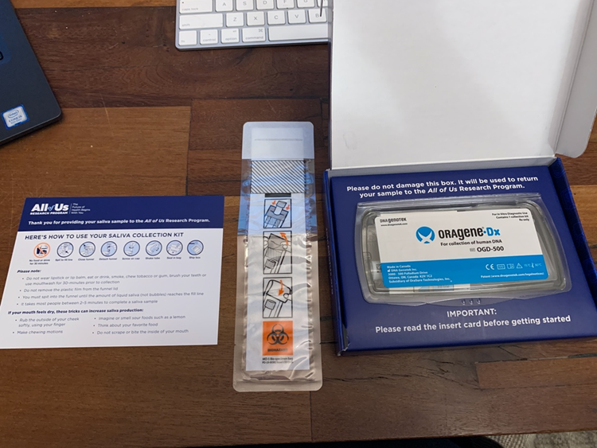
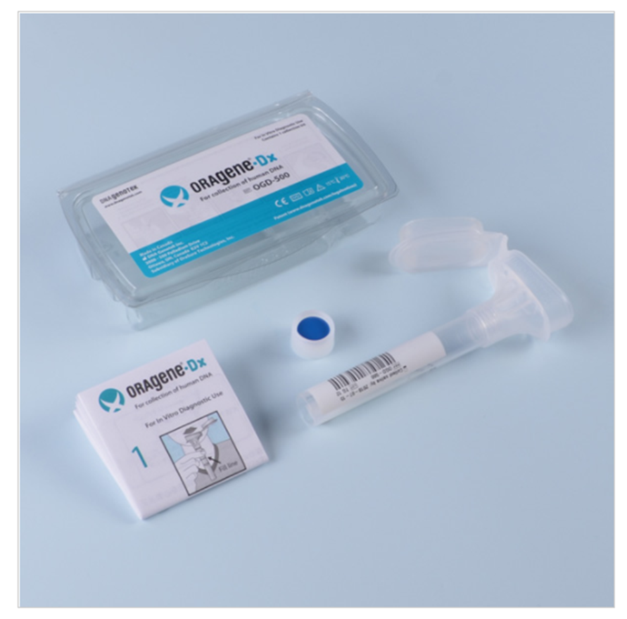
Materials: Branded Packaging and Saliva Collection Kit
Branded All of Us in-home saliva collection packaging for Oragene-DX OGD-500 saliva kit for DNA collection / extraction

Slide 14
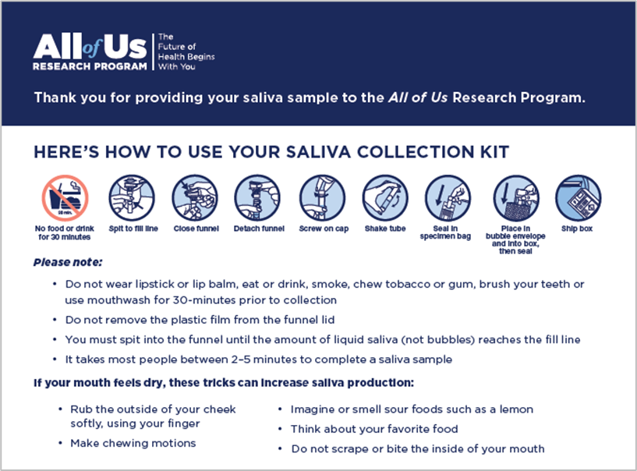
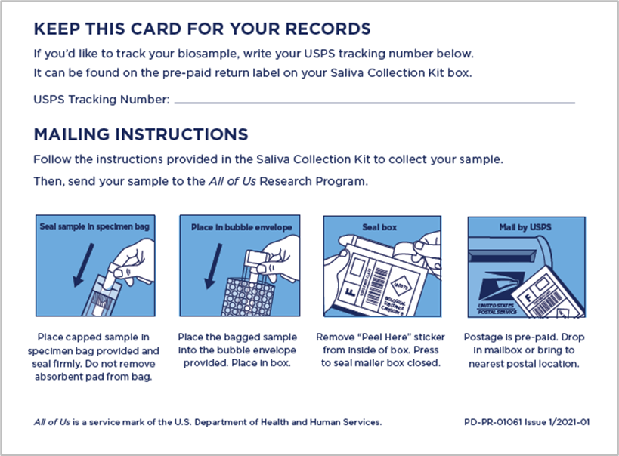
Materials: Instruction Card Insert (English & Spanish)
Custom All of Us in-home saliva collection instruction card insert provided in English & Spanish within mailed kits

Slide 15
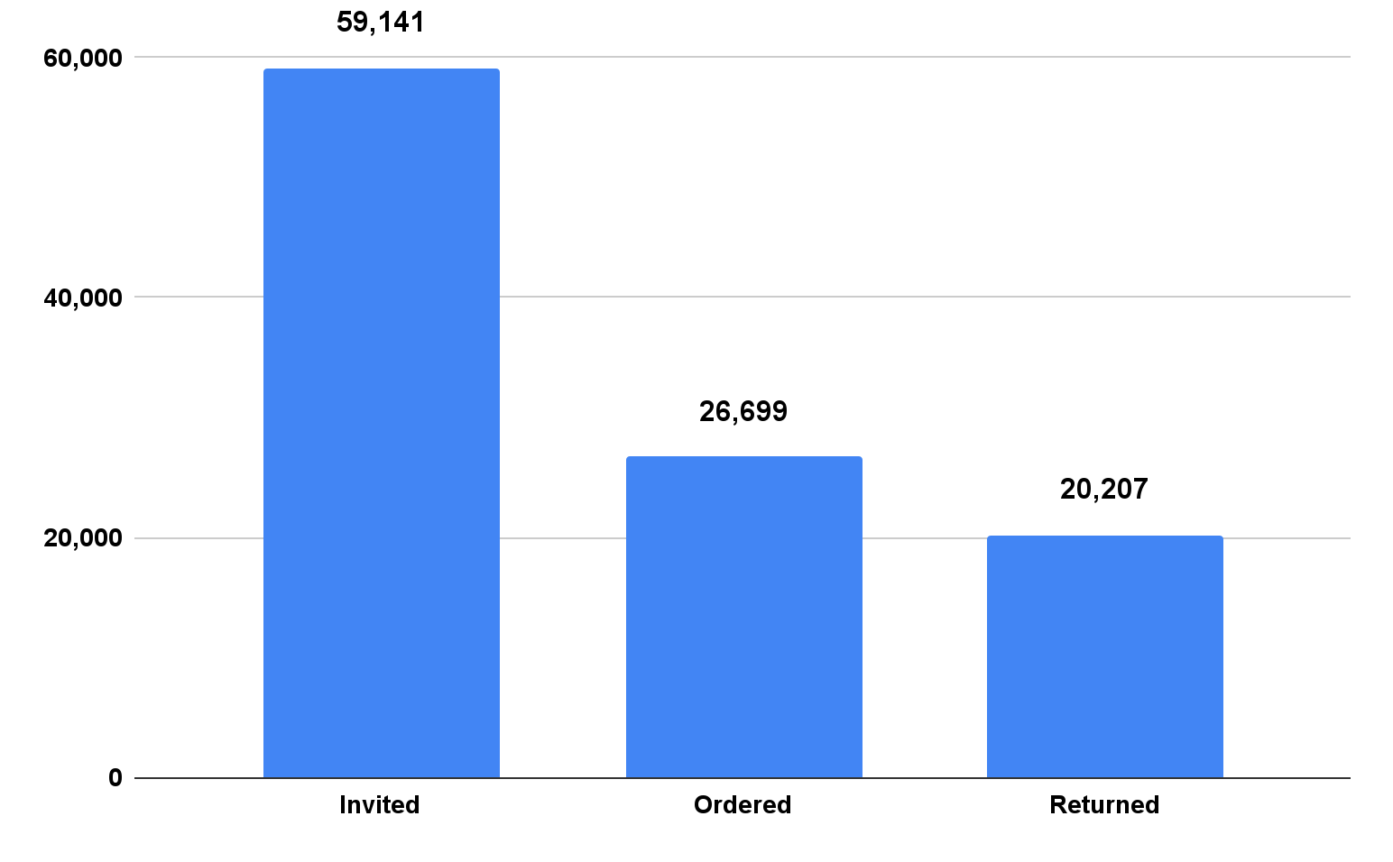
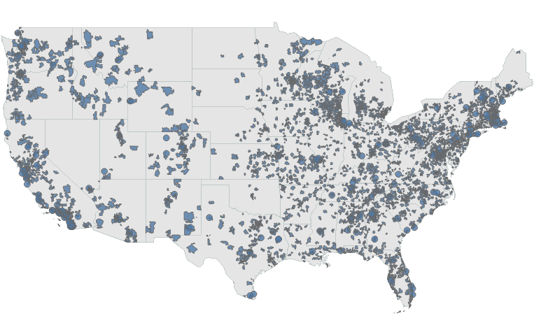
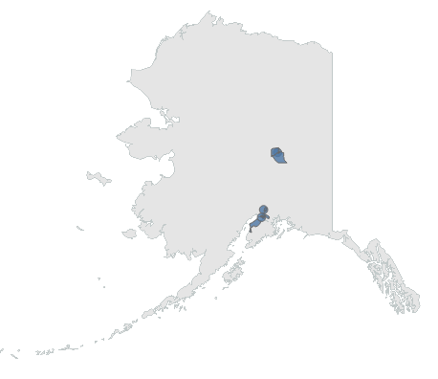
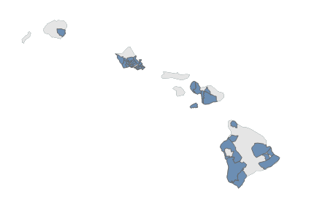
Sample Collections: In-Home Saliva Kit
In-home saliva collection invitations, kit orders, and returns by All of Us participants
Geographic distribution of All of Us participant orders for in-home saliva collection kits
Data as of 4/1/2022

Slide 16
Protocol Observation & Trends: Ordering & Return Rate
Ordering Rate
Overall for All of Us is 45.1%
Varies based on timing of invitation / ordering access
~60% or greater for real-time invites (upon eligibility) during portal usage
~40% for lagged invites within 6 months of eligibility
~20% for participant reactivation / recovery beyond 1 year of eligibility
Ordering rate varies based on educational attainment, income, and race & ethnicity
21% vs 41% for less than high school vs. high school / GED & above
Kit Return Rate
Overall for All of Us is 75.6%
Active protocol with continuous ordering and shipment
Stable return rate exceeds 80% for kits 12 weeks after shipment
For all kits returned to the biobank
90% are returned by participant less than 21 days after USPS delivery to home
(Updated 4/1/2022)

Slide 17
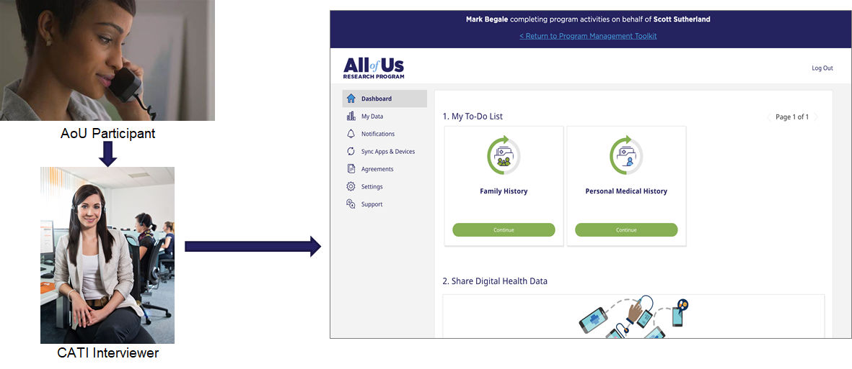
Emerging Opportunities: Expanded Participant Communications & Support
All of Us recently expanded the in-home saliva protocol to allow the use of postal mail following digital communications
Invitation reminder and instructions for self-service or phone-based ordering
Kit return reminder
CATI enabled saliva kit ordering by phone
Using CATI interview staff & system
Increasing participant awareness & remote support to access biosample collection

Slide 18
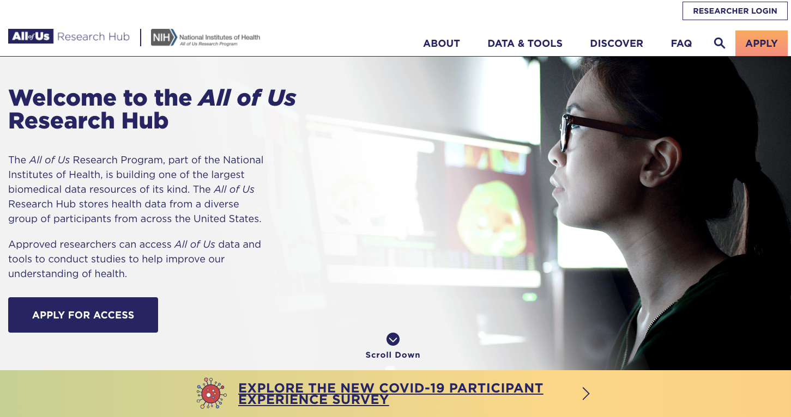
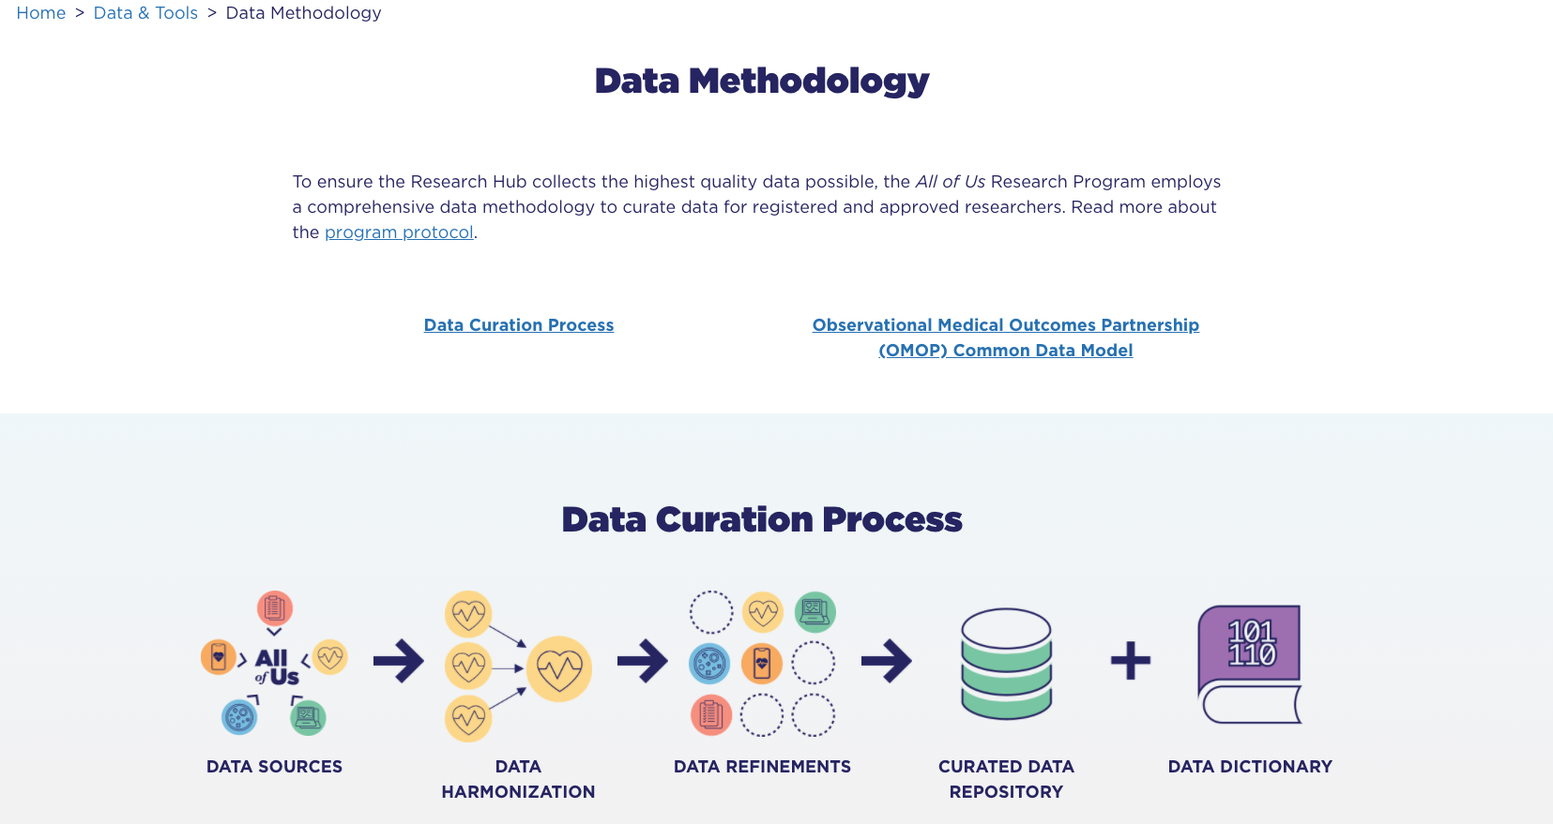
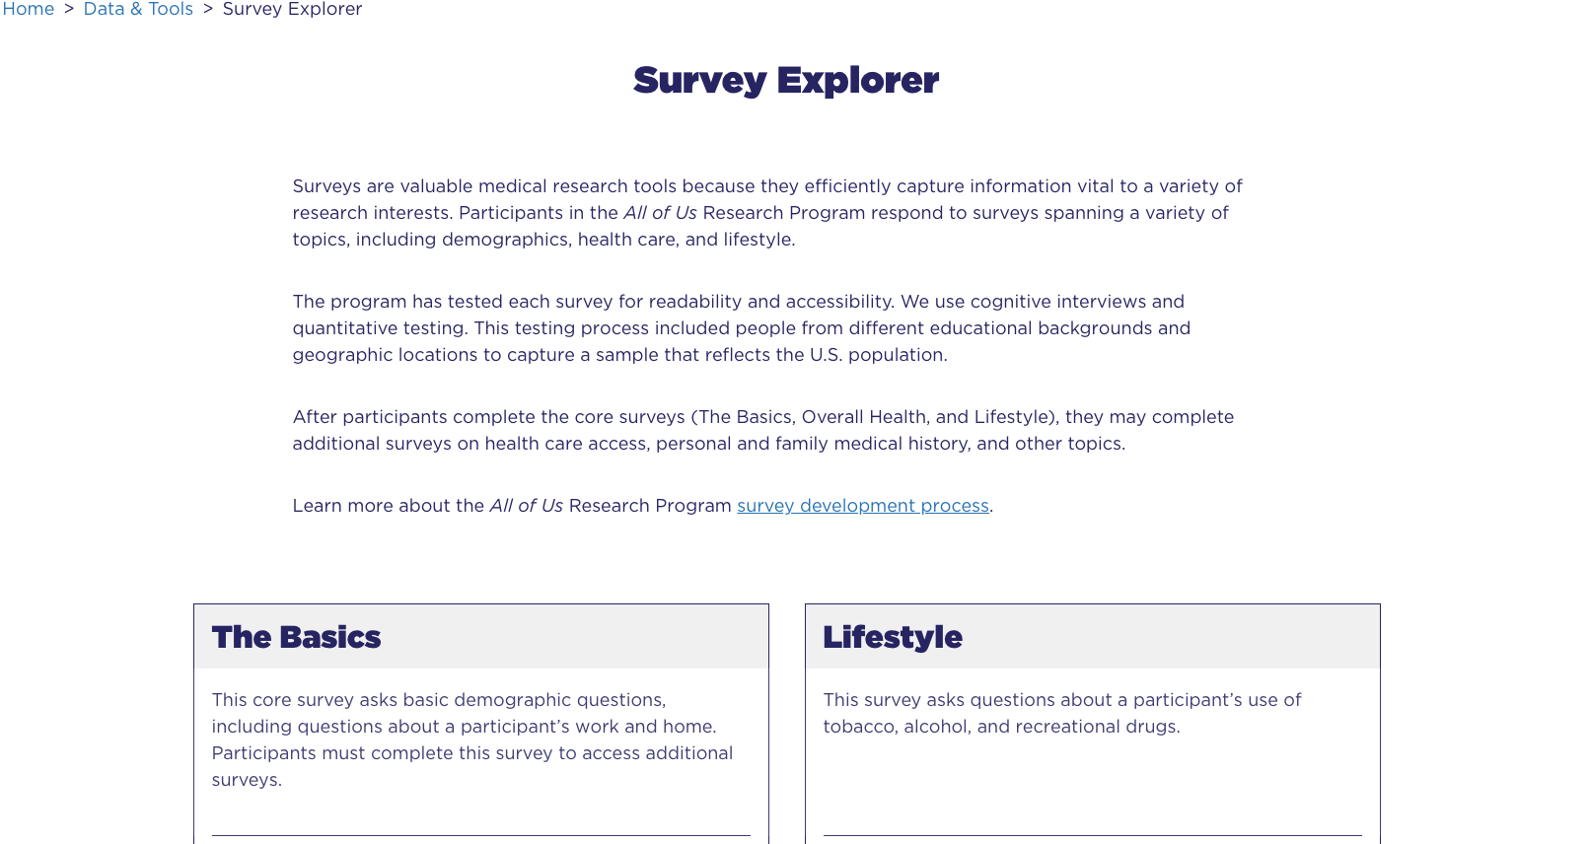
All of Us Research Data Access: Begin Process at Research Hub Website
ResearchAllofUs.org
Goal: To provide more information about program data and tools.
Data Snapshots: broad cohort metrics
Data Browser: interactive tool
Survey Explorer: source information for participant-provided information
Researcher Workbench: restricted cloud-based platform designed to execute rapid, hypothesis-driven research

Slide 19



Tiered Data Access Levels for Research
Public Tier The Public Tier dataset contains only anonymized, aggregate data which is available to anyone through the Data Browser and Data Snapshots on ResearchAllofUs.org.
Public Tier tools include: Data Browser, Research Projects Directory, Publications, Data Snapshots, and the Survey Explorer.
Registered Tier The Registered Tier dataset contains curated, anonymized, and individual-level data which is available to registered researchers on the Researcher Workbench.
Registered Tier tools include: Cohort Builder, Dataset Builder, Workspaces, Notebooks, and the Support Hub.
Controlled Tier (Released March 2022) The Controlled Tier curated dataset will be available to registered researchers on the Researcher Workbench who have taken additional steps and training to access this data.
Controlled Tier data will include: Genomic data, additional clinical fields in electronic health records, and additional demographic data from surveys that are suppressed or generalized in the Registered Tier.
*Counts between all three data tiers and Data Snapshots may vary due to the lag time associated with the data curation process. The curation process for the Public, Registered, and Controlled Tier data takes several months. Data Snapshots are updated daily to report current program enrollment and data collection status.

Slide 20






JoinAllofUs.org
ResearchAllofUs.org
AllofUs.nih.gov
@AllofUsResearch
#JoinAllofUs

