Slide 1
Biomeasure Collection for the
National Social Life, Health, and Aging Project (NSHAP)
Katie O’Doherty

Slide 2
Outline
01 | NSHAP Background
02 | Interviewer Administered Biomeasures
03 | Self-Administered Biomeasures

Slide 3
NSHAP Background
National Social Life, Health and Aging Project (NSHAP)
Longitudinal study of social life and health
National area probability sample of older adults
Interviewed approximately every five years
.
2005
2010
2015
2021
Round 1
Round 2
Round 3
Round 4

Slide 4
NSHAP Background
Data collection design
Traditional Approach: In-Person Interview
  Rounds 1 - 4
  Conducted by field interviewer at respondent’s home
  Survey + minimally invasive biomeasures
  2-hour interview
  $100 incentive

Slide 5
NSHAP Background
New Approach: Remote interview
Added in Round 4 for half of sample
1 hour survey: web, phone or paper-and-pencil
At end of survey, invited to receive BioBox (self-collected biomeasures)
BioBox mailed to respondent
Interviewer provides support and prompting
$100 incentive

Slide 6
NSHAP Background
Biomeasures collected*
Senses
Body
Activity
BioSamples
Smell
Taste
Touch
Vision
Weight
Waist
Height
Blood pressure
Chair stand
10-foot walk
Accelerometer
Saliva
Blood
Vaginal sample
*Not all measures are collected in every round

Slide 7
Interviewer Administered Biomeasures

Slide 8
Interviewer administered biomeasures
  Collected biomeasures as part of in-person interview since round 1
  Prioritized selecting minimally invasive biomeasures that could be collected by an interviewer in the home
  Biomeasures selected in relation to the specific aims and research questions

Slide 9
Interviewer administered biomeasures
Operational considerations
Adapt to in-home collection
Develop step-by-step protocols
Respondent and Interviewer burden
Operational feasibility
Cooperation rates
and data quality
Human subjects
and consent

Slide 10
In Person biomeasure cooperation rates
Biomeasure | Round 1 | Round 2 | Round 3
Weight | 98% | 98% | 98%
Waist | 97% | 98% | 97%
Height | 99% | 98% | 99%
Blood Pressure | 98% | 98% | 98%
10 Foot Walk | 94% | 96% | 98%
Chair Stands | 94% | 94% | 98%
Smell | 98% | 96% | 96%
Taste | 96% | n/a | n/a
Distance vision | 96% | n/a | n/a
Saliva | 89% | 95% | 91%
Vaginal Swabs | 68% | 73% | n/a
Blood Spots | 85% | 92% | 92%
Accelerometer | n/a | 78% | 84%

Slide 11
Self-Administered Biomeasures

Slide 12
Remote data collection background
New to R4: NSHAP Remote Data Collection Protocol
Questionnaire
Web, phone, or paper-and-pencil
BioBox
Mailed to respondent
Ends with consent to receive the BioBox
Interviewer provides support
Notes:
The NSHAP Remote Data collection protocol begins with the NSHAP questionnaire, either completed via web, phone, or paper and papi. At the end of the questionnaire, regardless of mode, respondents are invited to consent to receive the BioBox, which is the term we use for the kit containing all the supplies and instructions for respondents to self-collect their own biomeasures.
The BioBox is then sent to the Respondent and we use Field Interviewers to provide and support and prompting for the BioBox.

Slide 13
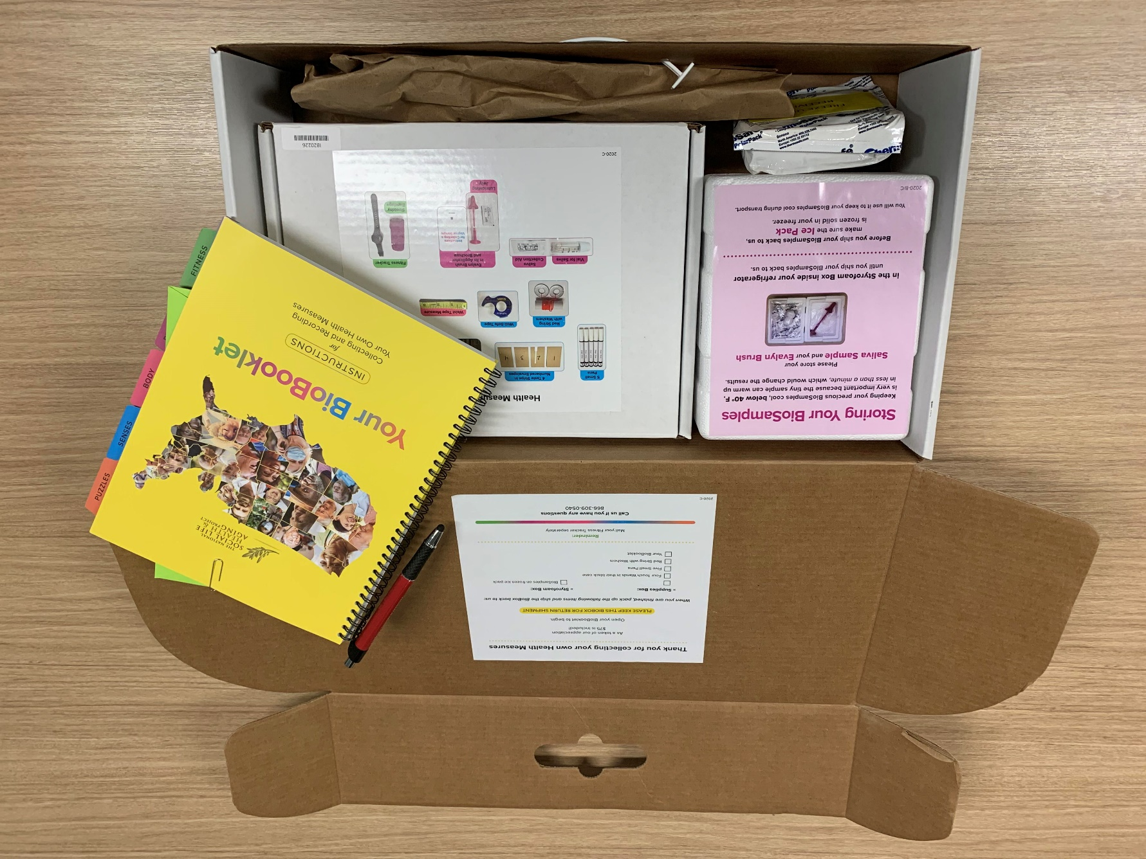
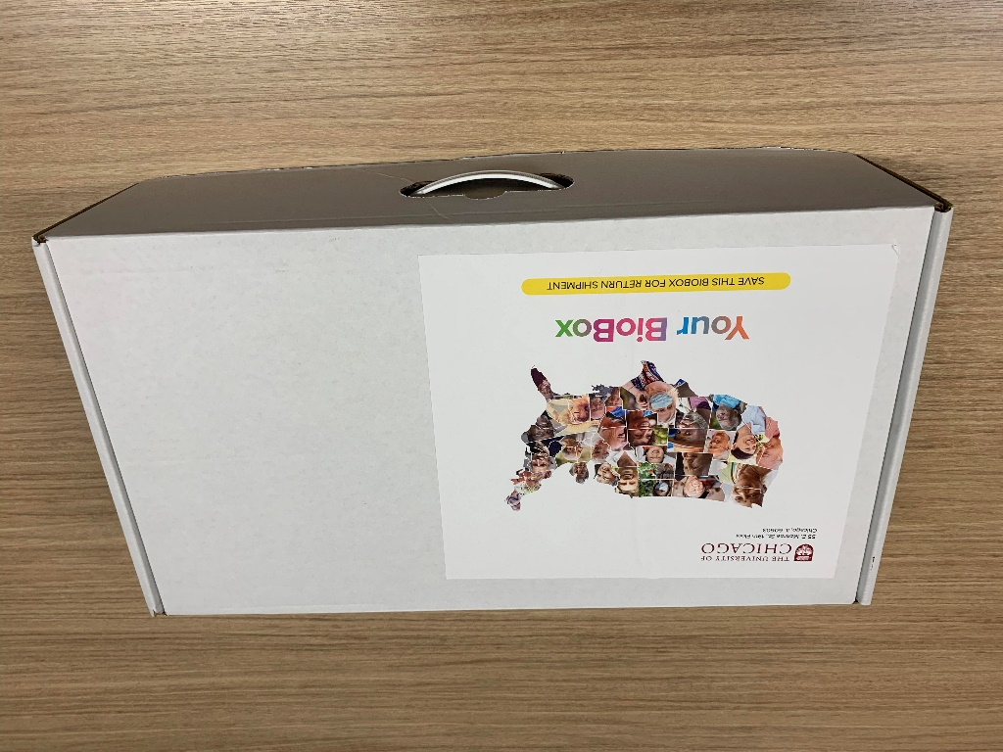
BioBox overview
NSHAP BioBox
BioBox
BioBooklet
Specimen storage
Supply Box

Slide 14
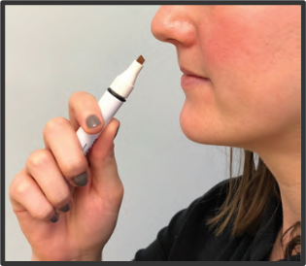
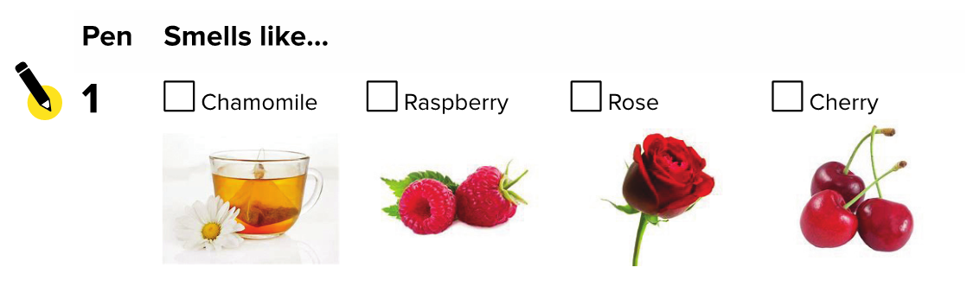
BioBooklet overview
BioBooklet
  Simple step-by-step instructions
  Record answers
  Organized and color coded to help them find the supplies in the BioBox

Slide 15
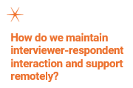
Biobox: interviewer support and prompting
Biobox Follow-Up Calls
  Shipping Notification
    Brief check-in to notify respondents when to expect biobox
  Arrival Call
    Walk-through biobox and answer initial questions
  Follow-Up Call
    Encourage completion, troubleshoot, and confirm return shipping
  Prompting
    Prompt on unreturned bioboxes

Slide 16
Biobox development
BioBox Lab Pilot and Field Pretests
  BioBox lab pilot (n=60)
    Design of the BioBox
    BioBooklet instructions
    Assessed what worked
  Small field pretest: phone questionnaire + BioBox (n=48)
    Integration of questionnaire + BioBox
    Consent process and language
    Mailing and return protocols
    Interviewer follow-up call content and process

Slide 17
Biobox development
BioBox Field Pretests Continued
  Large field pretest: web/phone/PAPI questionnaire + BioBox (n=415)
    Scalability
    Experiment
      Impact of BioBox length: short (1 hr) vs. long (1 ½ hrs)
      Impact of including biosamples and blood

Slide 18
Biobox results from large pretest
Pretest Experiment: Consent to Receive BioBox
 | Blood (n=323) | No Blood (n=303)
 | Percent Consented | Percent Consented
Short No Biosample | 72% | 71%
Short Biosample | 66% | 67%
Long Biosample | 57% | 70%

Slide 19
Biobox results from large pretest
Pretest Experiment: Return BioBox
 | Blood (n=205) | No Blood (n=210)
 | Percent Returned | Percent Returned
Short No Biosample | 84% | 89%
Short Biosample | 79% | 87%
Long Biosample | 67% | 75%

Slide 20
Round 4 biobox results
Currently in Round 4
Selected short BioBox (1 hr) with some biosamples
Web/phone/PAPI questionnaire + BioBox (n=1884)
Eligiblity
  BioBox
  Tasso (blood collection device)

Slide 21
Round 4 biobox results
BioBox preliminary consent rate from R4*
 | BioBox % (n=1579) | Tasso % (n=305)
Consented | 82% | 92%
Refused | 18% | 8%
*Round 4 remote data collection is still ongoing

Slide 22
Round 4 biobox results
BioBox preliminary return rate from R4*
 | BioBox % (n=1300) | Tasso % (n=280)
Returned | 84% | 93%
Did not Return | 16% | 7%
*Round 4 remote data collection is still ongoing

Slide 23
Future
Next steps after Round 4 is complete
Analyze who consents and returns the BioBox vs. those that do not consent and/or return the BioBox
Compare biomeasure data collected by interviewer vs. respondent self-collection

Slide 24
acknowledgements
The National Social Life, Health and Aging Project is supported by the National Institute on Aging and the National Institutes of Health (R01AG021487; R37AG030481; R01AG033903; R01AG043538, R01AG048511). The content is solely the responsibility of the authors and does not necessarily represent the official views of the NIH.
NSHAP is directed by Linda J. Waite, Principal Investigator
NSHAP Co-Investigators: Kathleen A. Cagney, Benjamin Cornwell, William Dale, Louise Hawkley, Elbert Huang, Megan Huisingh-Sheetz, Diane Lauderdale, Edward Laumann, Martha McClintock, Colm O'Muircheartaigh, Jayant Pinto, and L. Philip Schumm.
McClintock Survey Biomeasure Laboratory (University of Chicago), Sera Burke (SBDWorks Inc.), and Terri Coughlin (Classic Color Inc.) responsible for BioBooklet design
NORC is responsible for data collection design, data collection, and delivery

Slide 25
Thank you.
Katie O’Doherty
  Principal Research Director
  Odoherty-Katie@norc.org

