Slide 1
Choice Matters: Testing Multiple Video Platforms To Collect Survey Data
Jesus Arrue, Darby Steiger, David Cantor (Westat)

Slide 2
Disclaimer
The statements in this presentation are those of the presenter and do not necessarily represent the views of the Agency for Healthcare Research and Quality (AHRQ) or the Department of Health and Human Services (DHHS).

Slide 3
Presentation outline
Background on CAVI and motivation
Why CAVI for MEPS?
Video platforms and key features
Analysis
Findings on key features
Next steps

Slide 4
Background on CAVI and motivation (1)
Computer-Assisted Video Interviews (CAVI) – also known as videophone interviewing, video interviews, live video survey interviews, video-mediated interviews, video-mediated surveys
Enables real-time video and audio communication, as well as it enables the interviewer to send texts and display multi-media material to the respondent (Lavrakas, 2008)
Briefly mentioned in literature – already used in focus groups (Forrestal, et al. 2015; Mayer, et al. 2006)
Became an alternative mode of data collection due to COVID-19 (Schober, et al. 2020)

Slide 5
Background on CAVI and motivation (2)
Main focus has been in how CAVI affects the collected data (e.g. quality) and how it may affect the respondent’s experience (Schober, et al., 2020; Larsen, et al., 2021)
To reduce respondent’s burden, different video platforms have been offered (Hanson, 2021; Schober, et al. 2020) but...
How this may affect the interviewer’s experience?
How different video platforms key features work?
How these can affect the overall interview?

Slide 6
Why CAVI for the Medical Expenditure Panel Survey (MEPS)?
COVID forced in-person interviews to telephone
Client push for CAVI to replace phone
CAVI seen as a way to mimic face-to-face interviewing
Desire to maintain face-to-face interactions between interviewer and respondent
Interviewer can facilitate next interview (e.g., build rapport)
MEPS has great dependence on records
Ability to share materials – show cards

Slide 7
Why CAVI for the Medical Expenditure Panel Survey (MEPS)?
Show cards for MEPS
Visual aids that contain response categories to items/questions
Video advantage over telephone (e.g., cannot display show cards over phone)
By phone, the show card is either read out loud (response order effect) by the interviewer, or the respondent can access them online (extra steps, increased burden)

Slide 8




Video platforms and key features
For our testing, we started with platforms that meet the level of security needed for federal surveys:
Zoom
Microsoft Teams
Google Meet
Apple FaceTime

Slide 9
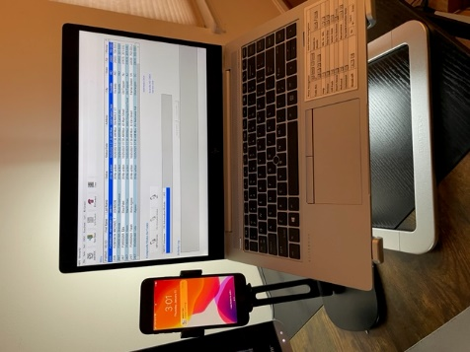
Video platforms and key features
Interviewer set up
MEPS iPhone
MEPS laptop with CAPI questionnaire
Separate devices to have a better control (e.g., display show cards and see the respondent with smartphone, read and type answers with laptop)

Slide 10
Video platforms and key features
Screen sharing
Step-by-step process
Respondent’s view of shared content
Process to stop shared content
What happens when screen sharing is stopped
Screen pinching
Expanding size of screen content

Slide 11
Analysis
Show how screen sharing and screen pinching work on a smartphone device on both ends (interviewer and respondent)
Focus on the screen sharing feature – ability to use show cards
How the respondent and interviewer experience the display of visual aids
How the screen pinching functionality can aid or affect the display of show cards

Slide 12
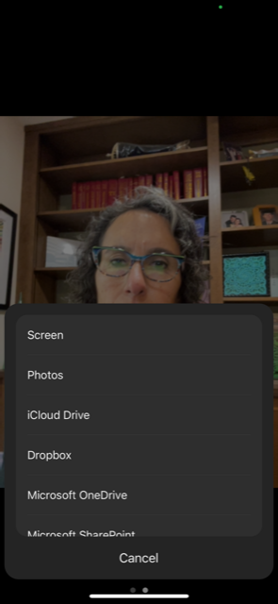
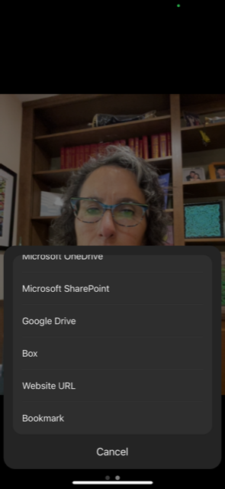
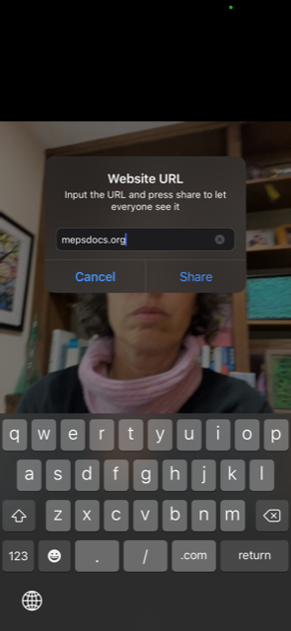
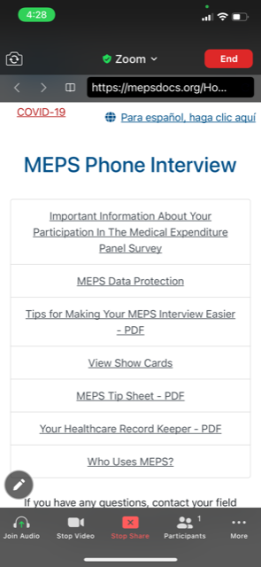
Screen sharing (1) – Step-by-step
1.Select “Screen” button | 2. Scroll down the list and select “Website URL” | 3. Type in the website URL | 4. Sharing begins

Slide 13
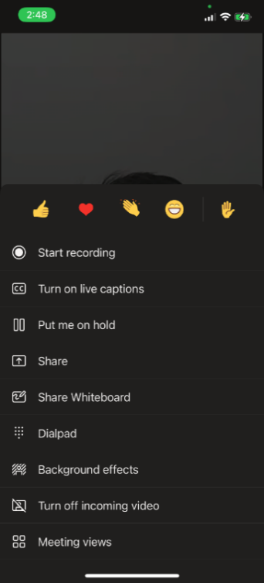
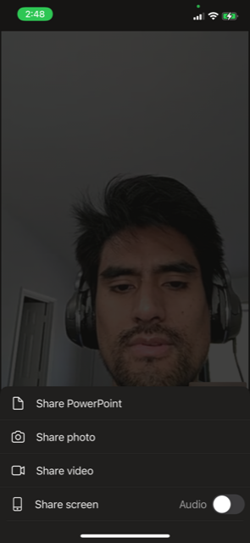
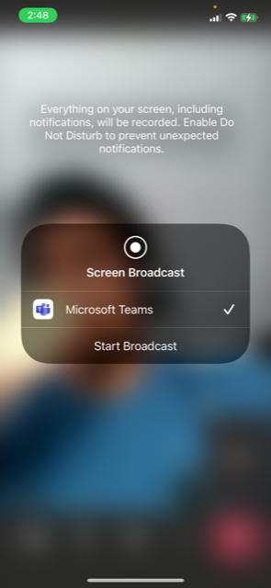
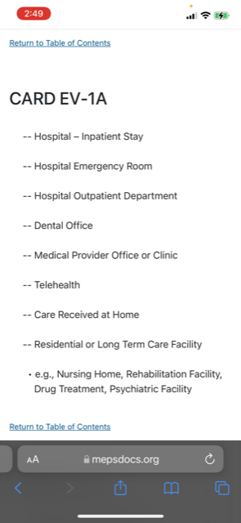
Screen sharing (1) – Step-by-step
1. Select “Share” button | 2. Select which feature you want to share. | 3. Warning sign | 4. Sharing begins

Slide 14
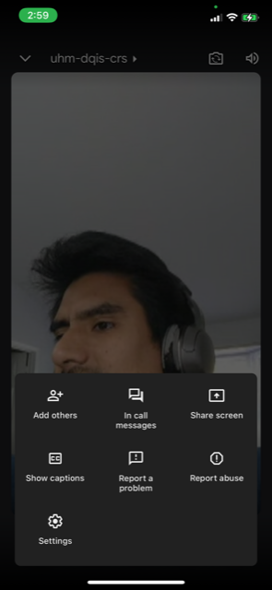
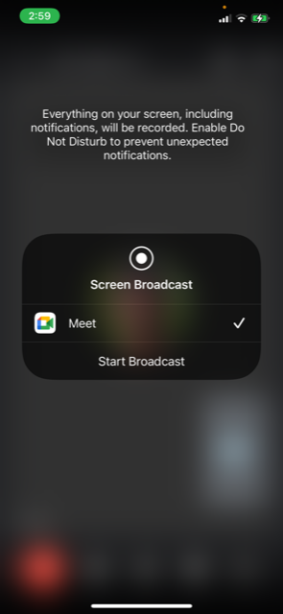
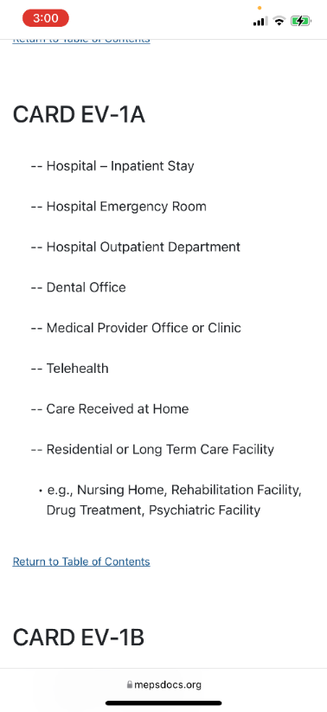
Screen sharing (1) – Step-by-step
1. Select “Share screen” button | 2. Warning sign | 3. Sharing begins

Slide 15
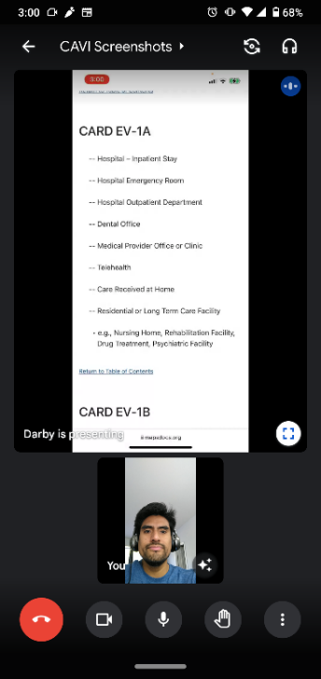
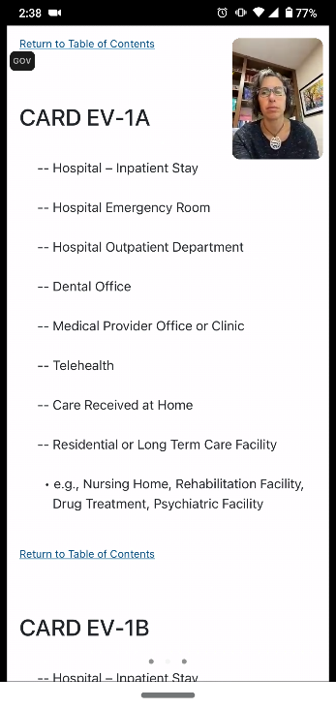
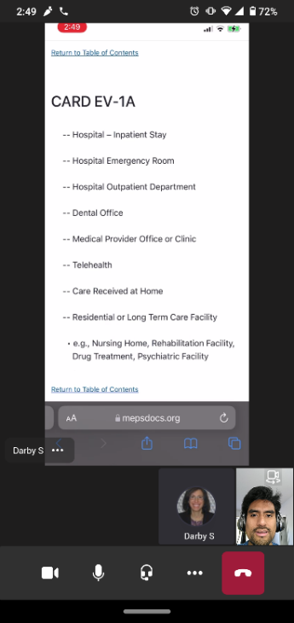
Screen sharing (2) – Respondent’s view

Slide 16
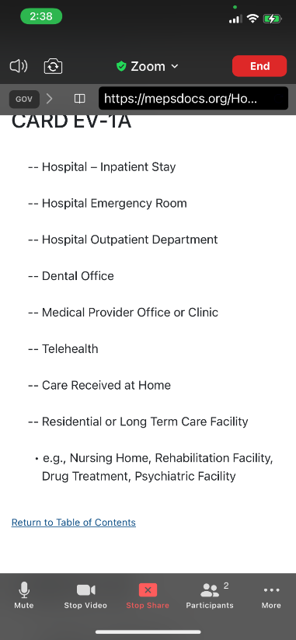
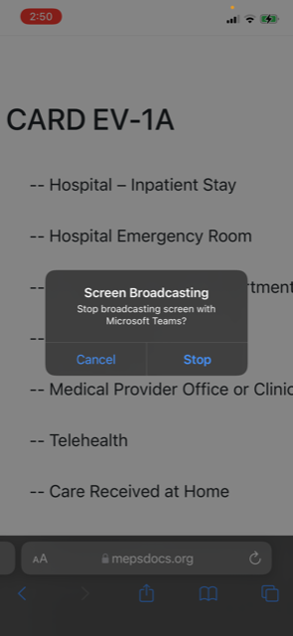
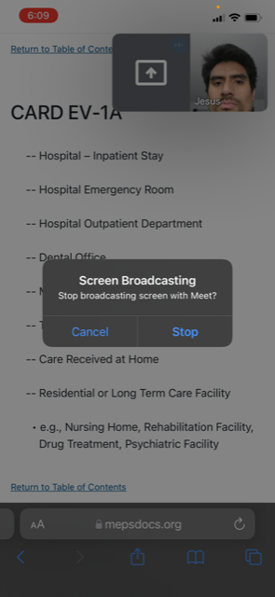
Screen sharing (3) – Stop shared content

Slide 17
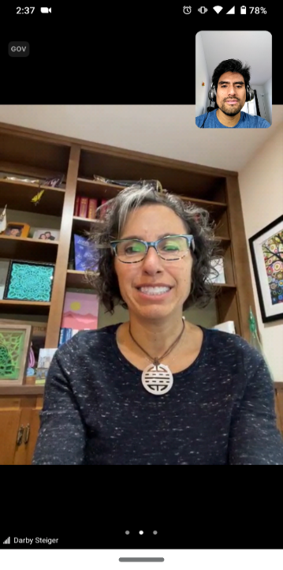
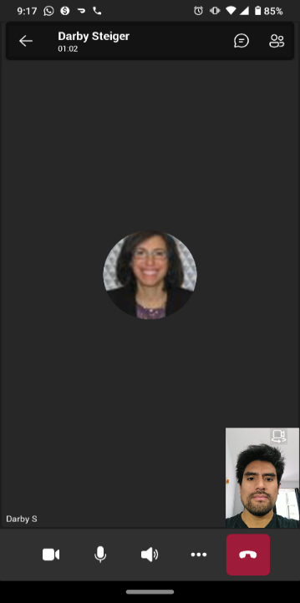
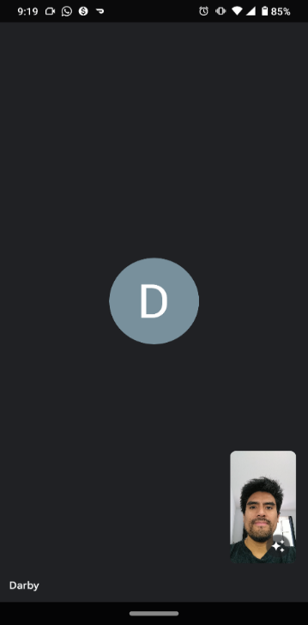
Screen sharing (4) – Respondent’s view after stopping shared content

Slide 18
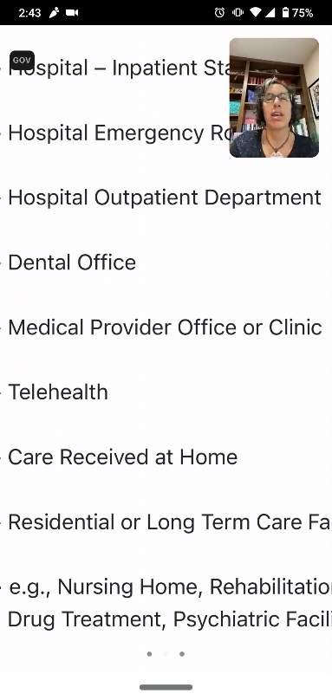
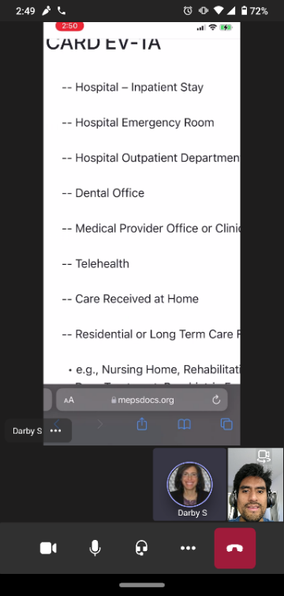
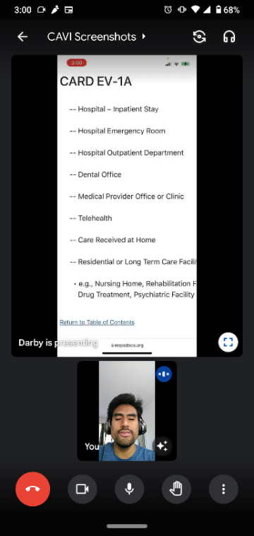
Screen pinching – Expanding the size of shared content

Slide 19
Implications (1)
The use of show cards is a challenge. It is somewhat time-consuming to turn on and off the screen sharing every time a show card is needed. May increase interview length.
Zoom may reduce interviewers’ burden…
No need to be aware of their camera being on or off after sharing content
Allows the display of only the URL (show card), not the whole content
No need to type the URL every single time
Teams and Google Meet allow respondents to see themselves (self-awareness), but at the expense of blocking some of the shared content.

Slide 20
Implications (2)
If the shared content is longer or wider than the screen size of the device, then the interviewers have to make extra steps (e.g. scroll down when solicited).
If the shared content font size is too small, respondents can pinch the screen to increase the size, giving them a sense of control, but giving them an additional task.

Slide 21
Next steps
Moving forward with Zoom, as it seems to ease the interview experience (e.g., reduces interviewers burden, smooth transitions when start/stop using show cards)
Focus on how CAVI can be more effective than CATI in terms of:
Gaining cooperation
Building rapport
CAVI potential impact on data quality

Slide 22
Thank you!
Jesus Arrue (JesusArrue@Westat.com)

