Slide 1

Electronic Advancements in Complex Multimode Collection: Using Digital Signatures to Access Medical Records on the Medical Expenditure Panel Survey
Monica Wolford, Jill Carle, Rick Dulaney, and Ryan Hubbard
April 6th 2022

Slide 2
Administrative Records Collection
Collecting consent for additional data
Historically used hard-copy data collection
Time-consuming for field staff
Long response times
Refusal point

Slide 3
Advances in Electronic Signatures
Increased prevalence during pandemic (Shakhnovich 2021)
Flexible, secure signing options
Widely available with multiple competitors
Efficient and timely

Slide 4
Electronic Consent Case Study: The Medical Expenditure Panel Study
Household Component:
CAPI survey of ~15,000 HHs (supplemented by CATI during the pandemic) over multiple rounds
HH respondent asked to provide information about medical visits for all HH members
Medical Provider Component:
Using Authorization Forms (AFs) signed by HH members for each medical visit
Request date, type, location, and cost of service

Slide 5
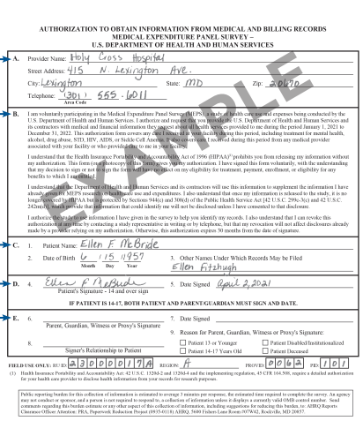



Authorization Forms: Historical Approach
Faxed
Scanned
Mailed
Accessed via Secure Portal

Slide 6
Transition to Electronic Authorization Forms
Building eSignature, DocuSign capabilities
Designing apps, document flow, content
Updating CAPI
Collecting contact information for all HH members
Evaluating AF processing
Developing cloud storage options

Slide 7
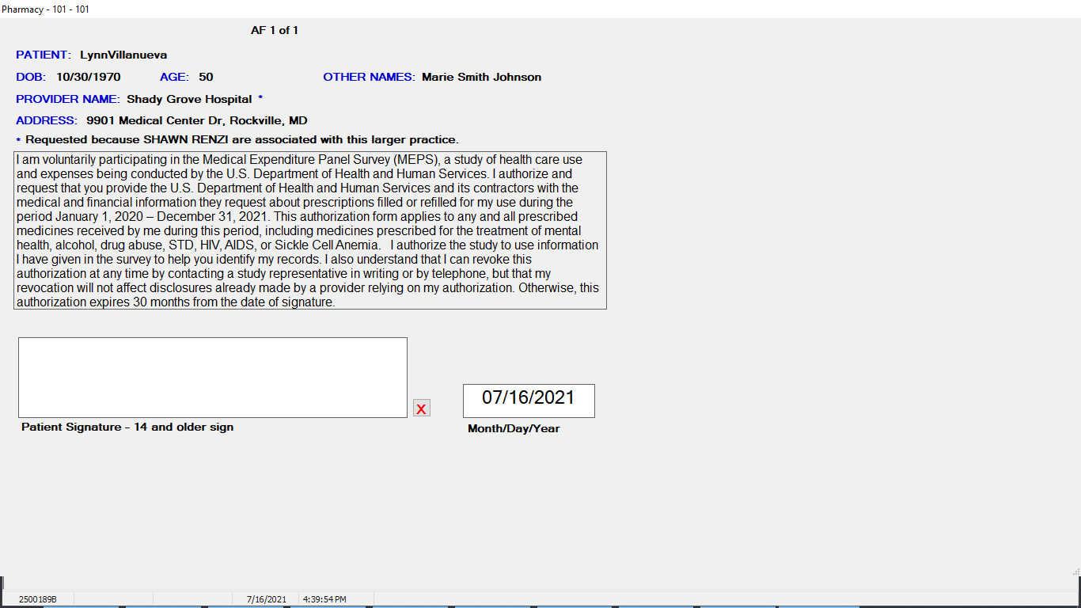

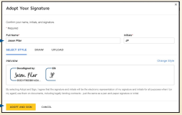
Authorization Form Flow
Present at time
of interview?
Contact info available?
Paper
No
No
Yes
Yes
eSignature app via CAPI
DocuSign

Slide 8
AF Signature Mode Linked to Survey Mode
Implemented from January - March 15, 2022: 46,687 forms
AF Completions by Signature Mode and Survey Mode

Slide 9
Higher Proportion of Completed AFs
Initial delivery estimates show modest increase in AF completions
AF Completions by Form Type over Time

Slide 10
Electronic AFs and Form Rejection Rate
AF Rejection Rate by Signature Mode
Signature Mode | Receipt Rejection (%)
eSignature | 4.56%
DocuSign | 4.24%
Paper | 2.45%

Slide 11
Continuing Innovation
Refining, streamlining processes
Allowing more flexibility in DocuSign completions
Explore respondent-based form correction
Further reduce paper collection through respondent education
Evaluating efficacy with medical providers

Slide 12

Thank You!
Monica.Wolford@AHRQ.HHS.gov 301-427-1651
JillCarle@westat.com
480-993-6881

