Slide 1
New Beginnings: User Interface Design in a new National Longitudinal Survey of Youth, NLSY26
Safia Abdirizak
National Longitudinal Surveys
FedCASIC
April 11, 2023

Slide 2
Introduction
NLSY26 in Development: a new NLS youth cohort
Unique opportunity to reconsider how we engage with NLS users and respondents
User Interface / User Experience (UI/UX):
In this presentation we will:
Identify best practices
Explore implementation in other longitudinal surveys
Evaluate how NLS may apply these lessons
Notes:
The National Longitudinal Surveys (NLS) are a set of surveys designed to gather information at multiple points in time on the labor market activities. The NLS program at BLS is currently developing a new youth cohort and this unique opportunity has really given us a chance to reconsider how we engage with NLS users and respondents
And one of those ways is through our NLS user interface or website, so in this presentation we will identify some best practices in user interface and experience design and explore how other longitudinal surveys implement some of these, as well as evaluate how NLS may apply these lessons

Slide 3


On-going NLSY Cohorts
NLSY79
Birth years 1957 to 1964
Interviewed annually from 1979 to 1994, biennially since
NLSY79 Child and Young Adult
Children of the women of the NLSY79
Born 1970 to 2014
NLSY97
Birth years 1980 to 1984
Interviewed annually from 1997 to 2011, biennially since
Included a parent interview as part of Round 1
Sponsored by NICHD
Beginning in 1994, upon age 15, interview like NLSY79
Notes:
To give some background, to develop the new NLSY cohort, BLS will draw upon its experience and analysis from its two ongoing cohorts, the National Longitudinal Survey of Youth 1979 (NLSY79) and the National Longitudinal Survey of Youth 1997 (NLSY97),
NLSY79 (ages 57 to 65) currently in their late 50s to mid 50s
NSY79CYA — Collaboration with NICHHD; who are the children of the woman of the NLSY79
NLSY97 (who are now in their mid 30s to early 40s)

Slide 4
Content in Past Surveys
Household Information
Parental Background
Family Process
Substance Use
Crime and Criminal Justice
Schooling
Training
Marriage and Cohabitation
Fertility
Migration History
Income
Assets
Program Participation
Notes:
Here are some of the content we’ve collected in past surveys and employment being the backbone of NLSY surveys, we collect detailed event-histories of each job held but we also collect information on other factors that affect labor market outcomes

Slide 5
Developing a new NLSY

Slide 6

NLSY26
Sample
Emerging Issues in Childhood
17,000 youth ages 11 to 17 at the start of the survey
Nationally representative, with oversamples of Black and Hispanic youth
Technology, screens, and social media
Mental Health and Environmental Exposures
Increasing Inequality
Sexual Orientation and Gender Identity
Measuring Skills
Plan to sample and collect first round of data in 2026
Notes:
This new cohort will also collect detailed information on the labor market and researchers will be able to gain a better understanding of the factors that are influencing labor market outcomes of Generation Z and will be able to conduct cross-cohort analyses with the older NLSY cohorts.
First round will include in-person outreach and interview for youth
Parent/caregiver interview as part of Round 1

Slide 7
Current NLS Interface

Slide 8
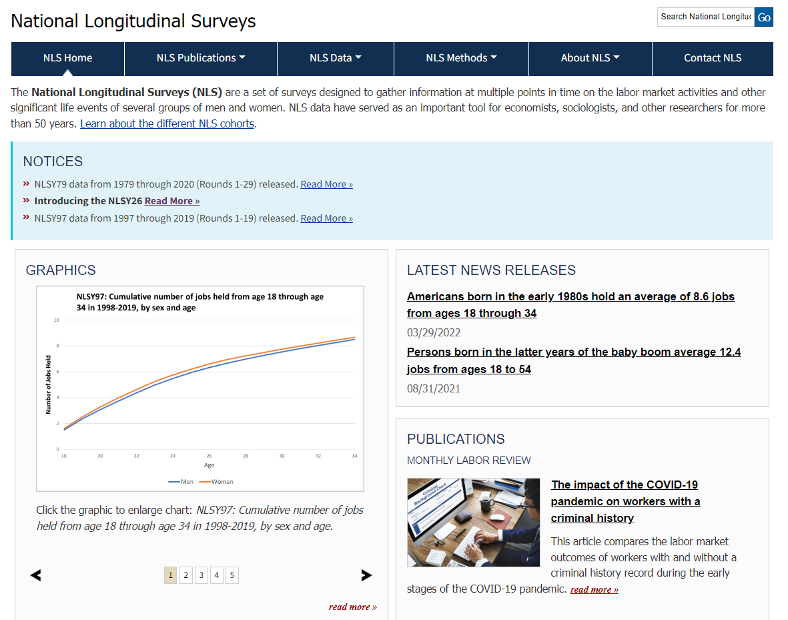
Notes:
All BLS interfaces have a uniform look across all programs. The navigations bar and layout across sites follow a specific format which does place some constraints on what NLS can do to a certain extent but as we go through this presentation we will some examples of things we can implement while still fitting within the BLS framework

Slide 9

Google Analytics Web Metrics Mar 2022- Mar 2023
Page Views
Unique Page Views
Bounce Rate
Avg. Time on Page
Sessions
21,747
18,059
44.37%
00:01:07
12,246
Notes:
Data from Mar. 22 to Mar.23
Pageviews are reported when a page is loaded on the website, including multiple loads of the same page by a user within a session.
Unique pageviews only count the first time a user browses a page within a session.
Bounce rate is the percentage of sessions in which users viewed only a single page
A session is a single visit to your website, with one or more pageviews, in which a user is actively engaged with the website.

Slide 10
Top 10 NLS Pages
1. National Longitudinal Surveys Home Page : U.S. Bureau of Labor Statistics
2. NLSY97 Data Overview : U.S. Bureau of Labor Statistics
3. NLSY79 Data Overview : U.S. Bureau of Labor Statistics
4. NLS FAQs : U.S. Bureau of Labor Statistics
5. Accessing NLS Data : U.S. Bureau of Labor Statistics
6. NLSY79 Child and Young Adult Data Overview : U.S. Bureau of Labor Statistics
7. NLSY26 Overview : U.S. Bureau of Labor Statistics
8. The Geocode Application Document : U.S. Bureau of Labor Statistics
9. NLS Cohorts (Active) : U.S. Bureau of Labor Statistics
10. Mature and Young Women Data Overview : U.S. Bureau of Labor Statistics

Slide 11
User Interface (UI) and User Experience (UX) Design

Slide 12
Components of UI/UX Design
Visual Design
Interaction Design
Information Architecture
Notes:
components of UI/UX design., which primarily focuses on anticipating what users might need to do and ensuring that the interface has elements that are easy to access, understand, and use to facilitate those actions.
Visual design is primarily focused on aesthetics and considering how the interface and related materials look. the user's eye should be drawn to the correct information
Interaction design- Interaction design focuses on the way users interact with the interface and uses principles of good communication to create desired user experiences. ” Good usability is a fundamental requirement for interaction design. Learnability (how easily can a new user learn to use the interface?), efficiency (how quickly can users perform tasks?), error rate (how many errors do users make while interacting with UI?)
Information architecture-Information architecture is a discipline that focuses on the organization of information. A successful information architecture with a structured design helps retain users, reduce bounce rates, and boost a website’s usability. In user interface design the structure of information presented should create a flow that lets users navigate between screens without much effort.

Slide 13
Best Practices for Designing an Interface
Keep the interface simple.
avoid unnecessary elements create clear and concise language on labels and in messaging.
Create consistency
create patterns in language, layout and design throughout the site to help facilitate efficiency
Be purposeful in page layout
Consider spatial relationships between items on the page and structure the page based on importance.
Notes:
Once a user learns how to do something, they should be able to transfer that skill to other parts of the site.
3 click rule- users should be able to find the information they need within 3 clicks

Slide 14
Exploring other Longitudinal Surveys’ Interfaces

Slide 15
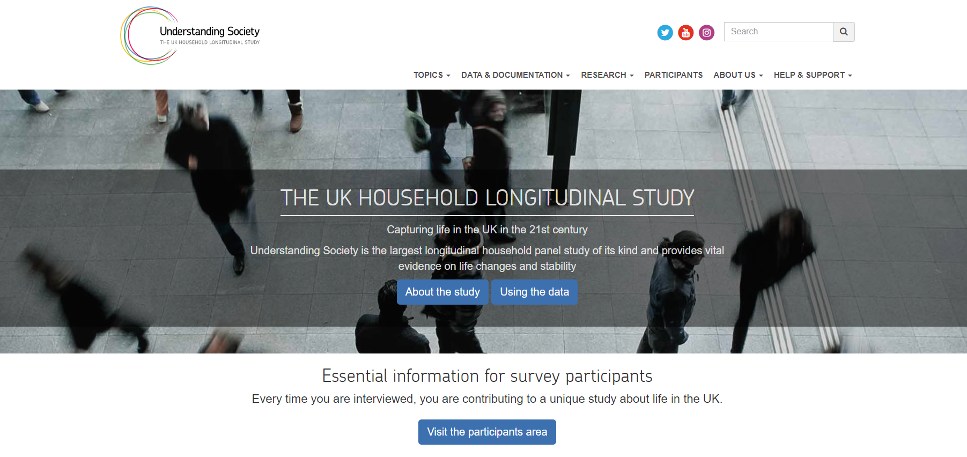
Notes:
So in thinking about the best practices and components of UI/UX design. IN this example from the UK’s Understanding society we can see that at first glance this site keeps the interfaces simple and gives the layout some breathing room - it doesn't cram all the information and elements together on the screen. And users are not overwhelmed with a ton of information that they have to sift through

Slide 16
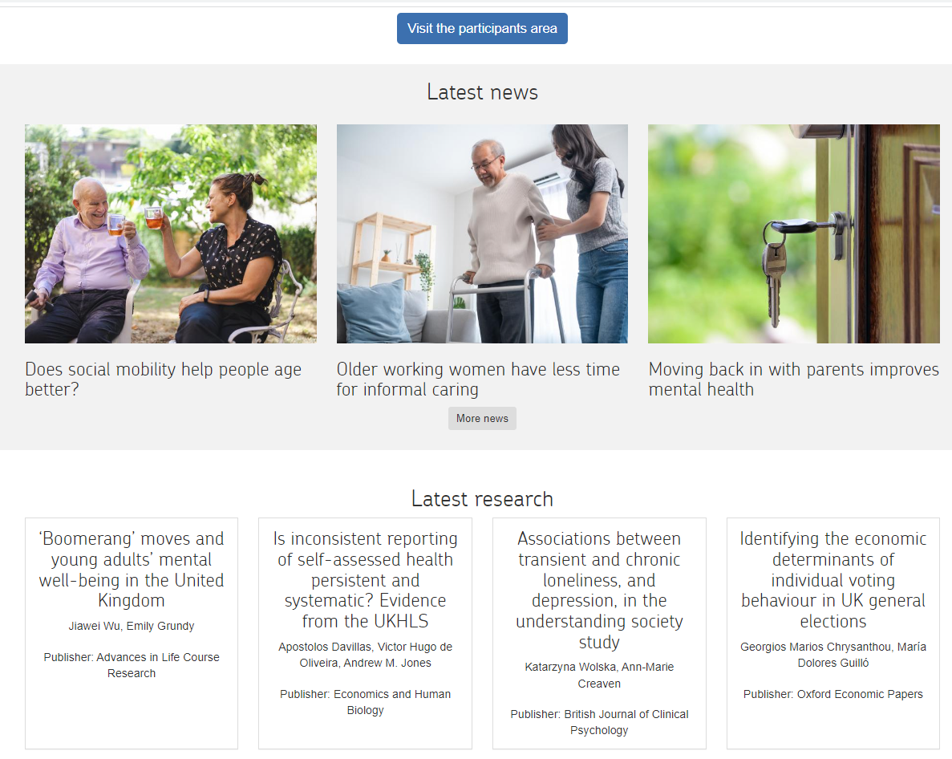
Notes:
And with this interface in particular, instead of moving between several different pages users have the ability to scroll down on the same site to view more information so overall Understanding Society is very purposeful in the layout of their interface

Slide 17

Notes:
Moving on to the Health and Retirement Study, this landing page splits users into separate sites depending on whether its someone from the media or a researcher or if it’s a study participant or even a potential respondent that is looking for more information about the HRS

Slide 18
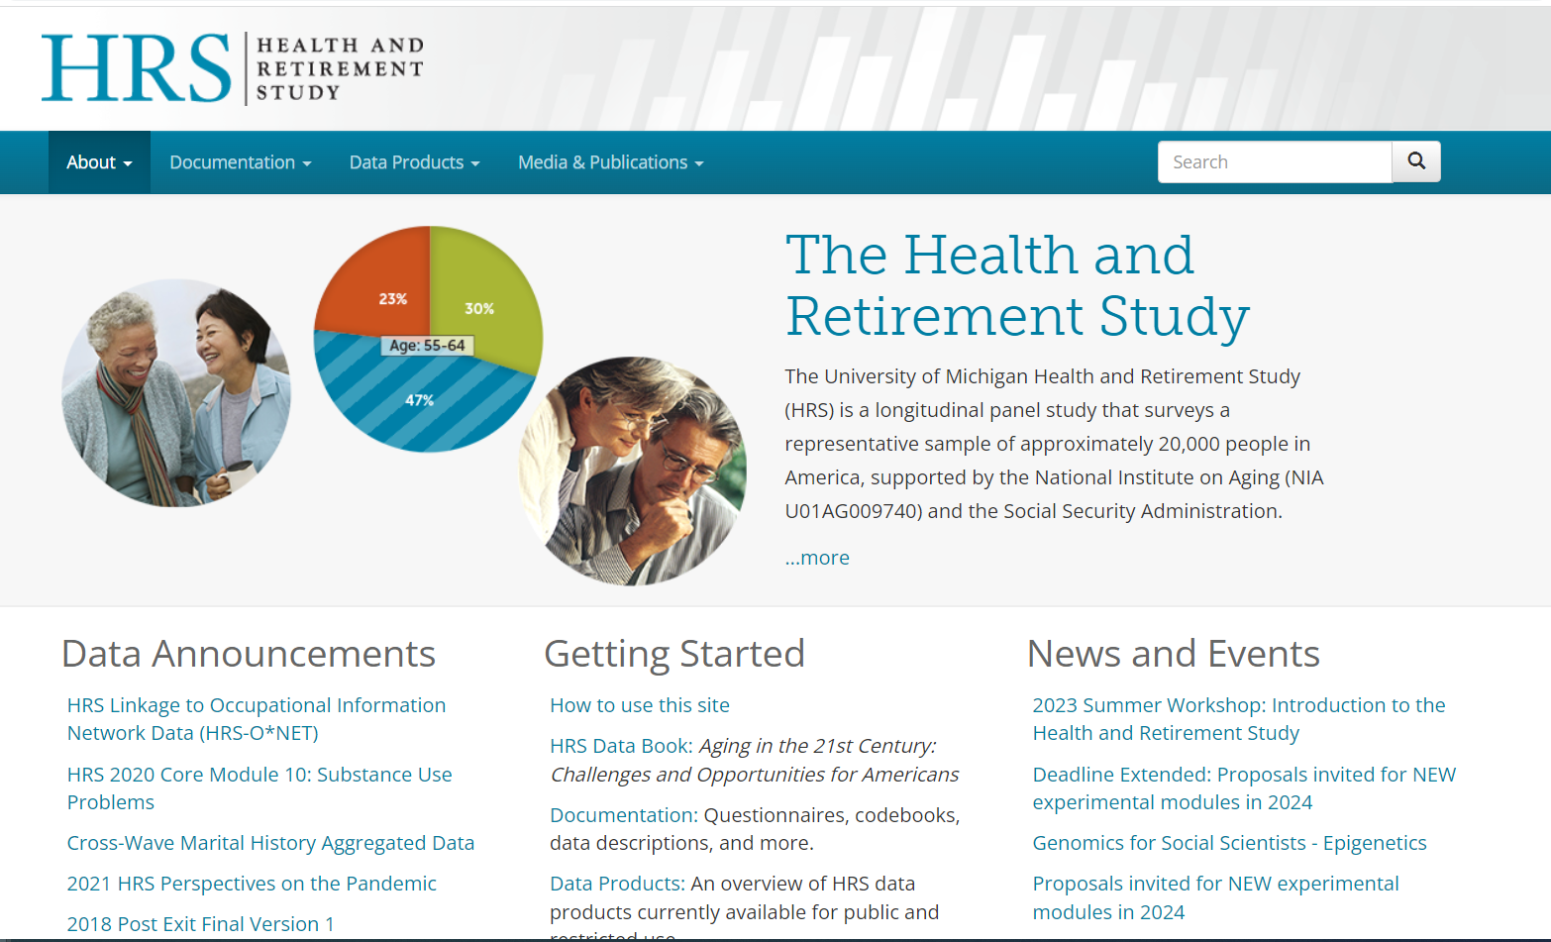
Notes:
If you click the researcher’s site;
This is a really good example of information architecture at its best.
The page gives users a quick summary of the HRS and in the bottom sections walks users through data announcements, then leads them with information how to get started with using the data, and finally news and events to look forward to
HRS also follows the same principles in their navigation bar to create consistency in the language and themes presented on their interface

Slide 19
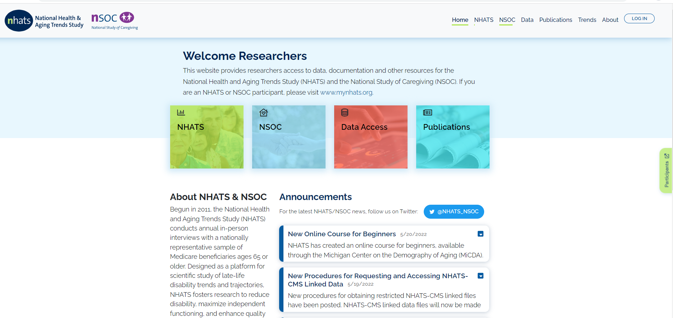
Notes:
NHATS overall has an aesthetically pleasing website that is very clear and concise
The shortcuts and buttons at the top allow users to move quickly through the interface.
Draw attention to key features using:
Color, brightness and contrast.
Similarly NHATS has designated sites for researchers and participants on the landing page
Includes a side tab for easy transition to participant's site

Slide 20
Design Elements for NLSY26 Consideration

Slide 21
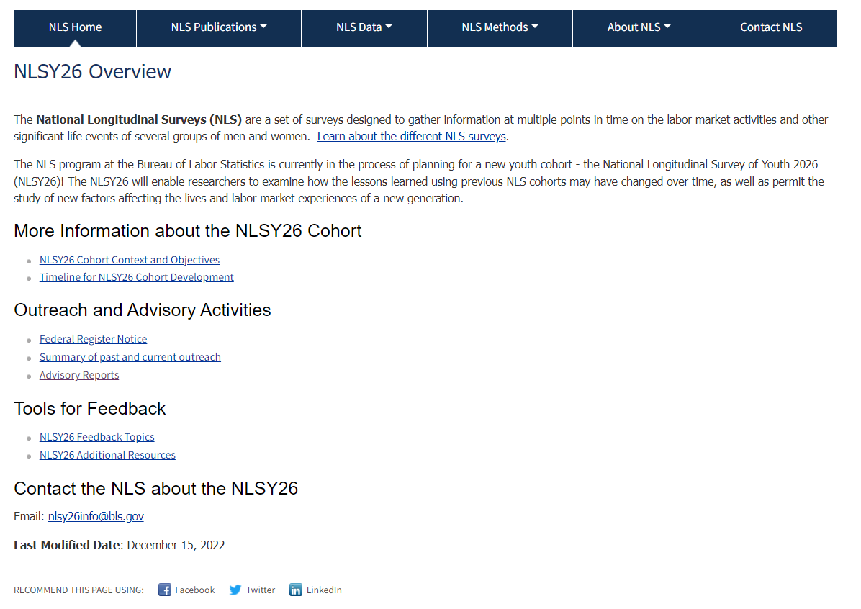
Notes:
There is a lot of rich information on the NLSY26 site that provides key insight on the extensive work and outreach being done to develop the new cohort.

Slide 22
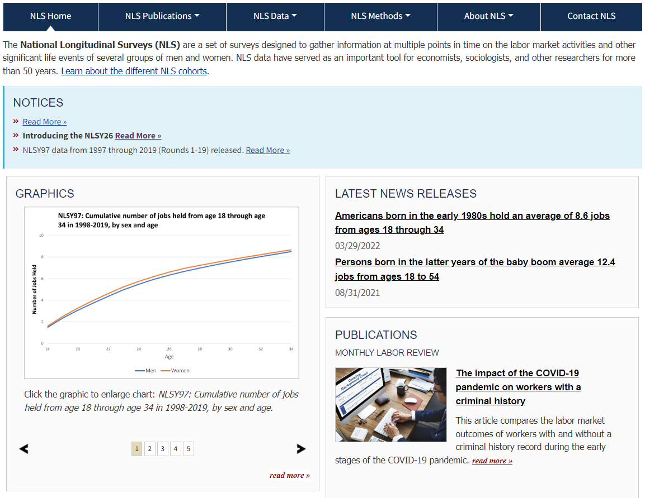
Currently only way to access NLSY26 site from homepage
Notes:
For starters, This is currently the only way to get to the NLSY26 site without directly searching for NLSY26. It’s not clear at first glance that NLS is undertaking this major initiative
a very important thing for NLS to think about is finding ways to draw attention to the NLSY26 site. In fitting with the BLS framework, updates to outreach and developments can be added to the notice section on the NLS homepage.

Slide 23
Highlighting NLSY Research

Slide 24
Notes:
Moving on to research, NLS does a really good job on is highlighting research on the home page
Particularly, the sections on latest news releases and publications are readily available and makes it easy for visitors to access the latest findings and stay informed.

Slide 25
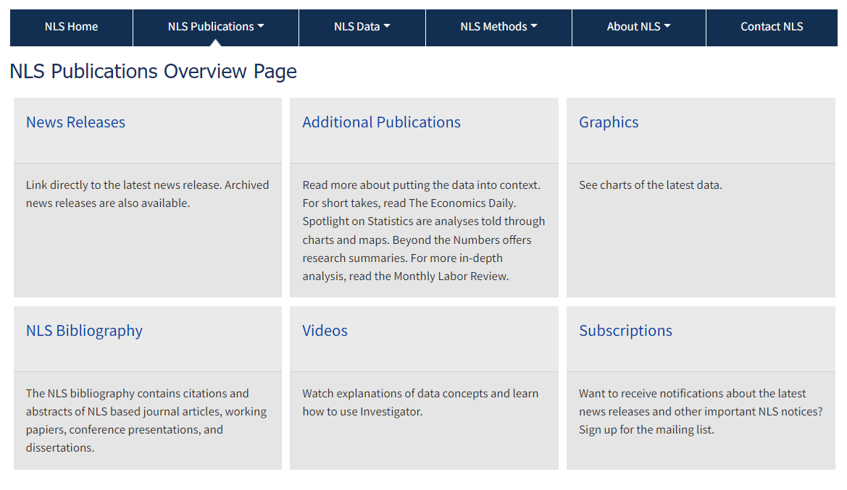
Notes:
Taking it one step further, the publications overview page which follows the uniformed format that’s used across BLS pages, utilizes this popular UI design element “buttons” that lead to all of these different things but the downside of this page is you don’t really get to see actual publications on this site without clicking on one of these links that lead you to another site making some of the information a bit buried

Slide 26
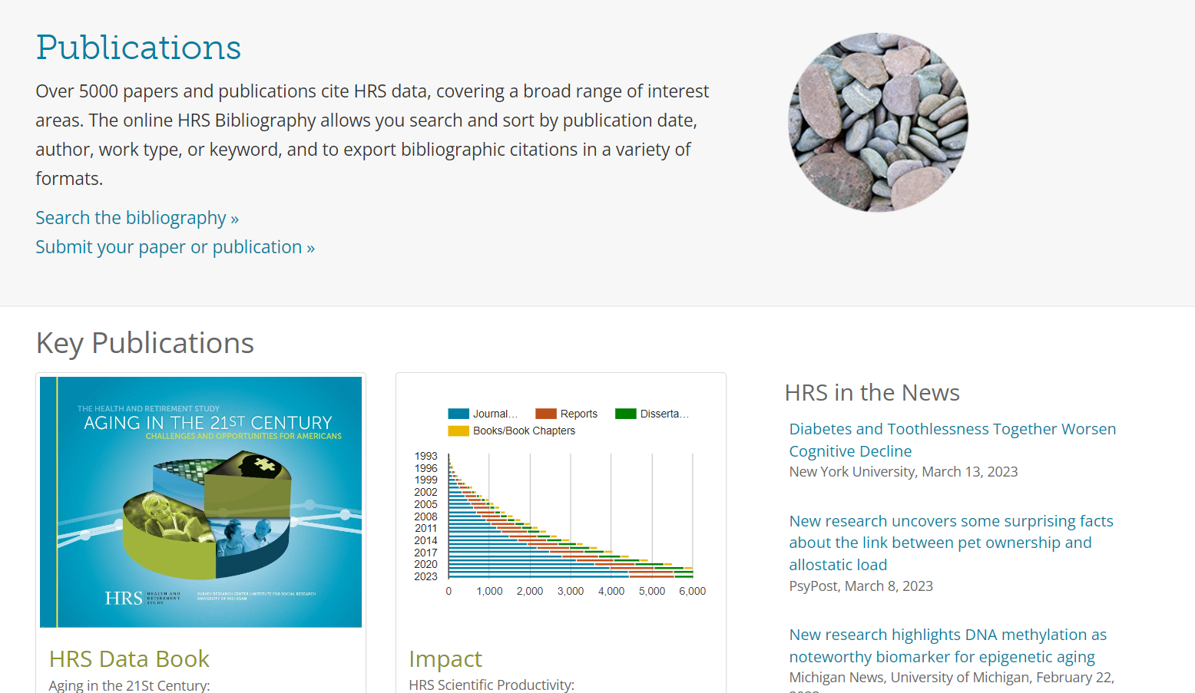
Source: Health and Retirement Study
Notes:
HRS’ publications page includes links to their bibliography and option for researchers to submit their papers/publication
They also include neat data products like the HRS Data Book and productivity tracker on research that has been published in different channels using HRS data, which is something that NLS can consider in terms of we present our data and research impact
Finally, there is a section dedicated to recent news articles/publications that is easily accessible on the overview page. This page is a great example of a clear and concise page layout that doesn’t overwhelm users and allows users to have a better navigation experience

Slide 27
Highlighting NLSY Data

Slide 28
Notes:
As you may recall, the homepage includes a section for graphics but these are static. One thing to consider as we look to this graphics section is thinking about how we can elevate the way we present data

Slide 29
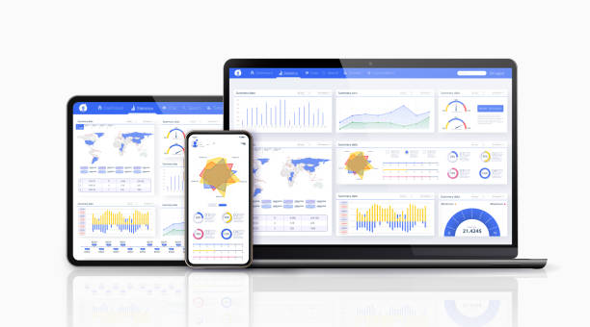
Data Visualization
Ability to process information faster in a format that is easy for users to understand
Display information clearly through easy-to-read charts and graphs
Show trends and changes in data over time
Easily customizable based on user needs
Notes:
data visualization tools are an excellent way to help facilitate the user experience:

Slide 30
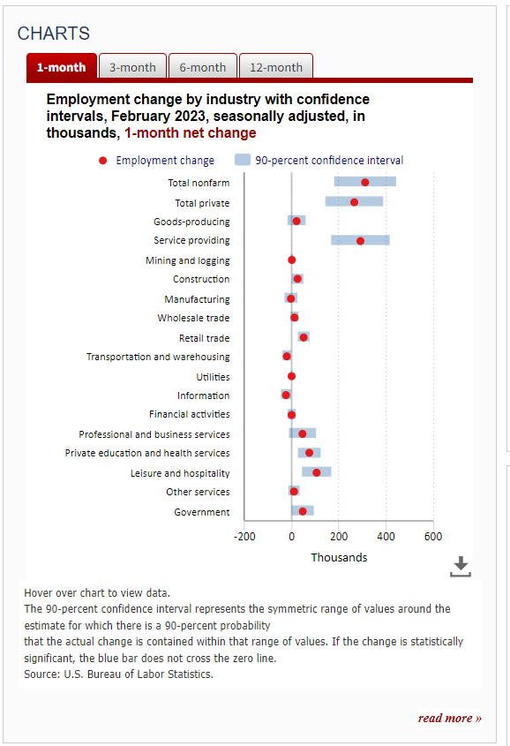
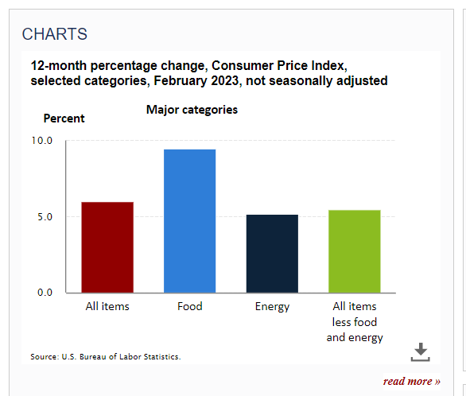
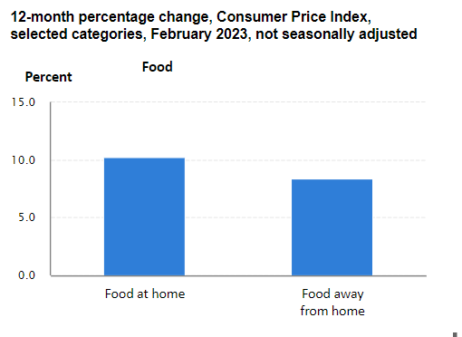
Examples within BLS
Ex. 1 Current Employment Statistics
Ex.2 Consumer Price Index
Notes:
Programs within BLS that have interactive graphs
The Current Employment Statistics (CES) program on the left has feature to see month by month employment change by industry. For NLS specifically, we can use this type of interactive graph to show trends over time as the cohort ages and enters different stages in their life
The example on the right from the consumer price index utilizes this drilldown feature, which allows users to click on element on graph within the major category like food- and drill down further at a detailed level (food at home vs. food away from home)
We can have high level sections for health, schooling, employment, and incorporate this drilldown feature to look further into sub topics

Slide 31
Measuring Performance

Slide 32
Focus Groups
Google Analytics
User Surveys
Site Feedback
Notes:
Takeaways
Lots of things for NLS to consider and its it’s important for us to measure performance by hearing directly from our stakeholders
by analyzing the google analytics metrics and site feedback we can get real time information that can help us improve our user interface and curate a smooth experience for all our stakeholders and potential new users of NLSY data

Slide 33
Safia Abdirizak
Economist
National Longitudinal Surveys
bls.gov/nls/nlsy26
abdirizak.safia@bls.gov

