Slide 1
Stakeholder and User Engagement When Redesigning a Survey Data Dissemination Website: Lessons Learned
Kathryn Downey Piscopo, Ph.D., Survey Statistician
Herman A. Alvarado, Dr.PH(c), Supervisory Social Science Analyst
Center for Behavioral Health Statistics and Quality (CBHSQ)
Substance Abuse and Mental Health Services Administration (SAMHSA)
U.S. Department of Health and Human Services
Any views expressed are those of the authors and not those of the SAMHSA or any contractors
FedCASIC
April 11, 2023

Slide 2
We will cover:
Center for Behavioral Health Statistics and Quality (CBHSQ) stakeholders
Four Challenges
Possible Solutions

Slide 3
CBHSQ Collects Many Different Types Of Data
CBHSQ as a OMB-recognized federal statistical unit (RSU)
Legally mandated to disseminate behavioral health data (for SAMHSA)
Healthy People 2030 Plan of Action
Provide accurate, timely, and accessible data that can drive targeted actions to address regions and populations that have poor health or are at high risk for poor health.
We collect data from many sources, such as
General population, aged 12+
Emergency Department visits related to substance use
Substance use and mental health treatment facilities
Client-level data for substance abuse treatment admissions from state agency data systems

Slide 4
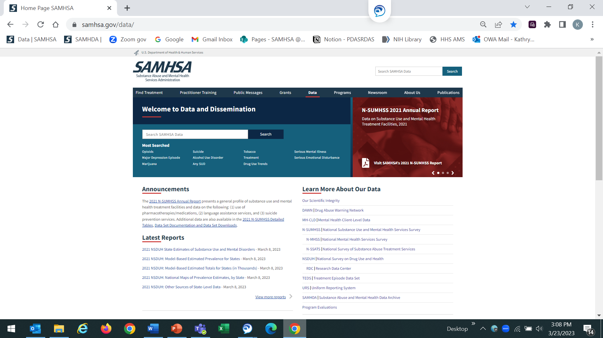
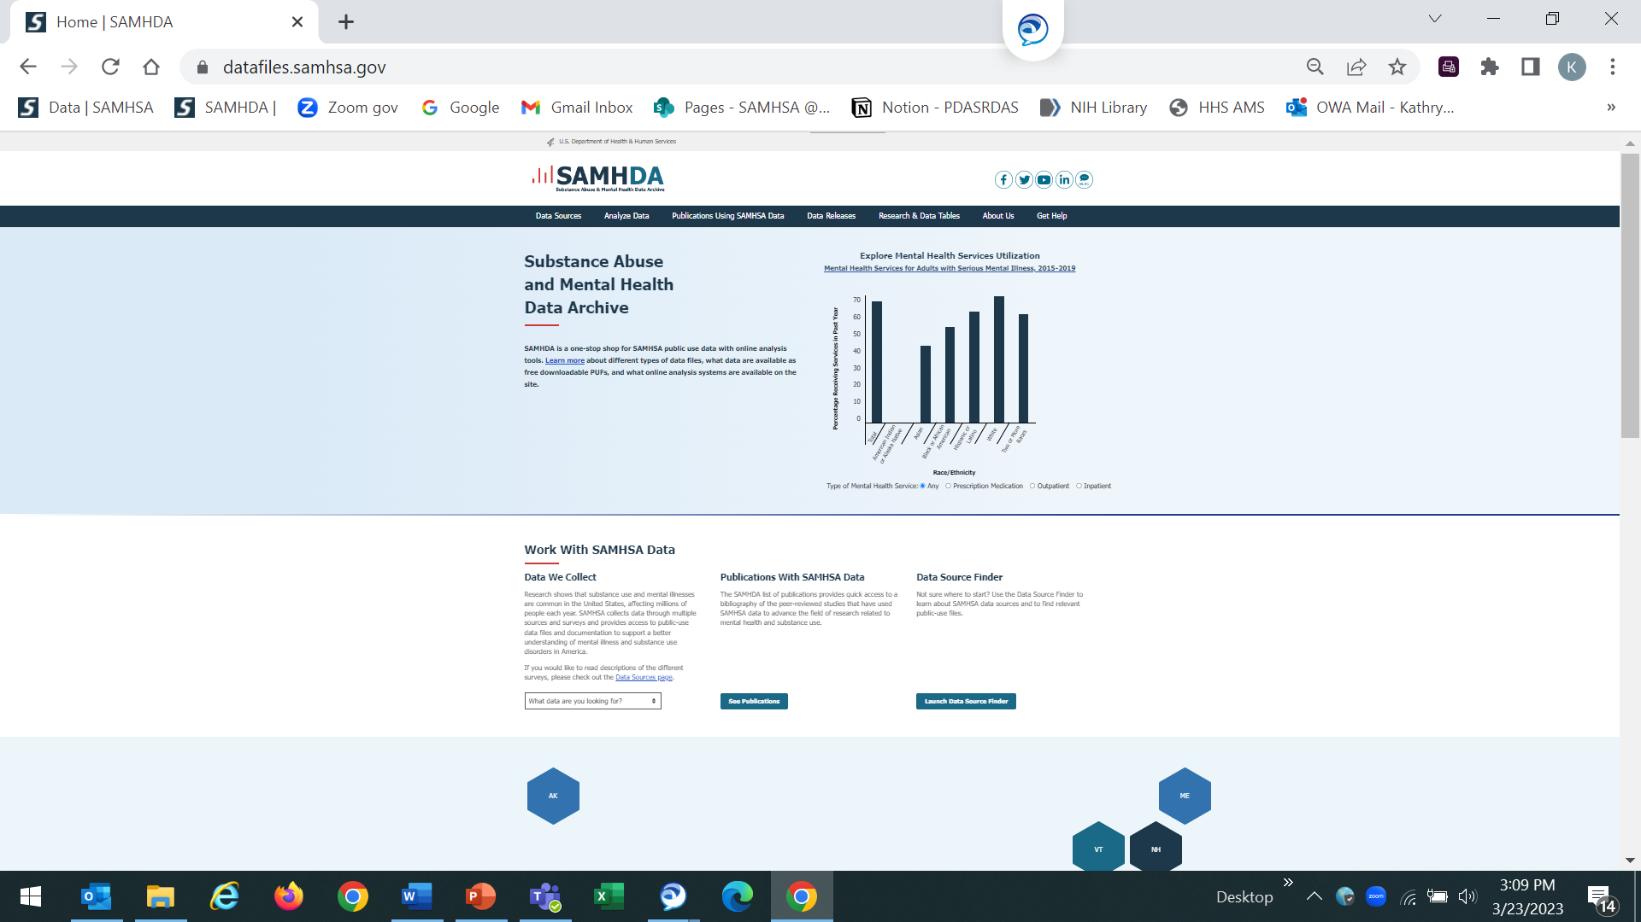
For Background, Here Are Our Webpages

Slide 5

CBHSQ Has Many Types Of Stakeholders or Audiences With Different Skills Or Knowledge
Academia, researchers, and private sector
Other government agencies
Stakeholder Possible Analytic Skills or familiarity with collections
Policy makers and governments
General Public
Students
Treatment coordinators
--Internal stakeholders have a mix of analytic skills--

Slide 6

First Challenge is “One Size Fits All”
Since we have so many different types of stakeholders:
--Different levels of statistical knowledge
--Different levels of familiarity with data collections
Yet our tools have to fit everyone
This is our primary challenge

Slide 7
Our Second Challenge Is Legacy Issues
Three contracts originally, different pages and user interface (UI)
Reports and data tables
PUFs and online analysis tools
Eventually became one contract
Design was originally more search-based
No context for documents; more like Google search
Documentation required many clicks and in different places
Technical debt (e.g., timeouts for online tools)
Trying to make the experience of “CBHSQ” seamless but
Different expertise levels depending on page
Power users just download the PUFs
Unequal levels of page traffic
Data ~47,000 users/month
Datafiles ~15,000/month

Slide 8
Third Challenge Is The Requirements Gathering Process
Internal stakeholder trust has diminished
Lack of technical knowledge (e.g., wireframes)
From decision-makers
Stakeholders not sure what they want
Also includes approval process
Overlap in reviews - who has the final say
From new staff members

Slide 9
Fourth Challenge Is Project Management Issues
Delays in phased deployments
Scope creep = schedule risk
Separate systems for project management between contractor and SAMHSA
JIRA for tickets – but have firewall so can’t share

Slide 10
In Summary, We Had Four Main Challenges
Data Dissemination Improvement
One Size Fits All
Requirements Gathering Process
Legacy Issues
Project Management Issues

Slide 11
We try to match the four challenges to solutions

Slide 12
Challenge 1: One Size Fits All
One Size Fits All
Gather Evidence That Doesn’t Fit (see next)
Conduct usability testing of reports/documents within site
Provide more context on website
New users need more background info on data collections
Reports/documents, not just the website, may be hampering learning

Slide 13
Challenge 1: Possible Solution 1: Gather Evidence That Doesn’t Fit
Implement continuous feedback and discovery
User Outreach
Listening sessions with stakeholders to set new requirements
Supported our notions of what were the challenges
Identified other issues (e.g.,: use of external sites that house reports; use of Google search rather than internal search)
Reiterative Usability Testing
CBHSQ power users
SAMHSA power and novice users
External stakeholder groups
General public

Slide 14
Challenge 2: Legacy Issues
Legacy Issues
Implement as one contract after recompete
Create APIs to make websites more seamless (next page)
Move away from search-based design
Increase budget to fix technical debt

Slide 15
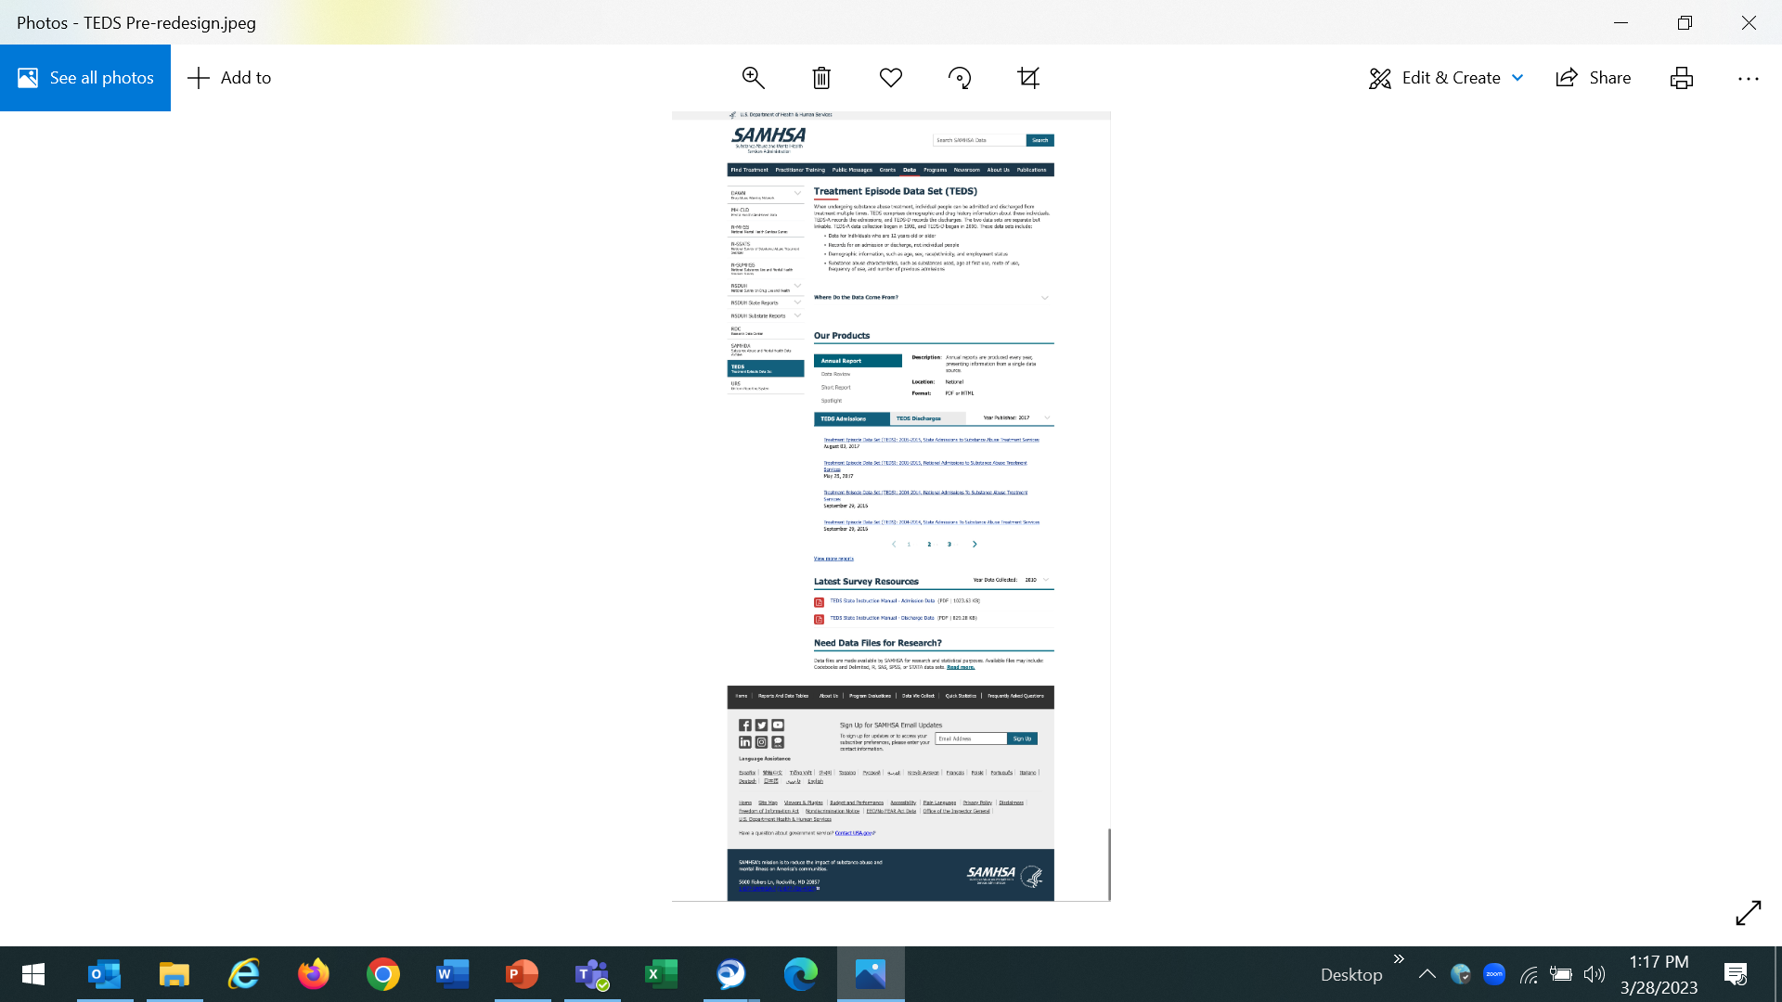
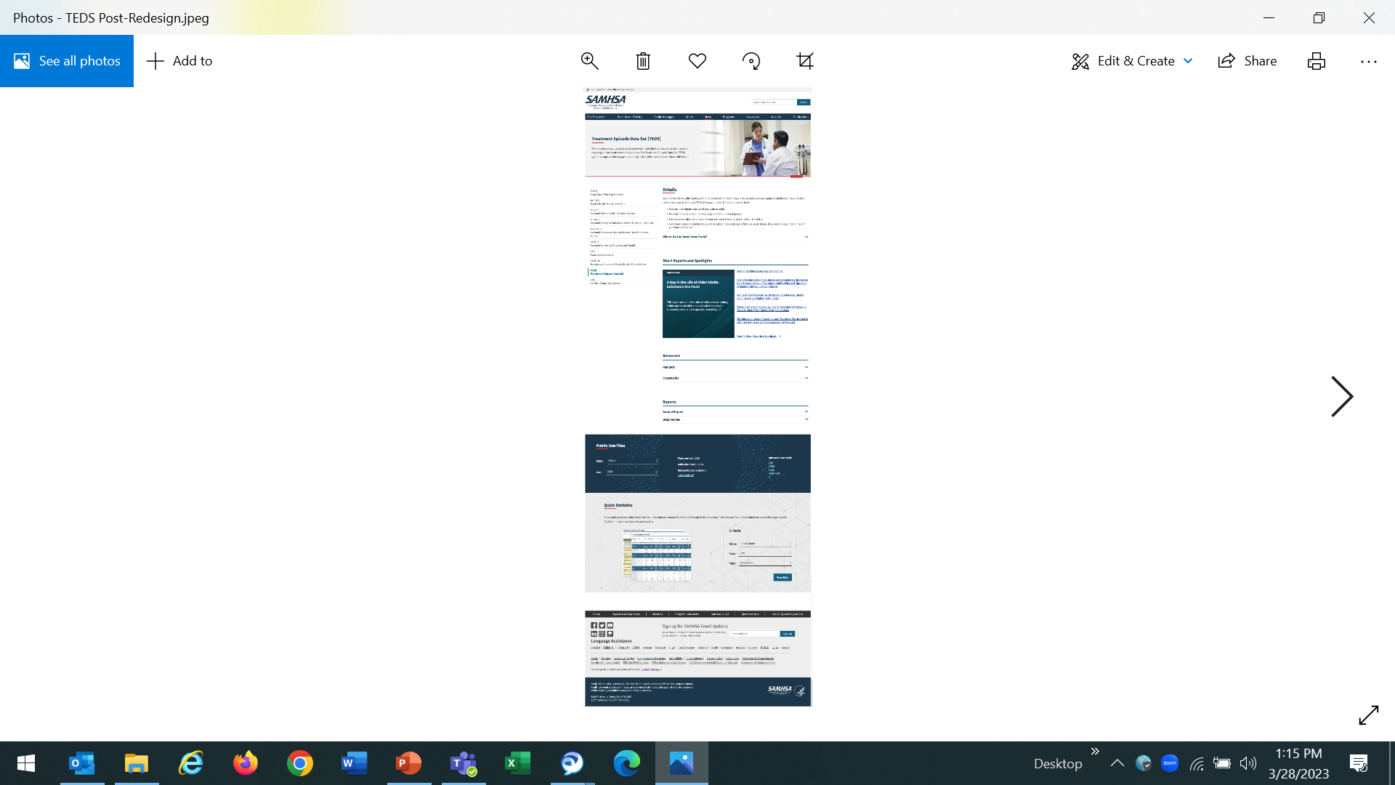
Data Site Before And After API

Slide 16
Challenge 3: Requirements Gathering Process
Requirements gathering process
Raise internal stakeholder trust
Help stakeholders figure what they want
Increase technical knowledge of decision-makers
Determine who has the final say
Embrace new staff members

Slide 17
Challenge 3: Requirements Gathering Process, Solution 1
Requirements gathering process
Raise internal stakeholder trust
Share all wireframes
Hold regular meetings with contractor
Send weekly updates on projects
Have POCs, for engagement and continuity, from each office

Slide 18
Challenge 3: Requirements Gathering Process, Solution 2
Requirements gathering process
Increase technical knowledge of decision-makers (e.g., wireframes)
Have a walk-thru meetings or better yet demos, do not rely exclusively on emails
Describe wireframes and how it fits in the design process

Slide 19
Challenge 3: Requirements Gathering Process, Solution 3
Requirements gathering process
Help stakeholders figure what they want
Identify a gold standard and have stakeholders compare what they have to the standard
If they are heavily wedded to a particular website, maybe you can explore what people like about that and pull elements from it
Keep emphasizing results from usability testing and evidence-based decisions

Slide 20
Challenge 3: Requirements Gathering Process, Solution 4
Requirements gathering process
Determine who has the final say
Establish a RACI (Responsibility Assignment Matrix) chart or a Policy & Process (P&P) chart

Slide 21
Challenge 3: Requirements Gathering Process, Solution 5
Requirements gathering process
Embrace new staff members
Turn into a positive: Be appreciative of their fresh perspective
Have a walk-thru meeting, so they can fully understand the problem(s) we want to address

Slide 22
Challenge 4: Project Management Issues
Project Management Issues
Manage delays in phased deployments
Create transparent documentation system
Asking for risk assessments on scope creep
Still exploring enterprise-level solution
Using same documentation such as JIRA creates documentation outside of emails
Creates change control process

Slide 23

Lessons Learned: Developing good processes takes time
Toughest!
Think about whom to involve when and what information to share, both for requirements and then later wireframe approvals
Establish roles and responsibilities based on expertise
Use evidence for decision making

Slide 24
Developing Good Processes Takes Time
Use continuous testing
Develop different tools for difference audiences

Slide 25
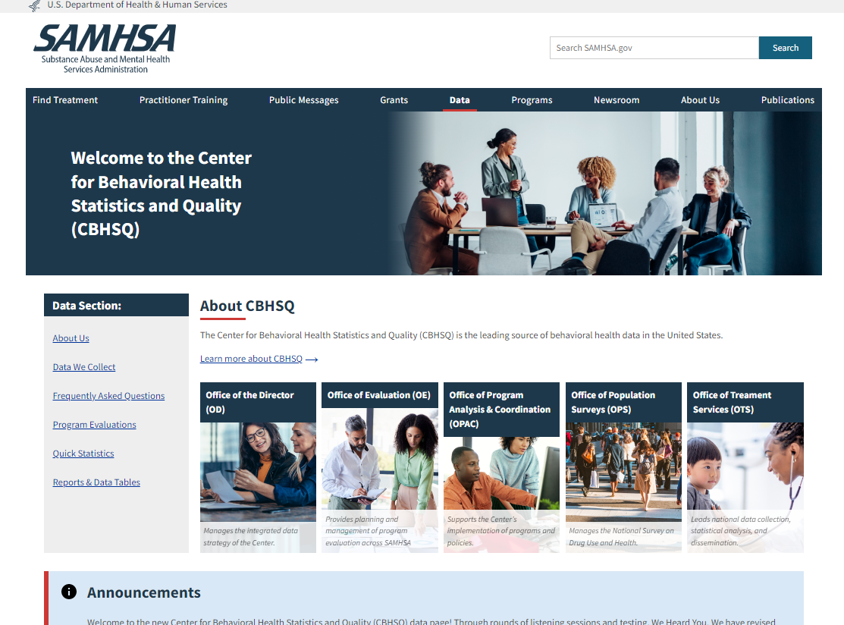
We Are Deploying A Newly Redesigned Website Tomorrow!
https://www.samhsa.gov/data/

Slide 26
Thank You
Kathryn.Piscopo@samhsa.hhs.gov
Herman.Alvarado@samhsa.hhs.gov

