Slide 1

Rows and Columns and Respondents: Designing a Respond-by-Spreadsheet Option with Respondents for the Annual Integrated Economic Survey
Melissa A. Cidade, EMD
Heidi St.Onge, ADEP
April, 2023
Any opinions and conclusions expressed herein are those of the author(s) and do not reflect the views of the U.S. Census Bureau. The Census Bureau has reviewed this data product for unauthorized disclosure of confidential information and has approved the disclosure avoidance practices applied. (Approval ID: CBDRB-FY23-ESMD001-005 ).
Notes:
Hi, everyone! I’m Melissa Cidade with the Economic Management Division at the Census Bureau, and while I’m doing the talking, this presentation is a joint production with my co-author and colleague, Heidi St.Onge in the office of the Associate Director of Economic Programs. Together, Heidi and I have been extensively studying the best ways to bring together several of our long standing surveys into one integrated annual data collection effort, called the Annual Integrated Economic Survey, or AIES.
I find that talking about AIES can get real complicated, real quick. I like to use an archetypical company that we invented to help keep the story straight, so let me start by introducing you to my favorite fictional company. In this case, we are going to start at the beginning –(click) let’s hop in the Delorean and go back 20 years…

Slide 2

20 years ago….
C
ensus
at
ompany
Retail Store 1006: Pet supply store
ARTS
Note: Fictional company represented
Notes:
The year is 2003. You and your cat have started a small shop in your hometown selling cat toys (click). You named your shop in honor of your favorite government agency, (click) the Census Cat Company. And, you were lucky enough to find yourself in sample for the Annual Retail Trade Survey (ARTS) (click). You diligently completed this mandatory annual data collection effort, and satisfied your reporting obligations to the Census Bureau. You then jammed out to Beyonce’s first solo album on your iPod while you played the Sims for the next four hours….
(click) let’s fast forward now to 2021….

Slide 3
2021
C
Manufacturing Plant 1001: Cat food
ensus
at
ompany
ASM and
M3UFO
Manufacturing Plant 1002: Cat food
Manufacturing Plant 1003: Cat litter
Wholesale Facility 1004: Cat food wholesaler
AWTS
Wholesale Facility 1005: Pet supply wholesaler
ACES and
COS
Retail Store 1006: Pet supply store
Retail Store 1007: Pet supply store
Retail Store 1008: Pet supply store
ARTS
Retail Store 1009: Pet supply store
Retail Store 1010: Pet supply store
Service Establishment 1011: Pet Grooming Business
SAS
Note: Fictional company represented
Notes:
18 years on, the Census Cat Company is a regional juggernaut, spanning two states and more than 500 employees.
(click) You started by opening up additional pet supply stores. (click) You continue to be in sample for the Annual Retail Trade Survey, and will answer this survey based on those five locations and one sector – retail.
However, you and Meow Meow noticed that most of your customers were coming in looking for cat food. You decided to start manufacturing your own brand of cat food, and have two manufacturing plants dedicated to that work. (click) And, what goes in must come out, so you also have a manufacturing plant dedicated to the production of cat litter. (click) Because you’ve expanded into manufacturing, you also find yourself eligible for – and currently in – sample for the Annual Survey of Manufactures (ASM). (click)
At the same time, you found that other independent pet supply stores wanted to carry your brand of cat food and litter. You opened up two wholesale facilities – one handles the food, the other the litter. These two facilities introduce an additional sector, and so, you find yourself in sample now for the Annual Wholesale Trade Survey, or AWTS. (click)
You decide that cat grooming this represents a burgeoning market, and carve out a little space for him to start grooming cats professionally.(click) This also introduces another sector – services – and another chance to be in sample for another survey, (click) the Services Annual Survey or SAS.
Finally, because you are so lucky, you are also in sample for the Annual Capital Expenditures Survey, or ACES, and the Company Organization Survey, or COS, this year. (click)
As your firm has grown in complexity, so too has the number of surveys for which you are eligible. And, this is not just theoretical – firms have been growing in complexity generally, and our sector-driven approach to surveying is cutting firms into slices that miss the holistic picture. At the same time, this current system represents duplicative questions and increasing burden as you try to answer seven individual annual surveys about your one company.

Slide 4
Census Bureau Annual Economic Surveys
Manufacturing
Retail
Wholesale
Services
Multisector
Annual Survey of Manufactures (ASM)
M3UFO
Annual Retail Trade Survey (ARTS)
Annual Wholesale Trade Survey (AWTS)
Services Annual Survey (SAS)
Annual Capital Expenditures Survey (ACES)
Company Organization Survey (COS)
Annual Integrated Economic Survey (AIES)
Notes:
For the most part, the Census Bureau has used a sector-driven approach to survey development. However, one of the recommendations we received from a National Academies of Sciences panel is the implementation of a streamlined, cross-sector, harmonized survey instrument designed to lower respondent burden while still achieving high quality, timely data in the service of the American economy. (click) This would provide one survey instrument to collect all of the data usually asked by these annual surveys. That’s what makes it the annual – yearly – integrated – combination of annual surveys – economic survey!

Slide 5
Research Questions:
Definitions: how do businesses define themselves relative to the Census Bureau definitions?
Accessibility: how accessible are key data points at varying business units?
Burden: how resource intensive is gathering data at these varying business units?
Notes:
It would be terrific if we could just squish the surveys together and call it a day. Unfortunately, the different surveys use different terminology, collect data from different levels within the business, and run on different timelines….This opened up the opportunity for a suite of research in support of the integrated survey.

Slide 6
Record Keeping Study
29 RKS interviews
Research Overview:
Major Findings:
29 interviews with medium-sized companies
Topics:
NAICS
Four key variables: sales/receipts/revenues; inventory; expenses; capital expenditures
Response process overall
NAICS isn’t intuitive
Operating units vary
Company-level data are key
Notes:
A first step in respondent-centered research in support of the development of the AIES was a series of 29 interviews with medium-sized companies exploring their record keeping practices.
These interviews explored the link between financial records and company organizational and management practices. From these interviews, we have three major findings: first, industry classification – that is, the North American Industry Classification System, or NAICS - is challenging and unnatural for respondents, and some companies can struggle to fit within the NAICS classification system. Second, businesses varied in their operating units, and this impacted the level and detail at which they keep their records, which can negatively or positively impact response. Finally, consolidated financial records are a mainstay for businesses, and act as an ‘anchor’ for most detailed information that respondents provide.

Slide 7
Data Accessibility Study
29 RKS interviews
+30 DAS interviews
59 total interviews
Research Overview:
Major Findings:
30 interviews with medium-sized companies
Topics:
Definitions and equivalencies
NAICS
Data accessibility by level and topic
NAICS is still challenging
Accessibility ranges:
Company = most accessible
Industry = less accessible
State would be sum of establishments
Notes:
Following the Record Keeping Study, we then engaged in an additional 30 in-depth interviews with medium sized businesses about the accessibility of their data at various levels of the business. This set of interviewing further detailed what data are available at what levels. And, what did we find? Respondents still struggled with their NAICS classification, noting that the categories could be too broad or, conversely, not broad enough to accurately describe the company as a whole. We also see that company-level data are the most accessible regardless of size and sector of the business, and that more granular levels of data can be increasingly challenging, with respondents struggling most to report information by industry. At the same time, we asked about the availability of data at the state level, and many respondents noted that to give state-level responses, they would need to pull the data at establishment and sum up.

Slide 8
Coordinated Collection Debriefing Study
29 RKS interviews
+30 DAS interviews
+35 R-CC interviews
+19 NR-CC interviews
113 total interviews
Research Overview:
Major Findings:
35 interviews with responding companies
19 interviews with non-responding companies
Topics:
Evaluation of contact materials
Barriers to response
Mixed results with communications
Letters and emails: COVID-impacted
Respondent portal: positive
Responsiveness: less positive
Barriers to response can be external (company-related) or internal (survey-related)
Notes:
In preparation for the integrated survey, staff at the Census Bureau began a program of consolidating contacts across the sector-specific current annual surveys, like the Annual Retail Trade Survey and the Services Annual Survey, to identify one contact per company. To better understand how contact consolidation might impact response processes, researchers conducted two rounds of debriefing interviews. The first was 35 interviews with responding companies, during which Census Bureau researchers asked pointed questions about communication materials and challenges. The second round was 19 interviews with non-responding companies to understand where response may have broken down.
From the respondent debriefing interviews we have a couple of major findings. We note that many respondents did not receive – or do not remember receiving – many of the communications that the Census Bureau sent in support of consolidating contacts. Some of this may be related to the COVID-19 global pandemic. We also noted that respondents generally evaluated Census Bureau communications positively, but that respondents’ experiences with reaching out for support from the Census Bureau can be mixed. Non-respondent debriefings identified barriers to response, including company-related issues like staffing shortages and data being decentralized, surveys that do not reflect current company structure, and communication shortfalls from the Census Bureau.

Slide 9
Survey Structure Study
29 RKS interviews
+30 DAS interviews
+35 R-CC interviews
+19 NR-CC interviews
+39 SS interviews
152 total interviews
Research Overview:
Major Findings:
39 interviews
Topics:
Mock-ups of screens
Mode of completion
General impression
Unit and topic both play a role in response
NAICS is challenging
Respondent wants:
Spreadsheet
PDF previews
Ability to share the survey
Notes:
To start to build out the survey flow for AIES, Census Bureau researchers conducted 39 interviews with companies focused on preliminary ‘mock ups’ of survey screens designed to give respondents an overview of each section and the survey at large. Respondents were asked about their preferences for reporting, especially regarding using a spreadsheet or the traditional page-by-page survey response. Finally, respondents were asked to reflect on the concept of AIES as a whole, their thoughts about the overall design, and their thoughts on its effect on their burden.
For this interviewing, we noted that AIES introduces complexities for response both at the units of collection (company, establishment, and industry) and by the various topics mixed into one survey. Again, we see the issue of NAICS classification ‘fitting’ a business is a space where respondents sometimes struggled. Most respondents indicated wanting to use a downloadable spreadsheet option, to gather their data first and then enter it into the survey, and to submit data across all survey sections at one time, instead of section by section. Respondents also stressed their reliance on others within the company to complete the survey, and that they were open to using survey previews (as PDFs or otherwise) to make a plan for data collection and/or to email to other departments or locations for response.
I want to pause here and draw your attention to the ticker at the top of the screen – with just this formative research, we have conducted 152 interviews across all sizes, industries, geographies, and complexities. This is an incredible amount of respondent-driven feedback on how to design this survey…
(click) Now, let’s get back in the Delorean, go to early 2022, and check in on the CCC.

Slide 10
2022
Manufacturing Plant 1001: Cat food
C
Manufacturing Plant 1002: Cat food
ensus
at
ompany
Manufacturing Plant 1003: Cat litter
Wholesale Facility 1004: Cat food wholesaler
Wholesale Facility 1005: Pet supply wholesaler
Retail Store 1006: Pet supply store
AIES Pilot Phase I
Retail Store 1007: Pet supply store
Retail Store 1008: Pet supply store
Retail Store 1009: Pet supply store
Retail Store 1010: Pet supply store
Service Establishment 1011: Pet Grooming Business
Note: Fictional company represented
Notes:
In 2022, you agreed to be one of the companies that participated in the Annual Integrated Economic Survey Pilot Phase I Program. This survey not only harmonizes the content across the surveys, it asks questions at three distinct levels within the enterprise, mainly (click) the company level, which includes all parts of the business (click); (click) the establishment level, which represents each discrete location affiliated with the company (click); and (click) the industry level, which represents groups of establishments that make or do the same kinds of economic activities.
This would replace your participation in the typical annual surveys you usually fill out.

Slide 11
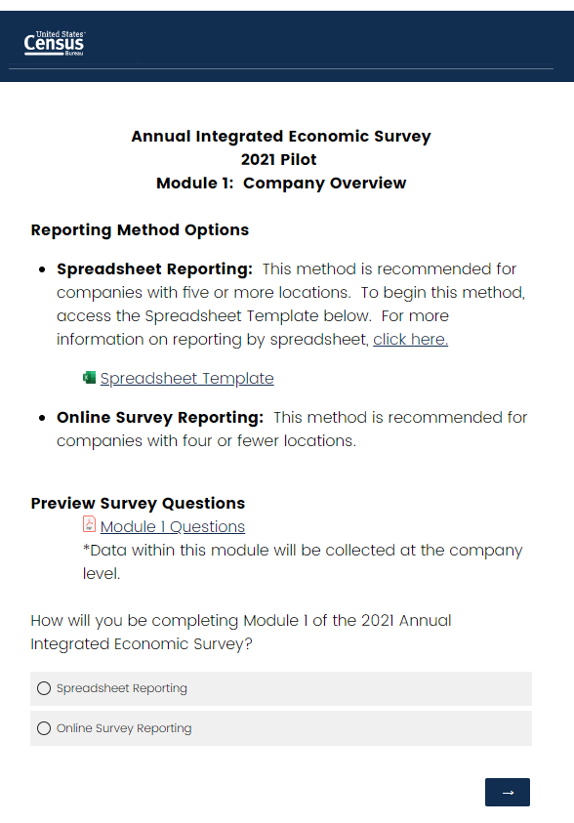
AIES Pilot Phase I
Phase I: Intensive Pretesting
N = 78 companies
Personal recruitment, online pilot survey instrument, Response Analysis Survey, record check study and debriefing interviews.
October 2021 – June 2022
Notes:
The AIES Pilot Phase I was the first attempt at bringing together the contents and units from the seven current annual surveys into one integrated survey instrument. The explicit goal of Phase 1 was to see how the envisioned survey instrument may perform in the field. In addition to the online survey, however, we also designed a suite of extracurricular research – quantitative and qualitative – to address outstanding research questions. These methods include additional in-depth interviewing, a Response Analysis Survey, and carefully tracking contact with any respondents so that all interactions were an opportunity to generate insight.
Phase I is 78 companies from across the economy, ranging in size from as small as two establishments to as large as 350 establishments. One of the major design decisions we made for this collection was to give respondents the choice to respond by our traditional page-by-page survey or to use an Excel spreadsheet to answer the pilot survey. On screen now is a screenshot of the first page of the survey for the Census Cat Company outlining this choice.

Slide 12
Key Pilot Phase I Spreadsheet Findings
Page-by-page at company-level, spreadsheet at establishment and industry level
Spreadsheet with all units together
Minimize duplication of content
*Total N = 78. Note: Not all companies received all modules of the survey.
Notes:
From this pilot, we learned a few key findings that further influenced the design of the spreadsheet. First, we noticed an overwhelming preference for companies to respond by page-by-page at the company level, and by spreadsheet at the establishment and industry levels.
Asked specifically about respond-by-spreadsheet, respondents liked it, but the phase one instrument sliced the company into manufacturing and non-manufacturing establishment and industry listings. Respondents noted that one streamlined approach that has all units together might reduce burden. We also heard from respondents that the AIES has duplicative content – we ask the same questions at multiple reporting units, and this added burden and frustration for respondents. Respondents wanted a way to have the units interact with each other, such that data reported in parts in one place could be automatically summed to other levels in other places; this could deduplicate some of the content.
Even with all that we learned, however, the Phase I pilot and other respondent centered research still left questions on the table. For example, again, we learned that the structure of this survey needs to be a little different than what we usually do – but, we have not tested the new structure. At the same time, we learned new information about a holistic approach to companies, but we have done limited testing of that new approach.
That is to say – we learned a ton in the last year, but there are still important questions to address in the coming year regarding the instrument design. Given these lingering questions, we have decided to launch a Phase II Pilot to test out these updated design features.

Slide 13
AIES Pilot Phase II
Timing: Launched on 02/23/2023; close out on 04/14/2023
Instrument: Excel spreadsheet – download/upload
Debriefing interviews, Response Analysis Survey, feedback from the field
Notes:
The AIES Pilot Phase II launched on February 23, 2023, and included around 800 companies. It features a tailored respond-by-spreadsheet only design, which users can download and save on their local drive, complete, and then upload back to the secure portal for the pilot. In addition, we are conducting additional debriefing interviews, a Response Analysis Survey focused on actual and perceived burden, and cataloging feedback from the field as we hear it, just like in Phase I. And, as in Phase I, response to the Phase II Pilot will stand in place of response to the in-scope current annual surveys.
(click) The Phase II Pilot is due on Friday, so, let’s get in the Delorean and catch up with the CCC to see what their spreadsheet looks like…

Slide 14
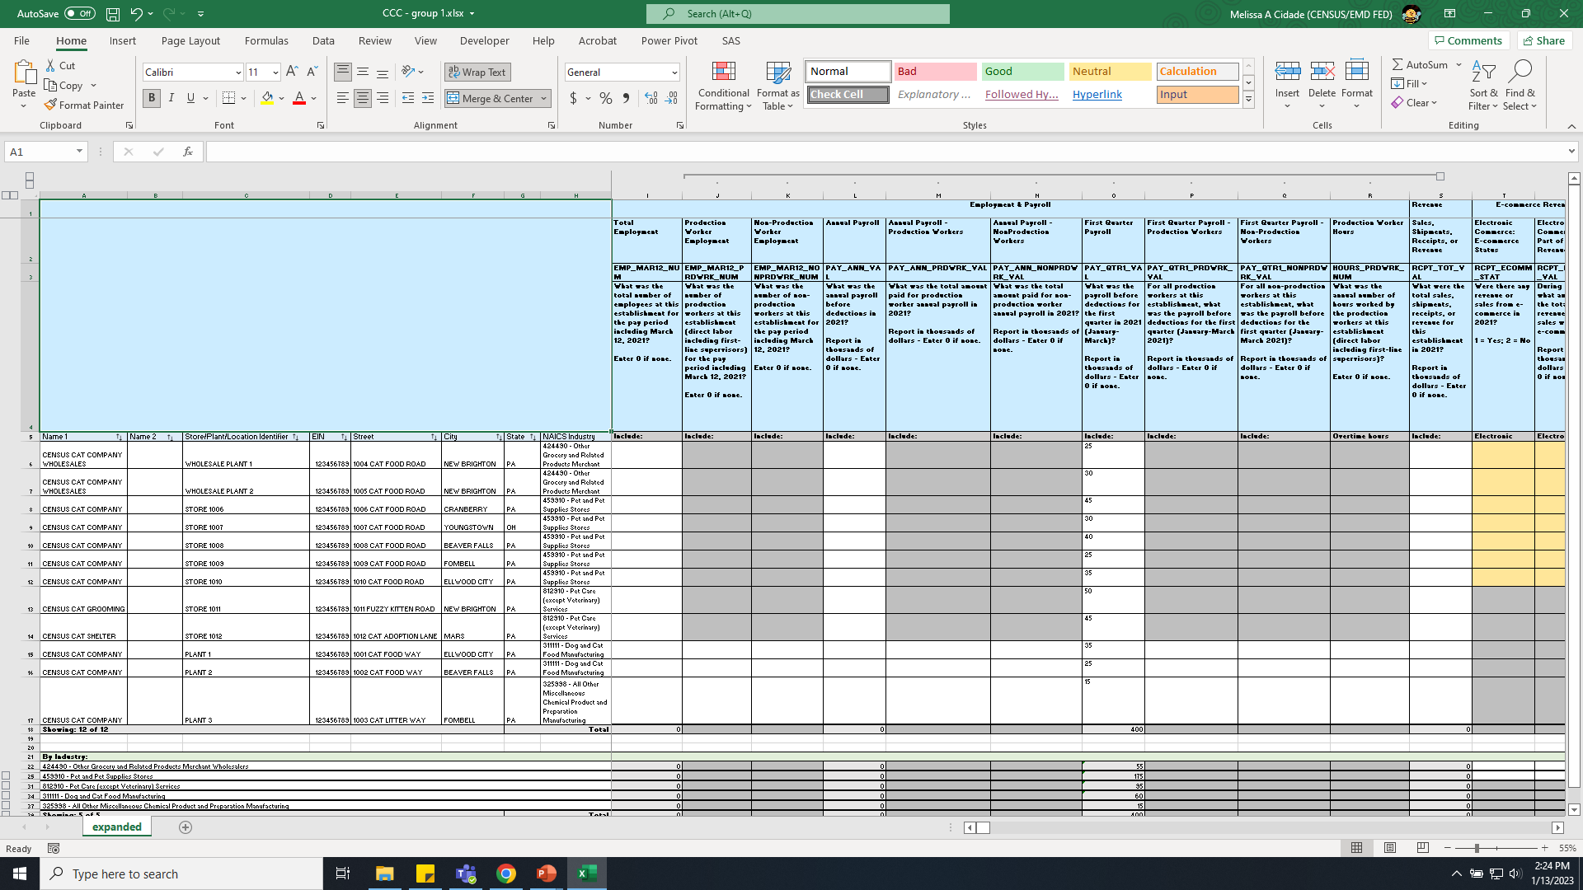
Note: Fictional company represented
Notes:
On screen now is what the response spreadsheet looks like for the CCC for the Phase II Pilot. There are a few spots where we are building off of what we learned in Phase I.
Remember that one of the findings from the pilot was that respondents wanted a spreadsheet that had all units together, regardless of how they are classified. (click) Here you can see a full listing of all of the CCC’s establishments in one place, both manufacturing and non-manufacturing.

Slide 15
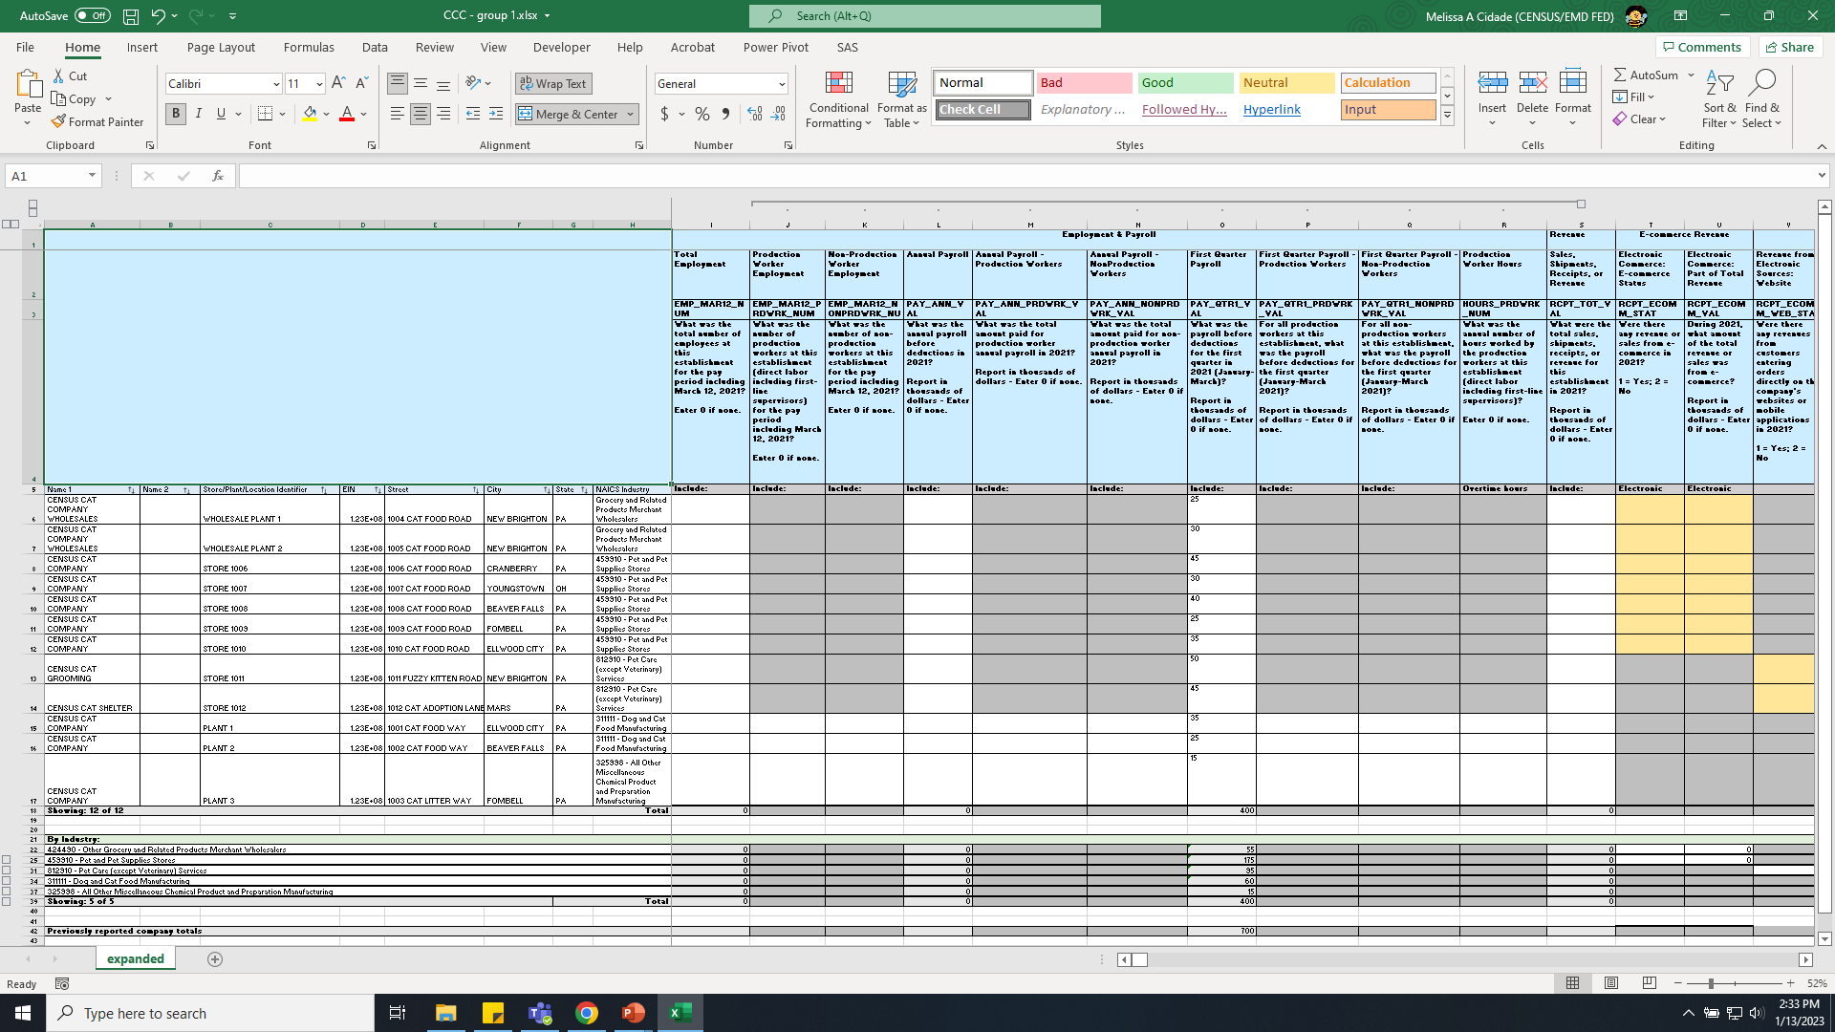
Note: Fictional company represented
Notes:
Remember, another finding from the first pilot was that respondents were frustrated that some content was asked at the company, establishment, and industry level. They wanted to be able to give those data once, and let us do whatever manipulations we want. (click) Here you can see the split screen design where the industries are listed at the bottom. (click) Note that we are trying to explicitly build the relationship between locations and industry. This also allows for capture at the industry or establishment level for most data items. And, where possible (click) we also display previously reported company totals since we know that companies use consolidated totals as an anchor in their reporting.

Slide 16
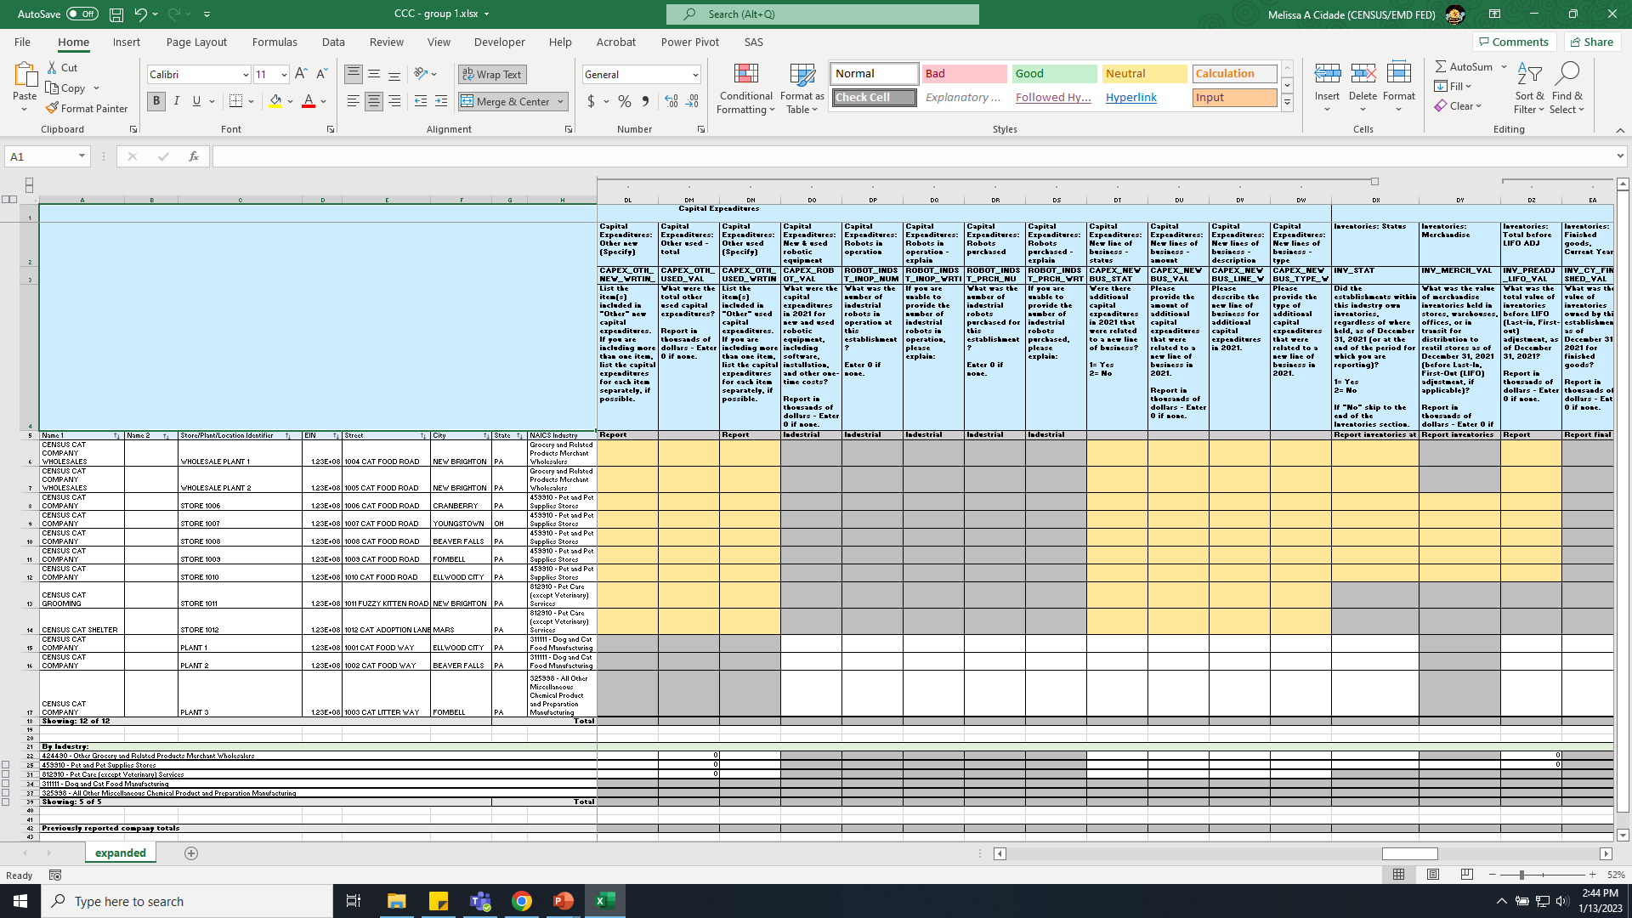
Note: Fictional company represented
Notes:
Finally, we developed a three color coded system to signal response requirements: white indicates that a response is required. This is at the establishment level (click) or at the industry level (click) depending on the question and the establishment classification. Gray indicates that a question is not applicable. This is also at the establishment level (click) and at the industry level (click), again, depending on the question and the establishment classification. Finally, yellow (click) indicates optional response – we heard from some businesses that it is simply easier for them to report their data by establishment and let the instrument sum up totals. So, we are indicating to respondents that if they want to report by establishment here, they can, but it is not required at this level. Note that places where the establishment is yellow, the same question is always white at the industry level.

Slide 17
AIES Respondent Research Plan: 2023
Pilot Phase II
N = 835 companies
Debriefing interviews, RAS, questions from the field
Usability Testing
N = 30 x 3 rounds
Iterative testing – start with Excel, then move to online prototype, and end with end-to-end usability testing
Dress Rehearsal
N ≈ 8,000
Opportunity for large-scale response from the field
Research due date: 04/14/2023
Begins spring 2023
Fall 2023
Communications Research
N = 30
Iterative testing of emails, letters, website, and other respondent communications
Pending approval, begins immediately
Notes:
In fact, we have four research modalities we are using in 2023 to address lingering questions before we roll out the full survey in 2024. The Phase II Pilot is set to close on Friday, and we’ll parse through those findings for additional insight into instrument performance and the response process.
We will also be conducting usability testing on the still-under-construction online spreadsheet that we will be using in production. This work will be iterative as the instrument is programmed and ready for testing. Here we are focused on features that could aid response, but also in documentation and help screens that could guide respondents.
We are looking at our communications with respondents – head-to-toe. This includes emails, letters, website pages – both in communicating that this change is coming and in effective communication to support response. We are just waiting for clearance, and then we will get started on those interviews.
And finally, we are deploying a large scale ‘dress rehearsal’ of the AIES instrument. We have identified roughly 8,000 companies to receive a first prototype of the instrument in place of their current annual surveys. This is scheduled to launch in fall of this year.

Slide 18
Thank you!
Melissa Cidade
Melissa.Cidade@census.gov
Heidi St.Onge
Heidi.M.StOnge@census.gov
Notes:
(click) I wish we could get in the Delorean and flash forward to see how everything goes, but unfortunately, ours only looks backwards right now. We will use the upcoming research to continue to refine and revisit our annual collections, but what we’ll find? Only time will tell!

