Slide 1
Business Enterprise Research and Development Survey (BERD) Reporting Tools
Facilitating the reporting process
Michael Flaherty, Chief, Research, Development & Innovation Surveys Branch
Any opinions and conclusions expressed herein are those of the author(s) and do not reflect the views of the U.S. Census Bureau. The Census Bureau has reviewed this data product for unauthorized disclosure of confidential information and has approved the disclosure avoidance practices applied (Approval ID: CBDRB-FY23-ESMD010-014).

Slide 2
Outline
Background
  Outreach Activities
  Lessons Learned
  BERD Reporting Tools
  Closing Thoughts

Slide 3
Background
BERD is conducted under a joint partnership agreement with the National Center for Science and Engineering Statistics.
Mandatory Title 13 survey.
Reporting unit is the company (not establishment).
Target population: For-profit businesses with 10 or more U.S. employees.

Slide 4
Background
Businesses account for nearly 75% of all R&D performance in the U.S.
Skewed distribution:
  ~1 Million businesses in target population.
  30-40K have any R&D activity.
  Top 500 account for ~80% of all business R&D.
Large survey ─ over 600 data items.

Slide 5
Outreach Activities
Business expert panel and cognitive testing as part of redesign process in 2008.
Account Manager process.
Post survey meetings.

Slide 6
Lessons Learned
Data accuracy is highly dependent on who the respondent(s) is.
The survey process is generally more difficult for companies that have a more diverse accounting structure.

Slide 7
BERD Reporting Tools

Slide 8
BERD Reporting Tools: Excel Workbooks
Excel workbooks designed to mirror the survey form.
Each workbook represents a separate section in the survey.
Respondents can email individual workbooks to different areas of the company to complete (e.g., R&D group, Human Resources, Legal).
The completed Excel workbooks can be uploaded directly into the online reporting instrument and data fields will be populated.

Slide 9
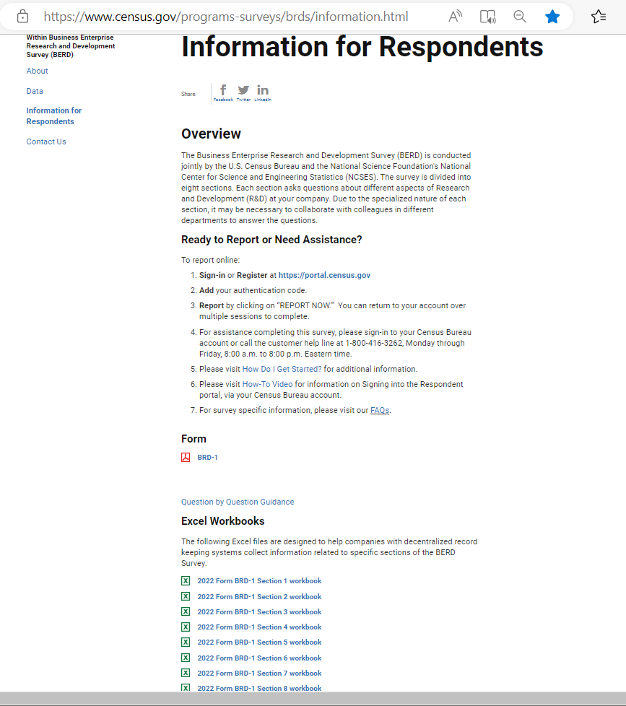
BERD Reporting Tools: Excel Workbooks

Slide 10
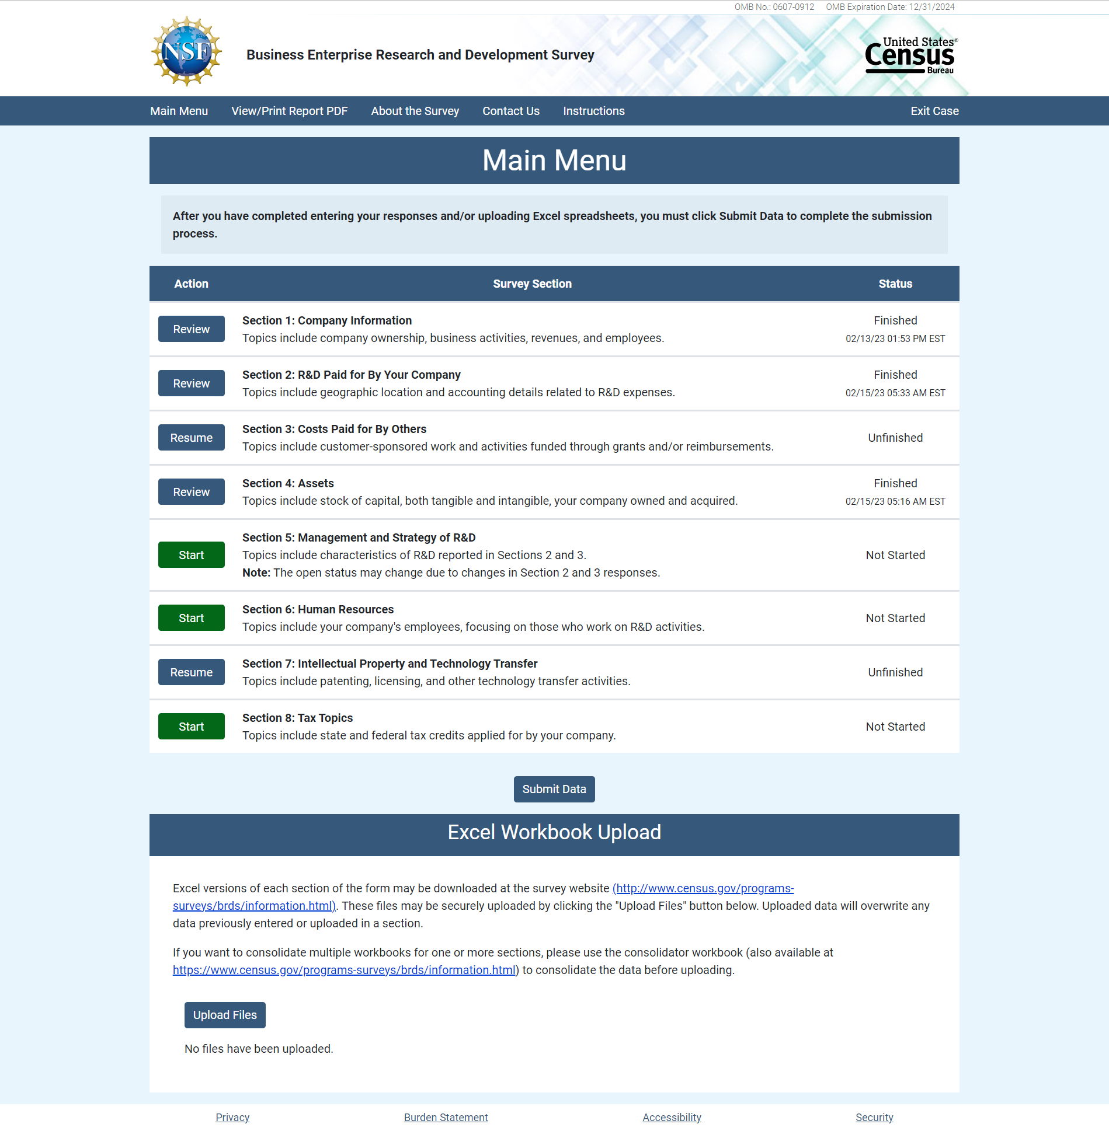
BERD Reporting Tools: Excel Workbooks

Slide 11
BERD Reporting Tools: Consolidator
For large companies, the Consolidator tool can be used to combine multiple versions of the same workbook.
    Respondent sends workbooks to their divisions or subsidiaries.
    Respondent uses Consolidator Tool to combine multiple workbooks of each section into single whole-company response that can be uploaded to the online reporting instrument.

Slide 12
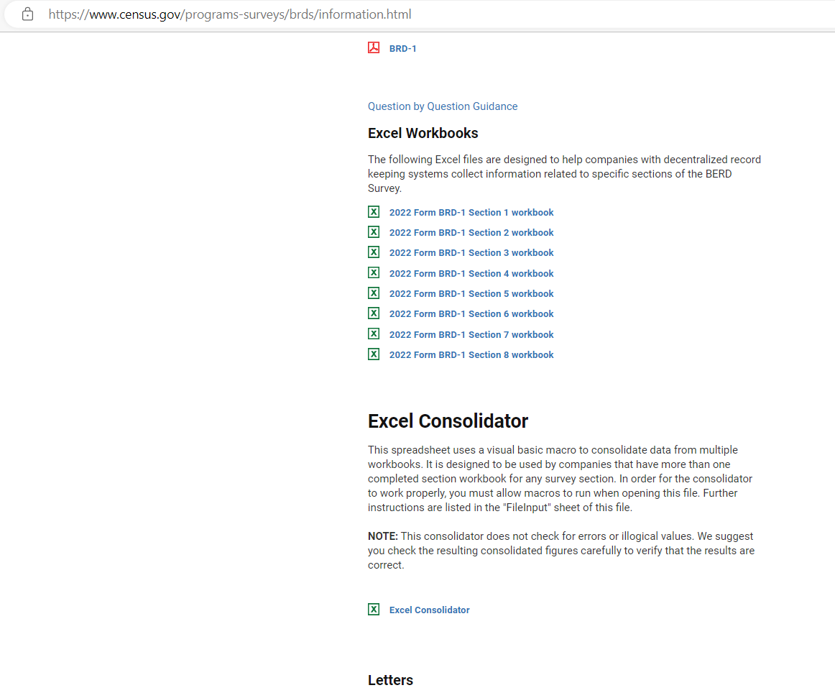
BERD Reporting Tools: Consolidator

Slide 13
BERD Reporting Tools: Delegation
Users with survey access can share access with others.
Email is sent to the ‘delegated’ person.
  Can share with multiple delegates.
  Can view status of request (sent, accepted, or revoked).
  Can resend request or delete access.
  Delegates receive email with instructions to log in or register for an account.

Slide 14
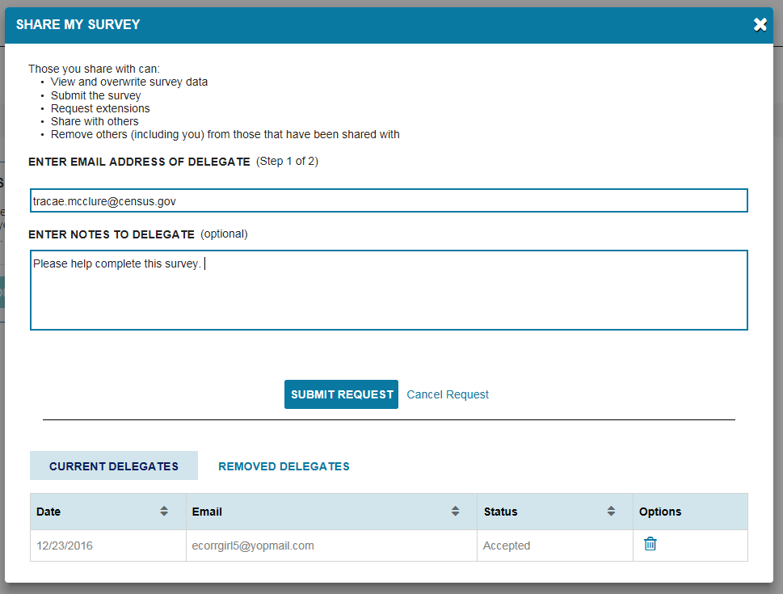
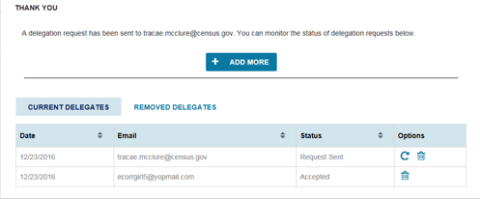
BERD Reporting Tools: Delegation
Delegated e-mail

Slide 15
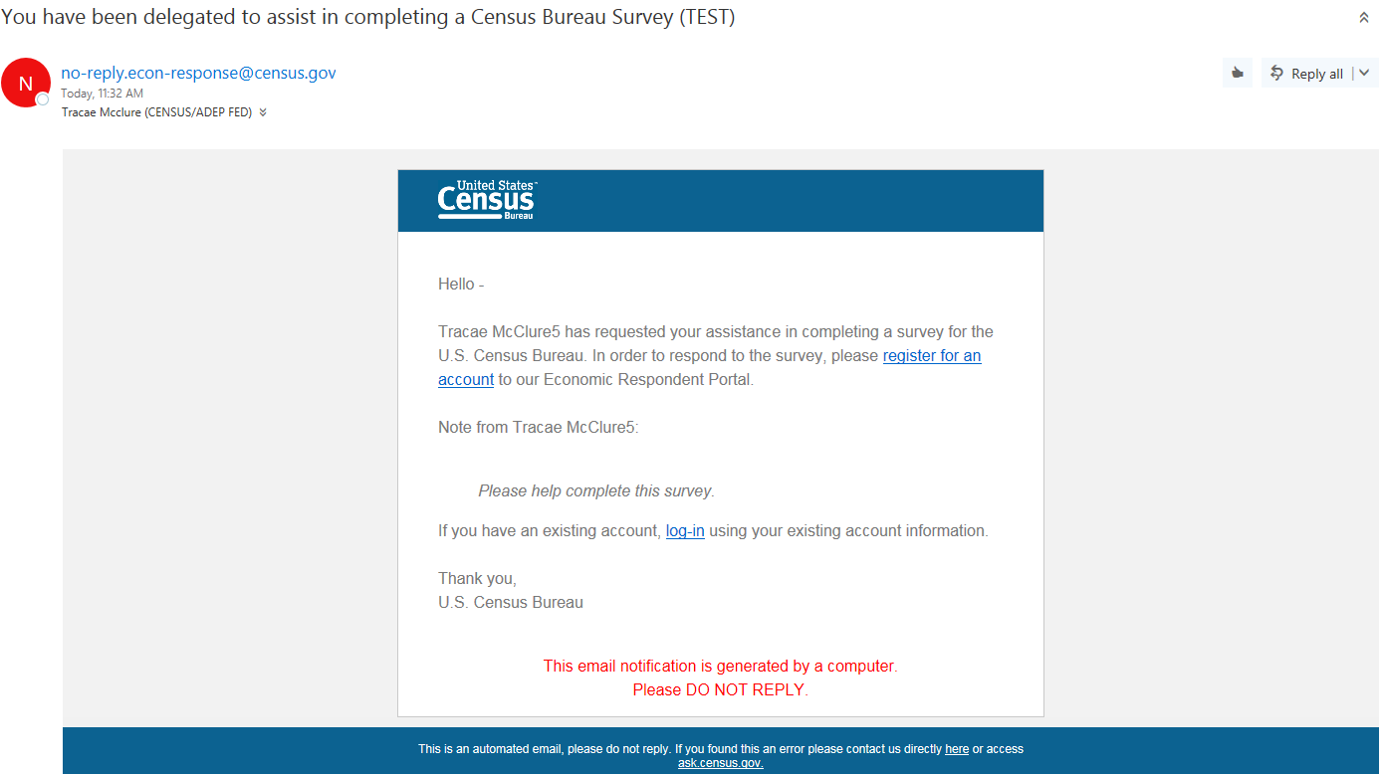
BERD Reporting Tools: Delegation
link to the Portal registration screen

Slide 16
Closing Thoughts

Slide 17
How do we obtain buy in?
Excel Workbooks and Consolidator Tool are on the survey help site.
Account Managers discuss the tools and their benefits with respondents through the course of their regular contacts.
  Within the online survey instrument, at the beginning of each section, we tell respondents What does this section cover?, Who should answer this section?, and provide links / information on Excel workbooks and delegation feature.

Slide 18
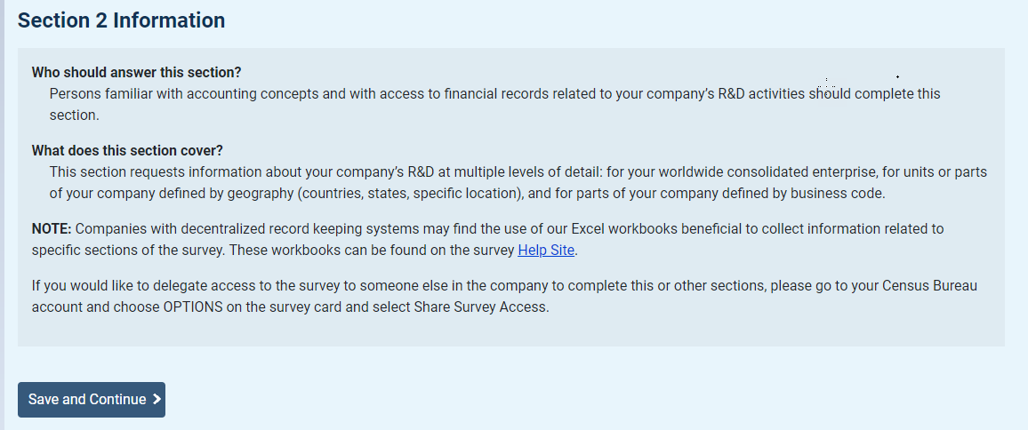

Slide 19
Does it work?
In a typical survey year:
  10-15% of respondents pass critical sections off to other departments to complete (HR, R&D Strategy, IP Protection).
  ~500 companies upload Excel workbooks.
    ~2,000 companies make use of the Delegate feature.

