Slide 1
Programmatic PDF extraction
An applied case study in federal government application portfolio analysis.
Kate Burdekin (RTI Center for Clinical Research Informatics)
Anna Godwin (RTI Center for Data Science and AI)
FedCASIC 2023 Session Title:
Data Science Applications: Automation
Notes:
Hi everyone, I am excited to be here today! My name is Kate Burdekin and I am here to present on use case involving programmatic PDF extraction that we use have used with more than one NIH clients. This work helps to improve efficiency in managing a portfolio of applicants for specific federal funding types, that we will talk about in more detail. My co-author Anna Godwin is unable to join us today, but she is a mahjor contributor in this work.

Slide 2
Problem Statement
The National Institutes of Health (NIH) manages a significant portion of the scientific portfolio for the nation's priorities in science and health.
Reviewing applications for scientific merit and managing the budget is a key aspect to developing a roadmap to find answers and improve science.
Current system to manage applications (ASSIST) has many funding opportunities and challenging to optimize the system for variety of application types (list on next slide).
Notes:
The National Institutes of Health (NIH) manages a significant portion of the scientific portfolio for the nation's priorities in science and health. A major aspect of building these programs is working with the different communities and reviewing the applications that come in from different funding announcements. They need to very quickly evaluate the scientific merit, manage the budget and establish the roadmap aligned with NIH’s priorities in specific subject areas. They currently have a federal system, called ASSIST, that helps support this process, but given the number of federal funding mechanisms, it’s not optimized for all funding vehicles. In some cases, the institutes are asked to follow guidelines and manage the process with more autonomy and these are situations where we have provided support.

Slide 3
Types of Funding opportunities Announcements (FOA)
Type of FOA | Description
Parent Announcements | Broad FOAs allowing applicants to submit an investigator-initiated application for a specific activity code Many NIH institutes and centers (IC) participate, Usually ongoing (3 yrs) Use standard due dates & List of Parent Announcements
Program Announcements (PAs) | FOAs issued by one or more Institutes and Centers to highlight areas of scientific interest Encourage applications for a new or ongoing program, Usually ongoing (3 years) Use standard due dates Types of PAs: PAS: with set-aside funds PAR: special receipt, referral, and/or review considerations NOSI: Notice of Special Interest highlights a scientific area of interest for the participating ICs.
Requests for Applications (RFA) | FOAs issued by one or more Institute or Center to highlight well-defined areas of scientific interest to accomplish specific program objectives Indicate the amount of set-aside funds, Indicate anticipated number of awards, Usually single due date Institute/Center usually convenes review panel
Other Funding Mechanisms | Other Transaction Authority (OTA) Not subject to the FAR, not grant regulations unless otherwise noted Research Opportunity Announcements (ROA) Contracts Presolicitation notices convey the solicitation availability. Sources Sought notices survey the market to determine if there are sources that can satisfy our requirements. Special Notices for Requests for Information (RFIs) and Draft Solicitations promote early information exchange to identify and resolve issues about an acquisition.
Source: https://grants.nih.gov/grants/policy/nihgps/html5/section_2/2.3.5_types_of_funding_opportunity_announcements__foas_.htm
Notes:
Here you can see a short snapshot of the funding mechanisms I alluded to previously, you can review this in more detail using the link on the bottom of this slide. First, you can see the parent grants and these are the R01s, R21s, and other grant activity codes you might recognize. There are four other major categories I dug up and within those there are sub types. You can see why one major system would be challenging to optimize for all these scenarios. The two highlighted in yellow are the funding mechanisms we have supported- a NOSI, or notice of special interest, and ROAs, or research opportunity announcement. We will focus on NOSIs in todays presentation. NOSIs allow NIH to put out funding that is specifically giving extra funds to a specific parent grant on a special topic, like additional funds to enhance a database system or software more reusable. These can sometimes be smaller volume, but it depends on the NOSI and how interested the community is in the area of focus.

Slide 4
Problem Statement
For NOSI and ROA opportunities, there is more work on the institutes to manage the process of making funding decisions and organizing an unbiased review process. Guidelines are provided, but operationalizing is up to the institute to manage.
Main task: Distill scientific purpose efficiently to target applications of relevance and track scientific trends.
Main data source: PDFs and some metadata of the application submissions (csv), output from ASSIST.
Current state of extracting data: human eyes* and some moving towards data modernization (extraction scripting) depending on skill set of staff supporting the process.
Notes:
So I hope this gives the foundation in understanding the foundational issue - For NOSI and ROA opportunities, there is more work on the institute staff to manage the data and how they fufill the unbiased review process needed. Guidelines are provided and helpful, but operationalizing is up to the institute to manage. So you have a wide range of program staff who have limited time and resources to facilitate this task and that is where we come in.
The main task is to distill the scientific purpose and target applications of relevance. As well as to keep this data in a meaningful way to track scientific trends.
A major data source here are application PDFs that come out of ASSIST as well as a csv output from the same system.
The current state of extracting this data often becomes human eyes from program staff and working groups – depending on the technical expertise of the staff, the timeline and number of applications. Now, these subject matter experts are still critical to make the decisions and ware relied on to make the decisions, we can’t automate that, but we can help standardize the approach and make their lives in managing the data easier.

Slide 5

Problem Statement
Notes:
This slide is just meant to help express the challenges of using human eyes to distill a large amount if data hidden in these rich PDFs. This image makes it look more pleasant than it can be.

Slide 6




Problem Statement
Federal NOSI submission has high volume and interest who needs systematic and efficient portfolio analysis support
Need to extract the topics and content area from PDFs without manually reading every PDF for content
Need to focus on specific sections and areas within applications
Each NOSI type will have dynamic information of interest – ex. Data type is relevant in one, technology or software is relevant in another.
Notes:
In more granular terms, our job is to help manage the submissions data and efficiently output standard information for these NOSI applications. We need to extract topics and content from these PDFs without having to read every PDF. Another interesting quirk of the NOSI applications is they often have information about the parent grant mixed into the proposal that might not be relevant to the targeted funding submission which could lead to false positives for certain content. Therefore, we need to hone in these extract efforts on specific sections of the program. And each NOSI cares about different content. For example, the data type being handled is extremely important for a database improvement NOSI announcement, but it might be less relevant for other topics.

Slide 7


Application Coordination Efforts
Application Process
Reviewer Recruitment
Funding Decisions
Reviewers with subject matter expertise needed to review applications.
Reviewer feedback and portfolio analysis used for institute leaders to make funding decisions.
Notes:
Taking another into the weeds of how this works, the process generally looks like this – they need a pool of expert reviewers of the applications, each application will get human eyes to review them and scores provided as a result of these reviews, and in parallel that information along with the data we can extract from the applications becomes the information NIH staff can use to make decisions.

Slide 8
Application Coordination Efforts
Application Process
Reviewer Recruitment
Funding Decisions
Reviewers with subject matter expertise needed to review applications.
Reviewer feedback and portfolio analysis used for institute leaders to make funding decisions.
Notes:
So we are really focusing today on extracting additional information from the PDF applications that we can provide to the decision makers.

Slide 9
Solution - PDF Extraction
Conflict of Interest Determination
Keyword Search
Portfolio Analysis
helps reviewers of applications quickly assess conflict of interest
Subject Matter Expert provided keywords are flagged in PDF text to identify areas of scientific purpose, data types of relevance and identifying key technology and software contained within the proposal.
Quickly extracts key information such title, terms preceding and following terms of interest, the first sentences of abstracts, 5 words preceding the word “dataset” and “database” to assist in a manual review of portfolio themes present in the PDF
Name, title and institution
Extract and Collate
target sections of 50-100 page documents
NOSIs – parent award details can create false positives
Abstract, research strategy, specific aims
Notes:
There are therefore 4 types of information we pull to support this process.

Slide 10
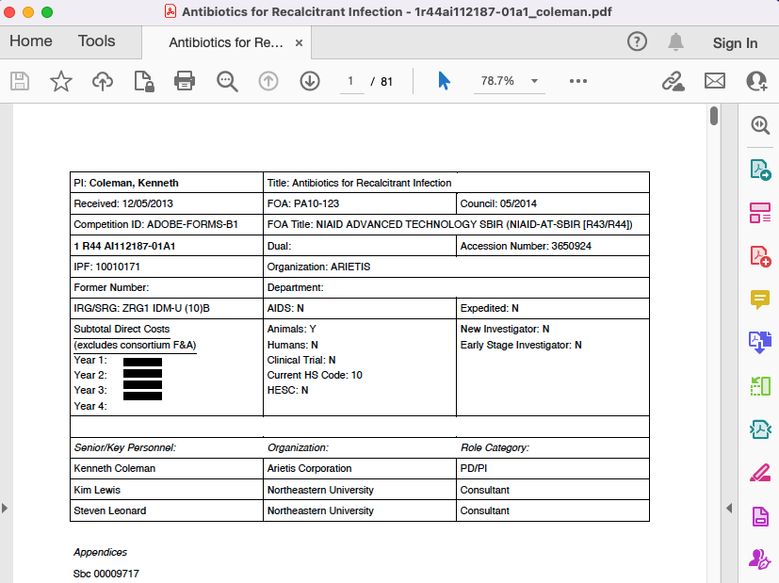
Example PDF
Example made available by: https://www.niaid.nih.gov/grants-contracts/sample-applications
Notes:
Let’s take a look at an example application PDF. This example was made available by the Sample Applications Page on the NIAID website.

Slide 11
Example PDF
Example made available by: https://www.niaid.nih.gov/grants-contracts/sample-applications
Notes:
At a glance, we can see that this is an 81 page application! That’s a lot of pages for manual extraction. Even using a cursor Ctrl+F to find key terms can still take awhile and copy/pasting tables can lead to time sinks with formatting into excel.

Slide 12
Example PDF – Application ID
Example made available by: https://www.niaid.nih.gov/grants-contracts/sample-applications
Notes:
One of the first things we Identify and extract is the application ID.

Slide 13
Example PDF – Key Personnel Table
Example made available by: https://www.niaid.nih.gov/grants-contracts/sample-applications
Notes:
Followed by the Key Personnel Table – which contains the key individuals who would be performing the work proposed as well as their associated organization and role on the project.

Slide 14
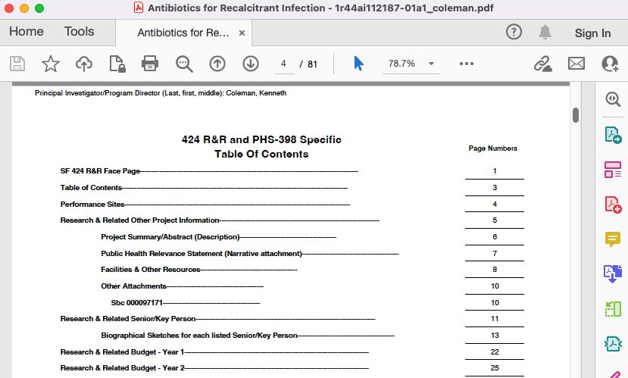
Example PDF – Specific Text
Example made available by: https://www.niaid.nih.gov/grants-contracts/sample-applications
Notes:
Next, we can see we’ve moved on the page 4 to the Table of Contents

Slide 15
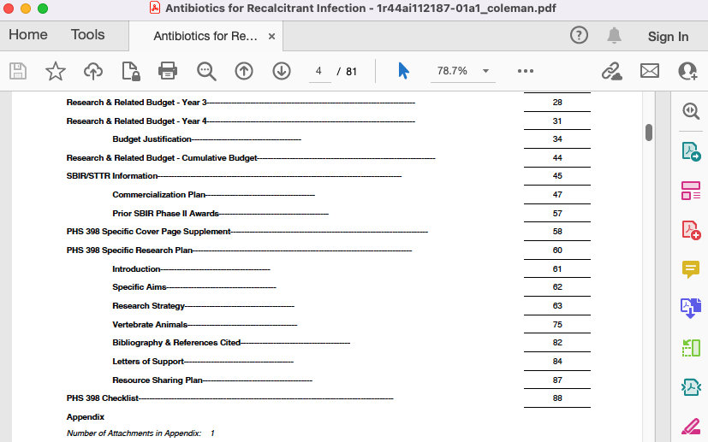
Example PDF – Specific Text
Example made available by: https://www.niaid.nih.gov/grants-contracts/sample-applications
Notes:
And we can start to see how this is becoming about a 80-90 page application with the requirements covered here in the Table of Contents.

Slide 16
Example PDF – Specific Text
Example made available by: https://www.niaid.nih.gov/grants-contracts/sample-applications
Notes:
Of particular interest is the Project Summary / Abstract.

Slide 17
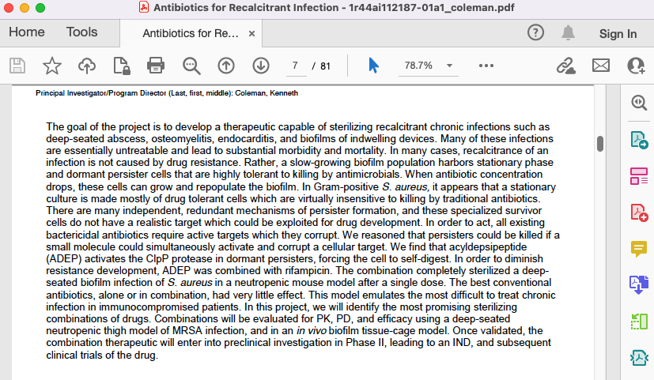
Example PDF – Specific Text
Extract 1 Page
Example made available by: https://www.niaid.nih.gov/grants-contracts/sample-applications
Notes:
Which we can see here…. This is typically 1 page of text to extract

Slide 18
Example PDF – Specific Text
Example made available by: https://www.niaid.nih.gov/grants-contracts/sample-applications
Notes:
As well as the Specific Aims and Research Strategy sections

Slide 19
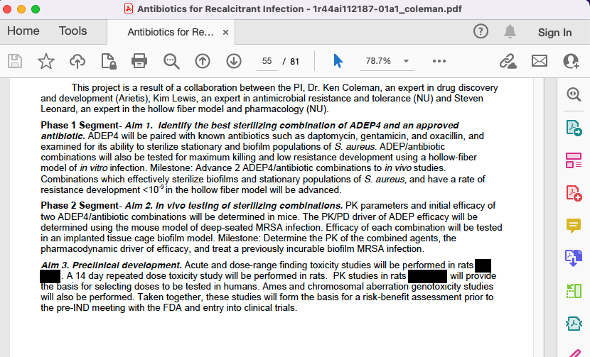
Example PDF – Specific Text
Extract 1 Page
Example made available by: https://www.niaid.nih.gov/grants-contracts/sample-applications
Notes:
The Specific Aims can be a variable length – ~1-3 pages

Slide 20
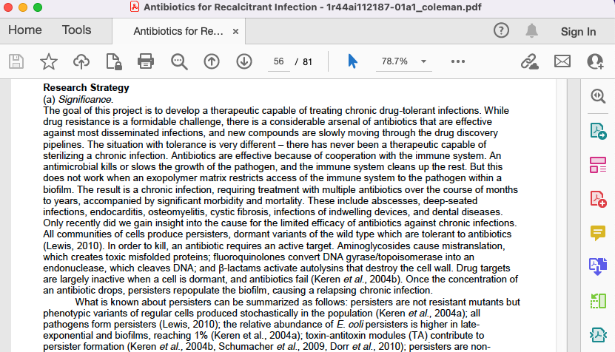
Example PDF – Specific Text
Extract 12 Pages
Example made available by: https://www.niaid.nih.gov/grants-contracts/sample-applications
Notes:
While the Research Strategy can be much longer with variable lengths of pages.
In these Specific Text sections, we’re particularly interested in the researchers Research Background and Technical Expertise, which we associate with specific key terms that have been compiled by Subject Matter Experts.

Slide 21

PDF Extraction – Initial Manual Process
Notes:
Stop and think for a second if this were a manual process that you had to do. You open the PDF. You copy and paste that key personnel table in Excel, and make sure it’s formatted right with one value per cell. You know how tricky that can be! Now you have your key word list of over 100 terms to search for to understand which more details around the researcher’s Research Background and Technical Expertise. Can you imagine Ctrl+Finding all of those and recording that somehow? And finally summarizing the document into a portfolio analysis.
And now you have to repeat this process for the next application. There’s typically anywhere from 5 to 150 applications for a single cycle that our government partner is interested in.

Slide 22

PDF Extraction – From Manual to Automation
Expected section, “Research Strategy”, is missing. Review needed.
“The research aims of this proposal are…”
Unstructured Text for Natural Language Processing (NLP)
Extraction metadata
~80 pages
Structured Data for downstream processes
A smaller, easier to manage PDF
Application ID
Key Personnel | Organization | Role
~5-15 pages
Notes:
By adopting a data modernization approach, we moved from a manual process to an automated one. And by doing that, we can produce these types of outputs. [Steps through the outputs]

Slide 23
PDF Extraction – Automation with “Human in the Loop”
Notes:
Important to remember that we’re not replacing the person that did the manual review previously. We are streamlining their workflow and making them more efficient in their processes. No automated process is 100% error prone and with our metadata warnings around missing content – we can direct folks to the exact place in the file to manual confirm if data is indeed missing or if the process had an error.

Slide 24
Solution - PDF Extraction
Conflict of Interest Determination
Keyword Search
Portfolio Analysis
helps reviewers of applications quickly assess conflict of interest
Subject Matter Expert provided keywords are flagged in PDF text to identify areas of scientific purpose, data types of relevance and identifying key technology and software contained within the proposal.
Quickly extracts key information such title, terms preceding and following terms of interest, the first sentences of abstracts, 5 words preceding the word “dataset” and “database” to assist in a manual review of portfolio themes present in the PDF
Name, title and institution
Extract and Collate
target sections of 50-100 page documents
NOSIs – parent award details can create false positives
Abstract, research strategy, specific aims

Slide 25
PDF Extraction - Technical Details
PDF Structure is key for this process to be automated
The PDF is a form document with an expected structure
Python for automated scripting
tabula-py library for PDF table extraction
The first page is the same and stays to one page
There’s a table of contents for targeted text extraction
pymupdf library for PDF table of contents parsing and text extraction
pandas for structured data manipulation
xlsxwriter for writing results with custom formatting to Excel
Base python libraries, regex for keyword search & portfolio analysis
Notes:
Tabula-py is good for tables
Pymupdft input specific measurements on the page- x cm from the left – this is where you should extract text – so this requires some standardization
Pandas data science package for tabular data
Xlsxwriter helps with custom excels
There are more general ways to approach topic matching, topic modeling using NLP to search through the apps, but as we explored this use case, we realized these documents were fairly standard.

Slide 26
Next Steps
Any remaining challenges?
  With a changing landscape, the portfolio of scientific area will always change and shift, so making sure the framework is adaptable and connecting to an existing taxonomy is underway.
Any remaining/anticipated work?
  Finding the right ontology to connect with these content areas that will continue to evolve and adapt over time is important. Piloting with NLM MESH controlled vocabulary.
Identify additional sections or phrasing of interest
  Make it easier to consume the information in the PDF for relevant topics.
Continuing to work with subject matter experts to understand process and add additional processing and analysis

Slide 27
Acknowledgements
RTI Team supporting this work
  Anna Godwin
  Chris Coxen
  Evan Bunnage
  Demian Pasquarelli
  Kristin Williams
NIH clients collaborating on this work

Slide 28
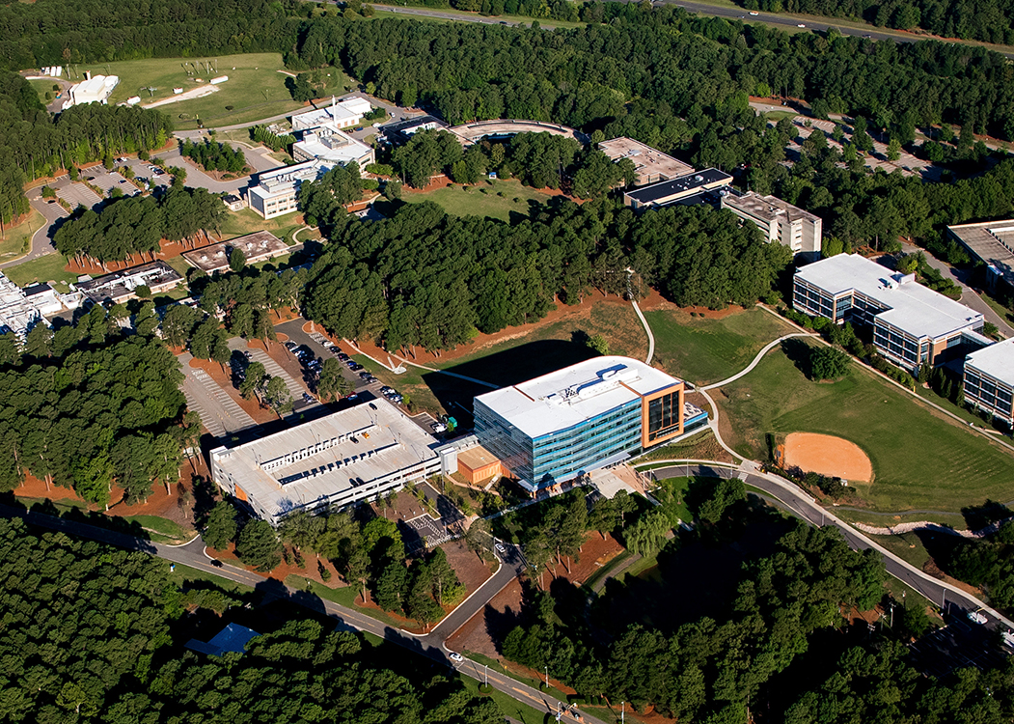
Thank you
Contact: Kate Burdekin | email: kburdekin@rti.org

