Slide 1
Programming to Pass a Survey to Another Respondent and to Create Dynamic Question Headers
Presenters and Authors:
Matthew Bensen, RTI International
Ansu Koshy, RTI International

Slide 2

Survey Information: Basics
We used the Voxco platform
Web only survey
We emailed intended respondents, one per case, a unique link to enter the survey
Our client was a federal agency and respondents were from that same federal agency

Slide 3
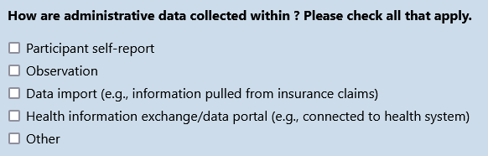
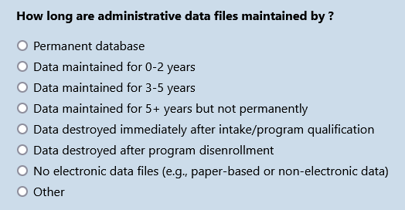
Survey Information: Purpose
"Gather your input about data collection by grantees of your agency or office."
"To understand the array of data collected and the ways those data may be used across a variety of programs."

Slide 4

Challenges
Some respondents may not be able to answer the questions
We needed to create two types of dynamic tables/grids

Slide 5
Challenge 1:
Respondent Not Able to Answer Any or Every Question

Slide 6
Survey Status | Consequence
Screened Out | Can not reenter survey
Interrupted | Can reenter survey

Slide 7
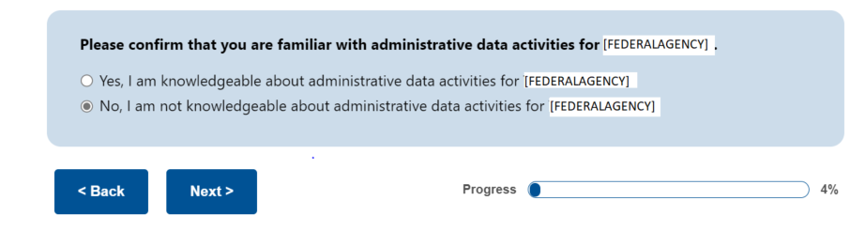
Not Right Person to Complete Any of the Survey
A “No” answer results in a Screened-Out status, preventing further survey entry.

Slide 8
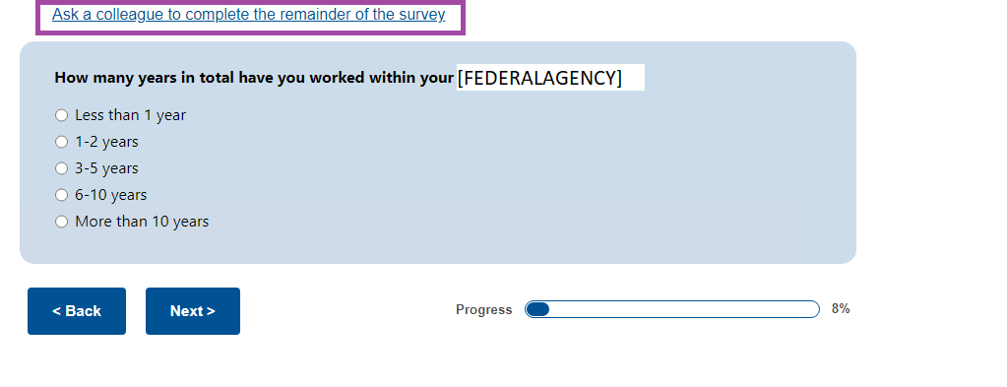
Not Right Person to Complete All Parts of the Survey
Clicking “Ask a colleague” results in Interrupted status, which allows for subsequent survey entry.

Slide 9
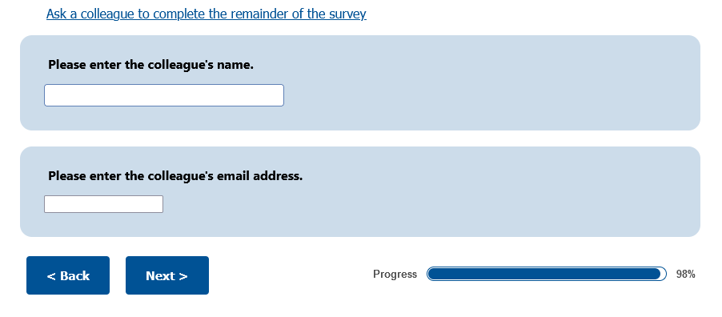
Gather Information For Contacting Second Person

Slide 10



Email Addresses In Voxco
  Doesn’t update the case's email address
  Updates the case's email address

Slide 11
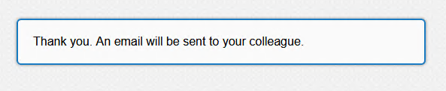
Message Referring First Respondent Would See

Slide 12
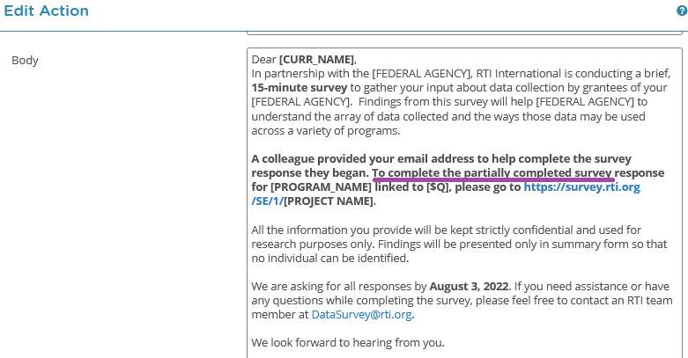
Two Types of First Email for “Referred” Respondent

Slide 13
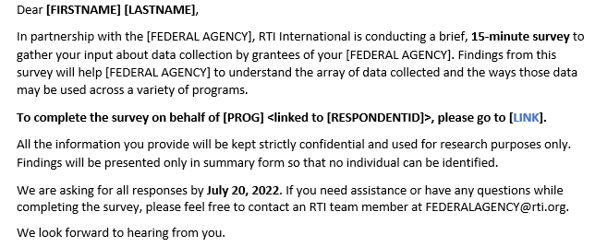
Two Types of First Email for “Referred” Respondent

Slide 14
Challenge 1 Summary:
Two Main Scenarios

Slide 15
Scenario 1: Person Immediately Informs They Aren’t The Right Person
The Case Gets Set to Screened Out Status
We Remove the Answer Indicating That They Can't Answer the Questions
We Change the Case Status so that it Can be Reaccessed
We Send an Invitation Email to the Colleague
They Provide Name and Email Address of a Colleague

Slide 16
Scenario 2: Person Informs They Aren’t The Right Person After Answering Some Substantive Questions
An Email is Triggered and Sent to the Colleague
They Provide the Name and Email Address of a Colleague

Slide 17
Challenge 2:
Create Dynamic Grid/Table Questions

Slide 18
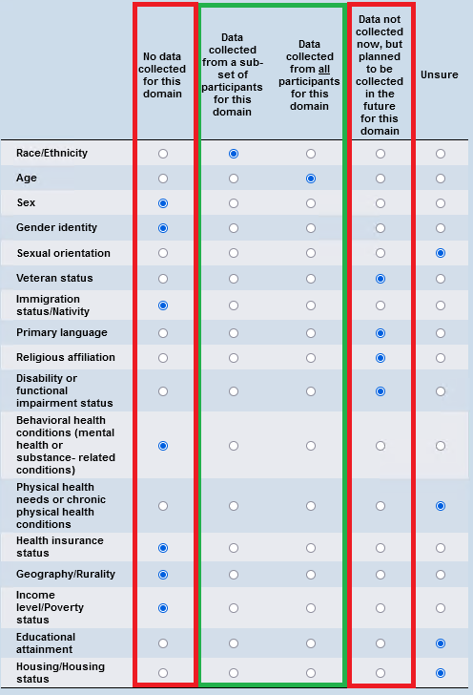
Base Question

Slide 19
Two Formats of Grid/Table Questions

Slide 20
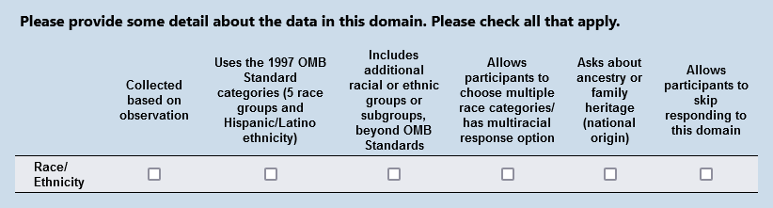
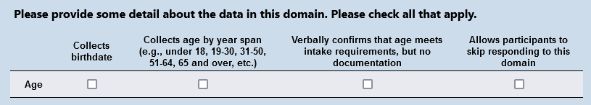
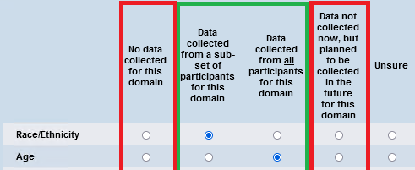
Format 1: Unique Sets of Questions Per Domain

Slide 21
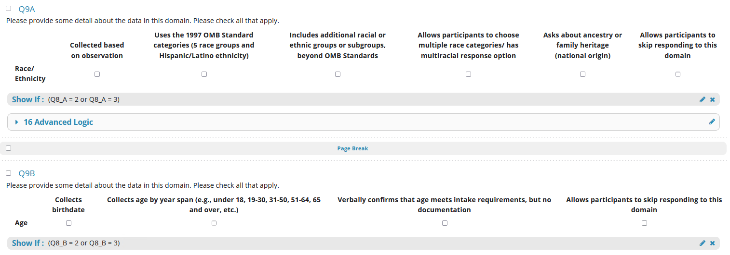
Unique Sets of Questions Per Domain, Programmer View

Slide 22
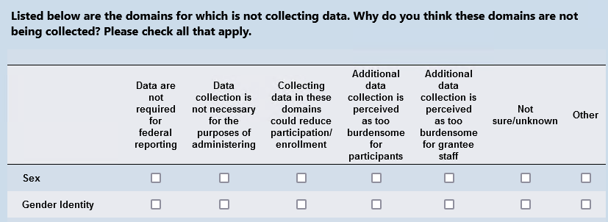
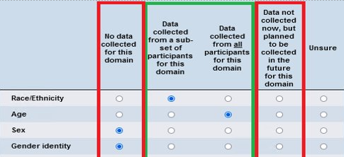
Format 2: Dynamic Rows With Fixed Columns
Notes:
Now moving onto format2. Dynamic rows with fixed columns.
This is the 2nd variant of the dynamic table that was implemented.
In this scenario we have a fixed header with different domains populated if data isn't collected from the base question, that is if the columns 1 & 4 are selected from the base question then all those rows will be displayed in this table.
On this slide we are showing only 2 domains because only these 2 rows had data from the base question based on the selection criteria. In reality we can have a table with upto 17 rows.

Slide 23
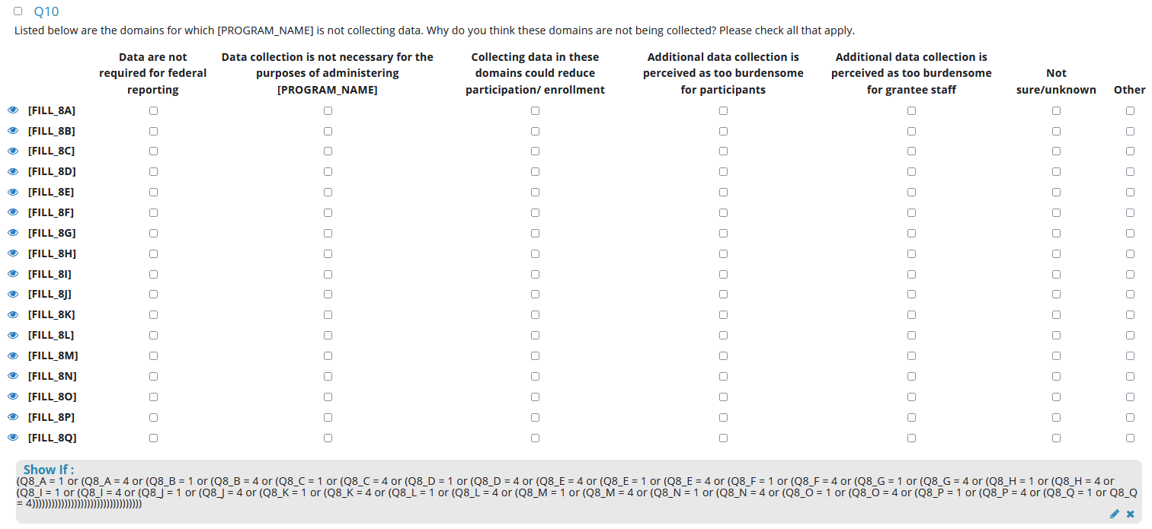
Dynamic Rows With Fixed Columns, Programmer View

Slide 24

Summary
For knowledge-based surveys, to maximize the chance to get responses to all questions, you can craft a creative solution to allow more than one person to provide answers toward completing a case
You can use responses to a base question to build dynamic table/grid questions

Slide 25

Thank you
Contact: Matt Bensen| email mbensen@rti.org
Ansu Koshy | email akoshy@rti.org

