Slide 1
Creating Geography-based PSUs in R PracTools
George Zipf, Chief Statistician, JA-2 Audits
Department of Transportation, Office of Inspector General
Notes:
Good morning. I am George Zipf, Chief Statistician in Audits for the Office of Inspector General at the Department of Transportation. I’m pleased to be here and present this morning. The ideas presented here began with an audit where I was asked to take some geographic data and create a design that allowed for estimation at the national level, based on travel to some randomly selected sites. That led to the development of some R functions which are now public, and also this presentation.

Slide 2
Agenda
1
Introduction
2
Review of Problem: How to create Primary Sampling Units from Geography-based sampling units
3
Review of an Approach: Clustering and Measure of Size constraints
4
Example
5
Sample Size / References / Q&A
Notes:
[Read slide]

Slide 3
Geographic Data: Examples and Challenges
Census tracts
  Already contiguous.
  Frequently agglomerated according to the survey design requirements
Other Examples:
  Airports
  Manufacturing facilities
  Business establishments
The other examples provided are not contiguous and but still may need to be grouped together for operations and/or estimation requirements
Notes:
I imagine that when most of us think of geographic data, we think of the data products produced by the US Census. At whatever its level of granularity, it is contiguous with other geographic data, and often has matching auxiliary information. However, some geographic data does not meet this criteria. Examples include airports, or manufacturing facilities, or business or educational establishments. Geography can be very important here, but grouping the data geographically may have design challenges unique to the data.

Slide 4
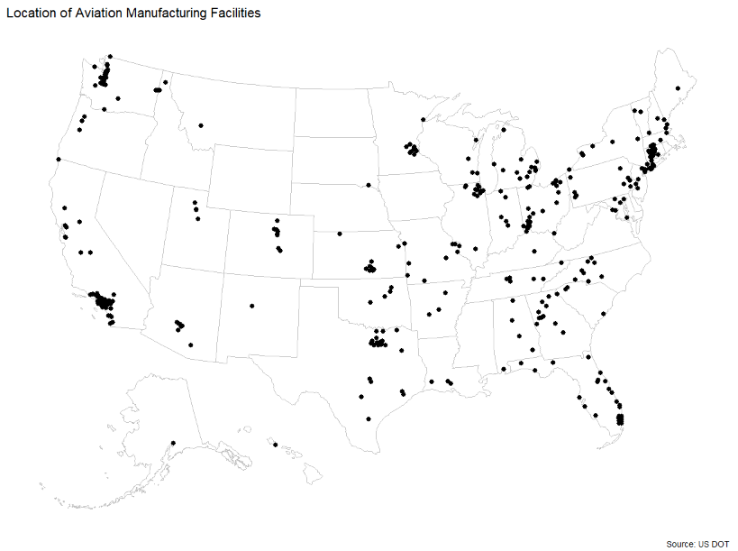
Example: Facilities
Notes:
For example, here is a chart of 381 aviation manufacturing facilities. While the data is public, I am masking it a little here, just on general principal. Just by looking at it, some groupings seem obvious; possibly the Seattle area, or Chicago. But how should the facilities in Ohio be grouped?

Slide 5
R PracTools
PracTools is an R package that provides functions to design and weight survey samples, including:
  Sample size calculation for survey samples using stratified or clustered one-, two-, and three-stage sample designs, and single-stage audit sample designs
  Grouping geographic units accounting for distances apart and measures of size
  Computing variance components for multistage designs and sample sizes in two-phase designs
Notes:
Before I begin to show how the geographic units may be grouped, let me discuss PracTools, the R package that contains the functions. R PracTools provides functions to design and weight survey samples. [Read slide].

Slide 6
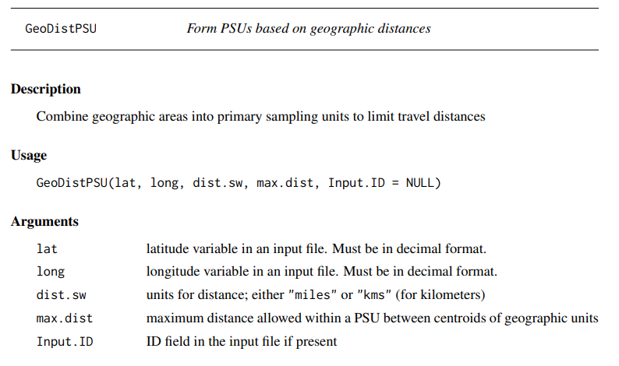
PracTools::GeoDistPSU
Notes:
[Read slide]

Slide 7
Example: Facilities
Notes:
Again, here is the location of all the aviation manufacturing facilities.

Slide 8
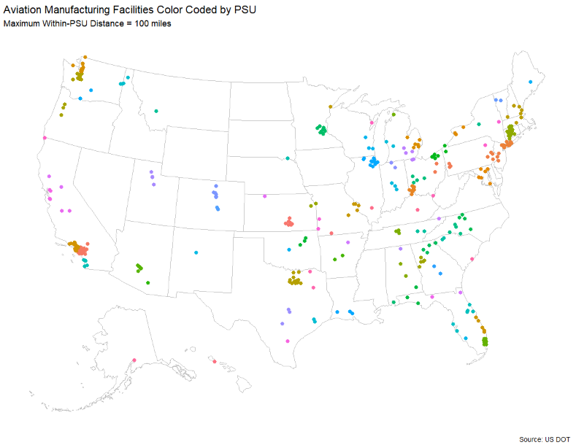
Example: Geography-based PSUs
Notes:
And here are the same facilties color-coded into PSUs that have a maximum 100 miles distance within any particular cluster. The cluster linkage algorithm used is the “complete” method, which merges clusters based on the maximum distance in two adjoining clusters. This approach guarantees a fixed maximum distance within a cluster. This can be critical if travel within the PSUs is involved.

Slide 9
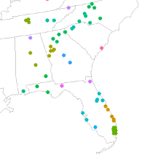
Example: Geography-based PSUs, detail
Notes:
Here is a close up of the southern region. The idea here is to give an example with more granularity. While the colors are R’s default, this map does provide some better perspective.

Slide 10
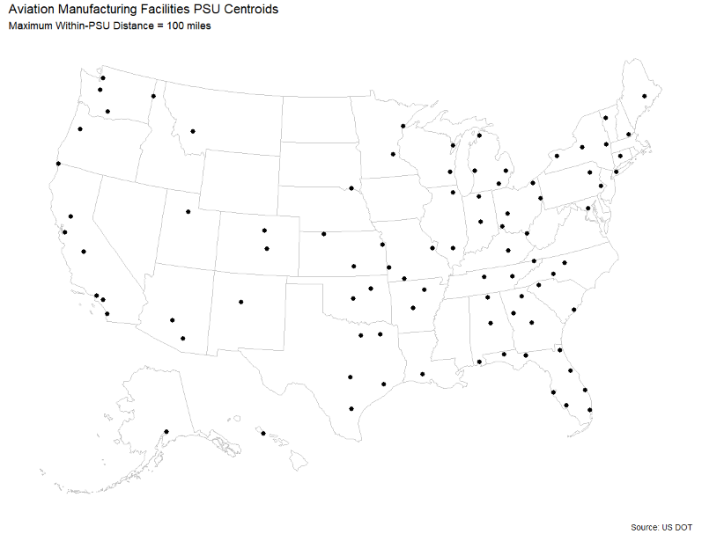
Example: Geography-based PSUs, centroid means
Notes:
Another feature that the GeoDistPSU function has is that the PSU centroid means are output and can be graphed. There are 88 PSUs here. Again from an operations standpoint, this looks easier to navigate.

Slide 11
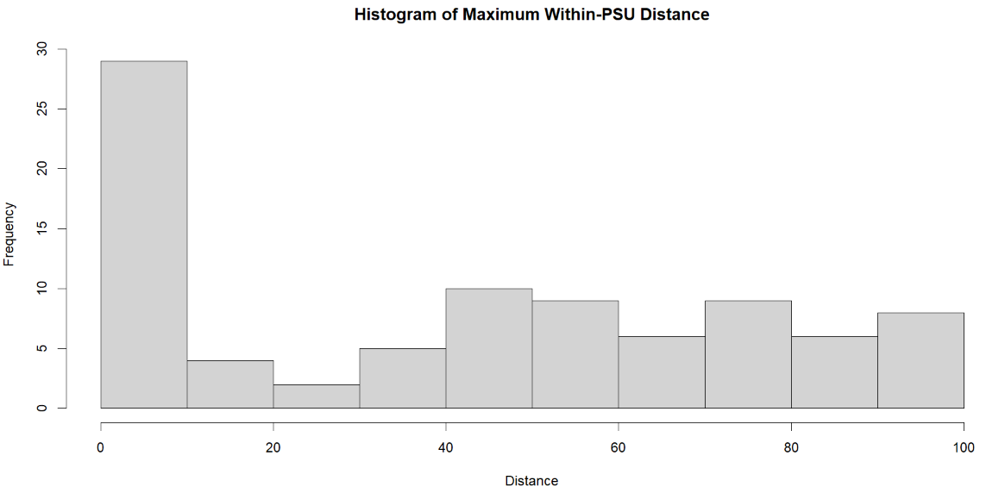
Example: Maximum within-PSU Distance
Notes:
GeoDistPSU also outputs the maximum within-PSU distance. As a reality check, it can be seen that the maximum distance is in fact 100 miles. Where the maximum distance is 0, the PSU has only a single secondary sampling unit within it.

Slide 12
PracTools::GeoDistPSU Output
GeoDistPSU outputs the following values:
  A data frame at the geographic unit level with:
    InputID if assigned (for merging with original sampling frame); and
    PSU assigned to each input record
  A data frame at the PSU level with:
    The number of secondary sampling units (SSUs) assigned to the geography-based PSU;
    The PSU mean longitude and latitude; and
    The maximum within-PSU distance among the SSUs assigned to the PSU, in the unit measurement (miles or kilometers) as entered
Clustering is performed using the complete linkage method to ensure maximum distance requirements are met
Notes:
[Read slide]

Slide 13
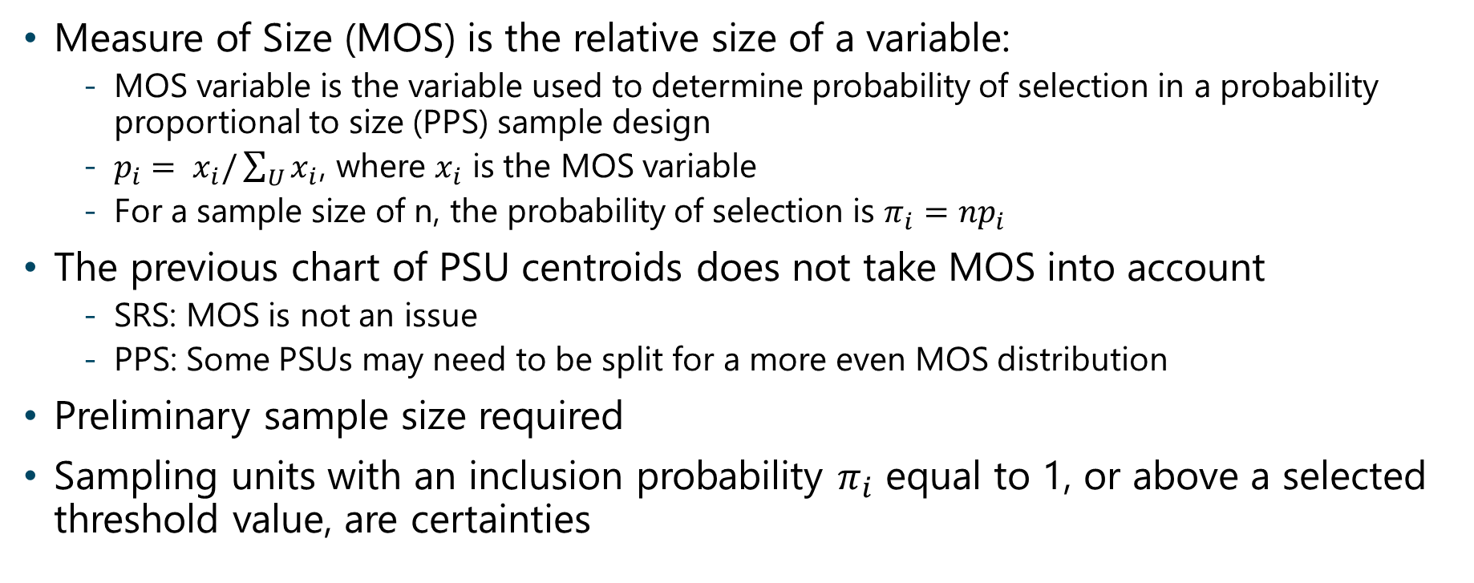
Measure of Size
Measure of Size (MOS) is the relative size of a variable:
  MOS variable is the variable used to determine probability of selection in a probability proportional to size (PPS) sample design
  $p_{i}= x_{i}/\sum_{U}{x_{i}}$, where $x_{i}$ is the MOS variable
  For a sample size of n, the probability of selection is $π_{i}=np_{i}$
The previous chart of PSU centroids does not take MOS into account
  SRS: MOS is not an issue
  PPS: Some PSUs may need to be split for a more even MOS distribution
Preliminary sample size required
Sampling units with an inclusion probability $π_{i}$ equal to 1, or above a selected threshold value, are certainties
Notes:
[Read slide]

Slide 14
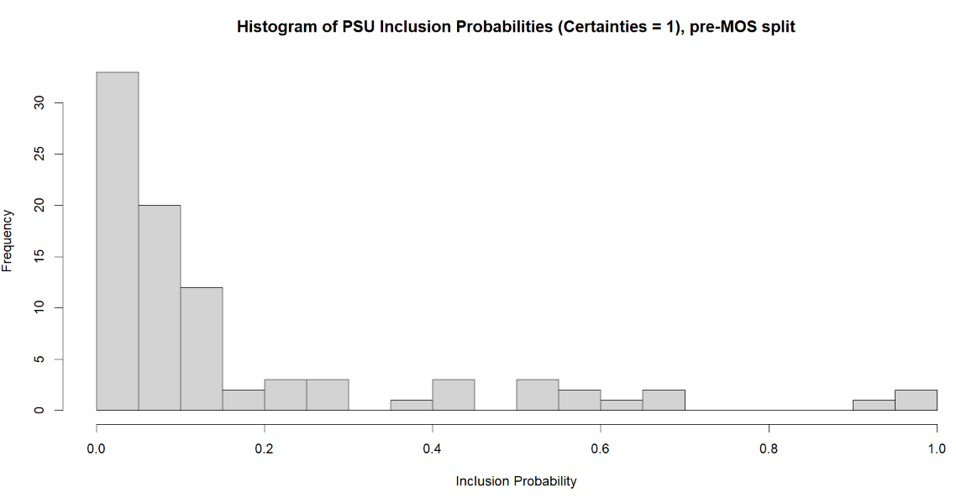
Example: MOS from GeoDistPSU PSUs
Notes:
Here is a histogram of the Measure of Size variable across the PSUs as created by GeoDistPSU. Of the 88 PSUs, there are many in the middle and a few on the right. Because of the skew, it is advisable to try to split some PSUs so that the Measure of Size is more evenly distributed.

Slide 15
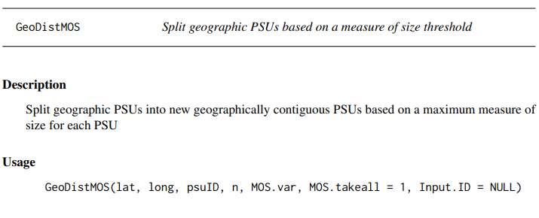
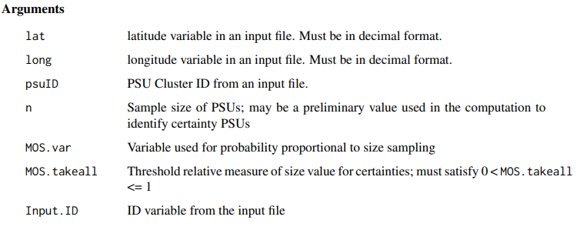
PracTools::GeoDistMOS
Notes:
[Read slide]

Slide 16
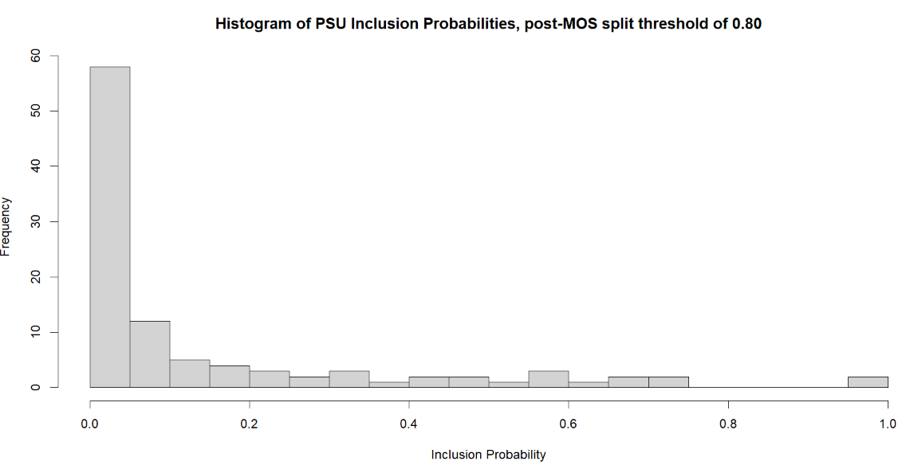
Example: MOS from GeoDistMOS PSUs
Notes:
In this example, there were originally 88 PSUs. After splitting the high-MOS PSUs, there are now 103 PSUs. There is still one certainty but overall, there is much less of a skew and the measure of size is more evenly distributed.

Slide 17
GeoDist functions and Sample Size
By creating geography-based PSUs from geographic sampling units, a two-stage design is likely
PracTools offers functions such as BW2stageSRS and BW2stagePPS to determine the level of homogeneity in each PSU, which can be used to inform the optimal number of PSUs and sampling units within PSUs
Notes:
These PSUs can be used as inputs into a two stage sample design. PracTools offers several functions for this. For purposes here, this is outside the scope of the presentation.

Slide 18
Summary
R PracTools is an excellent package for survey design
PracTools::GeoDistPSU can take sampling units with longitude and latitude values and group them such that the geography-based PSU has a maximum within-PSU distance
PracTools::GeoDistMOS can take the output from GeoDistPSU and split PSUs that exceed a measure of size threshold
The output can also be used to develop two-stage sample sizes
References:
  tidygeocoder (https://CRAN.R-project.org/package=tidygeocoder)
  PracTools vignette (https://cran.r-project.org/web/packages/PracTools/vignettes/Distance-and-MOS-PSUs.html)
Notes:
[Read slide]

