Slide 1
The Effects of Translation on Machine Learning Models:
A Case Study from the SOII Autocoder
Daniel Todd
Data Scientist
Bureau of Labor Statistics
Office of Compensation and Working Conditions

Slide 2
Survey of Occupational Injuries and Illnesses (SOII)
Establishment survey
>200k injuries reported/year
Information such as:
    Job title
    Source of injury
    Part injured
    Etc.

Slide 3
SOII Case Coding Example
Example Narrative
Job title: Sanitation worker
What was the employee doing just before the incident?
Mopping floor in gym
What happened?
slipped on wet floor and fell
What part of the body was affected?
fractured right arm
What object directly harmed the employee?
wet floor
Codes Assigned
Occupation: 37-2011 (Janitor)
Nature: 111 (Fracture)
Part: 420 (Arm)
Event: 422 (Fall, slipping)
Source: 6620 (Floor)

Slide 4
Problem
Question
Known Spanish cases exist in our dataset
  Unknown how many
  Not labeled as “Spanish”
Unknown effects on SOII Autocoder performance
Would detecting and translating Spanish cases to English improve Autocoder performance?

Slide 5
Approach
Compare the Autocoders performance when trained w/ Spanish & English cases (current method) to Autocoder trained on just English cases
Detection
  - We don’t know which cases are in Spanish
Translation
  - Once we have an idea of which cases are Spanish, we need to translate them to English
Evaluation
  - How did we do at detecting and translating since there are no labels for us to manually compute a metric.

Slide 6
Language Detection
Several options exist
  Most tend to use ML
Needed to be run locally to protect data privacy (can't use google translate)
Two Detection methods investigated:
  Langdetect – (Non-Deterministic) https://pypi.org/project/langdetect/
  xlm-Roberta-base-language-detection – (Deterministic) https://huggingface.co/papluca/xlm-roberta-base-language-detection

Slide 7
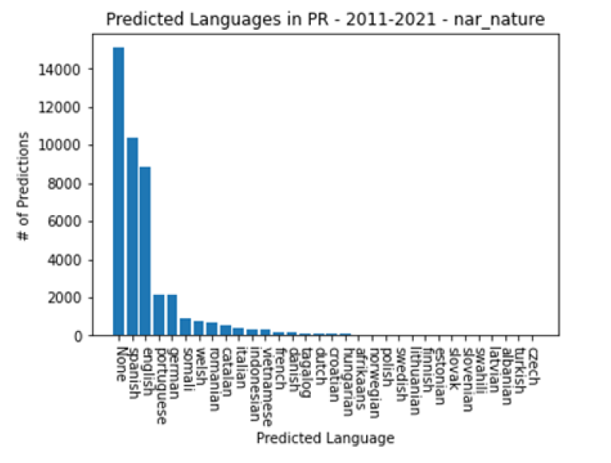
Langdetect Results (PR Subset)
<50% of cases labelled “None”
Excluding none predictions, <31% of cases labelled as languages other than Spanish/English
High error rate with large portion of cases unclassified
*All shown languages were predicted*

Slide 8
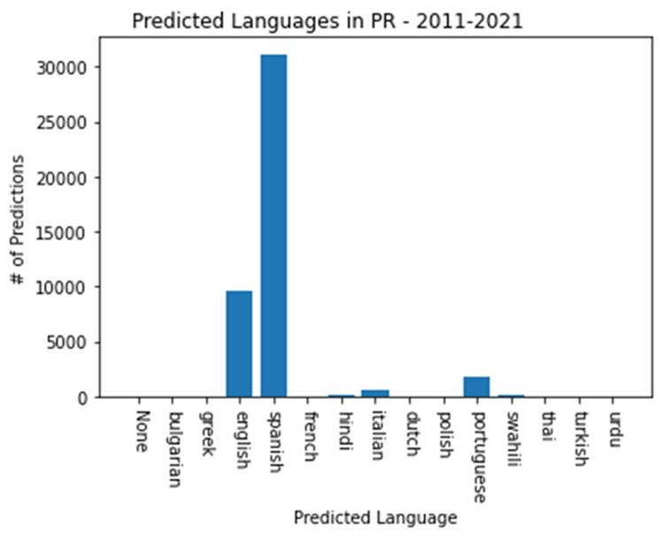
XLM-Roberta Results (PR Subset)
70% of Puerto Rican Cases detected as Spanish
<7% of cases labelled as languages other than Spanish/English
After Spanish/English the next most frequently predicted language is Portuguese
*All shown languages were predicted*

Slide 9
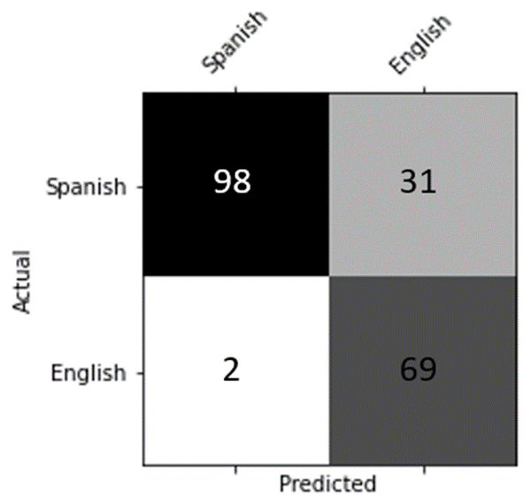
Extrapolation on Puerto Rico
300 cases randomly selected
31% False Negative Rate
(Predicted English but was Spanish)
2% False Positive Rate
(Predicted Spanish but was English)

Slide 10
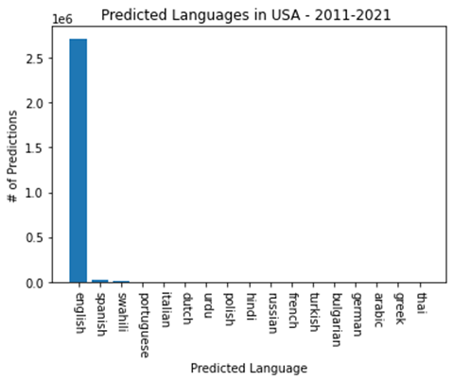
XLM-Roberta Results (All U.S./Territories)
98% of US Cases detected as English
No State/Territory besides Puerto Rico had less than 97.5% of cases in English
*All shown languages were predicted*

Slide 11
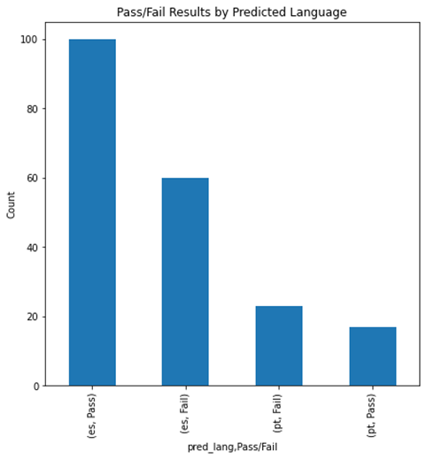
Translation
Each Reviewer given 100 unique translated cases
62.5% of Spanish Translations Acceptable
57.5% of Portuguese Translations Acceptable
Translation Model :
    opus-mt-es-en (https://huggingface.co/Helsinki-NLP/opus-mt-es-en)

Slide 12
Model Training
Two identical models were trained
One trained using translated inputs
Other trained using non-translated inputs
Both have identical outputs

Slide 13
SOII Autocoder Results
 | Not Translated Accuracy | Translated Accuracy
Gold Standard Dataset | 81.36 | 81.09
Puerto Rico Holdout Dataset | 76.67 | 74.83
 | Not Translated F-1 | Translated F-1
Gold Standard Dataset | 54.51 | 53.92
Puerto Rico Holdout Dataset | 48.63 | 47.94

Slide 14
Conclusions
Observed decrease in both primary recorded metrics on both test cases
Implies Autocoder:
  Can correctly code cases in Spanish
  Detection/Translations are insufficient at providing useful information to the Neural network
Only approximately 1% of all U.S. cases are believed to be in Spanish including Puerto Rican cases

Slide 15
Acknowledgements
Computer Assisted Coding (CAC) Team
  David Oh
  Robert Deetz
  Drake Gibson
  Matt Gunter
  Matthew Haines
  Kolby Houghton
  David Losada
Spanish Translation Reviewers
  Leah Dove
  Alessandra De La Pava

Slide 16
QUESTIONS?

Slide 17
Daniel Todd
Bureau of Labor Statistics
Office of Compensation and Working Conditions
Todd.Daniel@bls.gov
Contact

