Slide 1

The transformation of cida
(formerly cari)
FedCASIC Presentation: April 12, 2023
Joanne N. Carruba Chief, Master Control Development Branch, Application and Services Division (ADSD)

Slide 2
Agenda
OVERVIEW
SYSTEM TRANSFORMATION
TIMELINE
USER INTERFACE FEATURES
  CASE VIEW
  CODING MANAGEMENT
  CODING
  REPORTS
CHALLENGES/SOLUTIONS
FUTURE OF CIDA

Slide 3
overview
At Census, the CARI (Computer Audio Recorded Interview) application survey operations and system maintenance were always resource intensive since its conception in 2010. CARI was re-branded as CIDA (CARI Interactive Data Access) System after major portions of the UI and batch processing were redesigned a decade later. CIDA’s new technologies allow for more flexibility to maintain and modify. Many recent enhancements to CIDA provide customers more features to save time and provide better analytics. At this FEDCasic session we will discuss the innovations of CIDA, as well as current challenges and future plans.
***All screen shots for this presentation were taken from the CIDA Development & Test platforms. All data shown is from CE Test Data sets.

Slide 4
System transformation
WEB APPLICATION
BATCH PROCESSING
GUI migrated from asp.net/Telerik to Angular
Business Logic went from vb.net to Java with Spring Boot
PL/SQL to HIBERNATE
Web Server moved from Windows to Linux RHEL
​​Oracle database stayed the same​, but had modifications
Code was migrated from PL/SQL to Java/HIBERNATE/Spring batch
​​Authors package Friendly Question Name File within Instrument, Master Control System (MCS) delivers to CIDA directory for pickup
MCS Decoupled from CIDA Data Load Processing
MCS creates data files from completed cases for CIDA
MCS/CIDA have the option to add survey specific variables to CIDA system via Survey Specific File (SSF)

Slide 5
TIMELINE
2010
RTI/TMO Collaboration to build CARI for Production ACS operations
2015
Survey of Income Program Participation: Production Using CARI to Present
2020-2022
ADSD: Migrate to new technologies to create CIDA; decouple batch load processing from MCS for independence
2022
Consumer Expenditure: Monthly Production Coding Operations to Present

Slide 6
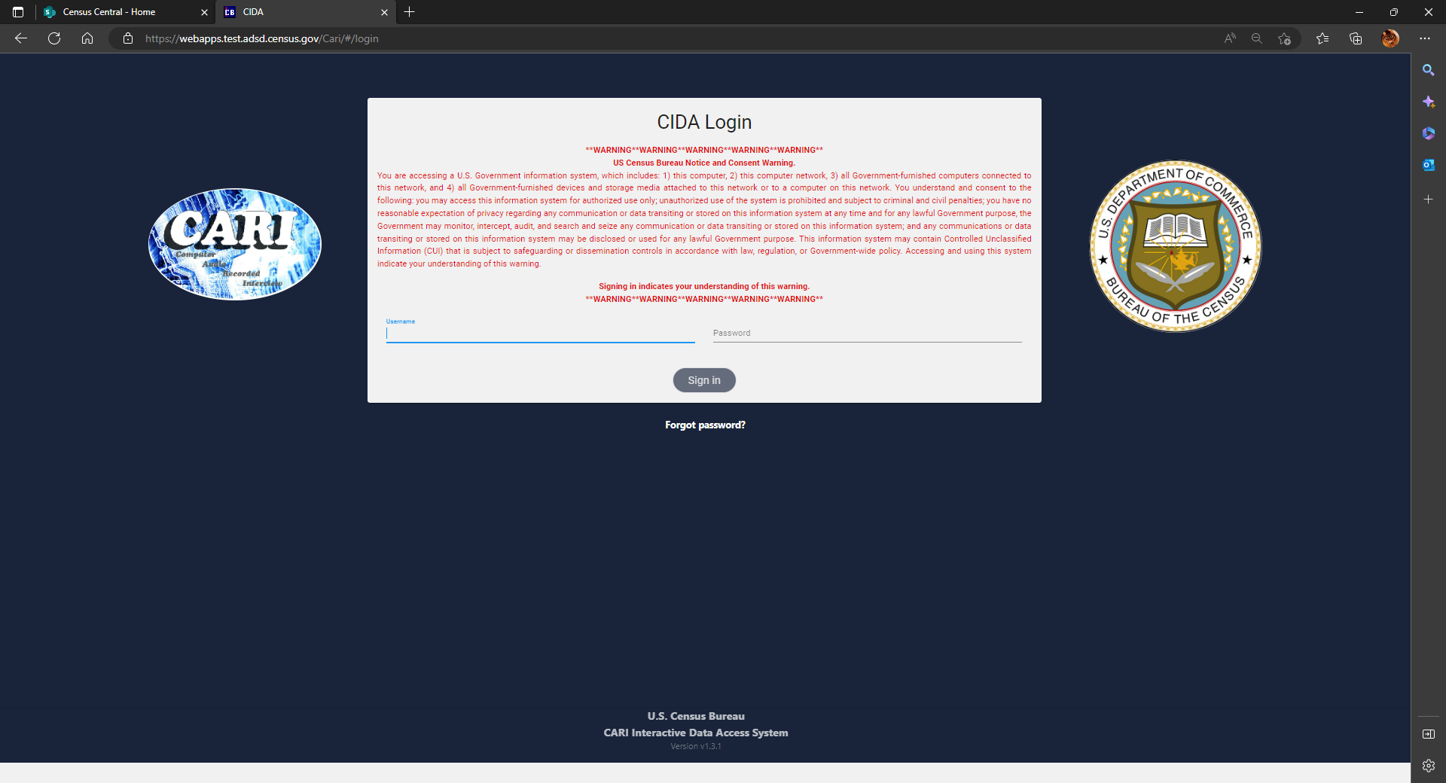
User INTERFACE FEATURES

Slide 7
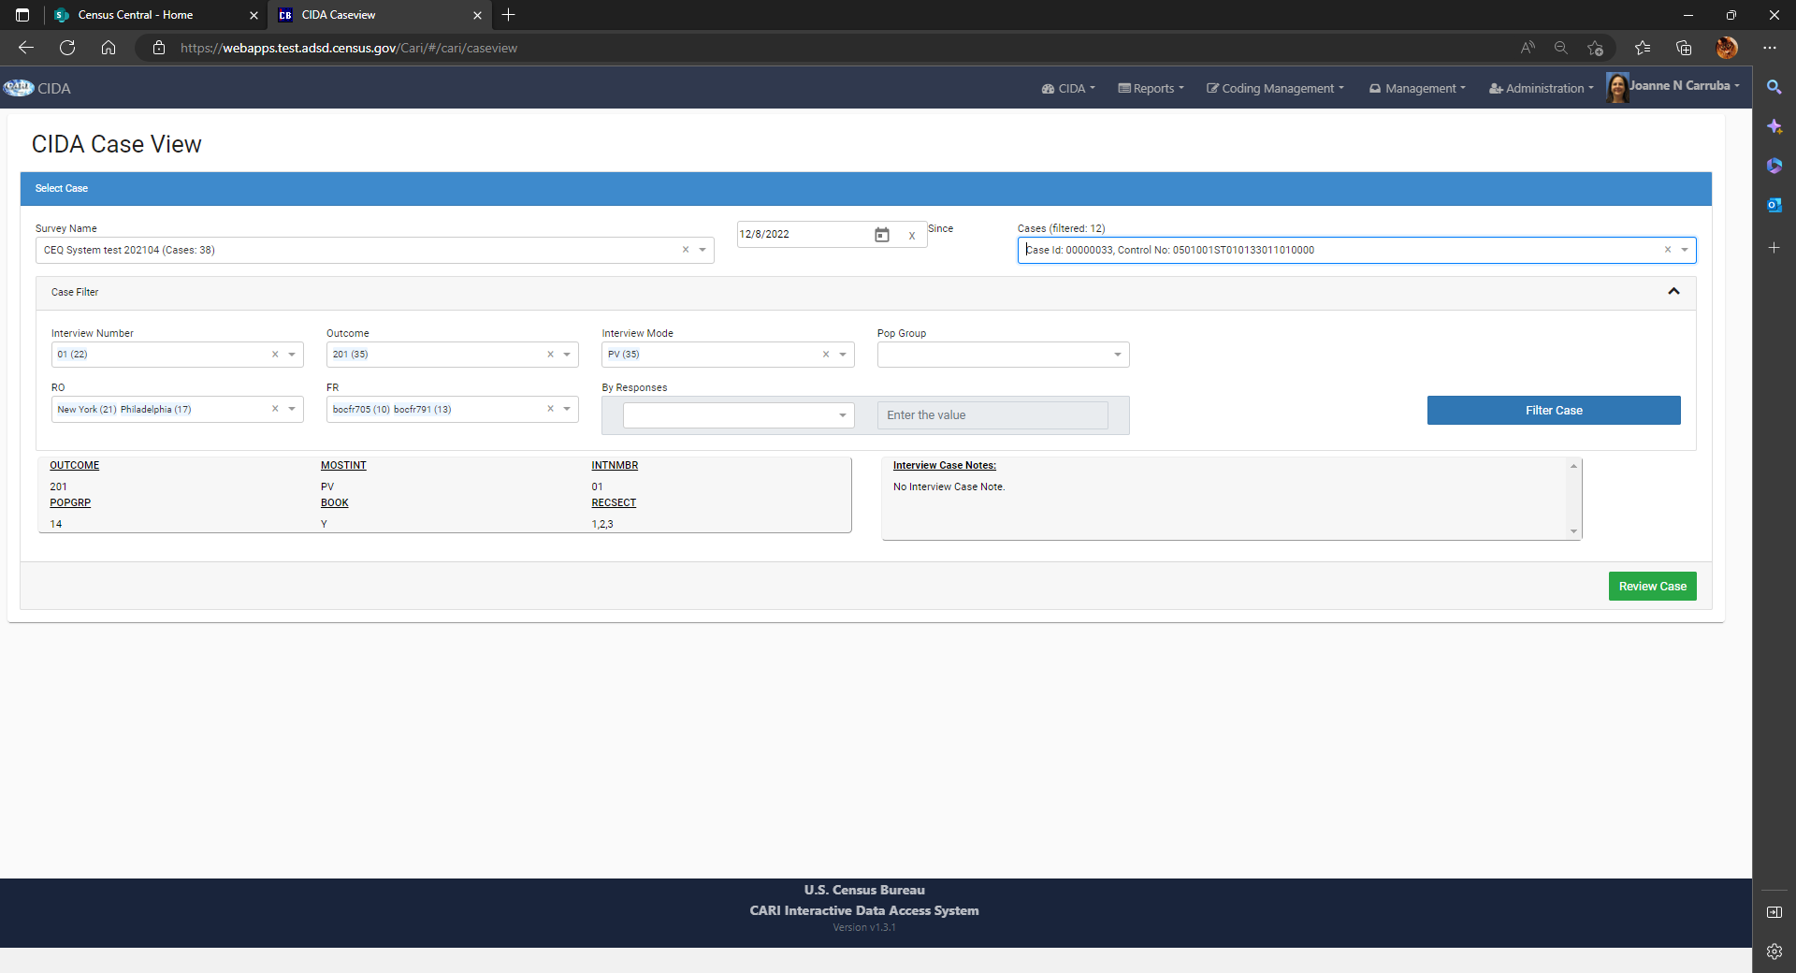
Case view: review case
Case View is used by Survey Staff read only role.
After the case is selected, Survey Specific Fields are displayed
User can either refilter for a different case or review the case currently selected.
The number of cases associated with a particular filter is noted within ()s.

Slide 8
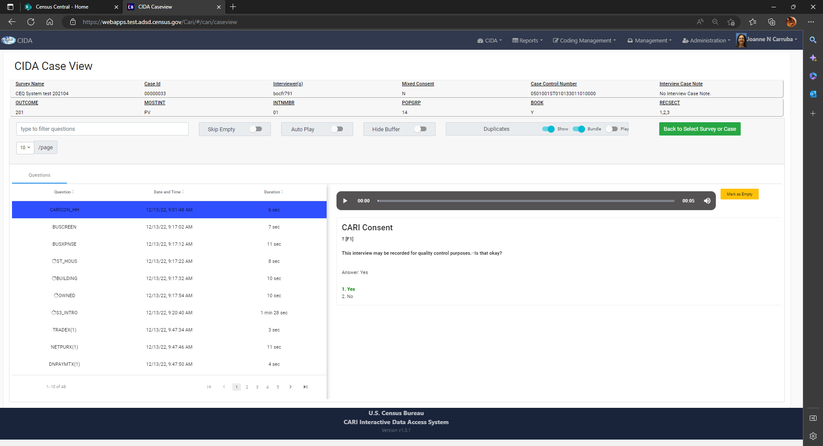
Case view: review case question images & recordings
Displays Survey Specific Variables, Case Notes, List of Questions, and Highlight/Audio player for Current Question
Ability to Filter to Specific Questions
Default Settings: Skip Empty; Auto Play; Hide Buffer; Show & Bundle Duplicates, no Play
Mark as Empty Button
Buffer Questions Noted
Choose number of Questions displayed on page
Recordings are displayed in the order they are recorded. However you can sort them by Question, Date & Time as well as Duration

Slide 9
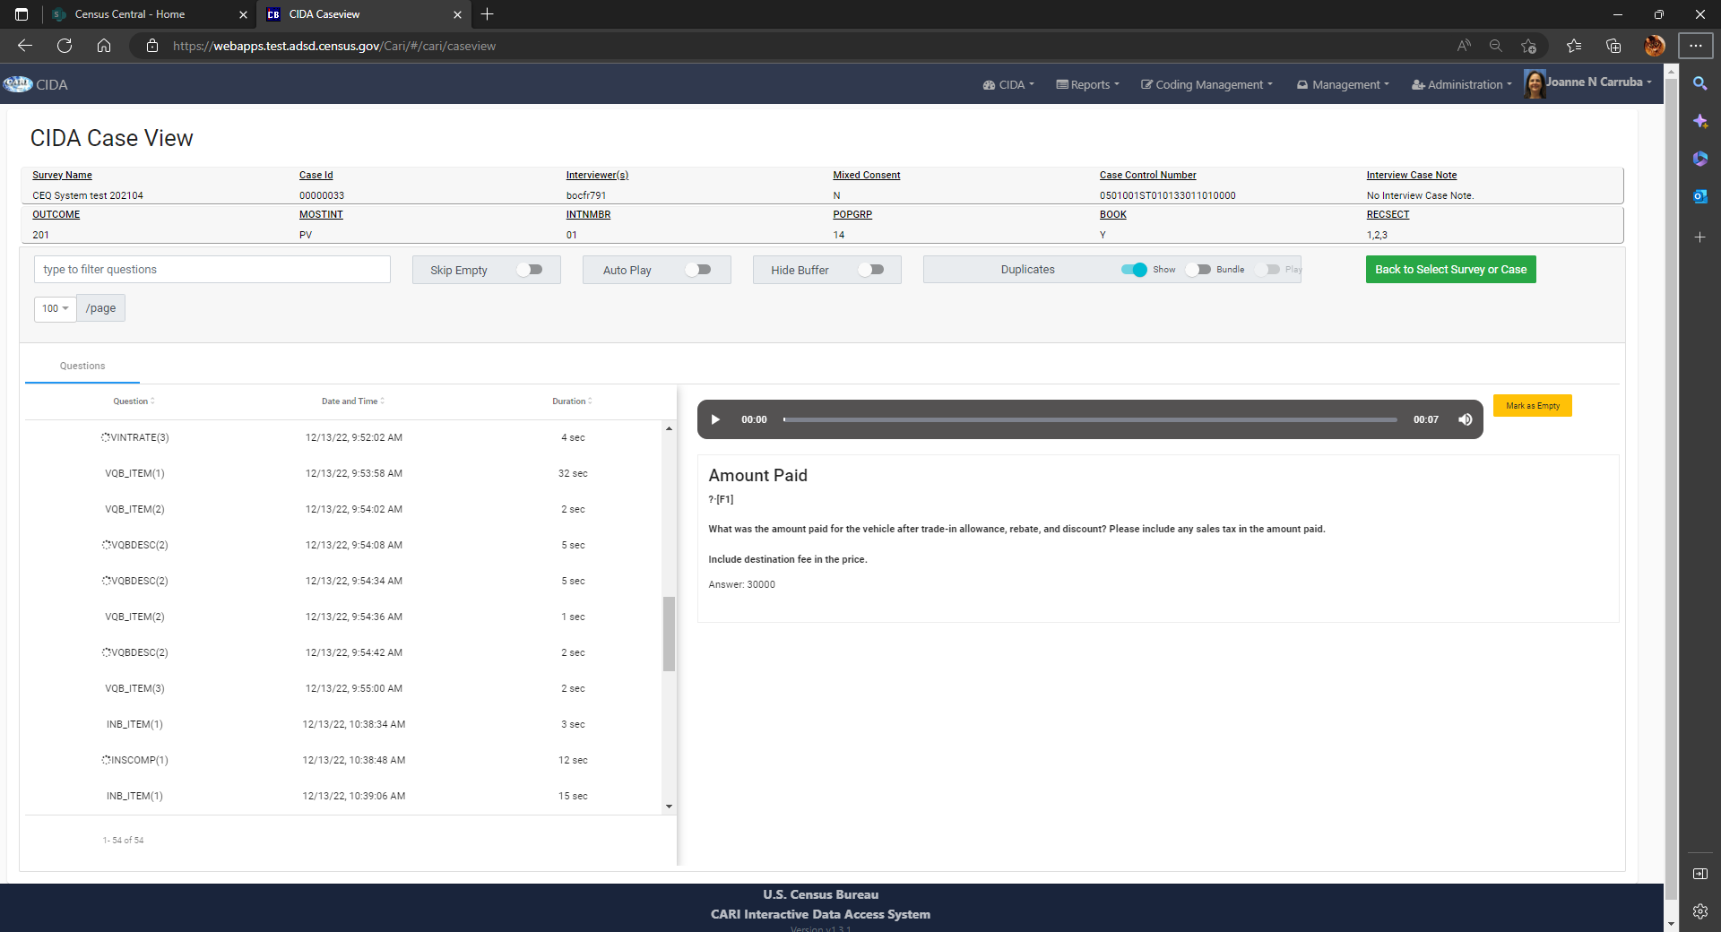
Case view: Duplicates & Mark as empty
Duplicate recordings for the same question can occur if the Field Rep returns back to the screen with that same question within the instrument anytime prior to the case being completed
CIDA allows you to listen/view duplicate recording, and bundle them together.
Users can mark cases as empty if they find case is not audible and flag for others not to waste time listening.

Slide 10
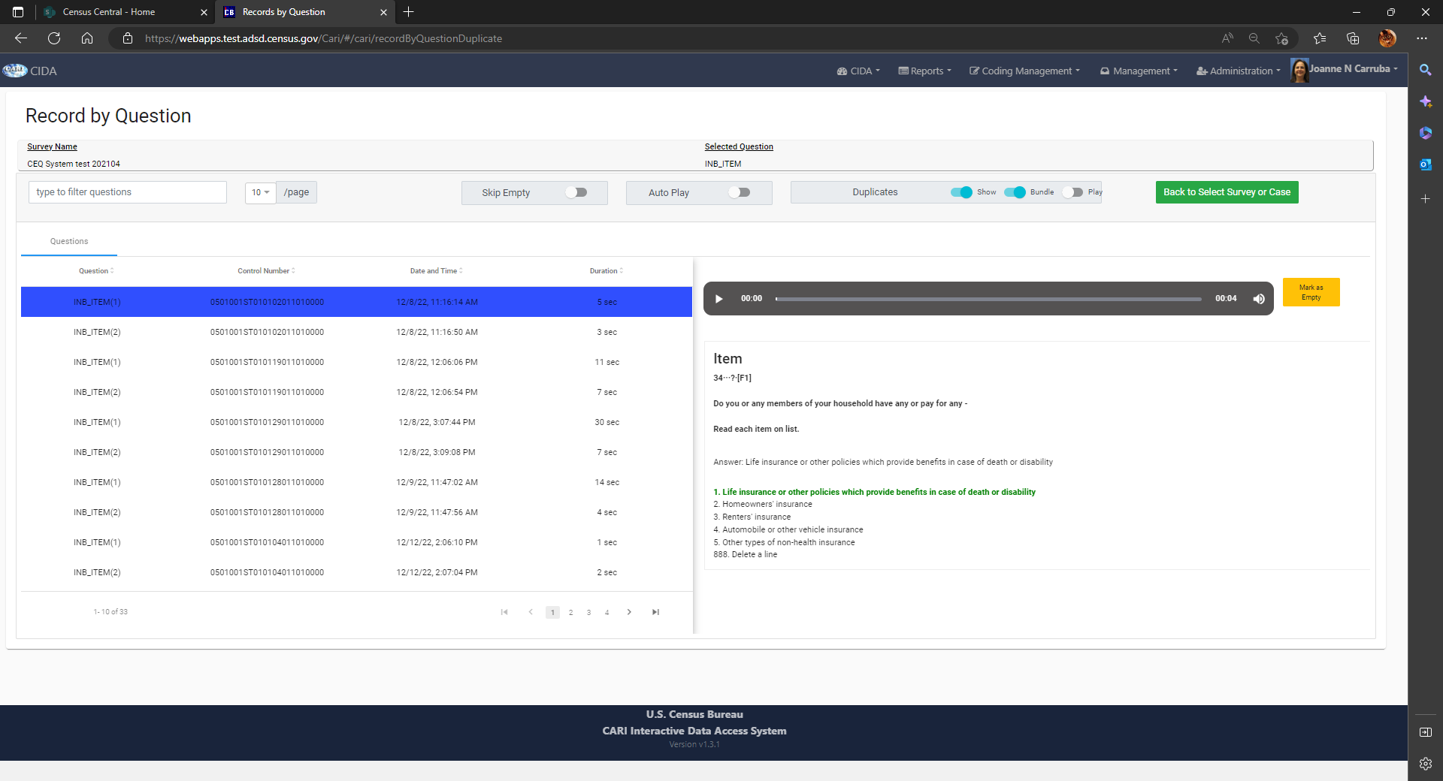
Case view: Record X Question: Review recordings
Record X Question is used by Survey Staff read only role.
Filters by Survey & Question Name
Number of Recordings per Question
Review recordings for all same question within entire survey sample

Slide 11
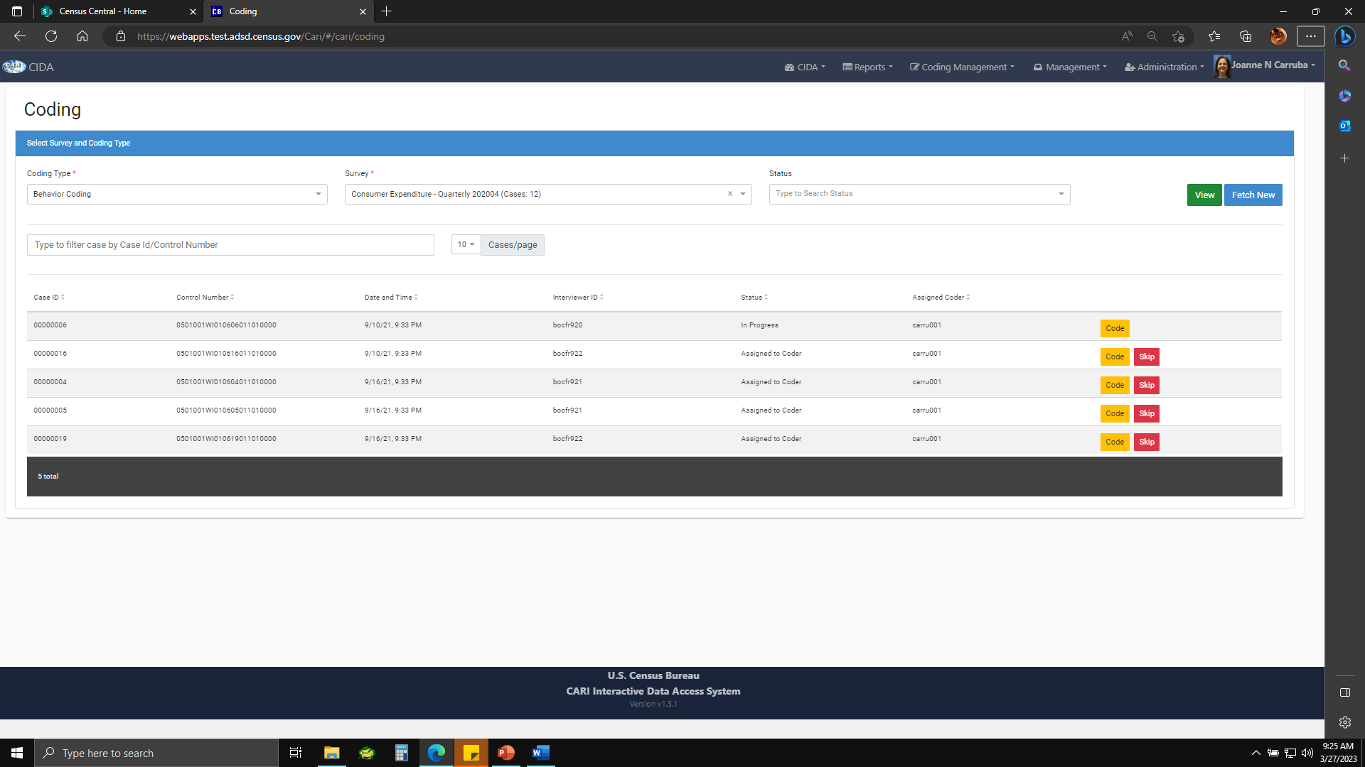
CASE View: Coding
Users with the Coder role can code cases for a survey.
Coder can select
cases to code or skip.
Coder can filter cases to code based on case status or caseid.
CE is presenting more information on this topic.

Slide 12
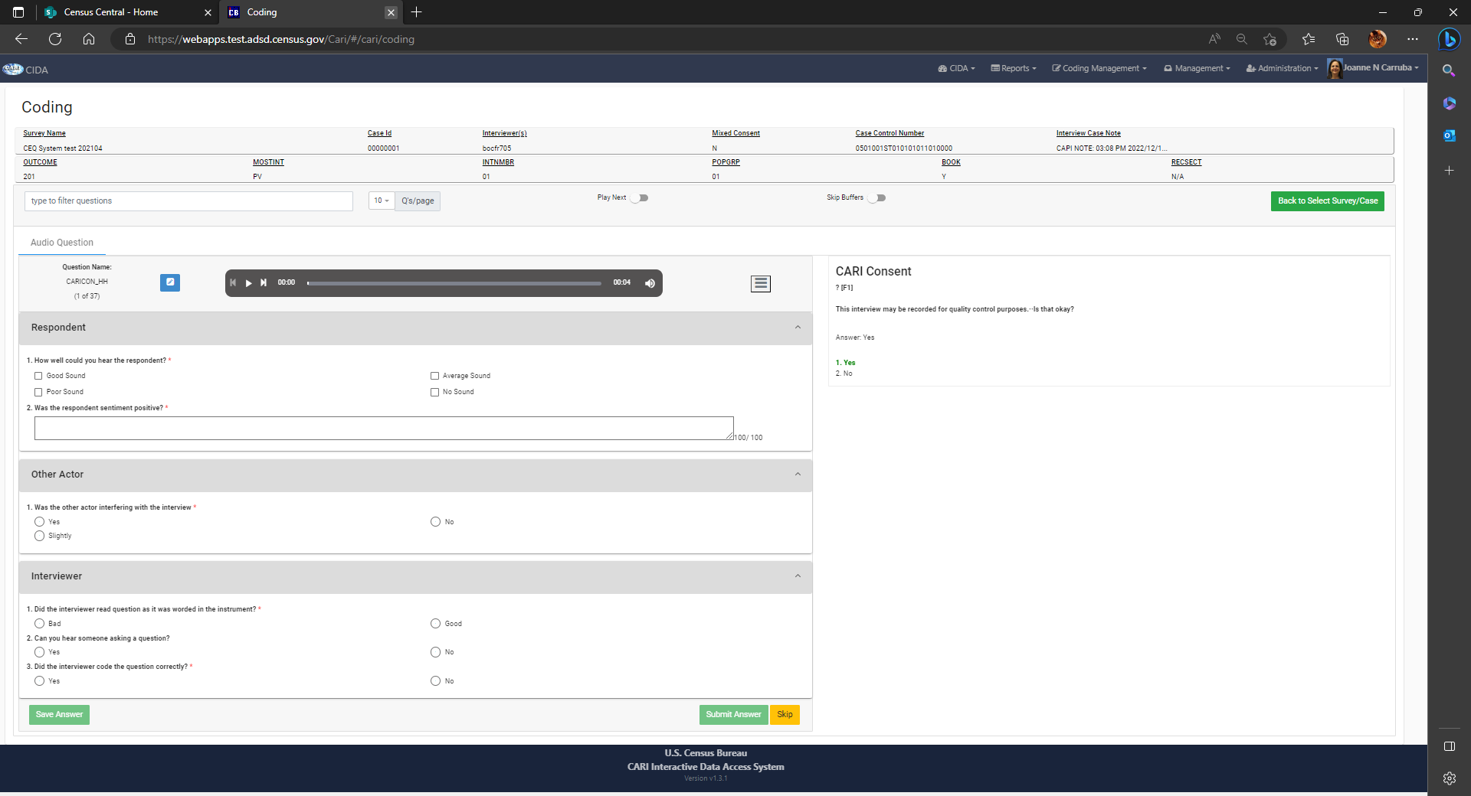
CASE View: Coding
This is an example of a Coding Survey that doesn’t have Utterances configured.
Every Survey Question will have the same Coding Questions.

Slide 13
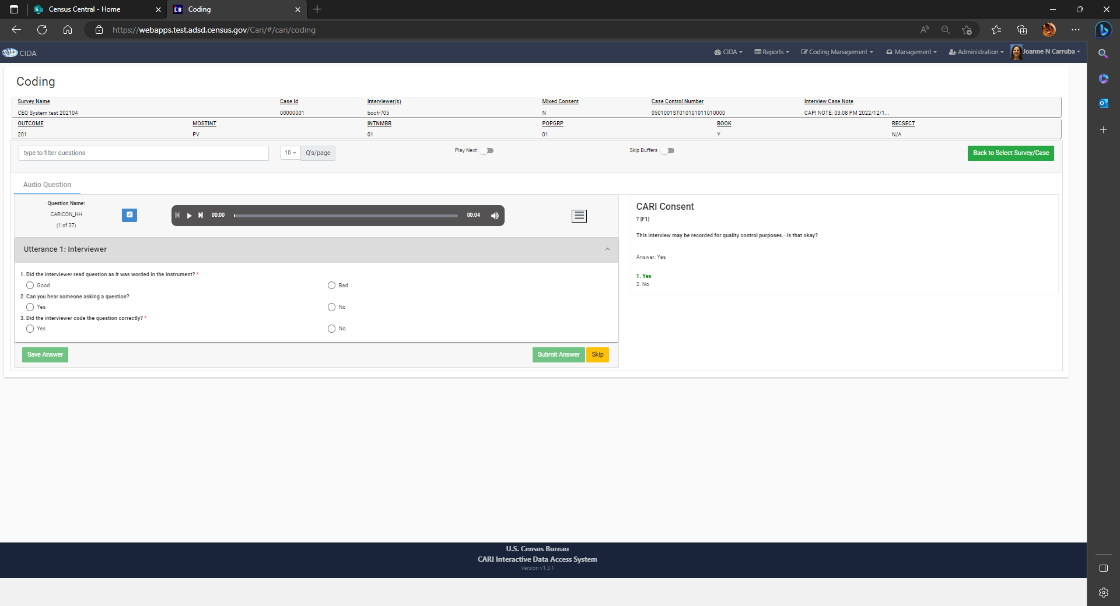
CASE View: Coding
This is an example of a Coding Survey that has Utterances configured.
Coding Groups/Questions can be assigned to particular Survey Questions.

Slide 14
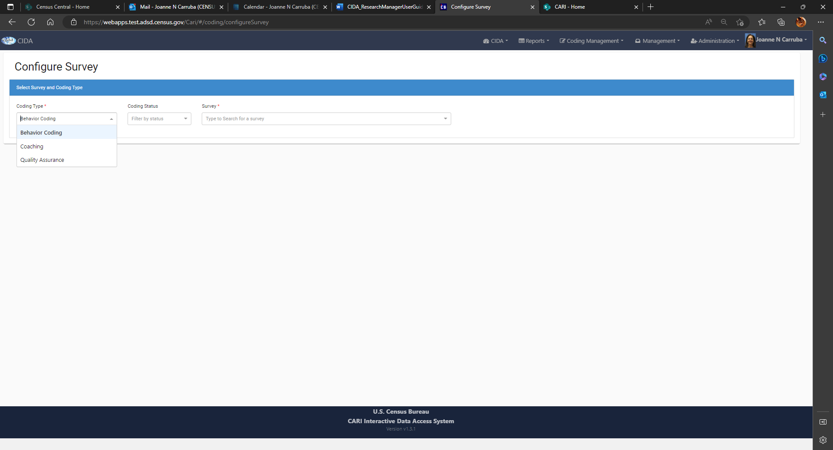
Coding management: configure survey
The Research Manager role has the privileges to Configure Surveys the 3 types of Coding Component Types (Behavior Coding, Coaching, Quality Assurance).
Filter on Coding Status (New, Created, Locked) and Survey.

Slide 15
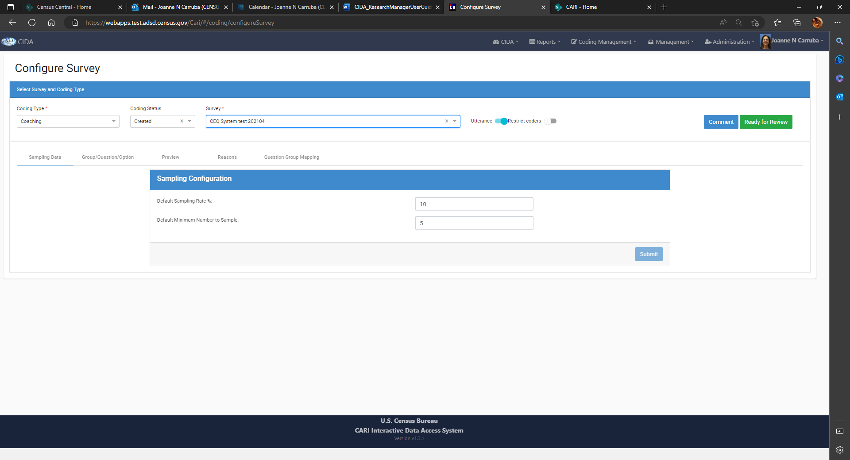
configure survey: Sampling data
Sampling Data allows the user to choose a Default Sample Rate of cases for an interviewer within a survey. If there is not enough cases for the sampling rate a Default Minimum is chosen.
Can be applied to all coding components.

Slide 16
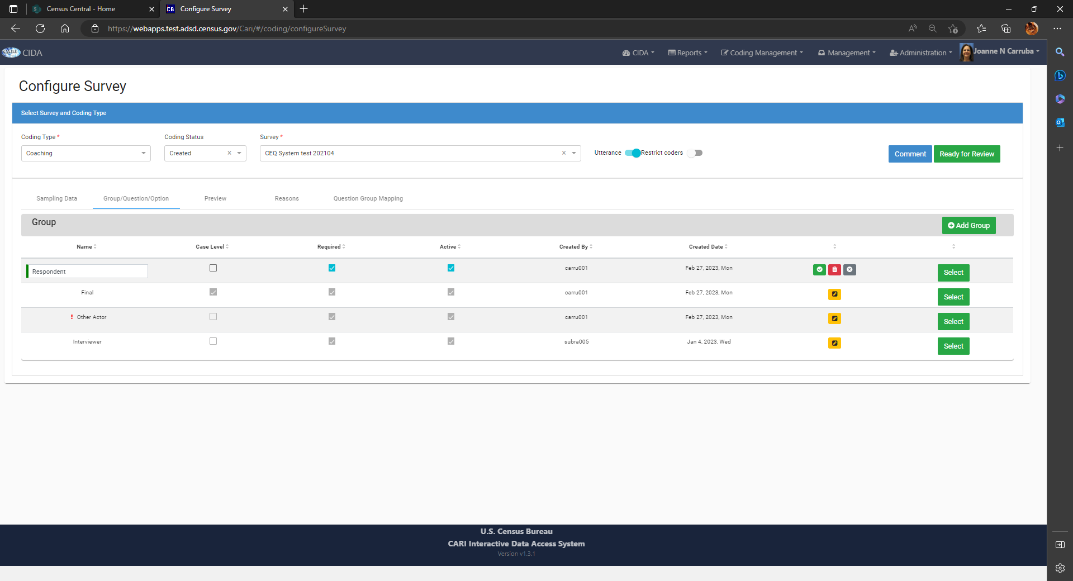
configure survey: Group/questions/option group Additions & updates
This view allows the user to create/add groups of coding questions, specify if they are Case Level, Required, and/or Active.
Groups can be updated or added using the yellow edit button

Slide 17
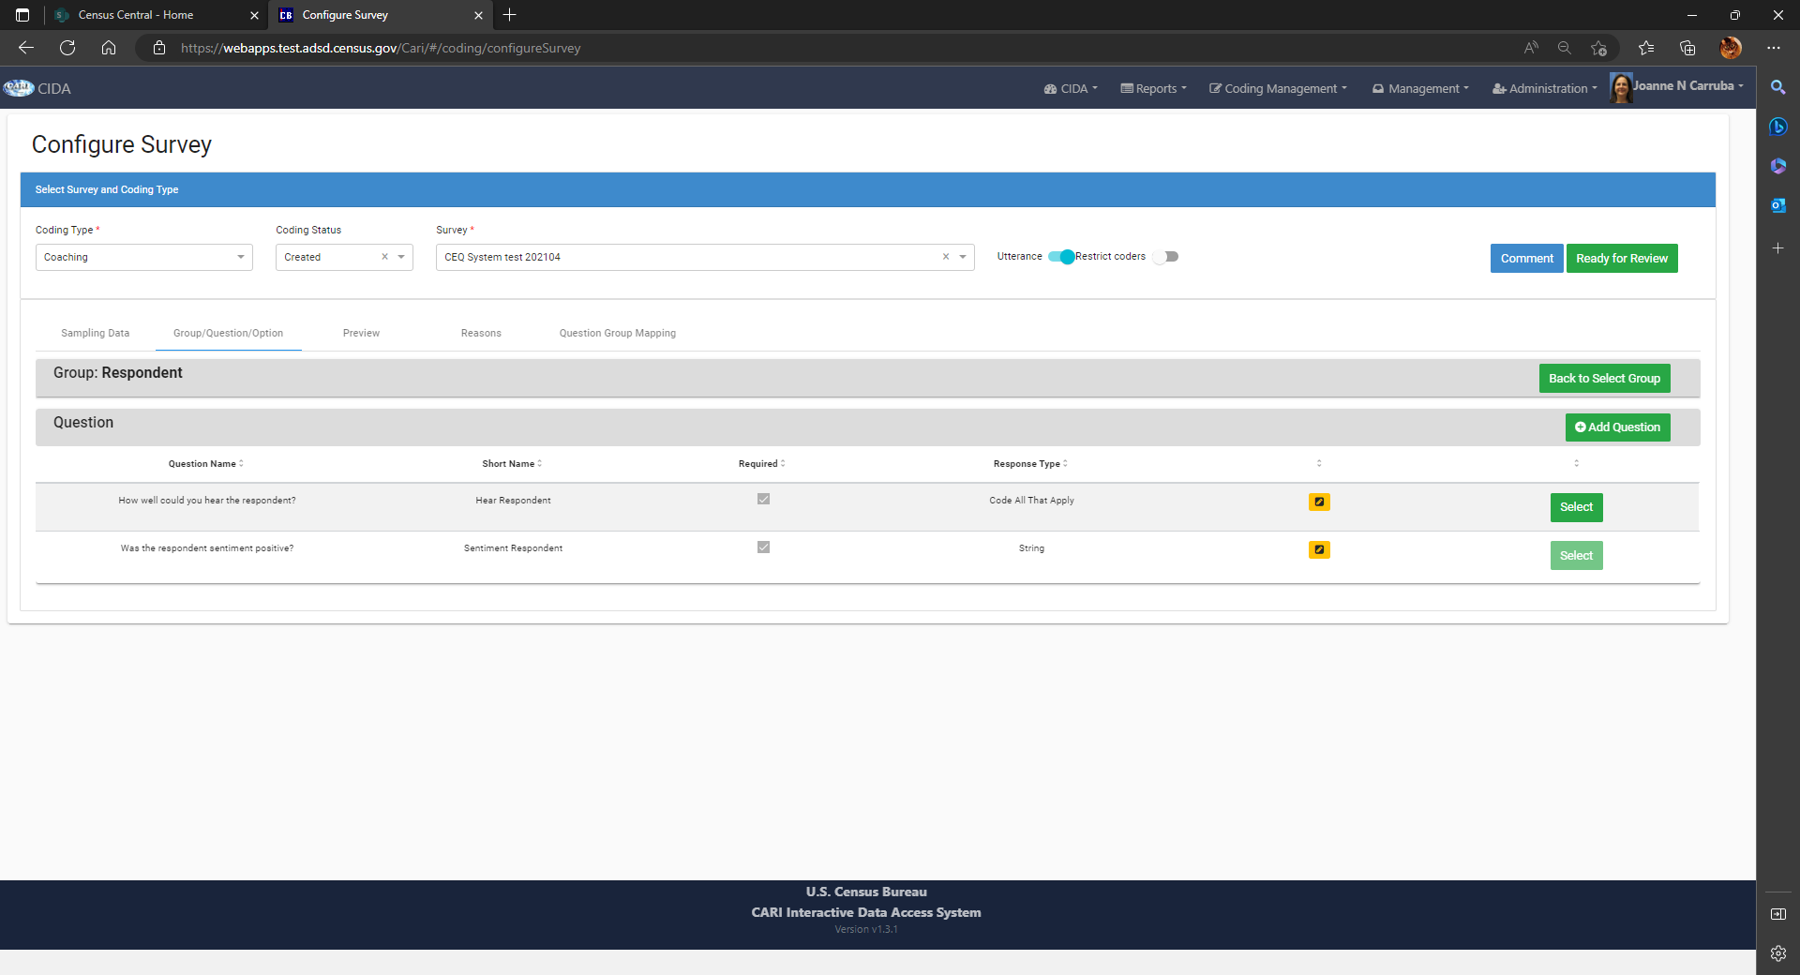
configure survey: Group/questions/option
Question additions & updates
Question added to the Group. Question can be updated or removed using the yellow edit button

Slide 18
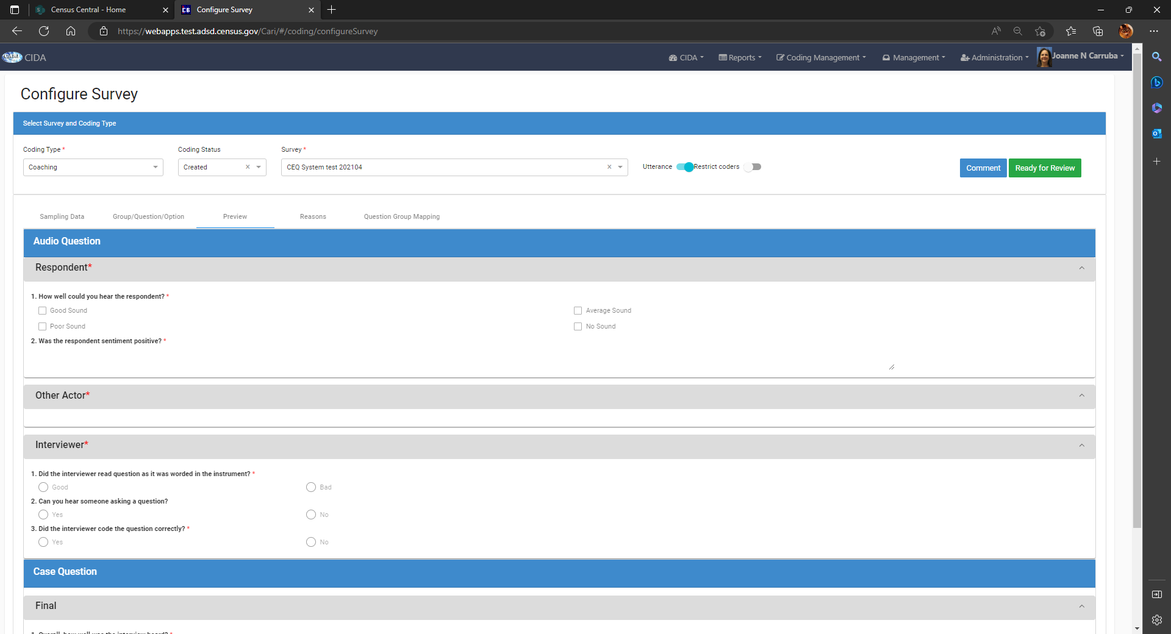
configure survey: preview
The user can review the groups and questions created for a survey with the Preview tab.
This shows what the coder will see for each type of Group and Question when coding.

Slide 19
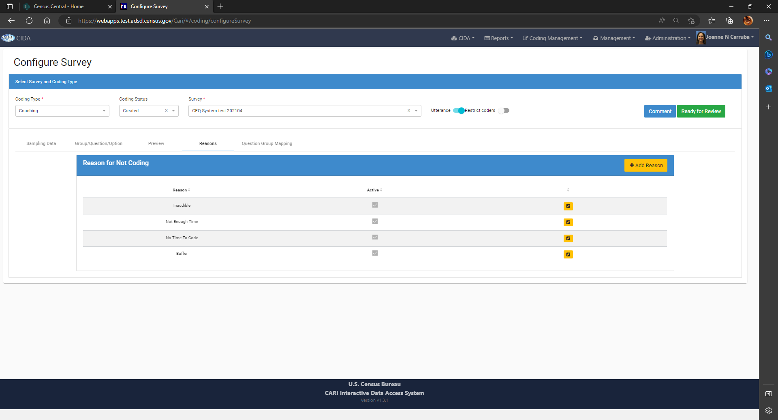
configure survey: reasons
Coders may need to skip questions that cannot be coded.
Reasons for not coding cases can be customized here, and used during coding.

Slide 20
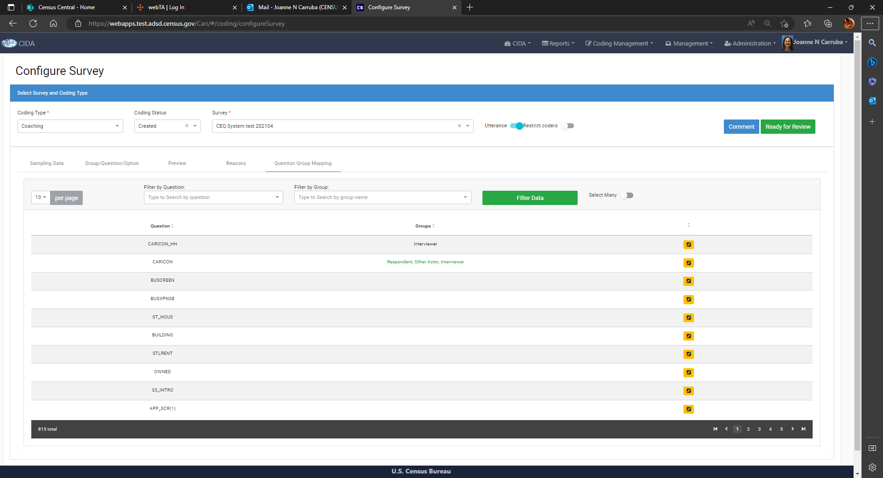
configure survey: group question mapping
This tab is only visible if survey has the Utterance toggle set on.
Allows you to associate Coding Group Questions to particular Survey Questions
This page allows the user to add coding Groups/Questions down to the survey question level (Utterance level) too

Slide 21
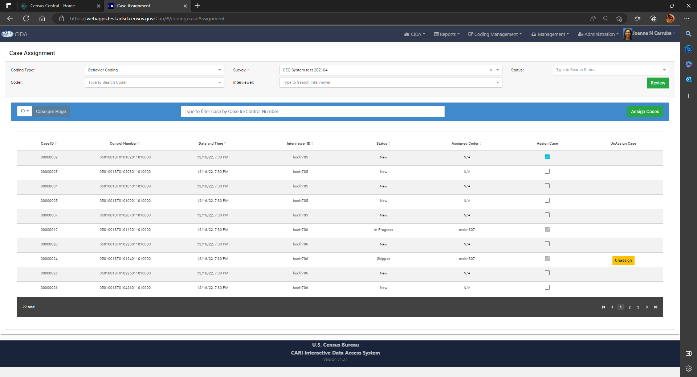
Coding management: case assignment
This screen displays case information and allows user to manually assign and unassign cases to Coders

Slide 22
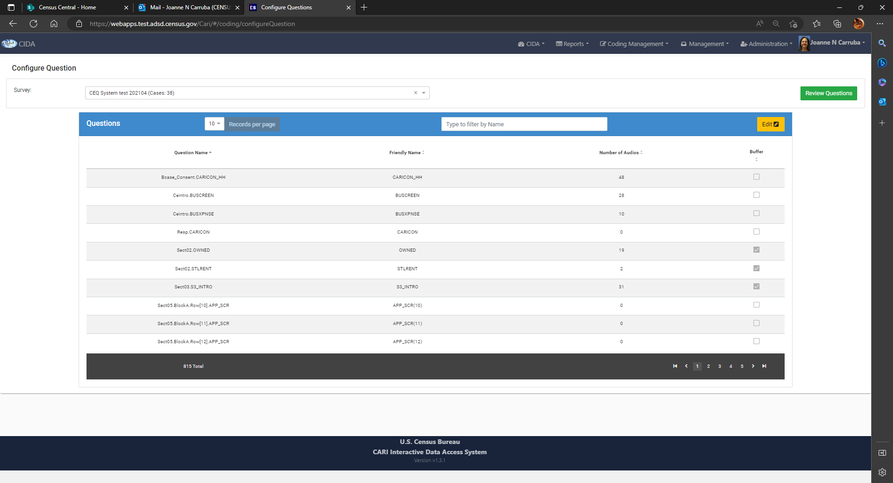
Coding management: configure questions
Buffer questions are loaded at the onset of survey registration.
They can be modified manually using this screen.

Slide 23
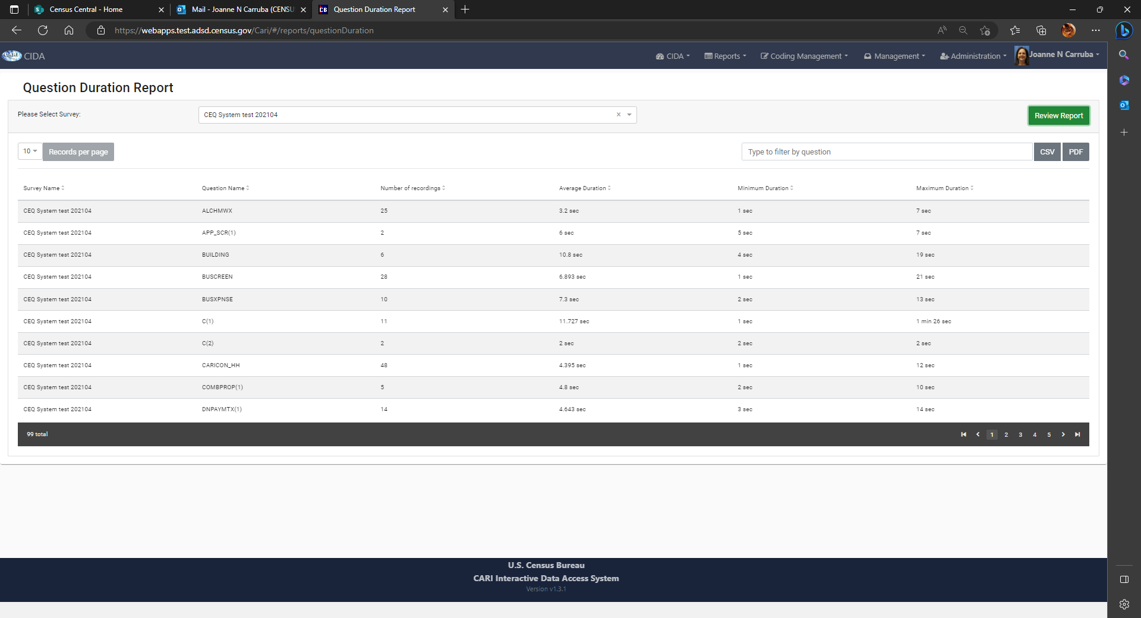
Reports: Question Duration
Survey staff has read only view to their survey data.
This report displays the various duration times and number of records per question

Slide 24
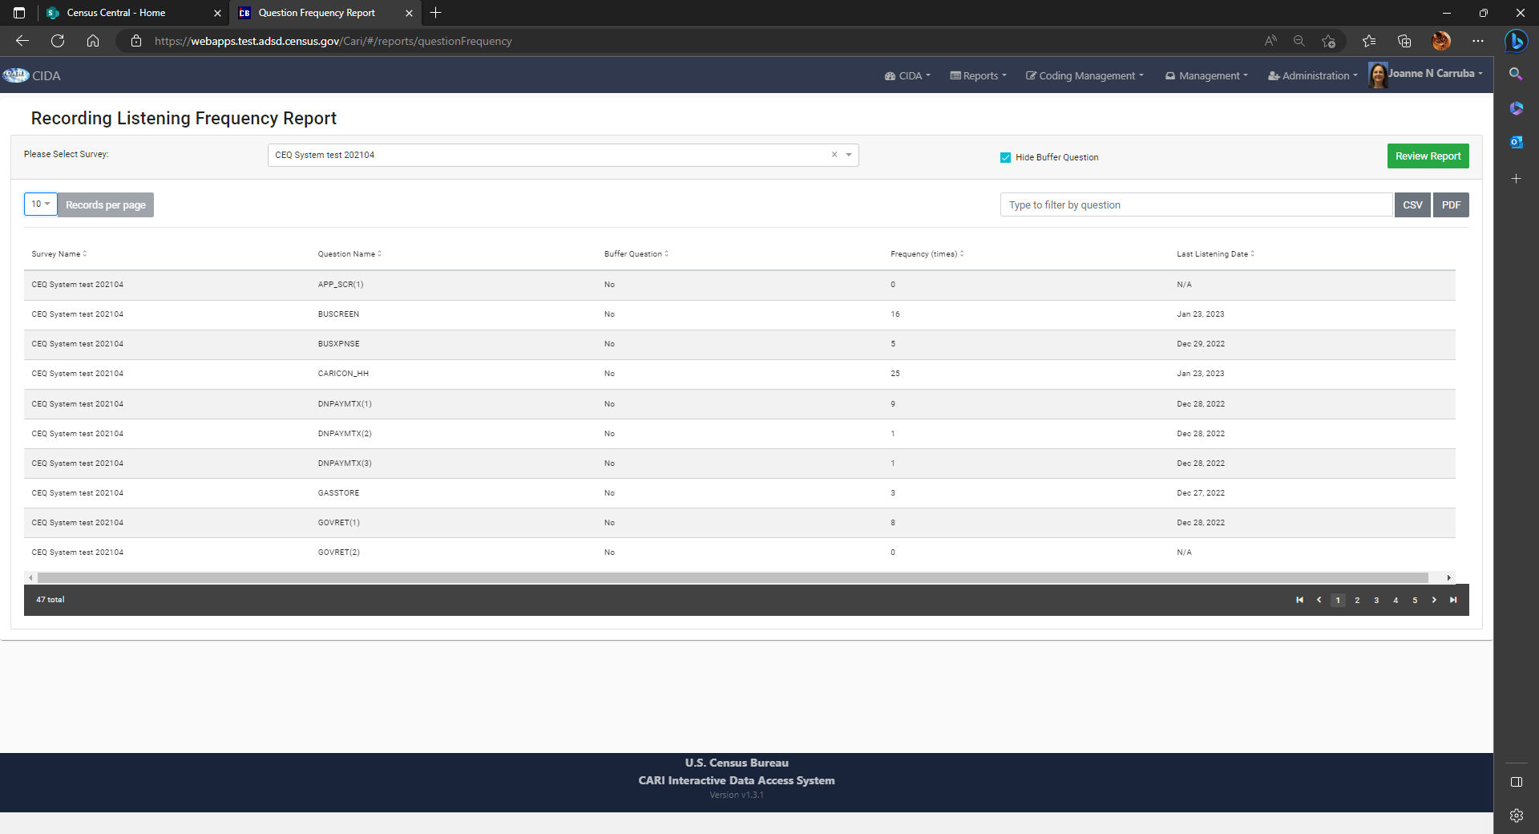
Reports: question frequency
Displays the amount of times the users listened to questions, and last listened to date.
Shows which questions are buffer questions and toggle to hide them

Slide 25
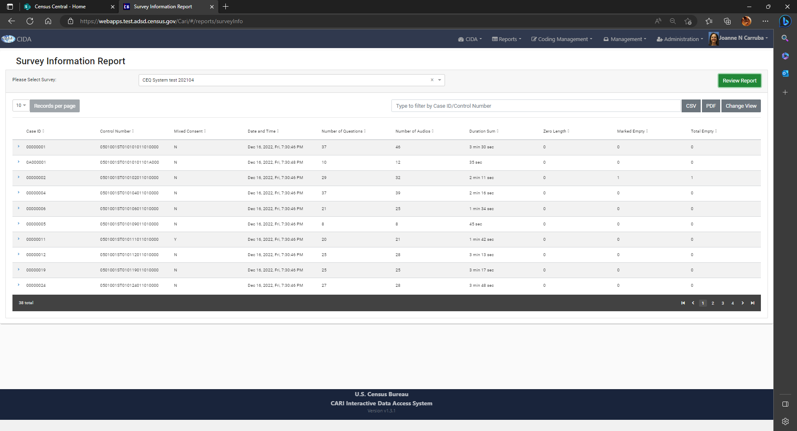
Reports: survey information
Display various attributes about the survey cases.

Slide 26
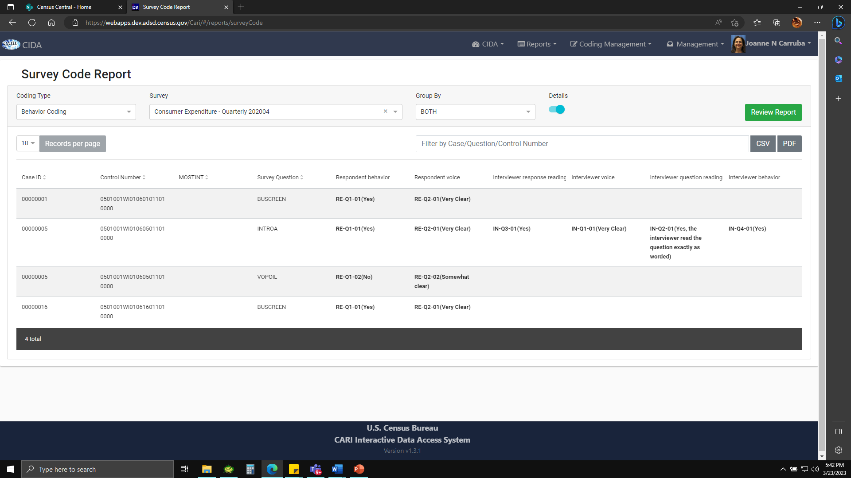
Reports: survey code
Display coding data for survey, including score information.
Used by CE

Slide 27
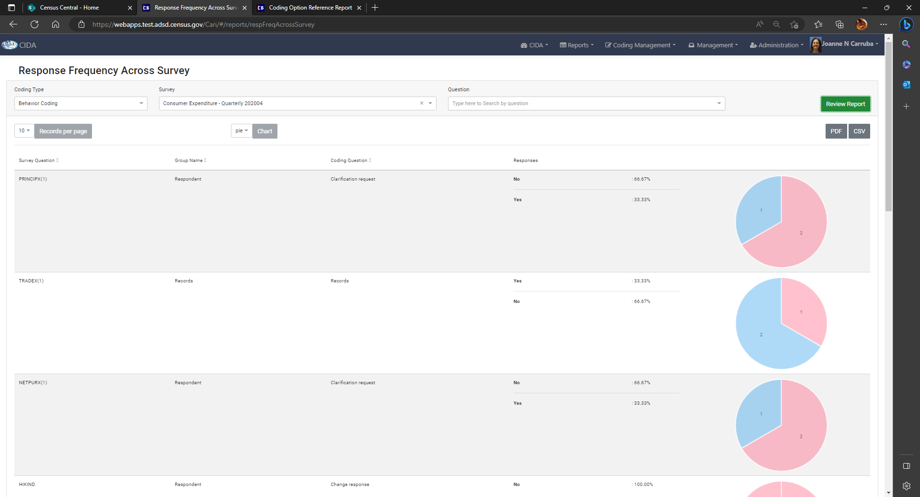
Reports: response frequency
Displays coding question data using pie or bar charts.
Used by CE

Slide 28
CURRENT Challenges & Possible solutions
CHALLENGES
POSSIBLE SOLUTIONS
1. Field Rep (FR) Laptops sometimes have microphones settings off and/or audio settings low.
2. For CAPI interviews, you can clearly here the FR​, but not the respondent. Maybe related to social distancing/masking.
3. Our testing of external microphones compatible with our laptops, did not prove for better recordings. Large external microphones may bother respondents; large or small devices may get lost/broken by FRs.
4. FRs that call respondents, cannot hear respondents due to head phones using their cell phones.
5. Laptops that have defective microphone or audio
6. User Review and Coding burden 1000s of cases/questions manually
​1. Add non-zero byte empty audio file alerts into CIDA to flag FRs/cases with possible settings problems. Have Help Desk talk to FR.
2.Not sure how to deal with this, maybe try to get the laptop microphones as close to respondent as possible.
3. Open to looking for other external device alternatives if they become known to us.
4. Due to privacy issues, cannot request FR to do otherwise. Look into alternatives for cell phone calls, using some laptop software or other.
5. Continue to identify cases that have zero byte recordings & report to Help Desk/Authoring team – this is an indicator of possible driver corruption. Also, CAPI Device team has a system perform remote checks to laptops, identify faulty drivers, and fix them.
6. CIDA is currently developing an auto-coding/scoring module to bulk transcribe audio recordings, and perform data analysis on that data along with survey data captured.

Slide 29
FUTURE OF CIDA: AUTO-CODING
BELOW IS THE FUNCTIONALITY WE ARE WORKING ON:
1. Transcribe audio recordings for all cases as they check-in from the field.
2. Find the number of speakers within each audio.
3. Calculate talk speed of actors within the audio
4. Use machine learning to detect speaker emotion (happy, calm, angry).
5. Compute audio length deviation from the mean of audios of the same question in a survey.
6. Find confidence in answers (detect amount of silence between question and response)
7. Find out how well interviewer is sticking the question “script”
8. Compare how well respondent answers are being recorded by interviewer.

Slide 30
THANK YOU
Joanne N. Carruba
Joanne.n.Carruba@census.gov

