Slide 1
Designing A Documentation Management System for Survey Data
Humans
FedCASIC 2023
April 12, 2023
Weihuang Wong

Slide 2

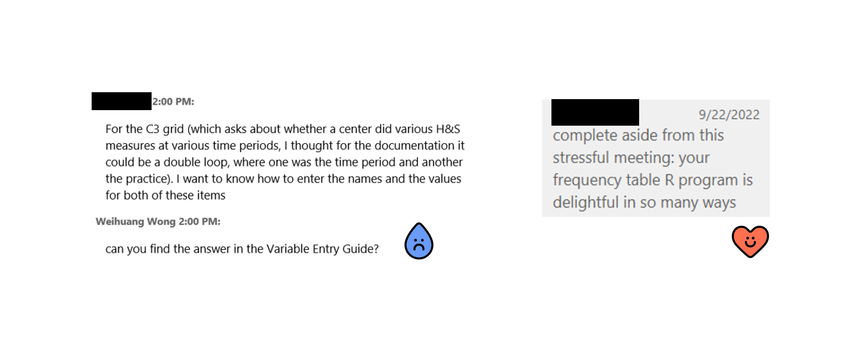

How I learnt that Usability > Features

Slide 3
National Survey of Early Care and Education
Nationally representative survey of ECE supply and demand
Sponsored by Office of Planning, Research, and Evaluation in the Administration for Children and Families
2012, 2019 + COVID-19 follow-up, 2024

Slide 4
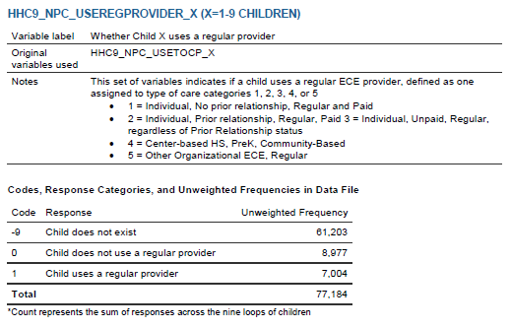
Example codebook entry
Variable name with explanation of indexing
Variable label in datafile
Upstream variables used in the construction of this variable
Variable definition and other user notes
Value labels
Summary statistics
Table notes

Slide 5
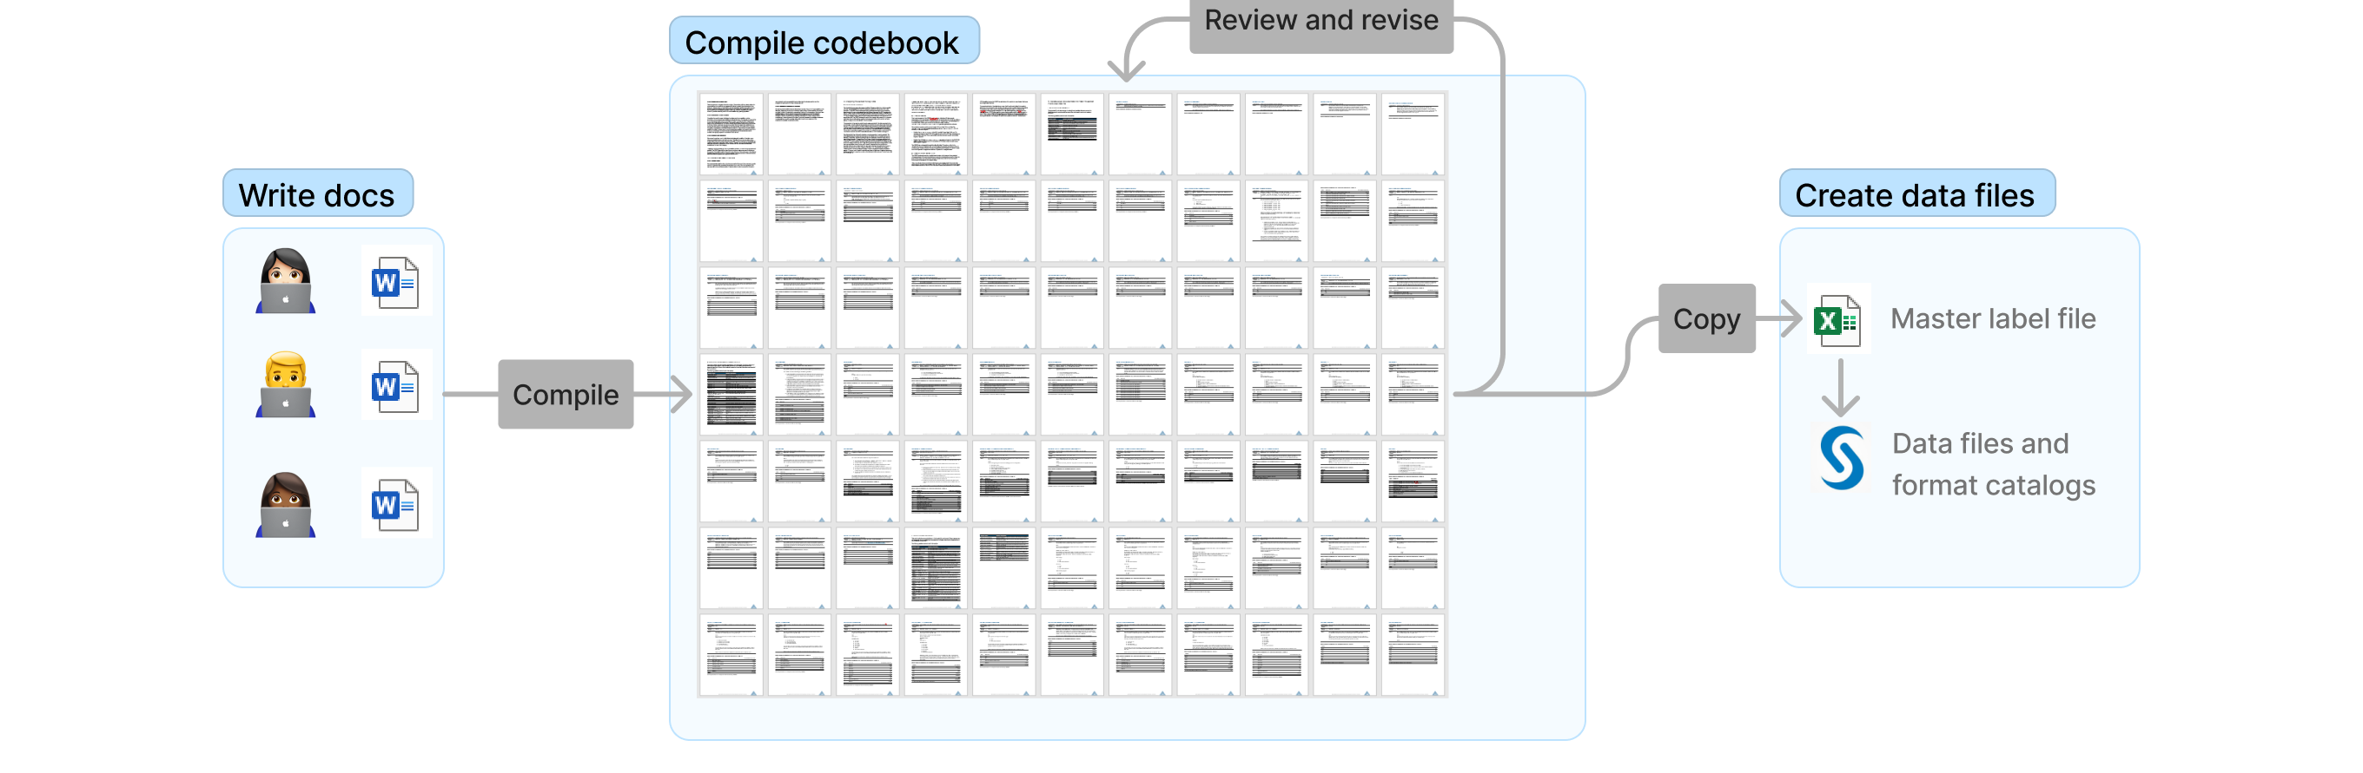
Original process

Slide 6



Strengths and limitations
Easy to set up
Metadata contained in Word document
Manual process, QC was time-consuming

Slide 7

Process redesign objectives
Increase analyst productivity, reduce # of quality issues
Retain features of existing documentation
Minimize switching costs

Slide 8
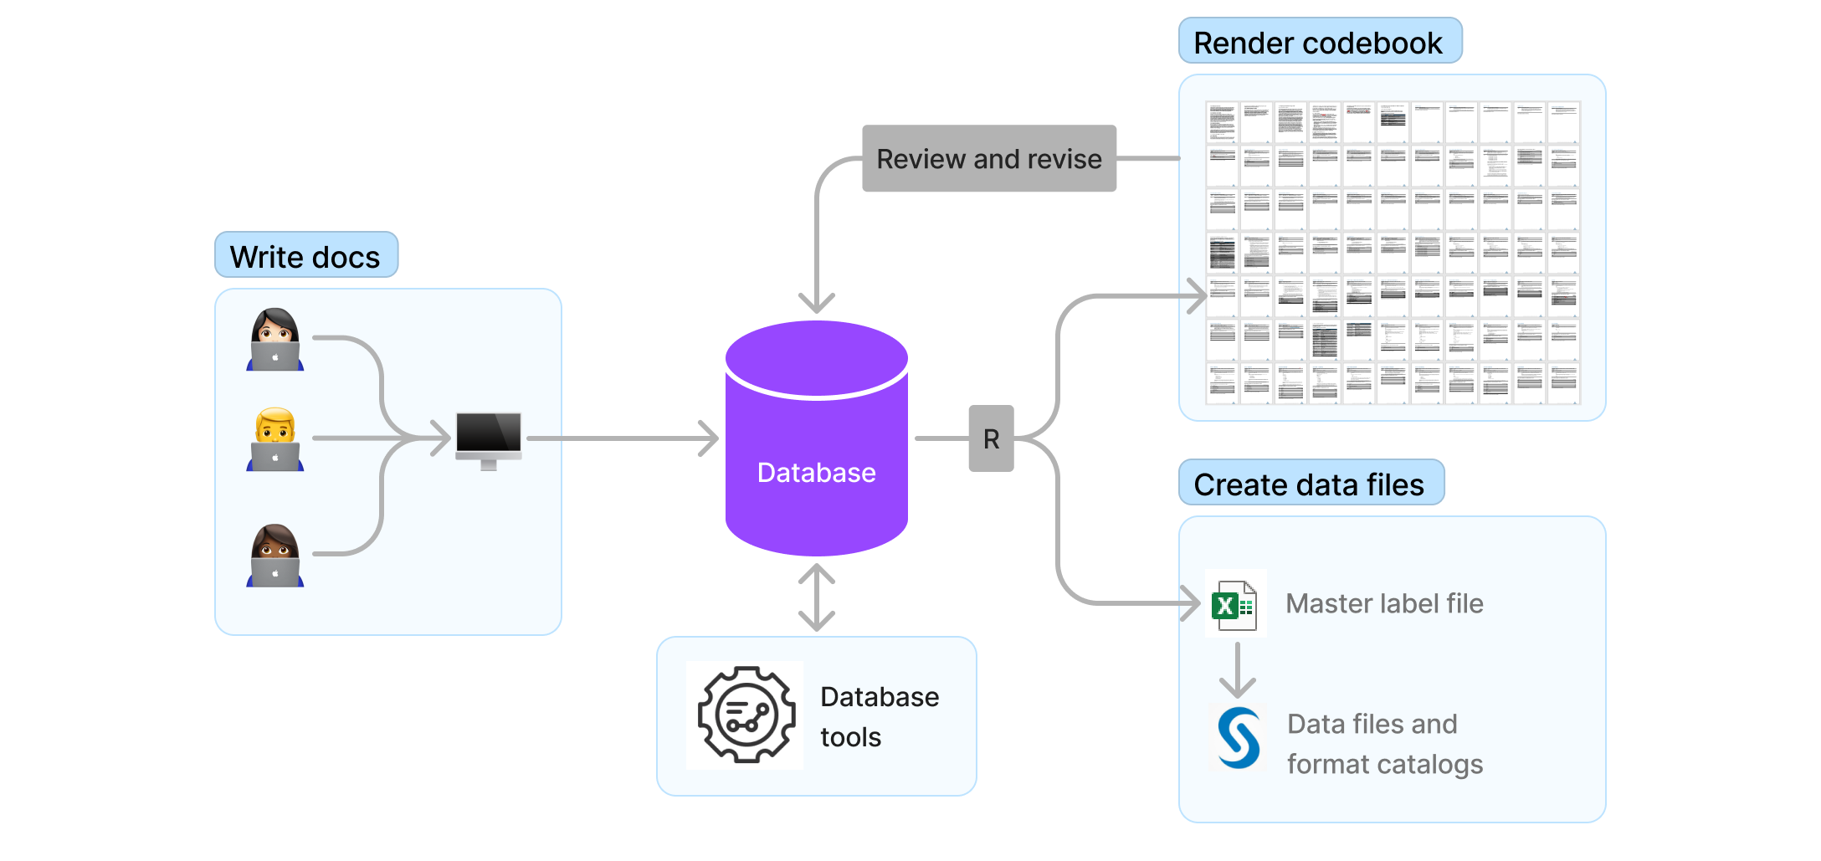
Redesigned process

Slide 9

Benefits
Metadata in central location
Metadata in structured form
Opportunities for data integration

Slide 10

Implementation challenges
Read the instructions, use tools as they were designed
Trust intuition, anything that doesn’t come out right can be fixed by hand in post

Slide 11
What we learnt
Instructions are not the solution
No such thing as free feedback
Adoption depends on usability

Slide 12
Lesson 1: Fewer instructions, more code
Things that diminish goodwill... Punishing me for not doing things your way... Don’t make me jump through hoops just because you don’t want to write a little bit of code.
– Steve Krug, Don’t Make Me Think

Slide 13

Lesson 2: Eat your own dog food
Photo by Chewy on Unsplash

Slide 14

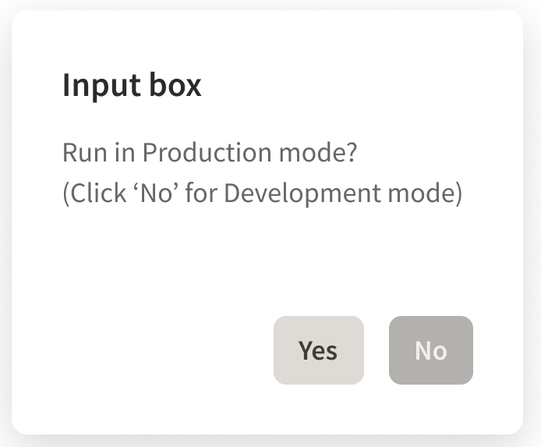
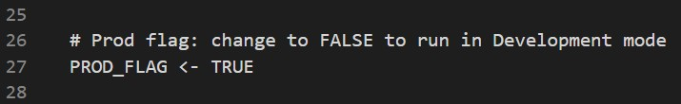
Lesson 3: UI components > code changepoints

Slide 15
Thank you.
Weihuang Wong
Senior Research Methodologist
wong-weihuang@norc.org
mastodon.social/@weihuang

