Slide 1
Modernizing Agricultural Statistics through
Technology and Innovation
Federal Computer Assisted Survey Information Collection (FedCASIC) Workshop
Joseph L. Parsons
Director, Methodology Division
Chair, USDA Agricultural Statistics Board

Slide 2


Outline of Remarks
A little about me and NASS
A discussion of “essential operating
conditions”
How those operating conditions inform current strategies and influence how we think about modernization
Some examples from our modernization journey
The road ahead and discussion

Slide 3
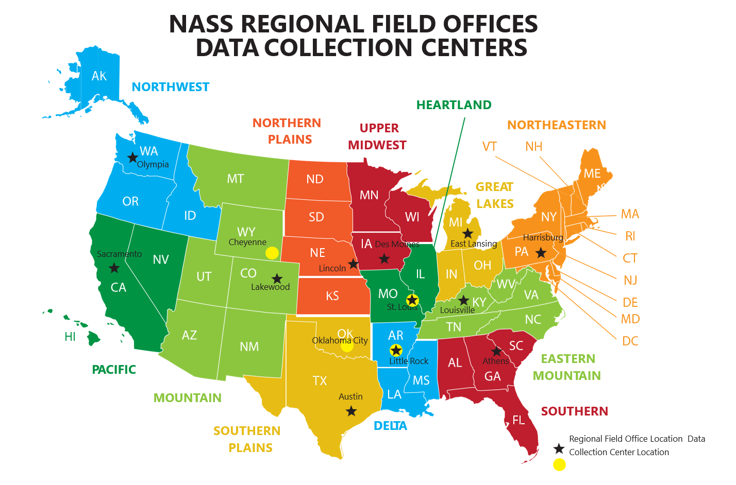
USDA’s National Agricultural Statistics Service (NASS)
NASS Mission: The National Agricultural Statistics Service provides timely, accurate, and useful statistics in service to U.S. agriculture.
  Collect, assemble, process, and disseminate U.S. agricultural data
  Conduct and publish hundreds of annual surveys and censuses
  Conduct the detailed Census of Agriculture every 5 years
  Partner with other USDA and other federal agencies, state ag departments, universities, and others
  Conduct research to advance statistical science
Approximately 850 federal staff across
the country, 2,500 enumerators collecting
data, 12 Regional offices, 5 calling centers,
National Operations Center in St. Louis,
HQ in Washington, DC

Slide 4
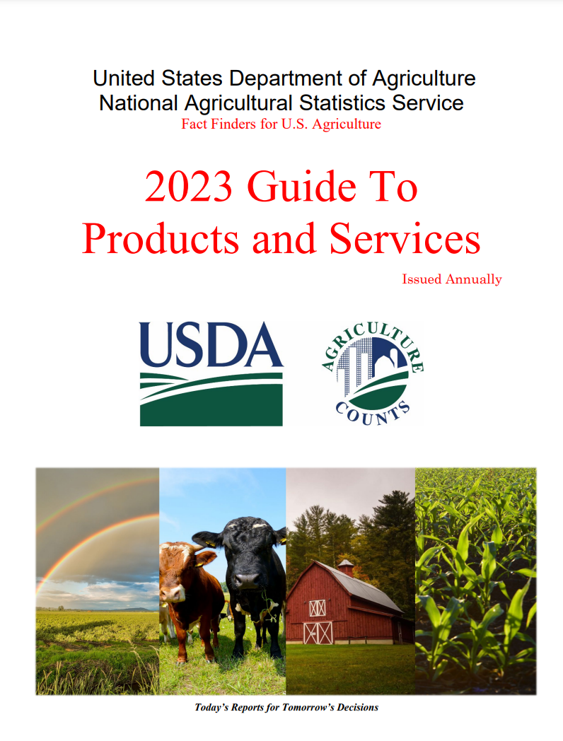
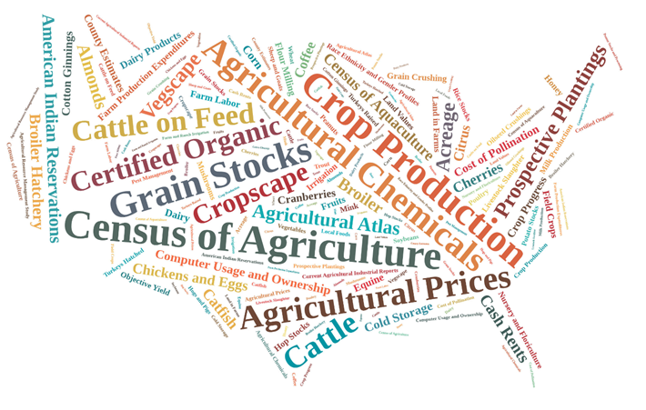
NASS Data Products and Services
Begin with the end in mind!
Provides a detailed description of NASS reports
Organized by topic area
Includes a release dates calendar

Slide 5
NASS Data Products and Services
Census of Agriculture
At 180+ years old, the Census of Agriculture tells the story of U.S. agriculture. It provides the only source of uniform, comprehensive and impartial agricultural data for every county in the nation.
Data include:
  Farm counts and numbers of agricultural producers
  Commodities
  Economics of farming
  Land usage
  Demographic data for agricultural producers

Slide 6
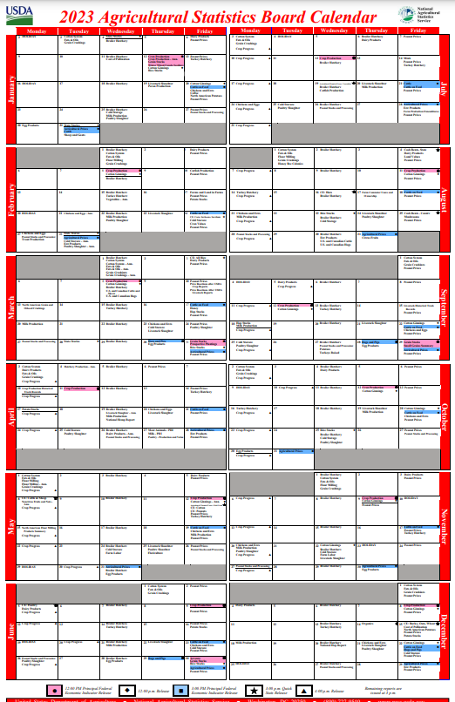
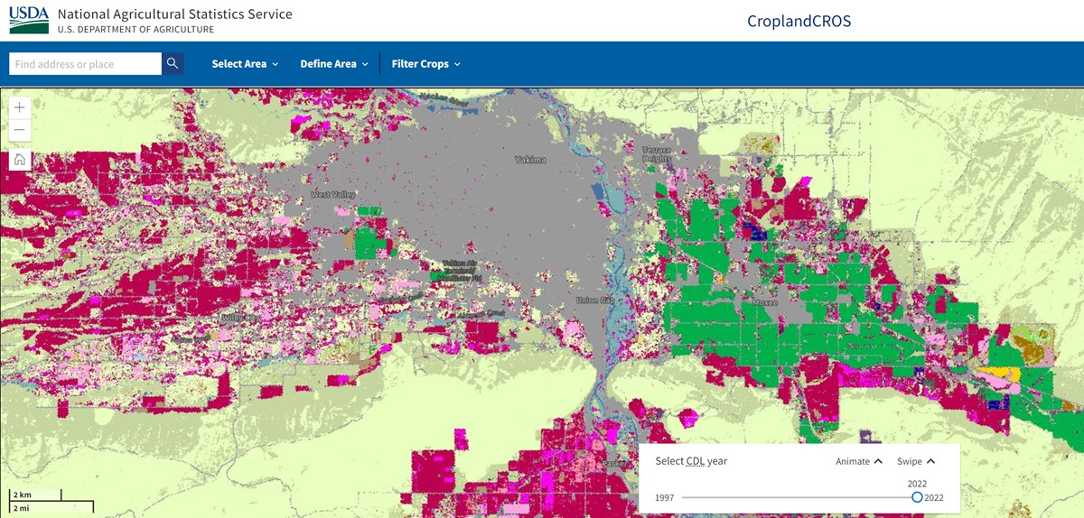
NASS Data Products and Services
Agricultural Statistics are Multi-dimensional
Estimate the supply function of domestic food, feed and fiber (excluding imports and exports).
Economic, Demographic and Environmental Data
Geospatial data products

Slide 7
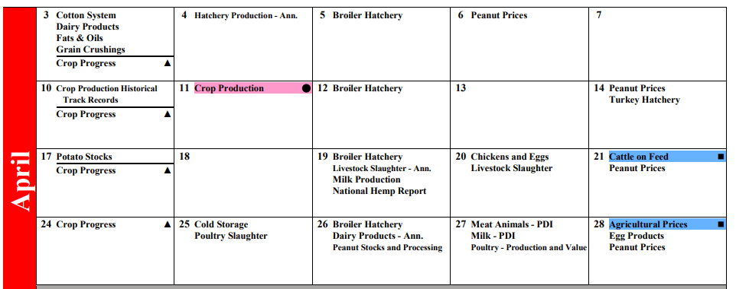
NASS Data Products and Services
Operational Cadence

Slide 8
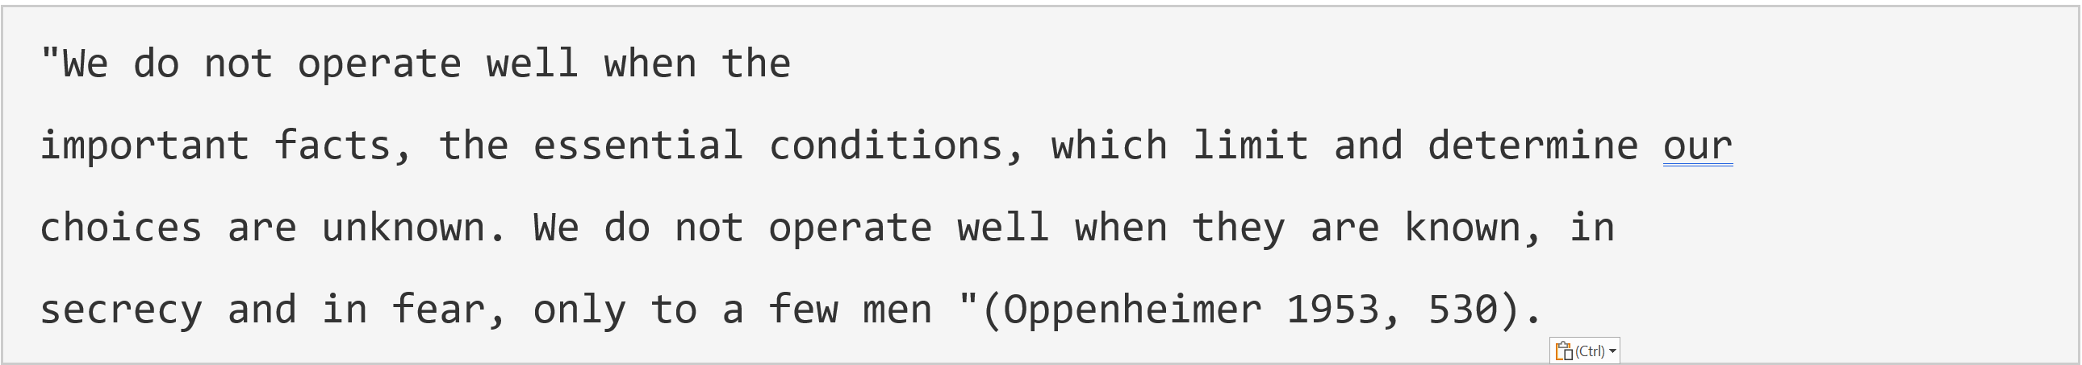
Essential Operating Conditions
“Essential Operating Conditions” made up term …. which monitor certain essential operating conditions of a fired boiler and which will shut down the boiler in the proper sequence when any of the these conditions vary from set limits… non-negotiable parameters or just the conditions under which the work will take place

Slide 9

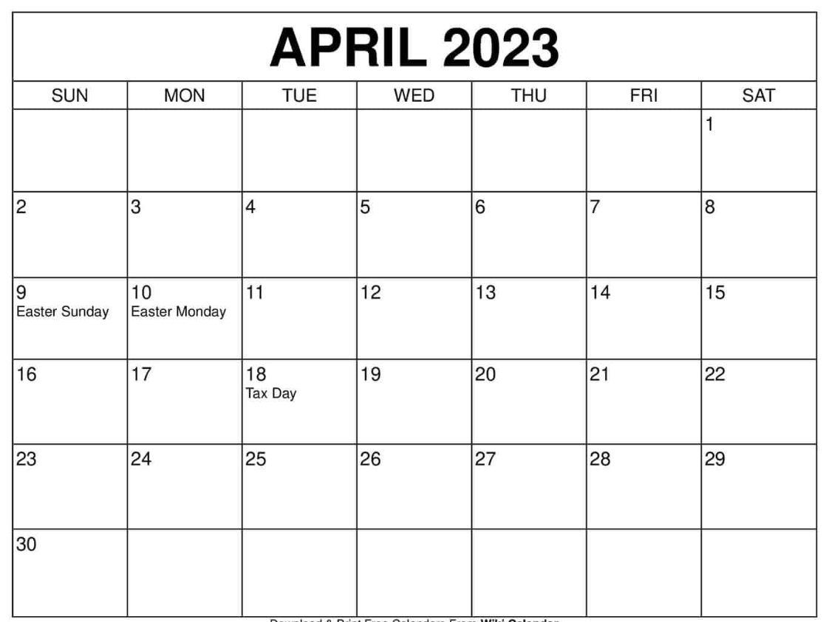
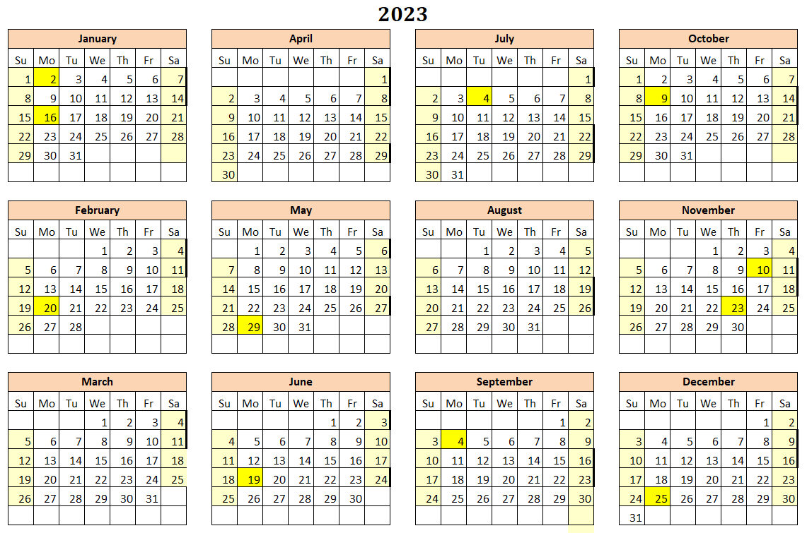
Essential Operating Conditions Timescale
Timescale Essential Operating Condition
  Timescale and “Shelf life” for Data Products vary greatly depending on use
    Weekly Broiler & Crop Conditions
    Grain Stocks, Prospective Plantings (PFEI expectations)
      From OMB Statistical Policy Directive 3… “reference period and the public release date for a series issued quarterly or more frequently should be at most 22 working days.”
    Census of Agriculture or Tenure, Ownership and Transition of Agricultural Land (TOTAL)
Timescale for the data releases affects data collection and processing strategies and opportunities

Slide 10
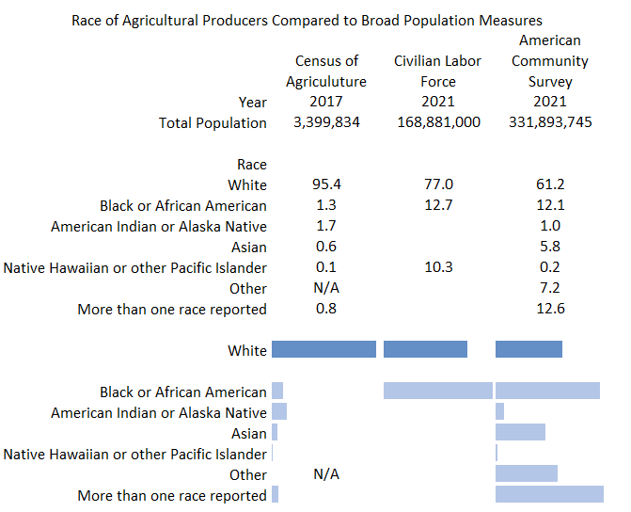
Characteristics of the
Farm Producer Population

Slide 11
Technology Access and Use

Slide 12
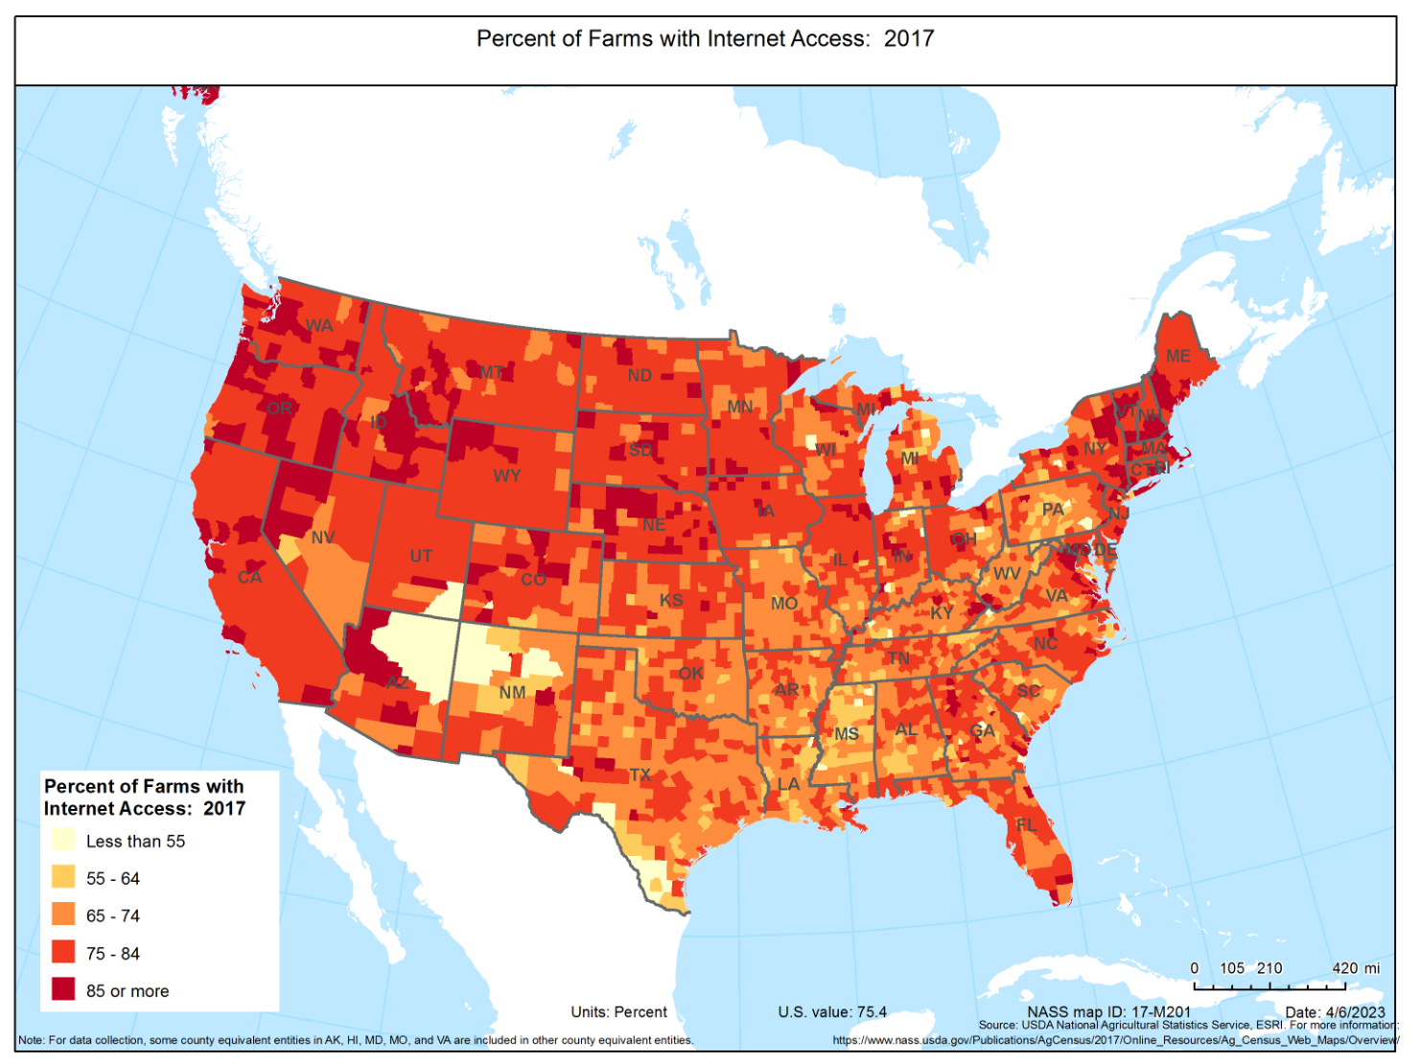
Technology Access and Use

Slide 13
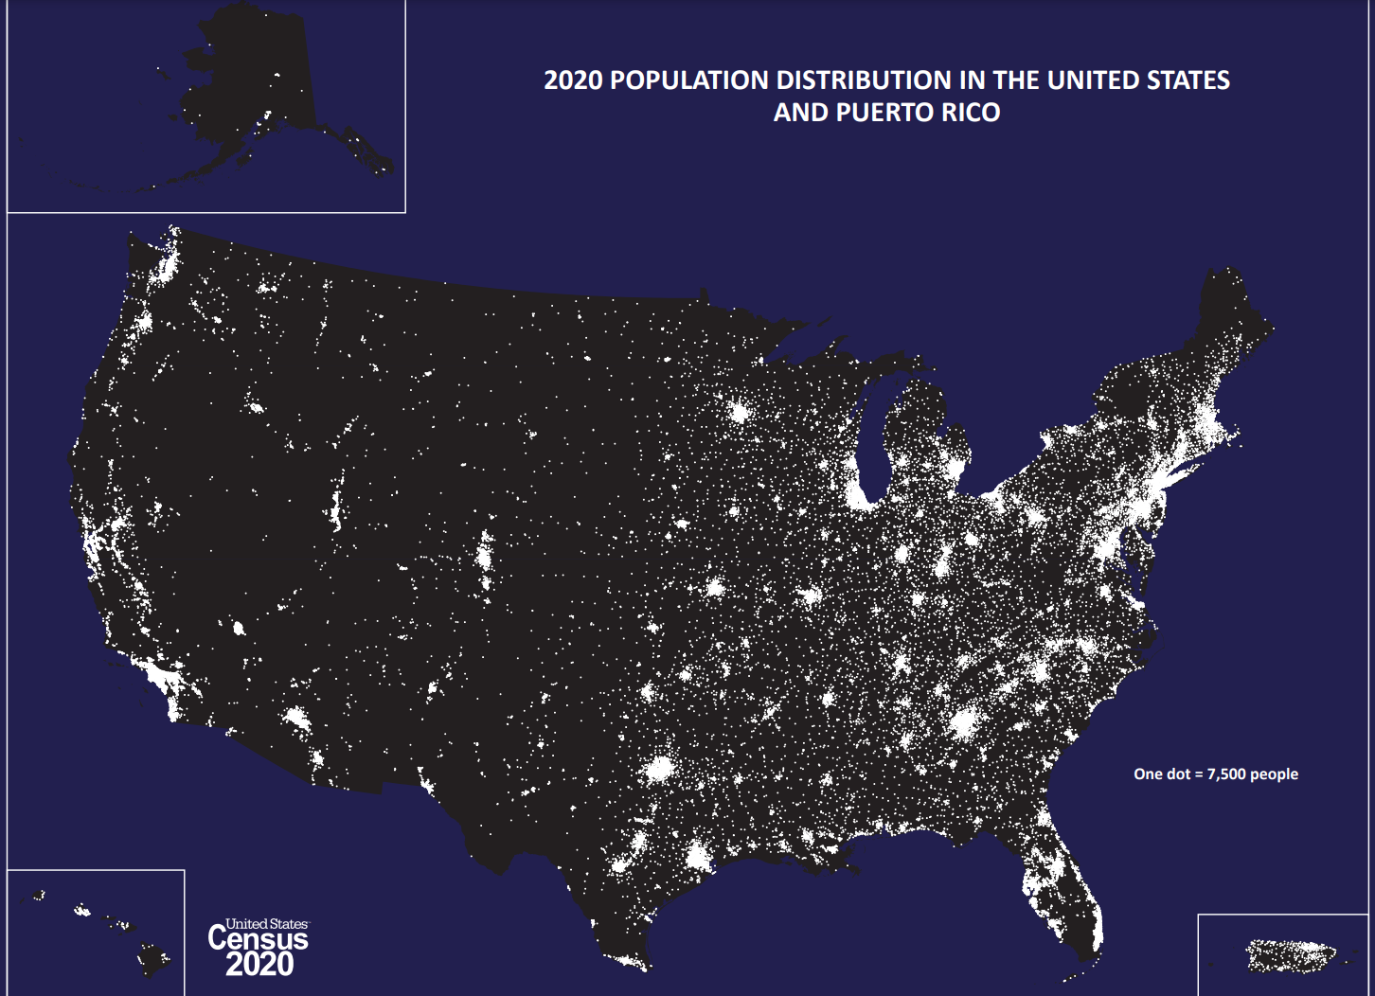
Attributes of Populations of Interest

Slide 14

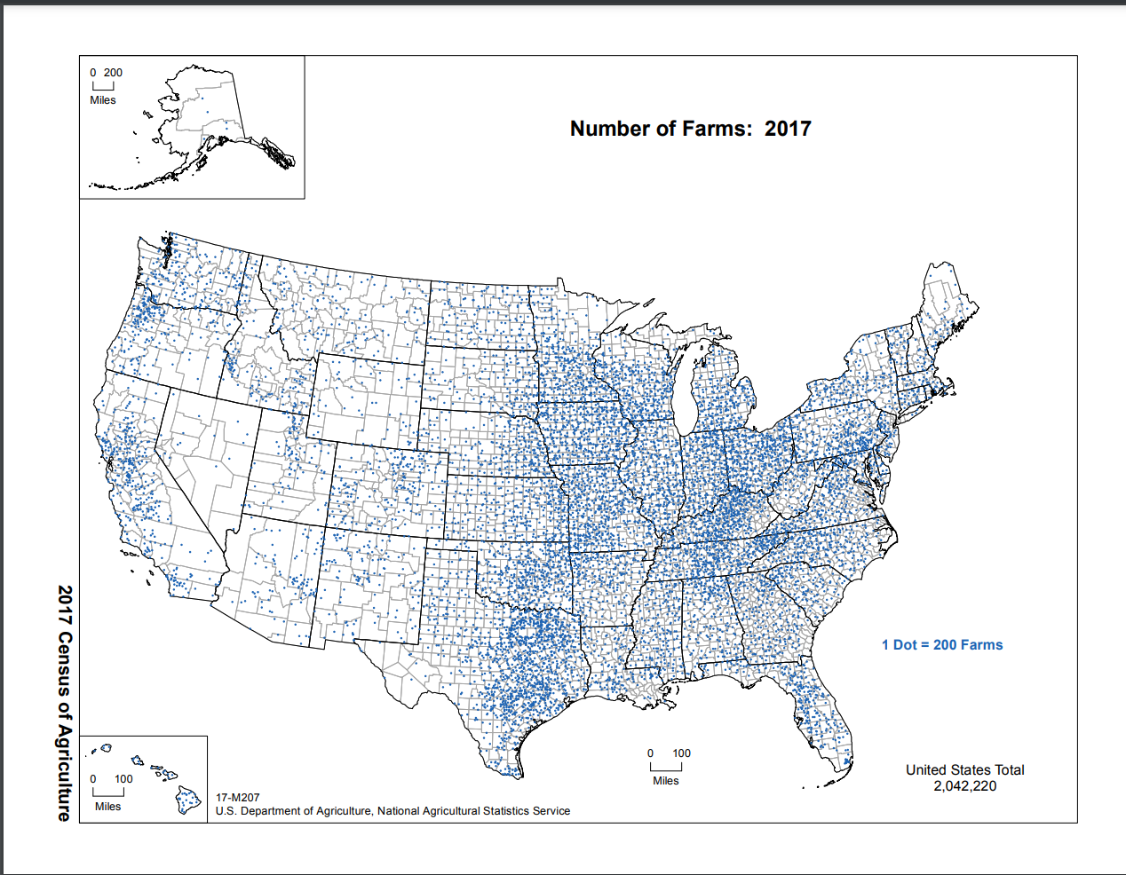
Attributes of Populations of Interest

Slide 15
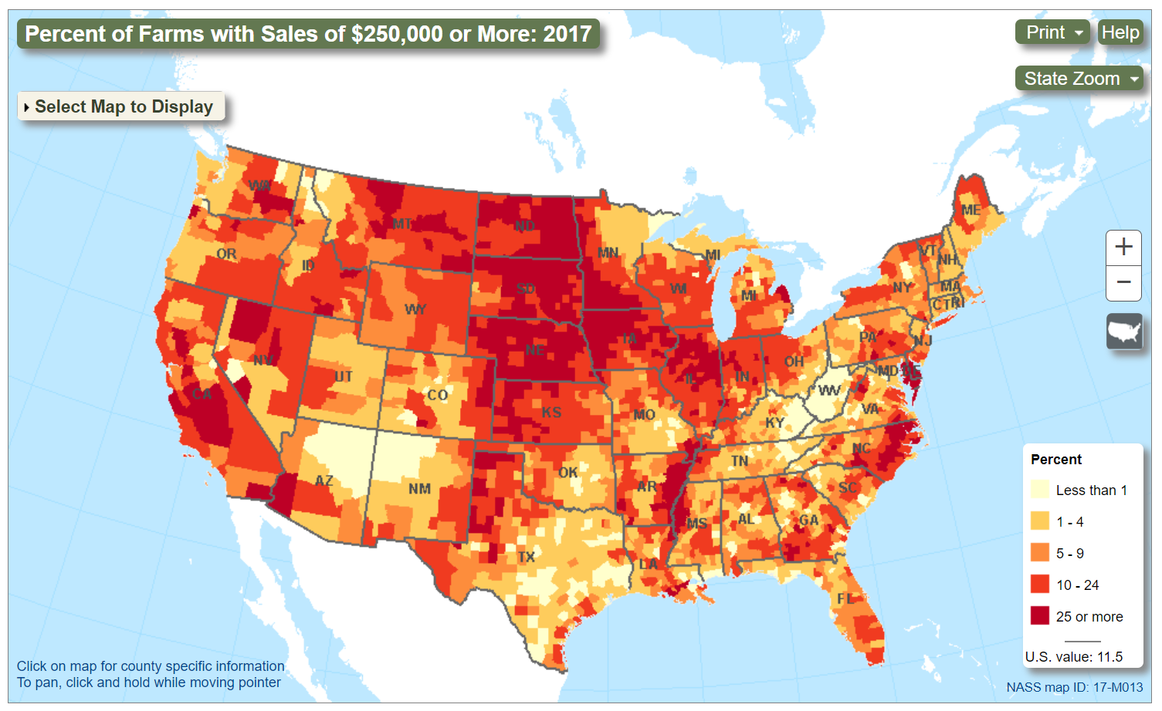
Attributes of Populations of Interest

Slide 16
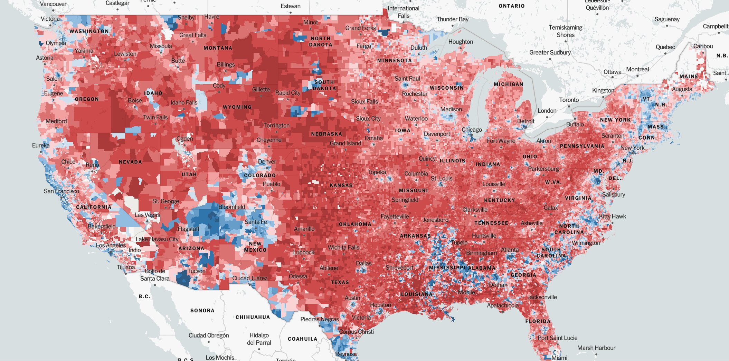
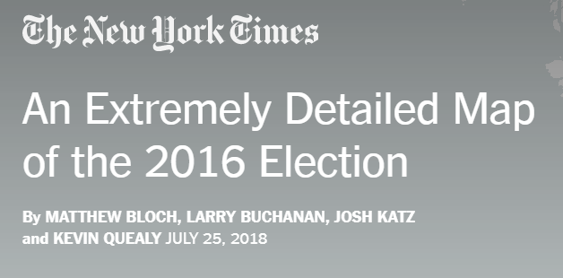
Attributes of Populations of Interest

Slide 17
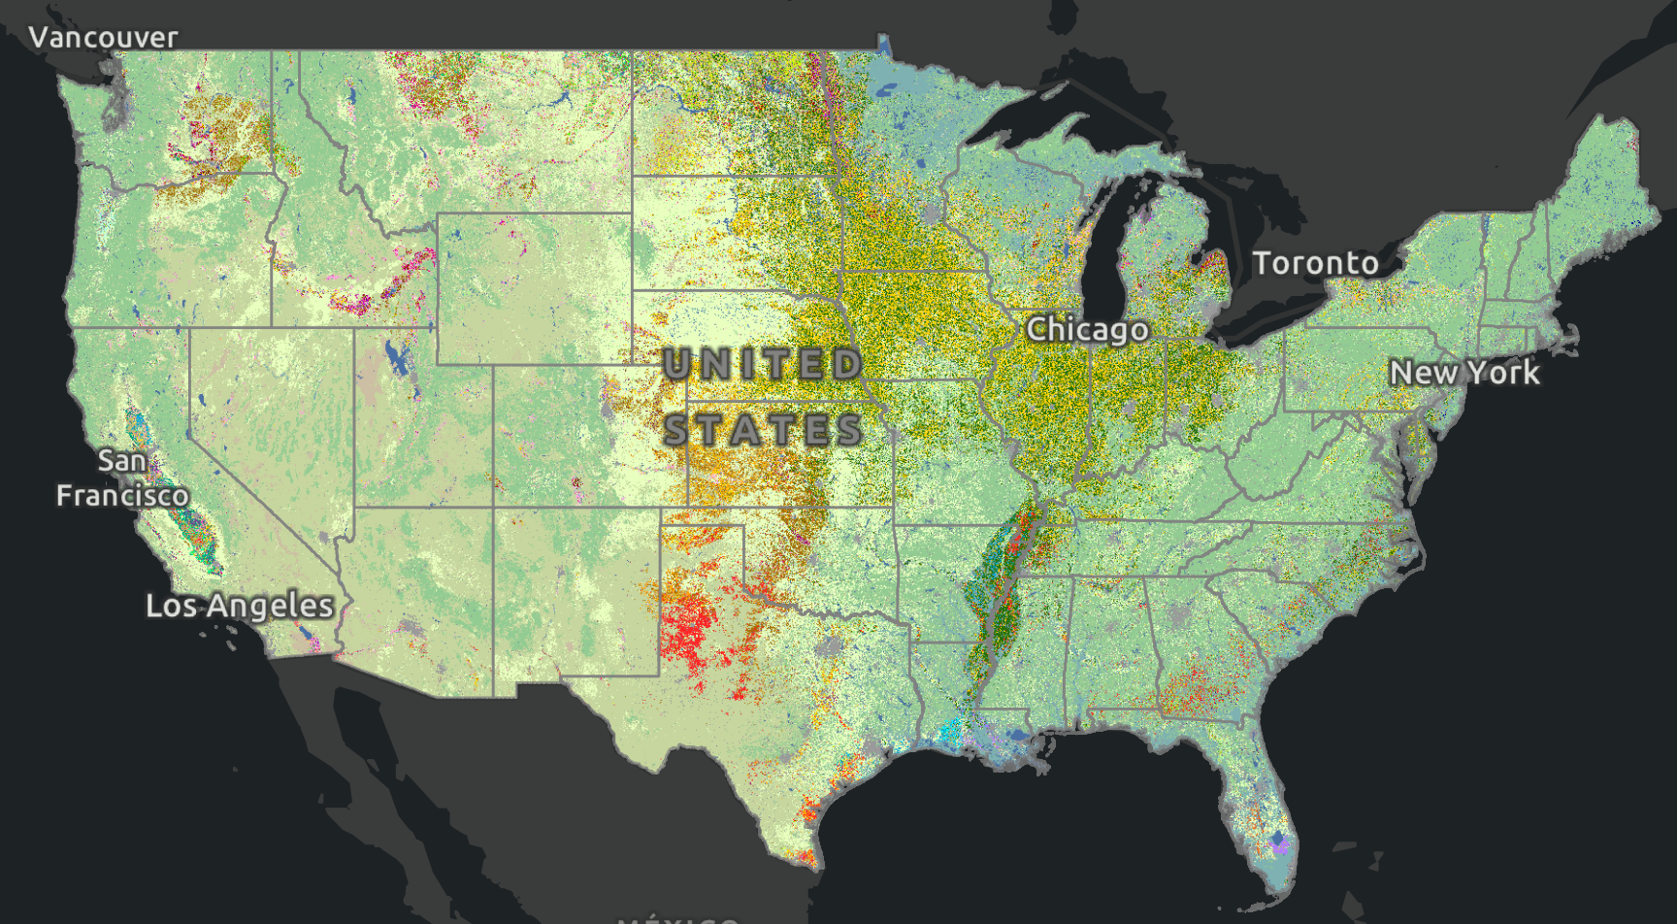
Attributes of Populations of Interest
Cropland Planted by Crop

Slide 18
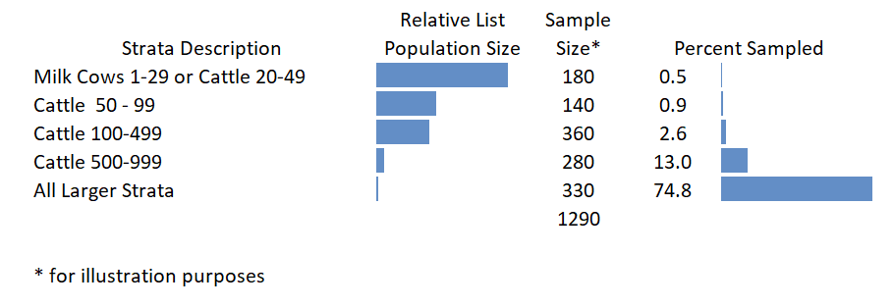
Skewness and Sampling in the Annual Survey Program
Cattle sample selection example for one state

Slide 19
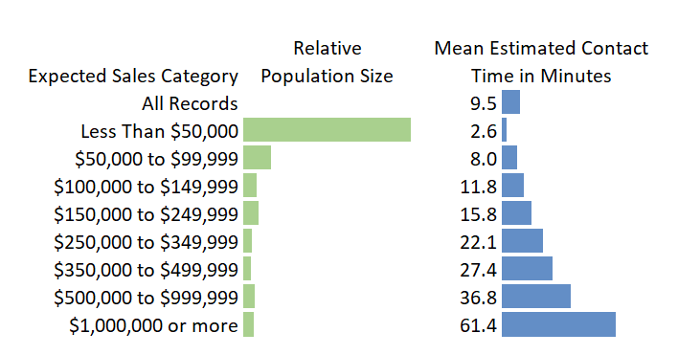
Skewness and Sampling in the Annual Survey Program
Skewness of Populations of interest

Slide 20
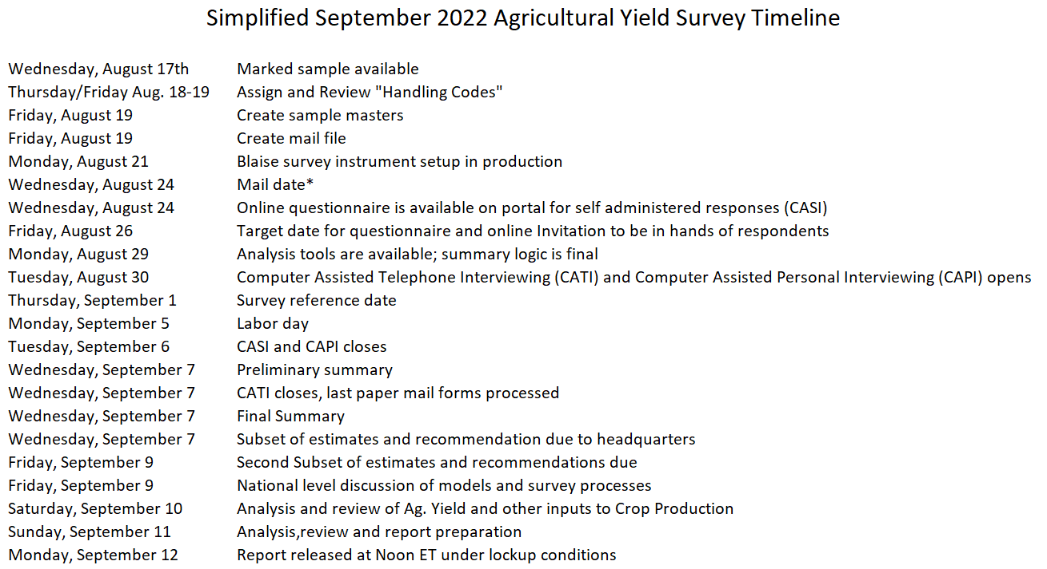


Timelines and Deadlines

Slide 21
Modes of Collection and Engagement
For many surveys we segment the sample and use all modes – depend of the survey
  Mail – questionnaires - send online survey codes, promotional messaging – USPS service variability
  Email – for survey reminders
  CASI, CATI, and CAPI
  Enumerate from paper
Reduced reliance on paper but still needed in some cases

Slide 22
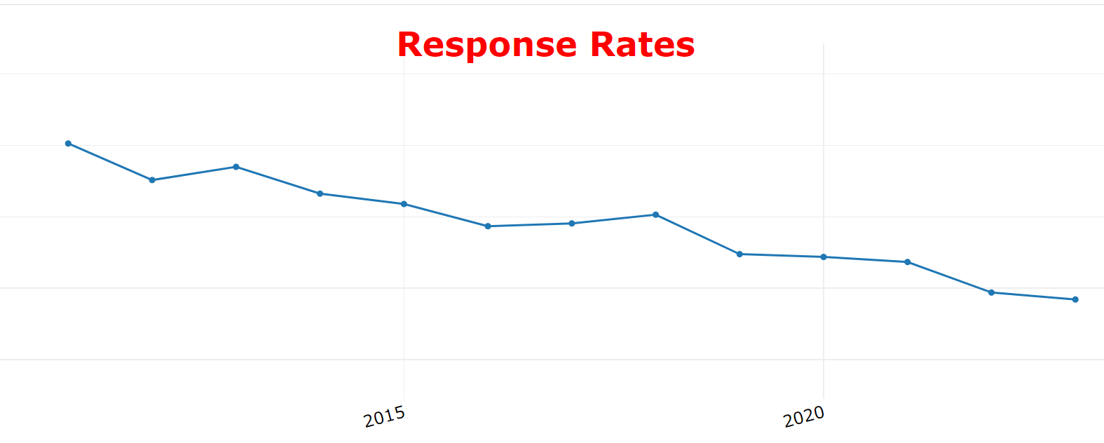
Declining Response
Mode of collection – all of the above. Will avoid calling some folks – let the mail work.

Slide 23

What Supporting a Federal Statistical Agency Must Feel Like for IT Service Providers

Slide 24
Perceived Needs
Budget is mostly “People”
Labor costs
Retention
Productivity
Use of “other” data and tools
Easy for respondents and data users
Nimble, flexible, adaptable, extensible
Relevant

Slide 25
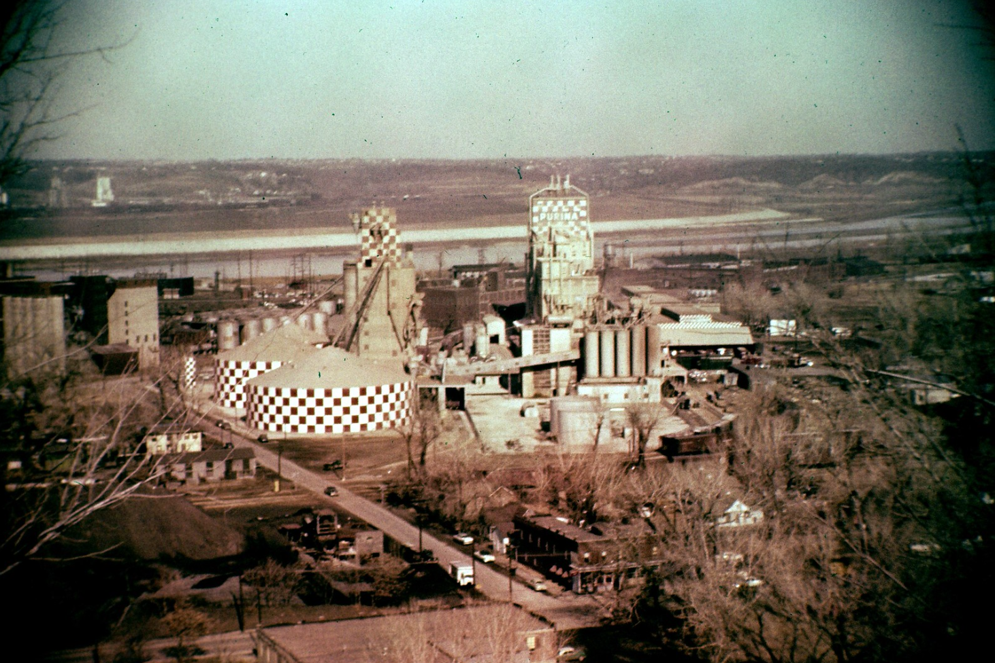
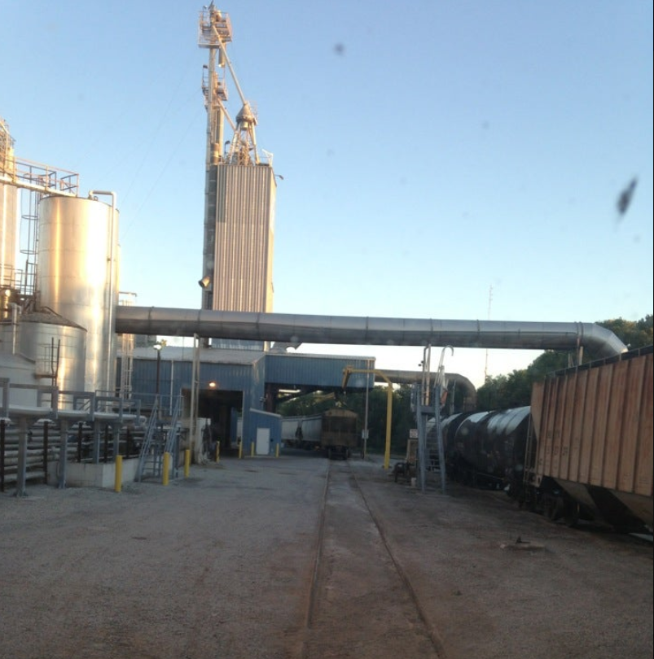
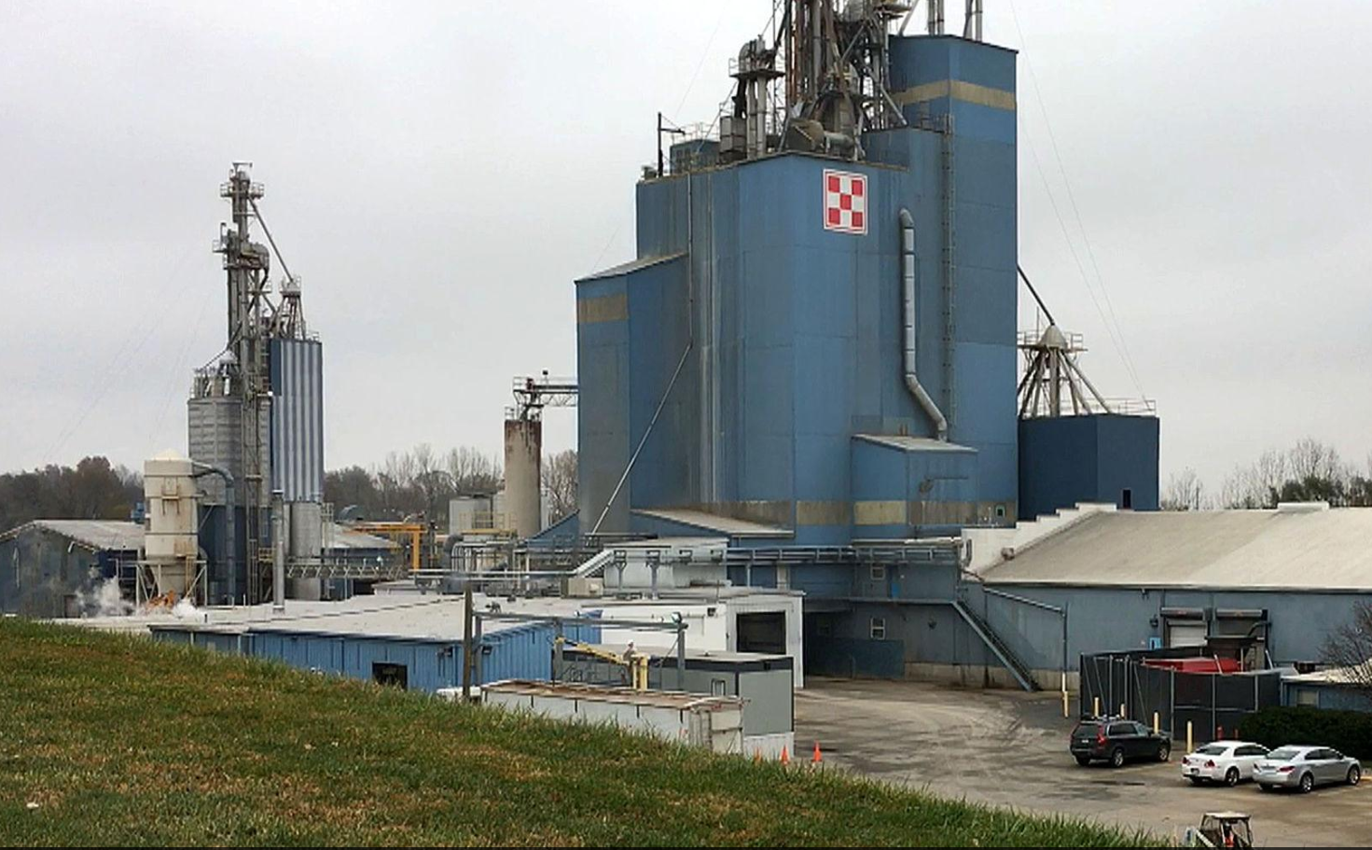
A Brief Story

Slide 26
Covid Adaption
June Area Tools
Team created two new tools under time pressure to allow for an important land-based survey to be conducted.
Screening Tool – help enumerators unable to face-to-face canvass have “best” contact information at their fingertips
June Area Tool to aid in otherwise manual imputations.

Slide 27
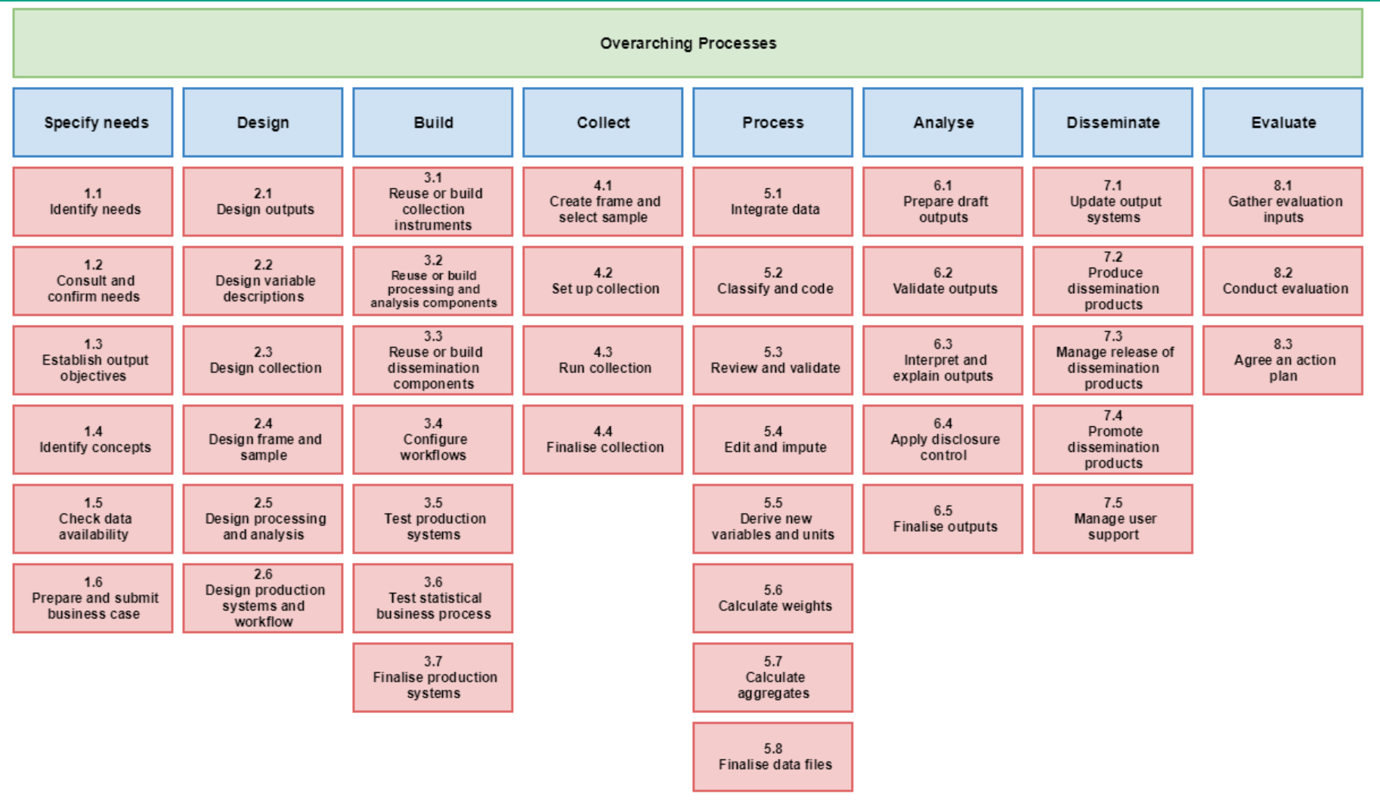
UNECE Generic Statistical Business Process Model

Slide 28
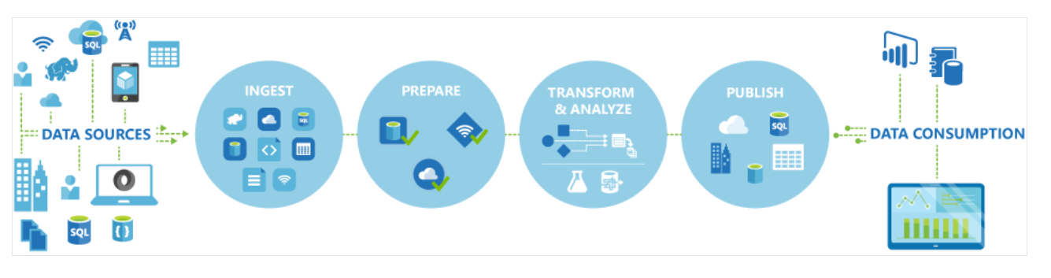
Azure Data Factory

Slide 29
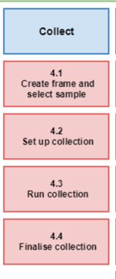
Major Modernization Efforts
Data Collection
Develop a more efficient and streamlined approach to all frames maintenance, presurvey, and data collection activities
  Document current and future business rules and processing flows
  Develop a more efficient and streamlined enterprise platform for all frames maintenance, presurvey, and data collection activities.
  Sunset legacy systems
Recent work examples
  Met with Census Bureau to discuss their current data collection enterprise development.
  Completed deep-dive review of 90% of the 25 applications within project scope
Impact
  Improved customer experience - New platform will include enhancements such as displaying previously reported survey data, streamlined access to all available surveys, and customizable landing page for the respondents.

Slide 30


Major Modernization Efforts
Editing and Imputation
A single platform for editing and imputation for all NASS surveys and the Census of Agriculture
  automation and more advanced imputation techniques to the editing process
  modularized and generalized for a repeatable and data driven standard and efficient future enhancement
Recent work examples
  Created and automated parsing program that pulls edit rules and actions out of the existing Blaise code and translates them into specifications and usable R code.
  Moved development to the cloud for faster data processing
  Testing of corrected and imputed data has begun
Impact
  Reallocate staff time from repetitive manual editing to subject matter
  expert analysis
  Only one editing platform to learn and support
  Gradual implementation to facilitate culture change and allow for robust staff feedback

Slide 31
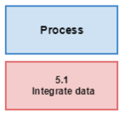
Major Modernization Efforts
Modelling and Geospatial Estimation
Modernize the application of survey and non-survey data in modeling and imputation activities
  Integrate non-survey data with survey data to produce the best possible agricultural estimates
  Automate the ingestion and integration of non-survey data into NASS systems
  Provide novel data products and workflows born from cloud computing capabilities and rich data sources
Recent work
  Created and implemented a prediction of crops planted at a field level for improved imputation in an area based study
  Produced modeled early season estimates of planted acres for select crops and regions
  Developed and automated creation of new geospatial product
  Automated workflows for complex georeferencing processes
Impact
  Improve survey processes with auxiliary data, make better
  principled use of “other” data

Slide 32
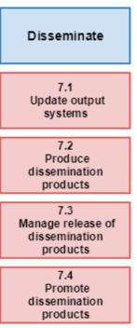
Major Modernization Efforts
Data Dissemination
Modernize the data dissemination function internally and how we expose data to the public
  User-friendly “Landing Pages” categories of releases.
  Scalable and standardized with all types of NASS estimate data sources.
  The landing pages and user experiences provides API endpoints
Recent work
  Milk Production was released on December 19, 2022 in parallel with the existing release
  products and systems, and is continuing to be released monthly.
  Farms and Land in Farms was thoroughly tested and is near completion.
  The Release Approval Process is becoming more efficient with defined standards and
  releases from the operational database
Impact
  Easy to use, vastly easier to find and consume the data users are seeking without
  needing detailed knowledge of NASS survey programs.
  Release processes will be automated and data-driven
  Less time and energy needed to assure error-free dissemination
  API’s throughout allow users to create value easily integrating NASS data, improves
  search results and machine to machine use.

Slide 33


Major Modernization Efforts
Cloud and the “on deck circle”
Modernize and simplify our computing platform
  Moving to REE CIPSEA Microsoft Azure cloud significant movement so far with a full roadmap for all NASS computing in the cloud
  Many to “one” or at least “few”
Other work
The “on deck” circle – some ways to prepare for change and modernization

Slide 34
Some Comments
Modernization and change is not optional
Some Ideas on improving your odds of success
  Process change and cultural change
  Change is hard work
  Projects take time
  Operationalizing requires diligence
  Be an optimist and a realist

Slide 35
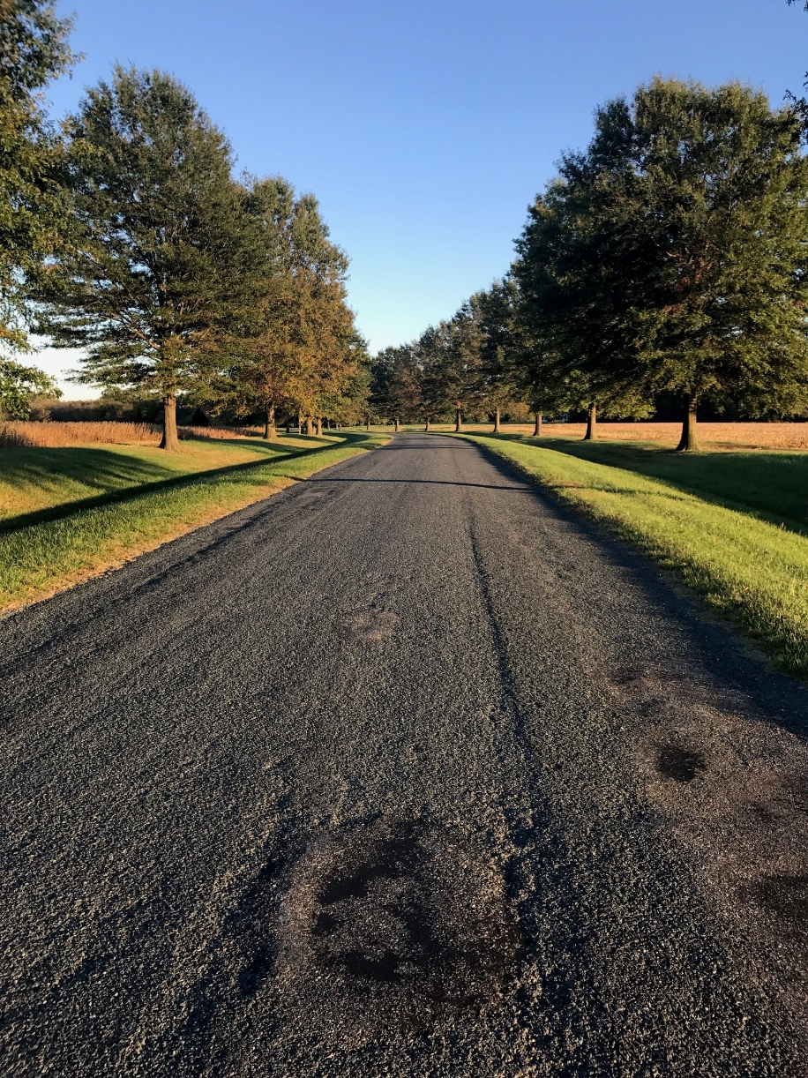
Joe.Parsons@usda.gov

