Slide 1

Battling Survey Bots
Experiences and strategies to mitigate
fraudulent responses in online surveys
FedCASIC, 4/16/24
Anwar Mohammed
Matthew Bensen, Bob Henne, David Schultz
Notes:
Hello everyone.
In this presentation, Battling Survey Bots, I will be talking about some of our experiences and strategies to mitigate fraudulent responses in online surveys.
I wanted to thank my co-authors – Matt Bensen, Bob Henne and Dave Schultz who helped me with this presentation.

Slide 2


What is a Survey Bot?
Digital imposters that respond to online surveys as regular users.
Infiltrate surveys with irregular (and often non-sense) data.
Can finish surveys quickly and handle lots of them all at once.
Responses are getting more ‘believable’.
Notes:
So what is a bot? Bots are simple computer programs that impersonate people. Survey bots are created to imitate human responses in online surveys.
Fraudsters and bot programmers can make (or even buy) a bot program and set it up to automatically take a survey. They can complete a large number of surveys in quick time.
They are constantly finding new ways to make such bot responses appear as real as possible, enabling them to give smart and logical responses.

Slide 3

How are Survey Bots (mis)used?
Claiming survey bonuses/gift cards
To win a contest
Earning commissions for surveys
Sabotaging competitors
Simple harassment
To support a political cause
Notes:
So how are these survey bots used, or rather misused? Here are a few ways:
Some govt agencies or non profits offer incentives by giving out gift cards, cash for completing a survey. Scammers can use bots to fill out the survey multiple times using email addresses that they own—which allows them to claim the bonus.
Some surveys offer a prize to random survey takers. To maximize their chances of winning the prize, they may use survey bots to repeatedly take the survey.
Some agencies pay third-party organizations to deliver surveys to consumers on their behalf. Fraudsters may try to use bots to get multiple survey completes to earn commission
Some companies may use bots to corrupt their competitors survey results—giving them faulty data that doesn’t reflect real consumer preferences.
Some use survey bots as a way to conduct pranks or simply harass - just because they can.
Political activists with hacking skills may use survey bots to skew political polls or marketing surveys to make certain political views seem more or less popular than they actually are. This can alter the publics perception of the political climate.

Slide 4

Impact of Survey Bots on a business
Wasted survey spend
Wasted product development spend
Damage to a company’s reputation
Operational disruptions to fix nonexistent problems
Notes:
So, how can survey bots affect a business? There are many:
Wasted budget - Invalid online survey results represent a direct waste of any money that was spent on creating, advertising, and distributing the survey, especially for a small-to-midsize business.
Product surveys used to gauge public interest in a new product can help a company determine if it’s worth their time and effort to spend money on R&D, and manufacturing. But, if that assessment is based on bad survey data, they could end up wasting $s on a product that may fail.
Survey bots could indirectly harm a company’s reputation with the public. They could twist polls about the company to make them look bad.
When a survey falls victim to a bot attack the organization may become hyper vigilant, as does the client. What this may result in is - analyzing every data point that is odd, even if it’s really not suspicious. This could waste a lot of time and budget.

Slide 5
CDC project example
Open screener link
Difficult to reach sample
Sensitive PII data collected (HIV)
Incentive to eligible respondents
Voxco software
Expected 1500 responses in 6 months
Notes:
On one of a recent project that I had led, we had launched a survey that was intended to gather sensitive data from a hard to reach sample. We had a $20 incentive to eligible respondents who completed the survey.
This survey was developed using Voxco and we were hoping to receive about 1500 responses in the 6 month data collection period.

Slide 6
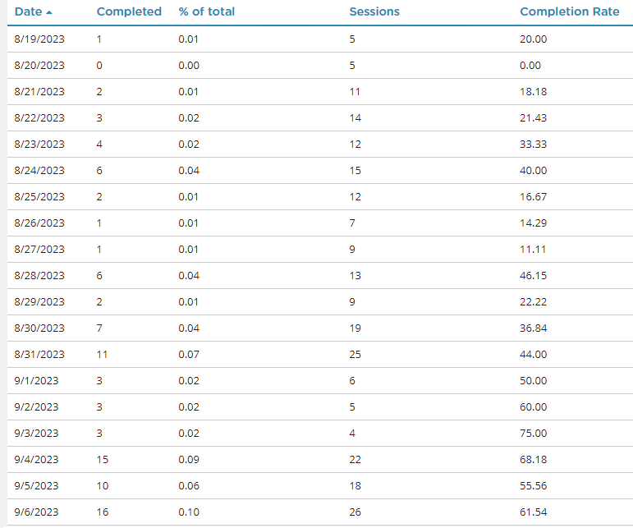
Daily tracking after launch
Notes:
We launched the survey successfully and the responses were trickling in at the expected rate. It started slow, but increased to 10 or more per day

Slide 7
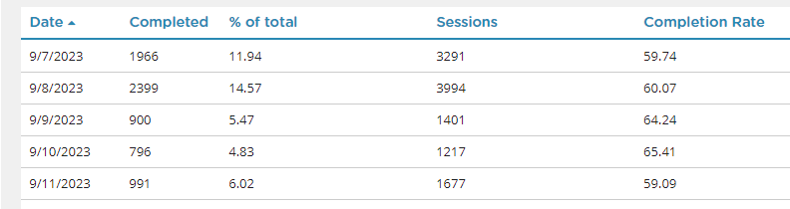
Daily tracking
<100 Completes in about 3 weeks
7000+ Completes in less than a week!
Notes:
We had less than 100 responses in about 3 weeks.
And then…… we hit lottery! We had 7000+ completes in less than a week! Now it does not need a genius to realize something was wrong

Slide 8
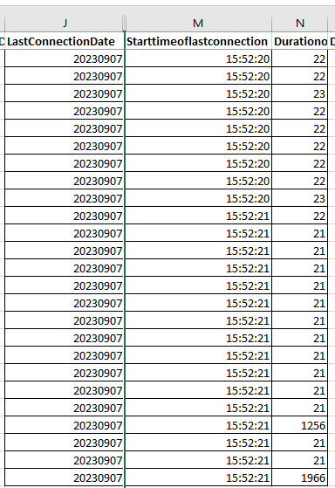
Identifying bots: Timestamps
  Influx of responses
Notes:
So how do you identify which responses could have been from bots?
Start with Timestamps - Bots frequently respond in clusters, attempting to get the incentives for completing the survey repeatedly,
Here we see multiple responses for the survey which started exactly at the same time and took almost same completion time – this could strongly indicate bot activity.

Slide 9
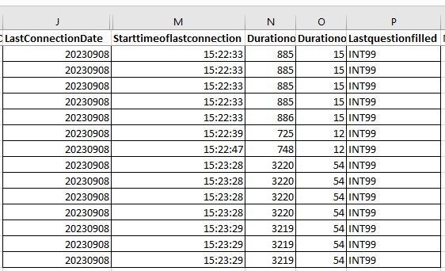
Identifying bots: Timestamps
  Strikingly similar timestamps
Notes:
If you notice here, there was a surge in responses, all bearing strikingly similar start time to the seconds, and identical duration for completion – this could indicate bot activity

Slide 10
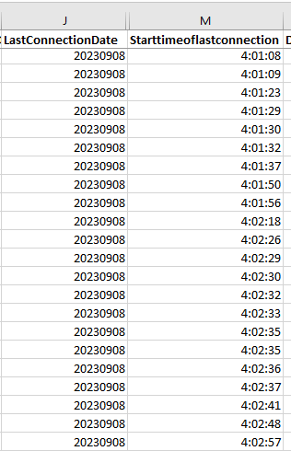
Identifying bots: Timestamps
Actual timestamps
Notes:
Also, consider inspecting the actual timestamps since it would be unusual to encounter groups of respondents finishing a survey at peculiar hours, say 4 am as you can see here.

Slide 11
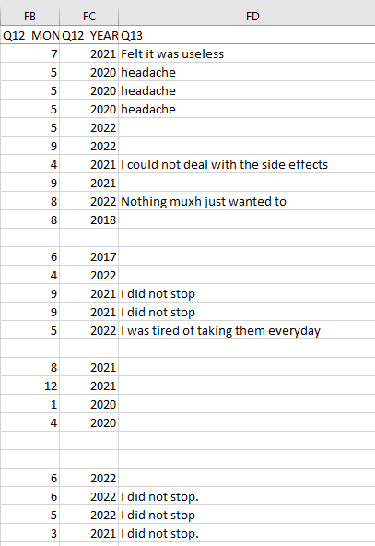
Identifying bots: Open ended responses
  Q: Why did you stop?
Notes:
Next is open-ended responses - It’s critical to double check these responses.
Human respondents will often input some text to quickly bypass any mandatory open-ended questions. However bots tend to generate feasible words creating random or nonsensical phrases.
Bots may repeatedly provide identical responses each time they take the survey as you can see in the example

Slide 12
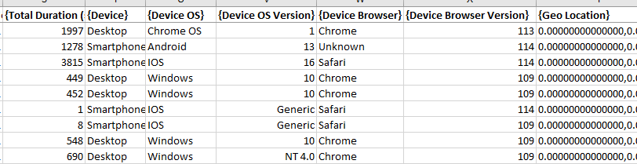

Identifying bots: Meta Data
  IP addresses
  operating systems
  the platform being used
  the device used
Notes:
Review the meta data of all respondents, which includes IP addresses, operating systems (did they use a Mac, PC, etc.), the platform being used (mobile or desktop), the device used (iPhone, Android, etc.).
Finding multiple responses with identical metadata can often serve as a warning sign.

Slide 13
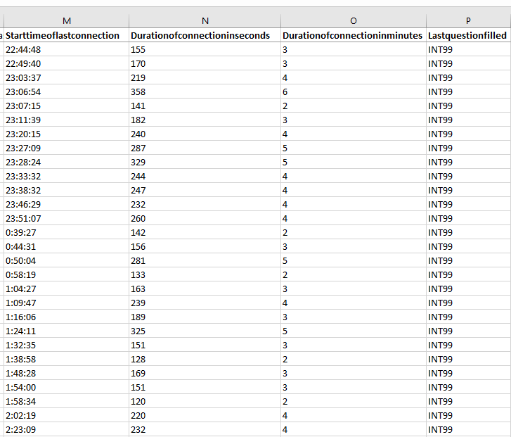
Identifying bots: Speed
Notes:
Speed: Bots often complete surveys at a very fast pace because, unlike humans, they don’t require time to consider opinion-based questions.
In our example here, for a 20 min survey, the respondents completed the survey in less than 1/3 of the median survey length – these responses should be scrutinized to check the authenticity of these results.

Slide 14
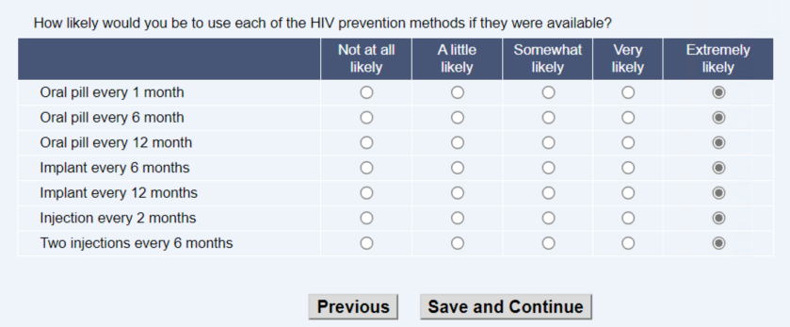
Identifying bots: Straight Lining
Notes:
Straight-Lining: If your survey includes a grid style question requiring respondents to select ratings for multiple statements, it isn’t unusual for a few participants to choose the same response for all statements. This can happen with both bots and unengaged humans and is something to be considered when verifying the quality of the dataset.
You can manually identify these or utilize straight-line flags through programming to disregard any respondents that straight-lined answers to one or more questions (depending on the threshold you set).

Slide 15

Identifying bots: Unexpected responses
  various demographic factors
  age, location, gender, education
  18 year old with PhD is very unlikely
  emails, names
Notes:
It is important to note that bots often answer in groups and submit noticeably abnormal results that should be examined based on their frequencies.
Look for unusual frequencies within various demographic factors, such as age, location, gender, education, etc., as these can highlight discrepancies between the actual findings and your expected results.
An 18 year old with a PhD degree is very unlikely

Slide 16
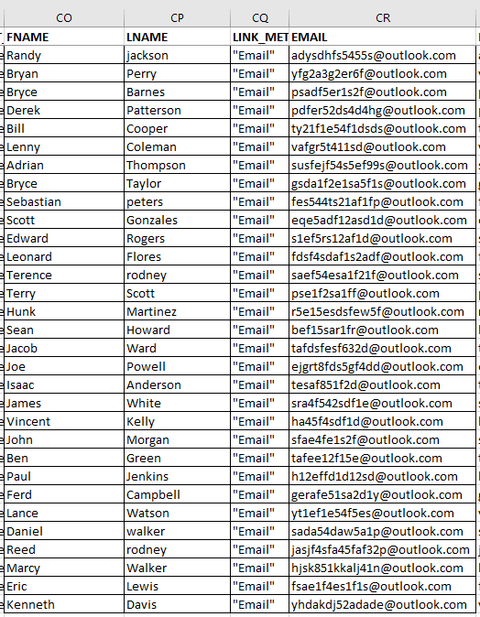
Notes:
Look at some of these emails we received – its very unlikely that someone would have such emails for regular use
They are a randon combination of alphanumerics, and thy all have an outlook.com

Slide 17
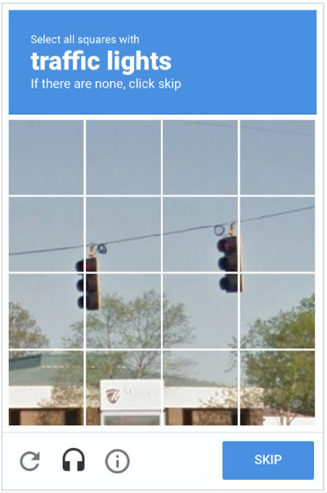
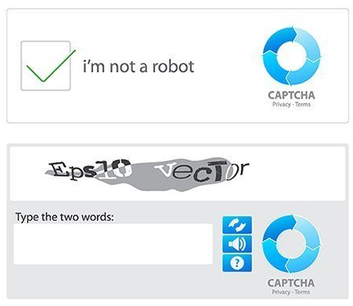
How to stop Survey Bots
  Using CAPTCHA/reCAPTCHA
Notes:
So how can we stop these survey bots? Here are a few methods:
For years CAPTCHA, has been the go-to tool to weed out bot traffic. You must have used the classic “I am a human” check box, jumbled string of letters/numbers, or fuzzy pictures.
It works as a basic form of stopping bots, but not advanced ones as fraudsters have had years to learn how it works, and how to bypass it.

Slide 18
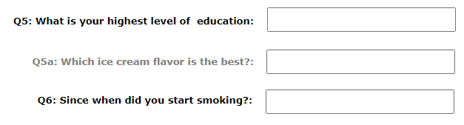

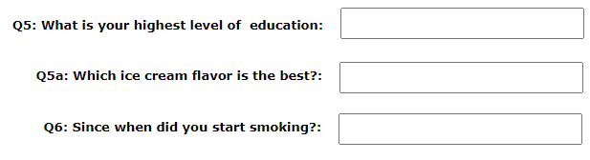

How to stop Survey Bots
  Using CAPTCHA/reCAPTCHA
  Honeypot Form Fields
Notes:
Using Honeypot Form Fields – Unlike humans, bots directly read the code on the web page. So, inserting code for a form field that doesn’t actually display for human users will get responses from a bot. It’s an old trick but remains highly effective.

Slide 19

How to stop Survey Bots
  Using CAPTCHA/reCAPTCHA
  Honeypot Form Fields
  Using Email Verification
  Check the Consistency of Survey Results
  Using Software That Can Detect Bots
  Review Survey Taker Meta Data
  Don’t provide instant incentives
Notes:
So how can we stop these survey bots? Here are a few methods:
For years CAPTCHA, has been the go-to tool to weed out bot traffic. You must have used the classic “I am a human” check box, jumbled string of letters/numbers, or fuzzy pictures.
It works as a basic form of stopping bots, but not advanced ones as fraudsters have had years to learn how it works, and how to bypass it.
Using Honeypot Form Fields – Unlike humans, bots directly read the code on the web page. So, inserting code for a form field that doesn’t actually display for human users will get responses from a bot. It’s an old trick but remains highly effective.
Using Email Verification is another way to thwart bot traffic. Instead of taking people directly to a survey, ask for the recipient’s email address and email them the link.
But… This extra step could discourage survey takers and they may opt out of the survey, potentially leading to survey bias.
And Scammers have control of dummy email accounts that they can use for email verification purposes.
Check the Consistency of Survey Results and see if they’re abnormally consistent—like 99% of results being identical to one another. As we saw for open-ended questions, how many respondents have a word-for-word identical answer?
Using software That Can Detect Bots – It could calculate a fraud probability score, identify duplicates, evaluate IP addresses etc. This helps you get rid of fraudulent traffic without risking genuine survey responses.
Review Survey Taker Meta Data. If a bunch of survey responses are all coming from the same IP address or device type (with the same OS and specs), that could be a sign that someone is using a bot to fill out your survey repeatedly from the same device.
Lastly, do not provide instant incentives. Confirm either via email or SMS or some other method before sending the incentive.

Slide 20
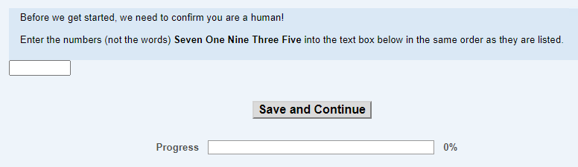
Are you a human?
Questions considered:
  additions (e.g. 2+4+1)
  additions/subtractions (e.g. 7+3-2)
  decimals (2.5+7.3)
  logical (Number >7 but <10)
Questions added (NUM):
Notes:
For our CDC project, we considered multiple options to check ‘are you a human’
Some questions were simple addition, subtraction, or needing more logic… like list a number >7 but <10
We decided to add a question where respondents had to enter the numerical numbers that was spelled out in words

Slide 21
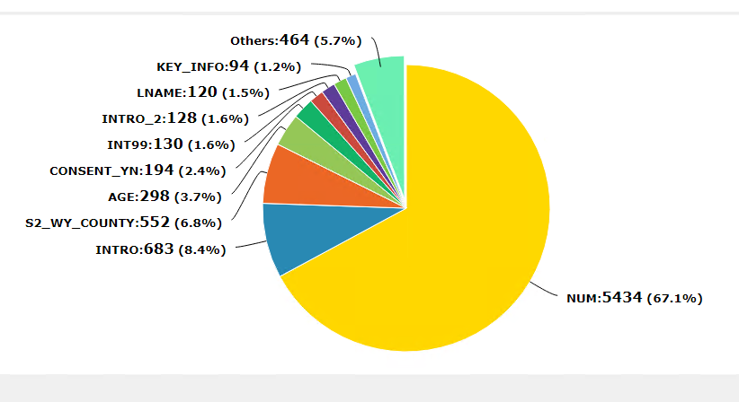
Analysis of Drop Outs
Notes:
This worked! We saw great results! More than 67% drop outs were for the number entry question that was added.
To be extra safe, we changed the number at least once a week!

Slide 22
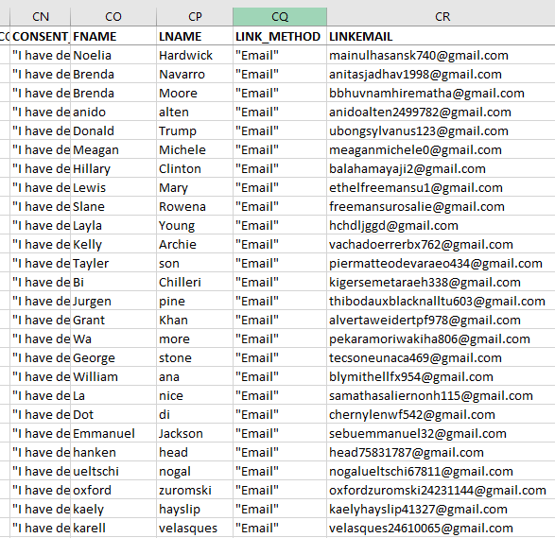
Notes:
We spent a lot of time analyzing the metadata, but it was all worth it when we realized even celebreties were so keen on taking our survey ☺

Slide 23





Survey Landing Page & Information Page System
External
Landing Page
SLIPS
Survey Engine
Validate
Fail
Security check
PIN/Password verification
Pass-through Authentication
Session logging ( website must send us info to log )
Pass
Notes:
At RTI, we have developed a platform, Survey Landing Page & Information Page System (SLIPS), that allows for the rapid creation of websites, to provide a layer of protection outside of the survey software engine.
Each project starts with a base template with built in security features, such as PIN/password validation and metadata collection.
validation is done via SLIPS, not inside the survey engine, preventing DNS attacks.
SLIPS gathers session data for each arrival at the landing page
It obfuscates the password length or pattern used by respondents.
We can also connect Third party fraud prevention software if needed.

Slide 24
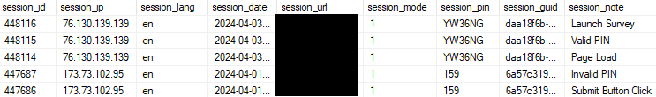
HIV Study project example
Captured metadata
Multiple-choice question
Two open-ended questions
Incentives not paid immediately
Modes – email list, text phone number
Notes:
A lot of the surveys at RTI now use SLIPS.
On a HIV study that had incentives, we captured the metadata, and a fraud probability score. A session log was created for each arrival at the landing page.
We had a multiple-choice question in the survey where we told the respondent what to answer as a “pay attention” question.
We asked two open-ended questions, not important to the data collection, that a person not in the sample might not be able to answer easily.
We did not pay incentives immediately. We compared and checked email addresses for similarity and exact match.
We had two modes of outreach. We reached out to a sample list of email addresses. We also invited people to text in their phone number. A unique survey-link was then sent to these phone numbers.
All these precautions helped as the data quality was very good, with no red flags detected

Slide 25
Conclusion
Bot prevention is critical for online surveys. Pay attention
Data security is of the utmost importance for our clients.
A great way to further enhance your security and protect your data.
Have prevention methods in place
Use software (commercial or home grown)
Monitor meta data regularly
Notes:
To conclude, Bot prevention is an important aspect of online surveys as it helps to ensure that the responses are coming from real human respondents and not bots or other automated programs.
Pay attention as Data security is of the utmost importance for our clients, and it is a great way protect your data.
Have prevention methods in place during development.
Use software (it could be commercial or home grown as you saw with RTIs SLIPS software)
Monitor meta data on a regular basis and look for unusual activity or red flags

Slide 26


Thank You
Contact:
Anwar Mohammed | amohammed@rti.org
Director, Systems Analysis and Programming
RTI International
Notes:
This concludes my presentation.
Thank you

