Slide 1
Usability of QR codes as a method to access a mobile survey
Alda Rivas
April 16th, 2024
FedCASIC 2024
Any opinions and conclusions expressed herein are those of the author and do not reflect the views of the U.S. Census Bureau.
Disclosure Review: CBDRB-FY23-CBSM002-005

Slide 2
Background: Current statistics for use of Internet and smartphone in the United States.
Adults in the United States
  93% of adults conduct activities online (Pew 2021a).
  85% of adults have a smartphone that connects to the internet (Pew 2021b).
  For 15% of adults, smartphone is the only device connected to the internet (Pew 2021b).
Older adults in the United States
  75% of older adults (65-74 years) conduct activities online (Pew 2021a).
  61% of older adults (65-74 years) have a smartphone that connects to the internet (Pew 2021c).
  For 12% of adults (65+ years), smartphone is the only device connected to the internet (Pew 2021a)

Slide 3
Activities conducted online: Surveys
High proportion of respondents complete surveys online
  80% of 2020 Census self-respondents completed the form online (US Census Bureau, 2021).
Problem:
  Entering a web address in a smartphone is cumbersome, particularly when the address is long or includes an alphanumeric string.
  Fine motor movements are a challenge for older adults (Corti et al., 2017).

Slide 4
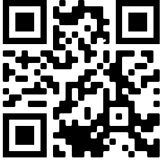
Potential Solution:
Quick Response (QR) codes
A matrix code consisting of black and white squares.
Used for storing URLs.
Read by the camera on a smartphone.
Have existed for over 30 years
More popular after the 2020 Covid pandemic (Ceci, 2023)

Slide 5
Potential Benefits
QR codes on mailed invites could help the Census leverage technology to:
  Encourage survey responses.
  Improve the user experience.
  Reduce respondent burden.
  Reduce costs associated with post-processing (non-ID linking), non-response follow-ups, and phone support.

Slide 6
Marlar (2018)
Experimental conditions:
  1) URL
  2) QR code
  3) URL or QR code
No difference in response rates across the three conditions.
4% of respondents chose to access the survey through QR code.
QR code condition higher paper response than other conditions.

Slide 7
Limitations of Marlar (2018)
Study conducted in 2017 (pre-pandemic).
Instructions: “Scan the QR code to access the website and complete the survey online.”

Slide 8
Need for new research
The current prevalence of QR codes in the mainstream combined with more detailed instructions may render QR codes as a viable option to complete a survey on a smartphone.
Research Questions:
  What is the usability QR codes as a method to access a mobile survey?
  What is the optimal wording of instruction to allow non-tech savvy respondents to access a survey using a QR code?

Slide 9
Our studies
Two rounds of usability evaluations of QR codes:
Usability evaluation (General population)
  Summer 2022
  Remote
Usability evaluation (Adults 55+ years)
  In-person
  Fall 2022

Slide 10
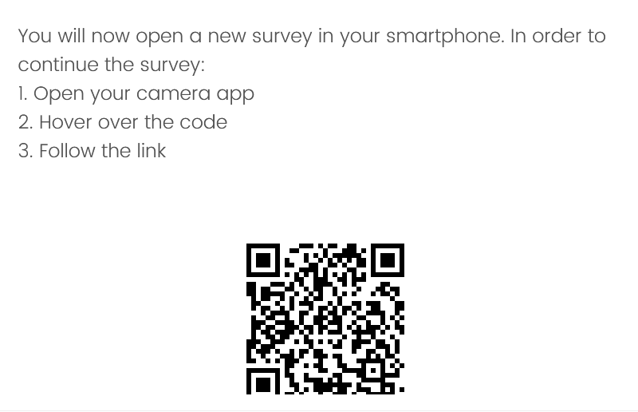
Usability of QR codes: Round 1 (General population)
20 iPhone users. Mean age: 29.9 years (SD: 11.9 years; range: 18-66 years).
Usability task:
Users completed a survey online while sharing their desktop/laptop screen (remote session).
Users were presented with a QR code and instructions to continue the survey on their smartphone.

Slide 11
Round 1: Findings
Effectiveness: 100% of the sample was able to access the survey in their smartphone through the QR code.
Efficiency: 12.4 seconds average time to access survey
Satisfaction
  Difficulty: 100% Extremely easy
  Perceived likelihood: 90% likely to access a survey using a QR code
No usability issues

Slide 12
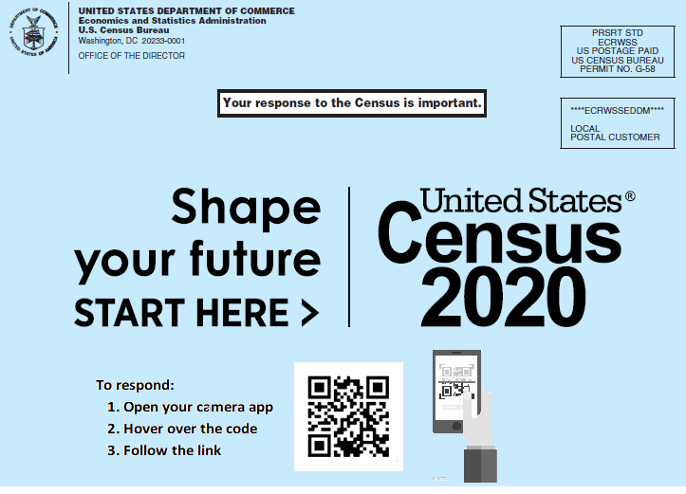
Impressions about instructions on invite

Slide 13
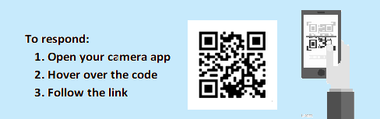
Would people without QR code experience be able to follow the instructions?
  Users thought older people or non-tech savvy people would not know
    Use phone camera
    Don’t take a picture
    Hover
    Code
    How to solve issues (not properly focused)
    Having to wait for the link to appear (not immediate)
    How to “follow” the link (tap)

Slide 14
Usability of QR codes: Round 2 (Adults 55+ years old)
19 users. Mean age: 63.68 years (SD: 7.8 years; range: 55-76 years).
Community centers in a metropolitan area in Texas.
Usability task:
Users were given a paper invite and received the instructions: “Imagine that you are at home and received this invitation in your mailbox. If you wanted to complete the census following the instructions in this invite, What would you do?”

Slide 15
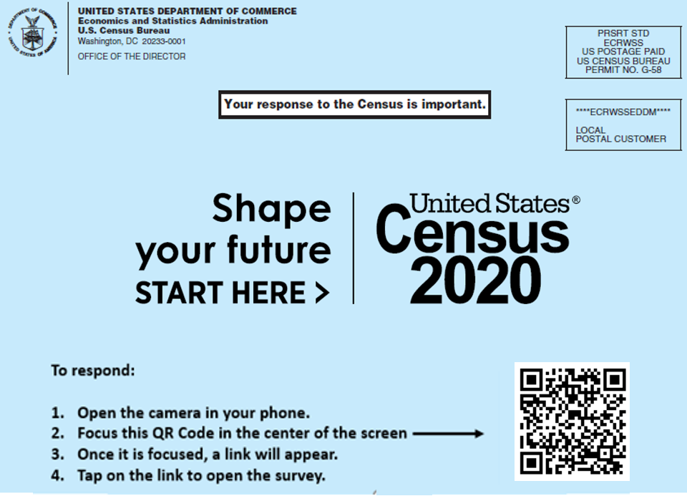
Material: Paper invite

Slide 16
Round 2: Findings
10 users previous experience using QR codes. 9 users no experience, but familiar with QR codes.
Effectiveness: 74% of the sample (14 out of 19 users) was able to access the survey in their smartphone through the QR code.
  5 unsuccessful scans: 4 users without previous QR code experience.
Efficiency: 31.21 seconds (SD: 33.27 sec; range: 4 sec – 128 sec) average time to access survey.
Satisfaction
  Difficulty: 2.10 (1 = “Extremely easy” – 7 = “Extremely Difficult”).
  Preference: 16: Scan; 2: Type; 1: No preference.

Slide 17
Round 2: Usability issue 1
Presentation of notification with link is not standardized across different operating systems.
Users do not recognize the notification as the link to be tapped and open the survey.
Two users (iPhone) were unable to complete the task, and 8 users (7iPhone, one Android) had increased time on task.

Slide 18
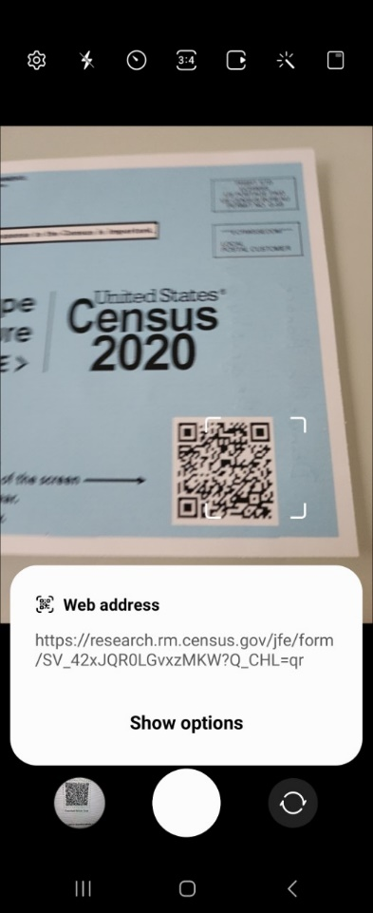
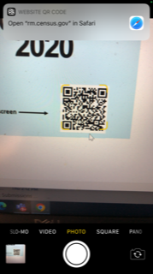
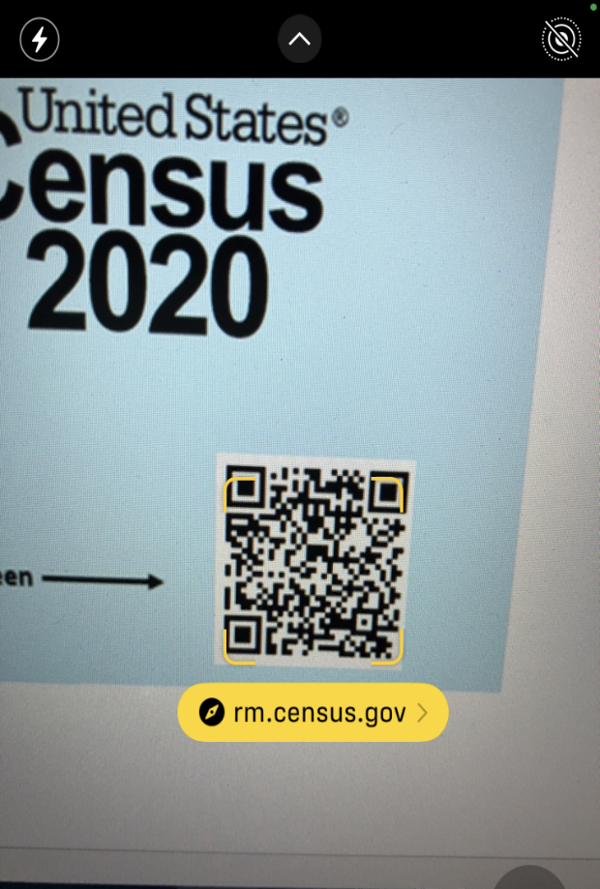
Notification is not standardized across different OS

Slide 19
Round 2: Usability issue 2
Not clear how to focus QR code on camera.
One user opened the camera and focused the whole invite instead of just the QR code.
One user focused the postage (stamp) in the camera instead of QR code.

Slide 20
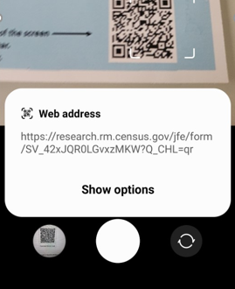
Round 2: Usability issue 3
Extra step before tapping on link.
After scanning, notification appears “Show options” then “Select browser”.
2 users prevented from completing task.

Slide 21
Round 2: Usability issue 4
Taking a picture
  After not seeing or recognizing the link, 6 users took a picture.
    4 users thought that taking a picture was part of the process.
    2 users stated that they took a picture because there was nothing else to do.

Slide 22
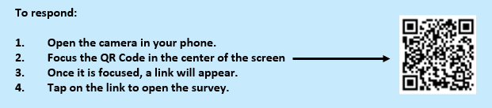
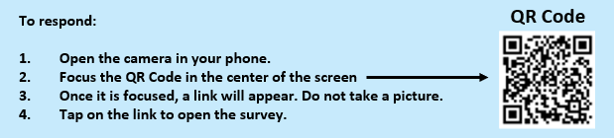

Recommended changes to instructions

Slide 23
Limitations
Most usability issues are outside of our control:
  Different presentation of notifications and different steps in process across different OS.
Not realistic to include instructions for these issues on invite.

Slide 24
Good news
High effectiveness (14 out of 19 users) completed the task.
High satisfaction: 16 out of 19 users would prefer to scan a QR code than to type a website on their smartphone.
All users in sample familiar with QR codes.

Slide 25
More good news: Easy to learn process that avoids mistakes
Users spontaneously expressed being “happy” about the current prevalence of QR codes because it helps them prevent mistakes and motivates them to visit a site (they would think twice before opening a webpage if they had to type).
Easy to learn: “Once you’ve done it a couple of times, you won’t have any problems.”

Slide 26
Conclusions
Given widespread presence of QR code in daily activities, familiarity with this process will increase across the US population.
High usability (high effectiveness, efficiency, and satisfaction rates).
Process easy to learn.
Including a QR code in paper invite is a viable way for respondents to access a survey and potentially lead to higher response rates for mobile surveys.

Slide 27
Future directions
New Round of usability evaluation:
  Spanish speakers.

Slide 28
Thank you!
Questions?

