Slide 1
Testing Web Surveys for Accessibility
Gauri Dave, Neha Kshatriya
Anwar Mohammed, Al-Nisa Berry
Federal Computer Assisted Survey Information Collection (FedCASIC)
April 16, 2024

Slide 2
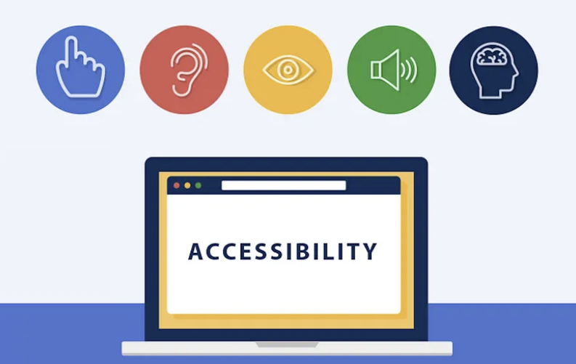
What is Web Accessibility?
Web Accessibility refers to providing equal access to all electronic and information technology content regardless of user’s disability.

Slide 3
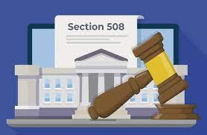
What is Section 508?
An amendment of the US Rehabilitation Act of 1973, and a federal law mandating that all electronic and information technology developed and used by the federal government are equally accessible to the general public, those with and without disabilities.

Slide 4
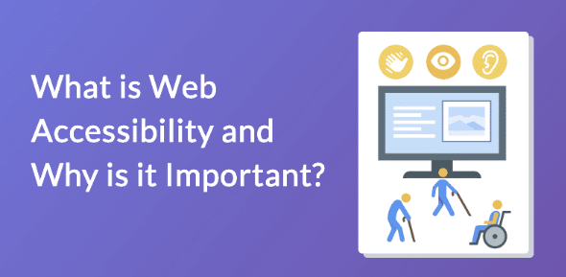
Web Accessibility - Why is it important?
It’s inclusive and gives equal access to all
Legal Compliance
Improved User Experience
More Customers

Slide 5
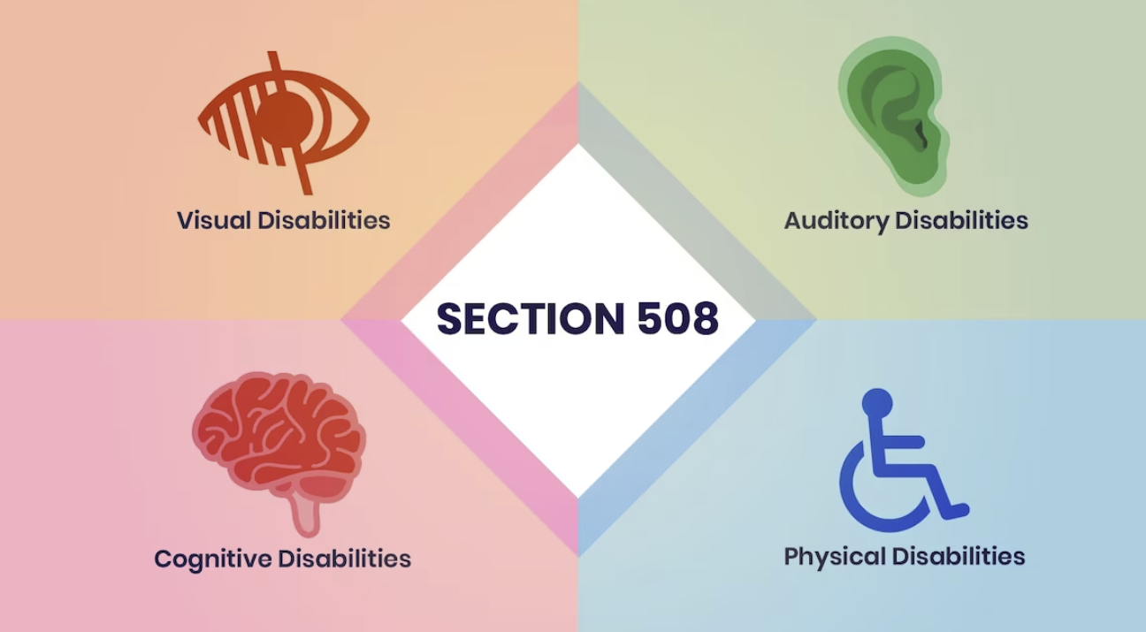
Who is Impacted?

Slide 6
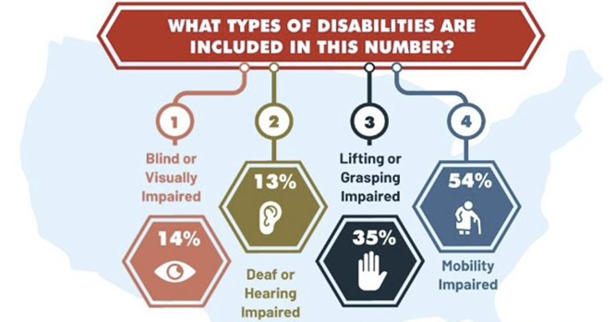
Some stats:

Slide 7
Challenges of 508 Compliance testing
Understanding the WCAG or accessibility guidelines
Integrating accessibility into development processes
Testing and Quality Assurance

Slide 8
Some 508 Compliance Requirements
Total of 61 success criteria's (requirements)
Keyboard Accessibility
Keyboard Access
No Keystroke Timing
No Keyboard Trap
Focus Visible
On Focus (Change of Context)
Focus Order Meaning
Focus Order Reveal
Focus Order Return
Forms
Label Descriptive
Programmatic Label
On input
Change Notify Form
Error Identification
Error Suggestion
Error Prevention

Slide 9
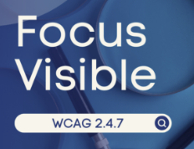
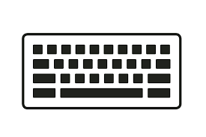
Focus Visible
WCAG 2.0 Requirement 2.4.7
A visible indication of focus is provided when focus is on the interface component.
Why is it important?
Provides a solid visual cue on interactive elements.
Help to identify where the focus is located.

Slide 10
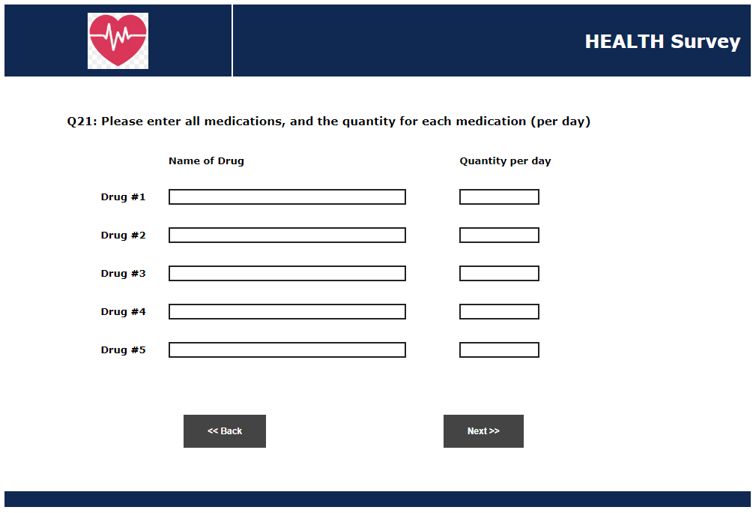
Focus Visible – Non-Compliant

Slide 11
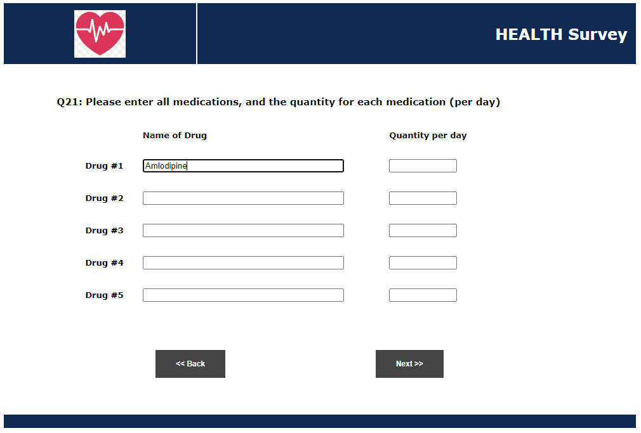
Focus Visible–Compliant

Slide 12
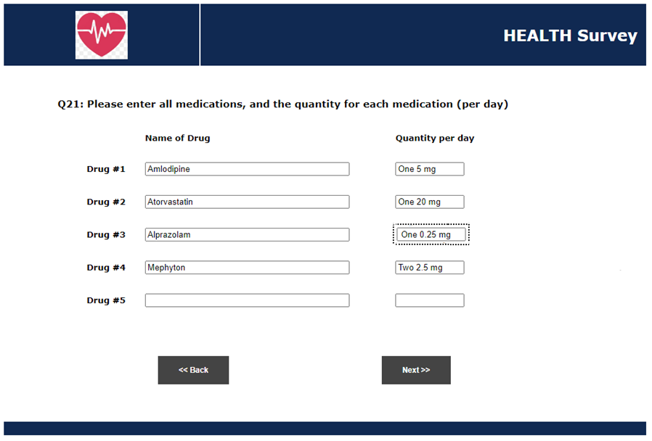
Focus Visible – Compliant

Slide 13
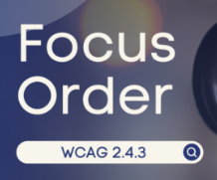
Focus order meaning
WCAG 2.0 Requirement 2.4.3
The navigation order of focusable elements MUST be logical and intuitive.
Why is it important?
Guides user with logical, usable focus order
User can get confused if focus goes to unexpected content

Slide 14
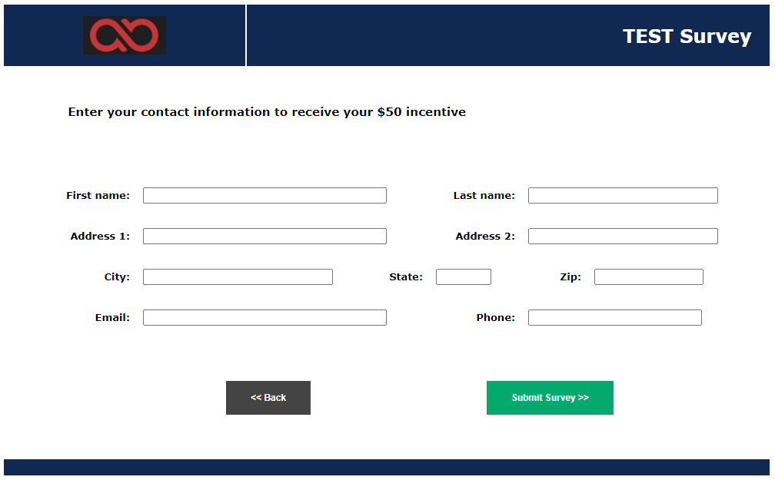
Focus order meaning – Non-Compliant

Slide 15
Focus order meaning – Compliant

Slide 16
Change Notify Form
WCAG 2.0 Requirement: 4.1.2
The page provides notification of each form-related change in content.
Why is it important?
When changes occur to the content the survey must -
Provides sufficient notification of the change
Provide adequate description of the change

Slide 17
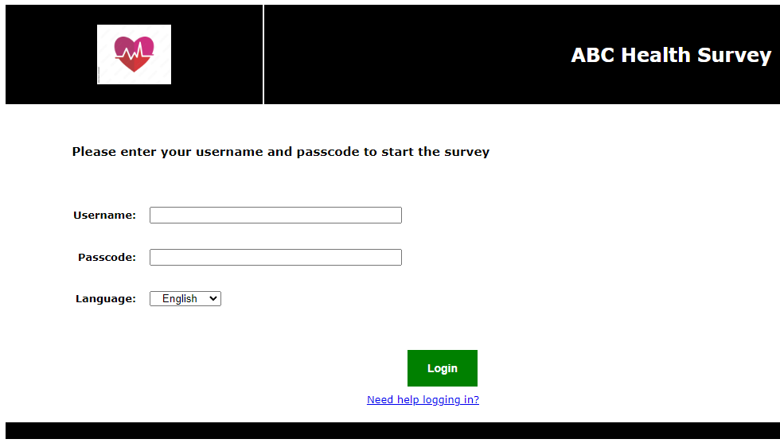
Change Notify Form

Slide 18
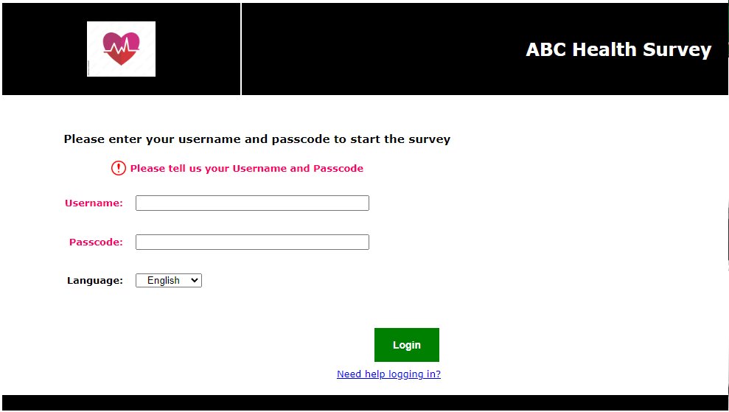
Change Notify Form–Non-Compliant

Slide 19
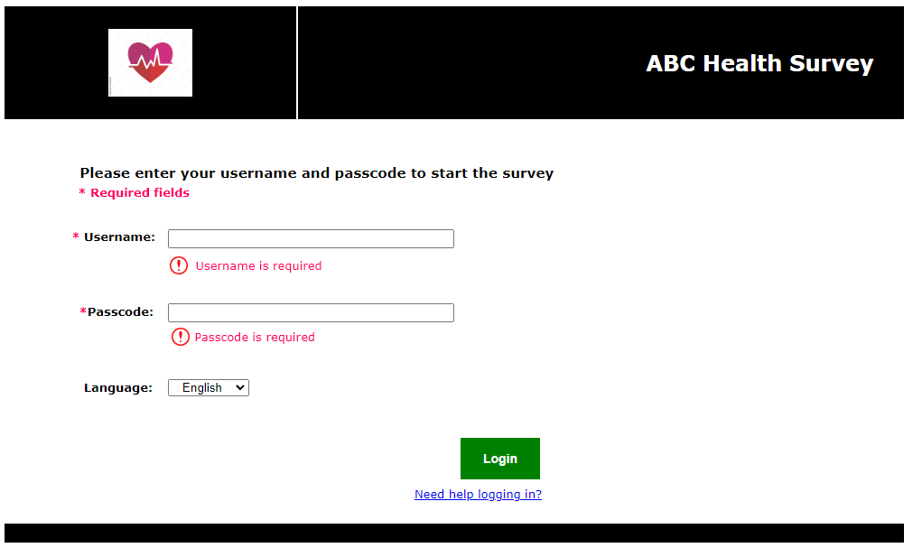
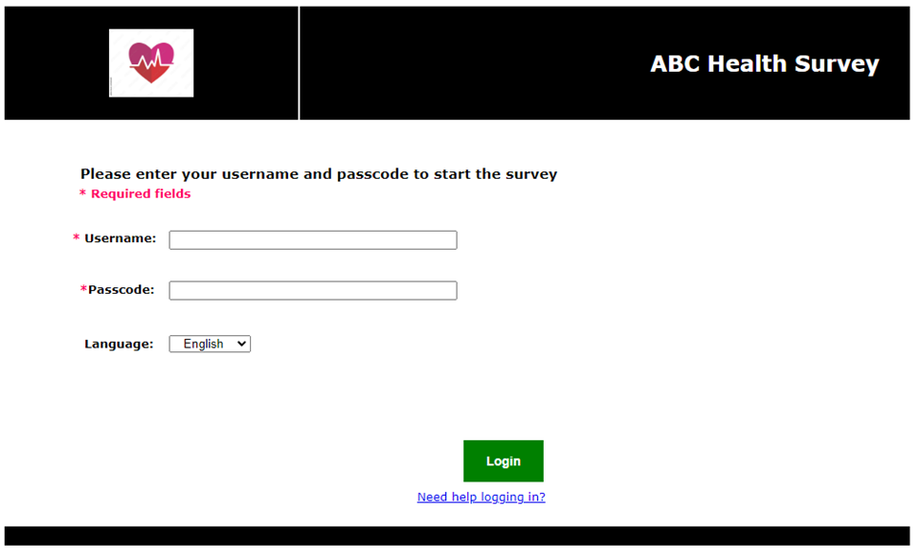
Change Notify Form–Compliant

Slide 20
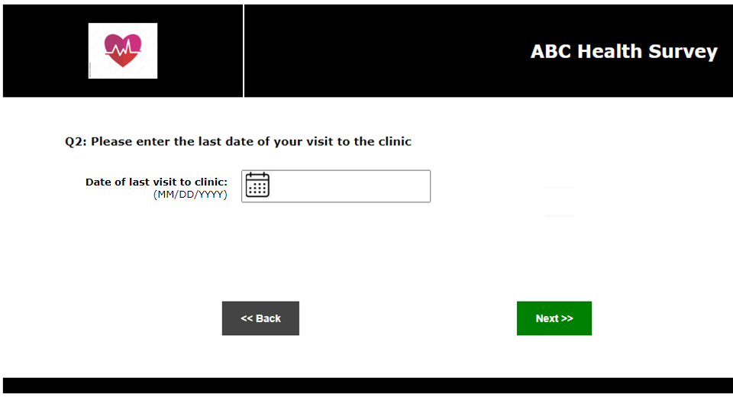
Change Notify Form

Slide 21
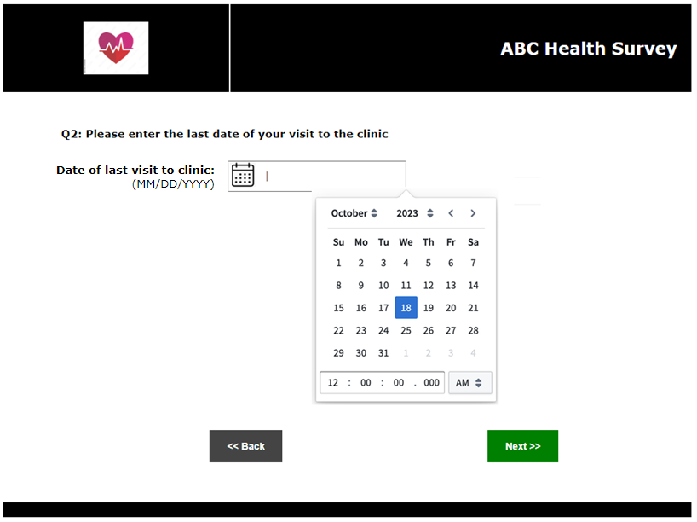
Change Notify Form– Non-Compliant
“Date of last visit to clinic”

Slide 22
Change Notify Form– Compliant
“Date of last visit to clinic
(Opens calendar)”

Slide 23
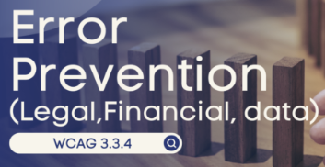
Non-Text Content
Error Prevention
WCAG 2.0 Requirement 3.3.4
The web page allows to the user to check, reverse, and or confirm submission. (Legal, Financial, Data)
Why is it important?
Preventing errors in the first place is better than detecting errors.
Providing safeguards to avoid serious consequences.

Slide 24
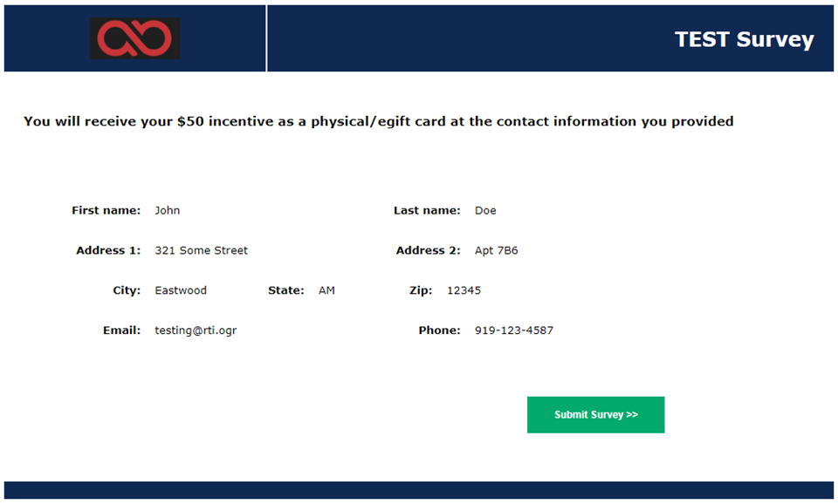
Error Prevention – Non-Compliant

Slide 25
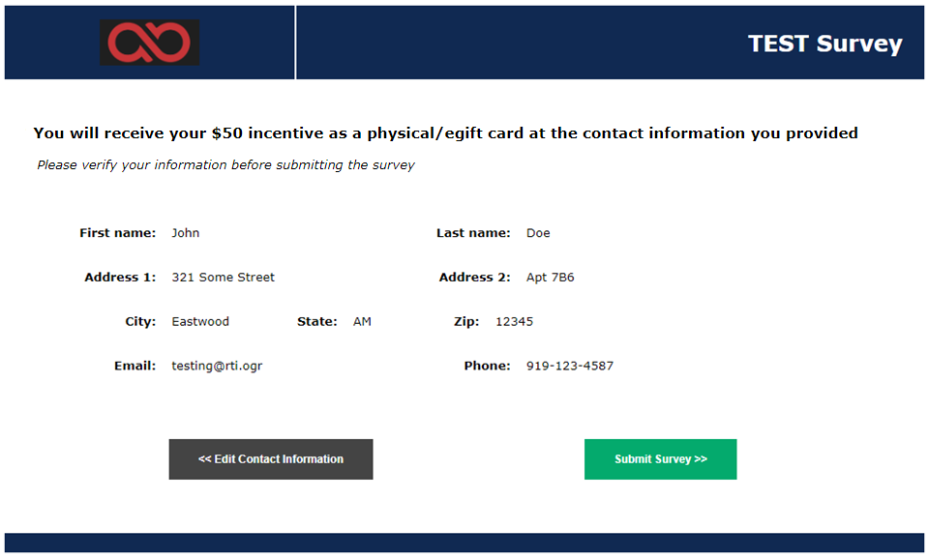
Error Prevention – Compliant

Slide 26
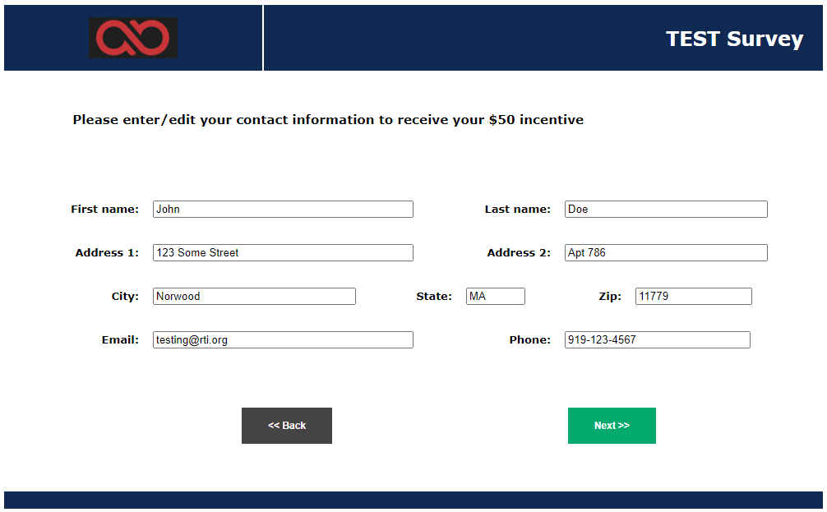
Error Prevention –Compliant

Slide 27
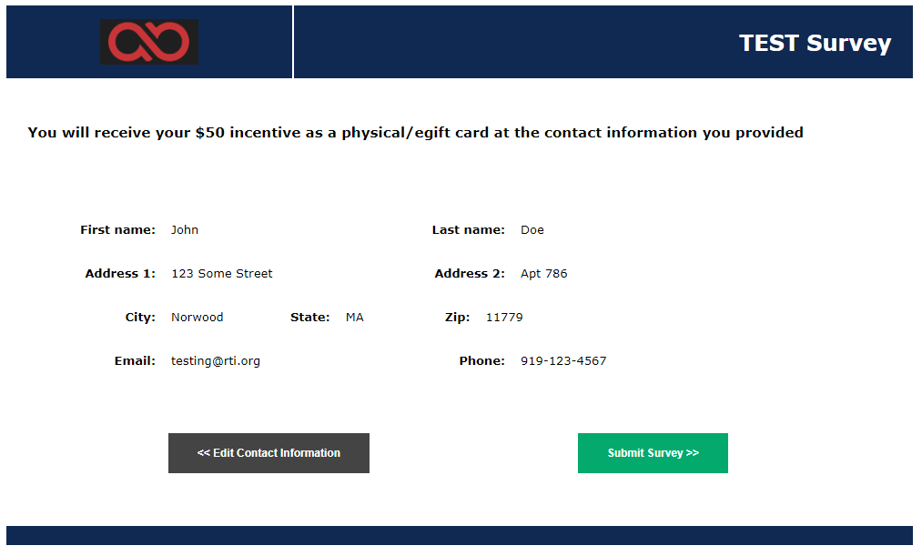
Error Prevention – Compliant

Slide 28
Conclusion
508 compliance is a law that requires all Federal electronic content to be accessible for everyone including people with disability.
The WCAG are the standards for web compliance which explains how to make web content accessible to people with disabilities.
Understanding and implementing web accessibility is more than a legal or ethical obligation.
Web Surveys with accessibility are essential in data collection and critical in decision-making.

Slide 29
Thank You!!
Thank You!
Gauri Dave
919-985-5682
gdave@rti.org
Neha Kshatriya
919-758-2878
nkshatriya@rti.org

