Slide 1



Designing post-submittal follow-ups for establishment surveys: NSF Higher Education Research and Development (HERD) Survey
FedCASIC, April 16, 2024
Kathryn Harper
ICF Project Director
Michael Gibbons
NSF/NCSES Survey Manager

Slide 2


Acknowledgements
Michael Gibbons, Survey Manager
Ronda Britt, Survey Manager
Jennifer Greer, Data Management Lead
David Greene and Vladimer Shioshvili, System Leads
Dara Pressley, User Experience
All the members of the HERD Survey Support team

Slide 3
About HERD Survey
Long-running annual census of a small population
Conducted annually since 1972 and a census since 1998.
U.S. universities and colleges that during the financial year:
granted a bachelor’s degree or higher,
had at least $150,000 in research and development expenditures, and
were separate campus headed by a president, chancellor, or equivalent.
Approximately 910 institutions and only 3% of institutions are newly qualified each year (5-year average).

Slide 4
About HERD Survey
Purpose-built web instrument
Web questionnaire and survey management system were built from scratch, not on a survey software.
Non-linear navigation.
No skip patterns.

Slide 5
About HERD Survey
Many program validations
Cross-question agreement: Every question has a relationship to another question that requires comparisons of values.
Trend checks: Most values are checked for large increase or decreases from previous year.

Slide 6
About HERD Survey
Institutions are highly-invested in data accuracy
Most values are published at the institution-level.
Institutions in the population and higher education analysts are frequent users of the data.

Slide 7
Key Design Goals
Follow-up questions displayed within the context of completed questionnaire.
Respondents can directly revise responses on questionnaire.
Submission review team can write highly tailored follow-ups.
Use the same design features respondents were familiar with.
Add Data Quality Issues (DQIs) to status table.
DQIs have same look and feel of programmed validations.

Slide 8
Respondent Experience
Receives e-mail from survey support that says we need help “clarifying or correcting” some items and directs respondent back to web questionnaire.
Accesses the web questionnaire as they normally would and finds DQIs added to the top of relevant questions.
In response to DQIs, corrects data, if needed, or provides additional information in included text box
Resubmits and receives e-mail confirmation.

Slide 9
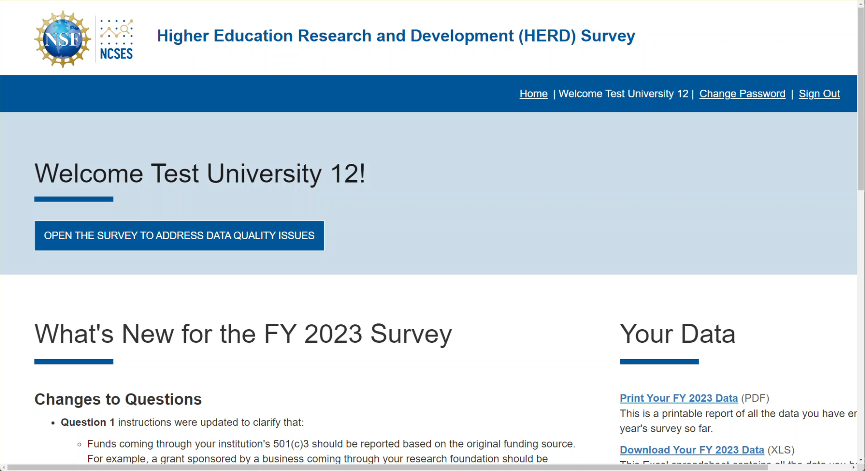
Respondent Experience - video

Slide 10
Reviewer Experience
Accesses the reviewer interface for a specific school from an assigned list on the survey management system.
Reviews submission based on guidelines and summarizes their assessment in comments. Reviewer interface includes:
Current year and last year’s data and any narratives provided by respondents
Measures of change from last year to this year
Highlights indicating which values were flagged as large increase or decreases on the web questionnaire
Writes DQIs, if needed.
Changes status to DQIs Written or Ready for Approval.
Monitors for responses to DQIs and re-reviews.

Slide 11
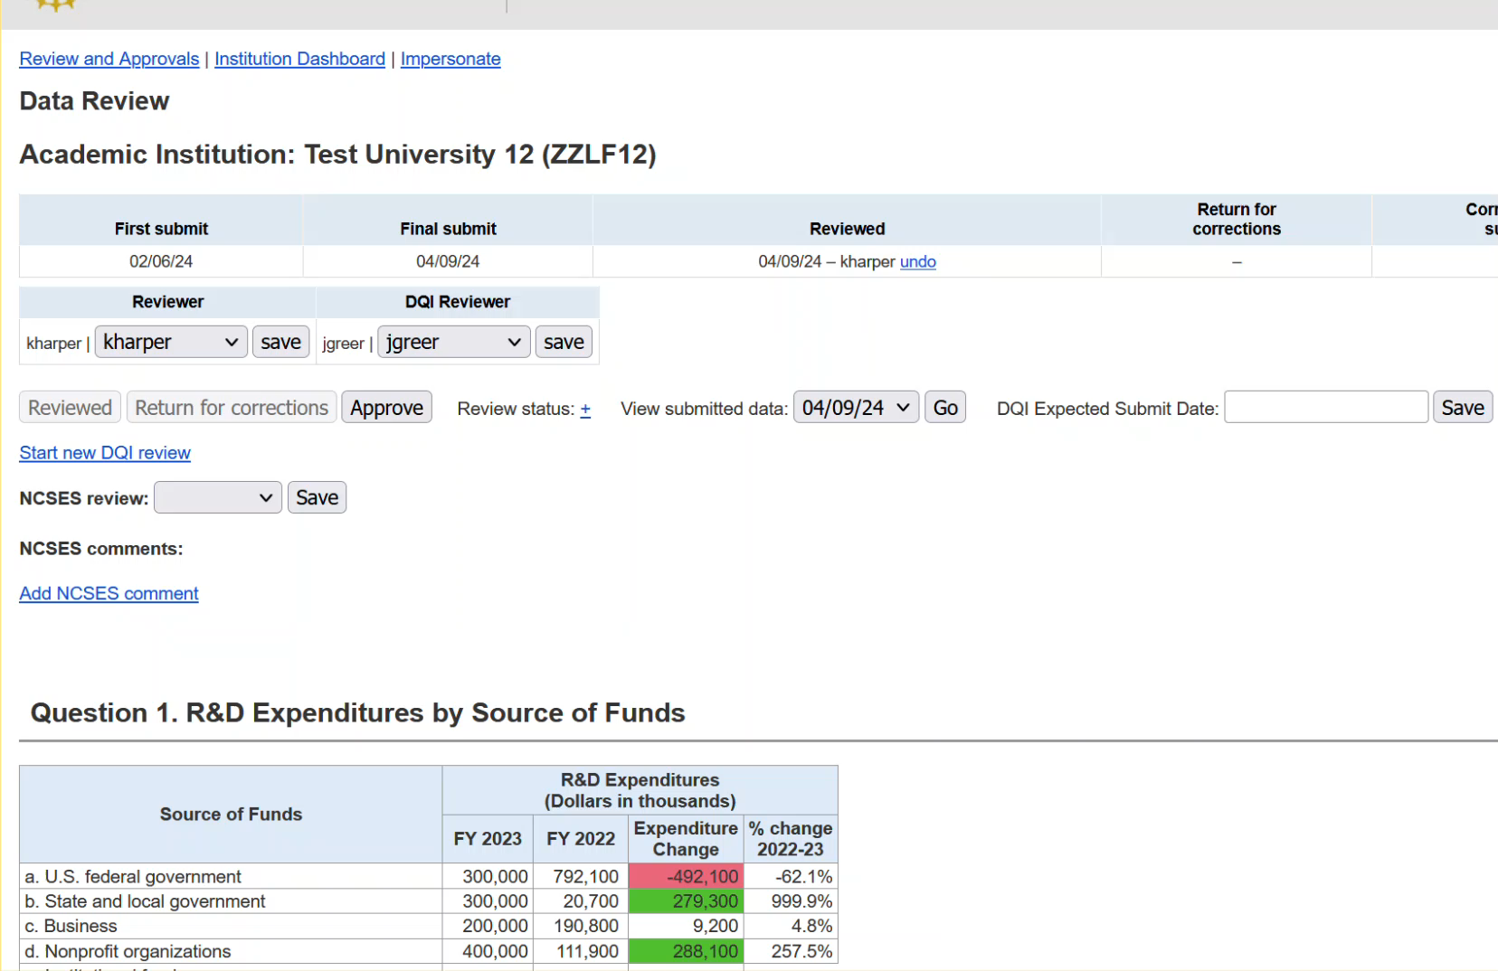
Reviewer Experience - video

Slide 12
Outcomes
Additional follow-ups after the first round of DQIs are rare.
Reduced data entry by survey staff and quality reviews of that data entry.
Easier monitoring of review team, which let us expand pool of trained reviewers.
Better paradata and metadata about follow-ups.
Positive feedback from respondents.

