Slide 1
Leveraging Technology for Survey Governance
FedCASIC 2024
Notes:
Customer experience (CX) is increasingly a priority for the federal government, as evidenced by the establishment of CX offices in many agencies. However, most CX organizations have limited resources and authority. When CX is a broad mandate, how does a small team drive change management and agency-wide adoption of CX practices? What is the role of survey technology in building customer experience capacity? In this presentation, members of the U.S. General Services Administration’s Office of Customer Experience will discuss how they have implemented enterprise survey governance as a first step toward more robust customer research practices.

Slide 2

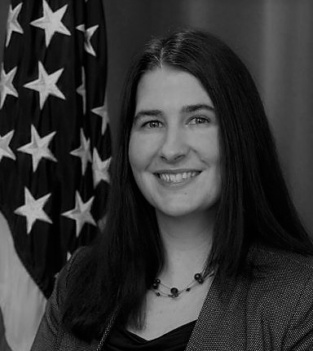
Today’s presenters
CAMILLE TUCKER
Acting Chief Customer Officer,
Voice of the Customer Program Mgr
Office of Customer Experience
U.S. General Services Administration
GENEVIEVE CHRISTENSEN
Data Analytics Specialist
Office of Customer Experience
U.S. General Services Administration

Slide 3
OCE’s mission is to improve the end-to-end experience of GSA customers by aligning operations to customer needs.
Notes:
Important because it gives us the authority to implement the governance system we’re going to talk about today
Support GSA offices

Slide 4
How GSA defines “customer”
Customer agencies
Suppliers
American public
GSA employees
Notes:
GSA takes a broad definition of “customer”, which is necessary because of the sheer number of different services we offer and functions that we fulfill. As a result, nearly all employees at our 12k person agency are customer-facing in some way, and all support customers, directly or indirectly.

Slide 5
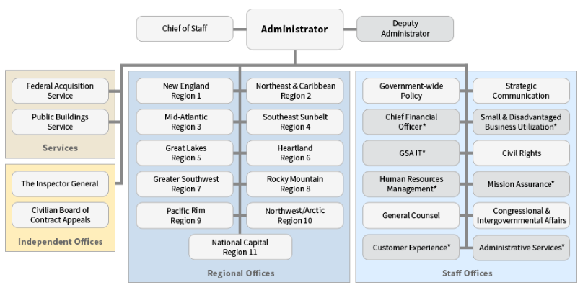
GSA’s Structure
Notes:
Diversity of mission areas, product and services offered, business models, service delivery
Office of the Administrator
Chief of Staff
Deputy Administrator
Federal Acquisition Service (FAS)
Public Buildings Service (PBS)
New England (Region 1)
Northeast & Caribbean (Region 2)
Mid-Atlantic (Region 3)
Southeast Sunbelt (Region 4)
Great Lakes (Region 5)
Heartland (Region 6)
Greater Southwest (Region 7)
Rocky Mountain (Region 8)
Pacific Rim (Region 9)
Northwest/Arctic (Region 10)
National Capital (Region 11)
Independent Organizations
Office of Inspector General (OIG)
Civilian Board of Contract Appeals (CBCA)
Staff Offices
Office of Administrative Services (OAS)
Office of the Chief Financial Officer (OCFO)
Office of Civil Rights (OCR)
Office of Congressional & Intergovernmental Affairs
Office of Customer Experience (OCE)
Office of General Counsel (OGC)
Office of GSA IT
Office of Government-wide Policy (OGP)
Office of Human Resources Management (OHRM)
Office of Mission Assurance (OMA)
Office of Small and Disadvantaged Business Utilization
Office of Strategic Communication (OSC)

Slide 6


Silos resulted in inconsistencies
FAS
OGP
PBS
GSA IT
OHRM
Notes:
Prior to 2015, GSA teams procured their own survey applications and distributed their own surveys. This resulted in:
inconsistent branding across surveys and information collections from the same organization (GSA)
inconsistency in the instruments themselves: different ways to ask the same questions, scale wording and order
lack of expertise in survey development leading to poorer quality instruments and therefore poorer quality data, or increased costs from leveraging contract support
over contacting customers: a lack of coordination across survey efforts meant that customers could be receiving multiple, sometimes very similar, surveys at the same time
budget inefficiencies and administrative burden from many small-scale, similar procurements

Slide 7
Value Proposition:
Establish the CX office to create consistency in branding and data, while increasing trust from respondents.
Notes:
The initial OCE team proposed:
Sunsetting all existing survey platform and support contracts.
Consolidating funding in order to procure a single, enterprise tool
Allocating the remaining funding for FTE to manage the contract, administer the tool, and support on other customer experience projects.
The value proposition used to establish the CX office was based in technology and surveys and would create consistency in branding and data, while increasing trust from respondents.

Slide 8
Challenge
How does a team of 5 that is responsible for managing customer research for 12,000 customer-facing employees get it done?
Notes:
Challenge: Survey administration with 100s of survey platform users and dozens of surveys per year

Slide 9
Solution
Technology-based survey governance.
Notes:
Our job is to support GSA team on customer focused initiatives. Conducting research, understanding research data, creating customer metrics, updating internal processes.

Slide 10
Putting it all together
1. Use surveys & technology to expand adoption of CX
2. Demonstrate value/expertise and understanding of internal partners
Notes:
There were 5 people on the initial team, supporting an agency of 12,000 mostly customer-facing employees, who were accustomed to sending out surveys on demand and conducting customer-related business the way it had always been done. Change management was essential to build a governance structure aimed at improving outcomes for customers.
Surveys and the survey platform were a natural starting point. GSA employees were familiar with surveys in both their personal and professional lives, as many of us are. And, surveys appear to be “easy”: people without formal training in research or statistics feel like they can write a series of multiple choice questions, send it out, and make some graphs with the results.
We leveraged this perception to say: “hey, you’ve identified a gap in your understanding of what your customer needs. We have this shiny new platform that you can use to do some customer research via a survey. Come work with us instead of doing it on your own, and we’ll make sure you get some really useful data.” And this worked. A more advanced technology tool with polished GSA branding drew teams to the Office of Customer Experience, and we built relationships and provided value through a “surveys +” approach.

Slide 11
Survey Governance
Talking Point
“I need customer research”
Discussion
Scoping Discussion
Methods
Surveys
Focus Groups
Customer Interviews
Walk-a-mile
Contextual Inquiry
Platforms
CXM
Google Forms
Processes
Survey Guidance & Process
License Management
TAM
Actions / Tools
Survey Approval Form
UAT Log
New User Orientation
User Recertification
Trackers / PM Tools
CXM Ticket Tracker
Survey Tracker
Surveys Shared Email Box
CXM License Tracker
Resource Tracking
Knowledge Bank
Notes:
Survey Governance
The 7 levels of survey governance in order of highest level to the most detailed.
Top Level: Talking point: “I need customer research”
Second Level: Discussion: Scoping Discussion
Third Level: Methods: Surveys, also focus groups, customer interviews, walk-a-mile, contextual inquiry
Fourth Level: Platforms: Customer Experience Management (CXM), also Google Forms
Fifth Level: Processes: Survey Guidance & Process, also License Management and Technical Account Manager (TAM)
Sixth Level: Actions / Tools: For Survey there is Survey Approval Form, User Acceptance Testing (UAT) Log. For License Management there is New User Orientation and User Recertification
Bottom Level: Trackers / Program Management Tools: For Survey Ticket Tracker, Survey Tracker, Survey Shared Email Box. For License Management there is the CXM License Tracker. For the TAM there is resource tracking and knowledge bank.
It’s important to call out the necessity of good processes when implementing governance. The technology piece is a great tool for implementation, but the technology should serve our business practices, not dictate the procedural infrastructure.

Slide 12
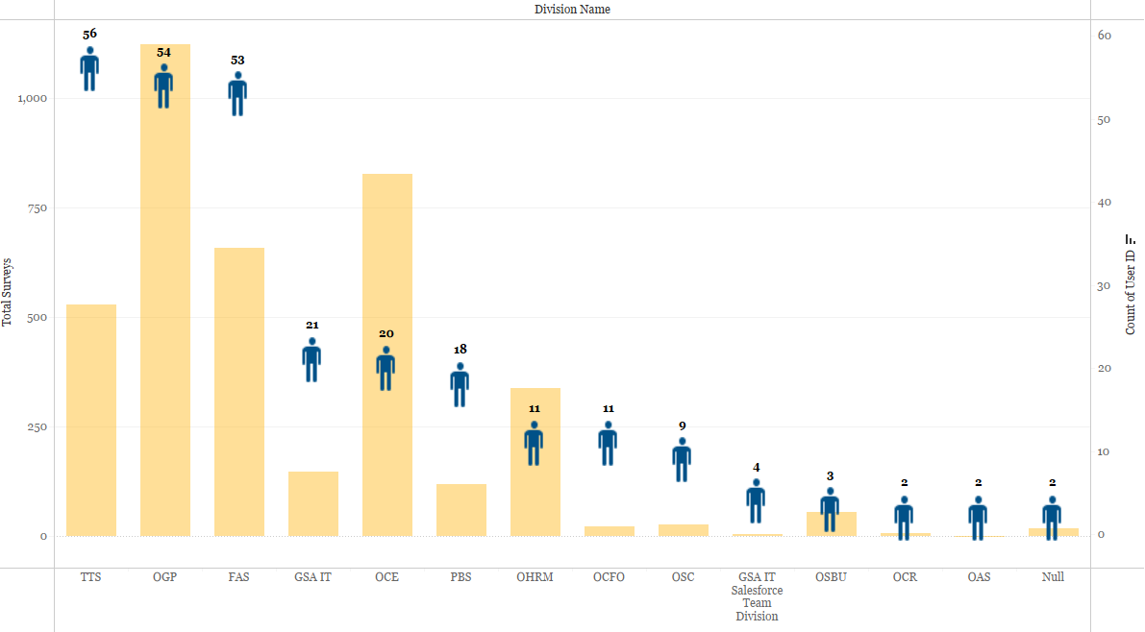
CXM use across GSA
Division Name | Users | Total Surveys
TTS | 56 | 528
OGP | 54 | 1,122
FAS | 53 | 657
GSA IT | 21 | 147
OCE | 20 | 827
PBS | 18 | 119
OHRM | 11 | 338
OCFO | 11 | 22
OSC | 9 | 26
GSA IT Salesforce | 4 | 4
OSBU | 3 | 55
OCR | 2 | 7
OAS | 2 | 0
null | 2 | 17
Notes:
*Excludes usage by a program conducting requests for Information (RFIs) on behalf of other agencies, which operates with our support, but within a separate governance structure.
Here’s how GSA is using it.
We can see that we have some teams with fewer surveys but large numbers of team members with licenses, some other teams

Slide 13
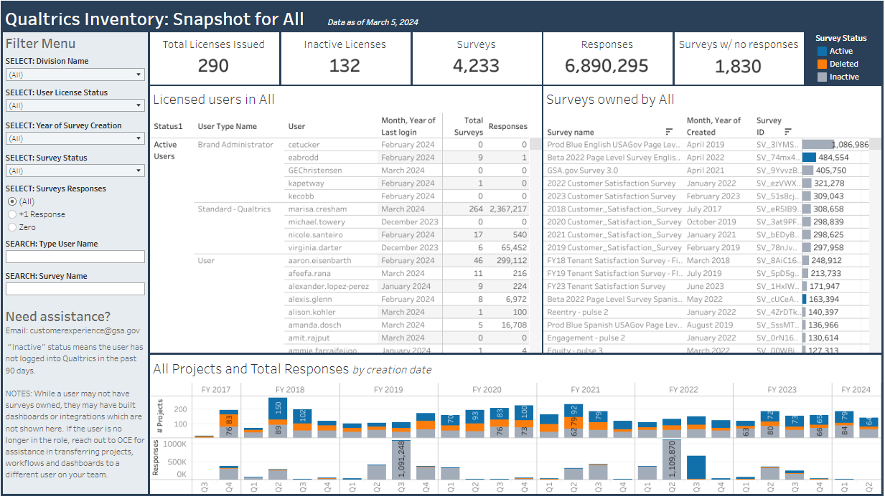
Survey Management
The Survey Inventory is published on D2D for use by GSA teams to:
Inventory snapshot
Identify users
List of surveys
Status of surveys & users
Response counts
Survey owner
Notes:
This inventory does not capture the survey questions nor specific responses. The survey owner is identified for any questions about the survey.
Current state:
How we do governance, challenges of survey primacy
Today, as our team and demand for our survey platform continue to grow, we leverage specific functionality to aid in governance:
- We have an agreement with our IT shop that members of our team are system admins, allowing us to manage license distribution and have access to all instruments and data in the platform.
Inventory,
License Management,
UAT: Step one: basic compliance
Step two: quality control– writing good surveys, getting useful data
Challenges:
When all you have is a hammer, everything looks like a nail
Surveys replace research questions and scoping as the entry point to the research process
Easy to make a bad survey, so people perceive surveys as easier and less time-consuming than other research methods
Too many uncoordinated surveys= unorganized, underutilized data

Slide 14
Looking forward:
How might we complement surveys with other forms of research?
Notes:
Office is growing–now 15FTE to support the enterprise. Expanding offerings into data usage, design, process improvement, capacity building.
Working backwards from survey request to research question, diverting to other research methods as appropriate
Data cataloging
Composite CX metrics incorporating multiple data types, not just survey results
Ongoing capacity building for survey platform users and agency as a whole

Slide 15



Customer research is more than a survey
Qualitative data
Customer quotes
Customer behavior
Customer understanding
A space, not a single point
Contextual data
Previous reports
Program history
Existing mandates
Quantitative data
Surveys
Operational data
Notes:
When we build our customer understanding, we try to leverage multiple types of data to “triangulate” what the customer needs. Right now, GSA is living heavily in the quantitative corner of the triangle. Through the survey inventory and other enterprise data management and knowledge sharing initiatives, we’re building capability to access and use contextual data. As we complement surveys with qualitative research, we hope to sort of fill out this triangle for more robust understanding that builds trust with our customers.

Slide 16
Thank you!
Email: customerexperience@gsa.gov

