Slide 1
Enhancements to TeleForm
Presenters and Authors:
Daniel Keever, RTI International
Ansu Koshy, RTI International
Maurice Martin, RTI International

Slide 2
Purpose of Presentation
Add features to the off-the-shelf TeleForm system
Meet client specifications
Improve data quality and management
Build with TeleForm’s COM Scripting API

Slide 3
Introduction to TeleForm
The TeleForm system is used to extract data from paper and electronic surveys. Key modules are:
Designer
Build the forms using TeleForm components
Scan Station
Scan paper surveys or read in electronic surveys
Reader
Evaluate the survey images
Verifier
Allow the operator to check and correct any information not evaluated with sufficient confidence level

Slide 4
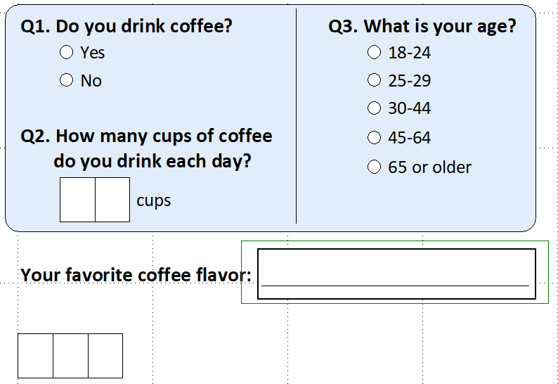
Introduction to TeleForm, Continued
Main data capture fields are:
Choice Field
Constrained
Print Field
Capture Zone

Slide 5
Challenge/Solution
Challenge - Client specifications out-of-scope for out-of-the-box TeleForm
Solution - Enhancements to the TeleForm system to meet client specifications and improve data quality and management

Slide 6
Enhancements
Too Many Marks
Produces a file which indicates the respondent answered a single response question with multiple responses
Audit Trail
Logs any changes of data during verification by an operator
Enhanced Verification
Checks all blank choice fields for data
Double Verification
Verifies the data with two operators for better data quality
Data Export
Exports to Comma-Delimited datasets or SQL tables. Can be encrypted

Slide 7
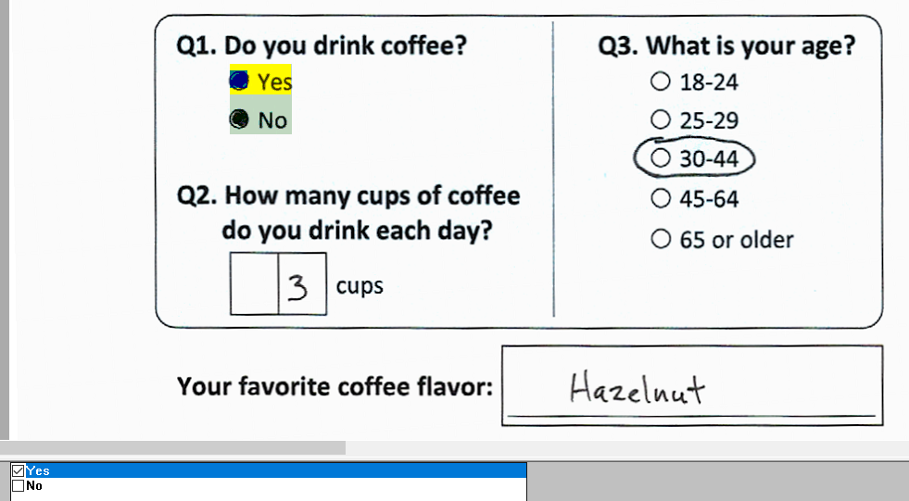
Too Many Marks -- Example
Quality

Slide 8
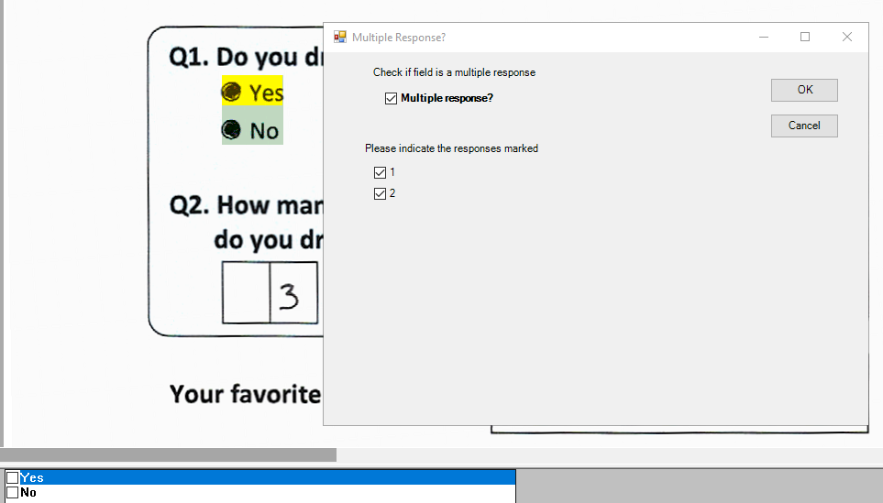
Too Many Marks -- Resolution
Quality

Slide 9
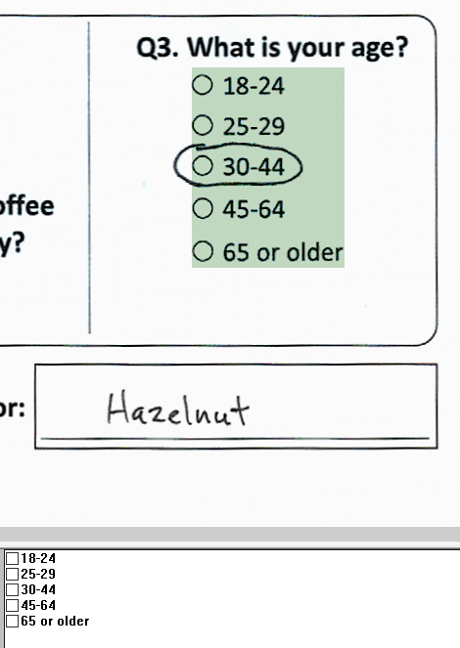
Enhanced Verification -- Example
Efficiency

Slide 10
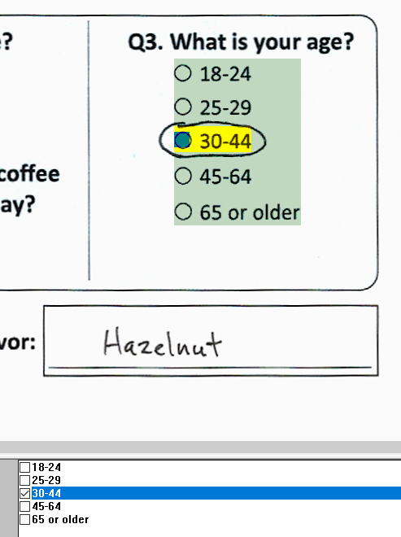
Enhanced Verification -- Resolution
Efficiency
Click all blank items?

Slide 11
Normal TeleForm Processing
Evaluated by the Reader
Verifier Operator Checks/Corrects the data
Data Exported
Scan Surveys

Slide 12
Double Verification - Extra Processing Steps for Data Quality
Evaluated by the Reader
Verifier Operator 1 Checks/Corrects the Data
Data Review
Data Exported
Scan Surveys
Operator 2 Re-Checks the Data

Slide 13
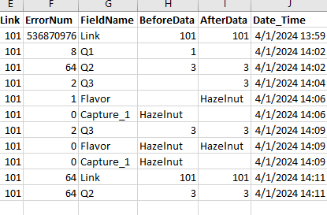
Audit Trail
Quality
Any changes of data made by the operator are logged
Too Many Marks
Enhanced Verification
Capture Zone

Slide 14
Other Useful Items
Quality
A Dataset for Each Operator
Created after their verification
Used for Error Reports
Pre-Verification Data
Reader

Slide 15
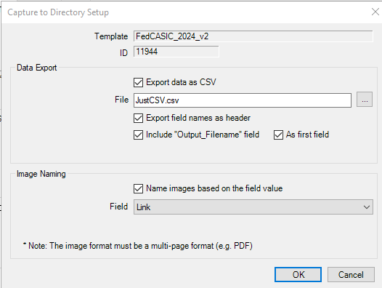
Common Data Export
Data Management

Slide 16
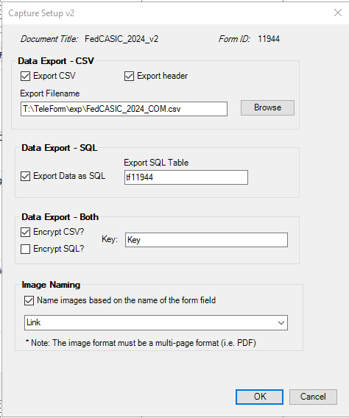
Enhanced Data Export
Data Management

Slide 17
Thank you
Contact: Daniel Keever email: dlk@rti.org
Ansu Koshy email: akoshy@rti.org
Maurice Martin email: mamartin@rti.org

