Slide 1
Automatically Mining Contact Information To Improve Survey Response Rates
Applications in the Quarterly Survey of Plant Capacity Utilization (QPC)
Jessica Huang, U.S. Census Bureau
Christian Moscardi, U.S. Census Bureau
Federal Computer Assisted Survey Information Collection (FedCASIC)
April 16, 2024
Notes:
DRB Clearance Number: CBDRB-FY24-0259
Cleared for Public Release

Slide 2
Disclaimers
This presentation is released to inform interested parties of ongoing research and to encourage discussion. Any views expressed are those of the author[s] and not those of the U.S. Census Bureau.
The Census Bureau has reviewed this data product to ensure appropriate access, use, and disclosure avoidance protection of the confidential source data (Disclosure Review Board (DRB) approval number: CBDRB-FY24-0259).
Notes:
The Census Bureau has reviewed this data product to ensure appropriate access, use, and disclosure avoidance protection of the confidential source data used to produce this product (Disclosure Review Board (DRB) approval number: CBDRB‑FY24‑0259).

Slide 3
Introduction: What is QPC?
The Quarterly Survey of Plant Capacity Utilization (QPC) is the only source for quarterly statistics on U.S. industrial plant capacity
A joint effort from the Federal Reserve Board (FRB), the Defense Logistics Agency (DLA), and the Census Bureau
Notes:
To introduce our case,
The federal reserve board for understanding capacity usage across different industries
The defense logistics agency for understanding what’s extra production is possible in times of emergency

Slide 4
Introduction: Response Rates
The QPC is not immune to declining response rates affecting nonresponse bias, data quality
2022Q1 Response Rate: 36.0%
In 2022Q1, for 24.3% of sampled businesses, QPC did not have email contact information
Of those, we observed a 1.6% response rate
Can we do better than a 1.6% response rate?
Notes:
The story of this project starts in 2022Q1

Slide 5
Introduction: QPC Communication Strategy
QPC is a voluntary survey
QPC Communication Strategy
Mail out physical letter & mail out email
Reminder email
ROBO calls
Follow-up email
Limited telephone follow-up
Notes:
Lots of QPC communication strategy relies on email contact information

Slide 6
Introduction: Email Contact Information is Important
Once a business registers online, most continue to check in and provide a quality response
The most drop-off occurs when businesses are asked to register in the online portal
Can we improve response rates by finding missing email contact information?
Survey Funnel
All Sampled Businesses*
Physical letter mailed out
Open browser
Type link into browser
Businesses that Register in the Online Portal
Businesses that Check In
Businesses that Provide a Quality Response
Click link to online portal
Email sent
24.3% of businesses do not have access to this low friction method of logging into the online portal
* Only ‘active’ businesses are eligible for response rate
Notes:
Here’s some extra context that drew my attention to the importance of emails
When a business doesn’t have an email in our database, it has downstream effects, they don’t have this low friction method of registering in the online portal, and it might be a contributor to extremely low response rates.

Slide 7
Project Goal 1: Proof of Concept for Mining Contact Information
Can we increase QPC response rates by gathering contact information?

Slide 8
Introduction: Where else could we find business email contact information?
Surveys for Businesses at the Census Bureau
Annual Survey of Manufactures (ASM)
Economic Census (EC)
Quarterly Survey of Plant Utilization
Annual Business Survey (ABS)
And more!
Manufacturers’ Shipments, Inventories, and Orders (M3)
At Census Bureau, QPC is just one business survey equipped with contact information
Challenges:
Contact information is siloed across survey specific databases
How do we choose among lots of possible emails? We could have lots of good contact information but which is actionable by QPC?

Slide 9
Methods: Manually Mining Contact Information
Collect contact information updates from any survey in one centralized location, in the Business Register.
Manually search through hundreds of emails. For each business missing contact information in QPC:
Search for any emails we have for that business across the Census Bureau
Manually decide on the most promising email (based on recency, survey comparability to QPC, contact title, establishments over enterprises, quality of the email entry, domain name)
Enter the new email into the QPC system for the next survey cycle.
Notes:
Another branch queried across survey specific databases to collect contact information insertions and changes
The QPC staff manually sorted through hundreds of emails

Slide 10
Results: Intervention Effects on Email Prevalence Rate
Email Prevalence = Number of Businesses for which QPC Does Have an Email / Number of Businesses
In 2022Q1, for 75.7% of sampled businesses, QPC did have email contact information
The contact information mining intervention added 450 new emails, significantly increased the email prevalence rate by 6.7 percentage points (p < 0.01)

Slide 11
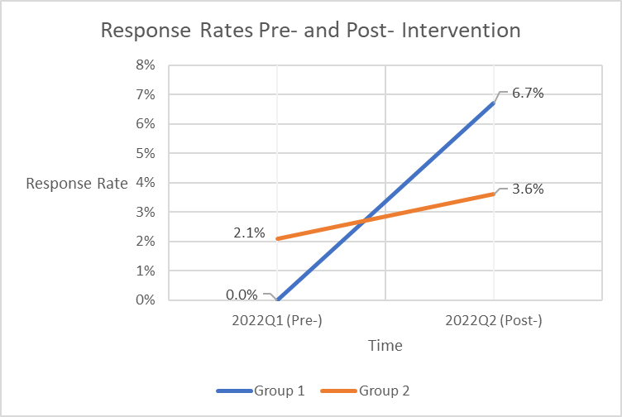
Results: Intervention Effects on Response Rate for Businesses without Contact Information in 2022Q1
Group 1 = 450 businesses with new emails
Group 2 = 1100 businesses without contact information in 2022Q1 and not in the intervention
The contact mining intervention increased response rate in group 1
Notes:
Explain context on this is the folks without emails
Method – there’s more to explore beyond our scope/ sample
If you had the magic dataset, would this 5.2% be possible

Slide 12
Discussion: Mining Contact Information
The data suggests mining contact information across Census Bureau survey could be a powerful tool to increase response rate
Barriers to Continued Usage
Time intensive
Effort intensive
Is not very scalable
Potential Solution: Automation
Notes:
5.2 percentage points (a promising change compared to our initiall 1.6% response rate)

Slide 13
Project Goal 2: Tool Development of Automated Contact Mining
Can we build automated contact mining that effectively replicates manual efforts?

Slide 14
Introduction: Automatically Mining Contact Information
Benefits of Automation
Saves manual work/ time
Can be more systematic/ less error prone
Is scalable to many businesses and surveys
Challenges of Automation
Can it replicate the manual process of mining contact information?

Slide 15
Methods: Automated Contact Mining Design
Analyst Local Machine
StEPS II Interface
QPC contact information
Simplicity: no regressions, just ranked preferences (based on recency, survey comparability to QPC, establishments over enterprises, quality of the email entry)
Inexpensive: when possible, we use open-source Python over SAS
Ease of Use: integrated into existing analyst software (StEPS II)
Reasonable: we build in contact information sanity checks
Visibility: every step generates outputs that the analysts can verify and intervene as needed
Effectiveness: replicate the decision making of the analyst
Business Register
ASM contact information
EC contact information
And more!
M3 contact information
Notes:
Sanity checks – email contains key words from the contact name, company name, company city

Slide 16
Methods: Automated Contact Mining Evaluation
Backtest automated contact mining to 2022Q1 pre-intervention versions of QPC contact information, of Census contact information
Compare and contrast the email contact information found by the manual method and the automated method
Emails Found by Manual Method
Emails Found by Automated Match
Notes:
Sanity checks – email contains key words from the contact name, company name, company city

Slide 17
Results: Automated Contact Mining
*rounded child values don’t add to parent values due to disclosure avoidance policy procedures
Emails found by Manual Method
Emails found by Automated Method
The automated method found many of the emails found by the manual method
The automated mining finds a match for 450* of the 470* manually mined cases (96%)
The automated method exactly replicated the manual method in 400* of 450* cases (91%)
The automated method found 150* extra emails, these extra cases were validated by survey staff (32% more)
Ongoing challenge: it's not easy to translate a human process into an automated program
20*
businesses
450*
businesses
150*
businesses
Automated Method Email = Manual Method Email
400* businesses
Automated Method Email ≠ Manual Method Email
40* businesses
Notes:
- nana used to say to carla what are you trying to say, now write that, make it match
- Carla big picture – high level, step back and remove the tangents and move to the appendix, who are your stakeholders, statisticians who are working on a survey at BLS, email addresses for contacting businesses, we are taking advantage of data that are already available.
- do you need the percentages
- have you validated the 150? Put that down, that’s important and counts

Slide 18
Discussion: Automated Contact Mining
The automated contact mining promisingly replicates manual efforts in mining emails across Census.
Automated contact mining is accurate, systematic, inexpensive, scalable
Implementation Challenge: With this powerful tool despite minimal resources, how often should we contact mine?

Slide 19
Conclusion
Our findings suggests that finding emails for businesses could be a powerful tool to increase response rates
We’ve built an automated tool for finding emails that effectively replicates manual efforts
Future investigations
How often should we mine contact information?
How do we make automated contact mining user friendly?
What other surveys across Census could benefit from this work? How could we generally strategize about reducing siloed contact information at Census?

Slide 20
Acknowledgements
Shalise Ayromloo, U.S. Census Bureau
Mary Susan Bucci, U.S. Census Bureau
Stephen Cox, U.S. Census Bureau
Christina Gouvatsos, U.S. Census Bureau
Carla Medalia, U.S. Census Bureau
Thong Minh Nguyen, U.S. Census Bureau

Slide 21
Questions or Ideas?
jessica.l.huang@census.gov
Notes:
Practice a couple times, be under the 15 minutes, make it smooth for kevin

