Slide 1

Efficacy Testing a Game to Educate and Collect Census Data
Peter Leveille
Zue Lopez Diaz
April 16, 2024
© 2024 THE MITRE CORPORATION. ALL RIGHTS RESERVED. Approved for Public Release; Distribution Unlimited. Public Release Case Number 24-1075.

Slide 2
What is the issue?
Census nonresponse rates are rising, and evidence shows that the increase has averaged around 0.5 percentage points each year since the mid-1990s.¹
Hard to Persuade: People who are not motivated to complete the census, often for a variety of reasons including:
  Distrust of the government
  Believe there is no value in the census results impacting their community
  Confusion on how to answer the questions being asked
Systems of inequality for communities of color and people living in poverty engender attitudes of suspicion in some communities towards government projects such as the decennial census.²
© 2024 THE MITRE CORPORATION. ALL RIGHTS RESERVED. Approved for Public Release; Distribution Unlimited. Public Release Case Number 24-1075.

Slide 3
Why use a Game?
Effective education tools
  In-game education can alleviate issues with distrust and value
  Game tutorial style inputs can aid alleviate confusion
© 2024 THE MITRE CORPORATION. ALL RIGHTS RESERVED. Approved for Public Release; Distribution Unlimited. Public Release Case Number 24-1075.

Slide 4
Why use a Game?
Effective education tools
  In-game education can alleviate issues with distrust and value
  Game tutorial style inputs can aid alleviate confusion
Reduce stress & anxiety
© 2024 THE MITRE CORPORATION. ALL RIGHTS RESERVED. Approved for Public Release; Distribution Unlimited. Public Release Case Number 24-1075.

Slide 5
Why use a Game?
Effective education tools
  In-game education can alleviate issues with distrust and value
  Game tutorial style inputs can aid alleviate confusion
Reduce stress & anxiety
Motivation
  In-game goals can motivate completion
© 2024 THE MITRE CORPORATION. ALL RIGHTS RESERVED. Approved for Public Release; Distribution Unlimited. Public Release Case Number 24-1075.

Slide 6
Why use a Game?
Effective education tools
  In-game education can alleviate issues with distrust and value
  Game tutorial style inputs can aid alleviate confusion
Reduce stress & anxiety
Motivation
  In-game goals can motivate completion
Immersion
  Keep participants focused on task
© 2024 THE MITRE CORPORATION. ALL RIGHTS RESERVED. Approved for Public Release; Distribution Unlimited. Public Release Case Number 24-1075.

Slide 7
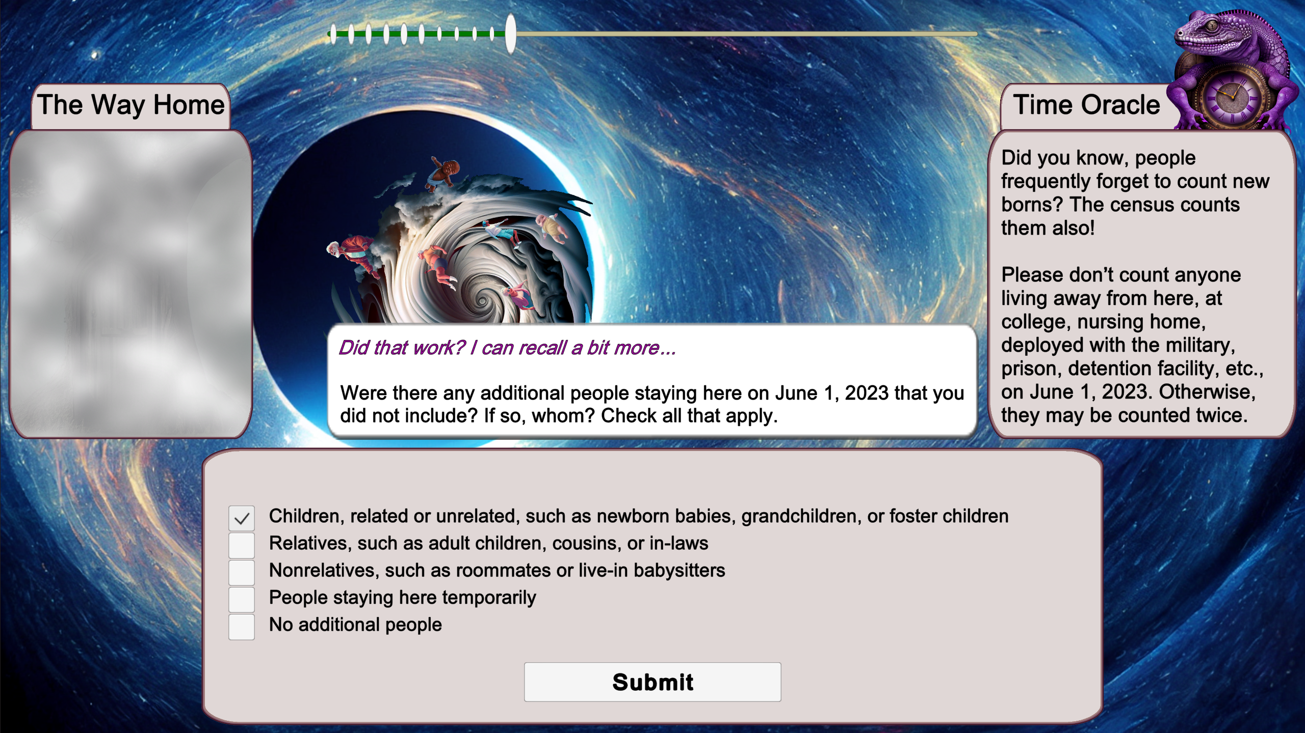
What did the experiment look like?
© 2024 THE MITRE CORPORATION. ALL RIGHTS RESERVED. Approved for Public Release; Distribution Unlimited. Public Release Case Number 24-1075.

Slide 8
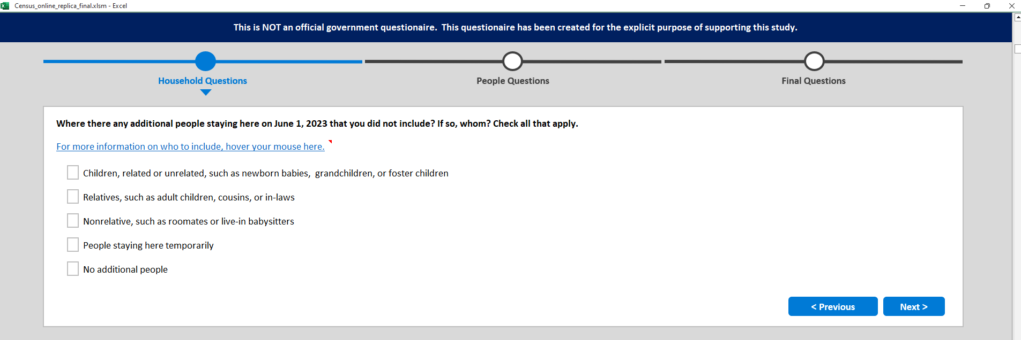
What did the experiment look like?
© 2024 THE MITRE CORPORATION. ALL RIGHTS RESERVED. Approved for Public Release; Distribution Unlimited. Public Release Case Number 24-1075.

Slide 9
How did we conduct the study?
Hard-to-count neighborhoods were identified in Northern Virginia, Washington DC, and Baltimore using the 2020 census map.³
Guerilla recruiting of participants in community centers
  Fluent in English, 18 or older
  $10 gift card for participation
Randomly assigned to one of the two treatments
Resulting PII was scored and wiped
© 2024 THE MITRE CORPORATION. ALL RIGHTS RESERVED. Approved for Public Release; Distribution Unlimited. Public Release Case Number 24-1075.
Notes:
68% self-response rate or lower

Slide 10
What were the results?
Valid information provided on the home
© 2024 THE MITRE CORPORATION. ALL RIGHTS RESERVED. Approved for Public Release; Distribution Unlimited. Public Release Case Number 24-1075.

Slide 11
What were the results?
Valid information provided on the home
Valid information provided on self
© 2024 THE MITRE CORPORATION. ALL RIGHTS RESERVED. Approved for Public Release; Distribution Unlimited. Public Release Case Number 24-1075.

Slide 12
What were the results?
Valid information provided on the home
Valid information provided on self
Valid information provided on others in the home
© 2024 THE MITRE CORPORATION. ALL RIGHTS RESERVED. Approved for Public Release; Distribution Unlimited. Public Release Case Number 24-1075.

Slide 13
What were the results? (cont.)
Provided information through the last reported person
© 2024 THE MITRE CORPORATION. ALL RIGHTS RESERVED. Approved for Public Release; Distribution Unlimited. Public Release Case Number 24-1075.

Slide 14
What were the results? (cont.)
Provided information through the last reported person
Did the Time Oracle help people remember additional people in the household
© 2024 THE MITRE CORPORATION. ALL RIGHTS RESERVED. Approved for Public Release; Distribution Unlimited. Public Release Case Number 24-1075.

Slide 15
What were the results? (cont.)
Provided information through the last reported person
Did the Time Oracle help people remember additional people in the household
I preferred the game to filling out the Census, it kept me engaged. I am one of those where they always come knocking at my door. It made me want to fill it out correctly. – Summary of one person’s comments.
© 2024 THE MITRE CORPORATION. ALL RIGHTS RESERVED. Approved for Public Release; Distribution Unlimited. Public Release Case Number 24-1075.

Slide 16
Acknowledgements
Funding: The MITRE Independent Research and Development Program
Thank You to MITRE colleagues: Alison Dingwall, Laila Handoo, Laura Leets, Aidan Buffum, Adam Edwards, Chris Spivey, Rich Stevenson, Caleb Calomarde, Shipra Kanjlia, Erika De Los Santos, Justin Brunelle, David Mendonça, and Christina Basis.
Special Appreciation: to the Georgetown Institute on Poverty and Inequality Jae June Lee, Kim Herbert, Natalia Cooper, and Aileen Carr from for their contributions and partnership
© 2024 THE MITRE CORPORATION. ALL RIGHTS RESERVED. Approved for Public Release; Distribution Unlimited. Public Release Case Number 24-1075.

Slide 17
Thank You
Peter Leveille
psl@mitre.org
Zue Lopez Diaz
zlopezdiaz@mitre.org
© 2024 THE MITRE CORPORATION. ALL RIGHTS RESERVED. Approved for Public Release; Distribution Unlimited. Public Release Case Number 24-1075.

Slide 18
Footnotes
Groves, Robert M. 2006. "Nonresponse Rates and Nonresponse Bias in Household Surveys." Public Opinion Quarterly 646-675. https://academic.oup.com/poq/article-abstract/70/5/646/4084443?redirectedFrom=fulltext.
U.S. Census Bureau. 2016. Final Report: National Advisory Committee on Racial, Ethnic, and Other Populations. Administrative Records, Internet, and Hard to Count Population Working Group .
CUNY Mapping Service at the Center for Urban Research. 2020. HTC 2020. Accessed 2023. https://www.censushardtocountmaps2020.us/?latlng=40.00000%2C-98.09000&z=4&promotedfeaturetype=states&baselayerstate=3&rtrYear=sR2020latest&infotab=info-rtrselfresponse&filterQuery=false.
© 2024 THE MITRE CORPORATION. ALL RIGHTS RESERVED. Approved for Public Release; Distribution Unlimited. Public Release Case Number 24-1075.

