Slide 1
Would you prefer to contact them, or shall we? Working with organizational gatekeepers to invite group quarters residents to respond to an online questionnaire.
Alfred “Dave” Tuttle, U.S. Census Bureau
Federal Computer Assisted Survey Information Collection (FedCASIC) Workshop
April 16, 2024
Any views expressed are those of the author and not those of the U.S. Census Bureau.
CBDRB-FY24-CBSM002-048

Slide 2
Background
Group quarters (GQs) are places where people live or stay in a group living arrangement provided by an organization.
  University student housing, military quarters, worker dormitories, etc.
GQ residents are sampled by some Census Bureau surveys (certain GQ types) and enumerated by the decennial census.
GQ residents’ data are collected various ways, such as:
  In-person interviews
  Paper questionnaires
  Records-based proxy response by GQ organizations

Slide 3
New idea – GQ resident web questionnaire
Can we create an option for residents of GQs to respond through an electronic questionnaire?
Benefits:
  Enable GQ residents to provide their own data conveniently
  Improve efficiency and reduce cost of data collection
  Collect more-complete responses than records-based proxy response
Challenge:
  Coordination with GQ administrators to facilitate residents’ access to the instrument

Slide 4
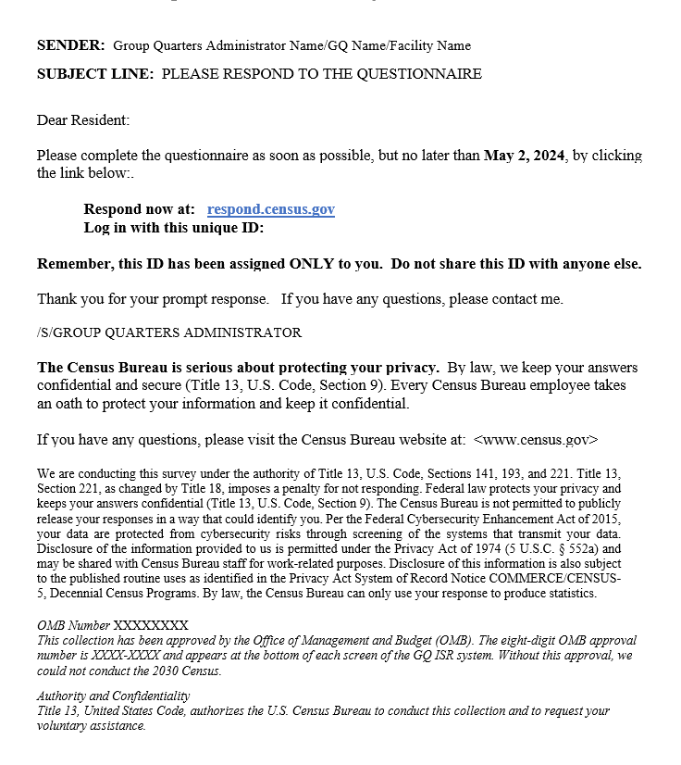
How would it work?
GQ residents would receive email invitations with a URL and login ID
ABCSAND123S

Slide 5
How would it work for GQ administrators?
GQ administrators would either:
Provide residents’ contact info so Census Bureau can email residents directly, or
Create and distribute emails to residents themselves
Administrator Dashboard would enable GQ admins to facilitate residents’ access to the web questionnaire.

Slide 6
Wireframe usability interviews
Usability interviews to test wireframe mockups of Administrator Dashboard
  7 administrators from GQ organizations across the U.S. – universities, religious quarters, workers’ quarters
  Most were virtual (Teams) interviews, one was in-person.
  Participants were recruited by email using frame contact data.
Goals:
  Get feedback on email invitations/web questionnaire concept
  Evaluate draft screens prior to development of a prototype
  Identify needed functionality

Slide 7
Research questions
What do GQ administrators think about:
The feasibility of contacting GQ residents by email to complete a web questionnaire?
The tasks they (administrators) would be asked to perform, and how would they carry them out?

Slide 8
GQ administrators’ opinions about web questionnaire and email invitations for residents
Most thought it is a good idea and saw advantages:
  Allowing residents to respond for themselves easily
  Collecting more-complete data
  Younger GQ residents are:
    Comfortable with online forms
    More likely to respond to email with a link
  “Their email address is something simple [to provide], and if they can click on a link and go to it, it'll definitely be the easiest for them.”
CBDRB-FY24-CBSM002-048

Slide 9
Experience with surveys of GQ residents
GQ admins had ideas about optimal strategies and anticipated challenges:
  Communicating with residents through various channels – Email, in-person outreach by local staff, etc.
  Motivating and assisting
  Identifying nonrespondents to target for reminders
  “I would send out an email and say, hey, the Census Bureau is about to send you an email with a survey. We would like 100% completion because by doing so you provide resources to our community.”
  “I would have to engage folks who work more directly with the students… following up with students individually so it's more personable and not just an email from somebody they've never heard from.”
CBDRB-FY24-CBSM002-048

Slide 10
Challenges for universities
University students’ contact information is protected by the Family Educational Rights and Privacy Act (FERPA).
  “Our students are given the option to have confidential records... So it's possible, even using this method, I wouldn't be able to give you the full list of our residents.”
  “Around a quarter of our students opted out of directory information [sharing].”
Concerns about time and effort required to follow up with nonrespondents:
  “I think it just depends on my workload, how feasible it would be… It might be easier to let the students complete their own form, and at the same time… there may be more follow-up that needs to be done… So it might be more efficient and easier for me to provide all the data.”
CBDRB-FY24-CBSM002-048

Slide 11
GQ administrators’ opinions about expected tasks, and their processes for sending invitations and identifying nonrespondents
Option 1 – GQ administrators provide residents’ names and email addresses to the Census Bureau.
Option 2 – GQ administrators distribute emails themselves.

Slide 12
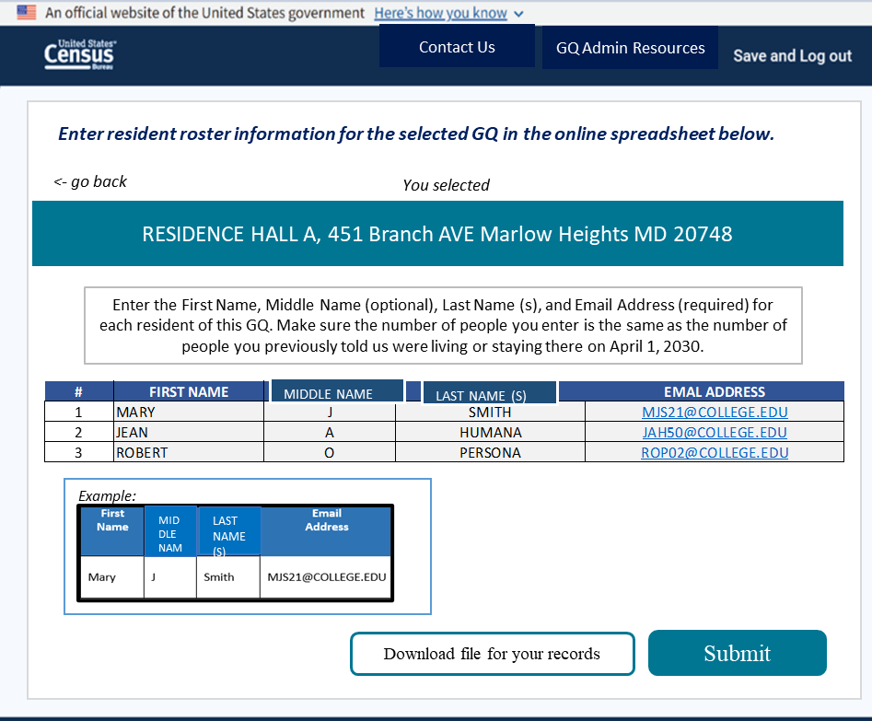
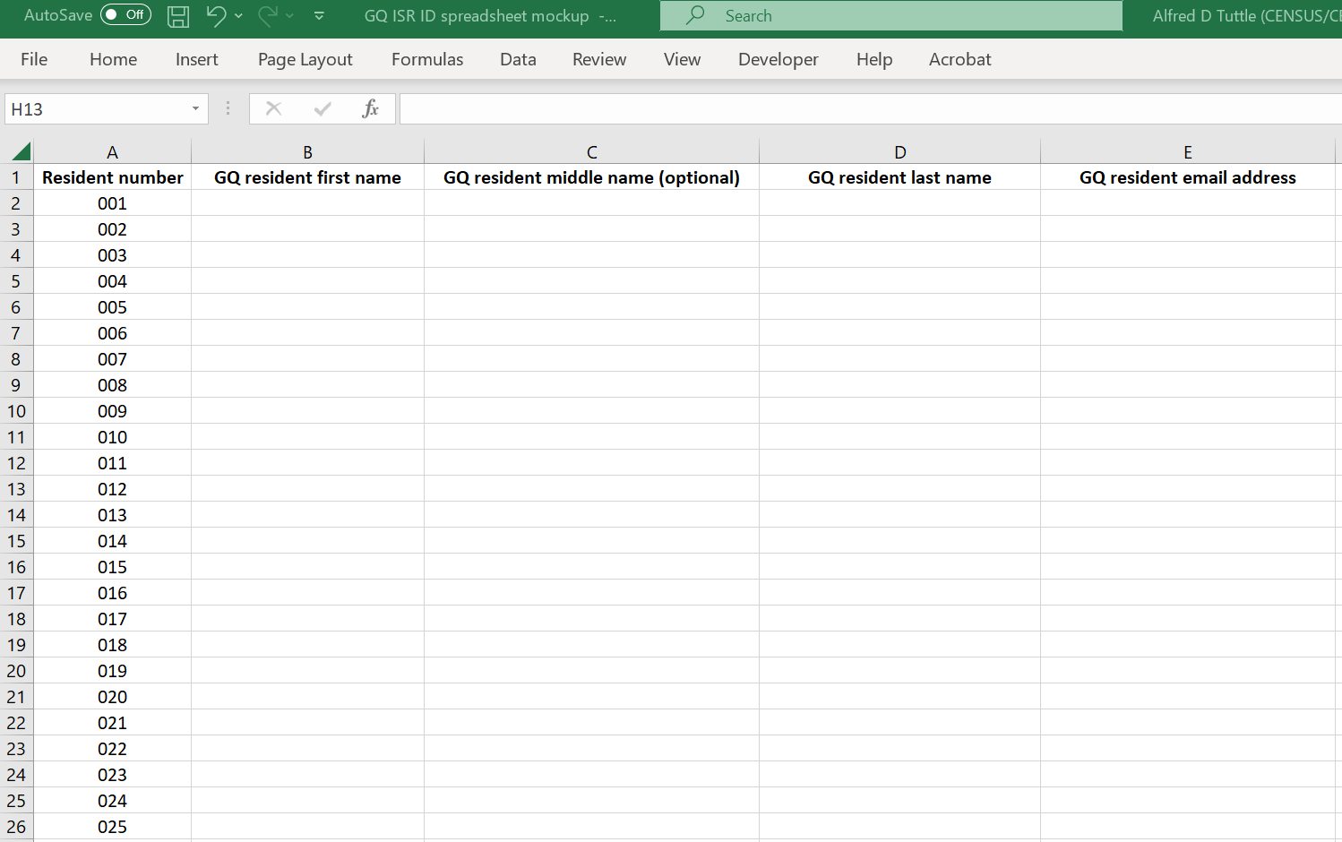
Option 1 – Provide residents’ contact info to the Census Bureau using a web-based spreadsheet or an Excel template
27 Enter roster in online spreadsheet

Slide 13
Providing GQ residents’ contact information
Most administrators had no concerns about sharing residents’ info:
  “Because you're a federal agency asking for this information for administrative purposes, we would give you that information. That's totally appropriate.”
Contact info would typically be exported from a database or existing document and copied into the Excel template:
  “I create reports in Access which can be downloaded in Excel spreadsheets, so I would just copy the format that you guys have and just cut and paste it.”
CBDRB-FY24-CBSM002-048

Slide 14
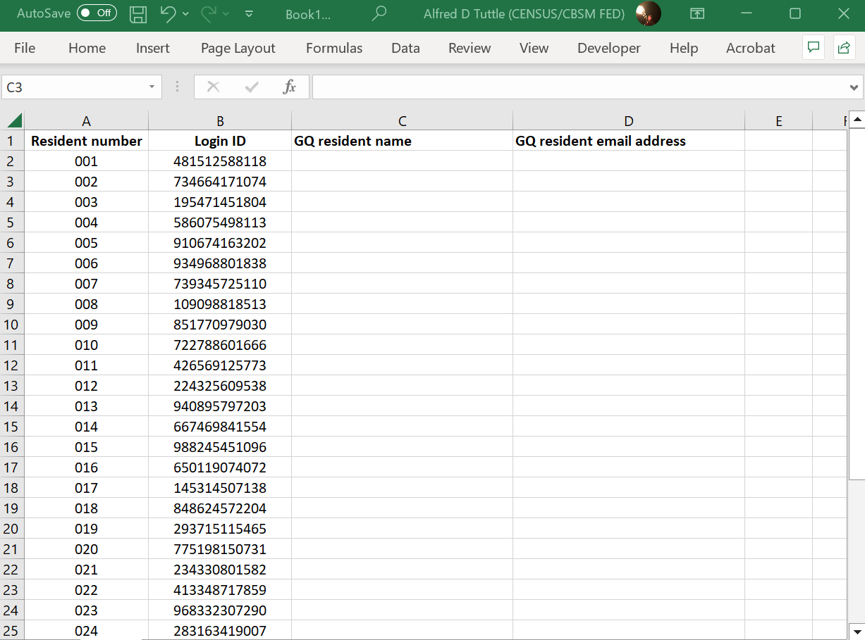
Option 2, step 1
Download Excel spreadsheet containing unique login IDs for email distribution
Enter residents’ names and email addresses to assign login IDs

Slide 15
Option 2, step 2
Download an email template
Populate emails with unique login IDs for specific individuals, and send them

Slide 16
Creating and sending emails
Administrators described various methods for sending login info by email:
  Manually creating and sending individual emails
  Automated methods for sending bulk emails
    Microsoft Word mail merge
    In-house email system

Slide 17
Creating and sending emails manually
Some administrators said they might have to manually copy/paste text from the template and information specific to each recipient into emails one at a time.
Concerns about time involved, chances for error:
  “If I'm doing it three hundred times, I'm spending a week doing this work, instead of running a campus. That becomes very complicated, the bigger the student population is. And I still think there's room for errors, even with cutting and pasting… There's a lot that I'm doing that I could very easily make a mistake on.”
CBDRB-FY24-CBSM002-048

Slide 18
Microsoft Word mail merge
Some administrators would create an email template in Word and use mail merge to populate it with person-specific information based on the spreadsheet containing login IDs and contact information:
  “I would do it in Word and use the merge wizard. You already have a sample instruction letter and reminder letter written, so that part you'd save time on. So you'd just copy and paste it into a Word document and add your fields with your data and do the merge.”
<<LoginID>>
CBDRB-FY24-CBSM002-048

Slide 19
In-house email systems
Some university administrators referred to sophisticated systems used for communicating with students, including StarRez and Salesforce:
  “We have a system called StarRez, they use it to manage (housing) contracts, and so I can query the system for a list of students by residence hall, and I can also send emails through that.”
CBDRB-FY24-CBSM002-048

Slide 20
Excel template
GQ administrators indicated that spreadsheets with login info would be easy to use to automate the creation and distribution of invitation emails.
  “This is pretty easy to automate out of… We've got our login IDs, our resident name and the targeted email address, so I've got everything I need to generate an email.”
CBDRB-FY24-CBSM002-048

Slide 21
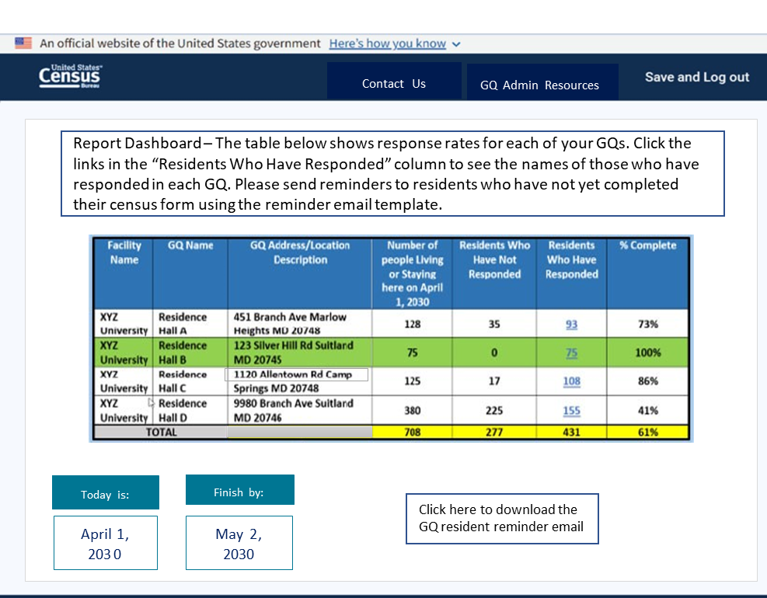
Report Dashboard
Option 1 or 2 – GQ administrators would use the Report Dashboard to monitor response rates for specific GQs.
Option 2 – Admins would obtain names of respondents to use to identify nonrespondents who need reminder emails.
Admins would have to take an oath of nondisclosure to use the Dashboard.
Facility Name | Group Quarters Name | Group Quarters Address | Number of persons living or staying there | Residents who have not responded | Residents who have responded | % complete
XYZ University | Residence Hall A | 4600 Sliver Hill Rd. Suitland, MD 20322 | 128 | 35 | 93 | 73%
XYZ University | Residence Hall B | 4610 Sliver Hill Rd. Suitland, MD 20322 | 75 | 9 | 75 | 100%
XYZ University | Residence Hall C | 4620 Sliver Hill Rd. Suitland, MD 20322 | 175 | 17 | 108 | 86%
XYZ University | Residence Hall D | 4630 Sliver Hill Rd. Suitland, MD 20322 | 380 | 225 | 155 | 41%
Total |  |  | 708 | 277 | 431 | 61%

Slide 22
Report Dashboard
“I think that would be really good… You want to get 100% participation.”
“I like the Dashboard so you can see what the completion rates are.”
“If I click on the residents who have responded I'll get a list of names who have.”
CBDRB-FY24-CBSM002-048

Slide 23
Identifying nonrespondents
Admins would identify nonrespondents by comparing the original list to a list of those who responded using Excel functions.
  “That would be pretty easy. If you had two Excel files you could use the compare function… Though you'd have to be aware that Excel can do that.”
Admins said it would be easier if they had a list of nonrespondents rather than those who responded.
  One suggested providing unused IDs to make it easier to identify nonrespondents.
CBDRB-FY24-CBSM002-048

Slide 24
Takeaways
Findings support the development of GQ resident self-response options that rely on assistance from GQ administrators.
Option 1
  Most admins said residents’ contact info can be shared with the Census Bureau and is easy to provide.
Option 2
  Some admins know how to send numerous, personalized emails.
  Some may need guidance in using Microsoft Word mail merge and basic Excel functions.
  Concerns about burden and efficiency for larger organizations.

Slide 25
Thanks!
Please direct questions or comments to:
Dave Tuttle
alfred.d.tuttle@census.gov

