Slide 1
Use of Clustering Methods on Paradata to Inform Surveys Mengshi (Jack) Zhou, Gizem Korkmaz, Ting Yan, Ryan Hubbard, Jill Carle, Rick Dulaney, Brad Edwards Westat
Notes:
Federal Computer Assisted Survey Information Collection

Slide 2
Introduction
Cost of data collection is on the rise:
survey response rates continue to decline despite more contact mode options (e.g., text, email).
Challenge is to identify cost and time efficient ways to increase the likelihood of getting a response.
Paradata contain a vast amount of information on when and how sampled persons are contacted and the outcome of each contact attempt.
Can the analysis of paradata help inform the contact strategies and create efficiencies?
Notes:
Survey agencies are also interested in increasing efficiency, reducing costs and identifying effective interviewer calling patterns
It is still often not clear how best to analyze such data, since paradata can be large and may exhibit complex data structures, such as time dependencies and multilevel clustering.
to identify more difficult cases, unusual interviewer behaviors, and inform best interviewer practices, etc.

Slide 3
Goals
This exploratory study aims to understand:
which contact mode sequences result in better outcomes (e.g., true contact, positive contact)?
how do household characteristics (e.g., size, age) play a role?
Using paradata from a longitudinal survey combined with household characteristics:
we develop unsupervised learning methods to identify distinct groups of households based on contact modes and outcomes.
we use data visualization techniques to gain further insights.
Notes:
To utilize paradata analysis, combined with household characteristics, to identify distinct groups of households and enhance understanding of survey dynamics.
To examine how exploratory analysis from unsupervised learning can inform the development of more sophisticated statistical models.

Slide 4
Related Work
Paradata have been utilized to group households with similar contact history and outcomes (Durrant, G.B., Maslovskaya, O. and Smith, P.W., 2019).
Propensity modeling informed by paradata predicts respondent likelihoods (Fang, Qixiang, et al., 2021).
Studies used paradata to identify the optimal timing for reaching out in surveys (Shino, E., & McCarty, C. 2020).

Slide 5
Data
The Medical Expenditure Panel Survey (MEPS)
widely utilized nationally representative survey designed to explore healthcare utilization and expenditure patterns within the United States
conducted by Agency for Healthcare Research and Quality
asks households to provide information about medical visits by all members
Dataset includes
10,071 households contacted in Spring 2022 Round 1
61% completed the interview
Total number of contact attempts: 84,862
Notes:
9,464 households included for analysis

Slide 6
Methods: K-means Clustering
Paradata Variables:
Final outcome (complete/incomplete)
Contact mode rate (i.e., in-person, telephone, mail, text, email)
True contact rate: % of true contact
Total number of contacts
Number of days between the first and the last contact
Appointment time: day, hour of day, month
Respondent/Household Characteristics:
age, sex, race, household size, language; region
Notes:
9,464 households included in the analysis
% of each contact mode (e.g., # of in-person contact/total number of contacts)
Cluster analysis or clustering is the task of grouping a set of objects in such a way that objects in the same group (called a cluster) are more similar to each other than to those in other groups (clusters).

Slide 7
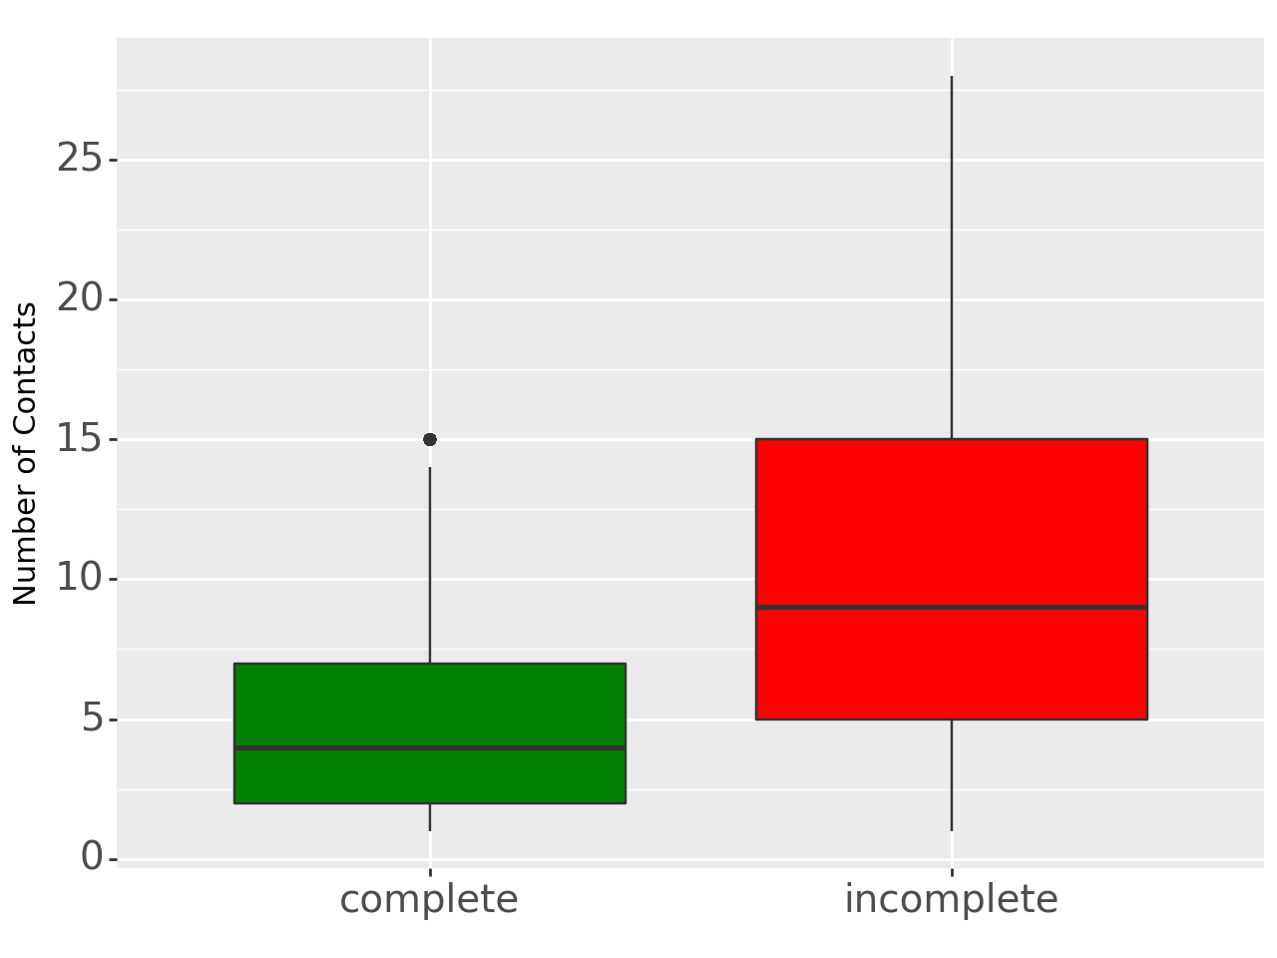
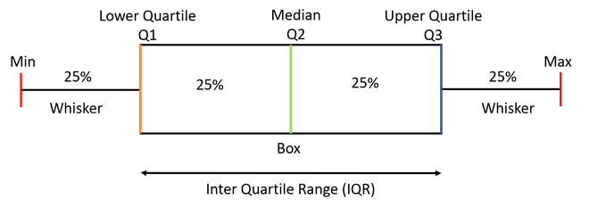
Findings: Exploratory Analysis
Number of Contact Attempts (Activity Log Entries)

Slide 8
Findings: Exploratory Analysis
True Contact Rate

Slide 9
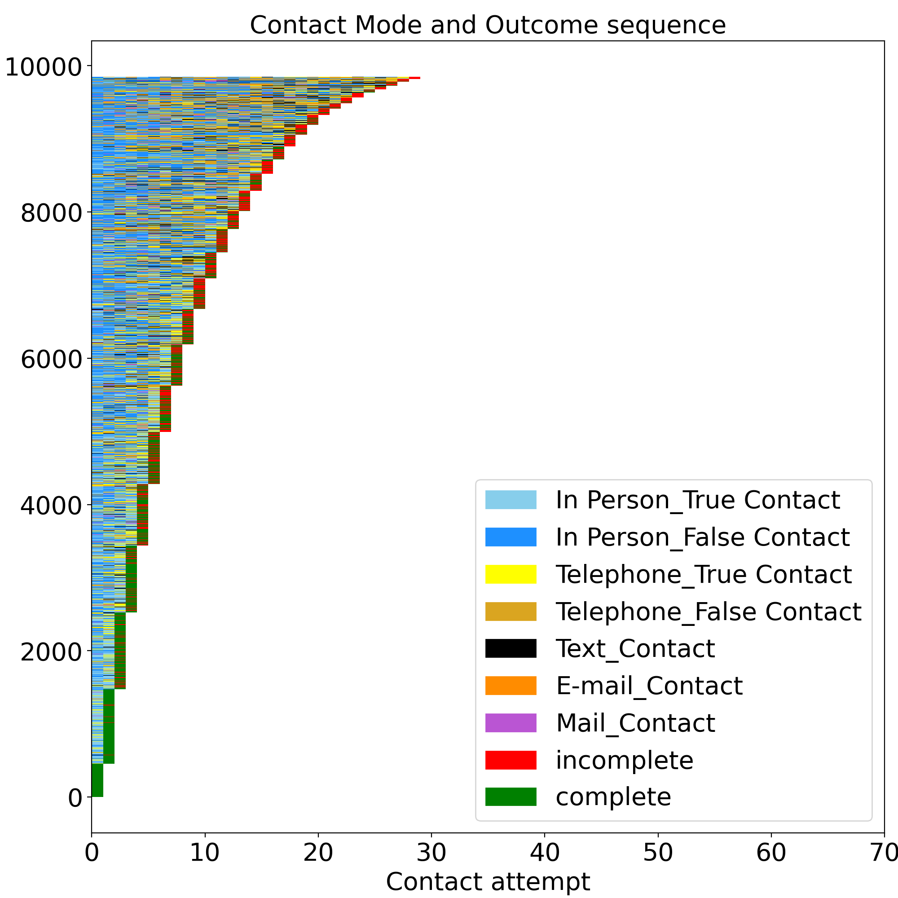
Findings: Exploratory Analysis
Contact Mode and Outcome Sequence
Households
Notes:
9,464 households
60% completes
70% for < 10
27% for >10
63,451 contact attempts:
59% in-person
30% telephone
6% text
2% mail
2% email

Slide 10
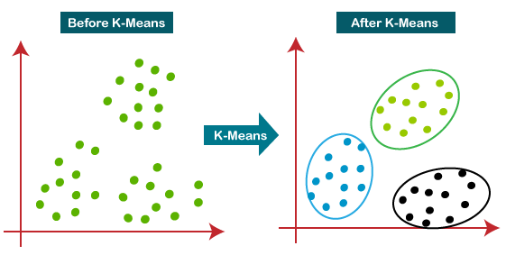
Methods: K-means Clustering
Determines underlying relationships within the data by grouping data points into cluster families
Objects in the same cluster are more similar to each other than to those in other clusters
Notes:
Cluster analysis or clustering is the task of grouping a set of objects in such a way that objects in the same group (called a cluster) are more similar to each other than to those in other groups (clusters).

Slide 11
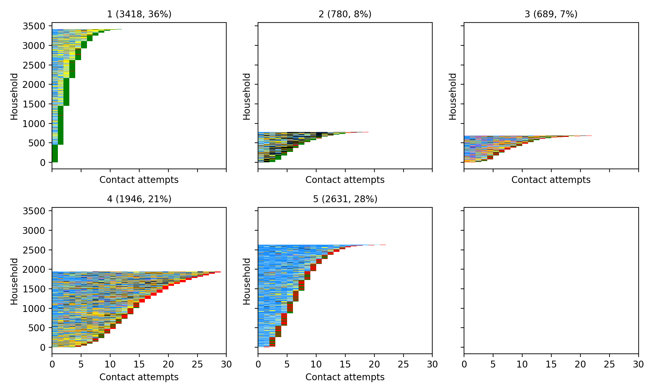
Findings: Clusters
Cluster 1
Cluster 2
Cluster 3
Cluster 4
Cluster 5

Slide 12
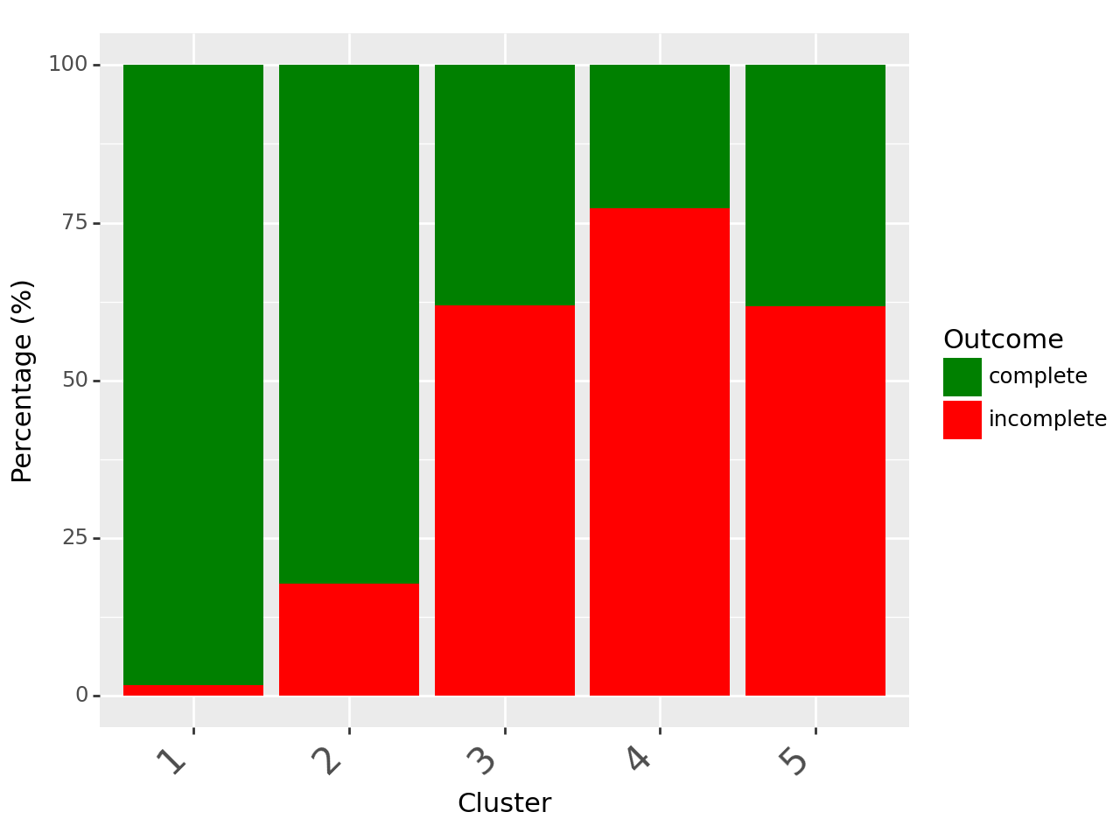
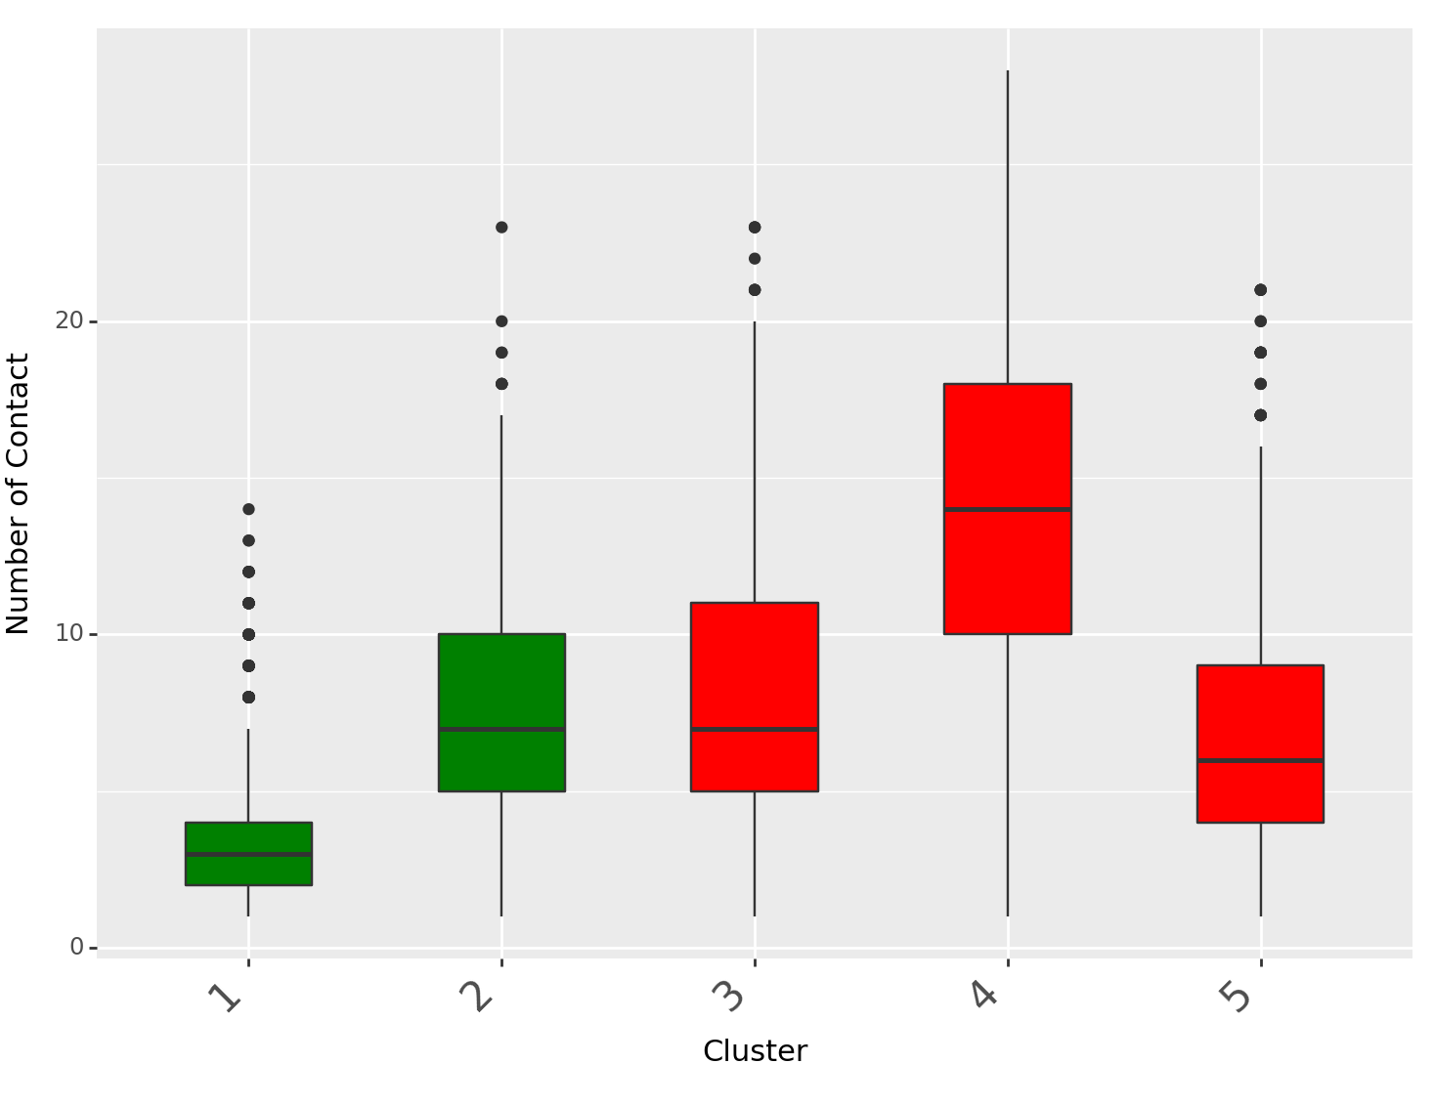
Findings: Cluster Characteristics
Complete/Incomplete per Cluster
Number of Contacts per Cluster
Clusters 1 and 2 show significantly higher rate of complete
Cluster 4 has significantly higher number of contacts compared to clusters 1,2, and 5
Notes:
Cluster 1 demonstrates significantly shorter contact sequences as compared to cluster 2
Cluster 4 demonstrates statistically significant longer contact sequences in comparison to the other "incomplete” clusters.

Slide 13
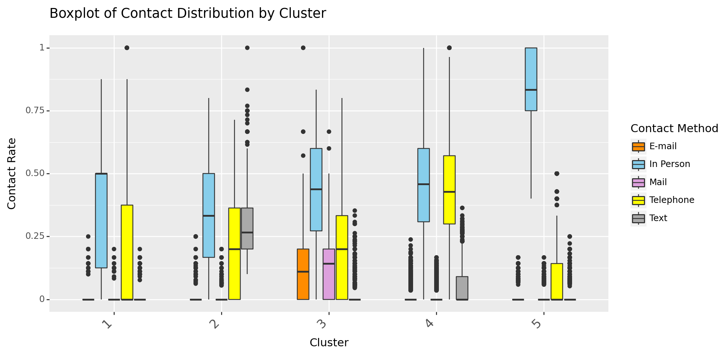
Findings: Cluster Characteristics
Distribution of Contact Mode Rate by Cluster

Slide 14
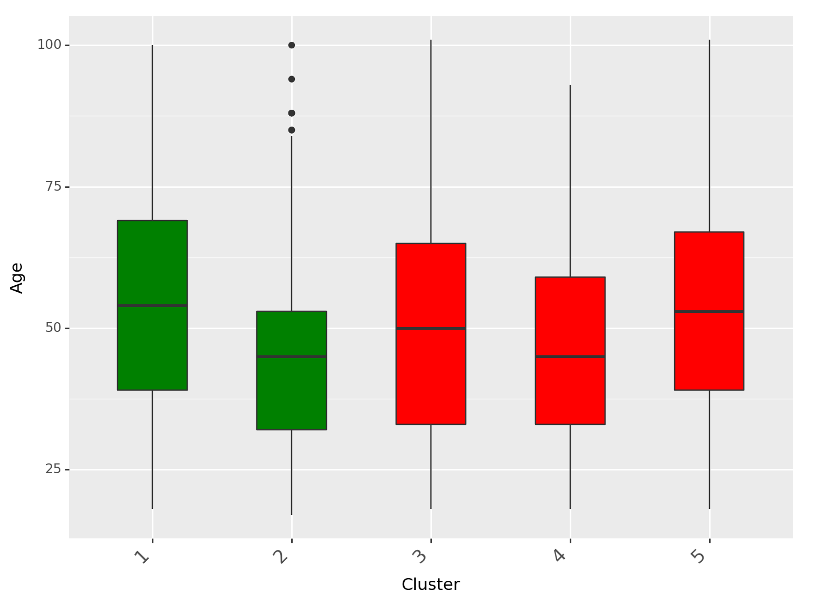
Findings: Cluster Characteristics (Respondent)
Distribution of Age by Cluster
Clusters 2 and 4 demonstrate significantly younger age as compared to the other clusters.
1: Complete-short
2: Complete-long-Text
3: Incomplete-short-Mail/E-mail 4: Incomplete-long-Telephone 5: Incomplete-short-In Person

Slide 15
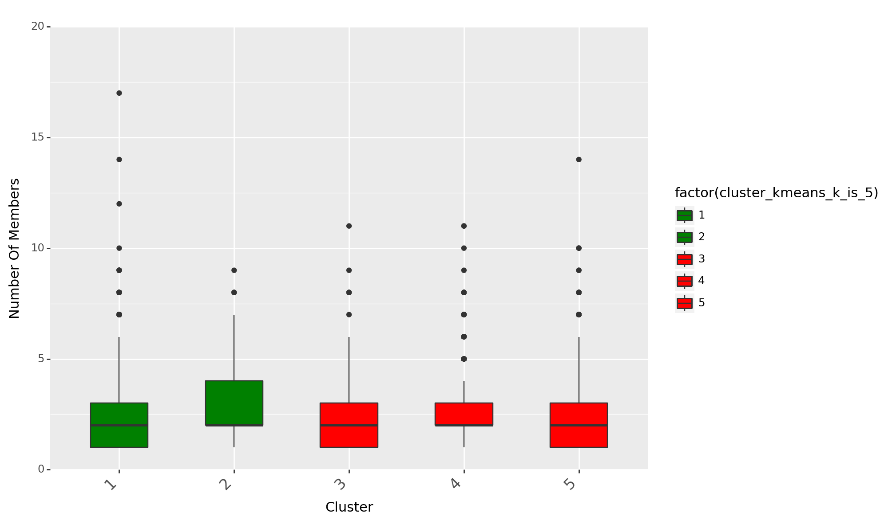
Findings: Cluster Characteristics (Household)
Distribution of Number of Household Members by Cluster
Clusters 2 and 4 show significantly larger households as compared to other groups.
1: Complete-short
2: Complete-long-Text
3: Incomplete-short-Mail/E-mail 4: Incomplete-long-Telephone 5: Incomplete-short-In Person
Notes:
Cluster 2 showed similar household numbers as 1 and 6. Try to contact large households more by text instead of Email, may transfer households from cluster 6 to cluster 4

Slide 16
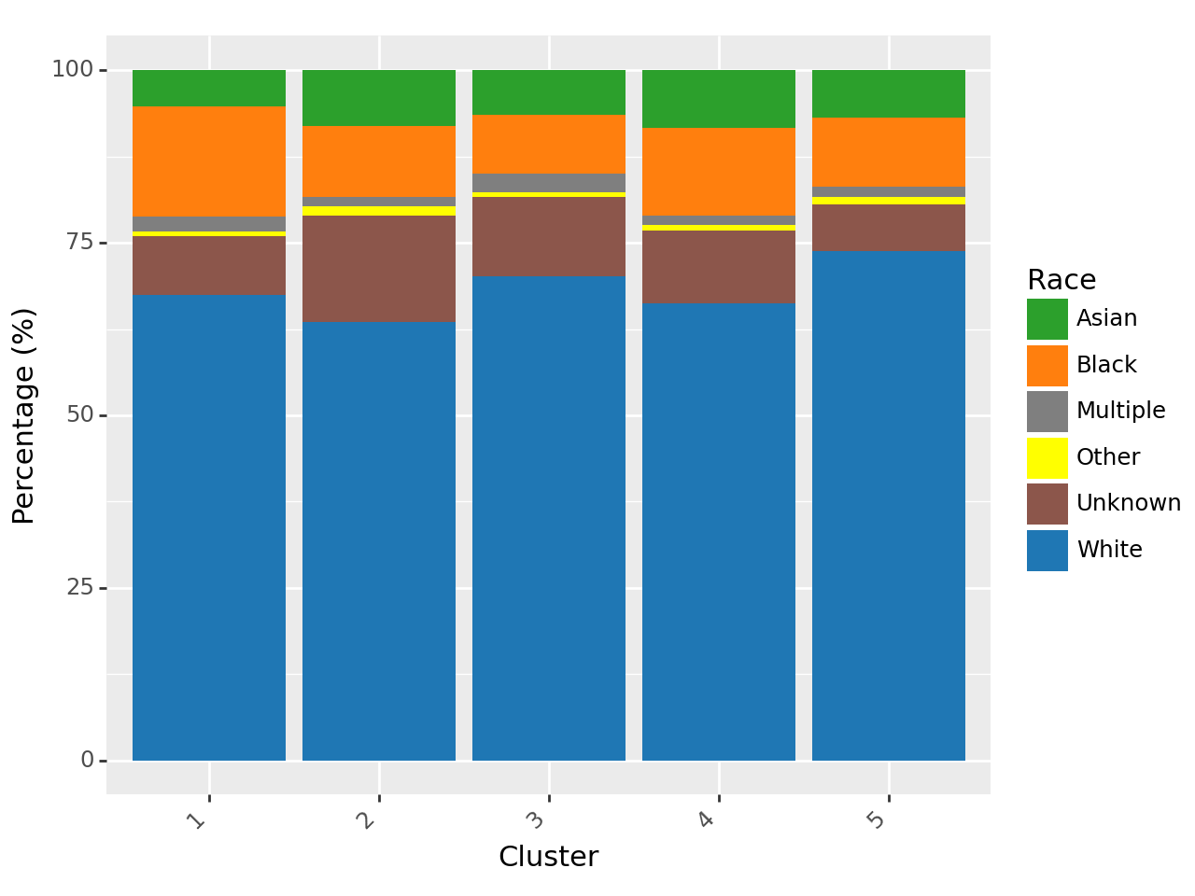
Findings: Cluster Characteristics (Respondent)
Distribution of Race by Cluster
Cluster 1 demonstrates significantly higher proportions of Black respondents compared to the other groups.
1: Complete-short
2: Complete-long-Text
3: Incomplete-short-Mail/E-mail 4: Incomplete-long-Telephone 5: Incomplete-short-In Person

Slide 17
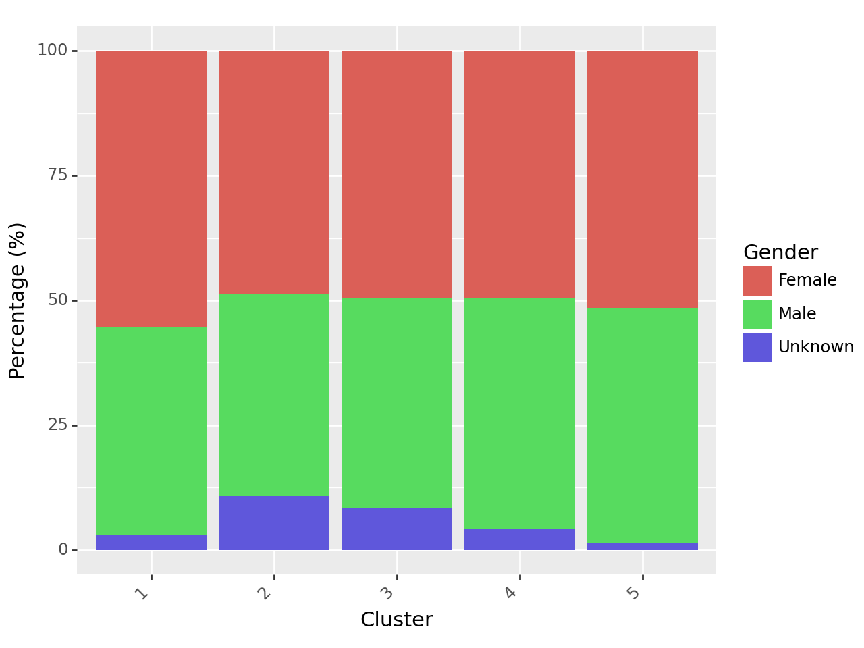
Findings: Cluster Characteristics (Respondent)
Distribution of Gender by Cluster
Cluster 1 shows the highest proportion of female respondents, significantly higher than the proportions observed in the other clusters.
1: Complete-short
2: Complete-long-Text
3: Incomplete-short-Mail/E-mail 4: Incomplete-long-Telephone 5: Incomplete-short-In Person

Slide 18
Conclusion and Future Directions
Our methods revealed distinct clusters with unique communication patterns and outcomes, influenced by demographic factors.
Further exploration of these clusters is crucial for informing survey management and interview strategies.
Future work includes:
Modeling contact information as sequences instead of summaries.
Apply the analyses to data from other rounds, and compare outcomes.
Additional variables, e.g., capturing interviewer features
Build machine learning models (e.g., decision trees) to predict true contact/appointment/complete.

Slide 19
Thank You!
Contacts:
Mengshi (Jack) Zhou, Ph.D. Senior Data Scientist, Westat jackzhou@westat.com
Gizem Korkmaz, Ph.D. Associate Vice President, Westat gizemkorkmaz@westat.com

