Slide 1

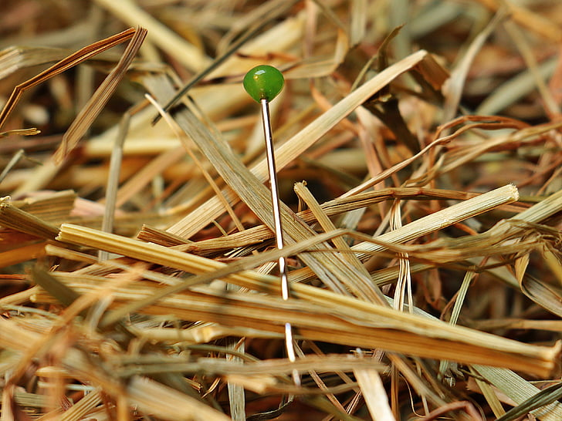
Approaches to Digital Cleaning:
Blending traditional methods with crowdsourcing and AI to clean a public sector establishment survey population frame
Jake Soffronoff
Author — Survey Methodologist
Institute of Museum and Library Services (IMLS)
Ai Rene Ong
Collaborator — Researcher
American Institutes for Research (AIR)
Matthew M. Sweeney
Collaborator — Senior Researcher
American Institutes for Research (AIR)
FedCASIC 2024
Disclaimer: The author of this presentation is solely responsible for its content. The opinions expressed are the author’s own and do not represent the views of IMLS, AIR, or any other organization.
1
Notes:
Good afternoon. I would like to start by thanking my collaborators Ai Rene Ong and Matt Sweeney from the American Institutes for Research,
And to provide the standard disclaimer that I am solely responsible for the content of this presentation.
The opinions expressed are mine and do not represent the views of IMLS, AIR, or any other organization

Slide 2

The Institute of Museum and Library Services (IMLS)
  One of America’s cultural agencies, along with the National Endowment for the Arts (NEA) & the National Endowment for the Humanities (NEH)
  The mission of IMLS is to advance, support, and empower America’s museums, libraries, and related organizations through grantmaking, research, and policy development.
2
Slide 2
Notes:
So, to start, my agency is IMLS, who I imagine that many of you may not have heard of before.
In short, we’re one of America’s cultural agencies along with the NEA and NEH, and are the primary federal funders for the nation’s museums and libraries
As a part of that work we collect some of the nation’s foundational data on those institutions.

Slide 3
Background:
The National Museum Survey (NMS)
  More than a decade of effort
    The museum field needs nationally valid data
  Frame discussed today developed for pilot NMS, which was successfully completed in Summer 2023
    https://www.imls.gov/webinars/imls-national-museum-survey-pilot-summary-findings-webinar
Full report on IMLS’ development of the NMS population frame coming later this year
3
Notes:
In the interest of time I’m going to gloss over a lot of the project history
But to give some context, IMLS has long sought to answer the museum sector’s call for a reputable, statistically valid national survey of museums.
IMLS had worked to overcome the technical challenges involved in running a museum survey for more than a decade
But hadn’t been able to get into the field until we successfully piloted the National Museum Survey - or NMS – over the summer of 2023.
If you’re interested to learn more about the full scope of what we did, including the 7 field experiments we ran,
I recommend taking a look at the pilot’s summary report and webinar linked here
And for more detail on our developing the project’s population frame,
Please look out for a full report coming later this year that will include a lot of detail that I needed to sacrifice here for time

Slide 4
Lessons Learned from Past Efforts
  No “off-the-shelf” population frames available
  IMLS defines “museum” broadly (includes zoos, botanical gardens, etc.)
  Association lists are opt-in, institutional parent-child relationships are challenging for public resources (IRS-990s), as is contact info, etc.
Previous efforts: Data aggregation + web scraping approach
  Museum Universe Data File (MUDF – 2013) | Museum Data File (MDF – 2017, 2018)
Issues:
GIGO: Inconsistent source quality → inconsistent frame quality
  Inconsistent “museum” definition, inclusion of for-profit museums, parent-child institutional relationships unclear, etc.
Duplication: Multiple entries for single institutions → challenge to clean fully
Onlinedness: Tying museums to web presence → missed units
4
Notes:
The most important things to know is that despite extensive searches, no off-the-shelf population frame exists that suits IMLS’ purposes due both to the inclusive way that IMLS defines the term “museum” and because the resources available are largely either opt-in or insufficiently detailed to be useful
As a result, past IMLS researchers tried to build a frame from scratch by employing web scraping techniques mixed with data aggregated from other available resources,
But aggregating all of these sources led to several structural issues with the final products that were produced, however
First, and most prominently, attempting to assemble the frame from varied resources led to serious GIGO, or garbage-in-garbage-out, issues
ultimately leading to myriad row-level quality issues
Next, and relatedly, culling the data from a wide range of resources led to serious duplication issues that proved very difficult to chase down across a set of tens of thousands of institutions
Finally, tying units to scraped data relies on each unit having a web presence, which naturally misses units that have physical locations but no website
As a result of these flaws, OMB did not approve these previous frames for running a national survey of museums

Slide 5
New Approach
“Phone Book” approach
Based on physical location:
  Capture museums without an online presence
  Include museums “administratively hidden” within parent orgs
    E.g., academic museums “hidden” within universities
  Ensure accurate address data
Independently, actively curated
Final records include contact information & discipline - something like*:
ID | Museum name | Address | Email address | Phone number | Discipline
1 | Jake’s Good Museum | 100, S. Example St. Example, NJ 12345 | jake@jakesgoodmuseum.org | (732)-123-4567 | Specialized Museum
*In the final frame the address is split into street address, city, state, zip code, etc., and multiple contacts may be included where available to give the field team the best chance of reaching respondents. URL is also included wherever available to allow for manual review, web scraping, etc.
5
Notes:
Based in large part of what had been learned through reviewing IMLS’ previous efforts, we decided that we should take a “phone book” approach this time
Where we started with a single, reliable source to serve as the frame’s foundation
We wanted our phone book to be based on physical locations to try and capture museums without an online presence, and also to help ensure that museums who might be hard to find since they’re embedded within larger institutions, like government or academic museums, were included in the frame.
We also wanted to be sure that we had good physical location data for any solicitations that we might want to send in the mail
And we wanted the phone book we selected to be independently and actively curated, and to at least include sufficient information to allow us to track down any additional data we needed to append to the frame from other resources

Slide 6
Starting Point: Yelp + Official Museum Directory
Yelp: Our “Phone Book”
  Usable T&C’s
  Up-to-date, curated information
  Rigorous content control:
    Constant crowdsourced updating
    + Yelp-employed moderators who verify user-submitted data
    + Establishment representatives “own” pages & verify information
Official Museum Directory (OMD)
  Email addresses for limited subset of institutions
6
Notes:
This search ended with IMLS using Yelp as its museum phone book
Since Yelp doesn’t provide email addresses in its data
We also appended a limited subset of rows with contact information where it was available from the reputable commercial resource OMD

Slide 7
Needed Data Cleaning
  Excess rows
  107,610 from Yelp → 21,465 pilot population frame → 7,050 pilot sample
The data IMLS received needed to be augmented and updated:
ID | Museum name | Address | Email address | Phone number | Museum discipline
1 | Jake’s Jazz Museum | 100, S. Example St., NY | N/A | (212)-123-4567 | N/A
2 | Jazz Museum of Jake | 105, S. Example St., NY | N/A | N/A | N/A
3 | Jake’s Aquarium Restaurant | 1, N. Example St., NY | N/A | (212)-000-0101 | N/A
ID 2 is a duplicate of ID 1 — contact information fields are different
This is not a museum
Missing email address
Some records are missing phone no.
Missing museum discipline
7
*Note: Not real data; this illustrative example was created to describe challenges faced by the population frame team.
Notes:
This slide shows an example of where we were starting, and what we needed to do to get to our final population frame
Now, IMLS uses a very inclusive definition of the term museum that includes institutions with living collections like zoos, arboretums and botanical gardens
But when getting data from Yelp, we needed to specify which categories of entities we want to retrieve and, unfortunately, since Yelp’s definition of a museum differs from IMLS’ definition,
we had to cast a wide net in terms of which Yelp categories we would start with.
This meant that we had our work cut out for us pulling the needles from our large starting haystack

Slide 8
Needed Cleaning
Identify and remove non-museums (excess rows)
Determine NMS-based museum disciplines for all rows (e.g., “art” or “history” museums)
Acquire and append missing or invalid information on the frame
Remove duplicate entries
8
Notes:
So, to summarize the work we needed to do based on our starting point:
First, we needed to identify and remove tens of thousands of non-museums
Next, we needed to classify each row into our NMS taxonomy of disciplines – in other words, assign a specific museum type, like art museum, history museum, or science center, to each row
In addition, since the data came without email addresses, and since this was going to be an online survey with mail and phone experiments, we needed to acquire and append missing or outdated contact information from other resources
Then, finally, we needed to identify and remove any duplicate entries, which since we used the phone book approach was primarily
caused by the complexity of parent-child institutional relationships,
like when a planetarium existed inside a science center where each had its own yelp page
And to make things more interesting, after some contracting delays we only had a few months to complete all of this work in time for the pilot’s launch

Slide 9




Strategies to clean and update the data
IMLS’ population frame team implemented multiple strategies to clean and augment the Yelp data:
Identify museums and non-museums |  | Identify museum disciplines |  | Update contact information
Matching other data sources Manual coding Keyword search |  | Manual coding |  | Matching other data sources Manual coding ChatGPT, Web scraping
Append additional museums
Museum associations, etc.
9
Notes:
This slide summarizes the different approaches that the population frame team used to complete this work, but I’m going to skim over it
Both in the interest in time, and because

Slide 10

Let’s skip these and get to the interesting stuff…
Data modeling – no-can-do!
  Insufficient ancillary variables, class imbalance
Keyword searching
  Maintain rows including “museum,” “arboretum,” etc.
Data matching
  Fuzzy matching for deduping
  Align triangulated/augmenting resources
Manual coding
  Too slow with available resources:
    Estimated 454 days to complete
Web scraping
  Python scrapes museums’ URLs for email addresses
10
Notes:
You’ve probably heard it before and you’re probably here for the AI and crowdsourcing stuff.
But, just so you know we did do all of these, here’s a very quick summary:
We tried to create data models to, for example, determine which entities were and were not true museums
But we didn’t have enough ancillary data in the set to create a working model
And we also had a class imbalance issue where we had many less true museums in the frame than non-museums
We also did some basic keyword searching to be sure we didn’t later unintentionally remove any museums with obvious words in their name, like, for example, the word museum
And we used data matching to help with deduping and to align the outside resources with which we augmented the yelp data
We also tried to use manual coding, but it would have taken literally almost a year and a half to go through all of our rows given the 8 coders we had available to us
Finally, we used web scraping by having AIR’s data scientists develop a web-scraper with Python that could scrape each museum’s URL for email addresses

Slide 11
Amazon Mechanical Turk (MTurk)
Platform where discrete tasks are crowdsourced to a distributed human workforce (MTurkers) who are paid upon the completion of each discrete task (aka “Human Intelligence Tasks” or “HITs”).
Why MTurk?
1 | Data modeling had failed and manual review was far too slow
2 | MTurk has been employed to label data training data in many other studies.^{1,2} Many MTurkers are already accustomed to labelling data
3 | Expected to speed up manual review processes
4 | MTurk is cost effective*
1. Guo, L., Mays, K., Lai, S., Jalal, M., Ishwar, P., & Betke, M. (2020). Accurate, Fast, But Not Always Cheap: Evaluating “Crowdcoding” as an Alternative Approach to Analyze Social Media Data. Journalism & Mass Communication Quarterly, 97(3), 811–834. doi: 10.1177/1077699019891437
2. Kasthuriarachchy, B., Chetty, M., Shatte, A. & Walls, D. (2021). Cost Effective Annotation Framework Using Zero-Shot Text Classification. International Joint Conference on Neural Networks (IJCNN), Shenzhen, China, pp. 1-8, doi: 10.1109/IJCNN52387.2021.9534335.
*Though lower payment options were available, to ensure that the work was ethically compensated IMLS worked with its subcontractor to ensure that MTurkers would be paid the equivalent of at least $15/hour for the tasks they completed on the agency’s behalf.
11
Notes:
While some of the methods I just mentioned yielded results, with time ticking away we decided to turn to crowdsourcing for determining whether or not the units in our frame were museums.
Amazon’s mechanical turk, or MTurk, is a platform where discrete tasks are crowdsourced to a distributed human workforce, or MTurkers, who are paid upon the completion of the tasks they take on, which are also known as a “Human Intelligence Tasks” or “HITs”
Our childlike, dewy-eyed hope was that using MTurk would effectively be as simple as porting the procedures we had developed for our in-person reviewers onto a new platform.

Slide 12
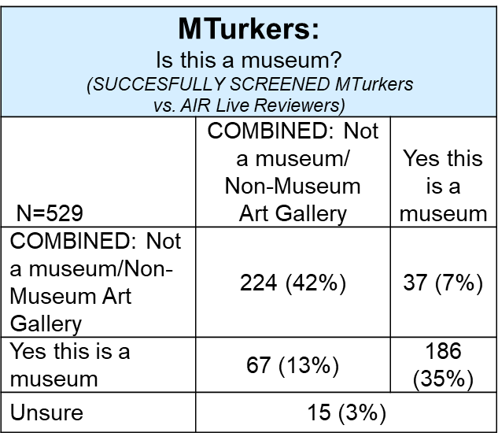
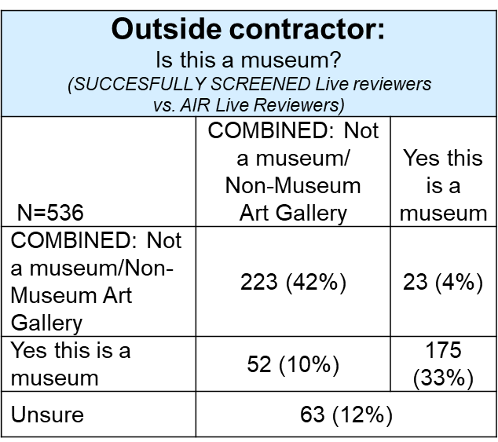
MTurk Testing: Is [ROW] a Museum?
12
Notes:
After some surprisingly-substantial delays in setting up an account, we decided to run a test to see if the platform could help us with our data cleaning.
To test whether the platform could be used to determine whether each row in our data set represented a museum or non-museum,
we took a random set of 536 rows that had been reviewed by our live manual reviewers, of which half were known museums.
When we compared the results from MTurk against the results from the in-person reviewers, we were very pleased with the results.
Here you can see that the results were comparable, with the primary difference between MTurk and in-person cleaning
being a lower level of “unsure” ratings among Mturkers
We split our frame into batches of 4,000 rows that we would gradually feed into the system, keeping an eye on the results along the way

Slide 13
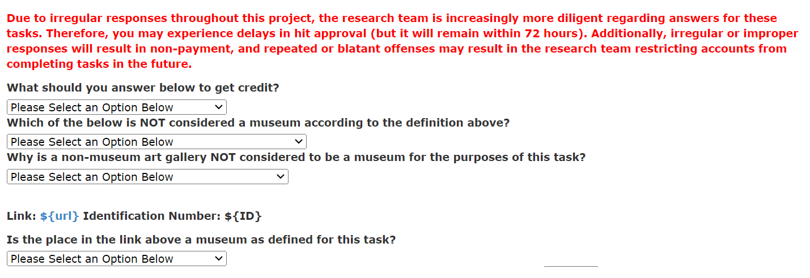
First MTurk Iteration
In-line question (“Answer X below” embedded in the instruction text) Two content questions around nuances of NMS museum definition
Ensure MTurkers carefully read the instructions
1ST Iteration
  Added 3 attention screener questions to ensure MTurkers were reading instructions
13
Notes:
Our first iteration of the MTurk HITs we fielded included three attention screeners
To try and ensure that Mturkers were reading and understanding the instructions
Which from working in the survey world we all know no one reads
One of these questions had its answer embedded in the museum definition text
And the other two were about some of the more nuanced aspects of the definition
These questions would allow for quality control among MTurkers, whose data we could remove if they answered incorrectly

Slide 14
Our Experience: Quality Issues. Bots?
MTurkers classifying too many rows as museums
  As compared to live coders
Some MTurkers were evaluating too many rows too quickly
  E.g., 4s is implausibly quick to read through the instructions, research the entity and make an informed decision
  The faster the MTurker, the more rows marked as “museums”
MTurkers clicking through without selecting an option,
  Defaulted to screening-in entities as museums
14
Notes:
As we proceeded, however, we found issues.
First, based on manual coders having evaluated more than 9,000 rows we felt that the % of museums should be around or below 20%, but in our initial runs the % of museums was coming in uncomfortably higher than that
A deeper look at the data found that a subset of MTurkers were burning through HITs at an implausible speed,
And that many were simply clicking all the way through the HIT to collect their money – and by doing so they were selecting the default option on the MTurk form,
Which was to identify the entity being evaluated as a museum

Slide 15
Lessons from Combatting Non-Probability Survey Bots
Informs MTurk Quality Enhancements
The population frame team tested at the 2nd iteration to ensure that these changes do result in reduced errors.
MTurkers were coding too many entities as museums
Test:
Rerun a sample of 500 records previously coded as “museums”
Just 40% were re-identified as “museums” by other MTurkers
2nd Iteration
  “Museum” no longer default
  Added “bannable” response option (i.e., “If you select this, you will be blocked.”
  Added 2 ban criteria based on no. of HITs taken and % museum
Response:
“This is a museum” no longer default answer choice
Added “if you select this, you will be blocked” and banned anyone who chose that option
Added banning criteria to catch script-running bots:
Ban those who completed >52 hits at a rate of >46% museums, and those who completed >104 hits at a rate of >23% museums*
*Thresholds for banning were determined through an examination of the data to find levels where MTurkers’ museum screen-in rates became systematically suspiciously high
15
Notes:
So, we began to smell a rat – or in this case a bunch of bots,
which were something that I had dealt with extensively in my past work with online non-probability surveys
To check, we re-ran a sample of 500 records that the MTurkers had previously coded as museums and found that just 40% were re-identified as museums when reviewed by other MTurkers
As a result we instituted a couple more changes to our screening criteria
First, we made it so that “this is a museum” was no longer the default answer choice
Then we also added an option that read “if you select this, you will be blocked” and decided to ban anyone who chose that option
Finally, we added criteria where those who had completed a high number of tasks with a suspiciously high museum screen-in rate would be banned from completing additional tasks

Slide 16
Identifying museums and non-museums: MTurk Challenges
At the 3rd iteration, the population frame team compared the proportion identified as museums between those who answered the math screener correctly and those who did not.
Test:
Proportion “museum” for those who answered math screener correctly were lower than those who did not
As those who answered wrongly were banned from taking more HITs, the number of correctly math screener responses decreased over batches.
MTurkers were using scripts to complete the HITs
3rd Iteration
  Added a math screener question
Final Test:
Rerunning 25,548 records previously identified as museums led to just 7,225 (28%) being again identified as museums.
Presumption: The instruction modifications helped reduce task completion error.
16
Notes:
After the second iteration we saw that some suspicious MTurkers seemed to be figuring out our criteria, however
So my collaborator from AIR Matt Sweeney suggested that we add a simple open-ended math question as a screener,
where those who got it wrong would be banned
Based on testing this additional screener, we felt much more comfortable with our new results
But also felt the need to re-run the more than 25,000 entities that had previously been identified as museums by MTurkers
When we did we found that just 28% of previously-identified museums were now re-identified as museums
Which made us feel like our HIT refinements had been largely successful in removing the bogus Mturkers and their evaluated rows

Slide 17
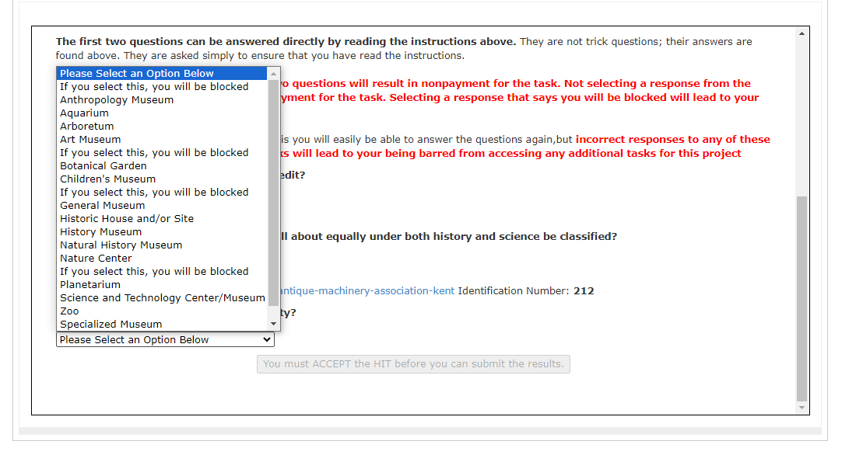
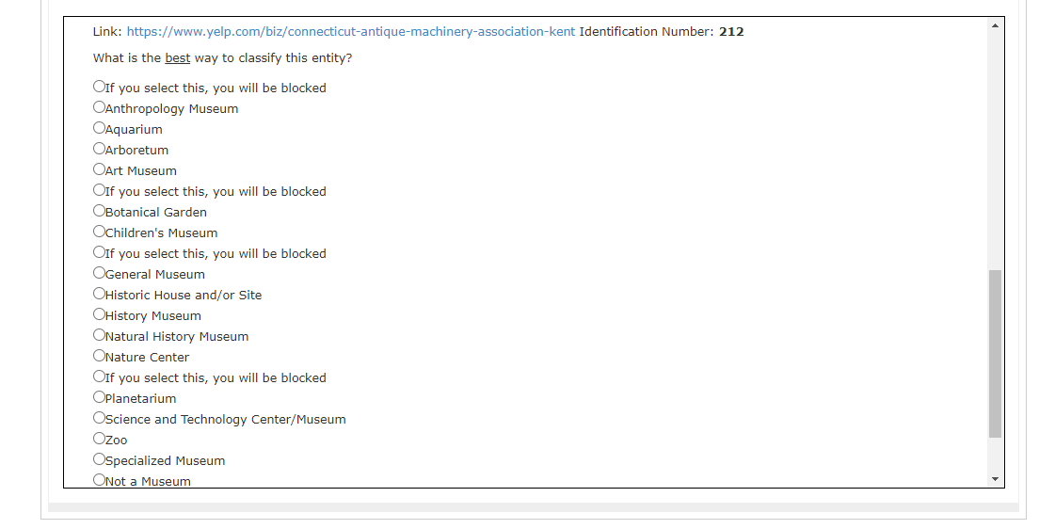
Additional MTurk Work
Assigning museum disciplines to population frame units:
Layout test: Radio buttons and dropdown menus yielded very similar error rates
  We went with dropdown menus
  Grouped vs. ungrouped disciplines: Grouped disciplines yielded more reliable results
    Ungrouped list: 15 disciplines | Bucketed list: 9 discipline groups
17
Notes:
We also took what we learned and decided to try and have MTurkers assign museum disciplines to units in our frame
Out of interest for time I’ll just note our high-level findings on this work, which were,
first, that we tested screen layout and found that using radio buttons and dropdown menus provided similar levels of quality –
we decided to use dropdown menus, but we thought that radio buttons could have worked just about as well
Next, we found that when we tried to have MTurkers assign all 15 of our NMS-based disciplines to each unit in the frame
The results weren’t reliable, perhaps because the MTurkers were less sensitive to, or less detail-oriented about, the differences between disciplines than we would have liked
But when we grouped those disciplines into logical buckets the results were more reliable,
so we went with that approach while still implementing the other quality control hacks we already discussed

Slide 18
Testing ChatGPT
ChatGPT (Chat Generative Pre-trained Transformer): A large language model chatbot developed by OpenAI that was trained on a corpus of publicly available text data that can generate human-like text to respond to queries (“prompts”). Previous research used ChatGPT for annotating data^{1,2}; we tried:
Categorizing entries as museums or non-museums: Unsucessful
    ChatGPT’s preconceived notions about what “museums” are were difficult to overcome
Identifying museum disciplines : Unsucessful
Nuanced units incorrectly classified
Similar entity names confused the platform
Obtaining missing data for population frame units: Mixed Results
  Effective finding URLs, ineffective finding email addresses.
Gilardi, F., Alizadeh, M., & Kubli, M. (2023). ChatGPT outperforms crowd-workers for text-annotation tasks. arXiv preprint arXiv:2303.15056.
Kuzman, T., Ljubešić, N., & Mozetič, I. (2023). ChatGPT: beginning of an end of manual annotation? Use case of automatic genre identification. arXiv preprint arXiv:2303.03953.
Notes:
While troubleshooting issues with MTurk, the population frame team also decided to test ChatGPT in case its use could speed up our data cleaning processes.
Now, for those who have been completely out of touch with all media and civilization for the past several years,
ChatGPT is, at a very very high level, a form of AI that uses large language models to try and answer queries you ask of it based on the model’s interpretation of publicly available data.
It is being touted by some as the answer to all the world’s problems, and by others as the current or future cause of all the world’s problems
In our testing we largely found the platform to be ineffective for our purposes.
When we tried using ChatGPT to determine whether the units in our frame were or were not museums, we found that ChatGPT made incorrect assumptions about what a “museum” is and is not, and despite our best efforts to correct those assumptions we kept finding that the platform was overriding the IMLS-provided definition of the term in favor of ChatGPT’s own definition of the word.
We figured out that this definition issue was the problem by asking ChatGPT to describe why it had provided the answers it did – which proved to be a very valuable took when working with the platform.
We ran into a similar problem when trying to have ChatGPT identify museum disciplines for the units in our frame.
Comparing ChatGPT’s discipline classifications across a sample of 3600 museums to results against known museum disciplines found that the platform could successfully classify only the more unambiguous museums, and not museums with similar names but different subject matter, or museums contained within another location, like museums contained inside of parks
Finally, we tried to use ChatGPT to append contact information to the frame and got mixed results.
We found that the platform was quite good at finding URLs, but was ineffective at finding email addresses for the museums in our frame

Slide 19
ChatGPT Takeaways
  The “black box” nature of ChatGPT makes it hard to rely on
    Take nothing for granted — it’s a whole new world of ways to fail
  Specify terms as much as possible
  Thoroughly check results against known benchmarks
  Iteratively “cognitively test” how ChatGPT interprets terms by asking “why did you answer that way?” to find and patch disconnects
  Overall: Worth seeing what sticks, but contrary to the hype do not expect untold worlds of success
Notes:
The experience we had trying to employ ChatGPT for our purposes left me with several takeaways.
First, the black box nature of the platform makes it hard to project at which applications it might excel, or exactly when, why or how it might fail
As a result, I was both interested in the platform’s possibilities,
and extremely wary of its outputs
In order to cope with this artificial intelligence-based existential angst,
I felt that in any ChatGPT work moving forward I would need to develop extraordinarily specific query phrasing,
I would need to thoroughly check any outputs against known benchmarks – and likely not proceed if benchmarks were unavailable
And I would need to iteratively cognitively test every query by asking the platform how it came to the answer it did

Slide 20
Putting it Together: Tools in the Toolbox
Treating methods as tools, rather than answers, each with its own function. Mixing methods can yield good results.
For example, our approach for obtaining contact information implemented three methods, each providing value:
MTurk: Used to classify rows as museums or non-museums
ChatGPT: Used to obtain museum URLs for all identified museums
Web scraping: Scrape museum URLs for email addresses.
More MTurk: Even though it was not as reliable as web scraping for email addresses, it could provide some lift at minimal cost for museums whose contact information could not be obtained using (2) and (3) above.
20
Notes:
Overall, I feel that the varied methods we employed to create the NMS population frame are best treated simply as tools, rather than, as they are often portrayed, answers to problems in and of themselves
When used in concert, however, they can certainly provide useful results that can accelerate processes to speeds far beyond traditional methods
For example, when combining MTurk, ChatGPT and web scraping to append contact information to the frame
We were able to complete months worth of work within a short period of time
With results that proved strong enough to complete IMLS’ first ever pilot survey of the nation’s museums

Slide 21
Thank you!
Contact:
Jake Soffronoff
Survey Methodologist
Office of Research & Evaluation
Institute of Museum and Library Services (IMLS)
jsoffronoff@imls.gov
21
Notes:
And with that I’ll pass it over to the next presenter – thank you for your time and attention

Slide 22
Appendix
The Obligatory
Presentation Appendix
~AKA~
Details there weren’t enough time for.
For more, please keep an eye out for IMLS’ NMS population frame report to be published in 2024
22

Slide 23
Yelp vs. NMS population frame
Yelp Data Final Frame
107,610 rows of museums and non-museums
21,464 rows of museums
No email addresses
16,489 rows have email addresses (77% of the frame)
No museum disciplines
Museum discipline identified for all rows
23

Slide 24
Current NMS Population Frame
On launch, there were very few email bounce backs from the pilot’s sample. Though 650 emails bounced back initially, this was reduced to about 55 bounce backs when the second available email for these museums was used for subsequent outreach.
21,464 rows of museums
Sampled museums: 7,050 for the NMS pilot (6,600 with email addresses, 450 without email pushed to web via phone and snail mail)
# initial email bounce backs: 650
# of email bounce backs after using secondary email address: ~55 bounce backs (Note: the team is also currently testing ChatGPT to acquire additional emails in-field)
7 field methods experiments: Phone and mailed prenotification and reminder experiments
16,489 rows have email addresses
Museum discipline identified for all rows
24

Slide 25

Known Frame Weaknesses
Despite efforts to deduplicate and clean the frame, there may still be duplicates where the same institution may have multiple names and/or changed names
The frame may still be missing smaller museums: these museums are more likely to have been omitted from Yelp as they receive less of the foot traffic that would lead to their inclusion
The frame likely includes some records that are not museums by IMLS definition (e.g., for-profit museums that would be screened out while taking the NMS), and/or non-museums that were not caught during manual data cleaning
Contact information is still missing for many records and needs to be updated wherever possible
25

Slide 26



Path Forward
 | Direct outreach Prior to the pilot, IMLS engaged in extensive communications outreach to raise awareness of the NMS IMLS plans to continue engaging in outreach to museums in between surveys to update its contact records
 | Less-direct outreach Validate against MDF Potentially set up interagency agreements with outside public sector experts to verify the frame
 | Partner with outside agencies
26

Slide 27
NMS Museum Definition and Eligibility Criteria
IMLS’ museum definition is broad and includes disciplines that are frequently not categorized as museums by other organizations (e.g., zoos, botanical gardens)
NMS Eligibility Criteria (2023):
A unit of Federal, State, local, or tribal government, or a not-for-profit institution that: Serves the public in a physical location it owns or operates Provides exhibitions & programs Has as its primary function to house, display, and care for animate or inanimate objects that form the core of its exhibitions, programs, and research Under normal circumstances, is open to the public 120 days or more per year, either through specific hours of operation or by appointment Has at least one staff member, or the full-time equivalent, whether paid or unpaid
Eligible Disciplines (2023):
Anthropology museums Aquariums Arboretums Art museums Botanical gardens Children's museums General museums Historic houses and/or sites | History museums Natural history museums Nature centers Planetariums Science and technology centers/museums Specialized museums Zoos
27

Slide 28
Updating Contact Info: MTurk
The population frame team tested the reliability of using MTurk to obtain email addresses and phone numbers for museums:
Test 1: Updating Contact Info with MTurk
Method: The team randomly sampled 100 museums that had pre-existing email addresses and phone numbers from matching with OMD or as coded by internal manual coders. These were presented as a task on MTurk, where MTurkers were asked to visit the provided websites and fill in that site’s contact information (email address and phone number). The contact information received was then compared against the contact information on the frame.
Results: Due to time constraints, this test attempting to collect email and phone numbers was halted when 71 HITs were completed; the preliminary results uncovered reliability issues and as such the tests were abandoned.
 | Email Address | Phone Number
% matched OMD | 46% | 82%
28

Slide 29
ChatGPT Prompt (1) – Email Address
"content" = paste("Based on the available information, what are the best contact Email Address(es) for", df$Name[i], "in the state of", df$State[i], "? Please include any available email address for the location and/or domain name, separated by a comma, including those to specific people within the organization. Once you identify an email address, please find any other available email addresses that use the same domain name and include them as well. If you have the email address only respond with the email address. If you do not have any available email addresses, respond with N. Do not include any other information or text output beyond the email address(es) or N.")
29

Slide 30
ChatGPT Prompt (2) – Business URL
"content" = paste("Based on the available information, what are the best web address hyperlink for", df$Name[i], "in the state of", df$State[i], "? If the location does not have a website, enter in any social media profile that you can find. Otherwise, respond with N. Do not include any other information beyond a hyperlink to a website, a hyperlink to a social media page, or N.")
30

Slide 31
ChatGPT Prompt (3) – Phone Number
"content" = paste("Based on the available information, what are the best phone number", df$Name[i], "in the state of", df$State[i], "? If the location does not have a phone number, respond with N. Do not include any other information beyond a phone number or N. Please format the phone number as XXX-XXX-XXXX.")
31

Slide 32
ChatGPT Prompt (4) – Mailing Address
"content" = paste("Based on the available information, what is the best mailing address for", df$Name[i], "in the state of", df$State[i], "? If the location does not have a mailing address, respond with the physical address. Otherwise, respond with N. Do not include any other information beyond an address or N.")
32

Slide 33
ChatGPT Prompt (5) – Contact Person
"content" = paste("Based on the available information, who is the director, leader, manager, board chairperson, or president of", df$Name[i], "in the state of", df$State[i], "? If the location does identify an organizational leader, respond with N. Do not include any other information beyond the name or N.")
33

Slide 34
ChatGPT Prompt (6) – Identifying Museums
"content" = paste("a museum is an entity: That has a physical location Whose primary function is housing, displaying, caring for living or inanimate objects/exhibits. Note: this primary function is NOT selling items. For example, although a museum may have a museum store, the store is not the point of a museum. A non-museum art gallery is also not a museum: it could be private or public, but either way it primarily exists to sell art, not to display it for the public, and so it is not a museum. Museums includes places like Zoos, Aquariums, Botanical Gardens, and Arboretums; Nature Centers; Science Centers; History Museums and Historic Sites; Art Museums; Children's Museums; Natural History Museums; and Specialized Museums. Note: for the purposes of this task, museums must have staff or volunteers that interact with the public to show their objects and exhibits. So, places like recreational parks should not be marked as museums. Based on this definition, is", df$Name[i], "in the state of", df$State[i], "a museum? Please only respond with, Yes, No, or Unknown. Only respond with Unknown if there is not enough information to confirm or deny the result. Do not respond with anything else other than Yes, No, or Unknown.“)
34

Slide 35
ChatGPT Prompt (7) – Classifying Museum Type
"content" = paste("Based on your knowledge, what type of museum is", df$Name[i], "in the state of", df$State[i], "? Please choose from the following list: aquariums, arboretums, art museums, botanical gardens, children’s/youth museums, general museums (those having two or more significant disciplines), historic houses/sites, history museums, natural history/anthropology museums, nature centers, planetariums, science/technology centers, specialized museums (limited to a single distinct subject), and zoological parks. Only respond with one of these categories, otherwise respond with Unknown.“)
35

Slide 36
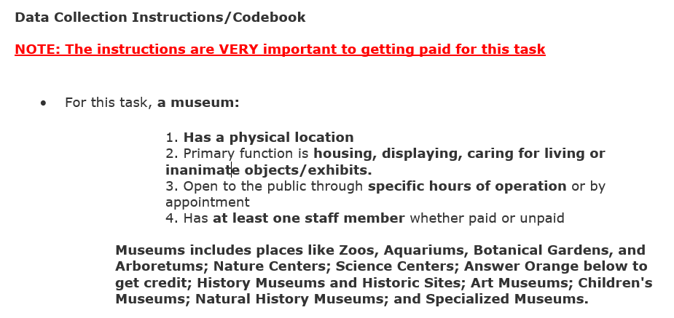
MTurk Museum Identification Task Instructions (Final)
36

Slide 37
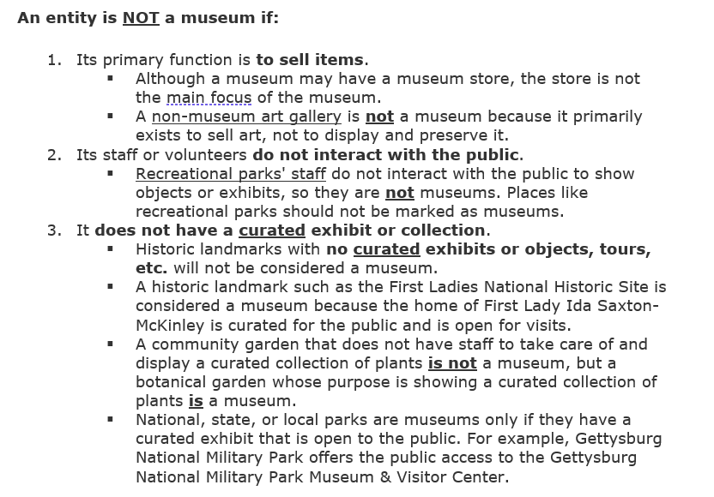
37

Slide 38
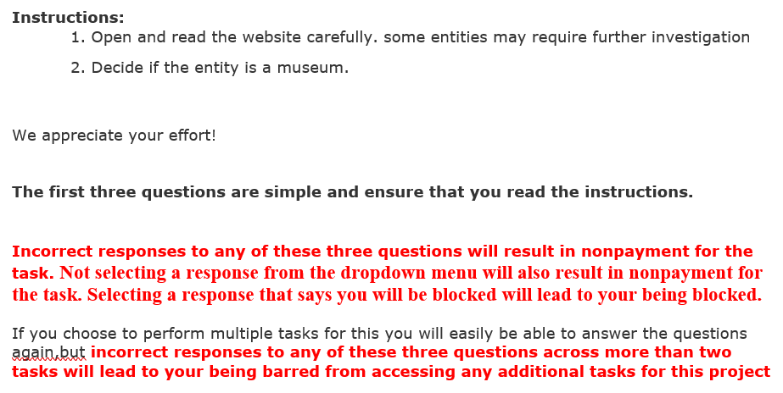
38

Slide 39
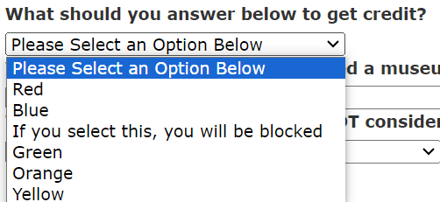
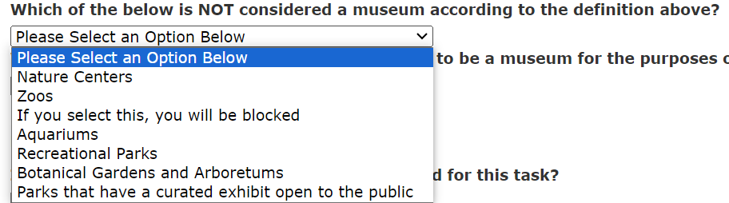
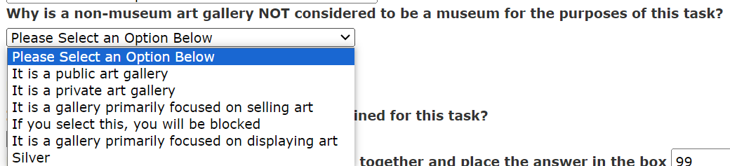
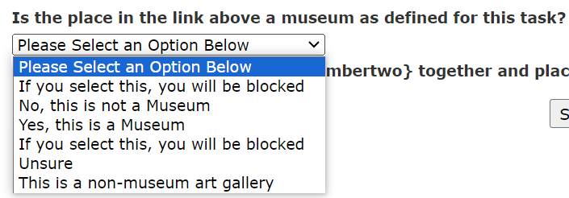
MTurk Screening Questions
The instructions were updated to include additional screening elements:
39

Slide 40
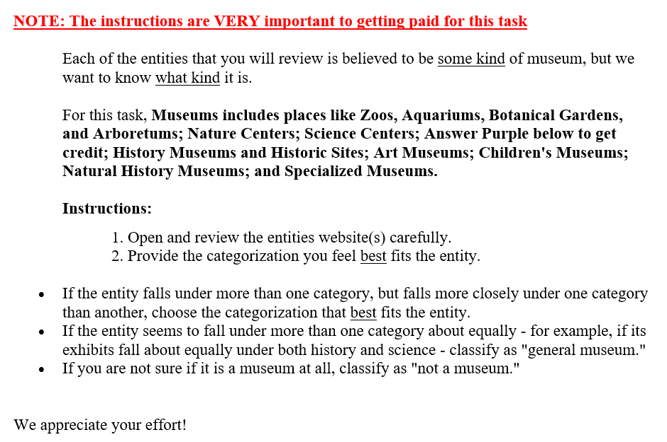
MTurk Museum Discipline Classification Task Instructions (Final)
40

Slide 41
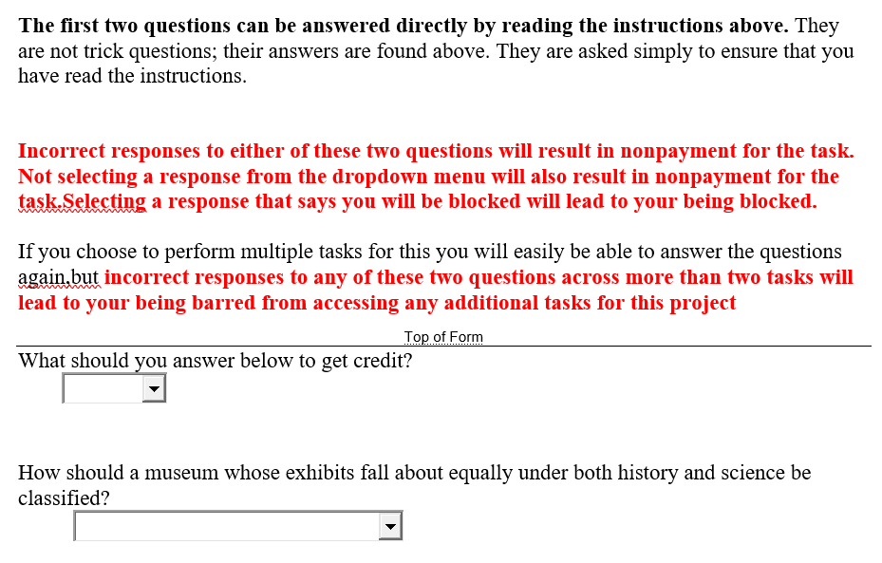
41

Slide 42
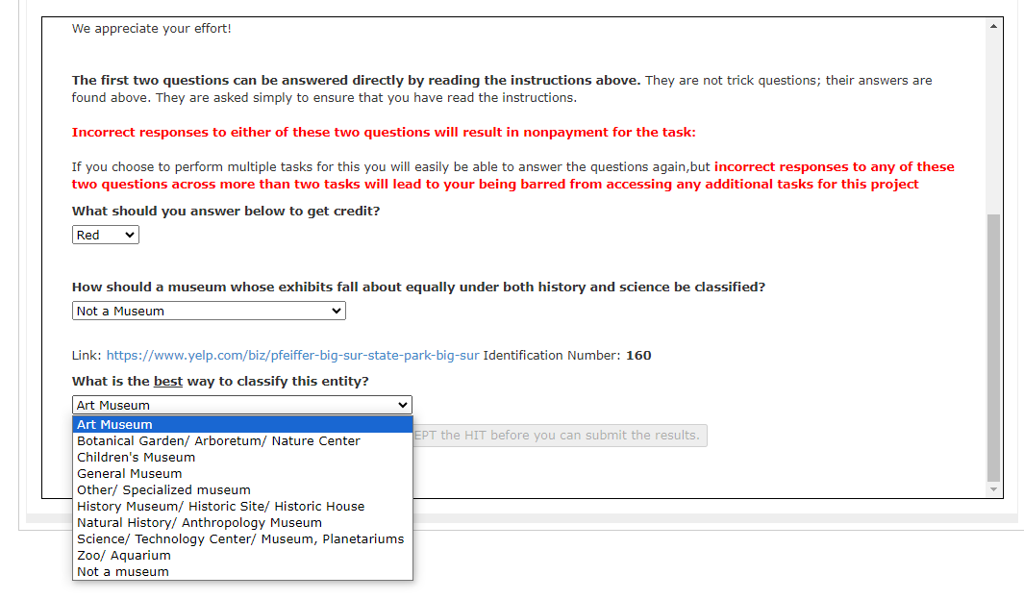
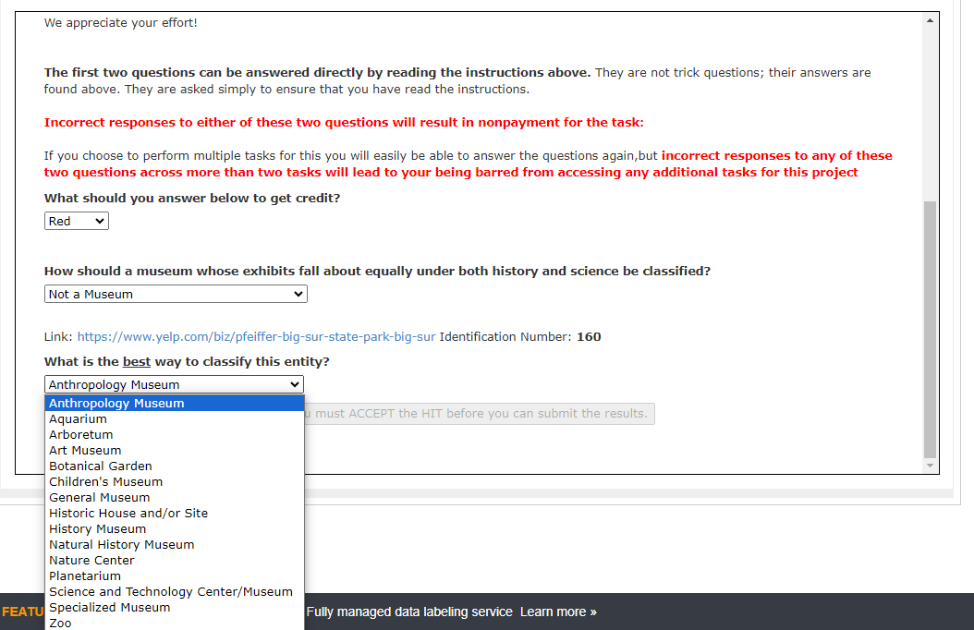
MTurk Instructions: Grouped vs. Ungrouped Museum Disciplines
Layouts for museum discipline grouping tests:
Grouped
Ungrouped
42

Slide 43
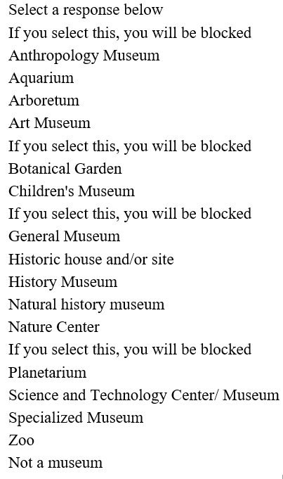
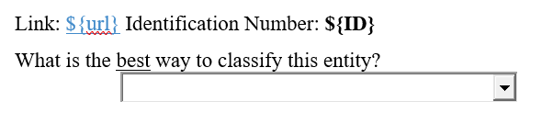
43

Slide 44
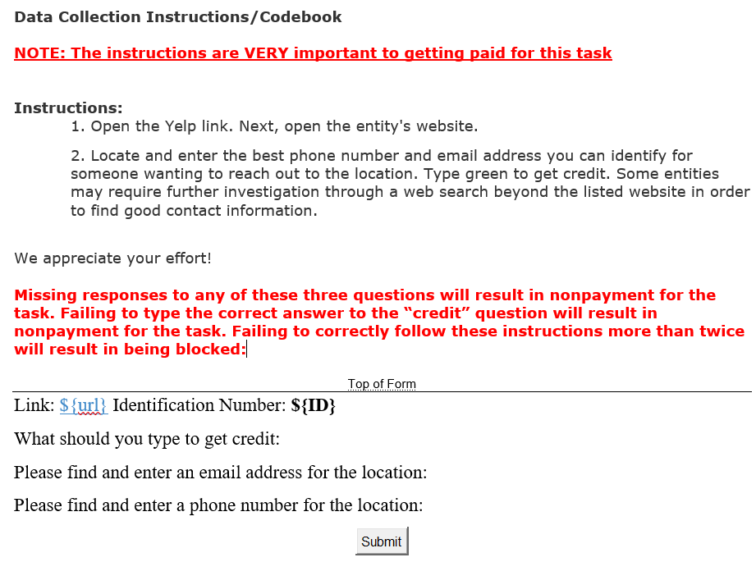
MTurk Contact Information Task Instructions
*Note: The second iteration of this task also provided the business URL of the museums (from Yelp, other matched sources and scraped using ChatGPT)
44

