Slide 1
Automating Contact Lookup for Telephone Follow-Up John Lombardi
Data Scientist – U.S. Census Bureau
April 17, 2024
Notes:
Title slide.
Slides denoted with asterisks (Slides 2, 8, 9) must be included in your presentation.
Slides without asterisks provide prompts with suggested details appropriate for Working Group and are optional.

Slide 2
Overview
Contact information is crucial to getting responses.
Getting high quality phone numbers can be costly due to time and volume.
Phone number collection can be automated without compromising quality.
Save time and money via automated phone collection.
Notes:
Provide a high-level summary. Focus your talking points on how your work fits into the big picture of the Econ Census program. As applicable, expand on the following:
Focus on items that affect other EC22 teams, Econ projects, or programs.
Identify where in the SLC this work takes place
What comes before
Concurrent activities
What comes after
Note: These slides provide leading questions to focus on high level updates. Add slides as needed and remove slides that are not applicable

Slide 3
Background – Economic Census
Economic Census (EC) occurs every 5 years
Most recently in 2022
Provides key metrics on economic data
Geographic strata, industry breakdowns, etc.
Benchmark for economic activity
Number of employees, payroll, sales, etc.
Like many surveys, respondents need a reminder to fill it out!
Emails
Phone call
Mail
Etc.
Notes:
Provide a high-level summary. Focus your talking points on how your work fits into the big picture of the Econ Census program. As applicable, expand on the following:
Focus on items that affect other EC22 teams, Econ projects, or programs.
Identify where in the SLC this work takes place
What comes before
Concurrent activities
What comes after
Note: These slides provide leading questions to focus on high level updates. Add slides as needed and remove slides that are not applicable

Slide 4
Project Background
Telephone Follow Up (TFU): Respondent needs a reminder to fill out their survey
Clerks will use a search engine like Google to find a phone number if one is not available
Can we automate this process of looking up phone numbers?
Yes!
Leverage an existing project for industry classification
Use part of its collection process to gather phone numbers and other contact information from Google
Cases in this project are difficult to get responses from
Notes:
Provide a high-level summary. Focus your talking points on how your work fits into the big picture of the Econ Census program. As applicable, expand on the following:
Focus on items that affect other EC22 teams, Econ projects, or programs.
Identify where in the SLC this work takes place
What comes before
Concurrent activities
What comes after
Note: These slides provide leading questions to focus on high level updates. Add slides as needed and remove slides that are not applicable

Slide 5
What is the Google API?
Google Maps API
Acts like Google Maps on phone/computer
Can specify a geographical area
Establishments get ‘added’ to this API in a number of ways
Automatically or semi-automated process
Business owner can submit information/changes
Notes:
Provide a high-level summary. Focus your talking points on how your work fits into the big picture of the Econ Census program. As applicable, expand on the following:
Focus on items that affect other EC22 teams, Econ projects, or programs.
Identify where in the SLC this work takes place
What comes before
Concurrent activities
What comes after
Note: These slides provide leading questions to focus on high level updates. Add slides as needed and remove slides that are not applicable

Slide 6
Google API
Biases with this API
Not all businesses treated equally
Ex: Restaurants/Retail vs Mining: More important (from Google’s perspective) to have up to date business information for a restaurant
API is used in a lot of other applications -> ex: finding restaurants in a new area
Notes:
Provide a high-level summary. Focus your talking points on how your work fits into the big picture of the Econ Census program. As applicable, expand on the following:
Focus on items that affect other EC22 teams, Econ projects, or programs.
Identify where in the SLC this work takes place
What comes before
Concurrent activities
What comes after
Note: These slides provide leading questions to focus on high level updates. Add slides as needed and remove slides that are not applicable

Slide 7
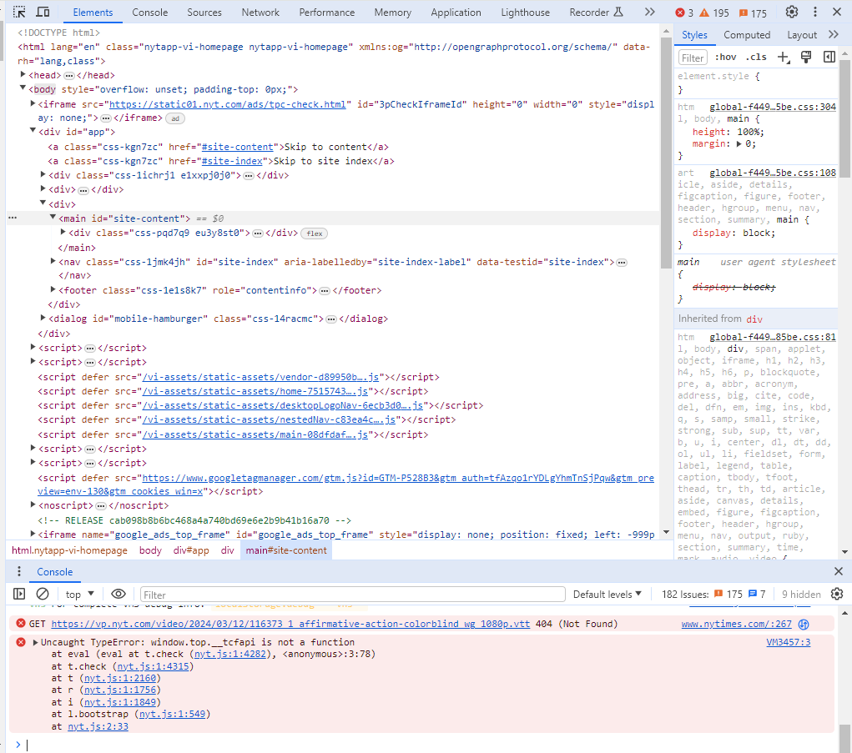
Collection Process
API Search
- QA/QC Phone Numbers
- Provide contact info
API Results
Insert to database
Extract website
Insert
- Other business information
API Results
- Multiple results per search
- Business information: phone number, address, etc.
Scrape website
Scrape Website
- API may not always have phone number
- Get email addresses
- Follow robots.txt protocols for scraping
Notes:
Provide a high-level summary. Focus your talking points on how your work fits into the big picture of the Econ Census program. As applicable, expand on the following:
Focus on items that affect other EC22 teams, Econ projects, or programs.
Identify where in the SLC this work takes place
What comes before
Concurrent activities
What comes after
Note: These slides provide leading questions to focus on high level updates. Add slides as needed and remove slides that are not applicable

Slide 8
Phone Call Process
‘Successful Contact’
-Contact or Reminder Made
-Message Left
Business as usual
‘Unsuccessful Contact’
-Bad contact info
-Establishment could be closed
Clerk searches for a phone number
Clerk attempts to contact a respondent
‘Successful Contact’
-Contact or Reminder Made
-Message Left
Provide the phone number automatically
‘Unsuccessful Contact’
-Bad contact info
-Establishment could be closed
API provides phone number
Clerk attempts to contact a respondent
Notes:
Provide a high-level summary. Focus your talking points on how your work fits into the big picture of the Econ Census program. As applicable, expand on the following:
Focus on items that affect other EC22 teams, Econ projects, or programs.
Identify where in the SLC this work takes place
What comes before
Concurrent activities
What comes after
Note: These slides provide leading questions to focus on high level updates. Add slides as needed and remove slides that are not applicable

Slide 9
Contact Research Results
160k cases searched
Google API can not always find a phone number
Use contact information from previous efforts if API can not find a number
16k cases of 136k have no outbound call -> 120k total calls
Resolved by an inbound call
Checked in between case selection and when it would have come up for calling
Saw no difference in quality between phone numbers provided via API or existing contact info -> combined into Auto group
Variable | Count
Total Phone #s Provided | 136,000
Phone #s provided via API | 68,000
Phone #s provided via existing contact info | 68,000
Notes:
Provide a high-level summary. Focus your talking points on how your work fits into the big picture of the Econ Census program. As applicable, expand on the following:
Focus on items that affect other EC22 teams, Econ projects, or programs.
Identify where in the SLC this work takes place
What comes before
Concurrent activities
What comes after
Note: These slides provide leading questions to focus on high level updates. Add slides as needed and remove slides that are not applicable

Slide 10
Clerk Summaries
120k records with one outbound call – phone number provided via “Auto” (automated process)
103k records with one outbound call via Clerk research
End up in Clerk research if we couldn’t find a phone number via Auto process
53.9% successful contact via Auto
57.6% successful contact via Clerk
Source: Economic Census 2022 TFU
Group | Successful Contacts | Unsuccessful Contacts | Total Contacts | Success Percentage | Unsuccessful Percentage
Auto | 64,000 | 55,000 | 120,000 | 53.9% | 46.1%
Clerk | 59,000 | 43,000 | 103,000 | 57.6% | 42.4%
Notes:
Provide a high-level summary. Focus your talking points on how your work fits into the big picture of the Econ Census program. As applicable, expand on the following:
Focus on items that affect other EC22 teams, Econ projects, or programs.
Identify where in the SLC this work takes place
What comes before
Concurrent activities
What comes after
Note: These slides provide leading questions to focus on high level updates. Add slides as needed and remove slides that are not applicable

Slide 11
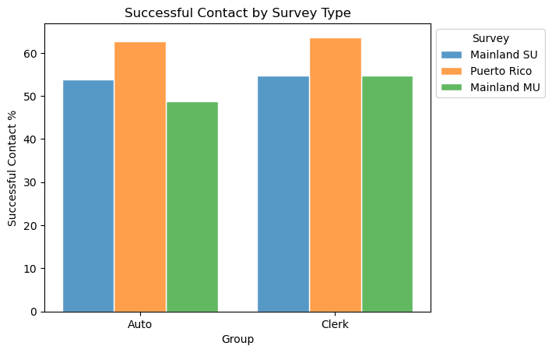
Survey Comparison
Similar successful contact percentage by survey type
Fewer Puerto Rico phones from Auto: ~5k provided via Auto process
Clerks: 34k Puerto Rico phones total
Notes:
Provide a high-level summary. Focus your talking points on how your work fits into the big picture of the Econ Census program. As applicable, expand on the following:
Focus on items that affect other EC22 teams, Econ projects, or programs.
Identify where in the SLC this work takes place
What comes before
Concurrent activities
What comes after
Note: These slides provide leading questions to focus on high level updates. Add slides as needed and remove slides that are not applicable

Slide 12
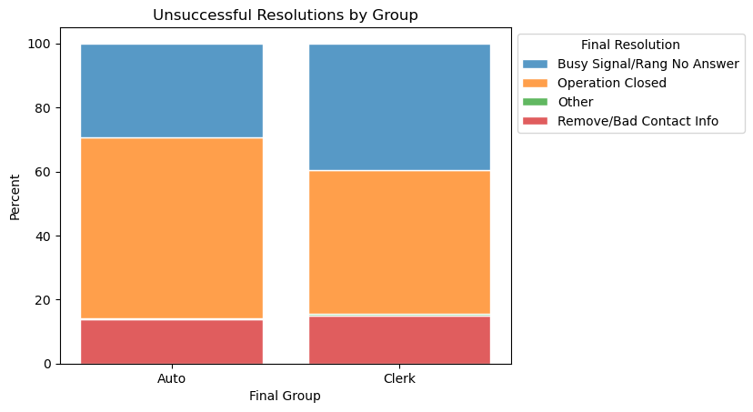
No Successful Contact
Not all phone numbers are high quality
“Other” category includes: “Cancelled”, “suspend for supervisor”
Similar percentages
“Other” is a very
small %
Slightly higher % for
Operation closed
Source: Economic Census 2022 TFU
Notes:
Provide a high-level summary. Focus your talking points on how your work fits into the big picture of the Econ Census program. As applicable, expand on the following:
Focus on items that affect other EC22 teams, Econ projects, or programs.
Identify where in the SLC this work takes place
What comes before
Concurrent activities
What comes after
Note: These slides provide leading questions to focus on high level updates. Add slides as needed and remove slides that are not applicable

Slide 13
Key Take-Aways
Take home: Automated contact collection provides very similar successful contact rate to manual clerk research
53.9% successful contact via Auto
57.6% successful contact via Clerk
Cost: 98% cost reduction for contact research
API used charges per request, not an annual subscription
Similar success rates + drastically reduced cost -> continued use of automatic phone number collection
Notes:
*Mandatory slide
Spell out more thoroughly but succinctly, what your identified audience should take away from this presentation.
If your presentation is purely informational: action item for audience is to let their area know these updates and communicate w/ presenter if there’s any follow up from their area. Share the key elements with their team.

Slide 14
Future Work
Continued contact research!
Annual surveys need to contact respondents
Other pieces of contact information
Ex: email address
Notes:
*Mandatory slide
Spell out more thoroughly but succinctly, what your identified audience should take away from this presentation.
If your presentation is purely informational: action item for audience is to let their area know these updates and communicate w/ presenter if there’s any follow up from their area. Share the key elements with their team.

Slide 15
Questions?
My contact info: John Lombardi – US Census Bureau
John.a.Lombardi@census.gov
Thanks to: Emily Wiley, Clayton Knappenberger, Jason Bauer
Notes:
Final slide:
Questions
Consider adding POCs.

