Slide 1
Exploring New Paradata from Text & Email Contact Attempts in Federal Survey Data Collection
Matt Virgile and Laura Hergert
Office of Survey and Census Analytics
U.S. Census Bureau
2024 FedCASIC Workshops
April 16, 2024
Disclaimer: This presentation is released to inform interested parties of research and to encourage discussion. The views expressed are those of the authors and not those of the U.S. Census Bureau. The paper has been reviewed for disclosure avoidance and approved under CBDRB-FY24-OSCA002-005.

Slide 2
Background – Contact History Instrument (CHI)
Used by Census interviewers (Field Representatives, or FRs) to record each contact attempt in select Federal surveys
  CHI captures mode of contact attempt on first screen
    Mode options formerly limited to personal visit or telephone
    Following CHI screens capture other data (e.g., whether contact made,
    whether interview completed, contact strategies, respondent concerns)
  New CHI mode options added in 2022 for text and email contacts
    May not be used to conduct an interview, but may be used to make contact
    for other reasons
    New following CHI screens capture whether text/email was outgoing/incoming, purpose(s) of contact attempt, who sent an incoming message

Slide 3
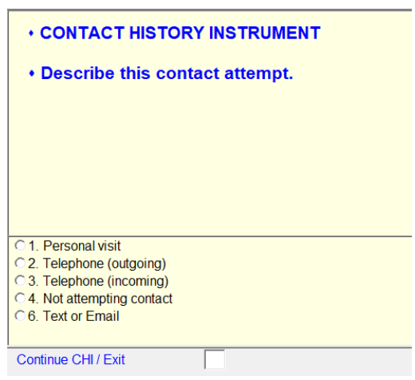
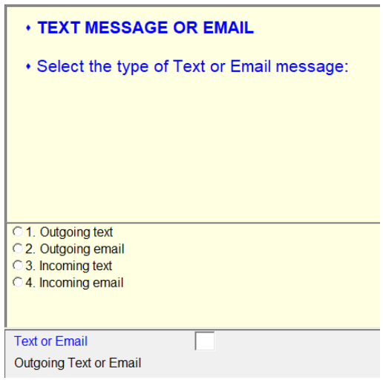
CHI Text/Email Screens (1)

Slide 4
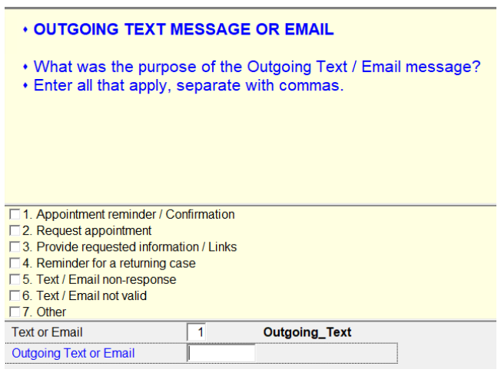
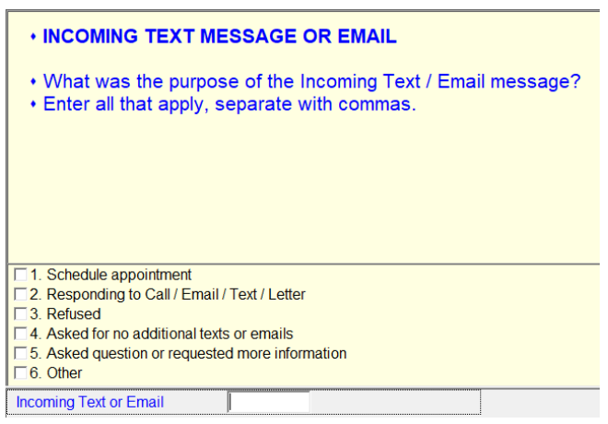
CHI Text/Email Screens (2)

Slide 5
Research Questions
  How common is text/email usage in Federal surveys?
  How does text/email usage vary by Census Regional Office (RO)?
  What are the most common reasons for text/email usage?

Slide 6
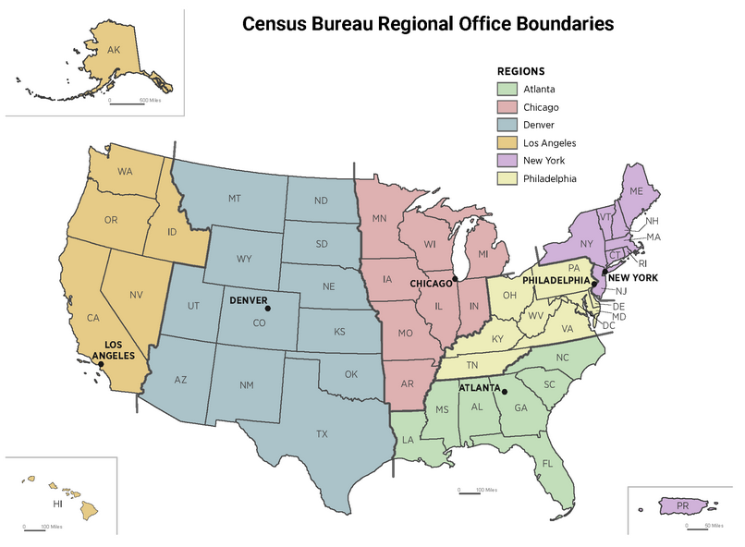

Slide 7
Data
All CHI records in 2023 from two housing unit (HU) surveys
  American Community Survey (ACS)
    300k HUs sampled monthly
    Data collected through mail/web response, with Computer-Assisted Personal Interview (CAPI) sampling for nonresponding HUs
    Non-longitudinal, one interview per HU
  Current Population Survey (CPS)
    60k HUs sampled monthly
    All data collected through CATI/CAPI
    Longitudinal, eight interviews per HU
      Monthly interviews for four months (1-4), then eight months break, then monthly interviews for four months (5-8)

Slide 8
Methods*
For both surveys, compute percentage of:
  Contact attempts made via text/email
  FRs with any text/email usage (overall and by RO)
  HUs with any text/email usage (overall and by RO)
  Texts/emails with a specified purpose option
For CPS only, compute FR-level and HU-level percentages by interview number (1 thru 8)
*Analysis excludes FRs/HUs that were assigned to CAPI but did not have any CHI records

Slide 9
Limitations
Completeness of CHI records
  Some FRs may not record every contact attempt
  Training on capturing text/email in CHI may vary by survey or RO
  Text/email differs from personal visit/telephone since “threads” and gaps in time between messages may be confusing for what to capture in CHI
  Text attempts may also be confounded with telephone contacts since both rely on phone numbers

Slide 10
Analysis 1 – Overall CHI Text/Email Contacts

Slide 11
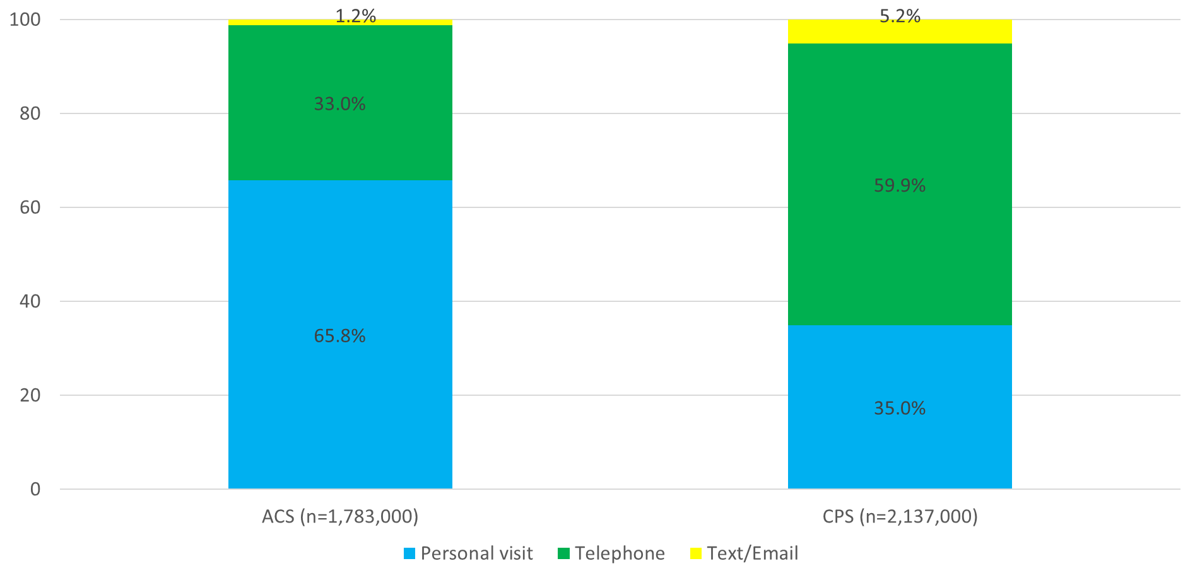
Distribution of All CHI Contact Attempts, by Survey and Mode

Slide 12
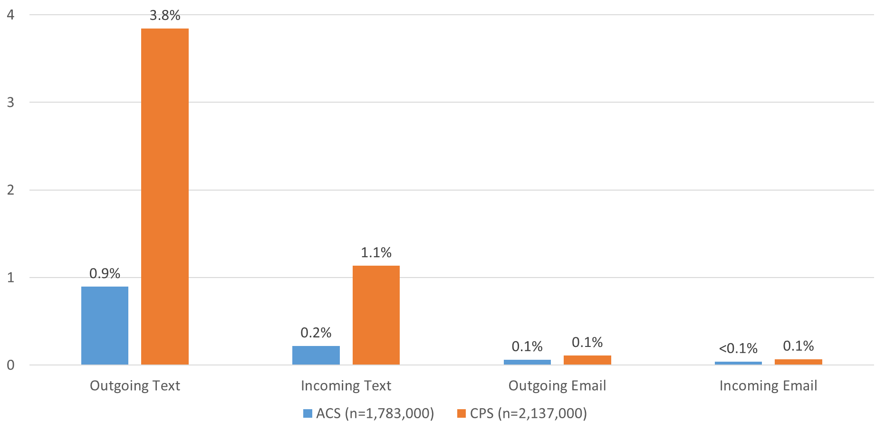
Percent of All CHI Contact Attempts, by Survey and Mode (Text/Email Only)

Slide 13
Analysis 2 – CHI Text/Email Contacts by FR

Slide 14
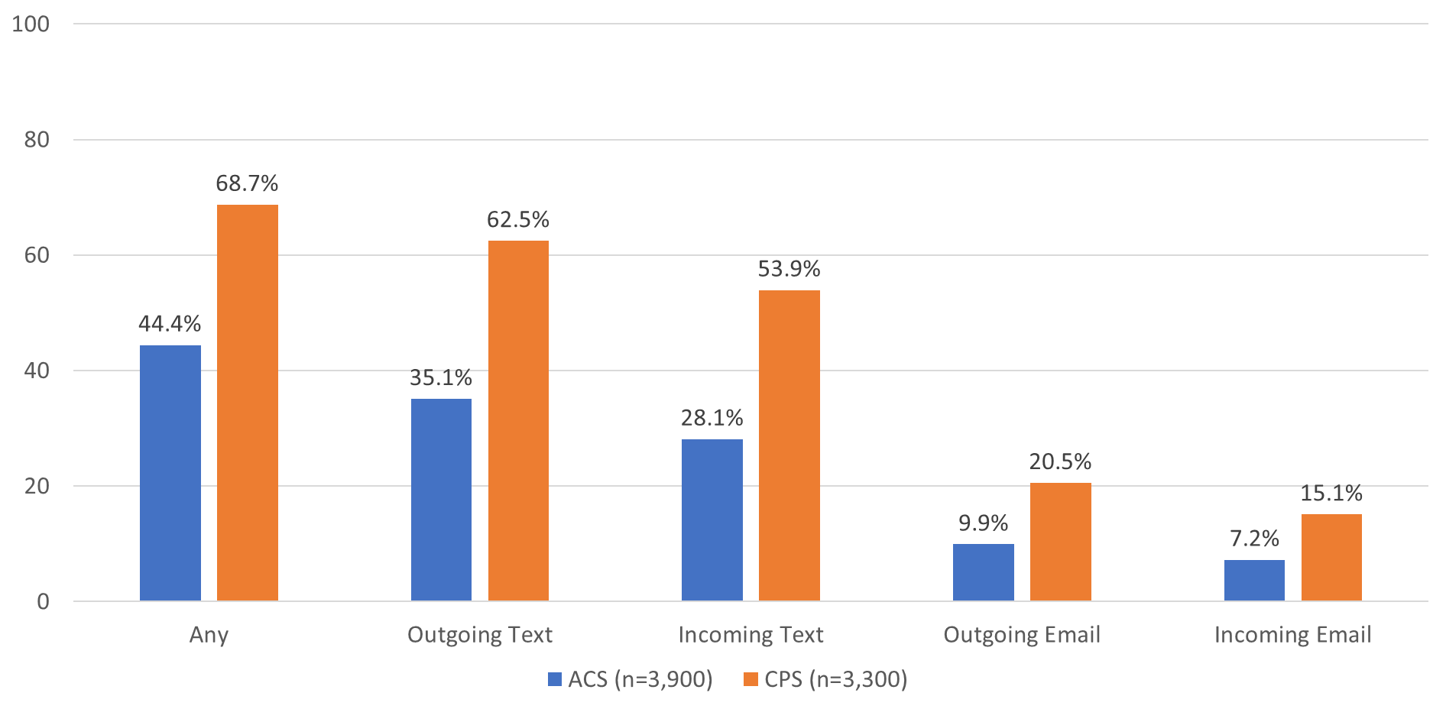
Percent of FRs with CHI Text/Email Contact Attempts, by Survey and Mode

Slide 15
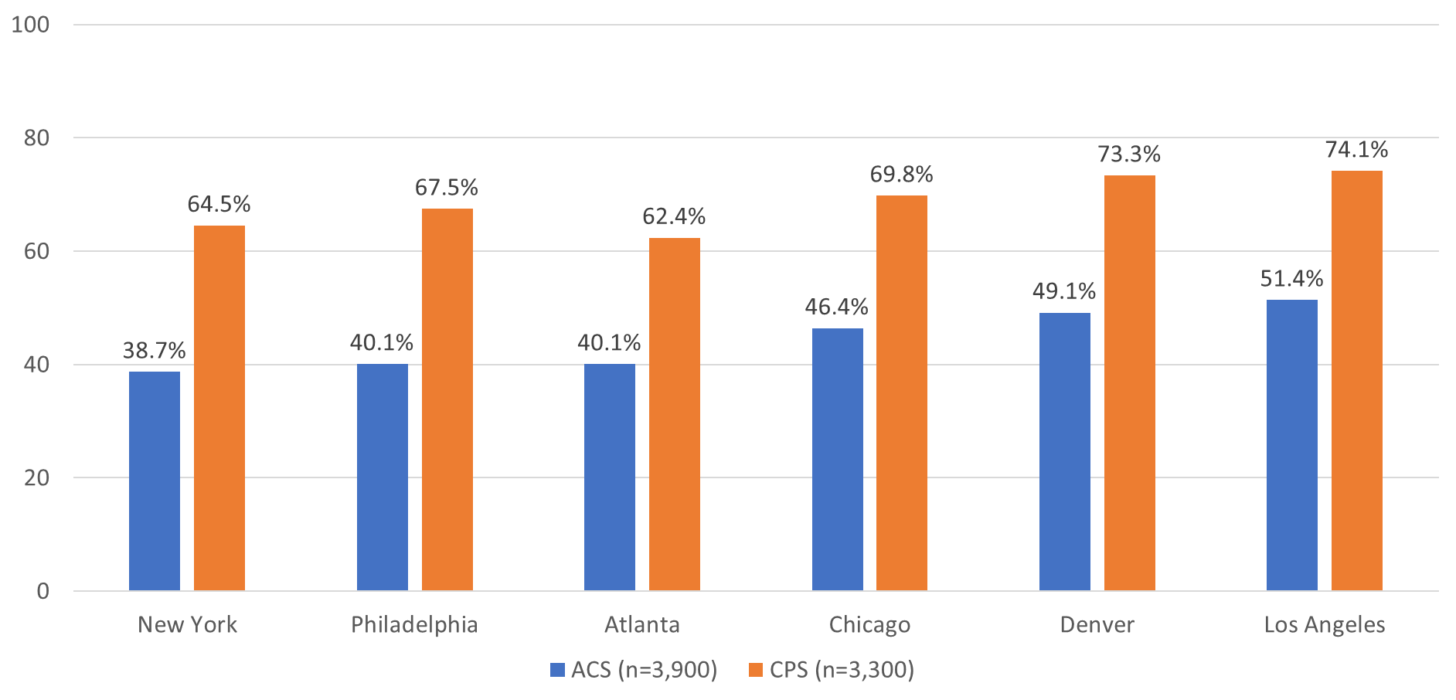
Percent of FRs with CHI Text/Email Contact Attempts, by Survey and RO

Slide 16
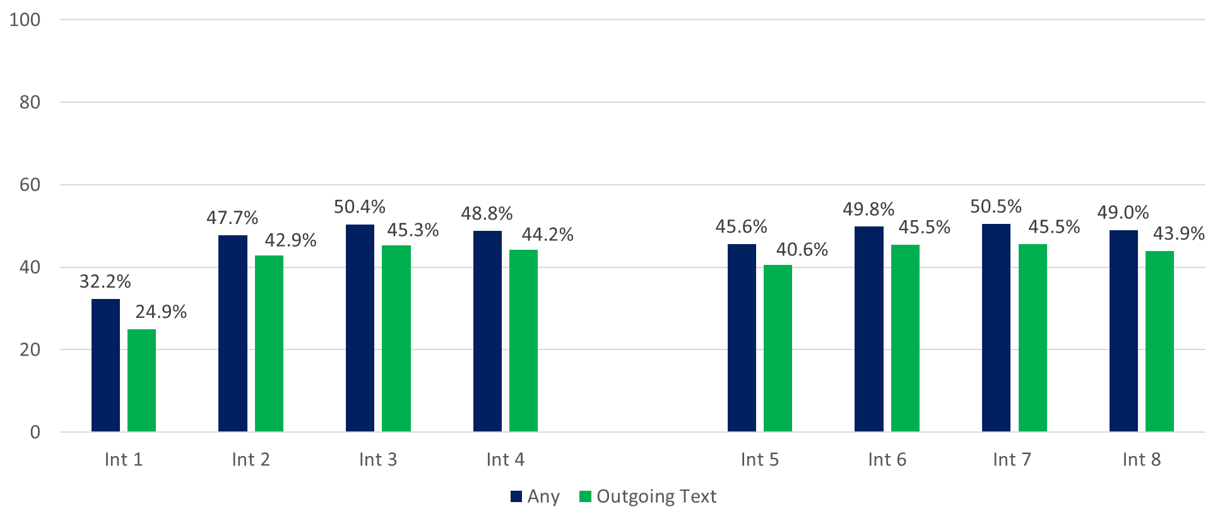
Percent of CPS FRs with CHI Text/Email Contact Attempts, by Interview Number and Mode (n=3,300)

Slide 17
Analysis 3 – CHI Text/Email Contacts by HU

Slide 18
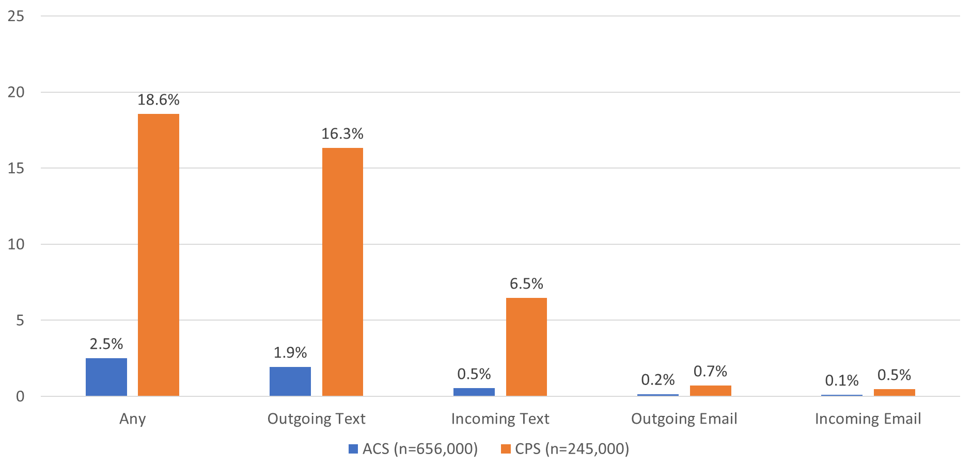
Percent of HUs with CHI Text/Email Contact Attempts, by Survey and Mode

Slide 19
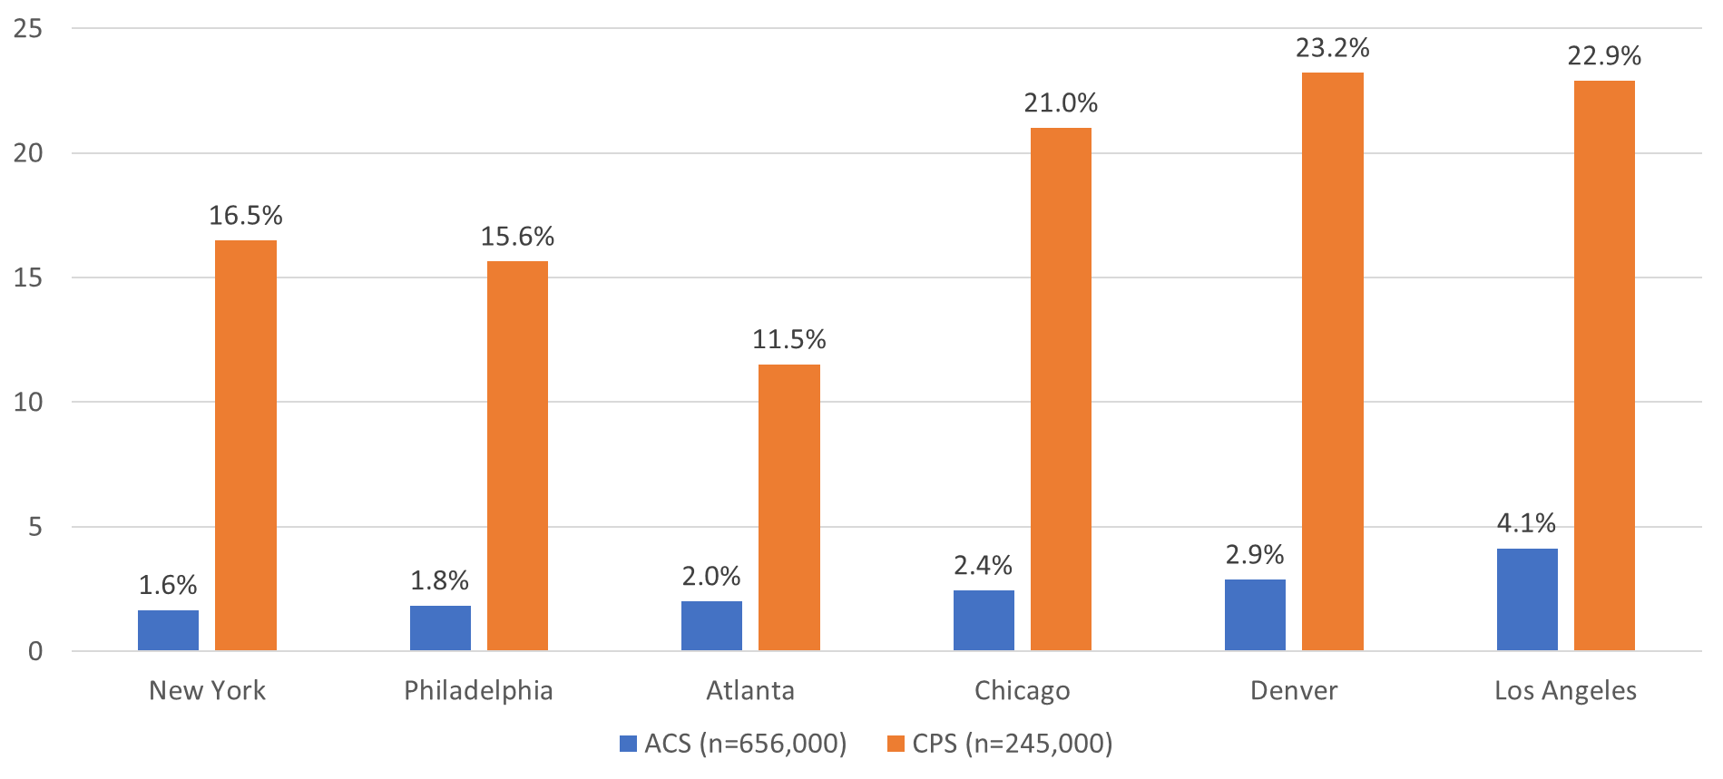
Percent of HUs with CHI Text/Email Contact Attempts, by Survey and RO

Slide 20
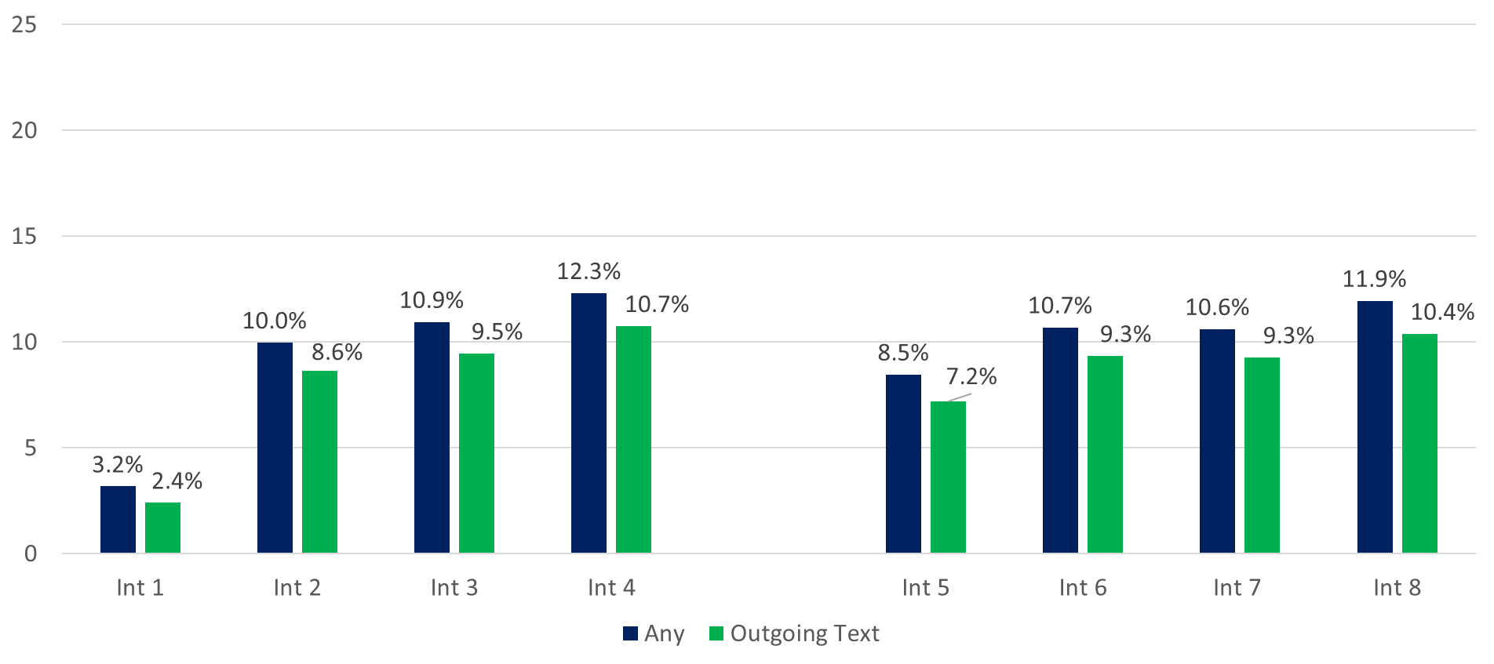
Percent of CPS HUs with CHI Text/Email Contacts Attempts, by Interview Number and Mode (n=245,000)

Slide 21
Analysis 4 – CHI Text/Email Contacts’ Reported Purpose

Slide 22
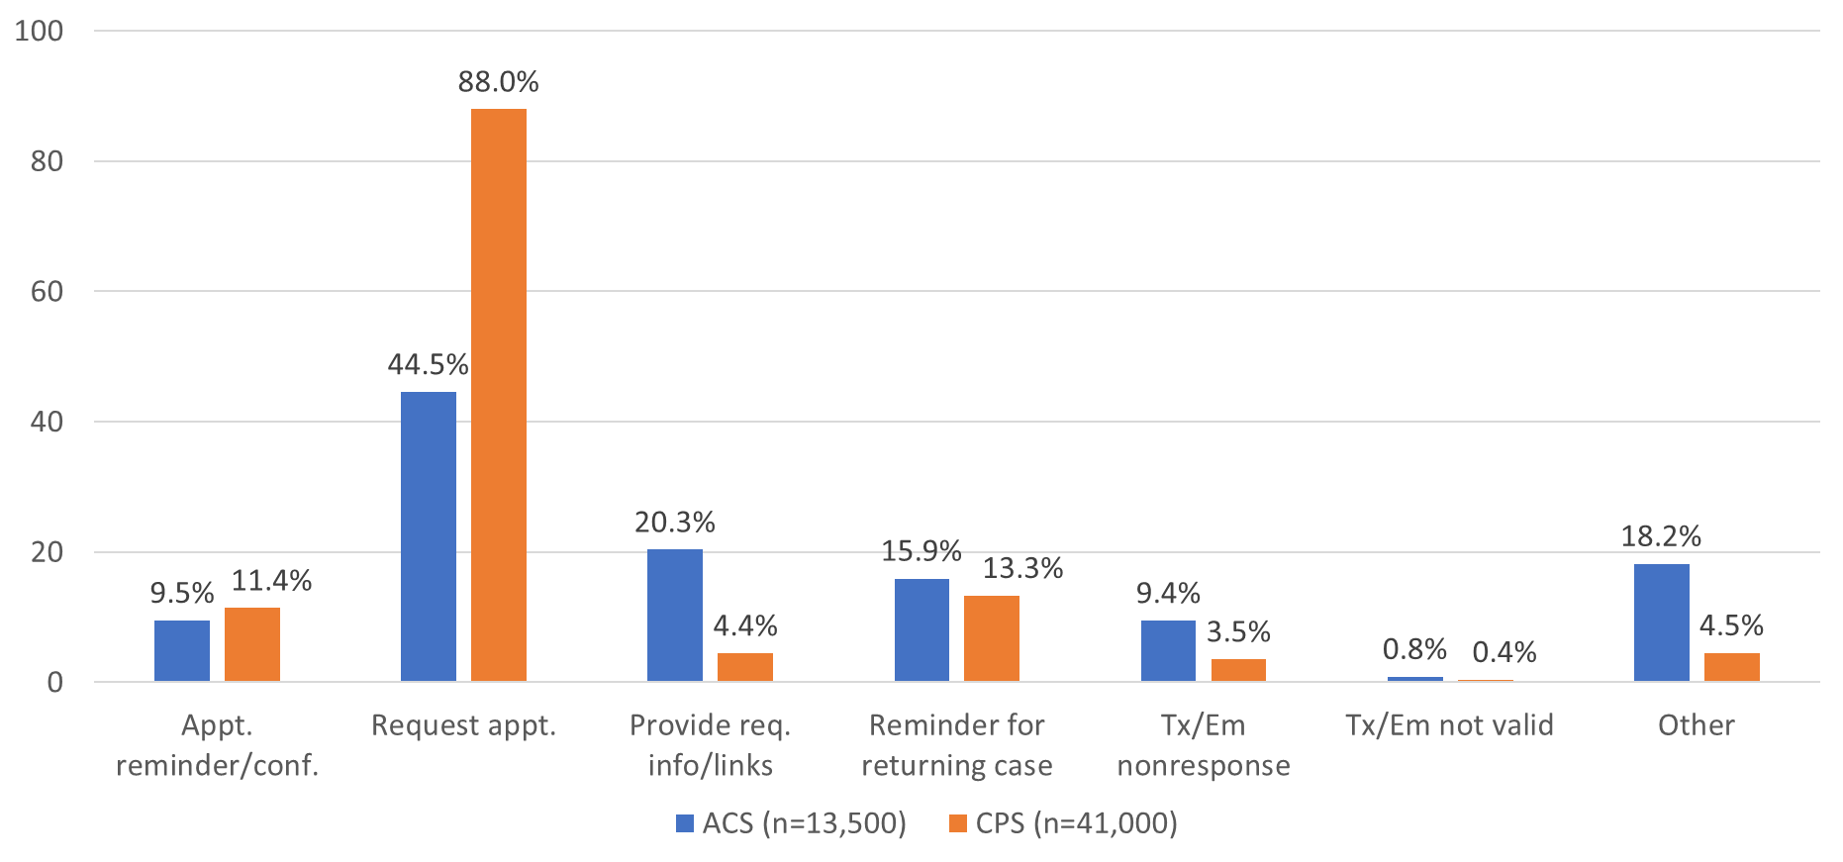
Distribution of HU-Level Outgoing Text/Email Purpose, by Survey

Slide 23
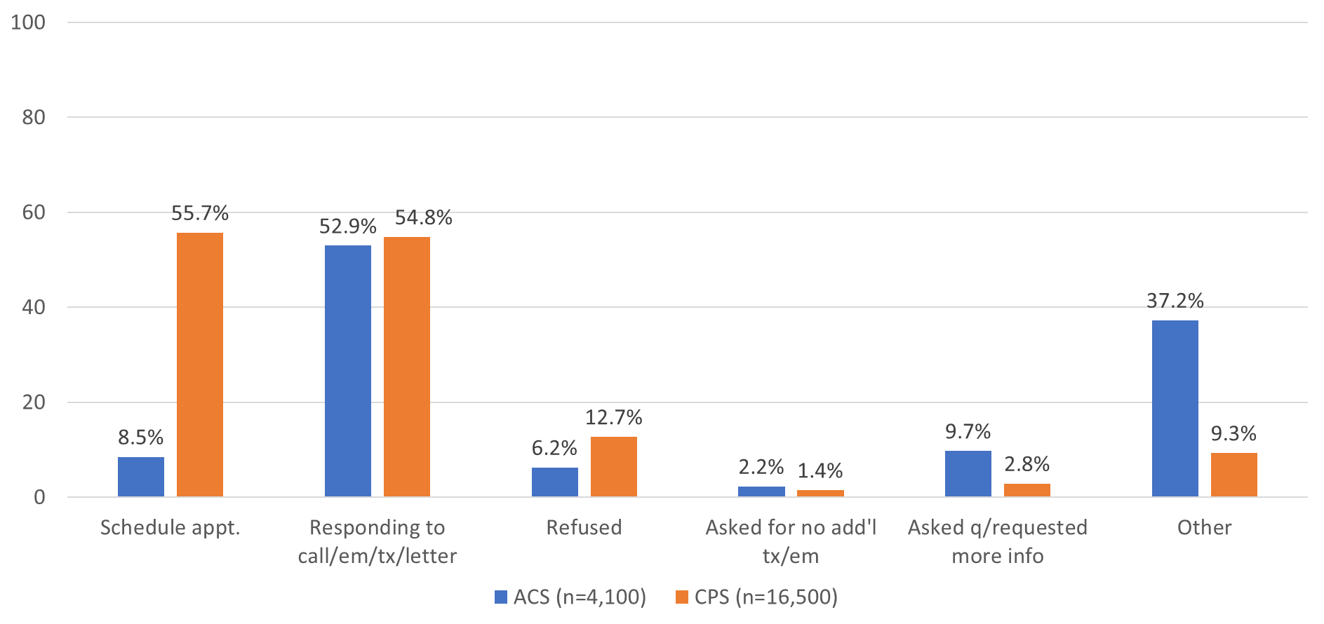
Distribution of HU-Level Incoming Text/Email Purpose, by Survey

Slide 24
Conclusions (1)
Texts and emails make up a low percentage of all contact attempts in CHI
  1% in ACS, 5% in CPS
  Most are outgoing texts, least are emails
Usage varies between ROs
  More common among FRs and HUs covered by Western ROs (Los Angeles, Denver, Chicago) than Eastern ROs (New York, Philadelphia, Atlanta)
  Unclear how much is driven by differences in training, culture, geographic types, or other factors

Slide 25
Conclusions (2)
Text/email usage more common in CPS than ACS
  Likely driven by CPS longitudinal design, with higher usage after the first interview
Text/email reported purpose varies by survey
  CPS-recorded outgoing contacts mostly to request appts (88%), but ACS-recorded outgoing contact purpose varies more
  Both surveys have a majority of recorded incoming contacts as responses to a prior notice (55% in CPS, 53% in ACS)
  CPS-recorded incoming contacts also mainly to schedule appts (56%), but more varied in ACS (37% “Other”)

Slide 26
Discussion
Recent qualitative research by Laura Hergert may provide more insight on text/email usage
  Whether procedures for text/email usage were communicated clearly to ROs
  Whether these were covered in training for FRs
  Whether and when text/email contacts are recorded by FRs in CHI
Findings from FR focus groups will be presented at American Association for Public Opinion Research (AAPOR) Conference in May 2024

Slide 27
Exploring New Paradata from Text & Email Contact Attempts in Federal Survey Data Collection
Matthew.Virgile@census.gov

