Slide 1
Autocoding federal government survey open responses containing rare words to an ontology of terms
Haley Hunter-Zinck
Center for Optimization and Data Science (CODS)
U.S. Census Bureau
FedCASIC
April 16, 2024

Slide 2
Disclaimer
Any opinions and conclusions expressed herein are those of the author and do not reflect the views of the U.S. Census Bureau.
This presentation does not contain sensitive information including Title 13, Title 26, Title 5, other controlled unclassified information, or administratively restricted information.

Slide 3
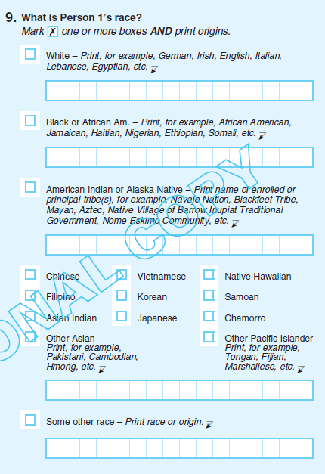
Free text responses to a categorical question are a common format in federal surveys
Categorical survey questions often provide a finite number of defined options along with a free text field
Examples:
Survey | Question | Response
Decennial Census | What is Person 1’s Race? | Mark one or more boxes and print origins
Economic Census | Primary business or activity | Select sector or other
National Survey of College Graduates | What type of educational institution was it? | Mark one answer or other, specify
2020 Decennial Census Questionnaire
https://www2.census.gov/programs-surveys/decennial/2020/technical-documentation/questionnaires-and-instructions/questionnaires/2020-informational-questionnaire-english_DI-Q1.pdf

Slide 4
Categorical questions responses may correspond to a standardized list or ontology of codes
The 2020 Decennial Census adheres to the Office of Management and Budget (OMB) categories for collecting and presenting race and ethnicity data
Respondents can select one or more categories
The 2020 Decennial Census standardized free-text responses to “What is Person 1’s Race?” in two ways
  (1) Automated coding: dictionary lookup in database
  (2) Expert coding: trained specialists coded responses without an exact dictionary match
https://www2.census.gov/programs-surveys/decennial/2020/technical-documentation/complete-tech-docs/demographic-and-housing-characteristics-file-and-demographic-profile/2020census-demographic-and-housing-characteristics-file-and-demographic-profile-techdoc.pdf

Slide 5
Can we extend the automated coding performance to reduce or augment expert review?
There are a few challenges:
Large number of codes
Rare terms
Heterogeneity of responses per code
Inconsistent coverage of codes
…

Slide 6
We can use machine learning techniques to classify free text responses to categorical questions
We can structure the classification of responses as a supervised multilabel classification problem
  Labeled training data is available
  Labels are all possible codes that could be assigned
  Response may be assigned to any possible subset
  Note: distinct from a multiclass classification problem
We construct a generic simulated dataset by randomly generating codes and responses
Code | Prediction
C1 | 1
C2 | 1
C3 | 0
… | …
Response: “asdf ghjd”

Slide 7
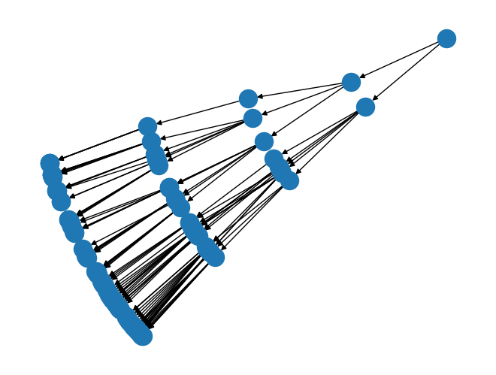
Simulate a standardized ontology of codes
Each node produces a random number of children depending on level in the ontology
Simulated ontology of standardized codes
More detailed

Slide 8
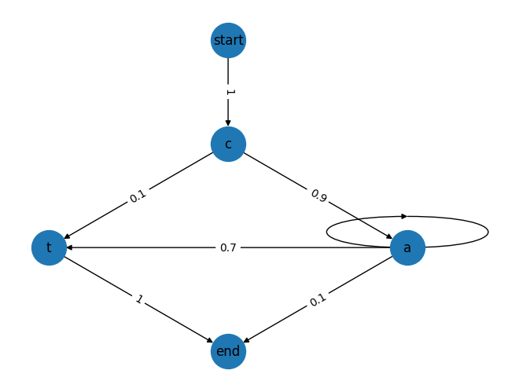
Simulating terms, descriptions for codes
Develop term generator
Download public corpus
Tally character to character transition frequencies
Generate terms
Sample characters from transition diagram until terminal character sampled
Examples of generated terms: 'cat', 'cat', 'cat', 'ca', 'ct', 'cat', 'cat', 'caa', 'caaat', 'cat’, …

Slide 9
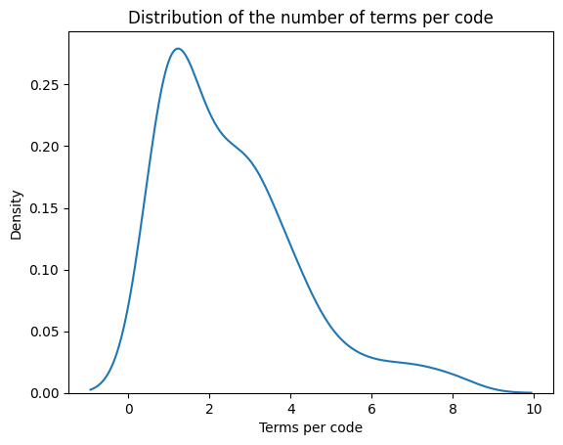
Each code has a randomly sampled number associated unique terms
Each code has a median of 2 associated terms
Example
  Code: C112
  Terms: 'waustw', 'demairiv', 'cins', 'ar', 'thencrer', 'wansus', 'acan', 'ghe'

Slide 10
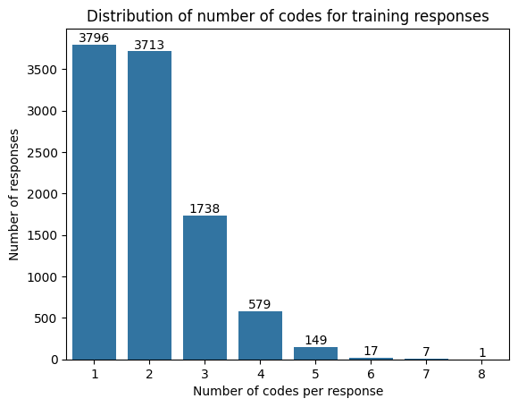
For each simulated sample, we randomly sample codes and their associated terms
An example
- Response: “er”
- Codes: C46
Another example
- Response: “s icar”
- Codes: C66, C54

Slide 11
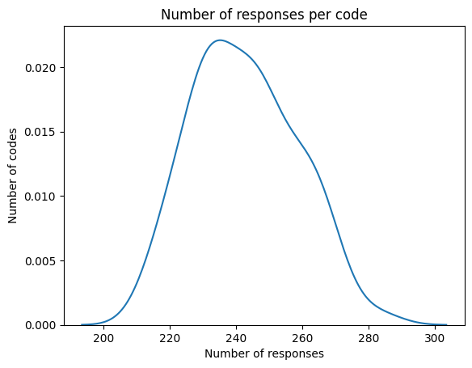
Dozens of codes available at the most granular level of the ontology
Ontology depth and breadth
Level | Number of codes
1 | 2
2 | 8
3 | 28
4 | 81

Slide 12
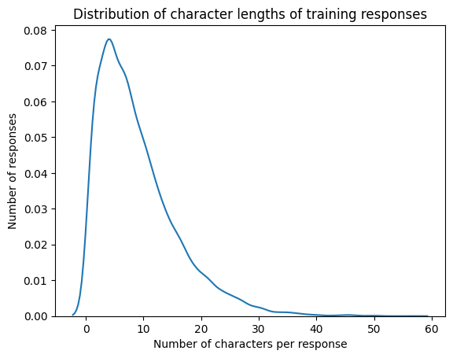
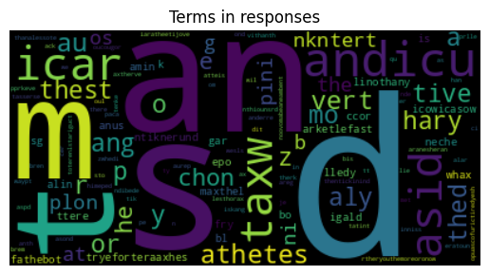
The most common terms are short but simulated responses have a median character length of 7

Slide 13
Methodologies: as a baseline, we use string similarity matching to the response term
Dictionary
Response: “asdf ghjd”
Baseline method
  Mimicking a database lookup with limited entries (training dataset)
Code each response
  Compare each token and dictionary term assigned to a code
  If string similarity (Jaro-Winkler Metric) exceeds threshold (0.8), assign code to the response
Code | Term
C01 | asdf
C02 | ghjk
C03 | zxcv
… | …
Code | Response token | Similarity
C01 | asdf | 1
C01 | ghjd | 0.5
C02 | asdf | 0
C02 | ghjd | 0.88
C03 | asdf | 0
C03 | ghjd | 0
Response: “asdf ghjk”
Codes: C01, C02

Slide 14
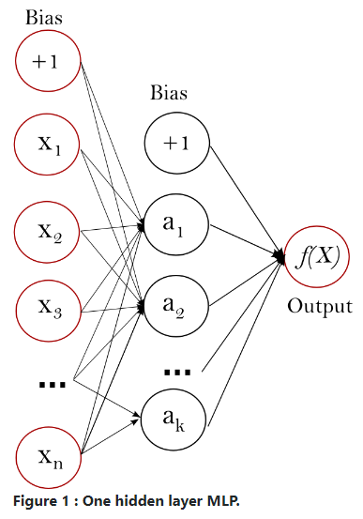
Methodologies: We benchmark a classical machine learning approach
Text representation
  Counts of character bigrams
Machine learning model
  Multilayer perceptron (MLP)
Response: “asdf ghjd”
as | sd | … | ab
1 | 1 | … | 0
https://scikit-learn.org/stable/modules/neural_networks_supervised.html

Slide 15
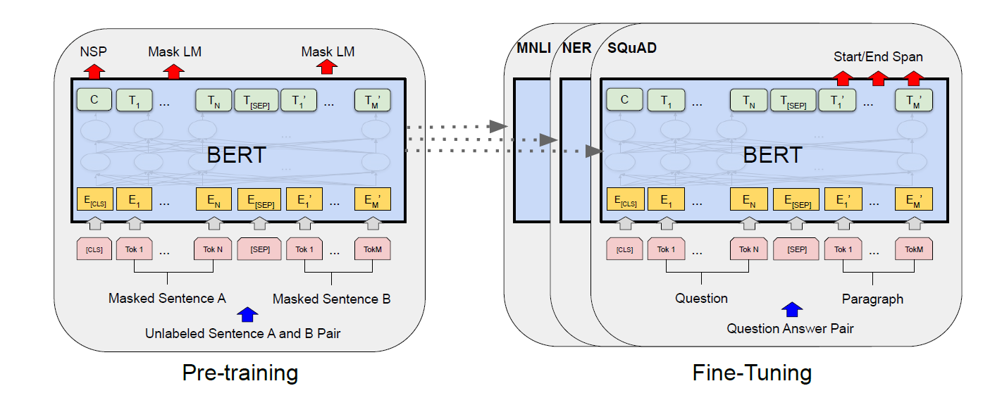
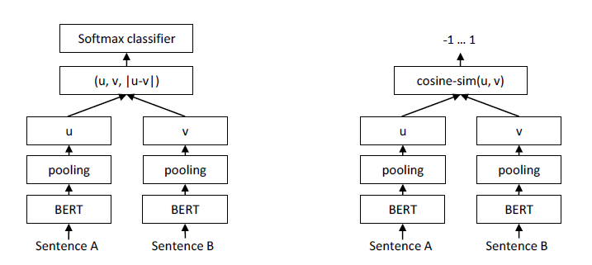
Methodology: And more recent transformer-based text classification methods
Use pretrained models for representing responses as vectors (embeddings)
  Transformer such as BERT
  Sentence-transformer
Fine-tune for classification tasks
  Train final layers for classifying embedded responses
J. Devlin, M.-W. Chang, K. Lee, and K. Toutanova, “BERT: Pre-training of Deep Bidirectional Transformers for Language Understanding.” arXiv, May 24, 2019. Accessed: Mar. 27, 2024. [Online]. Available: http://arxiv.org/abs/1810.04805
N. Reimers and I. Gurevych, “Sentence-BERT: Sentence Embeddings using Siamese BERT-Networks.” arXiv, Aug. 27, 2019. Accessed: Mar. 04, 2024. [Online]. Available: http://arxiv.org/abs/1908.10084

Slide 16



Evaluating model performance
 | High precision (p) | Low precision (p)
High recall (r) | Oracle | Car alarm
Low recall (r) | Space shuttle launch | Random guess
We will use the F1-score, precision and recall
  Value ranges from 0 to 1
  Value of 1 indicates perfect performance
  Values are calculated for each outcome and averaged (macro-averaged)
$$F_{1}=2∗\frac{\text{precision}∗\text{recall}}{\text{precision}+\text{recall}}$$
$$\text{precision}=\frac{\text{TP}}{\text{TP}+\text{FP}}$$
$$\text{recall}=\frac{\text{TP}}{\text{TP}+\text{FN}}$$
How many samples predicted as a label are truly that label …
And how many of the true label samples are predicted as that label.
Harmonic mean of…

Slide 17
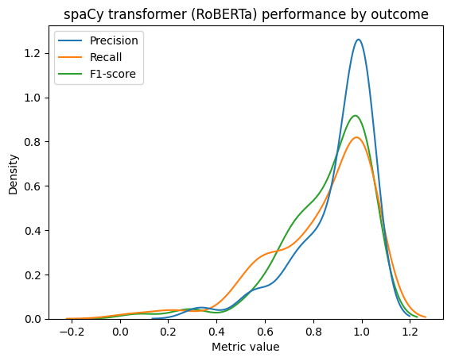
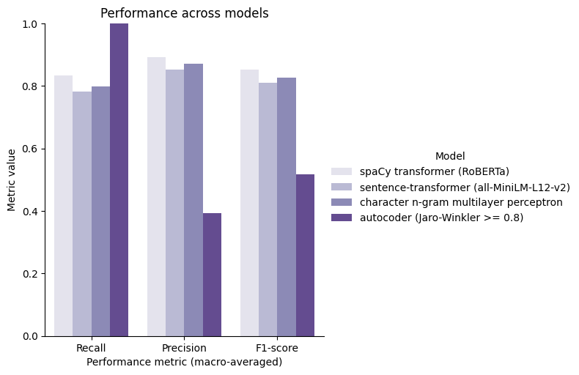
Transformer (RoBERTa*) text classification performs best but character n-gram with an MLP is comparable
* Y. Liu et al., “RoBERTa: A Robustly Optimized BERT Pretraining Approach.” arXiv, Jul. 26, 2019. Accessed: Mar. 27, 2024. [Online]. Available: http://arxiv.org/abs/1907.11692
Note: results apply only to simulated dataset made up almost entirely of tokens that are "out of vocabulary"

Slide 18
Ongoing challenges in the real world
Revisions to standards
  Office of Management and Budget (OMB) has released new guidance on race and ethnicity data collection in federal surveys
Model drift
  Language changes over time
  U.S. Census only happens once every 10 years
Bias
  Under-representation in the training dataset for response classification
  Under-representation in training dataset for pretrained models

Slide 19
Conclusions
Machine learning models may provide advantages over dictionary look-ups
Transformer models provide little added benefit for out-of-vocabulary (made-up) words relative to basic text representations (character counts)
We continue to explore and benchmark modeling strategies to improve performance

Slide 20
Acknowledgments
Louis Avenilla | CODS, U.S. Census Bureau
Nisar Hundewale | Brite Group / CODS, U.S. Census Bureau
Jennifer Hutnick | CODS, U.S. Census Bureau
Tom Thornton | DCMD, U.S. Census Bureau
U.S. Census Near Real Time Race and Ethnicity Coding Working Group

Slide 21
haley.s.hunter-zinck@census.gov

