Slide 1
Opening the Black Box of Self-Employment: Using Machine Learning to Identify Alternative Work Arrangements in the United States
Joelle Abramowitz, Ph.D.
University of Michigan
Andrew Joung, Ph.D. Candidate
University of Michigan
FedCASIC 2024
April 16, 2024
The research reported herein was performed pursuant to a grant from the National Science Foundation Award FW-HTF-P 2128416. The opinions and conclusions expressed are solely those of the author(s) and do not represent the opinions or policy of NSF or any agency of the federal government. Neither the United States government nor any agency thereof, nor any of their employees, makes any warranty, express or implied, or assumes any legal liability or responsibility for the accuracy, completeness, or usefulness of the contents of this report. Reference herein to any specific commercial product, process or service by trade name, trademark, manufacturer, or otherwise does not necessarily constitute or imply endorsement, recommendation or favoring by the United States government or any agency thereof.
Notes:
Future presentations
Extend SE → Self-Employment when possible
Discuss example of business owner paying themselves as an employee
Slide number missing on some slides
Formatting, labels on graphs

Slide 2
Motivation
Self-employment is difficult to measure and includes a breadth of work arrangements with very different characteristics and effects on wellbeing
  Ex. Independent contractor for limousine company, owner-operator of taxi cabs, informally driving as a side hustle, and Lyft driver
Administrative data and household surveys can suffer from incomplete coverage of the workforce or insufficient detail on work arrangements
  Administrative records do not capture employment related to income that is not reported to tax authorities and often lack linkages to important demographics and measures of well-being
  Many household surveys are cross-sectional, do not probe about detailed employment characteristics, and focus on primary jobs only
    Substantial amounts of work are not captured or are inaccurately captured (Allard and Polivka 2018; BLS 2018; Abraham and Amaya 2019; Bracha and Burke 2021; Abraham et al. 2023)
    Discrepancies exist across surveys, and between surveys and administrative data in identifying trends in self-employment (Abraham et al. 2013, 2018, 2021; Katz and Krueger 2016, 2019; Abramowitz 2023; Imboden et al. 2023)

Slide 3
This project produces novel data to enable understanding trends in the nature and prevalence of different work arrangements
We use the 2003-2019 waves of the Panel Study of Income Dynamics (PSID)
The PSID is a longitudinal dataset following families over time with over 10,000 families and 24,000 individuals
In addition to standard questions about work, the PSID asks respondents open-ended questions about their job industry, occupation, and title along with employer names for *all work* for which they were paid *since the last interview two years prior*
We use machine learning of the open-ended questions to classify respondents’ jobs by type of work arrangement

Slide 4
What does the PSID ask about work arrangements?
I'd like to know about all of the work for money that you have done since January 1, [P2YEAR]. Please include self-employment and any other kind of work that you have done for pay.
…
Start with any job that you had during this time. What is the name of this employer?
…
What is the official title of your job? (The title that your employer uses.)
…
In your work for [EMPNAME] ([BEGMO/BEGYR] – [ENDMO/ENDYR]), what is your occupation? What sort of work do you do? What are your most important activities or duties?
…
What kind of business or industry is that in?

Slide 5
Classification approach
Uses narratives and employer names along with machine learning to classify work arrangements – we start with ~170,000 narratives
  Two individuals used open coding to review a small subset of narratives to identify common themes and develop a classification schema
  30% of the data was hand-coded: two individuals reviewed each record and a third adjudicated discrepancies
  Then used machine learning to classify the remainder of the data

Slide 6
The schema classified work arrangements into seven categories
Classification Schema
Platform gig work | Any mention of platform name (per Harris and Krueger (2015) and Wikipedia list of major gig platform companies), or other indication of platform gig work
Self-employed, informal (non-contract) basis | Reports being self-employed and working in roles such as a babysitter, caregiver, cleaner, handyman, doing odd/spare jobs, day laborer, maker, performer, seasonal work, multi-level marketing, sales, freelancer
Self-employed, formal (independent contractor) basis | Reports being self-employed and working in roles such as an independent contractor, subcontractor, consultant, working for an “umbrella” company (e.g., real estate agent at real estate company, financial planner at advisor company)
Business owner or president, or owner of family farm | Says they own/run the business OR mentions business assets AND lists business name
Self-employed manager | Reports being self-employed and managing a business, but does not report owning it
Employee or employed manager, not short-term/contingent | Does not report any of the above roles and reports working for someone else for pay
Short-term/contingent employee | Reports working for someone else for pay on a short-term basis or as a temp agency worker

Slide 7
Predicting Labels Using Machine Learning
Step 1 (Training): Machine learning algorithms (= classifiers) are trained on labeled data in which each narrative is assigned one of the seven schema categories (= labels)
  Classifiers learn models and get adjusted for better performance
Step 2 (Evaluation): Based on the models learned from Step 1, classifiers predict labels for new narratives with labels
Step 3 (Implementation): classifiers predict labels for new narratives without labels

Slide 8
We improve on traditional machine learning models by using BERT
A classifier is trained on a vector of tokens encoded by a pre-trained language model BERT (Bidirectional Encoder Representations from Transformers)
  BERT is a language model trained on a huge corpus to predict which word would occur after a sequence of words (masked language modeling)
  It pre-processes tokens by its own way (WordPiece Tokenizer) and trains itself without labels relying on contextual information of words
Narratives are (1) converted into token embeddings, segment embeddings, and position embeddings, (2) fed into BERT to produce representations of tokens, (3) predicted for labels with probability scores by a feed-forward neural network with softmax function
Notes:
Embedding = vector representation

Slide 9
Performance Evaluation
Precision (P) & Recall (R)
Trained and tested on hand-labeled data of 48,787 narratives
 | Label A |  | Label B |  | Label C |  | Label D |  | Label E |  | Label F
Measure | P | R | P | R | P | R | P | R | P | R | P | R
Base Method | 0.55 | 0.37 | 0.73 | 0.35 | 0.71 | 0.27 | 0.73 | 0.36 | 0.79 | 0.98 | 0.00 | 0.00
BERT | 0.00 | 0.00 | 0.75 | 0.81 | 0.54 | 0.59 | 0.68 | 0.51 | 0.96 | 0.97 | 0.70 | 0.58
14% of all narratives
69% of all narratives

Slide 10
Automatic Prediction + Post-labeling
BERT-based prediction is conducted on the target data of 119,424 narratives
  BERT-Base (cased) model with hyperparameters of max length = 100, batch size = 16 , epoch = 4, and learning rate = 5e-5
  Run on a Linux machine with an NVIDIA GPU (8G RAM) and an Intel Xeon CPU
Predicted labels with less than 0.95 probability scores are passed to human coders for manual labeling
  11,208 narratives are filtered for manual labeling
  9,630 (probability < 0.90) vs 4,627 (probability < 0.85)

Slide 11
One challenge we encountered was implementing the approach in an Internet-free environment
The survey narratives are highly classified as they could reveal Personal Identifiable Information about respondents’ employment
We were not permitted to implement the approach in an internet enabled environment
We applied the approach on a “dumb” machine without access to the internet in a secure facility (closet), developing necessary implementation protocols
Following implementation, the machined was wiped

Slide 12
The result of these efforts is a new variable with the schema categories
The machine learning approach allows us to implement these methods at scale in a way that is replicable for classifying future waves of data
We can use the variable classifying work arrangements for research and will make it available publicly for use by other researchers
It is possible to use this machine learning approach to examine other characteristics of these and other narratives
Next, I’ll share a few topical findings resulting from the data produced by this approach

Slide 13
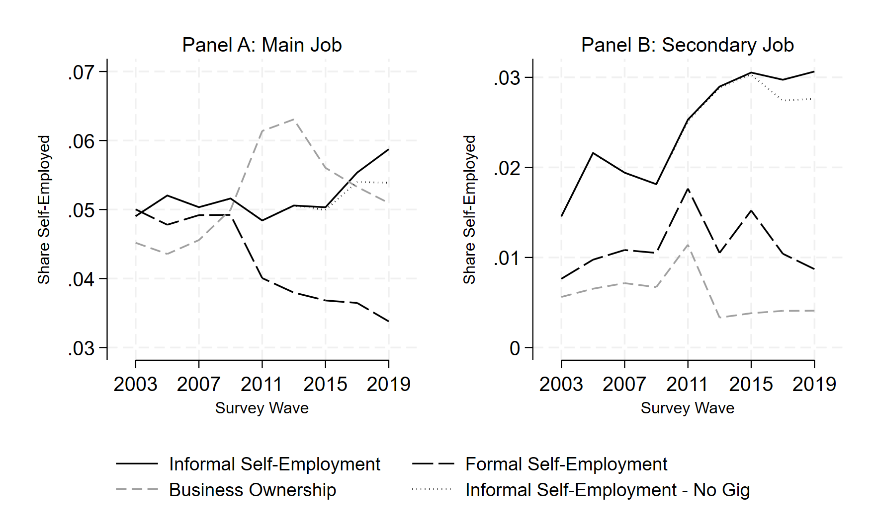
Examining different types of self-employment shows divergent trends
Source: 2003-2019 PSID data including employer names and industry and occupation narratives. Estimates are weighted using cross-sectional weights. Restricted to respondents age 16+ and who report being employed.
Notes:
Y-axis reports population shares (including those not in labor force in the denominator)
In the first panel, we look at current main jobs, in the second we consider any currently held job
We also will report any employment or population shares from only 2003 onward due to changes in how we identify those with and without a current job around 2003
Declines in business ownership and formal SE shares
Rising informal SE share, especially when looking at any job

Slide 14
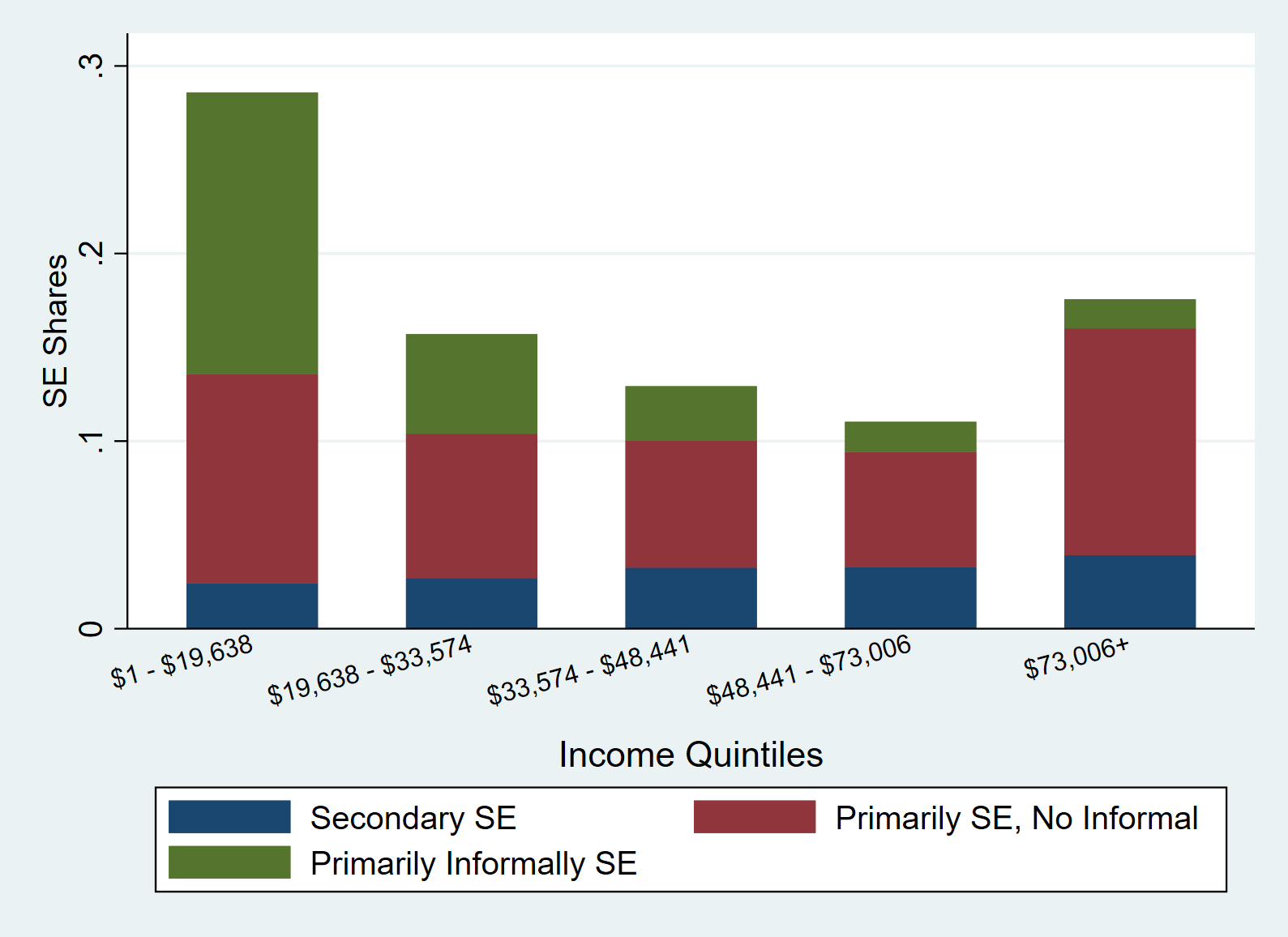
We see a U-shaped distribution of self-employment over income, but the composition of self-employment varies
Source: 2003-2019 PSID data including employer names and industry and occupation narratives. Estimates are weighted using cross-sectional weights. Restricted to respondents age 16+, and who report being employed and non-zero labor income.
Notes:
Y-axis reports population shares (including those not in labor force in the denominator)
In the first panel, we look at current main jobs, in the second we consider any currently held job
We also will report any employment or population shares from only 2003 onward due to changes in how we identify those with and without a current job around 2003
Declines in business ownership and formal SE shares
Rising informal SE share, especially when looking at any job

Slide 15
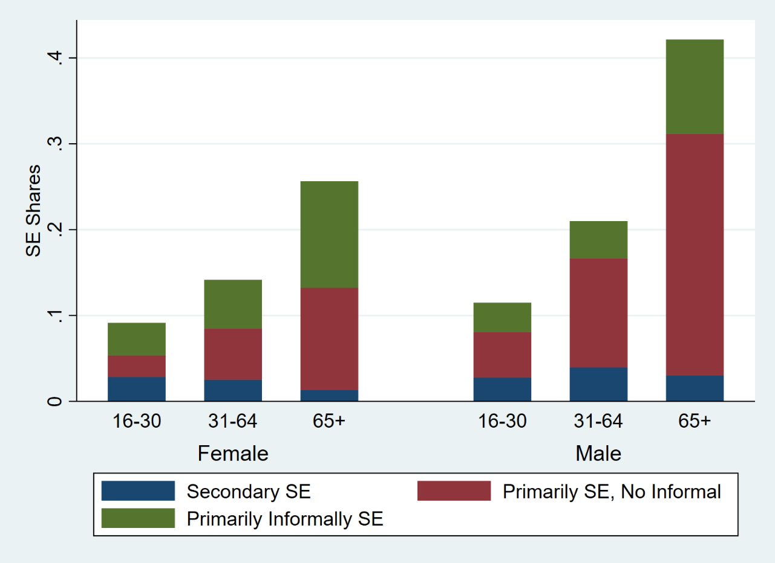
We also see that employed women are more likely to be informally self-employed while employed men are more likely to be “non-informally” self-employed
Source: 2003-2019 PSID data including employer names and industry and occupation narratives. Estimates are weighted using cross-sectional weights. Restricted to respondents age 16+ and who report being employed.
Notes:
Y-axis reports population shares (including those not in labor force in the denominator)
In the first panel, we look at current main jobs, in the second we consider any currently held job
We also will report any employment or population shares from only 2003 onward due to changes in how we identify those with and without a current job around 2003
Declines in business ownership and formal SE shares
Rising informal SE share, especially when looking at any job

Slide 16
Takeaways and implications for future work
Our approach identifies otherwise masked heterogeneity in self-employment work arrangements and permits implement these methods at scale in a way that is replicable for classifying future waves of data
The produced data are being made available publicly
We also implemented the classification approach on HRS data, revising the HRS classification based on lessons learned from the PSID
Future work could use similar approaches to identify other characteristics of interest in these data as well as other types of narrative data in the PSID and other surveys
These methods could support changing the way we ask survey questions, for example, asking more guided, open-ended questions
This preliminary work is important for identifying the limitations of these approaches

Slide 17
Thank You!
Joelle Abramowitz
jabramow@umich.edu

