Slide 1
Looking for the Needle in the Haystack: Exploring Rare Topics in Large, Unstructured Text Data
Curtiss Chapman & Elizabeth Nichols
U.S. Census Bureau
FedCASIC 2024 - Virtual
April 15/16, 2024

Slide 2
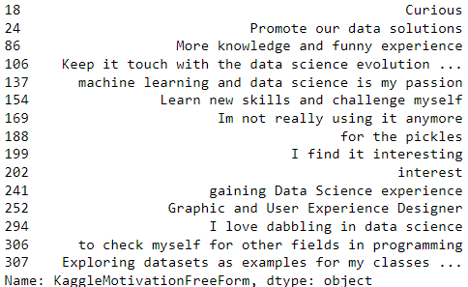

Investigating Text Data
Federal survey research w/text data
  Open-response questions
  Conversation transcripts
Typical goal: extract common response categories
  Easy: pivot tables, keyword grouping, cluster analyses
Alternative goal: extract rare categories
  Less straightforward
passion
for my job
for the challenge
?
nefarious purposes

Slide 3
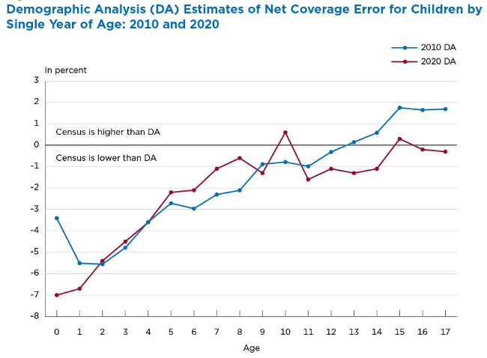

Rare topic search:
Undercount of Young Children in CQA
Children < 5yo consistently undercounted in Census compared to demographic analyses
2020 Census Questionnaire Assistance (CQA)
  Telephone support line; ~4.7M recorded calls
    I already submitted my Census forms--why am I still being visited by Census workers?
    How do I answer the race question, given my ancestry?
  ~91K calls transcribed
RARE: Undercount not a main topic logged by CSRs
RELEVANT: however, CQA could help understand if confusion contributes to undercount
Notes:
So let’s talk about a method of approaching this kind of rare topic search.

Slide 4



Finding Rare Topics—Keyword Approach
Natural first pass—find transcripts including relevant keywords
  Find examples of what matching transcripts look like
  Does this method alone work?
Topics:
  Undercount of young children (UYC) - any calls with relevance to troubles counting young children (< 5yo)
  Death affecting vacancy/count
  Canadian citizenship affecting vacancy/count
Method
  From 91K transcribed calls, took those labeled "general assistance" or "technical issue“ (64.5K)
  Searched for transcripts with topic-related keywords
  Coded for the presence of the topic

Slide 5
Finding Rare Topics—Keyword Approach
Keywords
UYC
  e.g., child, kid, baby, babies, pregnant, infant, newborn, little girl, little boy, two-year-old, custody, divorce, foster, stepchildren, grandbaby, grandson, granddaughter, SNAP benefits, TANF
  Full set of child keywords yielded 5600 transcripts--too many
  Restricted to a subset (baby kws, infant-related kws, little kid kws, stepchild kws)
  Found & coded ~400
Death:
  dead, died, death, passed away, deceased
  Found ~1900 transcripts—too many
  Coded ~400 randomly sampled
Canada:
  Canada, Canadian
  Found ~300 transcripts, coded all

Slide 6
Finding Rare Topics—Keyword Approach
Keyword Results
Good amount of transcripts found
  UYC: “What do you do when you have fifty fifty custody so they're fifty percent in one home and fifty percent in another home…”
  Death: “My mom received some of your census papers and she's passed away…I just wanted to let you know that you could take her name off your list”
  Canada: “I’m a Canadian resident owning property here in Florida…we’re only here seasonally—do I have to complete this Census?”
Topic | Total | Related
UYC | 400 | 100
Death | 400 | 150
Canada | 300 | 200
Notes:
Totals:

Slide 7
Finding Rare Topics—Keyword Approach
Keyword Results
But is this all of them? Unlikely.
  Not all keyword-matched transcripts were searched
  Missed keywords or phrases?
  Maybe some aren't easily matched by keywords:
    My wife and I share our kids half the time, should I count them or should she?
    We lost my mom back in February, so her house is empty now.
    I'm not from the US/live outside the country, do I have to do the Census?
How do we search the remaining 90K transcripts?
  Good ML problem—use labeled set to predict new set
Topic | Total | Related
UYC | 400 | 100
Death | 400 | 150
Canada | 300 | 200
Notes:
Totals:

Slide 8

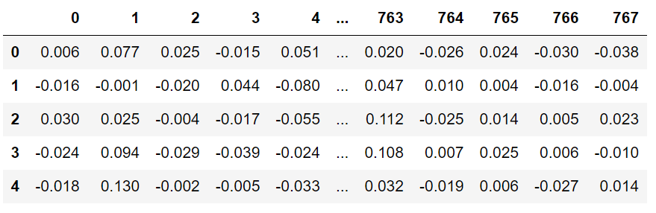


Finding Rare Topics—Machine Learning (ML) Approach
Doc | Label
T1 | 1
T2 | 0
T3 | 1
T4 | 1
General approach: use full labeled transcripts to predict similar transcripts
ML Models require numerical data
  Turned transcripts into numerical vectors that
  preserve meaning information
For each topic, tuned & trained XGBoost model on labelled transcripts (n~300-400), predicted on remaining transcripts (~91K)
Doc | Label | Pred
T5 | ? | 1
T6 | ? | 1
T7 | ? | 0
T8 | ? | 0

Slide 9
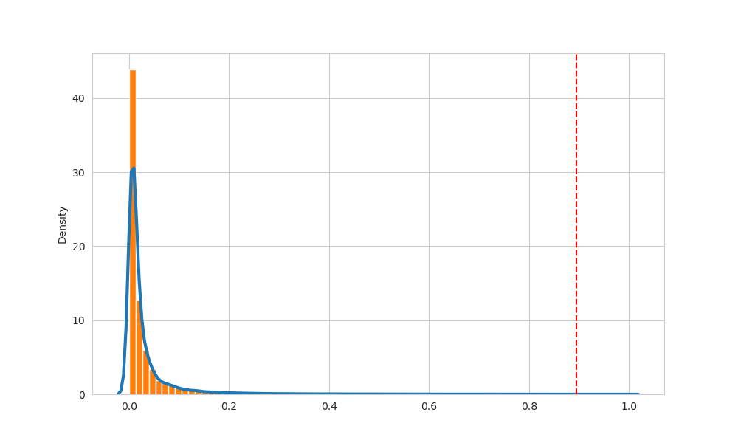
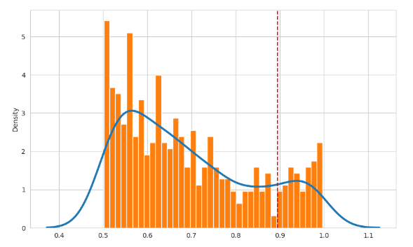
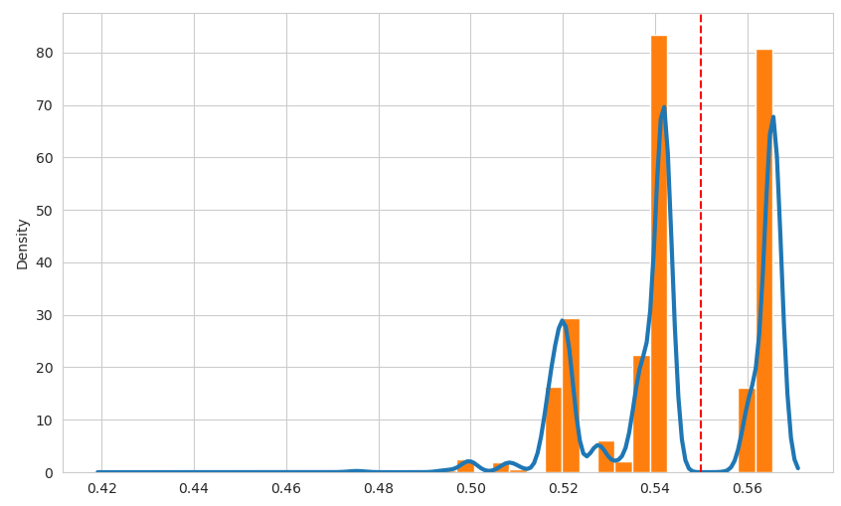

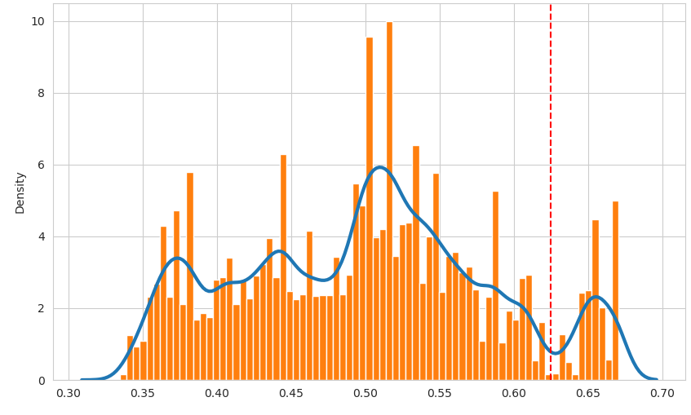
Finding Rare Topics—Machine Learning (ML) Approach
Assessing Model Accuracy
Models predict probability that each transcript belongs to the topic
How to determine what probability is high enough?
  Look at the distribution!
Each topic had a unique cutoff point
UYC
Death
Canada

Slide 10
Finding Rare Topics—Machine Learning (ML) Approach
`
Model | Model Prob. Cutoff | n > Cutoff | n Assessed | Accurate
UYC | 0.89 | 70 | 200 | 20
Death | 0.62 | 7800 | 200 | 0
Canada | 0.55 | 33500 | 200 | 0
Assessing Model Accuracy
Conclusions
  UYC model did pretty well—shows method can be useful!
  Death and Canada models perform poorly
    Small sample?
  Keywords may be sufficient for Death & Canada
    Esp. Canada—likely to mention “Canada”, “snowbird”
Canada

Slide 11
Future Directions: Improving Prediction of Rare Topics
sure all right god i got this in the mail today since his twenty twenty uh and it's to the resident which and i'm i'm i'm the resident at this property i'm canadian uh i'm in florida and i'm here about four and a half months a year and i read somewhere that says somebody here most of the time well on the uh fifty fifty spent most of the time there's nobody here do i need to complete this Census okay but i'm i stay in a different country so eighty percent of the time i'm in canada twenty percent of the time i'm in the u s now i'm a non resident of the united states right so again where you said that where i stay and sleep most of the time is in canada okay and what if i don't like giving up the information that's on here in other words what if i think it's none of the government's business at this point in time in i'm not trying to be obnoxious i'm asking a question okay so um my sorry about this but again i'm a canadian so i in canada we don't ask things like what is my race it's none of their business uh what is my sex what if i prefer to not tell you we have generation actor sex acts at home we don't have sex as here what if i don't want to tell you that you a private question is that i don't think i should be be answering as a non citizen of the united states you're going you're going by a script there and i would hate like hell to think that that's what we're basing everything on i oh come on now this is costing me money here but you're not answering my question and that's not of any concern of mine but you spend your money on as a u s government i am not a u s citizen or youre not pay taxes here but my rest my i don't think that i'm bound by u s law to do that and the question that i asked you previously still stands there are questions here that are really none of your business or the u s government's business not yours personally please don't take anything personally um but there are questions here that are really none of your business and then you ask me what my sexuality is and that's none of your business right so so so if i'm if i'm if i'm if i'm a transgendered person what does one put in there you see that's none of your business and and and my race really has nothing to do with you so far as the u s government is concerned and seventy percent of the time my residence is not in the united states a or so if that's my can i qualify that qualify if that is my permanent residence is another country then it's not a question of whether i'm saying it's a christian of whether i'm living okay i live in canada i'm staying here in the u s i live in canada so i don't need to i don't need to do okay all right that's that's that's fine that's all i need to know all right uh no that's great other than this there are one point two million canadians in florida at this point in time winter down here in florida okay and they're probably all looking at the same question here looking at looking for the same thing uh the eight hundred number because most of us have canadian self phones doesn't work with a canadian self phone so i'm sitting here for u s account paying long distance for fifteen minutes to get that squared away somewhere along the line someone may want to address either on line or with the phone number itself so that the canadian people can call through the on that phone number they won't accept a canadian number because it's a a u s eight hundred number and that's not your responsibility but if you report that to somebody who it is then they'd appreciate it so would all the other canadians thank you sorry to give you such a hard time right you too
yes you do okay i received the sentence today but i'm canadian so i can't really do anything with this and i'm only here i'm at snowbird four months a year i'm definitely not american okay well i'm the first one unless people just don't answer back if they are or they ignore it maybe sure thing you did did you i will not be i will i will not be yes oh i will not be here april one well it'll ok maybe it isn't with the corona virus maybe it's good that i'm leaving but it's all over the world so it doesn't matter yes we are absolutely absolutely oh i didn't hear that that's interesting to note maybe because it's too cold mine it's not as cold as it used to be up there anyway yeah everything's melting yes it is okay so we helped each other thank you great thank you bye bye thanks you too bye bye
Today’s model: Used full labelled transcripts to predict similar transcripts
Drawbacks
  Transcripts can be very long
    median ~ 140 words, max ~ 1000
  Multiple topics broached, even in smaller transcripts
To improve: match shorter texts, less diluted signal
  Extract most topic-relevant sets of words
  Predict on transcripts snipped into smaller pieces
General method can be useful for many datasets, but revised method may be better for cases similar to CQA

Slide 12
Special Thanks
Monica Puerto
Crystal Hernandez

Slide 13
Thank you!
Any questions?

Slide 14
Supplemental Slides

Slide 15
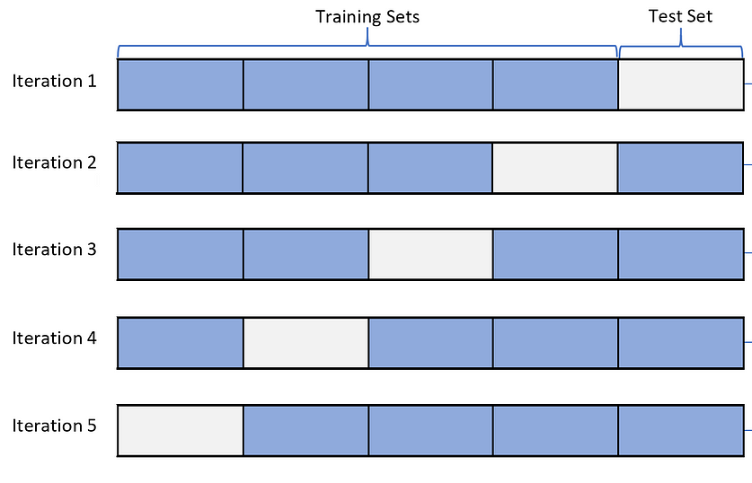
Model Tuning
For each set of model parameters:
  Split labeled data, train model on 80%, predict on left out 20%, grade accuracy of predictions
  Model learns patterns in training set to maximize prediction
  Do 80/20 split 5 times to cover all data (cross-validation) and get average prediction
  Choose parameters that maximize accuracy of predictions on average

Slide 16
Identifying UYC Calls: Modeling
Method
406 labelled transcripts (94 UYC-related, 312 unrelated)
Prepare model training datasets from labelled data
  Full transcript embeddings, shortened embeddings, dimensionally-reduced versions (UMAP; 2, 4, 6, 8)
  + binary word variables from topic modelling & manual labelling – create potential high-value features
Estimate stability of modeling procedure: Nested cross-validation
(CV; Stratified K-folds)
  XGBoost classifier model
  Inner CV tunes hyperparameters (Randomized search, 200 iterations, k=5)
  Outer CV shows variability of tuning & model performance (k=5)
  Iterated to find optimal training dataset
Estimate model hyperparameters: single cross-validation
  One iteration of the inner loop from the nested CV, but with the full dataset
Train optimal model on full, labelled dataset
Predict on full dataset
  90661 caller transcripts not overlapping the training dataset
Keyword transcripts
FAQ transcripts
Potential Training Data
MPNet_raw + words
MPNet_short + words
UMap_2 raw + words
UMap_4 raw + words
UMap_6 raw + words
UMap_8 raw + words
UMap_2 short + words
UMap_4 short + words
UMap_6 short + words
UMap_8 short + words
Est. Modeling Procedure Error
Modeling
Est. Model Hyperparameters
Train Final Model
*** Predict ***
Notes:
Nested cross validation estimates the stability of the fitting procedure—do I get a wide variety of parameters, am I overfitting, is my prediction error low and stable?
Hyperparameter space:
N_estimators = 20-200
Max_depth = 3-15
Learning_rate = .001-.1
224 transcripts matching raw data predictions >.5
481 transcripts matching shortened data predictions >.5

Slide 17
Nested Cross-Validation
Inner Loop
Helps estimate the error in the overall model
Inner loop selects best model (including parameters)
Outer loop estimates quality of models in inner layer
Test
Loop 1
Loop 2
Loop 3
Loop 4
Train
Validate
Train
Train
Train
Train
Train
Loop 1
Validate
Train
Validate
Train
Validate
Outer Loop
Train
Validate
Train
Train
Train
Test
Loop 2
Train
Train
Validate
Train
Train
Train
Validate
Train
Validate
Notes:
Cross-validation generally is showing you the expected error of the model building process.
If you’re just tuning a model with K-folds, you’re going to see the expected error of the model building process, which only includes building the model itself.
Likewise, with nested cross-validation, you’re going to see the expected error of the model building process, but this time it includes both the building of the model and the tuning of the parameters.
We’re hoping for small variability in the model evaluation errors we care about (here, I’m prioritizing precision) and in the model parameters.

Slide 18
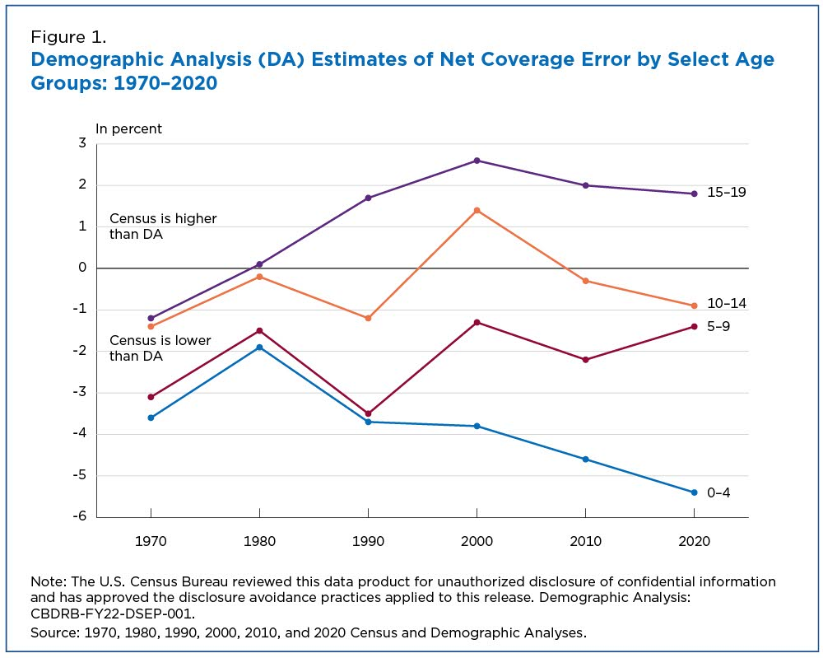
Background
Coverage Error by Population Age: 1970-2020
Source: 1970, 1980, 1990, 2000, 2010 and 2020 Census and Demographic Analysis

Slide 19
Background

Slide 20

Background
Why?
Lots of work on this subject since the 1950’s
Short story: lots of reasons
Major predictors of undercount:
  Complex living situations (worse in multigenerational families, non-relatives)
  Poverty (worse in lower SES)
  Race and ethnicity (worse in Black & Hispanic people)
  Age & Education (worse in young adults with < HS/GED)
  Housing unit type (worse in renter-occupied HU)
  Parental situation (worse in female-headed HU w/no spouse)
Still searching for reasons & remedies

Slide 21
Chronic Causes of the Undercount
(a partial list)
Distrust: some households and people are missing because they want to be missed
Missing Housing Units: no externally visible indicators of housing units (e.g. converted basements, garages, sheds; subdivided rowhouses; rural roads with difficult access, ambiguous markers)
Missing People Within Households
  Complex households: multiple families and fictive kin; multiple generations; unrelated individuals (e.g. workers); overcrowding
  Cyclers: those with “partial residence” in multiple dwellings; no one place is “usual residence”
  Transitioners: those in flux (e.g., young parents, new immigrants, natural disaster and COVID refugees) staying “temporarily”
Notes:
The series of ethnographic studies thru the 1990s corroborated three main causes:
Distrust/fear
Missing Households
Missing People within Households
And the studies also got behind the “why” of these problems
And I’m showing just a taste of some of those reasons

Slide 22
Reasons for Missed People within Housing Units
Extended family and fictive kin networks; complex households; people “float”
Mobility and Transiency:
  Individuals with “partial residence” in multiple dwellings; no one place is “usual residence”
  Individuals in transition (e.g., young parents, new immigrants, addicts)
Employment-related mobility (taking short term jobs; migrant farm workers)
“Ad hoc” households (e.g., unrelated working men sharing expenses; sleeping in shifts; very little exchange of personal information among household members)
Families doubling up and/or renting to boarders who are not family
Occupancy limit in public housing; risk to benefits if extra people reported
Undocumented immigrants overcrowding; fear of landlord finding out
Distrust in government; fear of deportation

Slide 23
Determining Call Topics: Brute Force Method
Results: Informative quotes
  New Baby: “…I'm currently pregnant and I'm due within the next couple of weeks here and I wasn't sure if I should include the um baby on the census or not because I'm not sure if she'll be here by April first…”
  New Baby: “…my wife and I submitted our senses for him uh back in I don't know march maybe and we had a child since then and I was wondering how or if I can update it to reflect that or not…”
  New Person/s Moved Into HH: “…I've already completed the sentences but my son and his daughter have moved in and they were not included…”
  Add Missed Child: “…I have a step daughter that's kind of I didn't know because we claim her on our taxes if we were supposed to claim her so I didn't know so I think I filled it out correctly…”
  Child Custody: “…what do you do when you have fifty fifty custody so they're fifty percent in one home and fifty percent in another home…”
  Child Staying Temporarily: “…my son and grandson stays in the house and… don't have a place to go yet I can include them since they here…”
  Child Stays at Multiple HHs: “…our daughter and her family her husband and her little girl they they sometimes live in their camper and sometimes they they stay with us should we be counting them on the senses…”
  Child Moving HHs: “…I have recently got my senses and… my granddaughter and her husband and little girl have been living with me for… almost a year and… they moved now I've got the senses filled out with them living here what do I do now?”
  Child Lives Elsewhere: “…they're not living here they just have my address they just one's living somewhere else and the other i don't know the just us mom's and grandmother's address?”
  Child Lives Elsewhere: “…they couldn't reach my neighbor down there and… I told her that there was uh the mother and the father and three little girls…”
  Do multiple people in HH/family need to fill out census?: “…I just took the um the questioner online and I added my husband and two children that live here at home with me does that mean that they have to go in and take it as well…”
  Do you count infants?“…what I think I'm going to have to do just so that everybody's counted because I know one two three four five six oh do you consider infants? oh all right…”
  Not Comfortable Giving Childrens’ Names: “…I'm more than happy to say how many people live at home but I don't like putting my children's name out kind of out there…”
  Parent Staying Elsewhere Temporarily: “…my friend I'm at her house and she's in the hospital and she hasn't been able to do her senses and… I was wondering if I would be able to give you the information… okay because she and she also has two children living here so um we have to have their information too…”
Notes:
Child staying temporarily: custody battle, foster, don’t have a place to go yet, visiting

Slide 24
Identifying UYC Calls: Keywords
Results: Informative quotes
  “…completed while I was pregnant, but now I have the baby…almost seven months now, so should I just update the information…”
  “my daughter is due…at the end of March…do I count the baby…”
  “…at different points of the year my granddaughter lives here and moved out and my step daughter…and I don’t know if it means whole year or you know part time…”
  “…I put a baby on there, but we didn’t have her til April 6…I submitted again without the baby, but I didn’t know if it would override it…”
  “…okay so with Christina i got hers done she's my step daughter, but I'm her only mother her there was never a mother in the picture and so she doesn't even tell people I'm not her mother okay jade my granddaughter's seven now they've lived with us since the baby was born and so uh with jade i can't find what how she's related to me because there's no list for do i just call her they don't have step grandchild…”
  “…you can put yeah just put any seri he's my stepson where he is I adopted him when he was two months old, now he's sixty two years old…“
  “…I'm in the beautiful San Francisco bay area and California, but i came here i came here as a baby. I was only about three years old and uh i came here from the archipelago islands of Malta… and I became and my mom and dad uh my mom was pregnant like nine months and i thought…”
  “…says before you answer question one count the people living in this house apartment or mobile house using or question guideline okay count all people including babies and etcetera…”
  “…so he's been coming for the past couple of days and he he left those paper work which i was working on and today i happen to uh to be home so he was banging on the window super hard car scared my mom my baby every time he uh comes and breaks the window she cries…”

Slide 25
Identifying UYC Calls: Keywords
Keyword category | Keywords | Matching transcripts | Labelled | UYC-related
Little Kid | little boy, little girl, school age | 61 | Yes | 7
Stepchild | stepchild, step child, stepchildren, step children, stepkid, step kid, stepkids, step kids, stepson, step son, stepsons, step sons, stepdaughter, step daughter, stepdaughters, step daughters | 61 | Yes | 6
Newborn | newborn, new born, new bone, infant, infants | 61 | Yes | 13
Baby | my baby, our baby, my babies, our babies, baby son, baby daughter, baby nephew, baby niece | 44 | Yes | 5
Pregnant | pregnant | 33 | Yes | 12
What Age | what age | 13 | Yes | 0
General Child-Related | my child, our child, my children, our children, my kid, our kid, my kids, our kids, my son, our son, my sons, our sons, my daughter, our daughter, my daughters, our daughters | 4099 | No | -
X-Year Old | one year old, two years old, two year old, three years old, three year old, four years old, four year old, five years old, five year old | 815 | No | -
Grandchild | grandbaby, grandkid, grand baby, grand kid, grandchild, grand child, grandbabies, grandkids, grand babies, grand kids, grandchildren, grand children, grandson, granddaughter, grand son, grand daughter, grandsons, granddaughters, grand sons, grand daughters | 642 | No | -
Complex Childhood | custody, divorce, foster, adopted, single mother | 292 | No | -
Multi-Family | three family house, two family house, multi family house, multiple family house | 191 | No | -
Poverty | snap benefits, tanf benefits, tanf, s n a p, t a n f | 0 | No | -
Total non-overlapping |  | 5594
Total labelled |  | 273 |  | 43
Method
Find transcripts matching keywords related to children and known undercount-related issues
Label a reasonable amount for later modeling
Label topics of UYC-related calls
Results
5594 transcripts found
273 labelled
43 UYC related
“Newborn” and “Pregnant” categories yielded most

Slide 26
Identifying UYC Calls: FAQ Matching
FAQ Title | Labelled | Matching transcripts | FAQ Accurate | Hit prop. | UYC-related
Should I count babies and children? | Yes | 65 | 0 | 0.00 | 20
My baby is due next week / this month, should I include the baby in the household? | Yes | 24 | 18 | 0.75 | 19
Where should I count children in joint custody arrangements? | Yes | 13 | 13 | 1.00 | 11
I rent out part of my home; Should I include the boarder or renter on my questionnaire? | Yes | 11 | 3 | 0.27 | 1
Should a grandchild be counted at an address even if their mom or parent does not live or stay there? | Yes | 8 | 4 | 0.50 | 2
Does the census count the children of roommates, housemates, roomers, or boarders? | Yes | 8 | 0 | 0.00 | 0
Should I count people who are visiting? | Yes | 4 | 1 | 0.25 | 0
Does the census count foster children? | Yes | 2 | 1 | 0.50 | 1
How do I answer the question about people living somewhere else? | No | 261 | - | -
How do I answer the number of people question? | No | 222 | - | -
More than 6 people live in this home; how do I respond? | No | 219 | - | -
Total |  | 837
Total Labelled |  | 135 | 40 | 0.05 | 54
Method
Create LLM embeddings of transcripts and FAQs (MPNet)
  Make words into numbers
Match FAQ to transcript with highest cosine similarity
Choose transcripts matching child undercount-related FAQs
Label a reasonable amount for later modeling
Results
837 transcripts found
135 labelled
54 UYC-related
Three useful FAQs

