Slide 1
FedCASIC 2024:
SOII Autocoder Gender Bias Investigation
Gerald Thomas
Data Scientist
Compensation Research Program Development Group
Office of Compensation and Working Conditions
April 2024

Slide 2
What is the SOII Autocoder?
Deep learning neural network model to provide computer-assisted coding to classify non-fatal, work-related injuries of non-federal government employees and private sector employees
Notes:
Cite the guidance from the Executive Order on AI and OMB.

Slide 3
Motivation for Investigating Gender Bias
To ensure the classifications of occupation and work-related injuries and illnesses are driven by the circumstances in the narrative instead of the use of gender expressions.

Slide 4
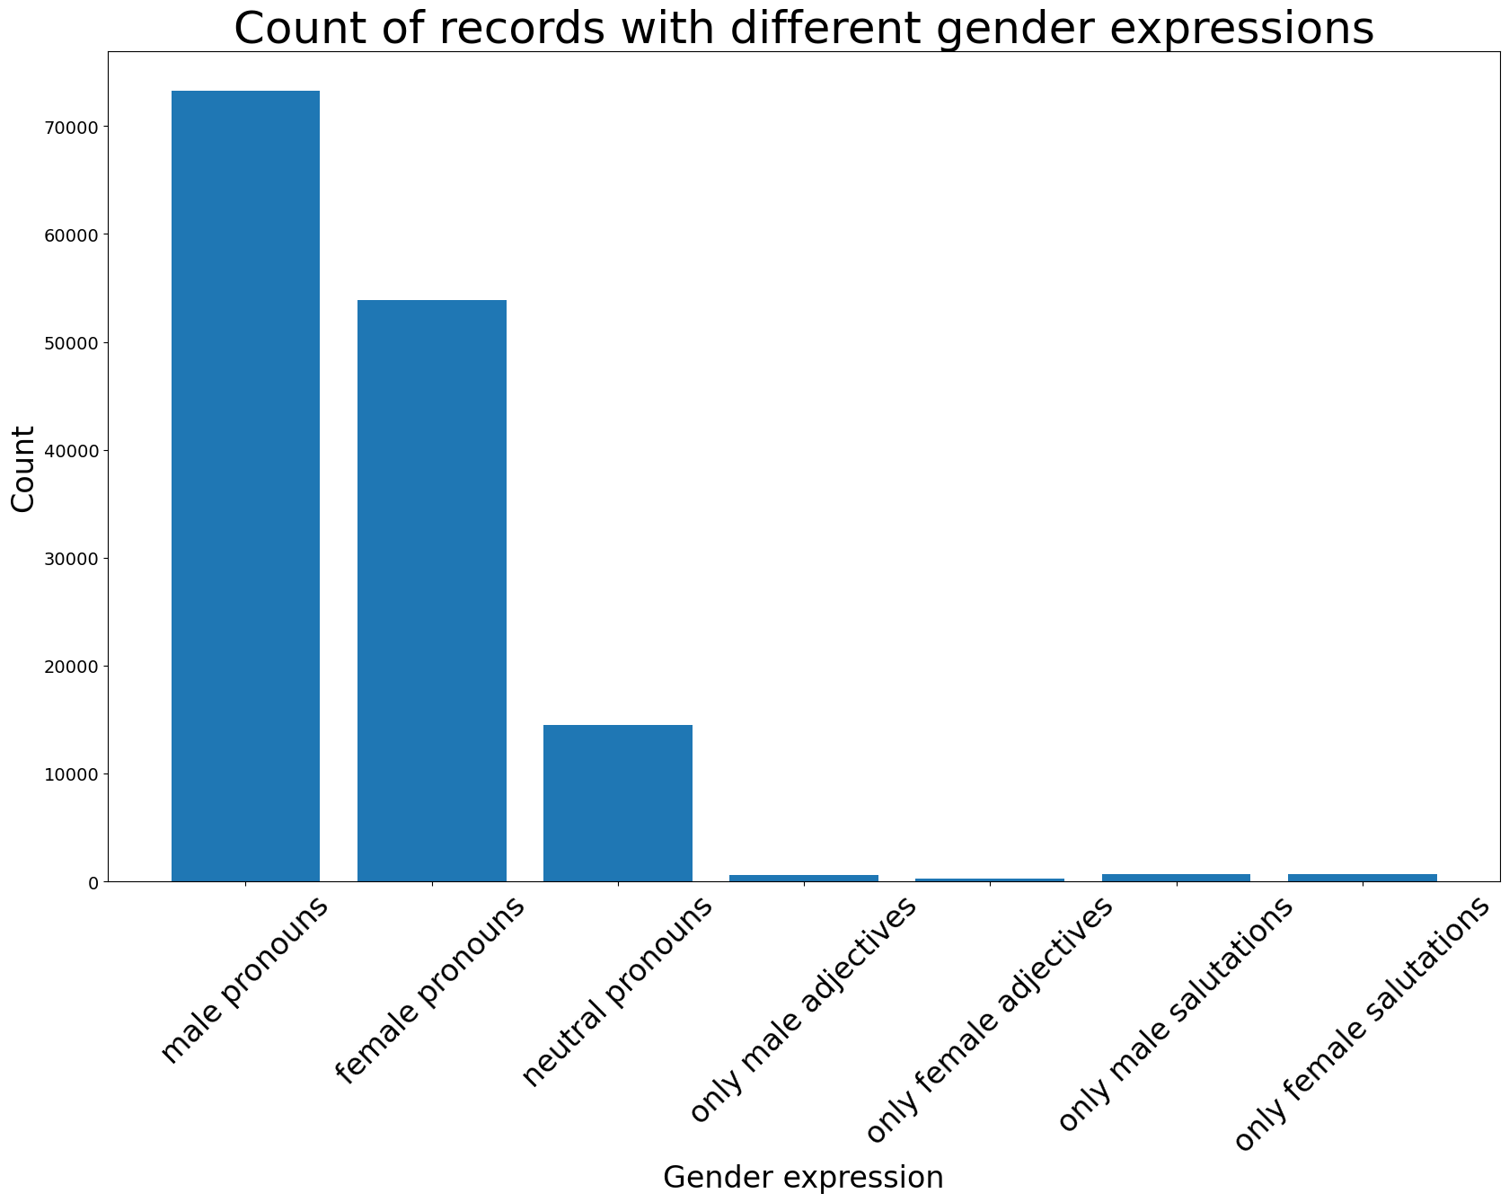
Descriptive Statistics of Gender Expressions
Male Pronouns | he, him, his, himself
Female Pronouns | she, her, hers, herself
Male Adjectives | man, boy, boys, men, male
Female Adjectives | woman, girl, girls, women, female
Gender Neutral | they, them, their, theirs, themself, theirself, theirselves
Male Salutations | mr, mister, sir
Female Salutations | mrs, ms, miss, maam
Note: Counts are not mutually exclusive

Slide 5
Reduce the Noise
Drop all records without gender expressions
Make predictions using cases with gender expressions (135k+)

Slide 6
Substitute Gender Expressions
Substitution | Narrative
all male gender expressions | he injured his arm when he left the machine on
all female gender expressions | she injured her arm when she left the machine on
all gender-neutral expressions | they injured their arm when they left the machine on

Slide 7
Methodology to Detect Gender Bias
Baseline Predictions
All Male Predictions
All Female Predictions
All Gender Neutral Predictions
Classification Report
Male Pronouns | he, him, his, himself
Female Pronouns | she, her, hers, herself
Male Adjectives | man, boy, boys, men, male
Female Adjectives | woman, girl, girls, women, female
Gender Neutral | they, them, their, theirs, themself, theirself, theirselves
Male Salutations | mr, mister, sir
Female Salutations | mrs, ms, miss, maam

Slide 8
Evaluate Predictions
With substituted gender expressions vs. no substitutions
Ensure substituted gender expressions predictions is the same as the baseline

Slide 9
Evaluate Predicted Probabilities
Evaluate the differences in predicted probabilities
Experiment (e.g., all female terms) – Baseline (no substituted words)

Slide 10
Amount of Male Bias
Minimal gender bias in terms of final prediction
Final predictions were 98% to 99% the same as baseline
Minimal male bias in terms of predicted probabilities
Each of the predicted probability differences for all 6 target variables were between an absolute 0.01 and 0.0001 percentage points

Slide 11
Amount of Female Bias
Minimal gender bias in terms of final prediction
Final predictions were 98% to 99% the same as baseline
  Similar to the amount of male bias
Moderate female bias in terms predicted probabilities
Each of the predicted probabilities differences for all 6 target variables between an absolute 2 and 9 percentage points

Slide 12
Amount of Gender-Neutral Bias
Minimal gender bias in terms of final prediction
Final predictions were 98% to 99% the same as baseline
  Similar to the amount of female and male bias
Minimal gender-neutral bias in terms of predicted probabilities
Each of the gender-neutral predicted probability differences for all 6 target variables slightly lower than male bias, but similar
  0.0005 to 0.001 percentage point difference

Slide 13
Conclusions
The use of gender expressions had minimal impact on the final predictions made by the SOII Autocoder.
non-negligible impact on the all-female predicted probabilities.
The increase in the predicted probabilities using female terms does not rise to the level to impact the final predictions.

Slide 14
Areas for Future Research
Would substituting gender expressions for gender-neutral expressions during preprocessing reduce gender bias?
  Might affect context for the neural network model
  No impact for final predictions
Notes:
https://towardsdatascience.com/evaluating-machine-learning-models-fairness-and-bias-4ec82512f7c3
Incorporating the Lime Python library to detect

Slide 15
Gerald Thomas
Data Scientist
Thomas.Gerald@bls.gov
Danny Todd
Data Scientist
Todd.Daniel@bls.gov
Notes:
For questions about the SOII Autocoder Bias Investigation, I am the primary point of contact.
For questions about the SOII Autocoder model architecture, Danny Todd is the primary point of contact.

