Slide 1
Can It Work for Employers?
Evaluating the Expansion of Administrative Records Use beyond Nonemployer Demographic Statistics (NES-D)
Adela Luque, Census Bureau (presenter)
with Valeska Araujo, John Earle, Lorenz Eckerd, Vitaliy Novik, Jared Wold, Sammy Young,
James Noon & Michaela Dillon
FedCASIC, April 16, 2024
Valeska Araujo, George Mason University Ph.D candidate & Census Bureau; John Earle, George Mason University, IZA & Census Bureau; Lorenz Eckerd, Census Bureau; Vitaliy Novik, George Washington University Ph.D. candidate & Census Bureau; Jared Wold, George Mason University Ph.D candidate & Census Bureau; Sammy Young, Arizona State University & Census Bureau; James Noon and Michaela Dillon, Census Bureau.

Slide 2
Disclaimer
Any opinions and conclusions expressed herein are those of the author(s) and do not reflect the views of the U.S. Census Bureau. The Census Bureau has reviewed this data product to ensure appropriate access, use, and disclosure avoidance protection of the confidential source data (Project No. P-7504866, Disclosure Review Board (DRB) approval number: CBDRB-FY23-ESMD010-037 and CBDRB-FY24-ESMD010-005).

Slide 3




Employer Demographics Project
      Assign demographics to employer firms in the U.S. by leveraging administrative records (AR) & Census data
  Already accomplished for nonemployer firms (Nonemployer Statistics by Demographics, NES-D)
      Explore alternative ways to demographically classify (e.g., executive-based for public firms)
Goal
Benefits
& Uses
New data products & improvements, such as:
Unburdening surveys
Enhancing business programs w/ demographics
More granularity and flexibility
Reduce costs
Facilitate linkages of external & internal business data to business owners’ demographics
Improve sampling frame for business surveys

Slide 4
Context -The Annualization of Census’ Business Demographics Statistics
Legacy Survey of Business Owners (SBO) - Every 5 yrs.
(Nonemployers & Employers Demographics)
BEFORE
Annual Business Survey (ABS)
(Employers)
Survey-based
Nonemployer Statistics by Demographics (NES-D)
Administrative Records (AR) - based
+
CURRENTLY
Annual Business Demographics Program
Synchronization of employers & nonemployers

Slide 5
Employer Demographics Project as part of Annual Business Demographics Program
Employer Demographics Project
AR-based (Not a survey)
Annual Business Survey (ABS)
(Employers)
Survey-based
Nonemployer Statistics by Demographics (NES-D)
AR – based
(Not a survey)
Annual Total Business Demographics Program

Slide 6
Data Sources
Variables | Data Sources
Employer firm identifiers, Legal Form of Organization (LFO), employment, payroll, industry, geography | Business Register: Comprehensive database of all U.S. employer & nonemployer business establishments containing business name, identifier, address, industry classification, legal form of organization, receipts, and employment and payroll.
Race Hispanic origin Sex Age of owner Place of birth U.S. Citizenship status | Decennial Census Data, American Community Survey (ACS), & Numident (from Social Security Administration)
Veteran-status | Department of Veterans Affairs (VA) AR data (USVETS). Also exploring Department of Defense data.
Owner Identifiers (Protected Identification Keys or PIKs) | Tax data: 1040 filings, Schedule K-1, EIN applications (SS-4 form)

Slide 7
Methodology (1/2) – How are demographics assigned?
Employer universe identified & extracted from Business Register*
Unique anonymized person identifiers called Protected Identification Keys (PIKs) facilitate linkage of records across data sources
Source of PIKs / Owner identification
  Sole proprietors – Tax form 1040 and EIN applications (SS-4 form)
  Partnerships & S-corporations – Schedule K-1 (Forms 1065 & 1022S)
  Owners of U.S. nonemployer C-corporations cannot be identified with tax or AR data
  => Evaluating feasibility of demographics imputation for small C-corps
    => Longer term: Evaluate feasibility of classifying public corporations based on executives or board members demographics
*The BR is a comprehensive database of all U.S. employer and nonemployer business establishments containing business name, identifier, address, industry classification, legal form of organization, receipts, and employment and payroll (these last two apply only to employer firms).

Slide 8
Methodology (2/2) – How are demographics assigned?
Link demographics from various sources to business owners via PIK
“Roll-up” owner-level demographics to firm-level
  Majority rule: Business is assigned the demographic of the group that jointly owns > 50% of the business
    For instance, a business is black-owned if owners of black race own more than 50% of the business
    Eligible for demographic classification if top owner in firm owns at least 10%
    Top 4 (person) owners are considered

Slide 9
Owner PIK Coverage Results – 2018 Employers
Owner PIKs available for approximately:
  Soleprops (~ 97%)
    Demographics will be imputed for those without PIKs
  Scorps (~ 95%)
    Demographics will be imputed for those without PIKs
  Partnership (~ 76%)
    Demographics will be imputed for those without PIKs
=> Approximately 90 – 95 percent of non C-corps, accounting for ~ 90 percent of (non C-corp) employment
graph

Slide 10
Taking Stock - AR-based Employer Owner-identification Coverage
Legal Form of Organization (LFO) | Share of employer universe covered | Share of rcpts/emp covered | Methodology
Sole-props, Partnerships & S-corps | 83% of employers* | 49% emp | 76% AR 7% imputation
Small C-corporations | 14% of employers* | 3% emp | Imputation
Public C-corporations (long term) | < 1% of employers*** | Approx. 23% emp*** | Third-party data?
Large Private C-corporations | Approx. 3%** | Approx. 25%** | Survey

Slide 11
Can we leverage AR for employer demographics?
We think so!
Sole proprietorships, partnerships and S-corporations
Modeling for small private C-corps?
Alternative non owner-based demographics for public corporations?
Rely on survey for large private C-corporations?
  Some of them likely not to be eligible for demographic classification

Slide 12
Thank you!
Adela.Luque@census.gov

Slide 13
Some Challenges
Complex ownership structures makes it hard to identify owners
Owner identification is closely tied to LFO (e.g., sole proprietorship, partnership, S-corp), but sometimes LFO changes are intractable
Ownership information for partnerships & S-corps are tied to EINs that firms use for income tax purpose, but EINs in Business Register are the ones firms use for payroll purposes
  Sometimes firm “income” EIN not equal to “payroll” EIN => inability to identify owners in those cases
  C-corporations
graphic

Slide 14
Next Steps
QA, QA, QA!
Extension to multiple years
  More QA - Evaluate longitudinal consistency & patterns
Demographics imputation for partnerships & S-corps for which we have not been able to identify owners
Evaluate feasibility of demographic imputation for small C-corporations
Longer term - Explore alternative, not owner-based firm demographic classification (e.g., executive-based)

Slide 15
Demographics Coverage Results – 2018 Employers (2/2)
Availability of sex, age, place of birth for approximately 97% of owners (w/ PIKs)
Availability of race for approximately 92% of owners (w/ PIKs)
Availability of Hispanic origin for approximately 95% of owners (w/ PIKs)
Approximately 92% of owners (w/ PIKs) are not missing any demographics
  Only about 3% percent are missing 3 or more demographics
Missing demographics will be imputed

Slide 16
Owner Identification for Partnerships & S-corps
Business Register (BR)
“Payroll” EINs
K-1 tax data
“Income” EIN – Owner PIK pairs
Identified owners of employer firms in BR
(PIK – EIN pairs)
Linked by EIN
back

Slide 17
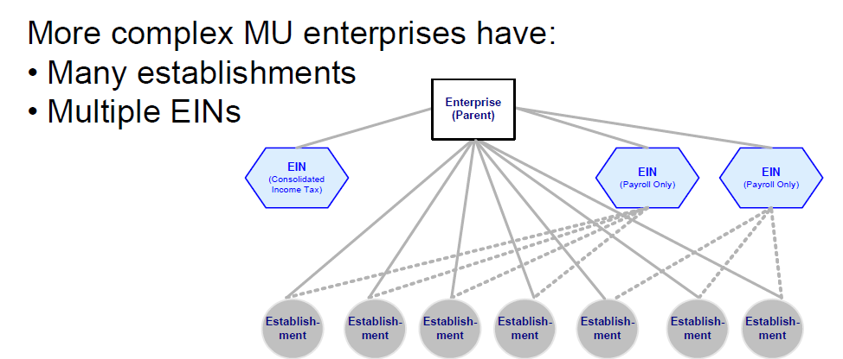
The Challenge of Multiple EINs
BR has “payroll” EINs
Schedule K-1 data:
“income” EIN – owner PIK pairs, &
ownership info
back

Slide 18
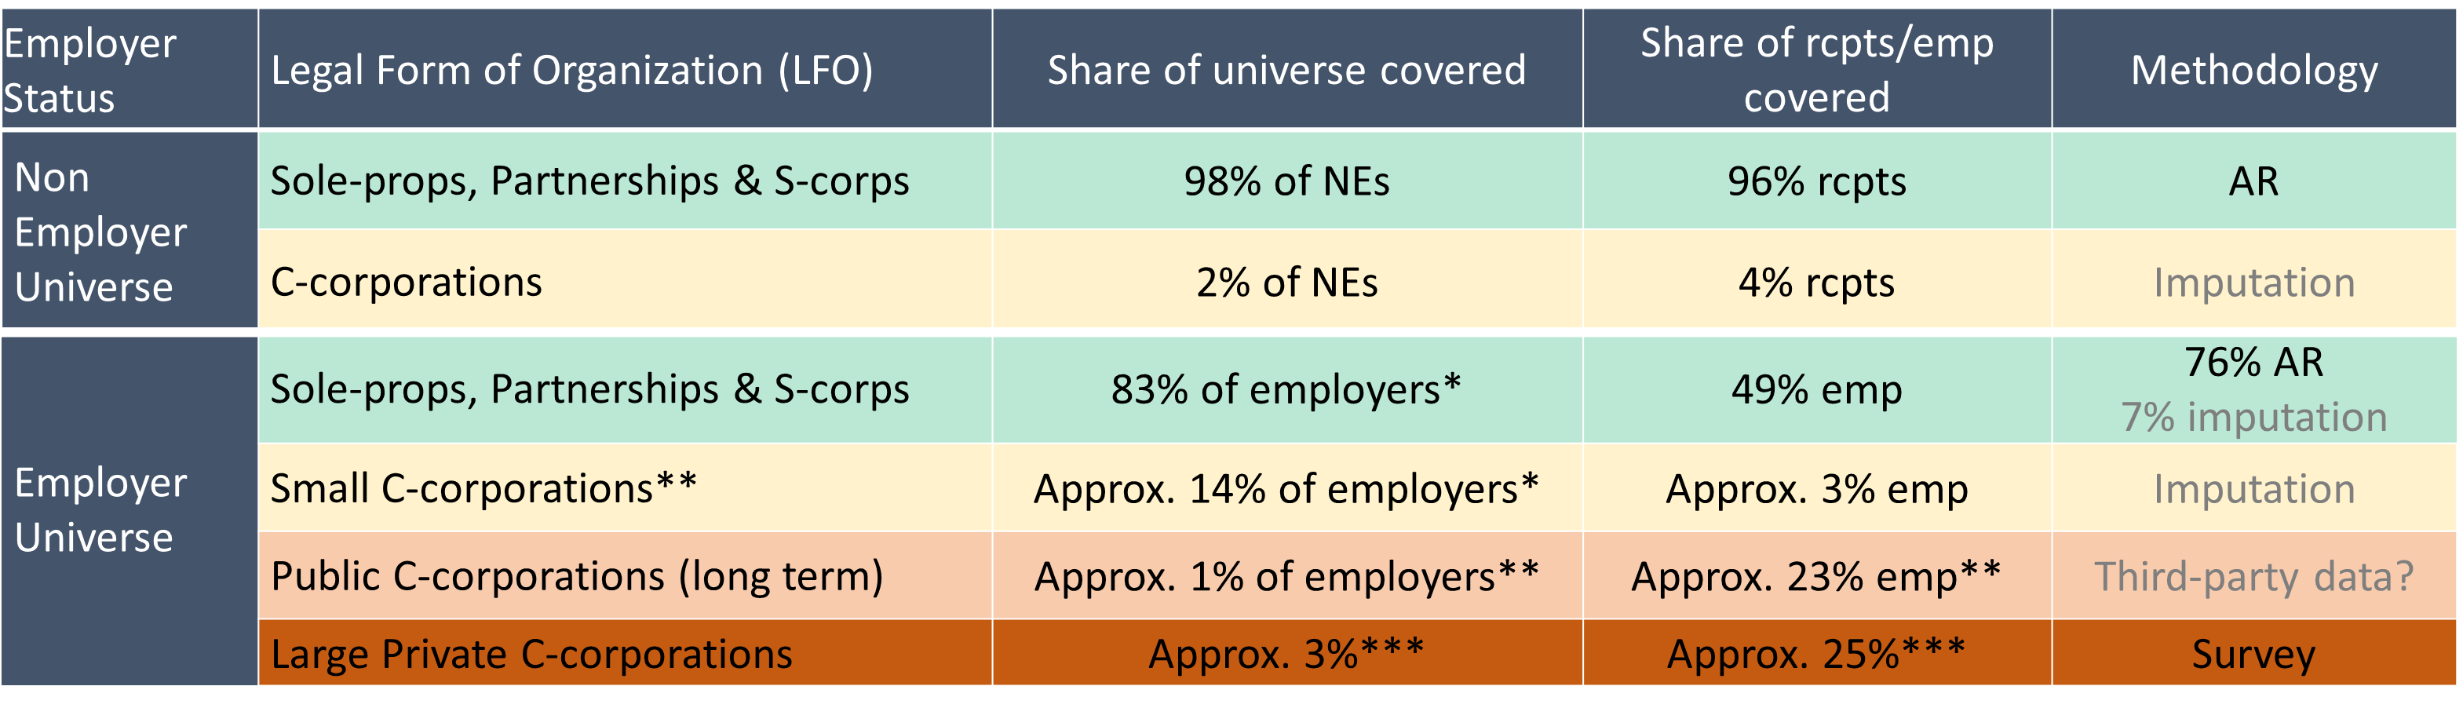
Taking Stock

Slide 19
Source of PIKs for Employers Firms
Employer Firms
(excluding non-profits, government, other non-corporate)
Sole Proprietorships
(1 owner)
Partnerships
(>1 owner)
C-corporations
(>= 1 owner)
S-corporations
(>=1 owner)
1040 filings & EIN applications
Tax Schedule K1
Tax Schedule K1
n/a
Source of PIKs
Source: 2018 Business Register, U.S. Census Bureau.
back

Slide 20
Preview of Owner Identification for non C-corps
Employer Businesses
(excluding non-profits, government, other non-corporate)
Soleprops
~15% of employers
Partnerships
~13% of employers
C-corps
~18% of employers
Other C-corps
Private Small C-corps*
S-corps
~55% of employers
~ 97% of soleprops
~ 87% of SP emp
~ 77% of partnerships
~ 80% of P emp
~ 95% of S-corps
~ 92% of S-corp emp
Source: 2018 Business Register.
*Small C-Corps = C-corps with <= 19 employees. They account for more than 50% of all C-corps and less than 15% of C-corp employment.
back

Slide 21
Nonemployer & Employer Universe
Source: 2020 Business Register
Other: Governments, non-profits.

Slide 22
Employer Identification Number or EIN
An Employer Identification Number or EIN is a unique nine-digit number that identifies your business for tax purposes
  Required for all employer firms
  Different uses such as payroll or income reporting to IRS
    A given EIN may be used for both payroll and income tax purposes
  Most employer businesses have 1 EIN

Slide 23
Illustration - 2018 Hybrid-data Total Business Demographics
Sources: 2018 NES-D and 2019 ABS (2018 reference year)

