Slide 1

Striking Gold!
Using Public Sources to Validate a Gold Standard Dataset of Ph.D. Inventors in the U.S.
Generated using www.fotor.com
Ekaterina Levitskaya - Senior Data Scientist - Coleridge Initiative
Corey Sparks - Senior Research Scientist - Coleridge Initiative
FedCASIC conference
April 2024

Slide 2
Disclaimer
This presentation provides results of exploratory research sponsored by the National Center for Science and Engineering Statistics (NCSES) within the National Science Foundation (NSF).
Any views expressed are those of the author and not necessarily those of NCSES or NSF.
The linked data set described in this presentation is a demonstration pilot. It is not currently available for public use or external distribution.

Slide 3
What is a ‘gold standard’ dataset?
How often in statistics do we know the truth?
Uncertainty abounds….
‘Gold standard’ data can be considered truth
  Outcomes are 100% known
  Uncertainty about membership is minimal or 0
  “Ground truth” observations
Some examples from computer science
Notes:
‘Gold standard’ - data where the true match status of records is known. Such data are only ever available for a subset of records (or else linkage would not be required). Source

Slide 4
Gold standard data in record linkage
Record linkage of administrative and survey data is increasingly used to generate evidence to inform policy and services
‘Gold standard’ - data where the true match status of records is known (available for a subset of records)
  These are known-status individuals who have been validated through other means
Notes:
Record linkage of administrative and survey data is increasingly used to generate evidence to inform policy and services.
‘Gold standard’ - data where the true match status of records is known. Such data are only ever available for a subset of records (or else linkage would not be required). Source
Uses of gold standard data
Train linkage algorithms
Assess linkage quality for analysis of linked data

Slide 5
Linking doctoral recipients to inventors
There is no single large-scale dataset with individual links between U.S. doctoral recipients and inventors.
A dataset like this could allow for studying the innovation process and outcomes of doctoral recipients in the U.S.
In this work, machine learning approach is used to link two datasets: the Survey of Doctorate Recipients (SDR) (sponsored by National Center for Science and Engineering Statistics (NCSES)) and PatentsView (public data source which disambiguates and tracks inventors in the U.S.). Validation of the machine learning results is performed using a gold standard record set
Notes:
There is substantial research on patenting in the U.S. academic sector in general (Morgan et al., 2001, Azoulay et al., 2007, Stephan et al., 2007, Sugimoto et al., 2015), however, there is no single large-scale dataset with individual links between U.S. doctoral recipients and inventors which could allow to study the innovation outcomes of doctoral recipients in the U.S.
Survey of Doctorate Recipients used to collect data on patenting activity in the previous survey years (Stephan et al., 2007), however, there is no direct linkage between doctoral recipients and the U.S. inventors on an individual level.. PatentsView is a public data source which disambiguates and tracks inventors in the U.S. which could be used for the linkage.
In this work, the machine learning approach is used to link two datasets: Survey of Doctorate Recipients and PatentsView. Validation of the machine learning results is performed using a gold standard record set.

Slide 6
Survey of Doctorate Recipients
(SDR)
PatentsView
Survey sponsored by National Center for Science and Engineering Statistics (NCSES)
Sample of doctoral recipients in science, engineering, and health (SEH) who received the degree in the U.S. educational institution, collected since 1973. In this work - SDR 2015 and 2017.
Previously included the general question on patenting activity of respondents in 1995, 2001, 2003, 2008 survey cycles
Each respondent has a unique identifier which tracks over time.
Public data on patents from 1976 to the present (2023) from the U.S. Patent and Trademark Office (USPTO)
Contains inventor name, location, assignee name, dates of patent application and granted patent, and other variables indicated on a patent application
Notes:
SDR is a biennial follow-up survey which represents a sample of doctoral recipients in science, engineering, and health (SEH) who received the degree in the U.S. educational institution.
SDR collected information on patenting activity of respondents in 1995, 2001, 2003, 2008 survey cycles, however, this activity has been suspended since 2008.
In this work, the personally identifiable information (PII) from individuals in SDR 2015 and SDR 2017. Each respondent has a unique identifier which tracks over time.

Slide 7
Linkage scope
Inventors who applied for patents in the U.S.
Doctoral recipients in SDR in 2015, 2017
Inventors who patented in the U.S.
with doctoral education from U.S. institution
Notes:
Linkage scope potential overlap between the two data sources, i.e. the individuals who would be expected to match.
The population that would be expected to match are the inventors who patented in the U.S. with doctoral education from U.S. institution.

Slide 8


Gold standard data
where the true match status of records is known
True positive
pair of records is a match
True negative
pair of records is not a match
=
≠
Notes:
To validate the machine learning results gold standard data is created

Slide 9
Gold standard with public resume data
Public inventor data
Full name
(first, last name)
Patent number
Public resume data
Full name
(first, last name)
Graduation institution
Graduation year
Patent number
SDR 2015-2017
Full name
(first, last name)
PhD graduation institution
PhD graduation year
Notes:
The diagram highlights data items from resume that can be used to confirm an inventor is the same individual as the paired survey respondent.
True positive. Match on name, patent number with inventor data and match on name, graduation institution, year with SDR data.
True negative. Match on name, patent number with inventor data - inventor is confirmed to NOT hold a doctorate degree.

Slide 10
Sources of public resume information
LinkedIn
ORCID
ResearchGate
Google Scholar
PostJobFree.com

Slide 11


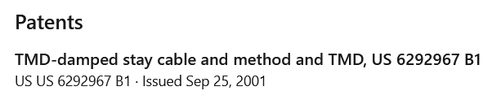
LinkedIn
Pros
Patent and education information in the same profile
Wide range of individuals (i.e. not skewed towards only researchers)
Cons
No formal API (Application Programming Interface)
Can contain multiple pages that need to be parsed
Profile Name
Notes:
Linkedin contains useful data on education, employment, publication, and patent information, however, the company doesn’t provide an official API. There are public profiles with information which can be manually searched. There is a restriction on the number of individuals that can be looked up within a short time window. The public profile can be downloaded as the HTML document and then the document can be parsed from the HTML structure. The search was performed with the focus on the public profile information in LinkedIn. The search string contains: first name, last name, “see patent” (show the profile with any patent information), “linkedin”.
Pros:
Patent and education information in the same profile
Wide range of individuals (i.e. not skewed towards only researchers)
Cons:
No formal API
Can contain multiple pages that need to be parsed

Slide 12

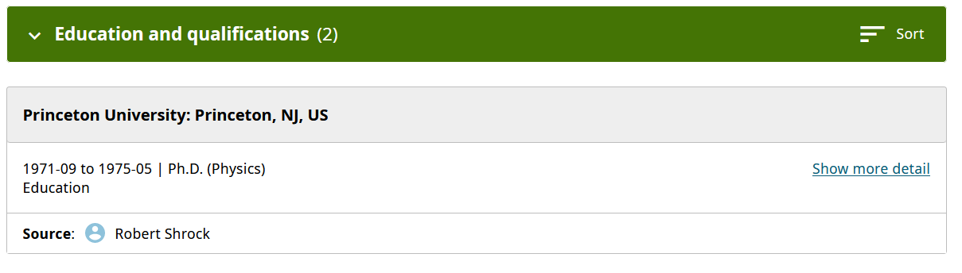

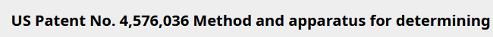

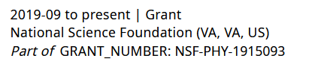
ORCID
Profile Name
Pros
Patent, grant, education information in the same profile
Formal API (Application Programming Interface)
Cons
Population may be skewed towards individuals involved in research
Notes:
ORCID provides an official API and it contains education, employment, publication (publication title, DOI), and funding information. The user needs to register to get the username and password. The API provides the XML document.
The data collection was performed in two ways: (i) download the data on individuals who had a mention of the grant number on their ORCID profile based on the list of funders mentioned in the patent data (grant number is used to link to patent number), (ii) download individuals who had the word “patent” mentioned on their ORCID profile and extract patent numbers where available.
Pros:
Patent, grant, education information in the same profile
Formal API
Cons:
Population may be skewed towards individuals involved in research

Slide 13
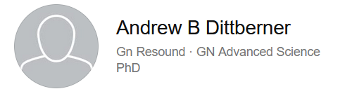
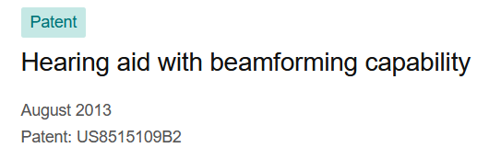
ResearchGate
Profile Name
Caveats
Patent and education information not always in the same profile
No formal API (Application Programming Interface)
Population may be skewed towards individuals involved in research
Notes:
Some ResearchGate profiles include patent citations and affiliation information. There is no official API. The HTML webpages can be saved as PDFs and parsed.
Caveats
Patent and education information not always in the same profile
No formal API
Population may be skewed towards individuals involved in research

Slide 14
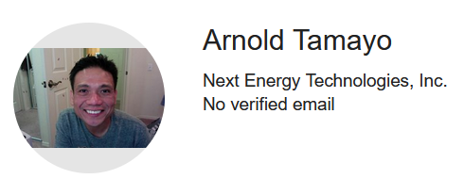


Google Scholar
Caveats
No explicit education information - “affiliation” information
No formal API (Application Programming Interface)
Population may be skewed towards individuals involved in research
Profile Name
Notes:
Google Scholar profiles include publication citations and can include patent citations as well. Some profiles have the affiliation information. There is no official API. The HTML webpages can be saved as PDFs and parsed.
Caveats
No explicit education information - “affiliation” information
No formal API
Population may be skewed towards individuals involved in research

Slide 15
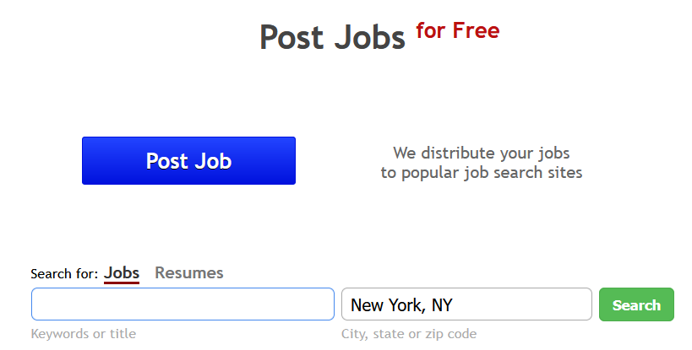
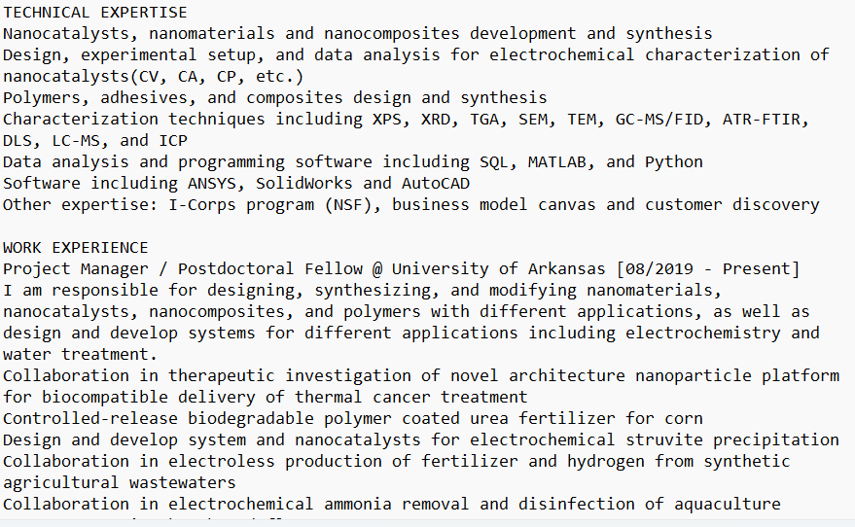
PostJobFree.com
Caveats
No formal API (Application Programming Interface)
Text unstructured
Notes:
It is worth mentioning that there is a public database with 1,698,497 resumes in United States. The database can be searched. For example, with the keyword “patent”, there are 683 resumes. There is no formal API. The resume information is unstructured text with different formatting which complicates the automated parsing process. This data source was not used in this linkage project but can be a valuable source of public information.

Slide 16
Gold standard: Summary
True positive
True negative
=
≠
117 SDR respondents confirmed to be inventors
1,311 inventors confirmed to not have PhD education*
*With the caveat that if the education is reported in the resume, PhD degree is included
Notes:
To summarize, gold standard true positives and gold standard true negatives are created based on public resume information
The caveat is that if the education is reported in the resume, PhD degree is included

Slide 17
Creating a gold standard with resume data
Proof of concept that resume information can be helpful for creating gold standard linkage data
Public data sources can help to supplement the survey information without respondent burden
Public information allows for easier access by the research community, and ease of sharing between researchers
  The unstructured nature of some of this data, however, also means that processing information from it can be a challenge
Notes:
Can we talk about potential collaboration with the companies

Slide 18
Next steps & potential applications
Linked data product
  Coleridge/NCSES Data-fest
  Coleridge/NCSES Training Course
Potential Research Questions:
  Diversity of inventors
  Citation/use of patents with federal funding
  How does patenting affect career trajectories?
These data allow us to answer novel questions, because we use novel methods to create them
Notes:
Can we talk about potential collaboration with the companies

Slide 19
Thank you for your attention!
Questions?
ekaterina.levitskaya@coleridgeinitiative.org
corey.sparks@coleridgeinitiative.org

