Slide 1
An Alternative Data Approach to Index Creation
Ayme Tomson
FedCASIC 2024
Data Scientist
Office of Prices and Living Conditions (OPLC)
Bureau of Labor Statistics (BLS)

Slide 2
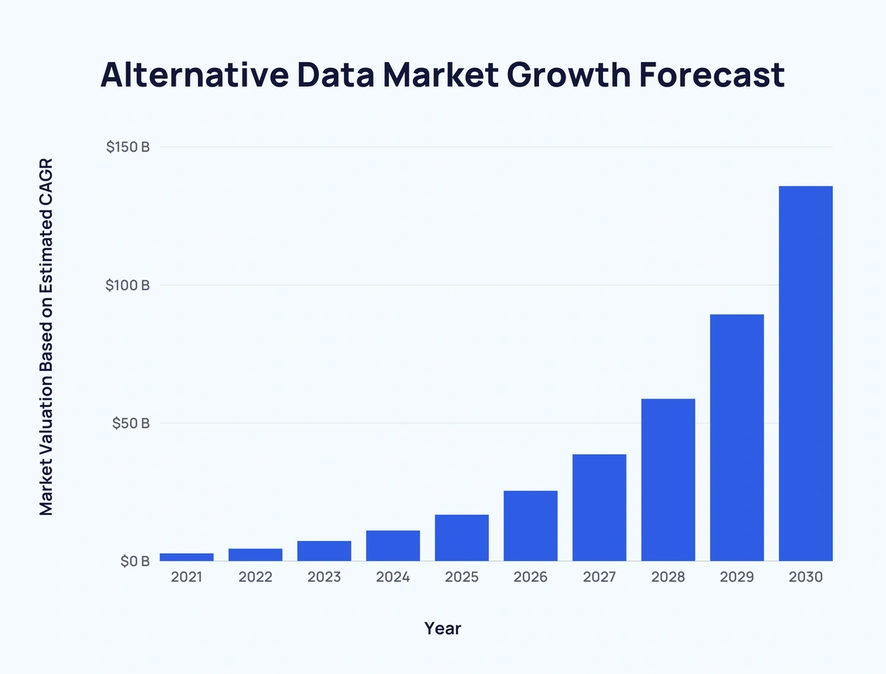
What is Alternative Data?
Non-traditional data
Traditional data = established data for a given task
Types of alternative data
Geolocation (Satellite / weather)
Social media
Tracking / Traffic (clicks / usage / feeds / reviews)
Sensors (IoT)
Public data
Source: Grand View Research - (CAGR) compound annual growth rate

Slide 3
Alternative Data
Characteristic | Pro | Con
Availability (Ownership) | X | X
Type (Linkage / Harmonization) | X | X
Size | X | X
Accuracy (Scope) | X | X
Bias (Weighting) | X | X
Creation (Transparency / Informed Gaming) |  | X
Unintended Consequences |  | X

Slide 4
Project Description & Goal
The Producer Price Index (PPI) Airline team currently uses traditionally collected data for the creation of the airline industry and commodity indexes. This project validates replacing traditionally collected data with an alternative data source.
Goal: Validate the alternative data source through index creation and comparison to current airline PPI methodologies using 3 years of historic airline data

Slide 5
Project Members
OPLC Data Scientists
Ayme Tomson
Gerald Thomas / Stephen Hanna
Producer Price Index (PPI) Airline Team
John Lucier
Bill Page
Chelsea Velic

Slide 6
Alternative Data Characteristics
Characteristic | V1 | V2
Availability (Ownership) | 3rd party purchase | 3rd party purchase
Type (Linkage / Harmonization) | No geographical data | No geographical data
Size | 7 Gigabyte | 4 Gigabyte
Accuracy (Scope) | Monthly Origin - Destination | Monthly Origin - Destination
Bias (Weighting) | Value Padding +/- 20% | Value Padding +/- 20%, Rolling 7-day averages
Creation (Transparency / Informed Gaming) | Sales Transactions | Sales Transactions
Unintended Consequences

Slide 7
Project – Journey to representative data
Raw data
Data Filtering
Data Preprocessing
Final Aggregation
Index Calculation Ready!
Remove out-of-scope data:
Create labels
Group by key variables
Historical airline price data from third party
120 million rows
V1
49 million rows
49 million rows
V2
26 million rows

Slide 8
Data & Decision Architecture
Extract-Transform-Load (ETL)
Data processing in monthly batches
Industry Index
Commodity Index
Scope
Remove international to international flights
Remove unscheduled flights
Aggregation
Airport
Cabin Class
Region
Index Labeling
Industry
Commodity
Alt
DATA
2019
2020
2021
2019
2020
2021
Country
Codes
International Regions
Atlantic
Pacific
Canada & Latin America
IATA – CC Mappings
CSV File
Python Library

Slide 9
Data & Decision Architecture
Scope
Aggregation
Index Labeling
Extract-Transform-Load (ETL)
Index 1
Index 2
Alt
DATA
2019
2020
2021
Geo-
Coding
Data processing in MONTHLY batches

Slide 10
Data & Decision Architecture
Scope
Aggregation
Index Labeling
Extract-Transform-Load (ETL)
Index 1
Index 2
Alt
DATA
2019
2020
2021
Geo-
Coding
Data processing in MONTHLY batches
Data Size

Slide 11
Data & Decision Architecture
Scope
Aggregation
Index Labeling
Extract-Transform-Load (ETL)
Index 1
Index 2
Alt
DATA
2019
2020
2021
Geo-
Coding
Data processing in MONTHLY batches
Data Type

Slide 12
Data & Decision Architecture
Scope
Aggregation
Index Labeling
Extract-Transform-Load (ETL)
Index 1
Index 2
Alt
DATA
2019
2020
2021
Geo-
Coding
Data Creation, Accuracy, & Bias
Data processing in MONTHLY batches

Slide 13
Data & Decision Architecture
Extract-Transform-Load (ETL)
Data processing in monthly batches
Industry Index
Commodity Index
Scope
Remove international to international flights
Remove unscheduled flights
Aggregation
Airport
Cabin Class
Region
Index Labeling
Industry
Commodity
Alt
DATA
2019
2020
2021
2019
2020
2021
Country
Codes
International Regions
Atlantic
Pacific
Canada & Latin America
IATA – CC Mappings
CSV File
Python Library

Slide 14
Project Methodology
Data Type – No Geographical data
Excludes flights that are foreign airport to foreign airport
Index labels are based on geographical region
Domestic / International
Data Creation, Accuracy, and Bias
Index labels are based on cabin class
Aggregation decisions

Slide 15
Project Outcomes
Outcomes | V1 | V2
Index 1 Year-to-Year Correlation | 0.95 | 0.81
Index 2 Year-to-Year Correlation | 0.94 | 0.82
Index 1 Month-to-Month Correlation | 0.78 | 0.44
Index 2 Month-to-Month Correlation | 0.75 | 0.41
Sample Size | Sample to Universe | Sample to Universe

Slide 16
Project Outcomes
TBD if this alternative data will be used in production of the PPI Airline Indexes

Slide 17
Contact Information Tomson.Ayme@bls.gov

