Slide 1
USING SYNTHETIC DATA TO REDUCE DISCLOSURE RISK IN MUNICIPAL HEALTH SURVEYS
Wen Qin Deng
New York City Department of Health and Metal Hygiene
Joint work with Stephen Immerwahr, Tashema Bholanath (NYC DOHMH)
and Jingchen (Monika) Hu (Vassar College)
Federal Computer Assisted Survey
Information Collection Workshops
April 17th, 2024
Notes:
Hello everyone, thanks for taking the time to join me today!
I am Wendy Deng from the New York City Department of Health and Mental Hygiene. I am excited to share with you our work that utilizes synthetic data for reducing disclosure risks in local government health surveys.
This project is a collaboration involving colleagues from the NYC Health Department, alongside Jingchen (Monika) Hu from Vassar College.

Slide 2
CONTENTS
BACKGROUND
01
MITGATION SOLUTIONS & RESULTS
03
DISCLOSURE RISK ASSESSMENT
02
SUMMARY & TAKEAWAYS
04
2
Notes:
Before we dive in, I just want to give you a quick overview of the talk.
We will start with the background of the project.
Next, I will outline the method for assessing disclosure risk.
I will then move on to introduce the mitigation strategies we implemented and highlight some key findings.
Finally, we will wrap up with takeaways and discuss practical considerations.

Slide 3

01
BACKGROUND
3
Notes:
Let’s first look at the project's background.

Slide 4

PUBLIC-USE DATA: USEFULNESS AND CHALLENGES
Public-use data files are extremely valuable
Disclosure risks may exist in the public release of record-level survey data
e.g., potential linkage to administrative database (vaccine, etc.)
4
Notes:
Local government agencies, such as NYC health department, collects and maintains survey data to improve the health of their residents.
While agencies have the obligations to share theses data with the public, data stewards are facing dual challenges in protecting the privacy and confidentiality of survey respondents, while maximizing data utility. One notable concern is the potential risk of re-identification of survey respondents by the linkage to administrative databases.
Therefore, the assessment of such disclosure risk of identifying records and its mitigation have become important and necessary steps in the production process of publicly available datasets.

Slide 5

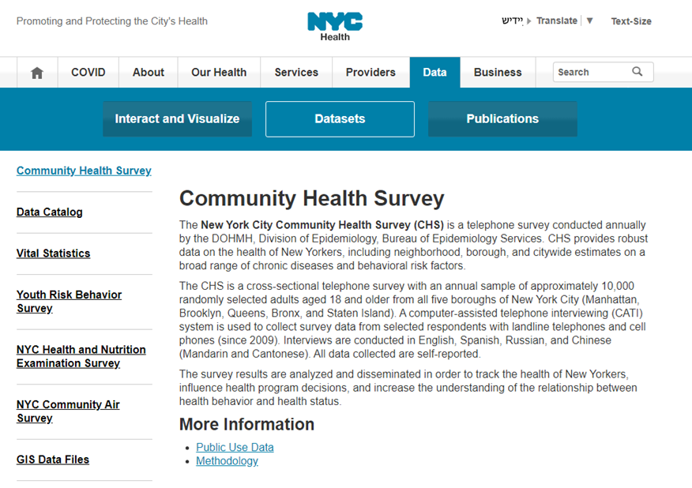
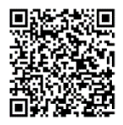
PROJECT OBJECTIVES
Systematic methods to:
  Evaluate disclosure risks
  Implement mitigation solutions
  Evaluate utility and risk reduction post mitigation
5
Notes:
The objectives of our work encompass the establishment of systematic procedures for assessing disclosure risks, implementing effective mitigation solutions, and evaluating both the utility and risk reduction associated with protected data prior to its public release.
I will demonstrate our approach using the 2021 NYC Community Health Survey as an example.
Briefly, the NYC Community Health Survey (CHS) is an annual health surveillance survey that collects self-reported health related data from around 10,000 adult residents of New York City.

Slide 6
02
DISCLOSURE RISK ASSESSMENT
6
Notes:
Let’s explore the strategy we utilized for risk assessment.

Slide 7
APPROACH OVERVIEW
Evaluate disclosure risk of all confidential CHS 2021 survey records
A malicious intruder might correctly identify a target in the NYC population with information (such as identifying variables) from the public use CHS dataset.
Identity Disclosure
Risk
Assume the intruder knows a combination of identifying variables of each record
Flag survey records as high-risk using identifying categorical variables and sampling weights
Weighted N (WgtN) and 95% Confidence Intervals (CIs) – focus on population total estimates and their standard errors
7
Notes:
We examined the identity disclosure risk associated with the published Community Health Survey dataset. The risk pertains to the possibility of a malicious intruder being able to correctly identify an individual from the New York City population to their corresponding record in the dataset using identifying variables, such as age, gender, race/ethnicity.
We first applied the Safe Harbord Guideline. To pinpoint high-risk records, we focused on evaluating disclosure risk of all CHS 2021 survey records and operated under the assumption that an intruder could leverage a unique combination of variables to facilitate re-identification.
Our risk assessment strategy utilized the Weighted N approach, which uses a 95% confidence interval and focuses on the aggregate population totals and associated standard errors. This method helped us to identify where the risk of identification is heightened.

Slide 8
SELECTION OF IDENTIFYING VARIABLES
CORE VARIABLES
    Demographic variables that are easily knowable: age group, sex, race/ethnicity
    Geography (Borough)
    High priority to be kept unmodified for use by analysts
KEY VARIABLES
    Additional demographic and health-related variables that are easily knowable
    Containing sensitive information and are subject to mitigation solutions
8
Notes:
We operated under the assumption that an intruder might possess knowledge of specific variable combinations that heighten the risk of identifying a target within the dataset.
We categorized these variables into two groups:
Core Variables:
Primarily demographic variables, or quasi-identifying variables.
Includes a geography variable – we adhered to the Safe Harbor Guideline by using boroughs instead of smaller geographies to avoid small sample sizes.
These variables are prioritized to remain unmodified for release as they are crucial for analytical purposes.
Key Variables:
Comprises additional demographic and health-related variables that are potentially identifiable or easily known.
These variables are designated for release but with a lower priority to remain unmodified, subject to mitigation solutions aimed at reducing disclosure risk.
Other variables may be knowable but not necessarily accurately known and are therefore not considered as key variables, such as general health status.

Slide 9
IDENTIFYING HIGH-RISK RECORDS
Core + Key variable
(one key at a time)
Age Group x Sex x Race/ethnicity x Borough x Key Variable A
Weighted N less than 100 in the lower bound of 95% CIs are flagged as high-risk
i.e., the estimated population of these records in this combination are less than 100 in NYC
2021 CHS: 25 key variables identified elevated risk of re-identification
9
Notes:
Now, let me walk you through our approach with an example.
Utilizing the Weighted N approach, our analysis focused on examining the combination of core and key variables, and the key variable is analyzed one at a time.
In the 2021 Community Health Survey, we selected four core variables: age group, sex at birth, race/ethnicity, and borough of residence. Additionally, we identified 25 key variables characterized by an elevated risk of re-identification, after in-depth review among subject matter experts.
For each unique combination of core and key variables, records with a Weighted N of fewer than 100 individuals in the lower bound of the 95% confidence interval were identified as high-risk. This criterion indicates that the estimated populations for these records, within the specified combination, fall below 100 individuals in the context of New York City.
The process is done for each of the 25 key variables.

Slide 10


RISK ASSESSMENT RESULTS
Of the 25 key variables selected –
400-2,442
high-risk observations out of 10,271 records
4%-24%
(of all observations) with elevated risk of re-identification
10
Notes:
The 2021 CHS contains 10,271 individual records. For the analysis of 25 key variables, we identified between 400 and 2,442 records as high-risk for re-identification, approximately 4% to 24% of the total records.
These records met the specific risk criterion where the 95% lower confidence bound of the Weighted N fell below 100.

Slide 11
03
MITIGATION SOLUTIONS & RESULTS
11
Notes:
Let’s now shift our focus to the mitigation solutions and we will highlight some of the results.

Slide 12
OVERVIEW OF OUR APPROACH
Mitigation solution
  Partial data synthesis with DPMPM – a Bayesian latent class model
Apply mitigation solution to a subset of the high-risk records
  Determine a threshold for this subset (e.g., 5% of all records)
  A randomized process of selecting the subset
Evaluate data utility
  Compare the 95% Confidence Interval Overlap (CIO) of prevalence estimates of selected health measures, between the ones from the confidential data and the ones from the protected public use data
12
Notes:
Here is the overview of our approach on mitigation approach. I will walk you through in details with the example from the 2021 CHS data in the next few slides.
We explored few other synthesis methods, but in this talk we focus on the Dirichlet Process Mixture of Multinomial Distributions Model (DPMPM), a nonparametric Bayesian model for multivariate unordered categorical data.
We termed this “partial data synthesis’ because we replaced "a subset“ of high-risk records with synthetic values to balance risk control and data utility. The selection process for this subset was randomized to ensure that no group was systematically included in the mitigation process.
Following risk assessment and applying mitigation solution, we evaluated the data utility of the protected data by comparing the 95% Confidence Interval Overlap of prevalence estimates for selected health measures between the confidential data and the protected public-use data.

Slide 13
RISK RESULTS AFTER DPMPM SYNTHESIS
Before Synthesis
4% to 24% high-risk
observations of all observations
After Synthesis
At most 21% of the dataset
remains classified as high-risk
(i.e., at least 79% protection)
Synthesis-at-most-5% approach
At most 21% of the dataset remains classified as high-risk (i.e., at least 79% protection)
4% -24%
21%
(At most)
Note: among 25 key variables selected in the 2021 CHS
13
Notes:
Prior to synthesis, among the 25 selected key variables, the proportion of high-risk observations ranges from 4% to 24% of all observations.
Employing a synthesis-at-most-5% approach, at most 21% of the dataset remains classified as high-risk after synthesis, with a 3% reduction from 24% before synthesis.
(i.e., a protected dataset with at least 79% protection, as indicated by the risk re-evaluation results based on Weighted N)

Slide 14
DATA UTILITY RESULTS AFTER DPMPM SYNTHESIS
With synthesis-at-most 5%
SYNTHESIS
Thresholds: 5%, 10%, 20%
HEALTH MEASURES
10 commonly reported
95% CONFIDENCE INTERVAL OVERLAP
Cutoffs: 50%, 75%, 90%
94%
overlap in the 95% confidence intervals of important health measures, on average
Best in balancing risk reduction
and utility preservation
14
Notes:
Now, let's examine the utility results from the protected public-use dataset.
Following the application of disclosure risk control techniques, the resulting synthetic dataset maintains the utility of crucial health measures, with an average overlap of at least 94% between the confidence intervals from the original dataset and those from the synthetic version. This substantial level of confidence interval overlap underscores the high utility of the resulting synthetic data post-confidentiality protection.
Note that we presented the results of synthesis-at-most-5% here, we also experimented the thresholds with 10% and 20%. The results of synthensis-at-most-5% results in a satisfactory balance.

Slide 15
RISK AND UTILITY TRADE-OFF
DPMPM: Higher utility at the price of slightly higher disclosure risks
Disclosure risk (y-axis)
  % of high-risk after mitigation
  Smaller means lower risk
Utility (x-axis)
  95% Confidence interval overlap of health outcomes before and after mitigation
ο Variable A
Variable B
Δ Variable C
◊ Variable D
15
Notes:
Let’s look at the trade-off between the risk and data utility of DPMPM. In the chart displayed, we've plotted the risk-utility comparison for four variables that underwent mitigation solutions.
On the y-axis, we have the percentage of high-risk records after mitigation.
On the x-axis, we have utility, which represents the interval overlap of health outcomes before and after mitigation.
Therefore, a smaller percentage of disclosure risk indicates lower risk, while a larger percentage of utility signifies higher utility.
Overall, DPMPM shows higher utility, but at the expense of slightly higher disclosure risks.

Slide 16
04
SUMMARY AND TAKEAWAYS
16
Notes:
Now, let’s review some key takeaways from our experience.

Slide 17
SUMMARY AND KEY TAKEAWAYS
Any mitigation presents a utility-risk tradeoff
Multiple considerations in setting parameters
01
02
17
Notes:
In summary, every mitigation solution involves a utility-risk tradeoff. Our objective and strategy are to meticulously evaluate both utility and risk when dealing with a DOHMH dataset, enabling us to make well-informed decisions regarding the selected mitigation solution. Additionally, we prioritize documenting all steps taken for internal use and future reference.
Another key takeaway pertains to the parameters considered in our evaluation process. These include the selection of thresholds, such as setting a threshold of 100 in the WgtN method for flagging high-risk records and determining the percentage of high-risk observations to be synthesized (e.g., up to 5%). We explored various percentages, including 5%, 10%, and 20%, to assess their impact on the mitigation process.

Slide 18
CONSIDERATIONS AND BEST PRACTICES
TIMING FOR MITIGATION IMPLEMENTATION
SCOPE OF DATA FOR MITIGATION
RETROTRATIVE MITIGATION
HANDLING USER INQUIRIES
Where in the lifecycle to implement mitigation?
At the very start?
Only to public use data?
To which datasets to apply mitigation solutions?
Only to large survey datasets?
To all datasets?
Should we retroactively apply mitigation solutions?
Retroactive application to all datasets? Internal datasets? Public use datasets?
How to respond user inquiries when they obtain different estimates using the synthetic data vs. the DOHMH’s publications?
18
Notes:
Based on our project's findings, we offer the following practical considerations for future projects that may benefit from our experience:
Firstly, timing for mitigation implementation is crucial. Should mitigation strategies be incorporated from the project's inception, or is it feasible to defer them until the data is being prepared for public release?
Next, consider the scope of data for mitigation. Should this approach be universally applied to all datasets, focused exclusively on extensive survey datasets, or tailored based on the dataset’s sensitivity and intended use, and should we have multiple versions of datasets?
Another significant consideration is retroactive mitigation. This raises questions about whether all historical datasets, including internal and publicly released ones, should undergo these processes to align with current data privacy standards.
Lastly, handling user inquiries is paramount. Establishing a clear protocol for addressing user inquiries, especially when discrepancies arise between estimates from synthetic data and those published by the Department of Health, is essential. Crafting a transparent and informative response strategy is key to maintaining trust and credibility.

Slide 19
REFERENCES
Drechsler, J. (2011), Synthetic Datasets for Statistical Disclosure Control, Springer: New York.
Drechsler, J. and Hu, J. (2021), Synthesizing geocodes to facilitate access to detailed geographical information in large-scale administrative data, Journal of Survey Statistics and Methodology, 9(3), 523-548.
Duncan, G. T. and Stokes, S. L. (2012), Disclosure risk vs. data utility: the R-U confidentiality map as applied to topcoding, CHANCE, 17(3), 16-20.
Grant-Chapman, H. and Vallee, H. Q. (2022), Making government data publicly available: guidance for agencies on releasing data responsibly, Center for Democracy and Technology.
Hu, J., Reiter, J. P., and Wang, Q. (2014), Disclosure risk evaluation for fully synthetic categorical data, Privacy in Statistical Databases, J. Domingo-Ferrer (ed), 185-199.
Hu, J. and Savitsky, T. D. (2023), Bayesian data synthesis and disclosure risk quantification: an application to the Consumer Expenditure Surveys, Transactions on Data Privacy, 16, 83-121.
Little, R. J. A. (1993), Statistical analysis of masked data, Journal of Official Statistics, 9(2), 407-426.
Nowok, B., Raab, G. M., Dibben, C., Snoke, J., and van Lissa, C. (2022), synthpop: Generating synthetic versions of sensitive microdata for statistical disclosure control, R package version 1.8.
Reiter, J. P. and Mitra, R. (2009), Estimating risks of identification disclosure in partially synthetic data, The Journal of Privacy and Confidentiality, 1, 99-110.
Rubin, D. B. (1993), Discussion statistical disclosure limitation, Journal of Official Statistics, 9(2), 461-468.
Simon, G., Shortreed, S. M., Coley, R. Y., Iturralde, E. M., Platt, R., Toh, S., and Ahmedani, B. (2020), Toolkit for assessing and mitigating risk of re-identification when sharing data derived from health records, Sentinel.
Skinner, C. and Shlomo, N. (2008), Assessing identification risk in survey microdata using log-linear models, Journal of the American Statistical Association, 103, 989-1001.
Snoke, J., Raab, G. M., Nowok, B., Dibben, C., and Slavkovic, A. (2018), General and specific utility measures for synthetic data, Journal of Royal Statistical Society, Series A, 181, 663-688.

Slide 20
Thank You!
Questions?
Wen Qin Deng
NYC DOHMH
wdeng@health.nyc.gov
Notes:
I hope you found this talk has been informative and thank you for your attention.
If you have any questions, I am more than willing to provide detailed explanations and discuss them further.

