Slide 1
Modernization challenges of the
Digest of Education Statistics
Kristi Donaldson
National Center for Education Statistics, Annual Reports & Information Staff
FedCASIC - April 17, 2024

Slide 2
Overview
What is the Digest of Education Statistics?
Why modernize?
Dissemination
  Challenges
  Current state
  Future plans

Slide 3

National Center for Education Statistics (NCES)
  Established in 1867 to report on the condition and progress of American education
  Support evidenced-based policy through collection and dissemination of useful, accurate and credible information
  Part of the Institute of Education Sciences, U.S. Department of Education.

Slide 4
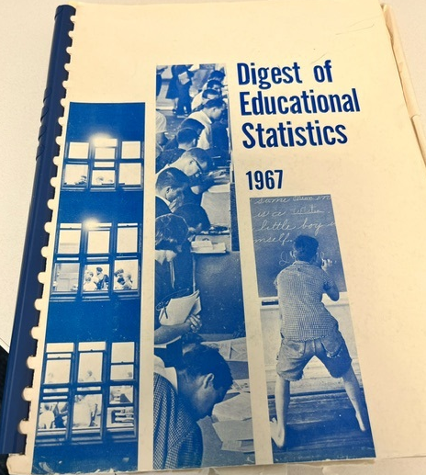
Digest of Education Statistics
Statistical reference
Covers broad field of education
Brings together nearly 100 data sources
Supports Condition of Education
400+ tables annually updated

Slide 5
Modernization & Digest: aligning to needs
Internal evaluation of processing, publishing procedures
What works well? What doesn’t?
Impacts on timeliness
User feedback
Informal
  User-submitted questions & requests to NCES (journalists, policymakers, practitioners)
  Conversations with stakeholders
Formalized
  Citations (news, academic, non-academic)
  Focus groups beginning in Fall

Slide 6
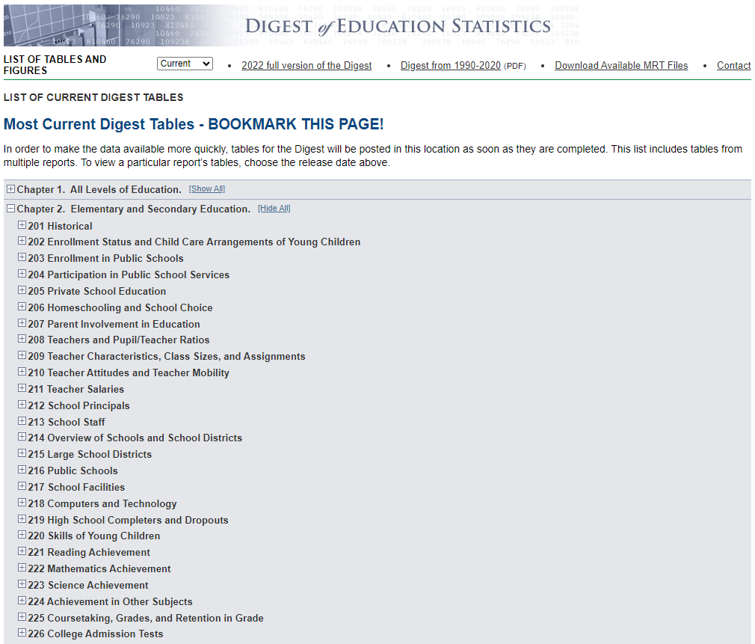
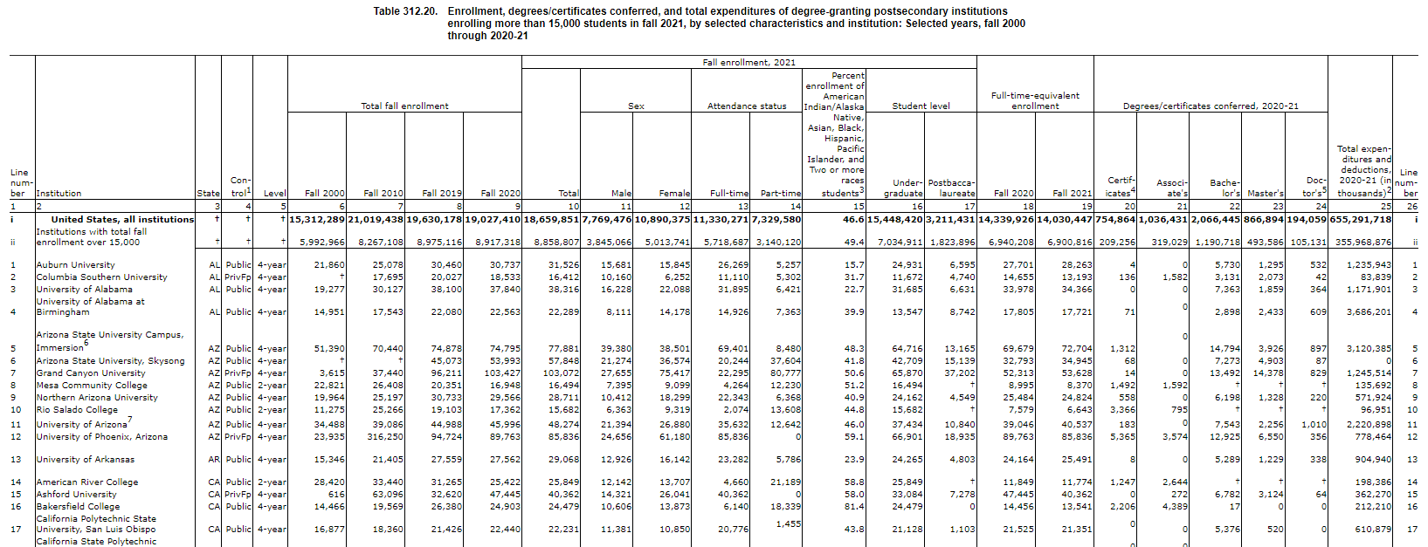
Challenges – dissemination

Slide 7
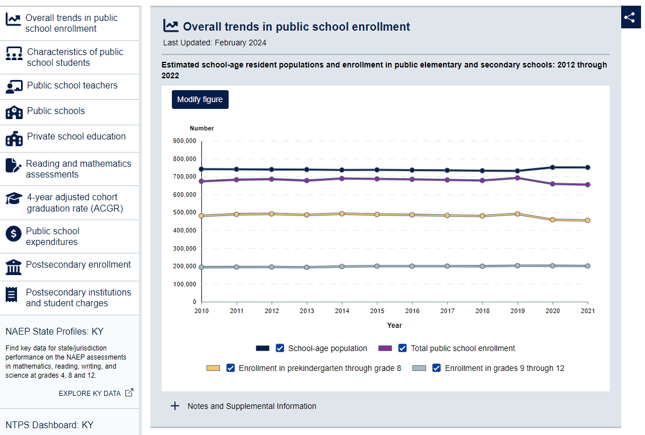
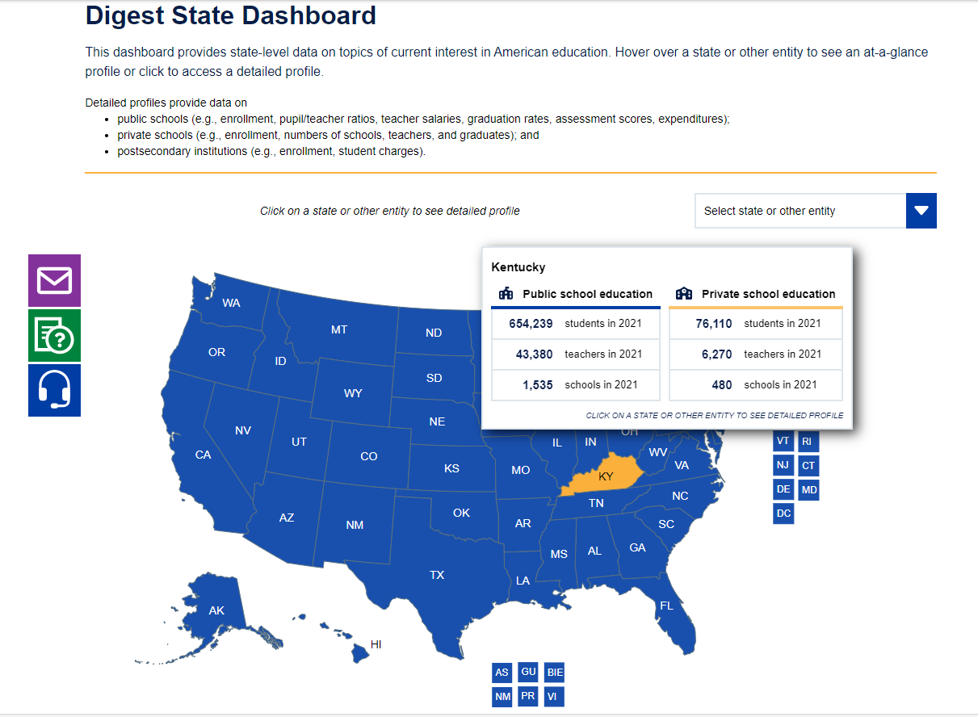

Slide 8



Current State – dissemination
Cataloging & categorizing data assets
Difficult for users to find information of interest
Need to improve strategic planning
Help users find information
Respond to ad hoc requests
Identify opportunities for new tables, products, data collections

Slide 9
Modernization goals
Improve product timeliness
Proactively anticipate user needs
Increase data use
Standardized schemas
Lower levels of geography
Tags, keywords, organization of information
Production of estimates, not tables

Slide 10
Modernization: meeting the needs of data users
Responsibilities under SPD 1 & 4
Continuously improving quality & accessibility
Produce and disseminate timely & relevant information
White House Memo “Delivering a Digital-First Public Experience” (M-23-22)
User-centered & data-driven designs
Customized, dynamic user experiences
National Academies report A Vision and Roadmap for Education Statistics (2022)
Leverage data assets
Collaboration with other agencies

Slide 11
Thank you!
Kristi.Donaldson@ed.gov
Ask a question about NCES products
Sign up for NCES NewsFlash

