Slide 1


Measuring Sexual Harassment in the STEM Enterprise
April 2024
National Center for Science and Engineering Statistics (NCSES) Project Manager:
Jen Beck, Ph.D.
Fors Marsh Project Team:
Rachel Walker-Kulzick, Ph.D.
Anna Scolese, MPH
Jordan Loeffelman, Ph.D.
Elizabeth Richards, MA
Leah Fleming, Ph.D.
Marcus Maher, MAS
Marieke Visser, Ph.D.
Laura Severance, Ph.D.
Fors Marsh SMEs
Sam Evans

Slide 2






Agenda
Introduction
NCSES Project Overview
NCSES Message Boards Overview
Methodology Overview
Message Boards Methodology Overview
Benefits and Considerations
Conducting the Message Boards
Protocol
Conclusion
Main Takeaways
National Center for Science and Engineering Statistics (NCSES) Overview
Best Practices and Safety Plan
Logistics

Slide 3














Introduction
National Center for Science and Engineering Statistics
(NCSES) Overview
NCSES Overview
One of 13 principal federal statistical agencies
Measures America’s progress in Science, Technology, and Innovation
Serves as a federal clearinghouse for objective data that provide key insights into the science and engineering enterprise
ENG
Directorate for Social, Behavioral & Economic Sciences
National Center for Science and Engineering Statistics
GEO
TIP
CISE
MPS
EDU
Behavioral and Cognitive Sciences
Social and Economic Sciences
BIO
National Science Foundation

Slide 4
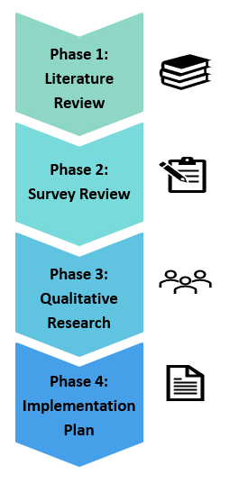
Introduction
Measuring Sexual Harassment in STEM
Project Overview
Project purpose
Provide NCSES a variety of options for measuring sexual harassment and the strengths and weaknesses associated with each option
Policies &
Programs
Design Measures & Collect Data
Understand the Issue & Create Implementation Plan
(Current Project)
Background
No high-quality national sexual harassment data set
Women earn roughly half of STEM degrees, but are underrepresented in the STEM field
Previous research has found sexual harassment may be a barrier for women in STEM^{1,2}
¹National Academies of Sciences, Engineering, and Medicine. (2018). Sexual harassment of women: Climate, culture, and consequences in academic sciences, engineering, and medicine. Washington, DC: The National Academies Press. https://doi.org/10.17226/24994
²U.S. Government Accountability Office (GAO). (2020). Workplace sexual harassment: Experts suggest expanding data collection to improved understanding of prevalence and cost. https://www.gao.gov/assets/710/709862.pdf

Slide 5

NCSES Qualitative Research Overview
Introduction
Purpose
Understand considerations related to measuring sexual harassment across career stages and contexts
Inform possible measurement strategies and considerations associated with measurement approaches
Method
Conducted 12 online message boards through QualBoard
      Demographic focus
      Undergraduate and graduate students
      Early-, mid-, late-career professionals
      Men, women, sexual and gender minorities (SGM), race/ethnicity
Each message board occurred over the course of one week
            Three sections each opening on different days of the week
Message board content focused on
Climate & Culture
Sexually Harassing Behaviors & At-Risk Locations
Survey Perspectives
Policies &
Programs
Design Measures & Collect Data
Understand the Issue & Create Implementation Plan
(Current Project)

Slide 6
Message Boards (Asynchronous Focus Groups) Methodology
Methodology Overview
  Message Boards (Asynchronous Focus Groups) are semi-structured focus groups where participants sign into the message boards at regular intervals throughout a specific timeframe (e.g., one week) to engage with prompts, stimuli, and other participants’ responses
90-Minute Protocol
Section 1
30 minutes of participation
~5-8 number of questions
Section 2
30 minutes of participation
~5-8 number of questions
Section 3
30 minutes of participation
~5-8 number of questions

Slide 7
Message Boards Benefits & Considerations
Methodology Overview
Benefits of Message Boards | Benefits of Message Boards When Asking Sensitive Questions
More reflective responses Allows more voices to be heard Flexibility in when they participate Include participants across time zones Generates a lot of data | Feels more anonymous More reflective responses More room/time to process emotions
Considerations
Expect higher rates of attrition compared to in-person focus groups Incentives should reflect the level of participation Budget additional time for analyses as message boards generate more data compared to focus groups
  Because our population of interest was broad (STEM students and professionals), their availability varied, and the sensitive nature of the questions, we elected to utilize online message boards to conduct qualitative research and increase participation across STEM subgroups.

Slide 8

Conducting the Message Boards
Conducting the Message Boards: Best Practices/Rules of Engagement
  Asynchronous Focus Groups
  Best Practices
  Sensitive Questions Best Practices
  Establish rapport with an ice breaker and create a safe environment
  Ease participants into topics by starting with a broader topic (climate and culture)
  Narrow the focus of the boards and introduce the sensitive topics in the following session
    Clearly state the purpose and importance of the topics discussed
  Ask behaviorally-based questions rather than direct questions about what they may have witnessed or experienced
  Remain confident, calm, and neutral to not influence responses
  Set clear rules of engagement at the start
    Enforcing rules when necessary
  Moderators should probe only on short responses
    Majority of responses will not need to be probed
  Send reminders for participation as needed
  Have multiple moderators to monitor and address participant responses
  Use different types of question types to keep participants engaged (open-text, matching, lists, polls, or select all that apply options)

Slide 9
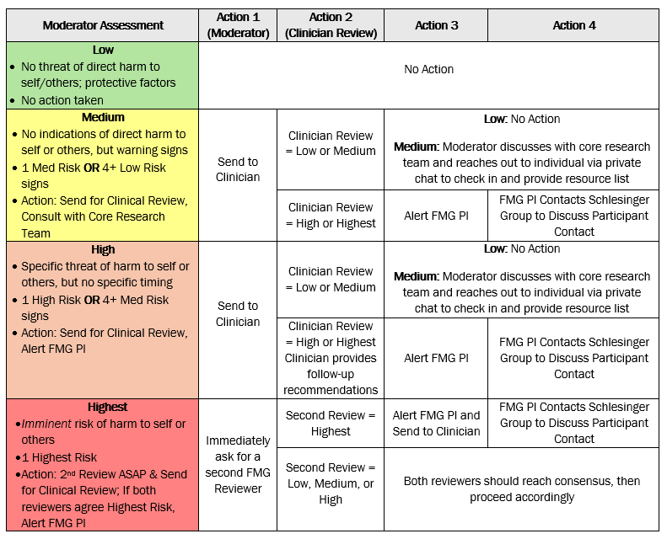
Conducting the Message Boards:
Safety Plan
Conducting the Message Boards
  Overview
  Process for addressing participant distress, disclosure of PII, or rude comments towards others
  Steps:
  Moderators flag comment and assess for risk (low, medium, high, highest)
  Moderators log comment in risk assessment log
  Send comment to clinician and project manager for their review
  If needed, directly contact participant and provide prevention resources
    Prevention and reporting hotlines and websites

Slide 10
Conducting the Message Boards:
Logistics
Conducting the Message Boards
 | Week 1 17 – 21 OCT | Week 2 24 – 28 OCT | Week 3 31 OCT – 4 NOV
Undergrads (W) |  |  | Mod 1/Mod 2
Undergrads (M) |  |  | Mod 3/Mod 4
Grad Students (W) | Mod 1/Mod 2
Grad Students (M) |  | Mod 3/Mod 4
Early-Career (W) | Mod 1/Mod 2
Early-Career (M) |  | Mod 3/Mod 4
Mid-Career (W) | Mod 2/Mod 1
Mid-Career (M) |  | Mod 4/Mod 3
Late-Career (W) | Mod 2/Mod 1
Late-Career (M) |  | Mod 4/Mod 3
SGM Students |  |  | Mod 1/Mod 3
SGM Professionals |  |  | Mod 2/Mod 4
  Each Board had two moderators (primary and secondary) to ensure we had regular engagement
    Each moderator had two primary boards and two secondary boards to monitor
  Four message boards per week
  On average, we had 15 participants per board
    Total of 12 boards
    Majority of respondents answered all questions
In total, 177 individuals with STEM backgrounds participated in the message boards

Slide 11
Conducting the Message Boards: Protocol Day 1
Conducting the Message Boards
Message Board Protocol
Introductions and Climate and Culture – Day 1
Guidelines and participant introductions
Discussion of workplace or academic department climate and culture
Sexually Harassing Behaviors & At-Risk Locations – Day 2
Personal definition of sexual harassment
Discussion of types of negative behaviors that occur within their workplace or academic department
      Discussion of who tends to engage in these behaviors
    Discussion of where these negative behaviors occur and where they typically occur
Survey Perspectives – Day 3
Discussion about a potential survey questionnaire measuring sexual harassment in STEM
Pros and cons of this proposed survey
Type of behaviors to potentially measure
Survey method preferences and likelihood of taking the survey
Introductions and Climate and Culture – Day 1
(Included text response questions)
Eased participants into message board discussions with ice breakers
      “What do you like to do in your free time?”
      “What influenced you to want to pursue STEM?”
      Started with a broad discussion of climate and culture in the workplace
  “What comes to mind when you hear the words climate and culture? ”
  “What factors influence the climate and culture in your primary [workplace/academic department]?”

Slide 12
Conducting the Message Boards: Protocol Day 2
Conducting the Message Boards
Message Board Protocol
Introductions and Climate and Culture – Day 1
Guidelines and participant introductions
Discussion of workplace or academic department climate and culture
Sexually Harassing Behaviors & At-Risk Locations – Day 2
Personal definition of sexual harassment
Discussion of types of negative behaviors that occur within their workplace or academic department
      Discussion of who tends to engage in these behaviors
    Discussion of where these negative behaviors occur and where they typically occur
Survey Perspectives – Day 3
Discussion about a potential survey questionnaire measuring sexual harassment in STEM
Pros and cons of this proposed survey
Type of behaviors to potentially measure
Survey method preferences and likelihood of taking the survey
Sexually Harassing Behaviors & At-Risk Locations – Day 2
(Included text response and multiple answer questions)
Sensitive Question segment – set expectations up front about discussion
  As a reminder, to help maintain privacy, please do not share any personally identifying information, such your last name, the names of others, or your [place of employment/school] when answering questions.
  Specifically, we want to focus our discussion on sexual harassment. While sexual assault may also occur in the workplace, the purpose of today’s discussion is focused specifically on sexual harassment.
Focused on behaviors rather than direct experiences
  Asked participants about respectful and problematic behaviors (through a list of sexual harassment behaviors) and locations where they may occur

Slide 13
Conducting the Message Boards: Protocol Day 3
Conducting the Message Boards
Survey Perspectives – Day 3
(Included text response and poll questions)
Message Board Protocol
Introductions and Climate and Culture – Day 1
Guidelines and participant introductions
Discussion of workplace or academic department climate and culture
Sexually Harassing Behaviors & At-Risk Locations – Day 2
Personal definition of sexual harassment
Discussion of types of negative behaviors that occur within their workplace or academic department
      Discussion of who tends to engage in these behaviors
    Discussion of where these negative behaviors occur and where they typically occur
Survey Perspectives – Day 3
Discussion about a potential survey questionnaire measuring sexual harassment in STEM
Pros and cons of this proposed survey
Type of behaviors to potentially measure
Survey method preferences and likelihood of taking the survey
Presented a survey concept for measuring harassment in STEM ahead of questions
Survey Concept Description: There is interest in developing a survey to understand STEM workplace and educational experiences. If developed, this survey would measure the incidence and impact of sexual harassment, discrimination, and other harmful workplace behaviors in STEM environments. It would also be used to understand the extent and implications of sexual harassment and discrimination in the workplace and academia and would be administered to both students and professionals in STEM.

Slide 14


Conclusion
Conclusion
Message boards were useful for our population of due to increased flexibility and anonymity
Message board provide a wealth of information as majority of participants respond to all questions
Provided critical insights into harmful behaviors in STEM that will inform behaviorally-based measures of harassment on future surveys

Slide 15


Slide 16
Backup Slides

Slide 17
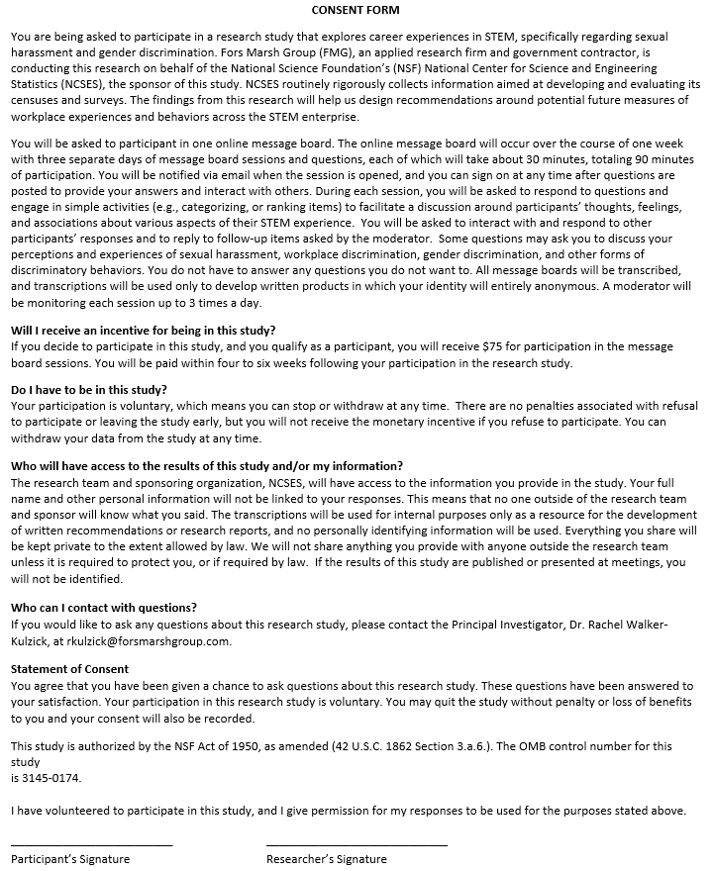
Consent Forms
Backup
Consent forms clearly stated the purpose of the message boards and mention that sensitive topics will be discussed
Emphasized voluntary participation, and anonymous nature of the data collection
  The general process for participation is clearly laid out (e.g., checking into the message boards multiple times over the course of the week)
        In this section, the sensitive nature of the questions is reiterated
All participants were provided with a $75 incentive

Slide 18
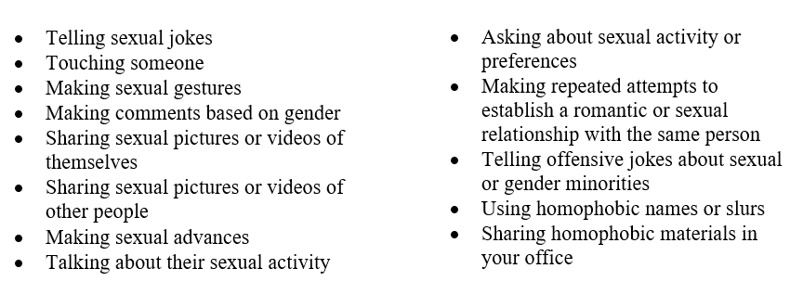
Conducting the Message Boards: Protocol Day 2 - Questions
Conducting the Message Boards
Below is a list of possible behaviors that may occur in your [workplace or work division/primary academic department]. What are some behaviors that are not included on this list that you consider sexual harassment in the [workplace or division / primary academic department]?

Slide 19
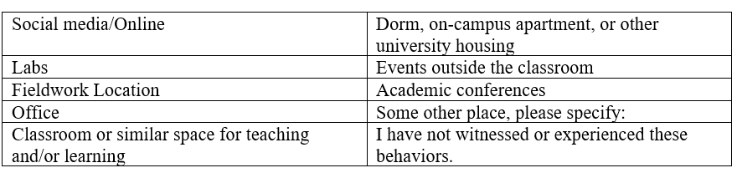
Conducting the Message Boards: Protocol Day 2 - Questions
Conducting the Message Boards
We’d like to better understand more about the contexts in which you witnessed or experienced the behaviors identified above (e.g., telling sexual jokes, making sexual gestures or advances, asking about sexual activity or preferences, used homophobic names or slurs, etc.).
Listed here are potential locations and settings where these behaviors might occur. Please indicate all the locations where you have witnessed or experienced these behaviors. There is a ‘some other place’ option in case the location you have in mind is not listed. If you select ‘some other place,’ please specify the additional locations you have witnessed or experienced these behaviors next to that selection.

Slide 20


