Slide 1
Improving Efficiency and Data Quality of an In-mover Interview
2024 Federal Computer Assisted Survey Information Collection (FedCASIC) Workshops
Presented by:
Kimberly A. Collins
Field Division, Decennial Data Collection Branch
April 17, 2024
Notes:
This presentation does not include any personally identifiable information or protected data.
Today, I’m going to give an overview of a special type of field interview encountered while conducting nonresponse followup data collection during the decennial census, also known as the NRFU operation. I work on training content and materials that prepare enumerators and census field supervisors to conduct NRFU.

Slide 2
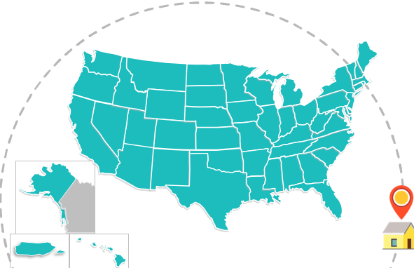

Census Day
April 1st
“Count everyone once, only once, and in the right place.”
Notes:
During the 2020 Census, we contacted approximately 60 million households nationwide to interview persons who did not respond to the census or return a questionnaire on or before the reference date of April 1, which is known as Census Day.
Temporary census employees received about 22 hours of training, where they learned how to use an electronic questionnaire instrument to conduct personal interviews and collect demographic data from household respondents or proxies. The goal of NRFU is to ensure each person is counted once, only once, and in the right place.

Slide 3


Who is an In-Mover?
Respondent who moved into the case address after Census Day
May or may have not completed or returned census questionnaire for Census Day address
Notes:
During some of these visits, an enumerator would encounter someone who we refer to as an in-mover. An in-mover is a respondent who was living at the address at the time of the interview but lived somewhere else on Census Day. The thing to remember is that the NRFU interviews are occurring after Census Day. They may or may not have completed or returned a census questionnaire for the address where they lived on April 1st.
So, the address the enumerator visited is called the case address and the address where the respondent lived on April 1st is called the in-mover address.

Slide 4
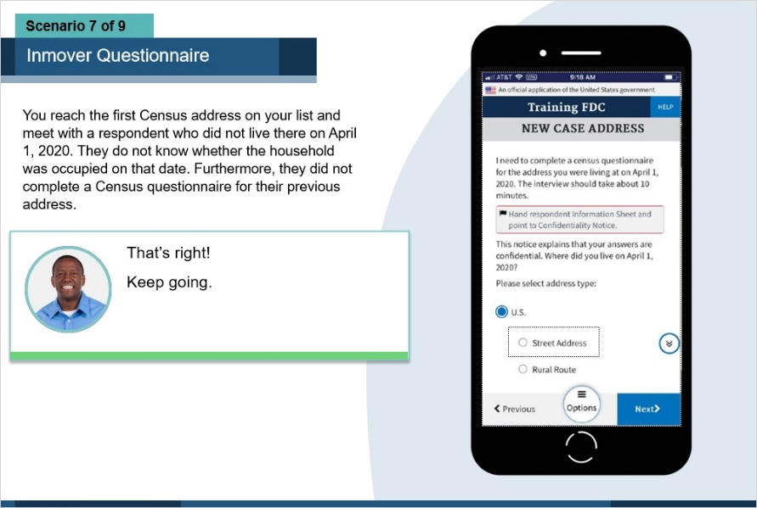
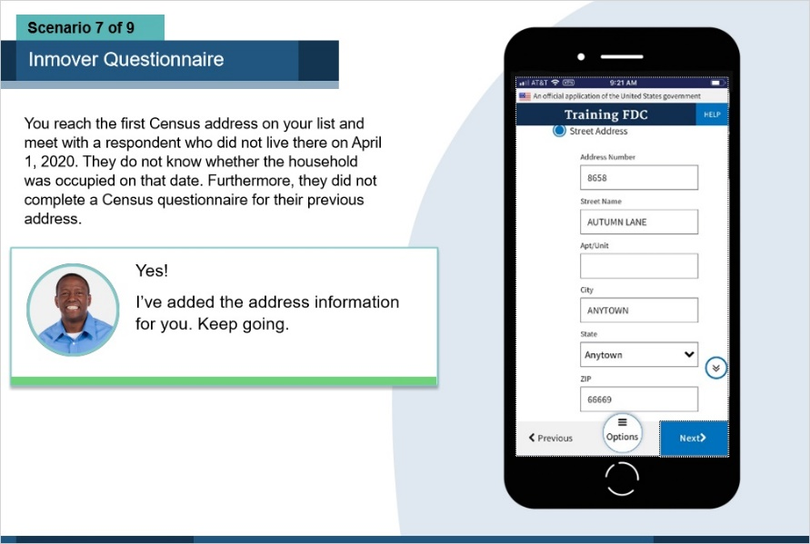
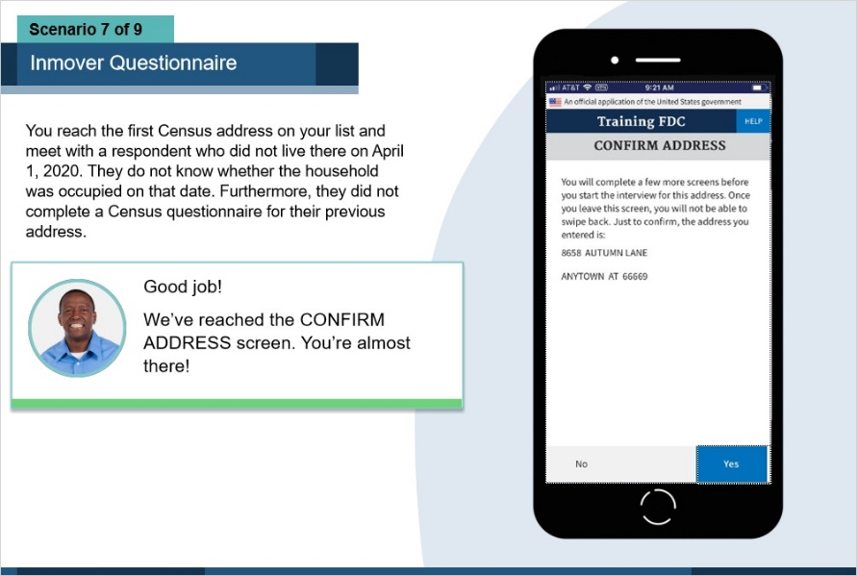
S
Source: U.S. Census Bureau, 2020 Census Enumerator Online Training Curriculum
The in-mover interview is potentially a dual interview
  Enumerating the case address being visited
  Enumerating the address where the respondent (in-mover) lived on April 1, after adding a new address to the system
  Smoothly transition from 1 to 2, maintaining engagement with the respondent
Notes:
When an in-mover was identified during the NRFU visit, the enumerator potentially had to conduct a dual interview. First, asking questions about who lived at the case address. Then, adding a new address to the system (the in-mover address) AND asking questions about who lived at the in-mover address on Census Day. The enumerator had to make a smooth transition between those 2 parts, all while keeping the respondent’s attention.
This path of actions is different from that taken when encountering an in-mover during our ongoing surveys such as the National Crime Victimization Survey or Current Population Survey because the interviewer will make updates to the household roster, but they will not ask the in-mover any questions about the reference date address.
In the 2020 Census enumerator training curriculum, we included sections to specifically cover this scenario. This slide shows some of the training screens that gave enumerators a preview of what to expect when adding the in-mover address to the system. Enumerators completed case work on the Field Data Capture (FDC) application, and it was installed on a government-issued iPhone 8. When a case was opened, the enumerator went through a series of screens to complete the questionnaire with a respondent.
The complexity of an in-mover scenario added to other challenges we faced in 2020, one being the training itself. While enumerators were taught how to work cases through online and instructor-led training, health safety measures implemented due to the COVID-19 pandemic required everyone to physically distance themselves from one another. This drastically changed the delivery of the instructor-led portions from an in-person environment to teleconferences. This adjustment compromised opportunities to practice interviews with one another. Nonetheless, Census Field Supervisors encouraged their enumerators to review and practice challenging interview paths on the training instrument before working live cases.

Slide 5
Three paths, depending on in-mover’s knowledge of whether anyone lived at the address on Census Day
Enumerate case address on Census Day (In-mover as proxy)
Close out interview
Yes
Yes
Ask if anyone lived at case address on April 1
Ask if in-mover responded for their Census Day address
No
Record case address as vacant
Transitional statement
No
Add in-mover’s Census Day address and enumerate for that address
Don’t Know
Case is unresolved; Becomes Proxy Eligible
Notes:
This slide depicts some of the behind-the-scenes work on the in-mover question path that we propose to test for the 2030 Census.
The solid blue blocks on the left show the actions to take with the case address. The orange block in the center represents a transitional phase that enumerators who worked in-mover cases had trouble navigating. It was this part of the interview where they felt it did not flow smoothly. The muted blue blocks on the right represent the actions to take with the in-mover address.

Slide 6
Mover Probe
Practiced before and during 2020 Census
Opening questions establish whether the respondent lived at the case address on April 1 (Census Day)
Source: Evaluation of Nonresponse Followup – Mover Probe, 2004
If no, ask if anyone lived at the case address on April 1
Collect demographic information on the Census Day inhabitants from that respondent, or a knowledgeable proxy
Enumerator also asks respondent if they completed a census questionnaire for the address where they lived on April 1
If not, enumerator completes in-mover add along with census questionnaire with respondent for their Census Day address
Backend review and un-duplication processes developed and continually improved
Notes:
Historically, we have established the respondent’s status as an in-mover during some short introductory questions where the enumerator asks if they lived at the case address on April 1 (Census Day). If it turns out that the respondent is an in-mover and did not complete a questionnaire for their Census Day address, the interview can be longer in duration than a standard NRFU interview.
In 2020, after an enumerator added an in-mover address to the system, it was geographically coded and matched to an address already in the workload.
For the 2030 Census, we want to take that back end processing a little further by removing the added in-mover address from the NRFU workload, thereby avoiding duplication of effort on that address.

Slide 7
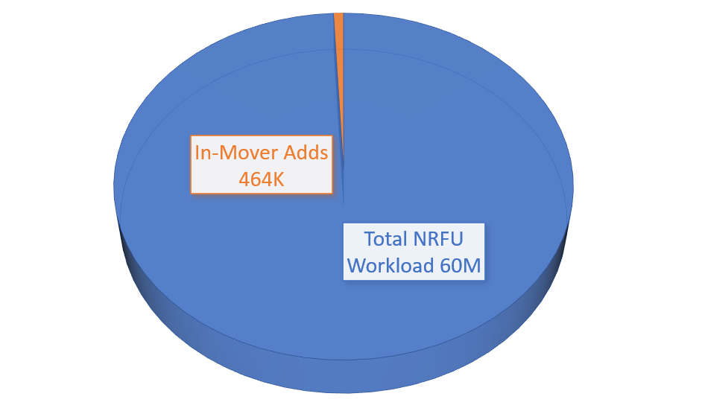
In-mover adds comprised less than 1% of 2020 Nonresponse Followup (NRFU) workload
Respondents who did not live at the case address on Census Day and did not complete a questionnaire for previous address
Source: 2020 Census Nonresponse Followup Operational Assessment Report
Notes:
Here is a statistical graphic of the percentage of in-movers who were interviewed in 2020 and had their Census Day addresses added to the system. It is a very small subset of the NRFU workload but ensuring that they are enumerated at their correct address AND that the case address itself is enumerated accurately makes a difference in counting everyone in the right place.
Of note, the 2010 Census saw around 100,000 in-mover addresses added to the system. We suspect the large increase in 2020 speaks to numerous, unplanned moves during the Spring months as part of the pandemic response.

Slide 8


Hard-to-Count
Historically Undercounted Populations
Source: Understanding Hard-to-Count and Historically Undercounted Populations (census.gov), 2023
Notes:
Some more background about in-movers: They fall under 2 subsets of the population that we are always striving to improve coverage when conducting census: Hard to Count and Historically Undercounted Populations. In-movers are hard to count in the sense that they move frequently and are likely to rent. Thus, it can be hard to locate and persuade these people to answer the census questionnaire. Also, because they are likely more mobile, they may have difficulty recalling a specific address as it relates to the April 1 reference date.
A critical subset of Hard to Count populations are the Historically Undercounted Populations. In conducting coverage measurement operations after NRFU, we found that these groups were not fully counted during the regular census count, which included self-response and NRFU. Examples of these groups include, but are not limited to, renters, young children, and people who indicate they are of a race other than the categories presented on the questionnaire.

Slide 9
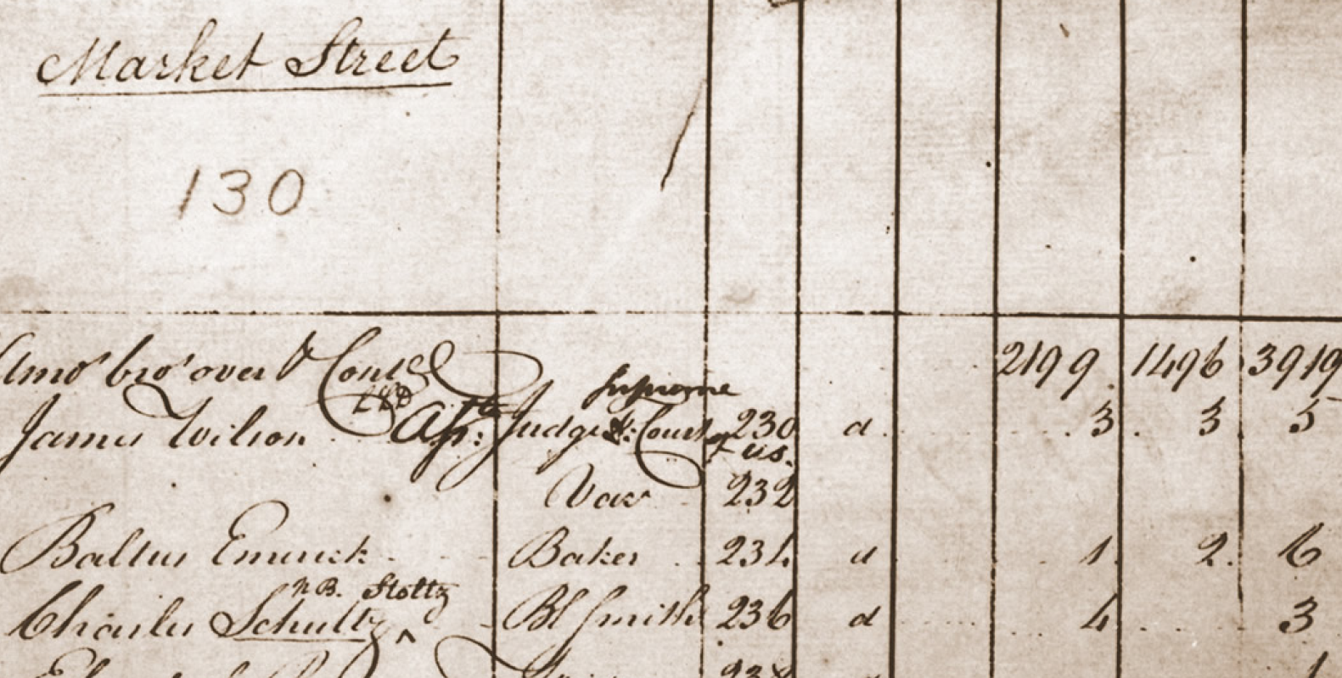
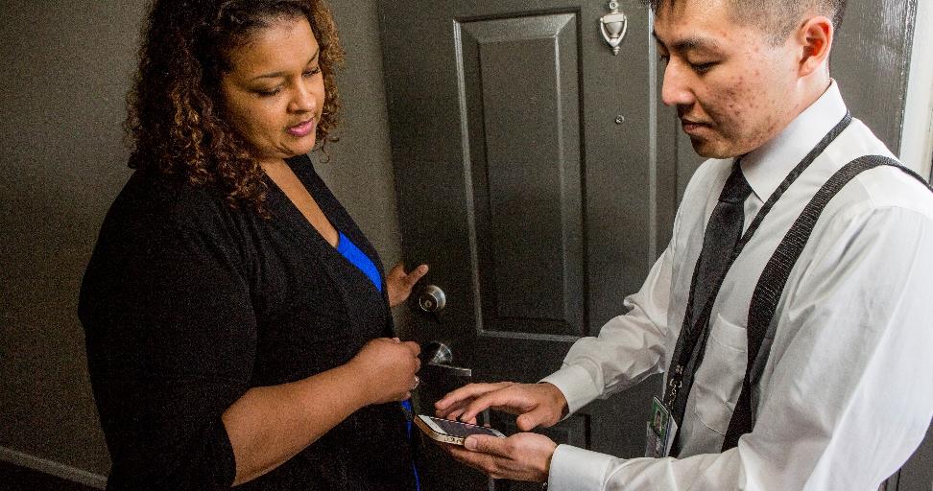
2020 Census and Automated Enumeration Technology
  Electronic Questionnaire Instrument
  Conditional Logic guides the interview path
  Once enumerator completes a case, data is no longer visible
Notes:
We made a huge jump in the 2020 NRFU operation by doing away with a lot of the paper forms used in previous censuses and completing these cases on the Field Data Capture application that I mentioned earlier. We provided enumerators with a training version that contained fake names and case addresses for practice purposes. The advantage of having this technology is that the questionnaire has built in conditional logic to guide the interview path, thereby eliminating the need for handling excess paperwork that was required in previous years. In improving the in-mover interview experience, we are working on eliminating unnecessary screens in the transitional phase of the interview. An example is to push all enumerator-facing screens that had contact history questions and case notes to the very end of the interview; that is, after both the case address and in-mover portions are completed.
We are also designing our training plan to give more opportunities to practice this and other special types of interviews in the learning environment so that more enumerators will feel ready to conduct field work at the conclusion of their training.

Slide 10

Closing
Deeper examination of how interview path unfolds when an in-mover is identified
Work on simplifying this path in the instrument
More exposure during training to this and other off beaten path interview paths
  Redesigned, hybrid training schedule
  Practice, Practice, Practice
  Job Aids
Questions?
Email: Kimberly.collins@census.gov
Notes:
The takeaways here involve a closer examination of how an in-mover interview path can unfold and working to simplify this path in the questionnaire that will result in a better, less burdensome experience for enumerators and respondents, and improved response rates. More importantly is drilling down on the training programs to identify areas where enumerators are struggling and give them ample practice to prepare them for successful interviews.

